Slide 1
Pandemic Planning 101
Tools to Aid In Congregational Planning
Congregational Ministry Assessment
Design Thinking 101

Slide 2
Congregational Ministry Assessment Guide
We Will Walk Through This Tool Together.
Laura Will Email You This Powerpoint, So You Can Recreate This Experience With Your Congregation’s Leadership.
Together We Will Seek To Ask Questions About What Ministry Should Look Like In The Midst Of Pandemic.

Slide 3
Ministry During Pandemic
We Acknowledge:
God is up to something new in this pandemic. We believe the Holy Spirit is moving ahead of the church, calling the church into a new future, in a time of disruptive social and cultural change.
We are all in the midst of a situation we have never been in before. This presents some new leadership challenges for the local church. Even pastors who are really good at leading in the local church are facing challenges which they don’t know how to address.
Perhaps, instead of working harder at old ministry patterns that are breaking down, we could seek to identify and embody together faithful ways to lead the church more deeply into God’s life and love for the world.

Slide 4
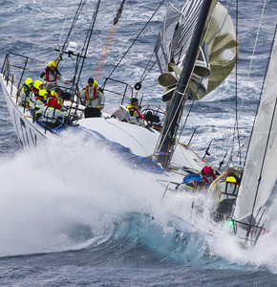
What Boat Is Our Congregation In? Why?
This Photo by Unknown Author is licensed under CC BY-SA-NC

Slide 5
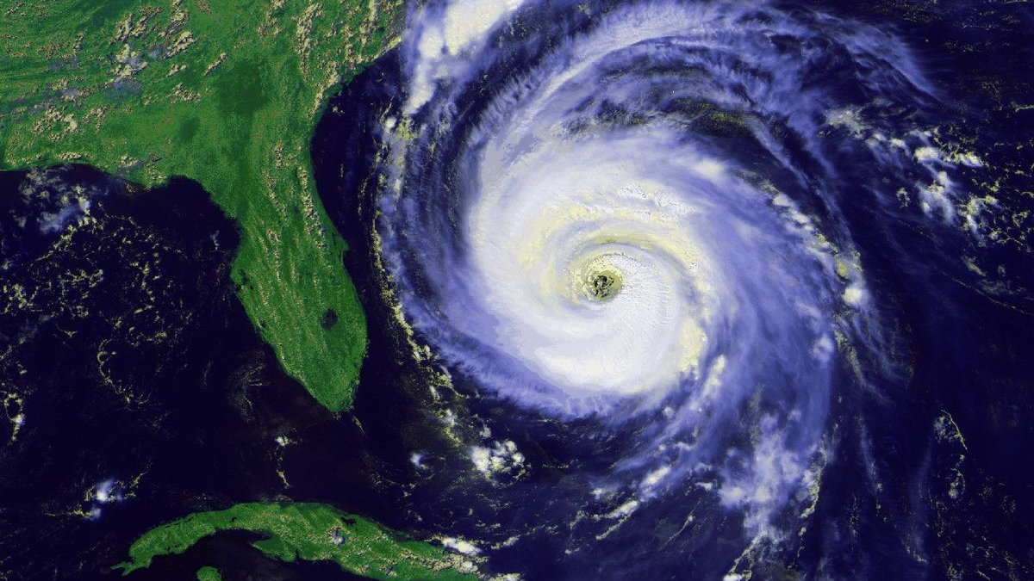
Eye of the Hurricane
When we talk about disaster recovery we often talk about:
Defining Event: The disaster that changed the situation
Immediate Response: The emergency response in the days after the defining event
Long Term Recovery: The long term recovery that takes months or event years
Where are we?
This Photo by Unknown Author is licensed under CC BY-SA

Slide 6
Luke 8:22-25
One day Jesus said to his disciples, ‘Let us go over to the other side of the lake.’ So they got into a boat and set out. As they sailed, he fell asleep. A squall came down on the lake, so that the boat was being swamped, and they were in great danger.
The disciples went and woke him, saying, ‘Master, Master, we’re going to drown!’
He got up and rebuked the wind and the raging waters; the storm subsided, and all was calm. ‘Where is your faith?’ he asked his disciples.
In fear and amazement they asked one another, ‘Who is this? He commands even the winds and the water, and they obey him.’
What do you hear? What stands out to you? What is God saying to us?

Slide 7
Discussion 1: What is the Role of the Church During a Pandemic?
How might our role (or mission) shift during the pandemic?
Come up with one or two ideas of what you think the church’s primary role is during this pandemic.
This Photo by Unknown Author is licensed under CC BY-SA

Slide 8
Discussion 2: Ministry During a Long Term Hurricane
If we are still in the defining event of this disaster, our ministry may look different right now. Lets discuss:
In a pandemic, how might the capacity of our employees, members and community be different?
How might the emotions and tensions of our people be different?
How might our short and long term plans be different?
How might we want to re-asses our Partnerships or Lack of Partnerships with Neighboring Congregations?

Slide 9
Discussion 3: What Does It Look Like…
Can we do everything we were doing before the pandemic, during a pandemic? Why or Why Not?
What are the most important things we should focus on? What fulfills our mission?
What are the grief, fear and emotional needs we need to keep in mind?
How can we help our congregation or our neighbors as we are learning to do new things?
What can we let go of for a season?

Slide 10
Discussion 4: What Does it Look Like…
If you were going to design a church from scratch to exist during the pandemic, what would you do?
What would it’s mission be?
What needs would you seek to meet?
What ministries would it offer?
What platforms would you use?
What kind of leaders would you need?

Slide 11
Design Thinking
How To Plan During a Pandemic
This Photo by Unknown Author is licensed under CC BY-SA-NC

Slide 12
What Is Design Thinking?
Design thinking is an innovative problem-solving process rooted in a set of skills.
REFLECT: Fully Understand the Problem—Listen
PLAN: Involve Users as you imagine what could be
ACT: Experiment and Prototype
OBSERVE: Reflect on how things went
This Photo by Unknown Author is licensed under CC BY-SA-NC

Slide 13
Reflect- User Centric Design
Design thinking is all about finding solutions that respond to human needs and user feedback. People, not technology, are the drivers of innovation, so an essential part of the process involves stepping into the user’s shoes and building genuine empathy for your target audience.
For us? Who do we need to listen to? How do we listen?

Slide 14
Plan- Collaboration
Innovation is about collaboration. It’s not about a leader coming up with a fantastic idea and casting a vision and making it happen. Leadership in Innovation involves creating the space and framework for many people to come together and share their collective genius.
For us? How do we create space and framework in our context for our people to be creative?

Slide 15
Act- Experimentation
Innovation is about action. It’s about trying new things. It’s about turning them into prototypes, testing them, and making changes based on user feedback. Design thinking is an iterative approach, so be prepared to repeat certain steps in the process as you uncover flaws and shortcomings in the early versions of your proposed solution. Don’t be afraid of failure.
For us? How do we lean toward action instead of caution?

Slide 16
Observe- Reflection
Whenever you try new things you will want to take some time and observe what happened, reflect on what happened, adjust and try again. Often we forget this part of the cycle!
For us? We have been trying lots of new actions. How can we reflect on how our new actions have been going and adjust?

Slide 17
Backwards Design
This Photo by Unknown Author is licensed under CC BY-NC
This Photo by Unknown Author is licensed under CC BY

Slide 18
Backwards Design and Confirmation
What do I hope the confirmation students learn during a pandemic?
Example: How do we help our confirmation students feel connected to God during this pandemic.
How will I know they have learned this?
Example: When they are sharing their God connections with each other and church leaders.
What actions or experiments can I do to make sure this happens?
Example: Let’s plan a weekly zoom event where we experience faith practices and sharing with each other.

