Slide 1
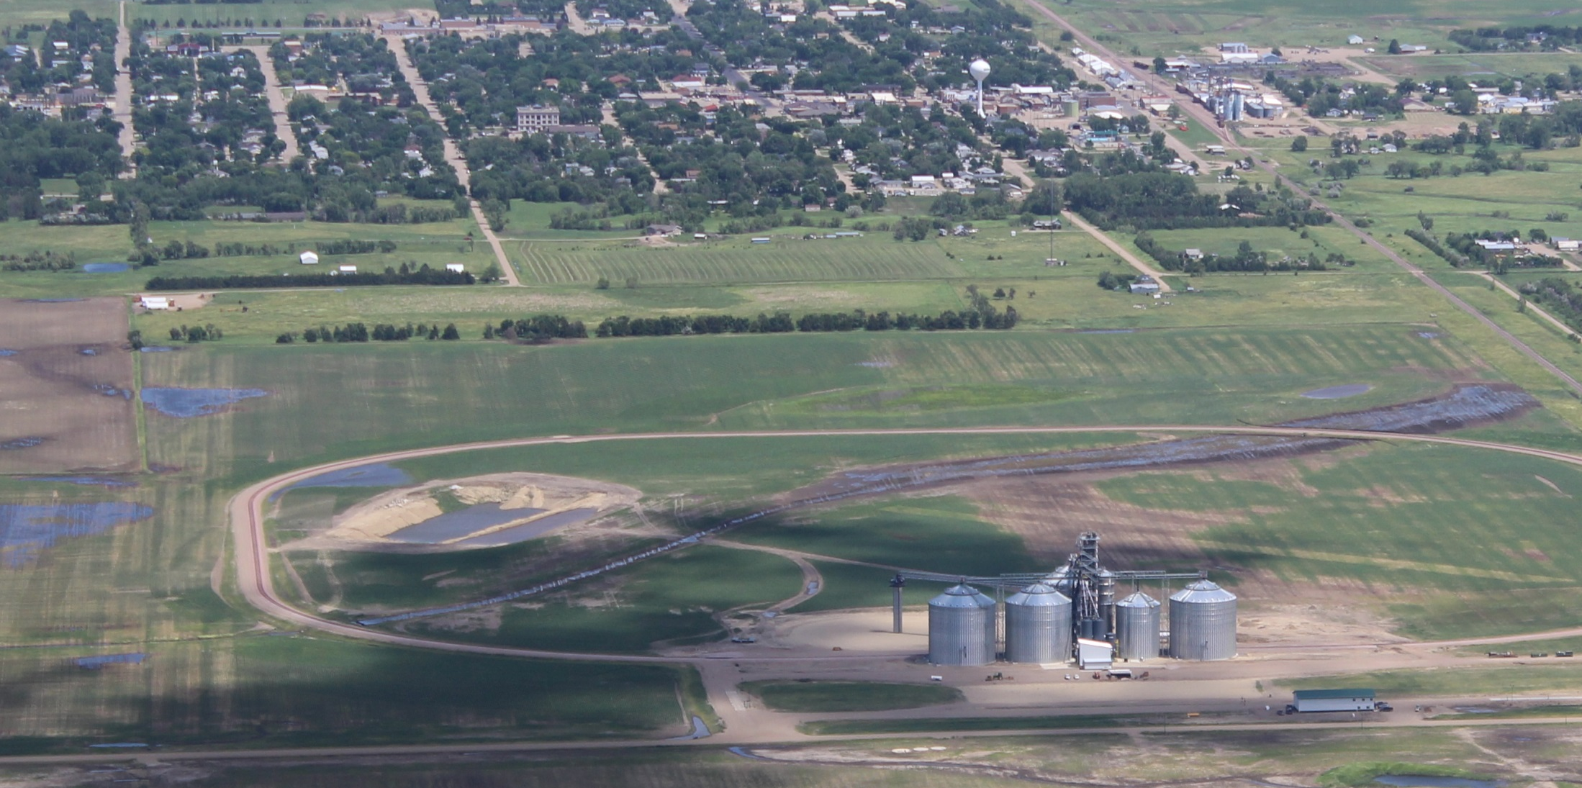
ADM-Benson Quinn
Miller, SD

Slide 2
The Land of Plenty?
A Grain Market Outlook
Miller, SD
February 26, 2014
Kim Rugel, Benson Quinn Commodities, Inc.
Futures and options trading involve significant risk of loss and may not be suitable for everyone. Therefore, carefully consider whether such trading is suitable for you in light of your financial condition. This report includes information from sources believed to be reliable and accurate as of the date of this publication, but no independent verification has been made and we do not guarantee its accuracy or completeness. Any reproduction or retransmission of this report without the express written consent of Benson Quinn Commodities, Inc. is strictly prohibited. The information and comments contained herein is provided by Benson Quinn Commodities, Inc. (“BQCI") and in no way should be construed to be information provided by Archer Daniels Midland Company. BQCI is a wholly owned subsidiary of Archer Daniels Midland Company and An Introducing Broker for ADMIS

Slide 3

Grain Markets 2014
Glass Half Empty?
Glass Half Full?
Notes:
3

Slide 4
Fundamental Price Factors
World Macro-Economic Conditions
Basic supply/ demand input
Weather
Grain Markets
Investment
Community
China
Long term US/World supply needs
Notes:
4

Slide 5
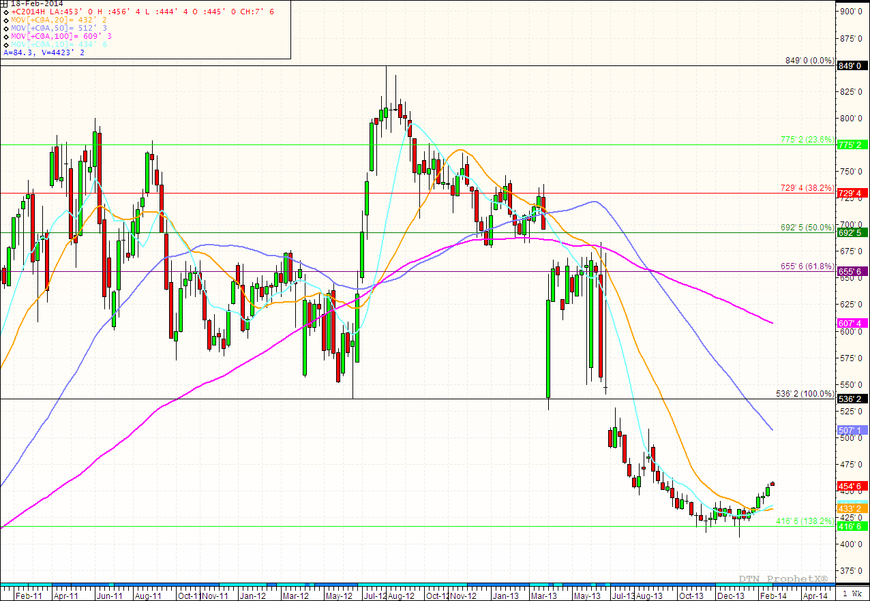
High Prices are the Cure for High Prices
Notes:
5

Slide 6
“What Goes Up, Must Come Down.”
High prices encouraged increased global plantings
World wheat, corn and soybean production was record large
High prices shifted demand to other markets
Brazil was world’s largest exporter of corn last year
New low price environment has attracted demand
World feed demand shifting back to corn from wheat
Demand is not exceeding supplies for first time in 5 years
Bearish supply environment has shifted investment funds away from commodities or to shorting the market
Notes:
6

Slide 7
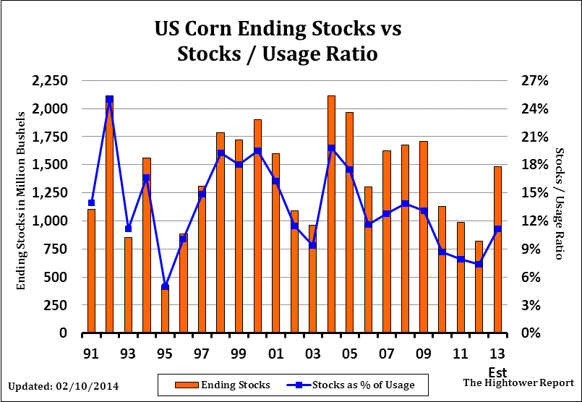
Supply Bull to Supply Bear Market
Notes:
7

Slide 8
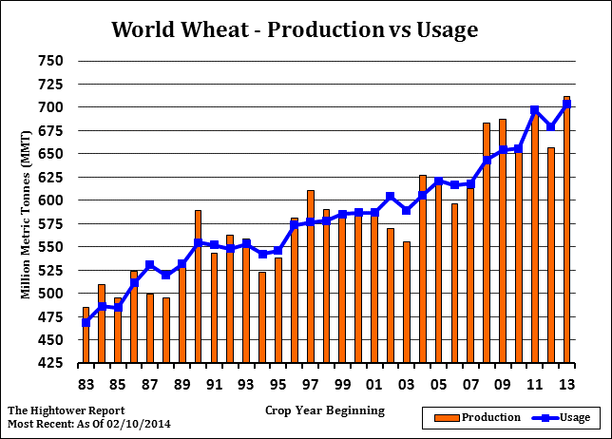
Supply Bull to Supply Bear Market
Notes:
8

Slide 9
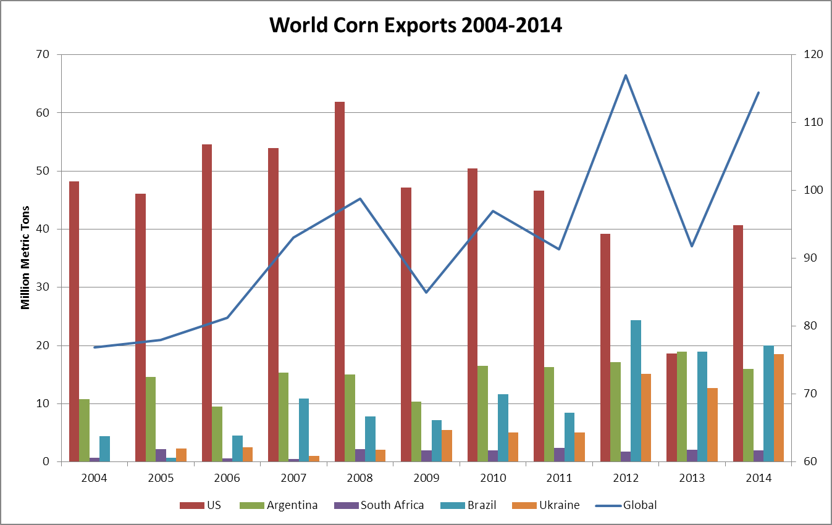
Shifting World Export Markets
Notes:
9

Slide 10
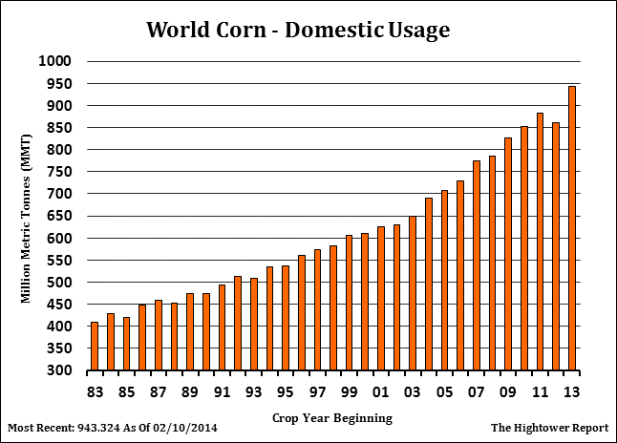
World Corn Demand Rebounding
Notes:
10

Slide 11
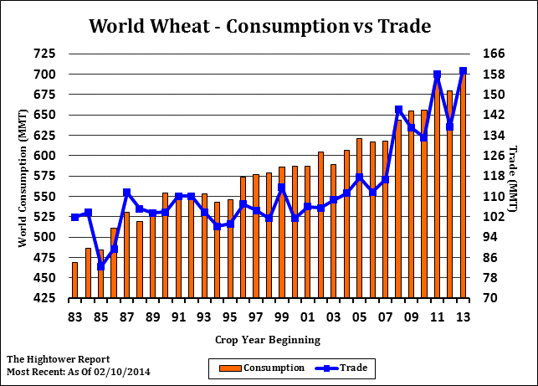
World Wheat Trade Recovers
Notes:
11

Slide 12
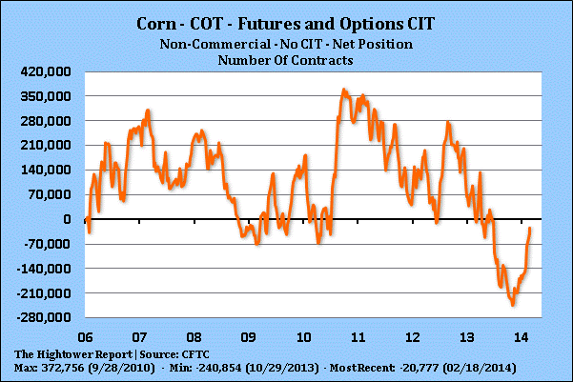
The Money Left the Marketplace
Notes:
12

Slide 13
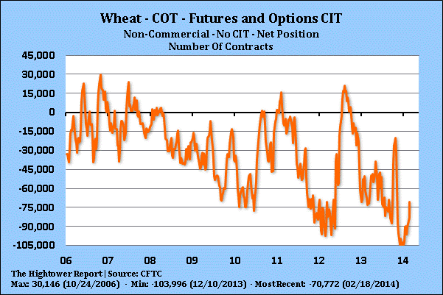
The Money Left the Marketplace
Notes:
13

Slide 14
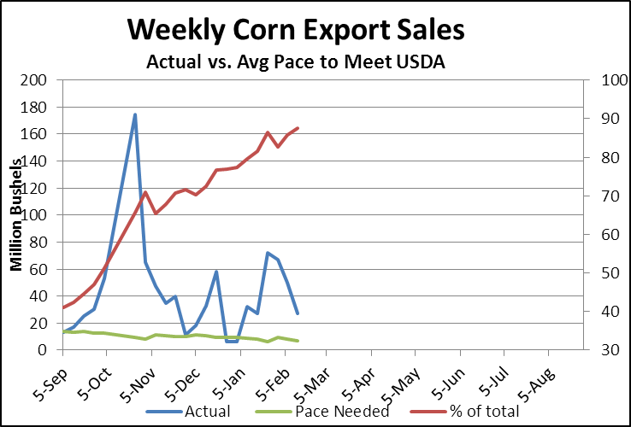
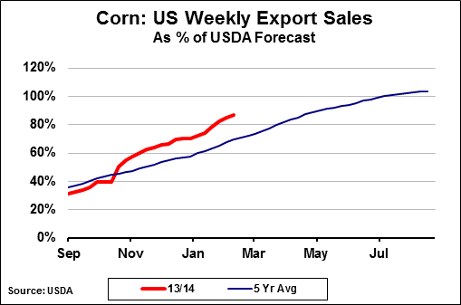
Improving Export Outlook: Corn
China rejecting MIR 162 and cancelling US sales
Unshipped sales to China: 1.5 MMT or 60 mil bus.
South Korea and Japan taking rejected cargoes
Notes:
14

Slide 15
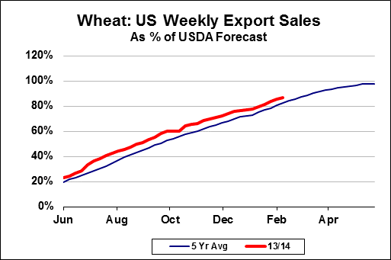
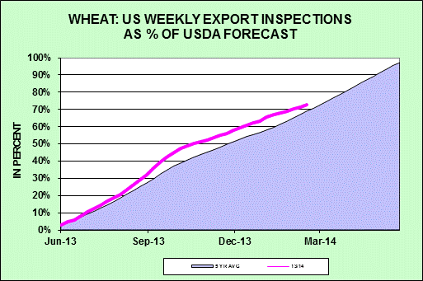
Improving Export Outlook: Wheat
China bought SRW early in season
Brazil bought HRW in fall due to Argentine issues
US demand picking up due to Canada logistic issues
Notes:
15

Slide 16
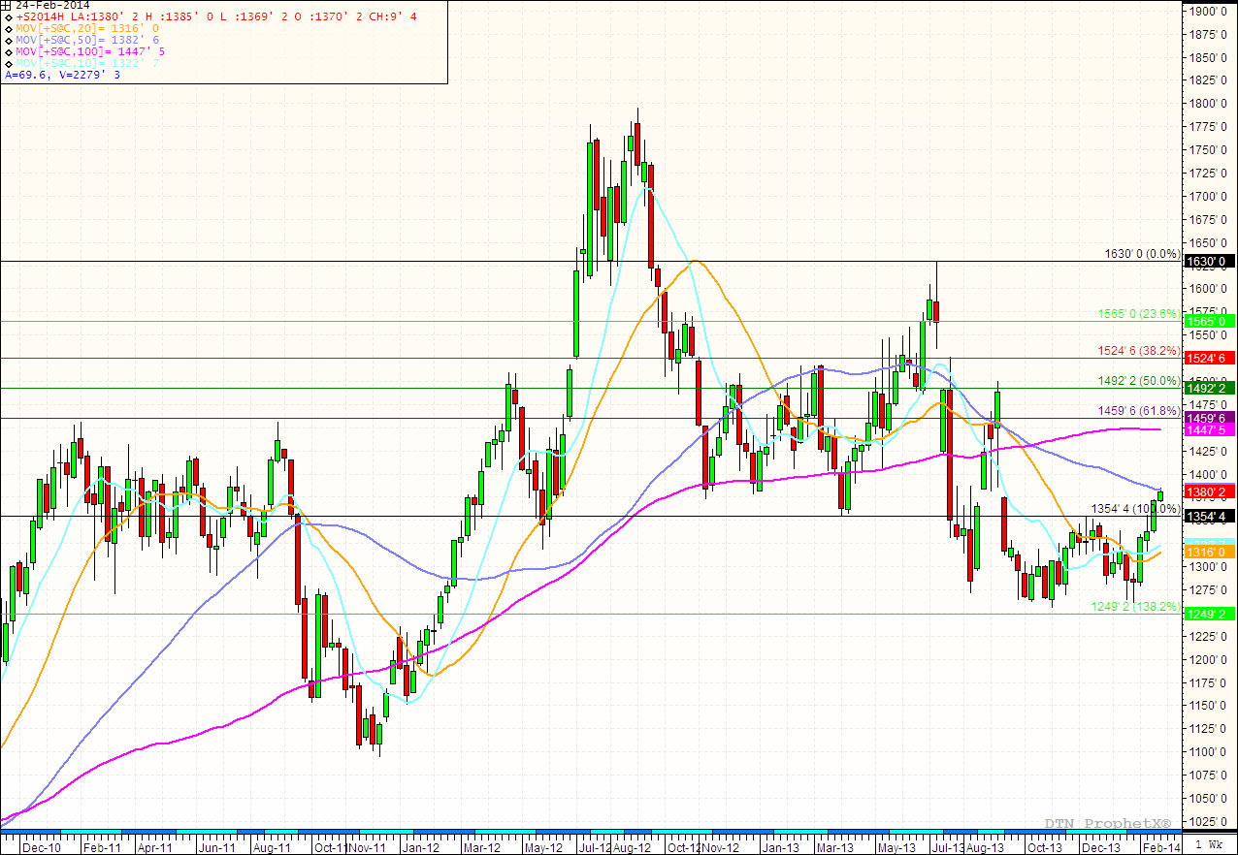
Similar Dynamics in the Beans
Notes:
16

Slide 17
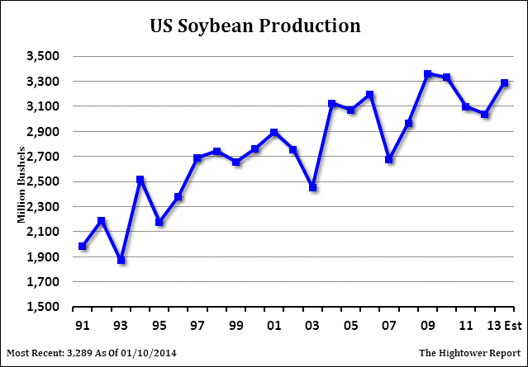
Rebounding US Production
Notes:
17

Slide 18
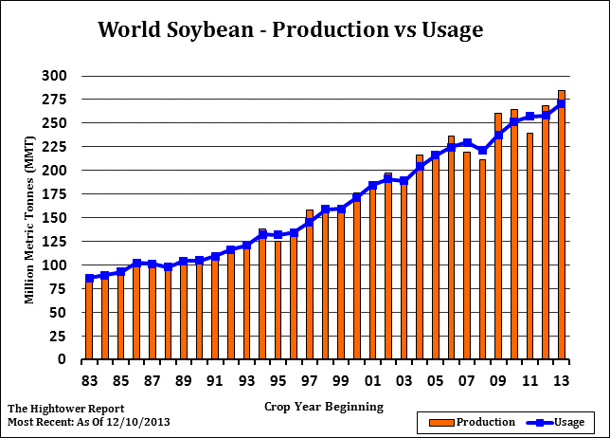
Global Supply Exceeds Demand
Notes:
18

Slide 19
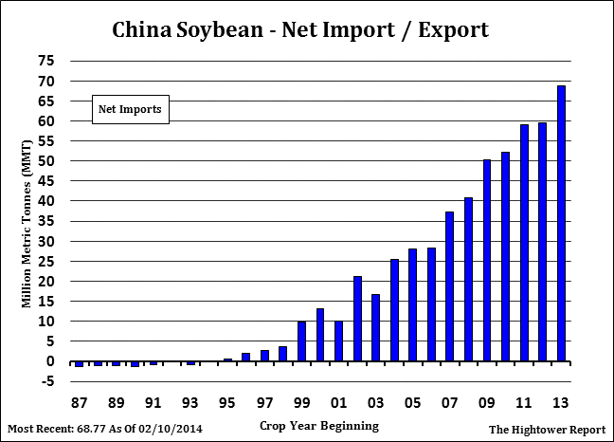
Yet, China Demand Grows 15.3%
Notes:
19

Slide 20
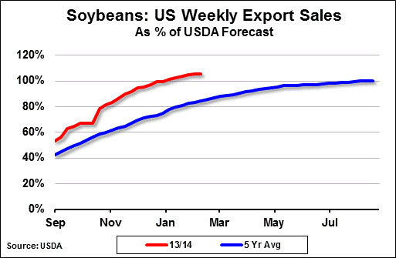
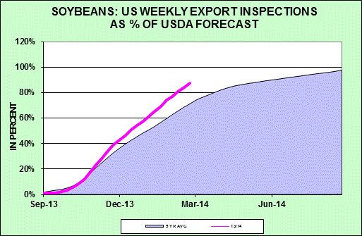
Demand for US Beans not Slacking
Exports at 105% of forecast +78 mil; shipments at 84%
China cancellation expected 2-3 MMT or 73.5-110 mil bus.
China unshipped sales: 4.03 MMT or 148 mil bus.
Unknown destination unshipped sales: 1.52 MMT or 55.8
Notes:
20

Slide 21
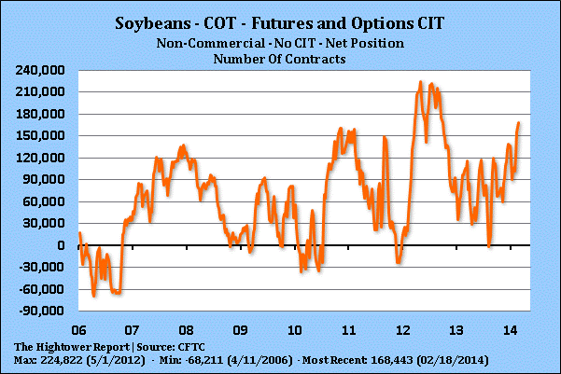
The Money Has Skin in the Game
Notes:
21

Slide 22
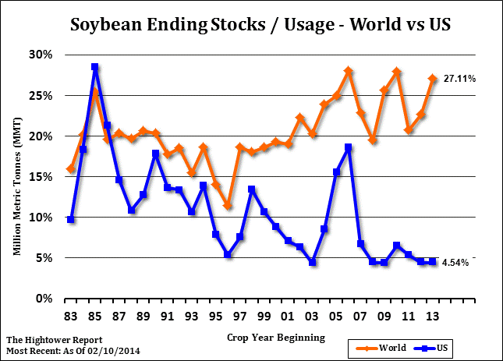
US Stocks Remain Tight vs. Global
Notes:
22

Slide 23
2014 – Record Production?
USDA Outlook Forum: First look at 2014 S&Ds
Starts with assumption US weather will be normal
Production forecasts based on trendline yields
Early acreage estimates based on economics
US balance sheet seen expanding
Are we moving into new marketing environment?
  Protecting cost of production vs. maximizing profits
Have a Marketing Plan:
  To sell old crop, new crop and 2015 crop
  ASP contract, Minimum Price, Floor Price, Min/Max Contract
Notes:
23

Slide 24
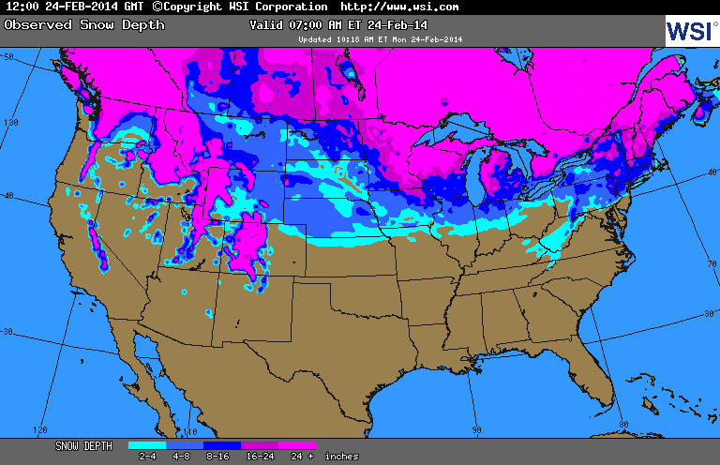
US Snow Cover
Notes:
24

Slide 25
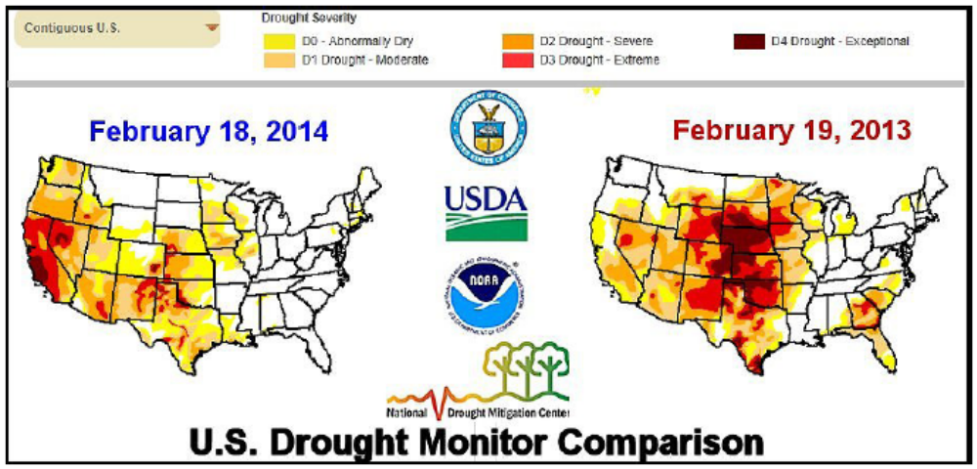
US Drought Monitor
Notes:
25

Slide 26
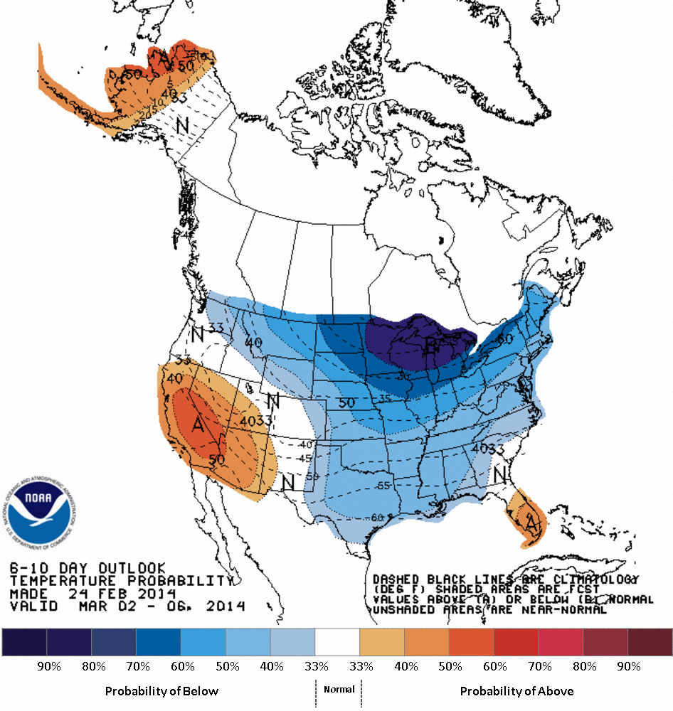
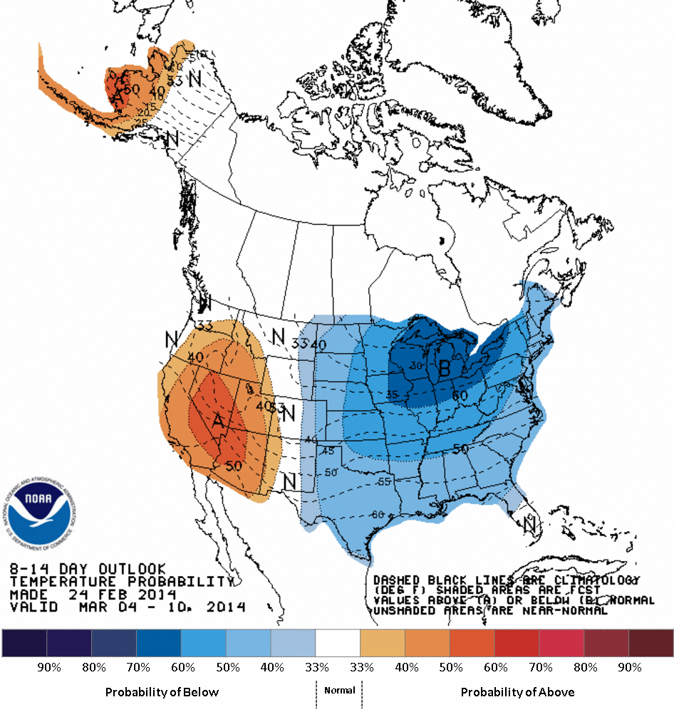
US Short Term Temp Outlook
Mar 2-6
Mar 4-10
Notes:
26

Slide 27
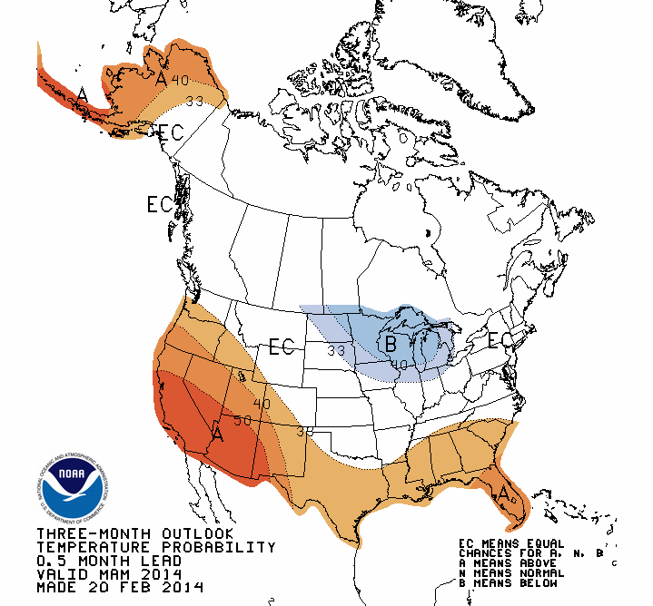
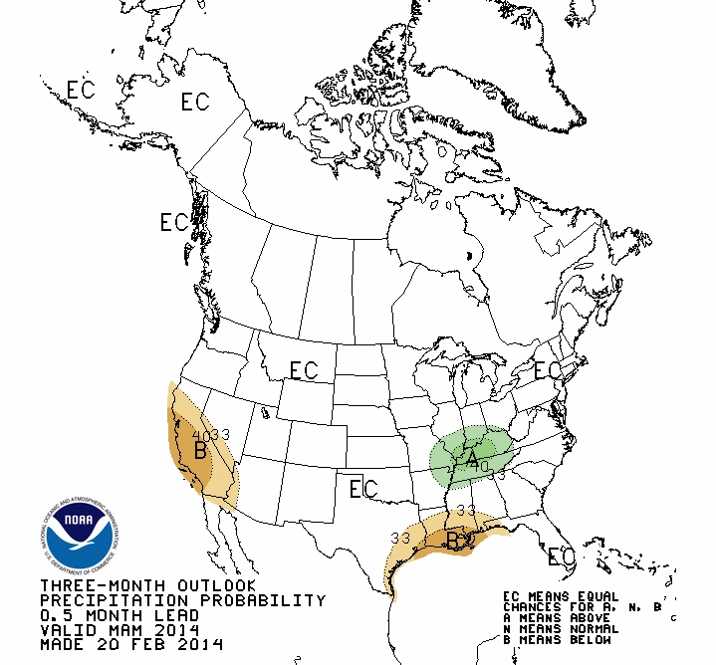
Spring Outlook MAM/NOAA
TEMPS
PRECIP
Notes:
27

Slide 28
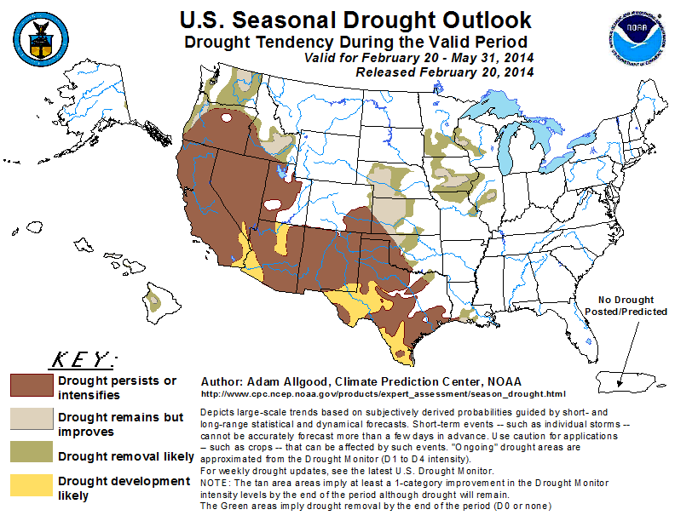
Spring Drought Outlook/Noaa
Notes:
28

Slide 29
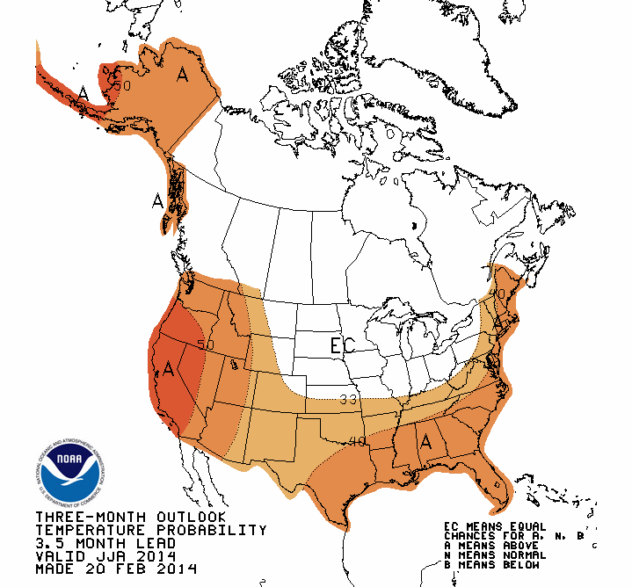
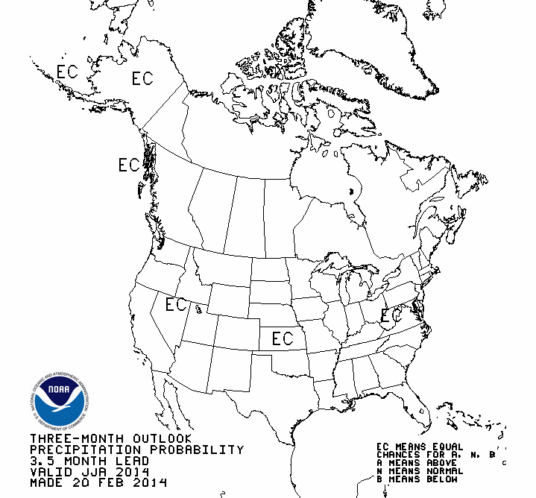
Summer Outlook JJA/NOAA
TEMPS
PRECIP
Notes:
29

Slide 30
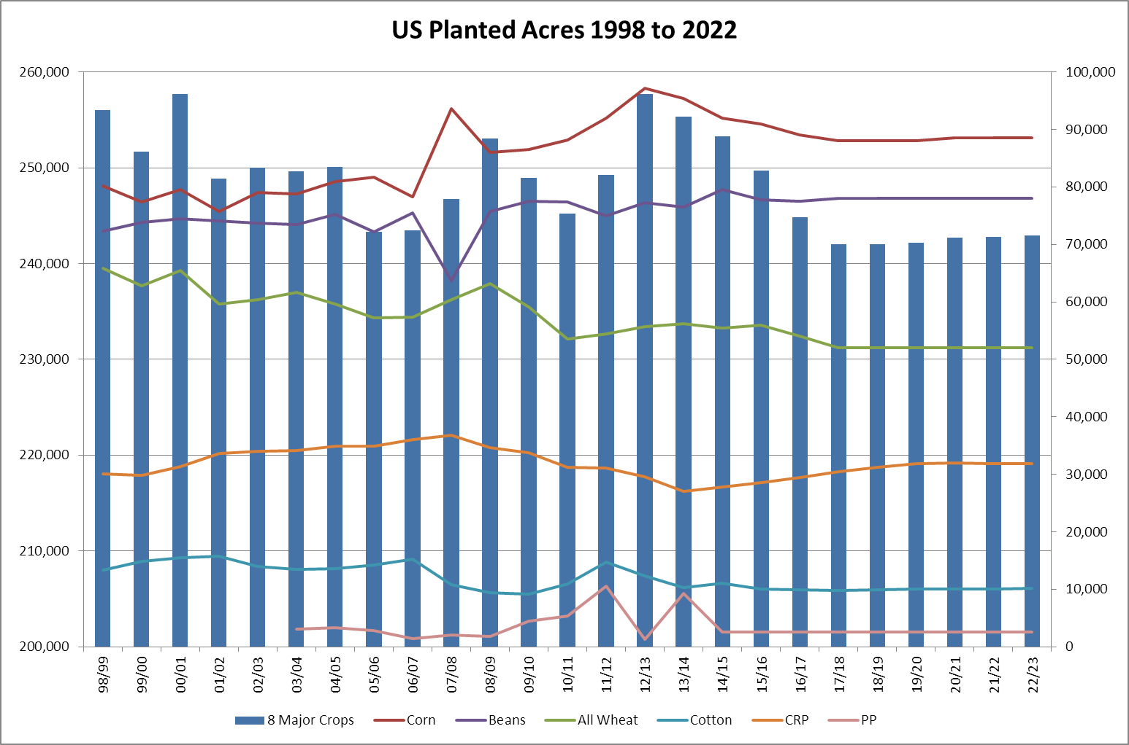
US Planted Acreage Outlook
14/15 253.8 down 1.6 mil
Notes:
30

Slide 31
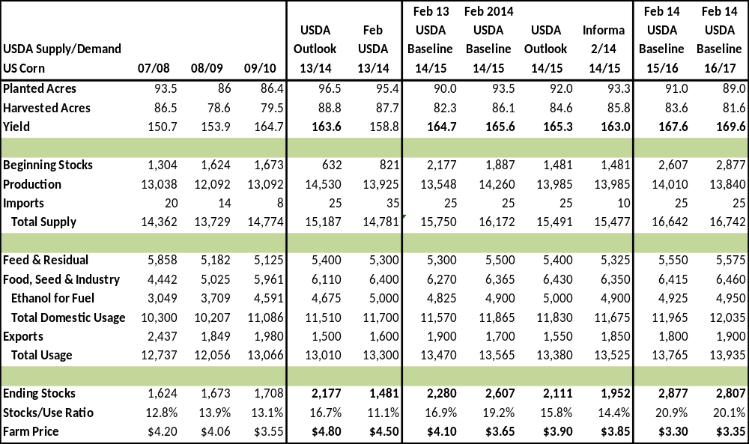
US Corn Supply and Demand
Notes:
31

Slide 32
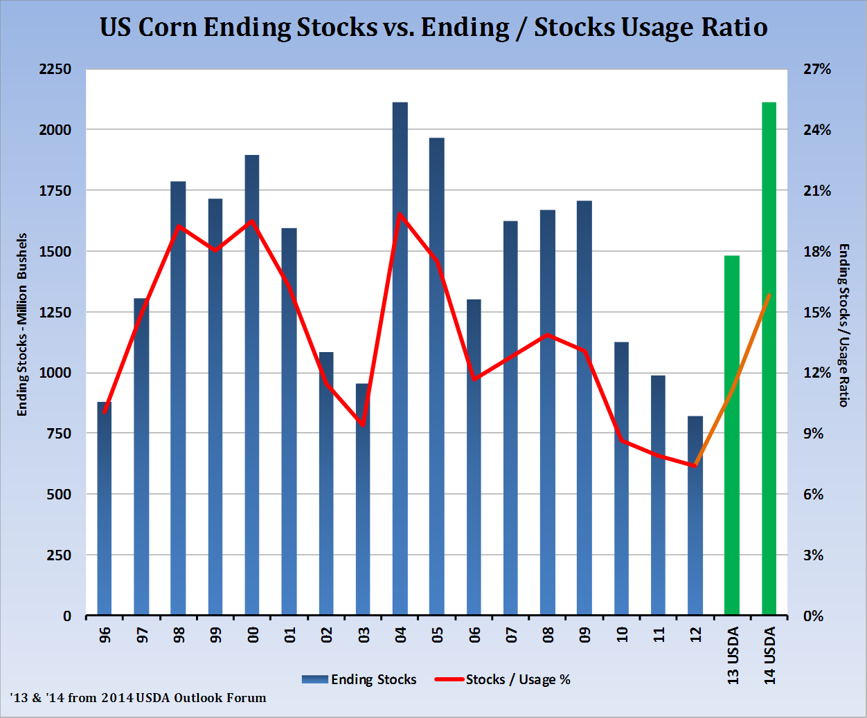
Corn Stocks Grow Exponentially
Notes:
32

Slide 33
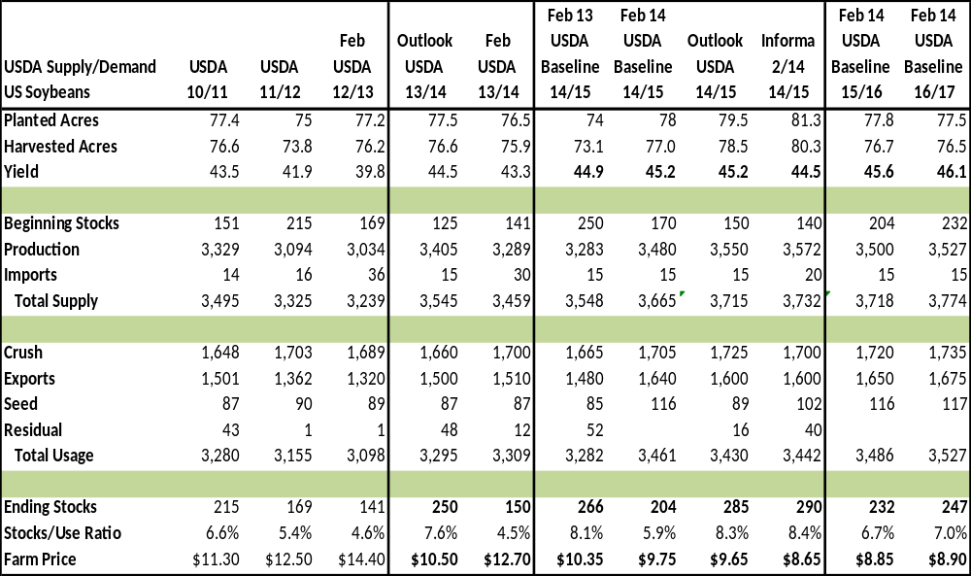
US Bean Supply and Demand
Notes:
33

Slide 34
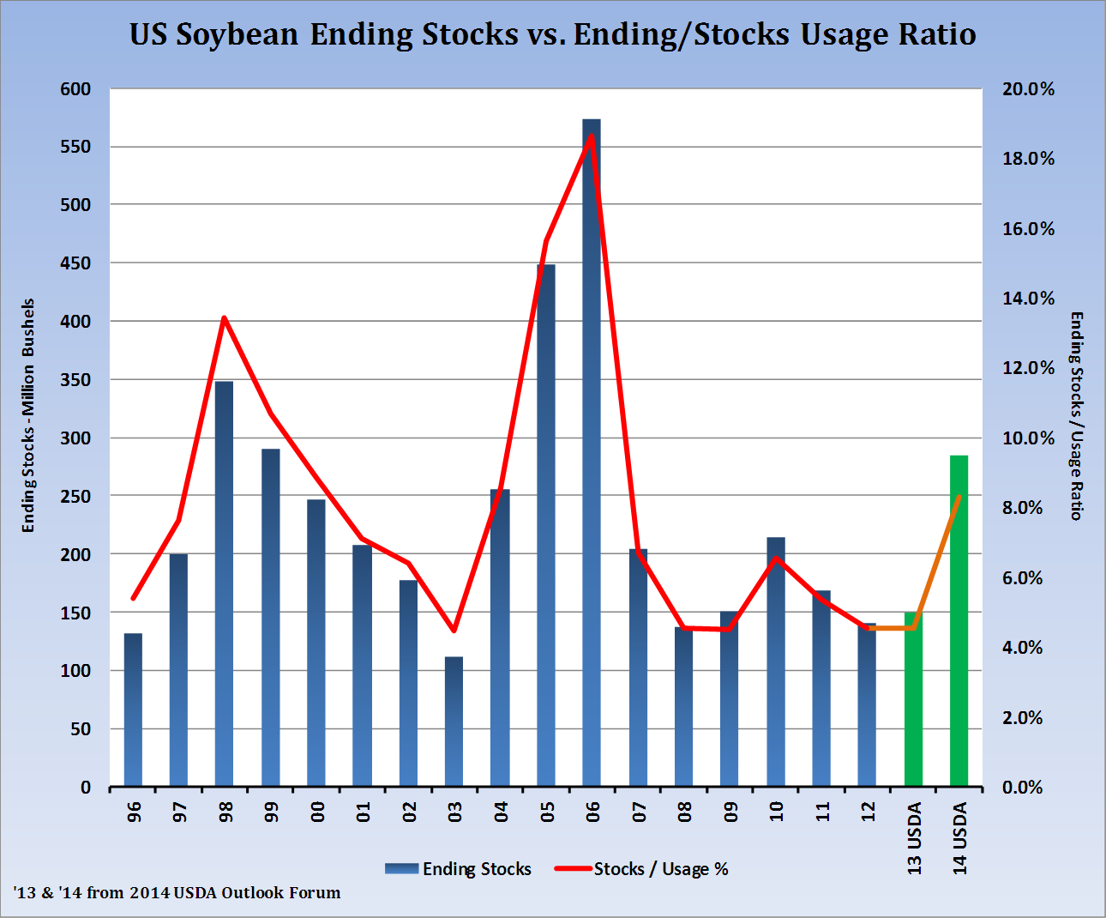
Bean Stocks to Nearly Double
Notes:
34

Slide 35
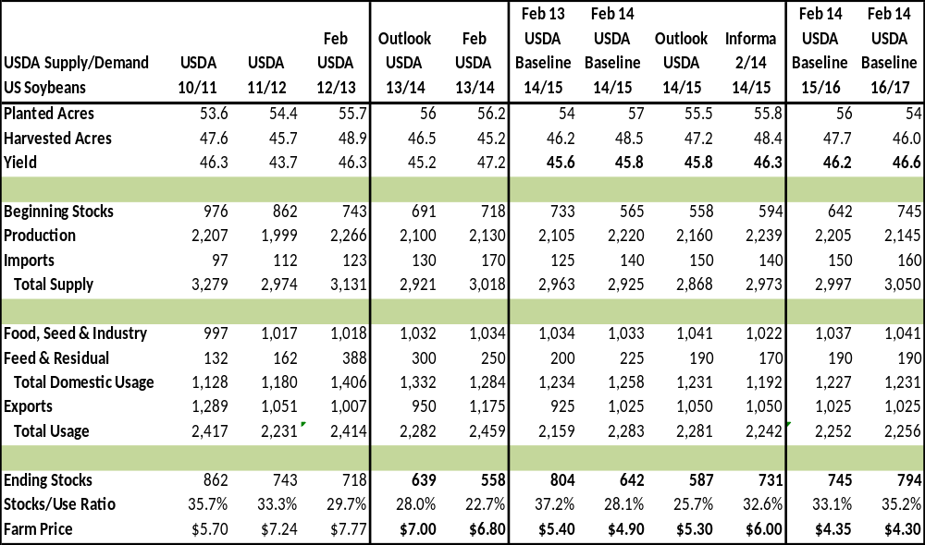
US Wheat Supply and Demand
Notes:
35

Slide 36
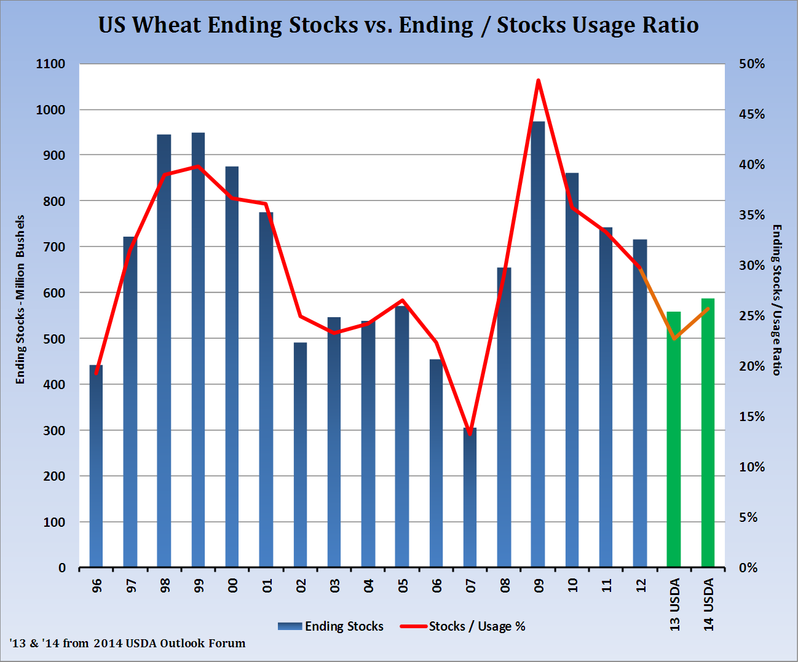
Wheat Stocks Steady Growth
Notes:
36

Slide 37
Marketing Tools
Hedge to Arrive – futures only, if bullish basis
Basis – basis only, if bullish futures
Open Offer – target price marketing
Average Seasonal Price – Spring pricing window
Minimum Price Contract – attach call, use if bullish
Floor Contract – attach put, use if bearish
Min/Max Contract – attach options sets floor and ceiling
ADM Marketing Partners Advisory recommendations
ADM Advantage
Notes:
37

Slide 38
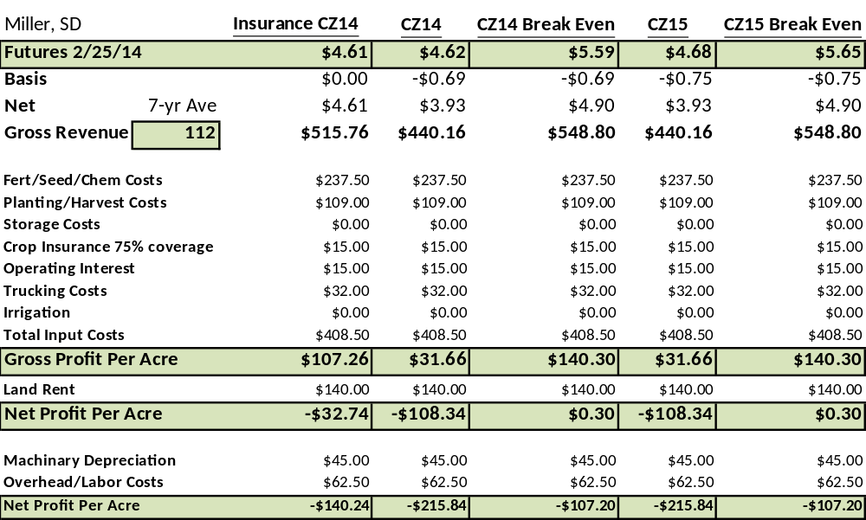
Corn Cost of Production 14/15
Notes:
38

Slide 39
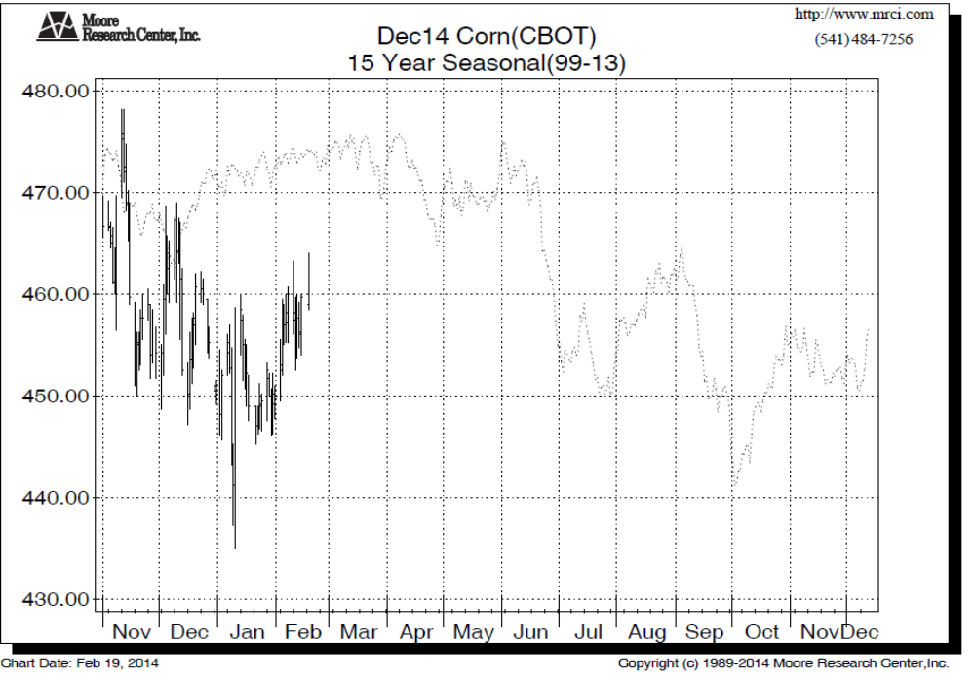
December Corn Chart
Notes:
39

Slide 40
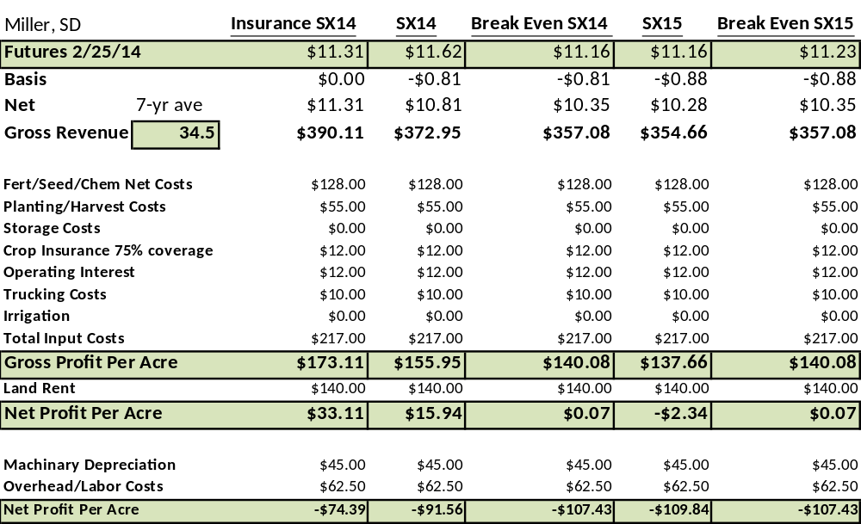
Bean Cost of Production 14/15
Notes:
40

Slide 41
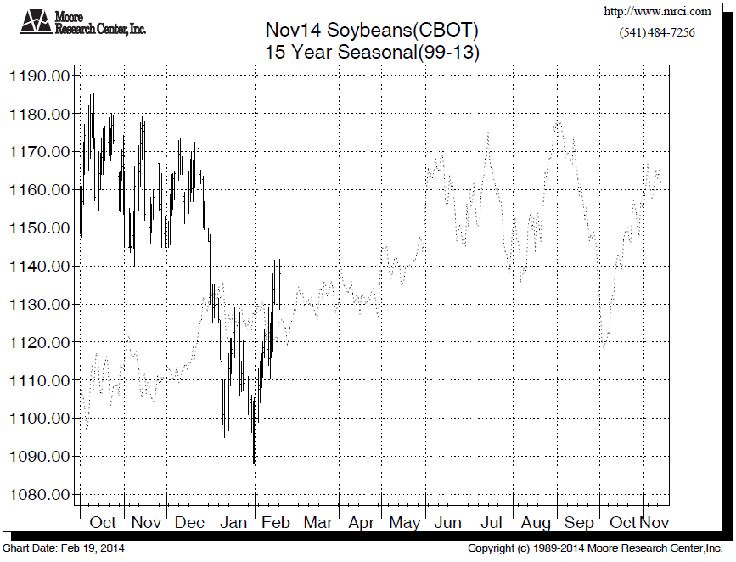
November Soybean Chart
Notes:
41

Slide 42
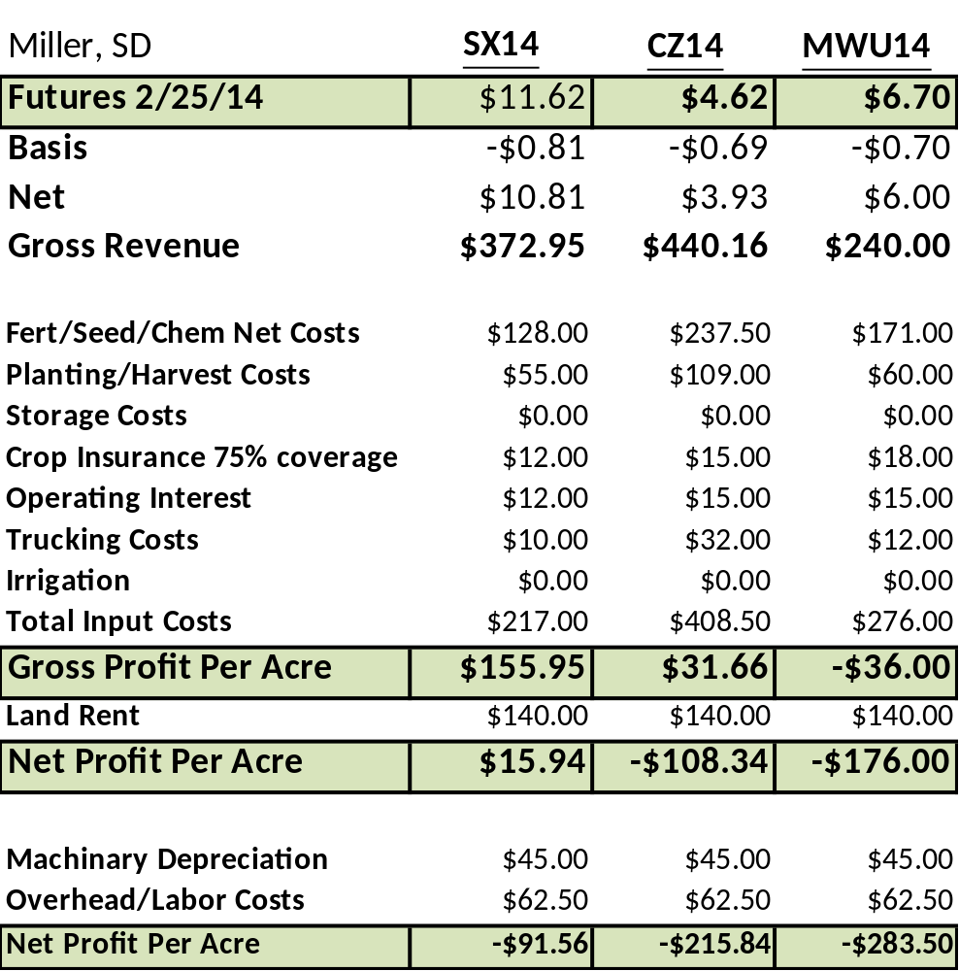
Best Return Current Market14/15
Notes:
42

Slide 43
What Could Change Price Outlook
US Acreage Mix: Corn vs. Beans
US Weather
China/World Weather
Money Flow
US Economy/Inflation?
Black Swan?
Notes:
43

Slide 44
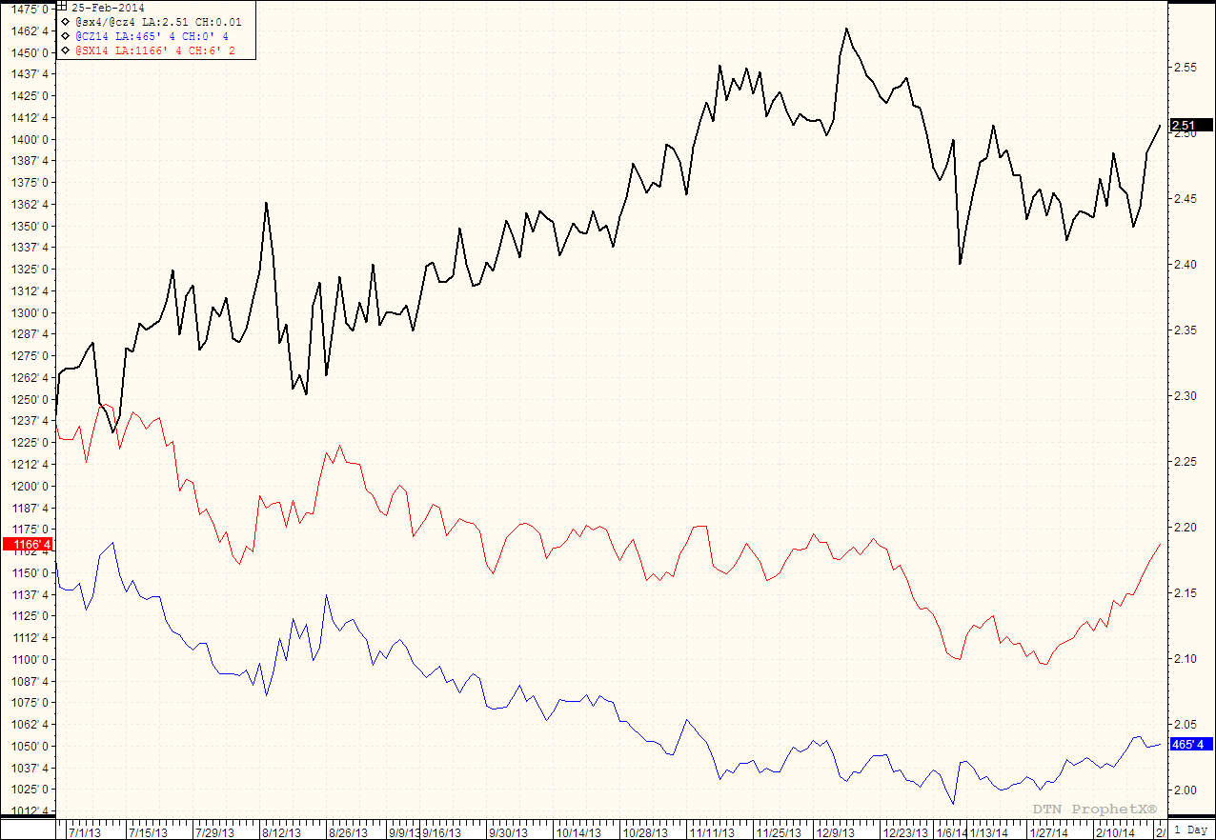
Corn to Bean Price Ratio
Notes:
44

Slide 45
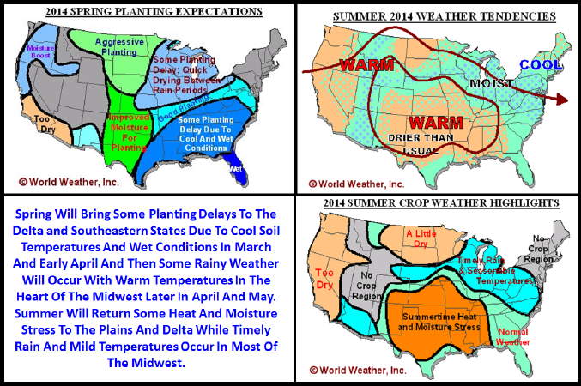
Summer Outlook/World Weather
Notes:
45

Slide 46
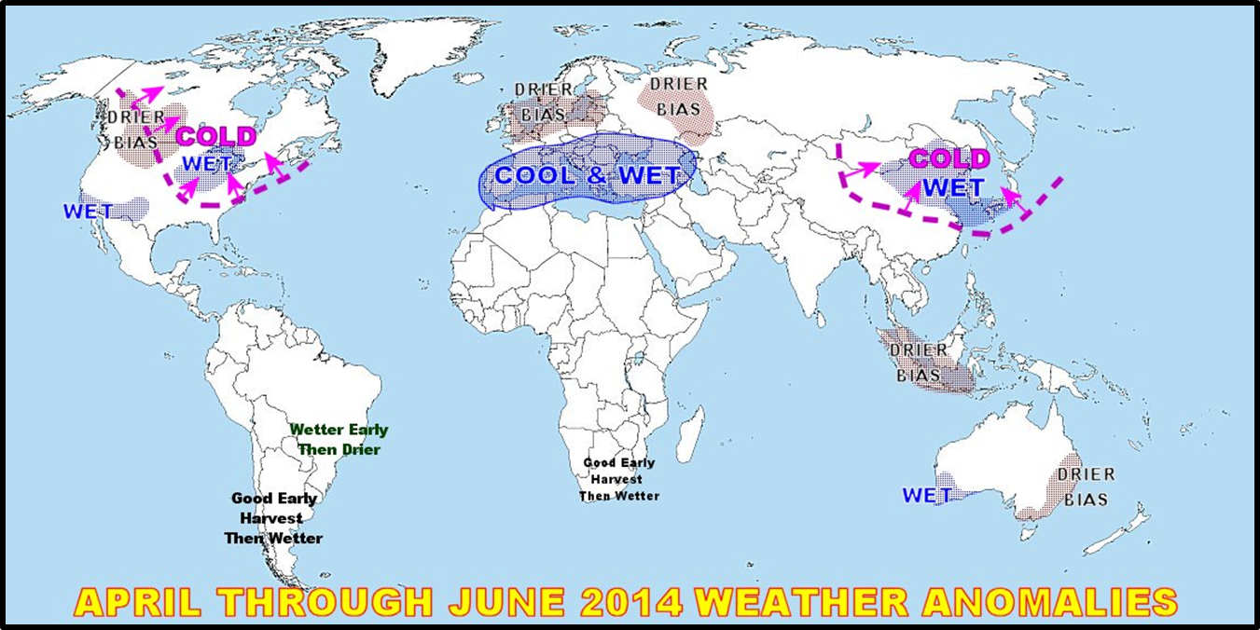
Global Weather Hot Spots
Notes:
46

Slide 47
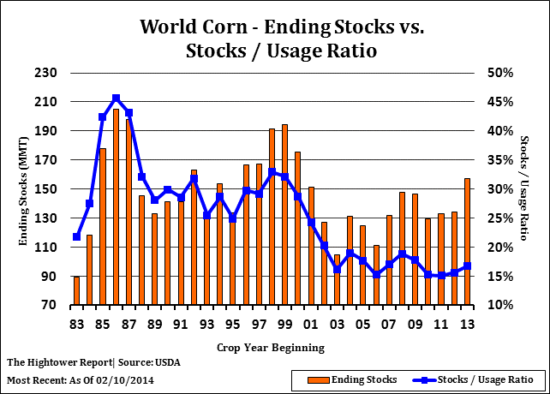
World Corn Ending Stocks
Notes:
47

Slide 48
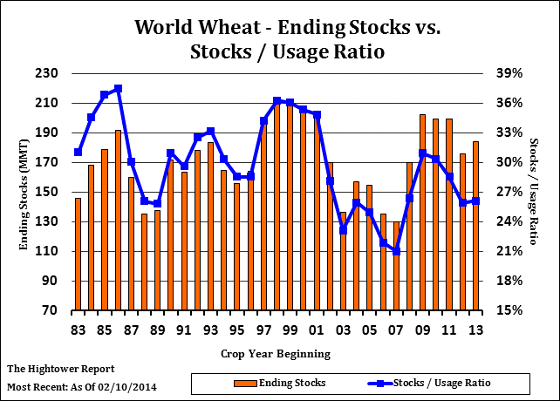
World Wheat Ending Stocks
Notes:
48

Slide 49
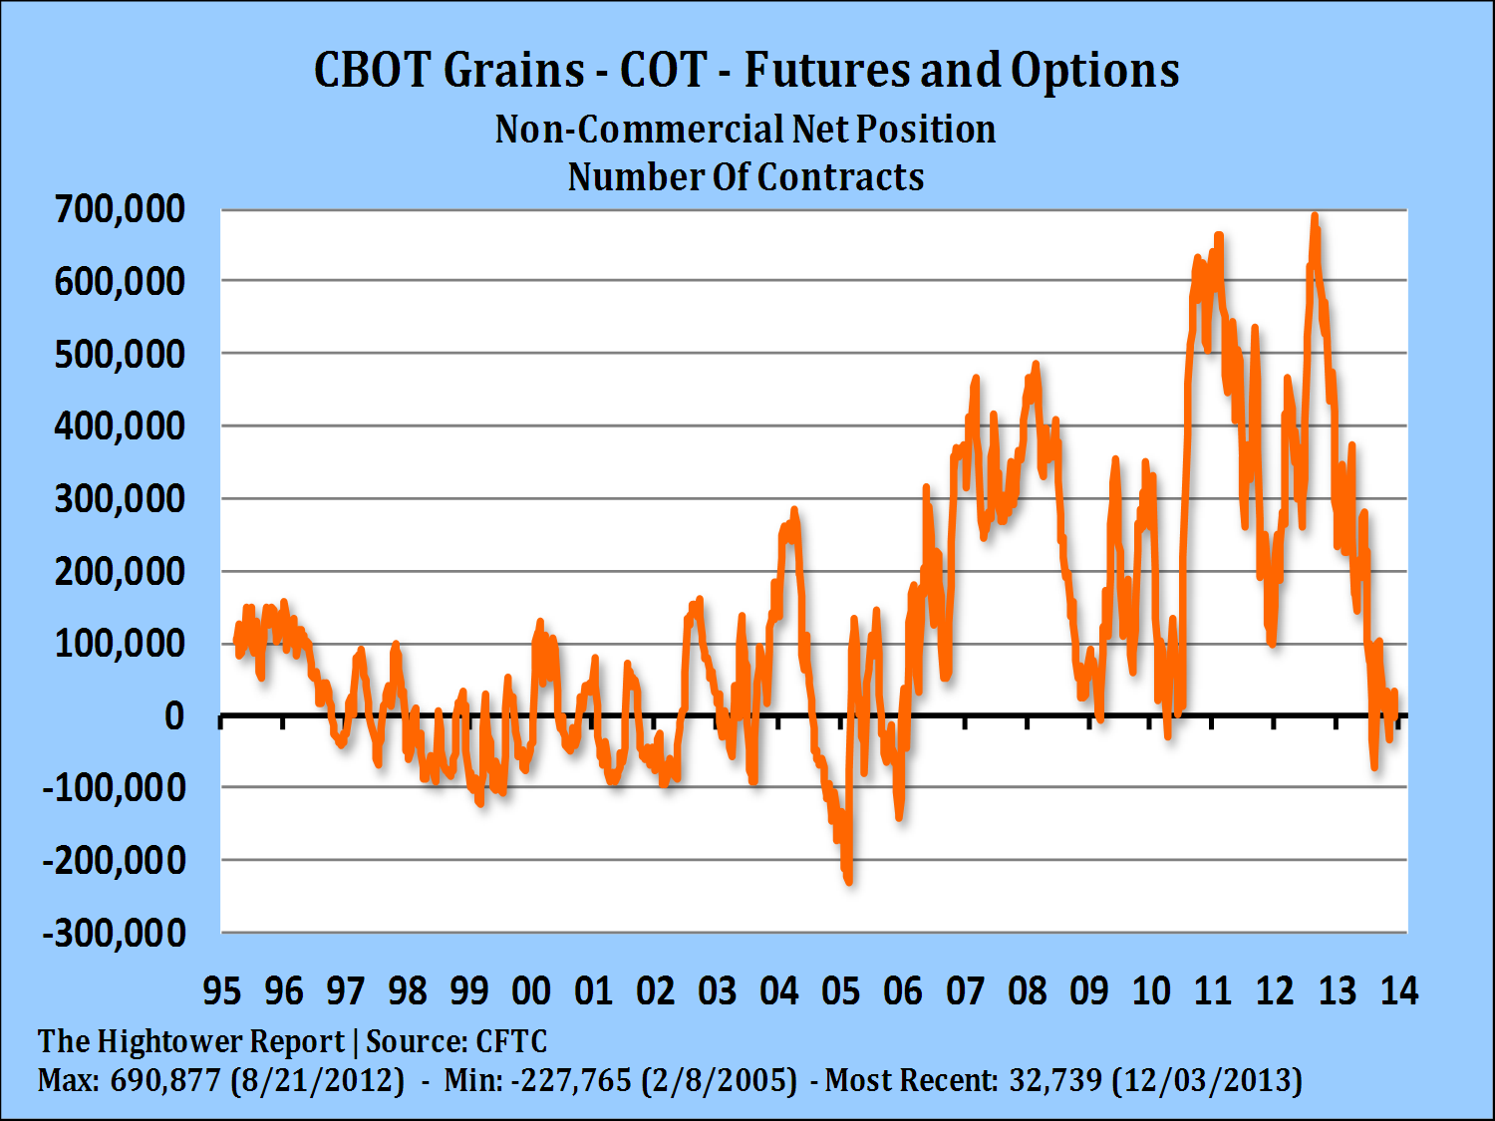
Money Flow Out of Commodities
Notes:
49

Slide 50
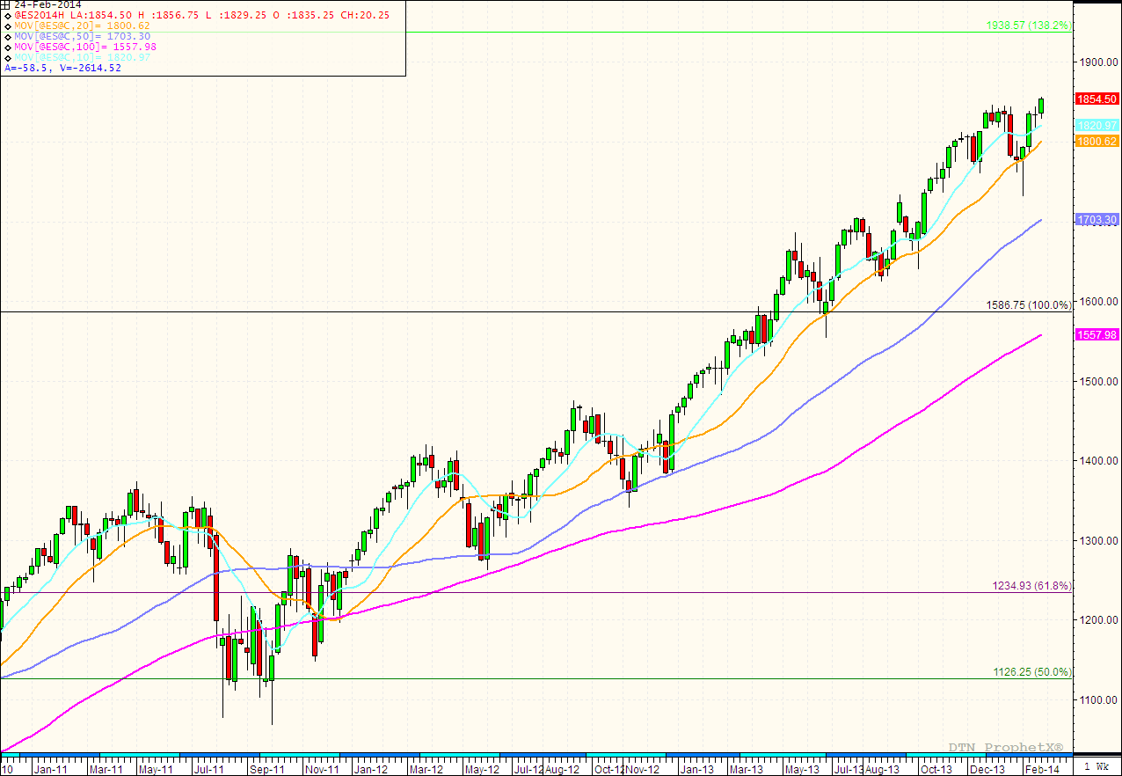
Equity Bubble?
Notes:
50

Slide 51

World Unrest/Black Swan?
Attributed: Reuters/Khaled Abdullah
Notes:
51

Slide 52
Sources:
USDA
CFTC Commitment of Traders reports
World Weather Spring Outlook
NOAA
NASS Census County Yield data
Charts from The Hightower Report and DTN
Cost of Production analysis estimated on regional data
Kim Rugel
Benson Quinn Commodities, Inc.
Minneapolis, MN
800-438-7070
kim.rugel@adm.com
ADM-Benson Quinn
Hitchcock, SD
Jeff Gottman and Kallie Craig
605-266-2530

