Slide 1

[
Welcome
To
ABC MARKETING CO.
Reputation Marketing Strategy

Slide 2
Technical Sign Off Meeting
Todays
Video Your Interview
V
Set Up Your Framing
Setup Your Sound
Film Your Interview
Rep Marketing Strategy
R
Give You A Step By
Step Strategy For Building A 5 Star Reputation
F
Feedback Survey
Give Us Feedback On Our Strategies And Your Experience

Slide 3




Question?
Three Services Are Virtually Identical
Service
Service
Service
A
B
C
Four Good Reviews
Two Bad Reviews
No Reviews
Six 5 Star Reviews
Which One Would You Choose To Buy?

Slide 4
“Reputation Marketing” Is The Most Effective Way To Market…
What’s Your Experience With Reputation Management?
You Don’t Make Money
Managing…
Reputation Management
Is Obsolete…
Smart Businesses
Start With
Reputation
You Make
Money
Marketing

Slide 5

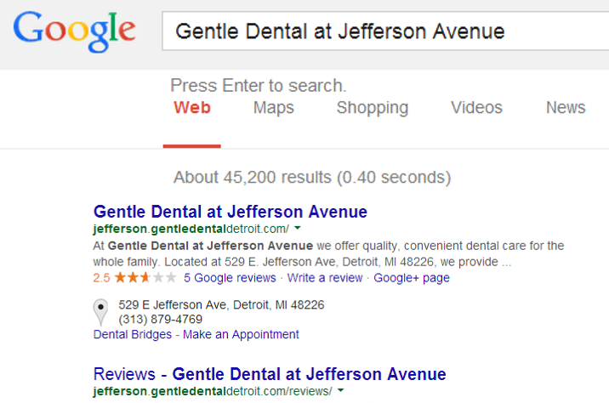
Marketing Game Changer
1
“80 Million Google Plus Pages Merged With Each Companies Website
And Reveals The Companies Reputation To Their Customers”
Search For Any Company Name
+
The City Reveals
Their Reputation

Slide 6

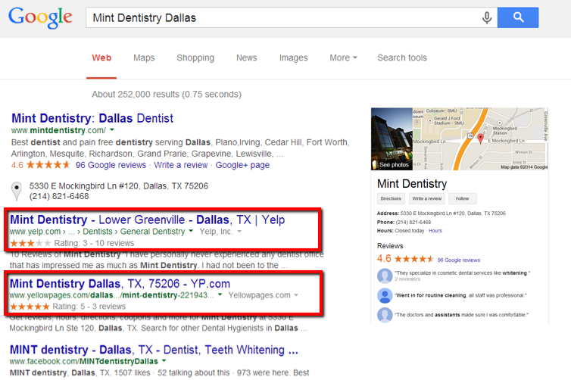
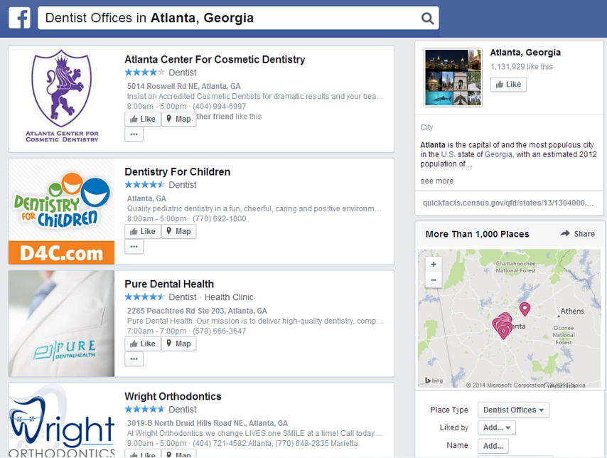
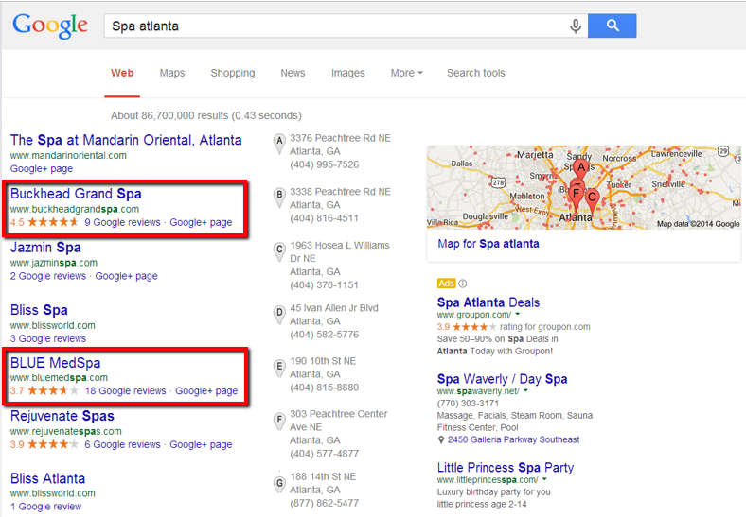
Marketing Game Changer
2
Businesses Must Have Reviews To Compete Online… Why?
“Reviews Are A Major Part Of Online Marketing.”
Google+ Maps
Social Media
Local Directories
SEO Rankings
Pay Per Click

Slide 7


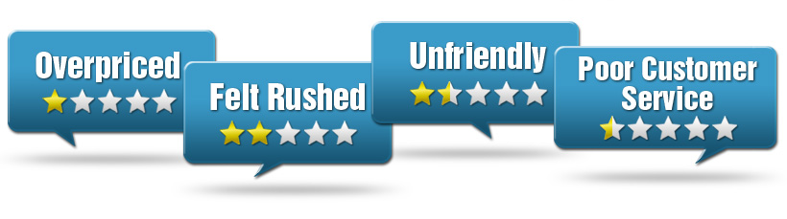
Marketing Game Changer
3
SEO… Social Media… Pay Per Click… Local Marketing
None Of It Is Effective Anymore….
If You’re Not Monitoring And Get A Bad Review
Build A 5 Star Reputation First
STEP:1
Market The Business With Website, SEO, Social Etc.
Market Their Business to Get More Customers
STEP:2
Help The Build Their 5 Star Reputation

Slide 8

Marketing Game Changer
4
Reviews Give You Pre-Qualified Presold Leads
Because Buyers Trust Reviews…
As Much A Family And Personal Recommendations
72% Of Buyers
Trust Reviews As
Much As Personal
Recommendations.
~ Bright Local

Slide 9
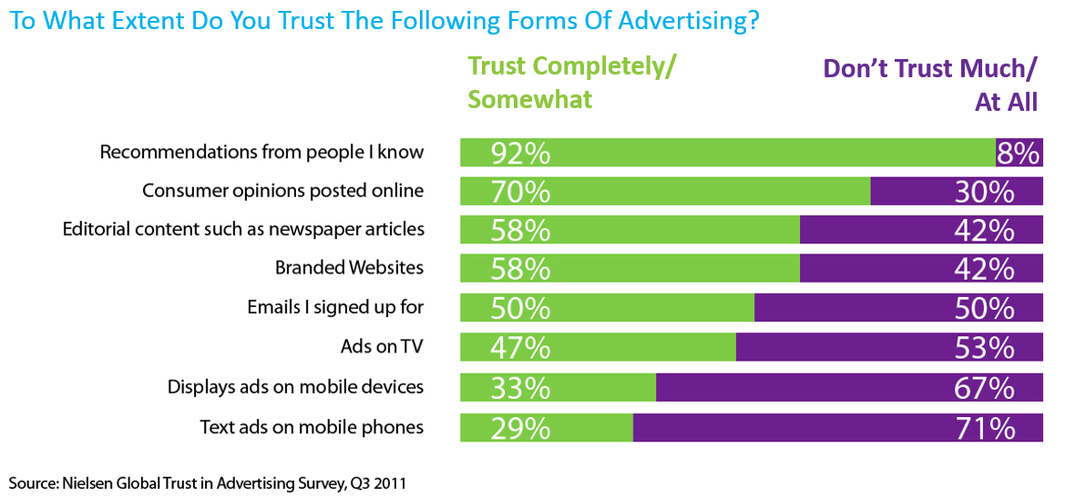
Biggest Shift In Marketing In 10 Years

Slide 10




Q:
Choosing Your Business
How Many Reviews Does A Consumer Look Up Before
Making A Decision?
10
REVIEWS
Q:
Trusting Your Business
How Many Reviews Does A Business Need Before They
Consumer Can Trust Them?
6-10
REVIEWS
F:
Without Six 5 Star Reviews Your Business Isn’t Trusted

Slide 11

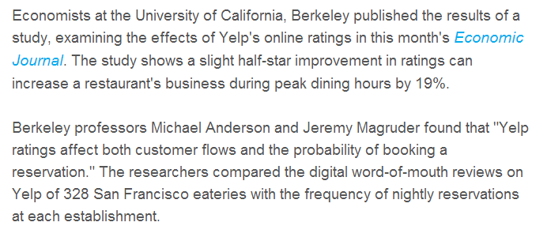

Reputation Marketing
“Reputation Marketing Has Proven To Increase Business By 19% By Increasing ½ Star Rating Online”

Slide 12
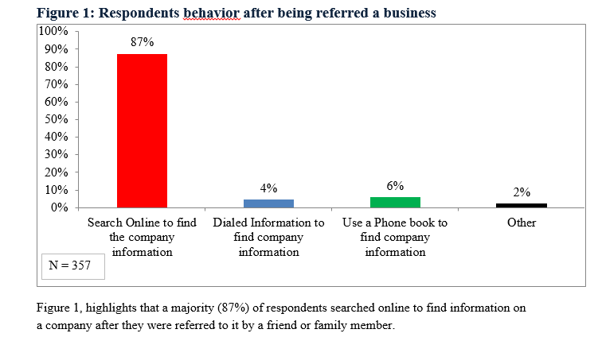
Reputation Marketing & Referrals
Q:
“After Being Referred A Business, What Do You Do Next?”
Real Strategic Inc. All Rights Reserved

Slide 13
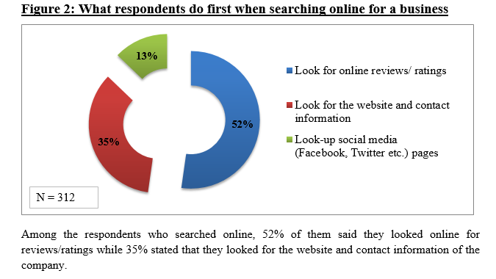
Reputation Marketing & Referrals
Q:
“After Being Referred A Business, What Do You Do Next?”
Real Strategic Inc. All Rights Reserved

Slide 14




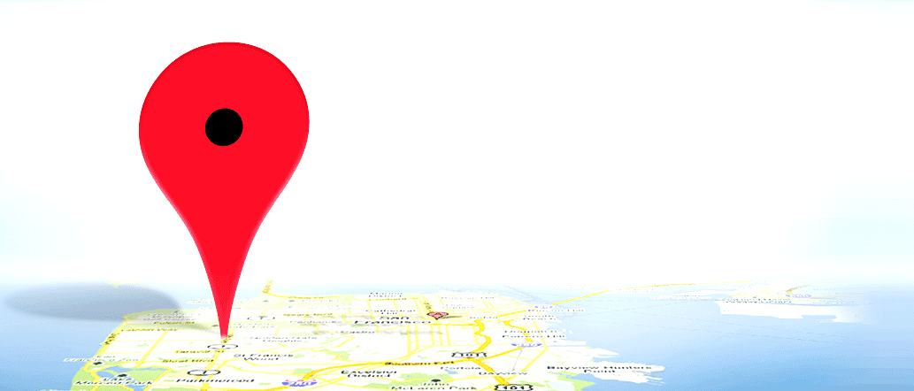
Q:
Does Reputation Impact Online Or Traditional Marketing?
TV & Magazine Ads
SEO Marketing
Social & Mobile Media
Newspaper & Radio
Direct Mail
Website Marketing
Reputation Impacts All Your Marketing Including Referrals

Slide 15

Definition Of Reputation Marketing:
Wikipedia: The “Reputation Marketing” field has evolved from the marriage of
the fields of Reputation Management and Brand Marketing.
Reputation
Management
Brand
Marketing
Reputation Marketing:
Building A Five Star Reputation, And Then Market
Your Reputation To Get More Customers.

Slide 16

Let’s Show You A Strategy That Can
Give You More Customers With “Reputation
Marketing”
Q2: What’s The
Average Yearly Revenue
Per Customer?
Q1: How Many Customers Do You Service Per Month?

Slide 17
Marketing
Strategy
The Perfect
Reputation

Slide 18
The Perfect Reputation Marketing Strategy
- Monitor
- Alerts
- Reporting
- Train Staff
- Feedback
- Reviews
Manage
Reputation
Build
Reputation
Market
Reputation
- Images
- Videos
- Website
- Social media

Slide 19


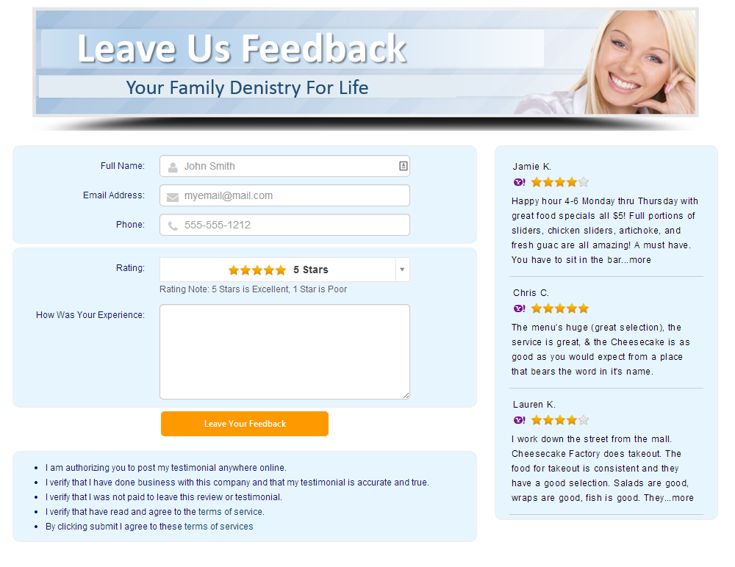



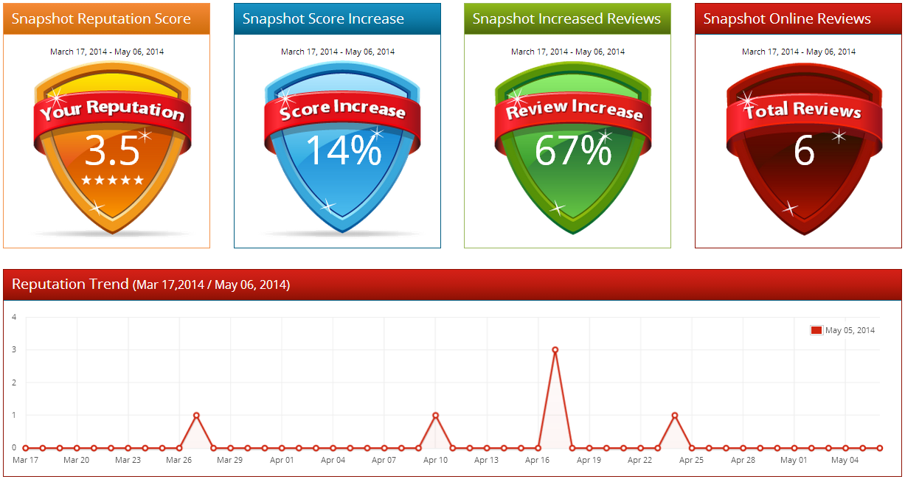
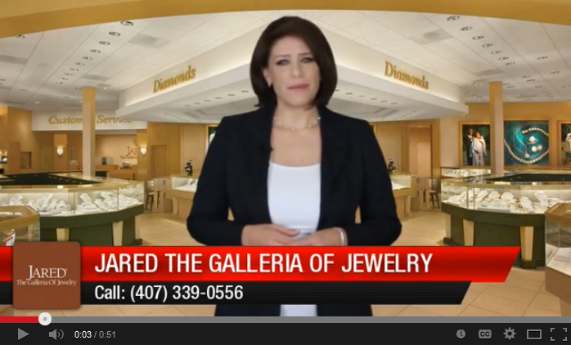


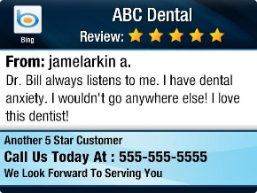









Our Proprietary Reputation Marketing Strategy
Our Staff & Services
Capture Customer Feedback
Feedback Pages
Daily Monitoring
“Incredible Service, I highly recommend them. They are always on time.”
Review
Alerts & Reports
Staff
Services
We Monitor Top
Local Directories
We Market 45 – 60 Second
“Review Commercials”
We Redirect To
Get Reviews Online
We Market Reviews
On Your Websites
We Market Reviews
On Your Social Media
We Market Review Images On Your Social Media

Slide 20
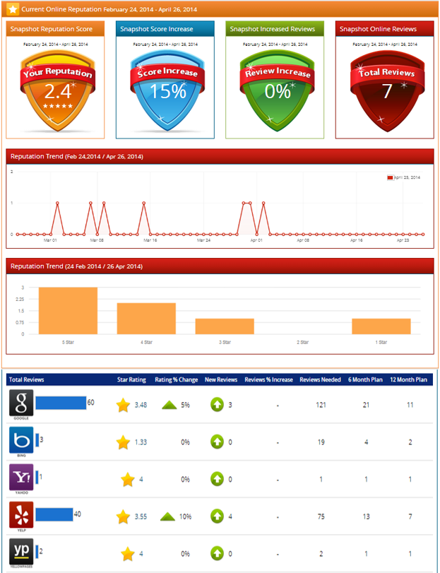
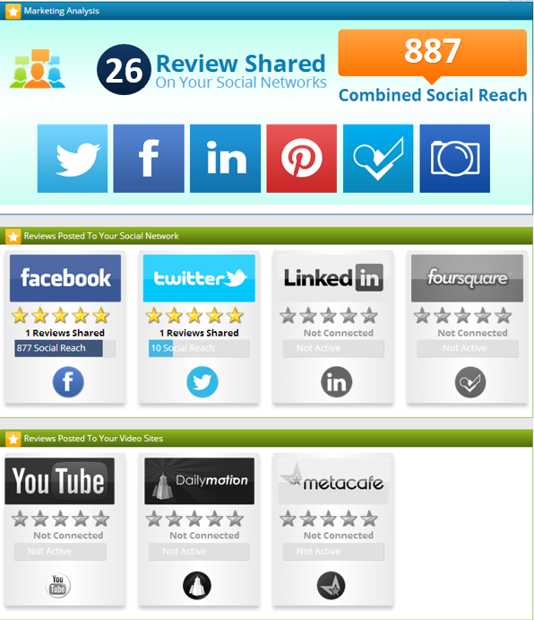
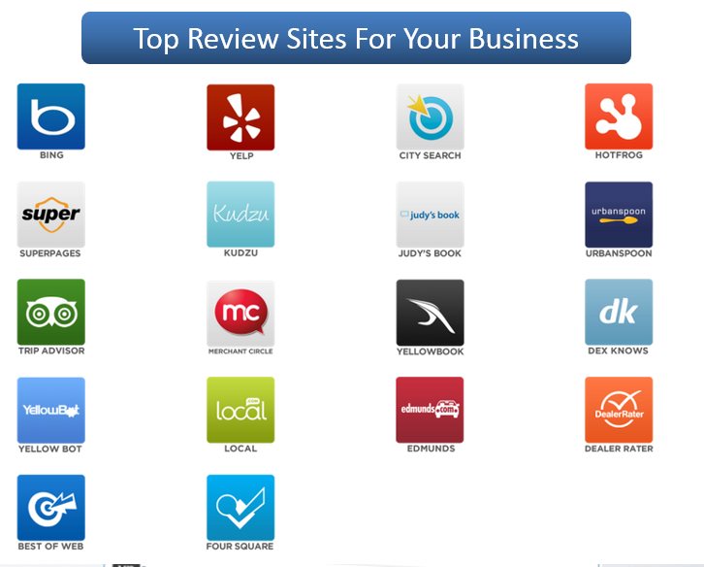
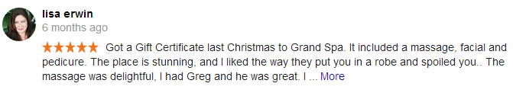
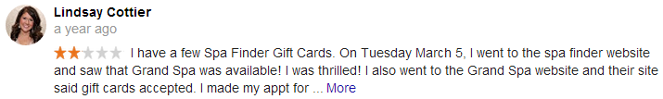


Manage
Reputation
Build
Reputation
Market
Reputation
Team Monitors Your Listings
Send You Review Alerts
Respond To Bad Reviews
Detailed Reptuation Reporting
Alert
Alert
Monthly Marketing Analysis
Sales Staff
Support Staff
Inspire Your Your Staff

Slide 21
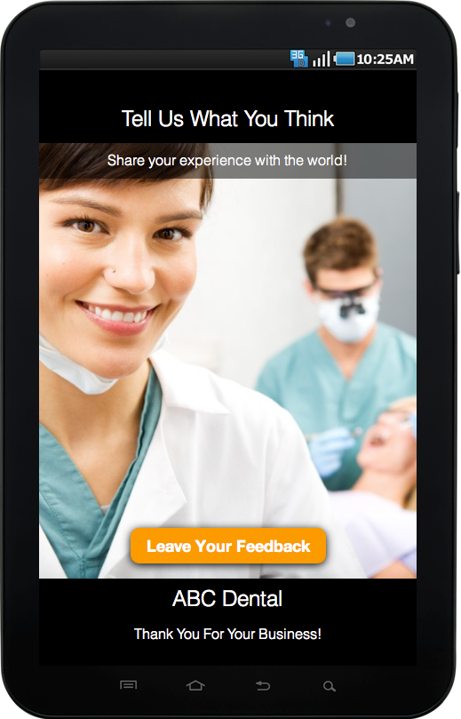
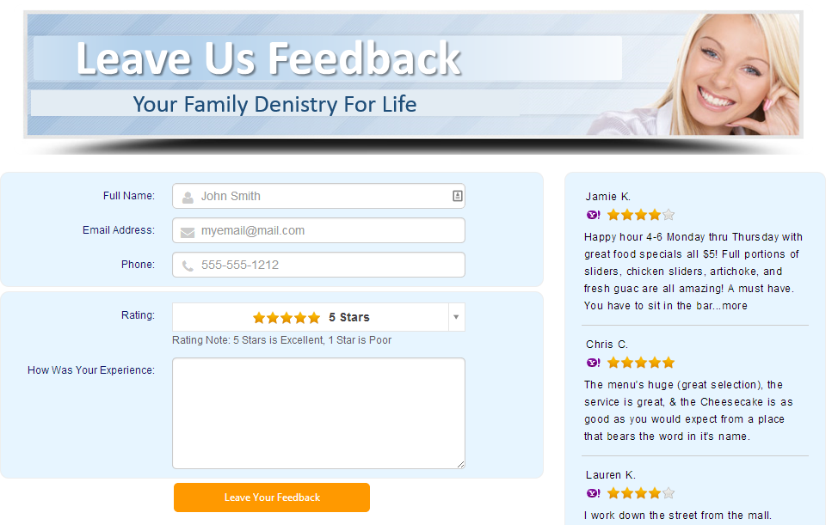
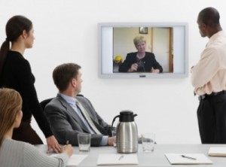
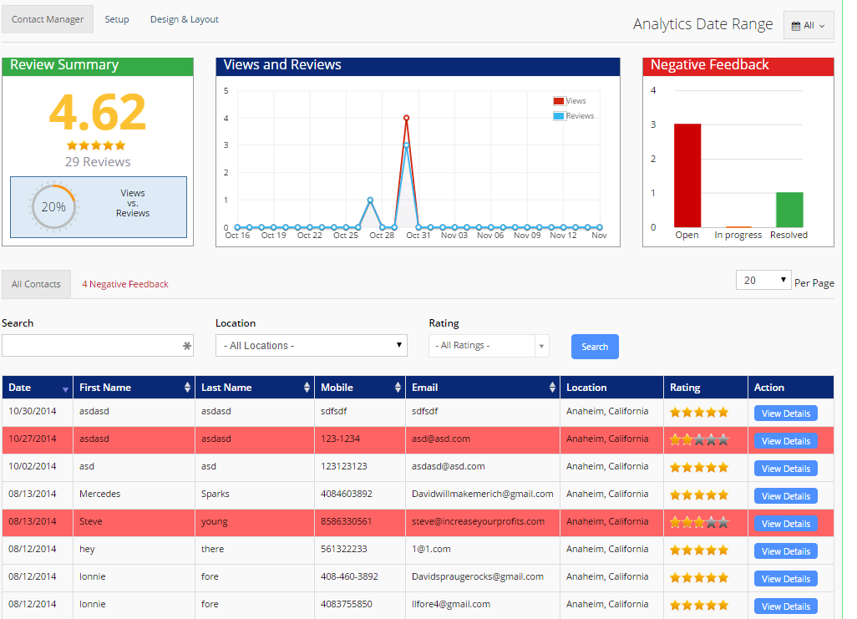
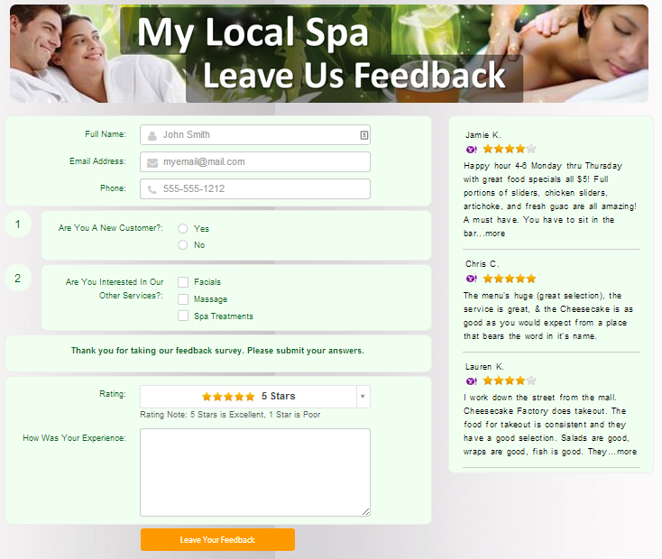
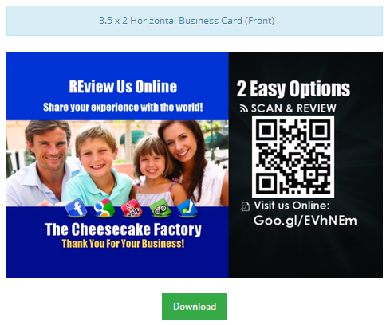
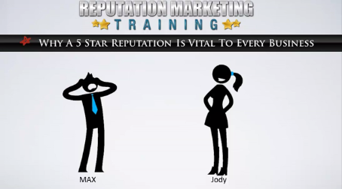
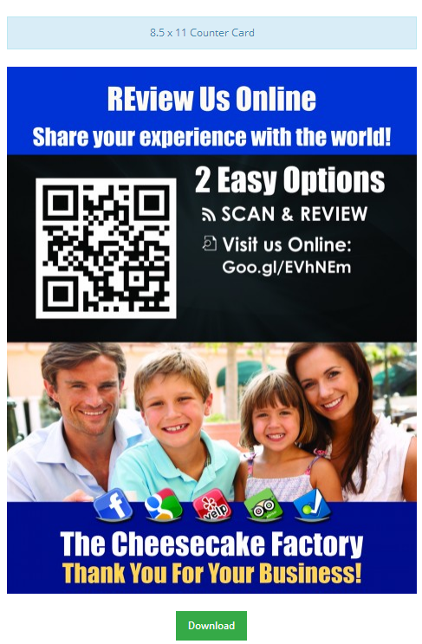

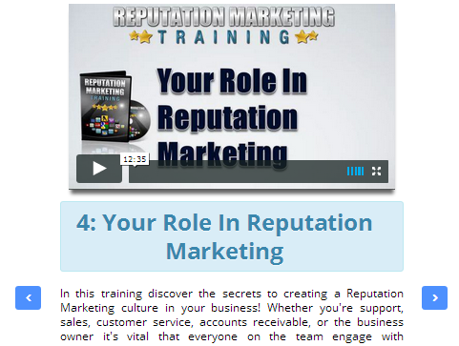
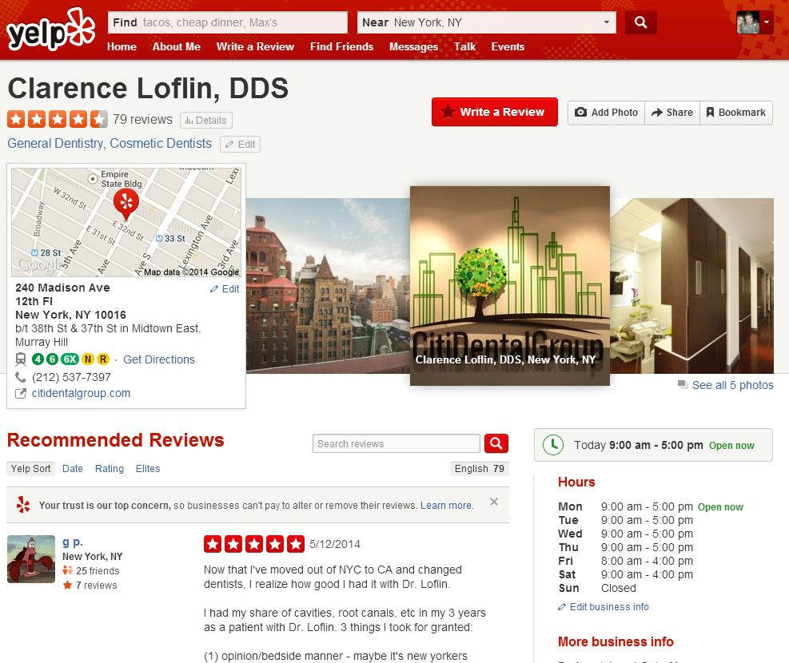
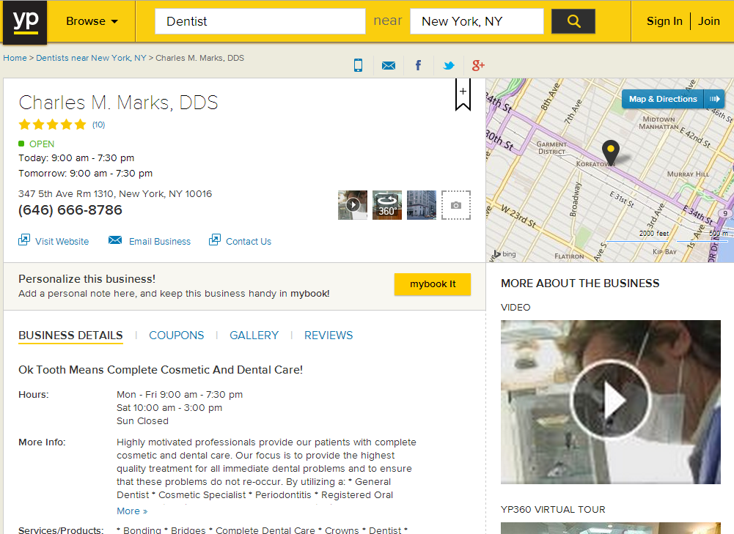
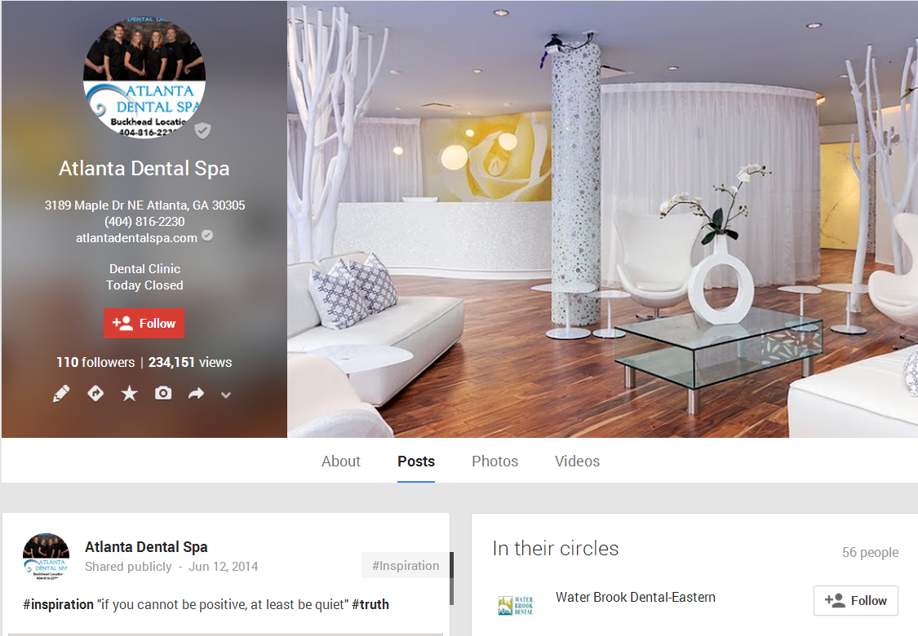



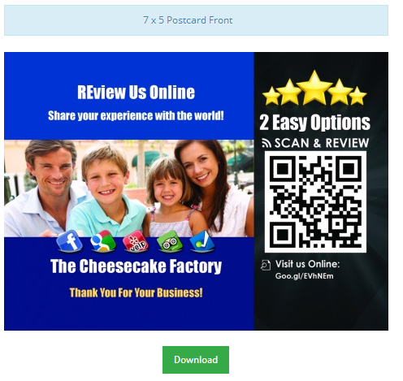
Review Capture Media Center
Manage
Reputation
Build
Reputation
Market
Reputation
“Incredible Service, I highly recommend them. They are always on time.”
Review
Build Employee Training Center
Feedback Survey Pages
Custom Print Media Center
Custom Mobile Review App
Proprietary Posting System
Customized Feedback CRM

Slide 22

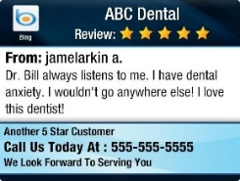
Services
Manage
Reputation
Build
Reputation
Market
Reputation
We Market 45 – 60 Second
“Review Commercials”
Staff
Market On Your Website
Market To Social Media
Market To Photo Sharing
Market To Video Sharing
We Market Review Images On Your Social Media
We Market Reviews
On Your Websites
We Market Reviews
On Your Social Media
Market In Presentatons & Sales Media

Slide 23
Reputation Marketing Strategy
  Personally Train All Your Staff On Reputation
  Develop A Reputation Strategy For You To Get Reviews Fast
  Build Your Reputation & Position You As The Market Leader
  Monitor & Alert You On New Reviews Everyday
  Build A Customized Mobile App To Collect Reviews
  Program Professionally Designed Survey And Feedback Pages
  Create Monthly Reputation & Feedback Analysis Reports [Build Culture]
  Post Reviews To Your Website, Blog, Plus 1 Other Site
  Daily Post Your Reviews To FB, Google+, LinkedIn & Twitter
  Create Professional Review Images For Daily Syndication
  Create & Broadcast Monthly “Review Commercials”
  Build A Customized Feedback CRM With All Your Feedback
What Would It Cost To Hire Someone Each Month?

Slide 24
Lets Put A Strategic Proposal Together
To Help You Build A 5 Star Reputation
And Market That Reputation To
Get More Customers…
What Date Do You Have Available So
We Can Show You Your
Final Edited Interview And We Can
Show You Your Personalized
Reputation Marketing Proposal
At The Same Time?

Slide 25

Thanks For Being A Part Of Our Beta Program
We Can’t Wait
To Share It
With Our Team
Please Give Us
Your Feedback

Slide 26
The Perfect Reputation Marketing Strategy
- Monitor
- Alerts
- Reporting
- Train Staff
- Feedback
- Reviews
Manage
Reputation
Build
Reputation
Market
Reputation
- Images
- Videos
- Website
- Social media

Slide 27

3
1
Brand Marketing
$10,000’s
Problem
Problem
SEO Marketing
$1000’s
Our $997
Program After Beta
Five
4
Video Marketing
$10,000’s
5
Problem
Problem
2
Powerful REASONS
Problem
To Have Customer
Review Commercials
Every Month
Social Media
Marketing
$1000’s
Reputation Management
$1000’s
Review Commercials Help Solve All
5 Problems For A Fraction Of The Cost
Notes:
Attention!
Before you open this template be sure what you have the following fonts installed:
Novecento Sans wide font family (6 free weight)
http://typography.synthview.com
Abattis Cantarell
http://www.fontsquirrel.com/fonts/cantarell
Icon Sets Fonts:
raphaelicons-webfont.ttf from this page: http://icons.marekventur.de
iconic_stroke.ttf from this page: http://somerandomdude.com/work/open-iconic
modernpics.otf from this page: http://www.fontsquirrel.com/fonts/modern-pictograms
general_foundicons.ttf, social_foundicons.ttf, accessibility_foundicons.ttf from this page: http://www.zurb.com/playground/foundation-icons
fontawesome-webfont.ttf from this page: http://fortawesome.github.io/Font-Awesome
Entypo.otf from this page: http://www.fontsquirrel.com/fonts/entypo
sosa-regular-webfont.ttf from this page: http://tenbytwenty.com/?xxxx_posts=sosa
All fonts are permitted free use in commercial projects.
If you have difficulties to install those fonts or have no time to find all of them, please follow the FAQs:
http://graphicriver.net/item/six-template/3626243/support

Slide 28
3
1
Brand Marketing
$10,000’s
Problem
Problem
SEO Marketing
$1000’s
We Have
Something Very
4
Special
Video Marketing
$10,000’s
5
Problem
Problem
2
Problem
For Our
YOU
Social Media
Marketing
$1000’s
As Our Beta Tester
Reputation Management
$1000’s
To Help Solve All These Problems
Every Single Month
Notes:
Attention!
Before you open this template be sure what you have the following fonts installed:
Novecento Sans wide font family (6 free weight)
http://typography.synthview.com
Abattis Cantarell
http://www.fontsquirrel.com/fonts/cantarell
Icon Sets Fonts:
raphaelicons-webfont.ttf from this page: http://icons.marekventur.de
iconic_stroke.ttf from this page: http://somerandomdude.com/work/open-iconic
modernpics.otf from this page: http://www.fontsquirrel.com/fonts/modern-pictograms
general_foundicons.ttf, social_foundicons.ttf, accessibility_foundicons.ttf from this page: http://www.zurb.com/playground/foundation-icons
fontawesome-webfont.ttf from this page: http://fortawesome.github.io/Font-Awesome
Entypo.otf from this page: http://www.fontsquirrel.com/fonts/entypo
sosa-regular-webfont.ttf from this page: http://tenbytwenty.com/?xxxx_posts=sosa
All fonts are permitted free use in commercial projects.
If you have difficulties to install those fonts or have no time to find all of them, please follow the FAQs:
http://graphicriver.net/item/six-template/3626243/support

Slide 29
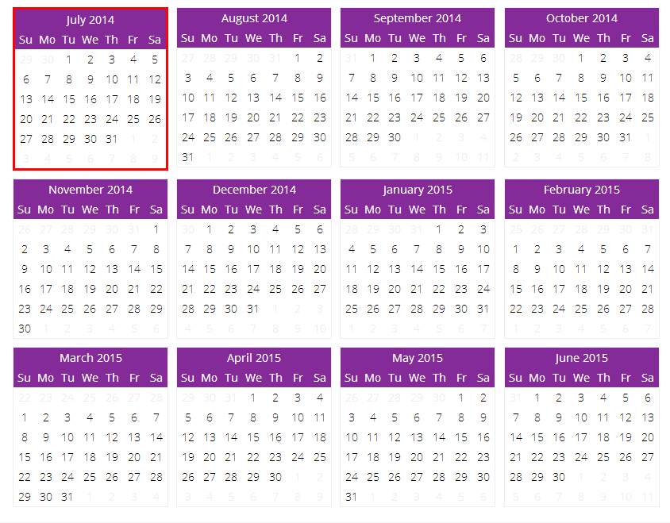
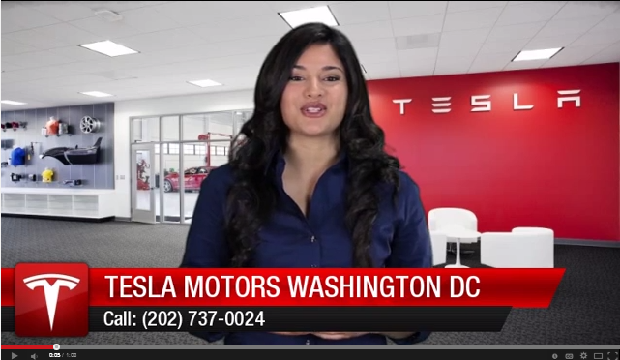
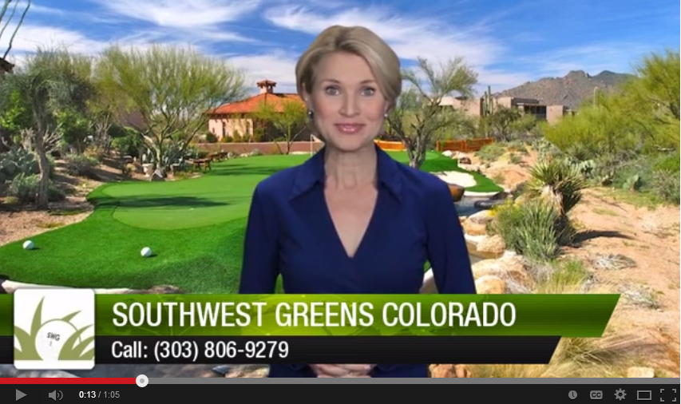
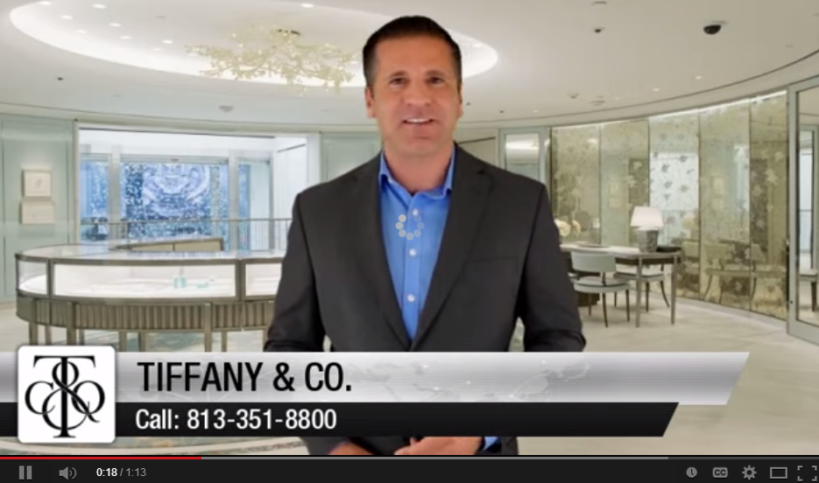
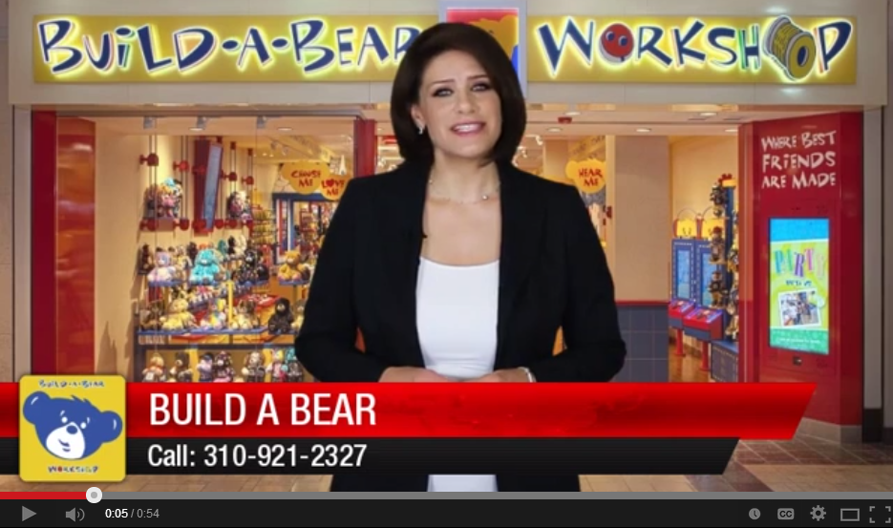
Special For Our Beta Testers
“Do You Want To Crush Your Competition?
“Competition Crusher”
July
August
September
October
- Hosted By Professional Spokes Model
- Shot In Hollywood Style Studios
- Prime Time Graphics And Animation
- Green Screened Office Backgrounds
- On Location Ipad View Of 5 Star Review
- Call To Action Close
- Perfectly SEO Optimized
- Video Syndication
- Social Media Syndication
- Facebook, LinkedIn, Google+ etc.
- You’ll Crush The Competition When
They See Your 5 Star Reputation
November
December
January
February
November
December
January
February
12 Review Commercial
1 Video Per Month
For The Same Price
One Time Limited Offer

Slide 30
Thanks For Being A Part Of Our Beta Program
We Can’t Wait
To Share It
With Our Team
Please Give Us
Your Feedback

