Slide 1
Political Cartoon Analysis
Brown v. Board of Education (1954)

Slide 2
For each of the following political cartoons, answer...
What do you see in the cartoon? Make a list of the people, objects, etc.
Which of the items on the list from Question 1 are symbols? What does each stand for?
What is the artist’s message in the cartoon? Is there political bias?
Who would agree with the message? Who would disagree?

Slide 3
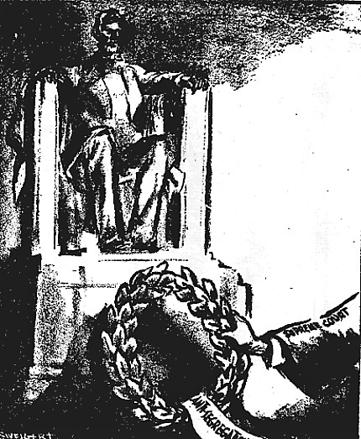
Cartoon #1
What do you see in the cartoon? Make a list of the people, objects, etc.
Which of the items on the list from Question 1 are symbols? What does each stand for?
What is the artist’s message in the cartoon? Is there political bias?
Who would agree with the message? Who would disagree?
Source: Chronicle (San Francisco), May 18, 1954. Reproduced with permission.

Slide 4
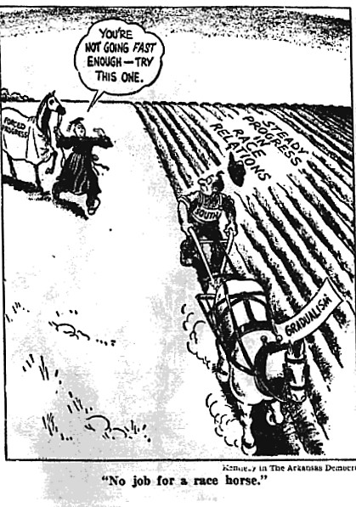
Cartoon #2
What do you see in the cartoon? Make a list of the people, objects, etc.
Which of the items on the list from Question 1 are symbols? What does each stand for?
What is the artist’s message in the cartoon? Is there political bias?
Who would agree with the message? Who would disagree?
Source: Democrat (Arkansas), May 22, 1954. Reproduced with permission.

Slide 5
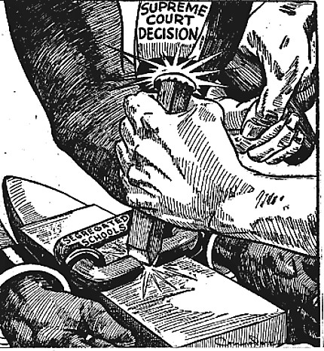
Cartoon #3
What do you see in the cartoon? Make a list of the people, objects, etc.
Which of the items on the list from Question 1 are symbols? What does each stand for?
What is the artist’s message in the cartoon? Is there political bias?
Who would agree with the message? Who would disagree?
Source: Defender (Chicago), June 12, 1954. Reproduced with permission.

Slide 6
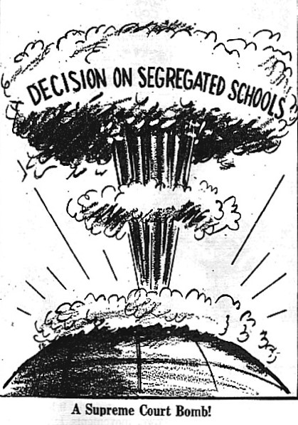
Cartoon #4
What do you see in the cartoon? Make a list of the people, objects, etc.
Which of the items on the list from Question 1 are symbols? What does each stand for?
What is the artist’s message in the cartoon? Is there political bias?
Who would agree with the message? Who would disagree?
Source: Afro-American (Richmond), May 22, 1954. Reproduced with permission.

