Slide 2
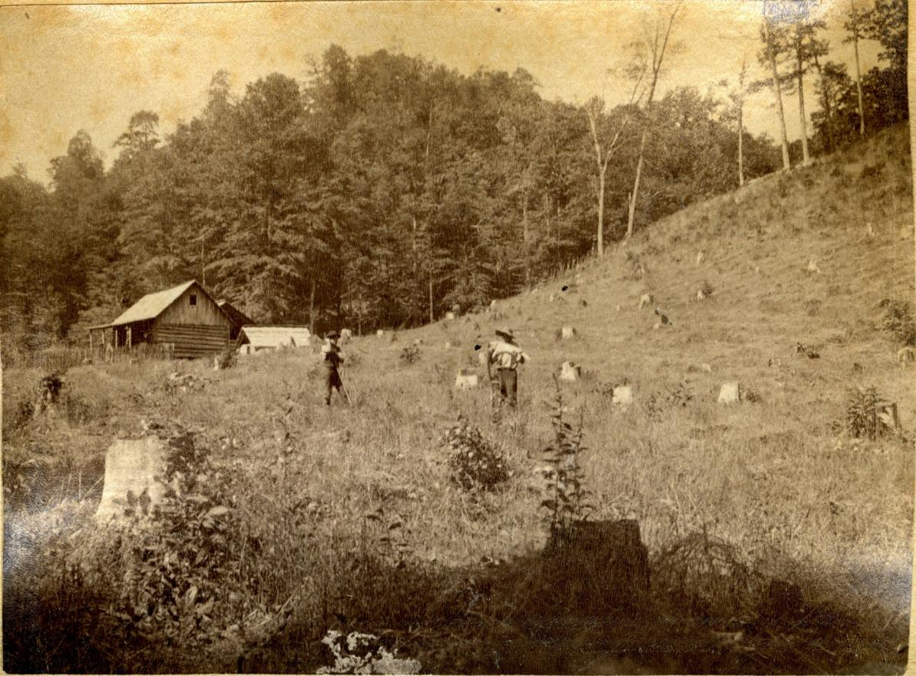
KENTUCKY’S IMMIGRANT COLONIES
KENTUCKY’S IMMIGRANT COLONIES

Slide 3
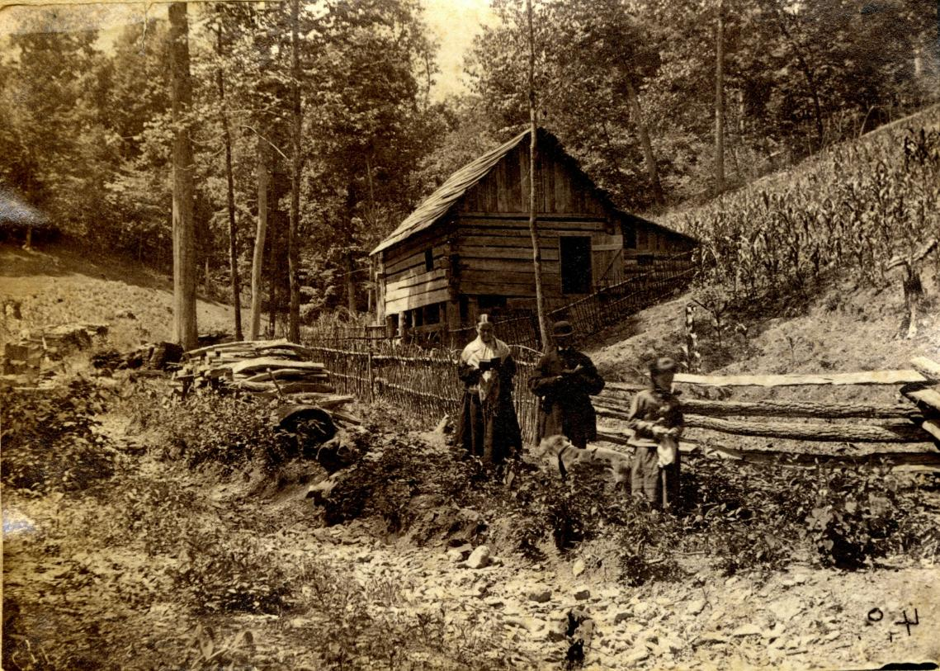
KENTUCKY’S IMMIGRANT COLONIES

Slide 4
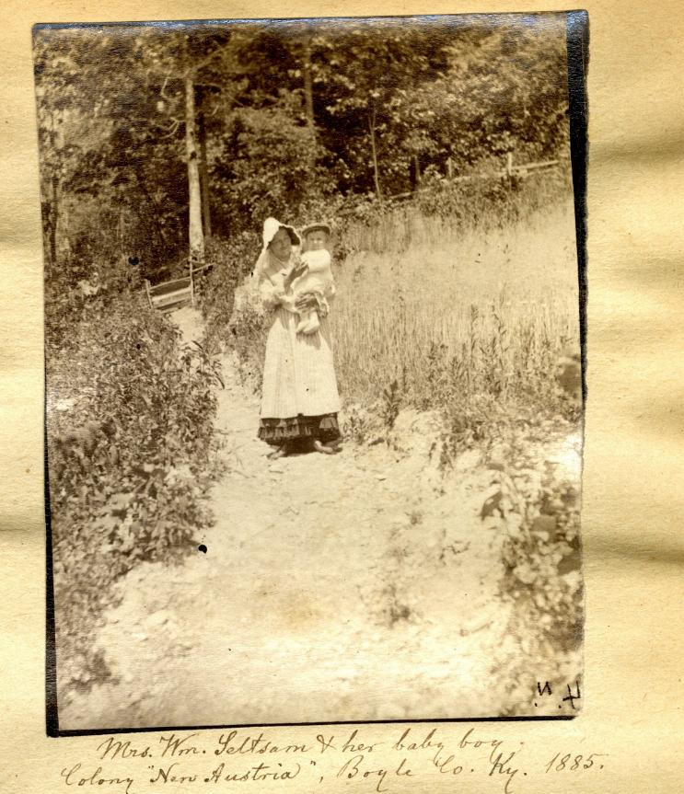
KENTUCKY’S IMMIGRANT COLONIES

Slide 5
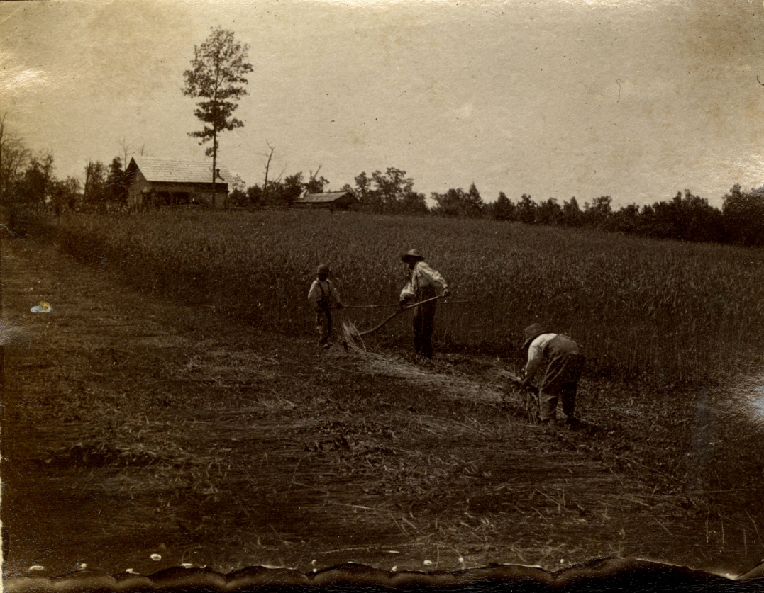
KENTUCKY’S IMMIGRANT COLONIES

Slide 6
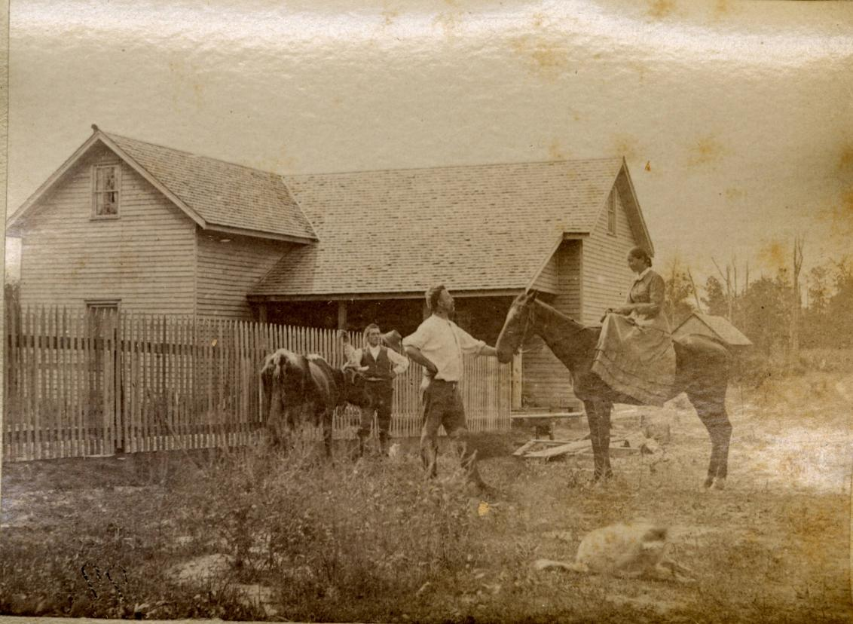
KENTUCKY’S IMMIGRANT COLONIES

Slide 7
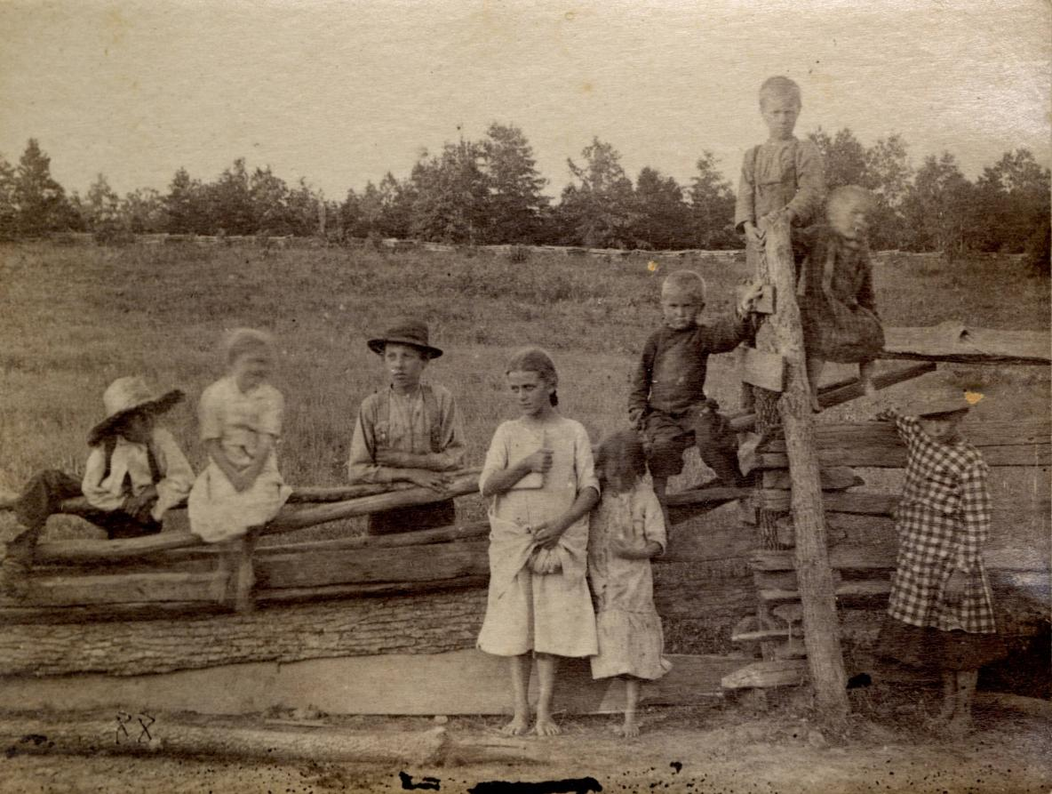
KENTUCKY’S IMMIGRANT COLONIES

Slide 8
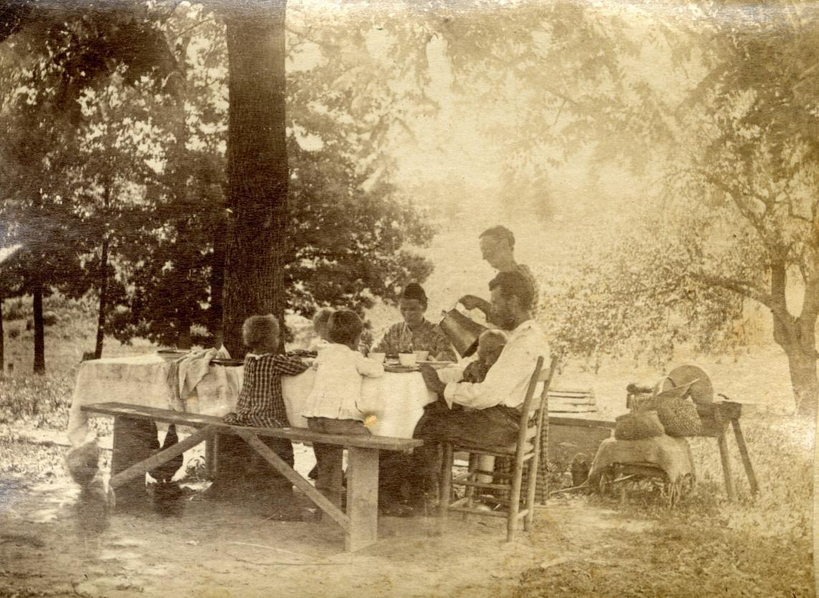
KENTUCKY’S IMMIGRANT COLONIES

Slide 9
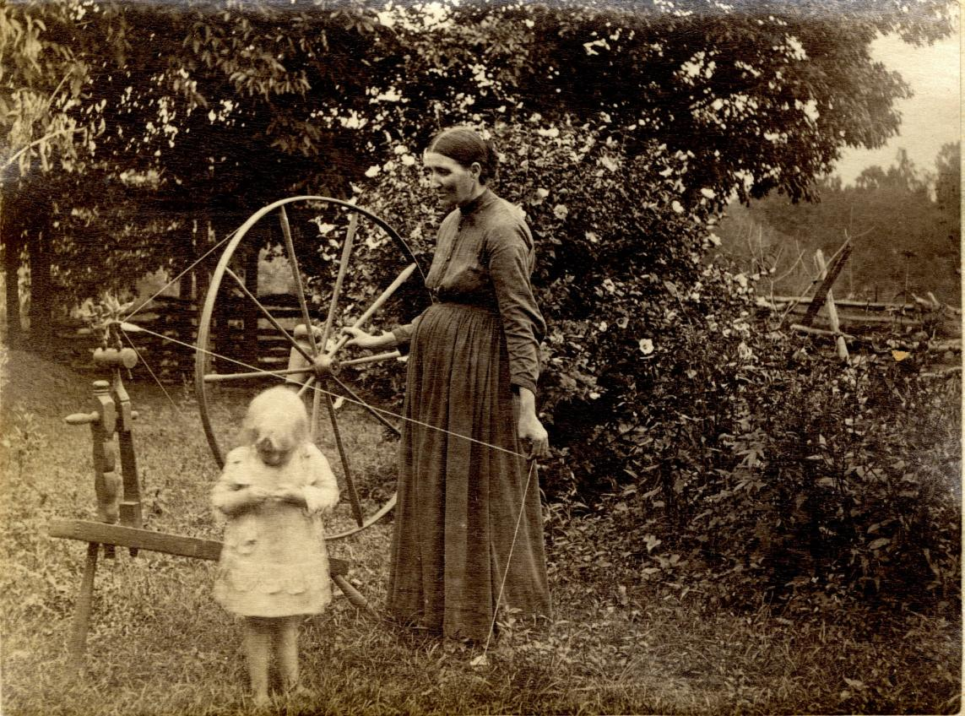
KENTUCKY’S IMMIGRANT COLONIES

Slide 10
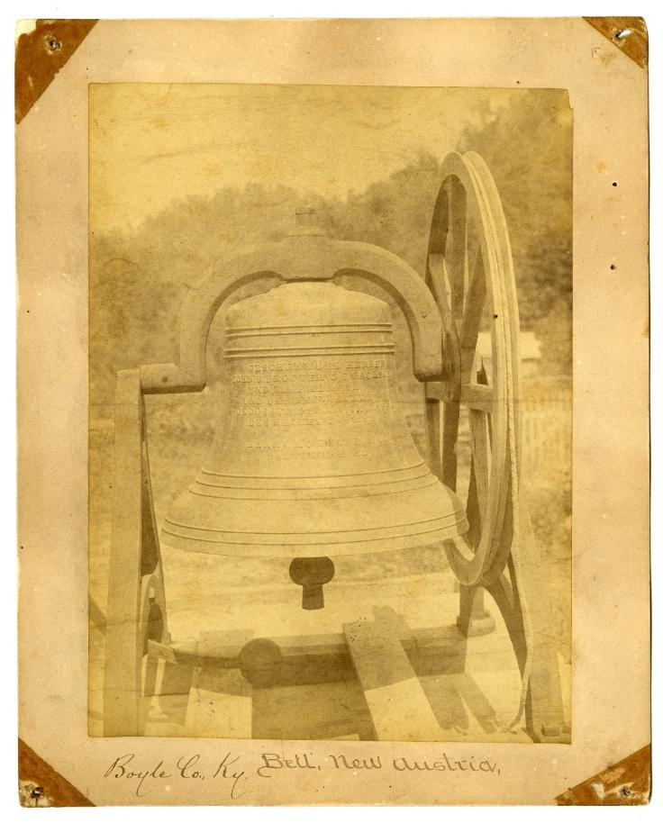
KENTUCKY’S IMMIGRANT COLONIES

Slide 11
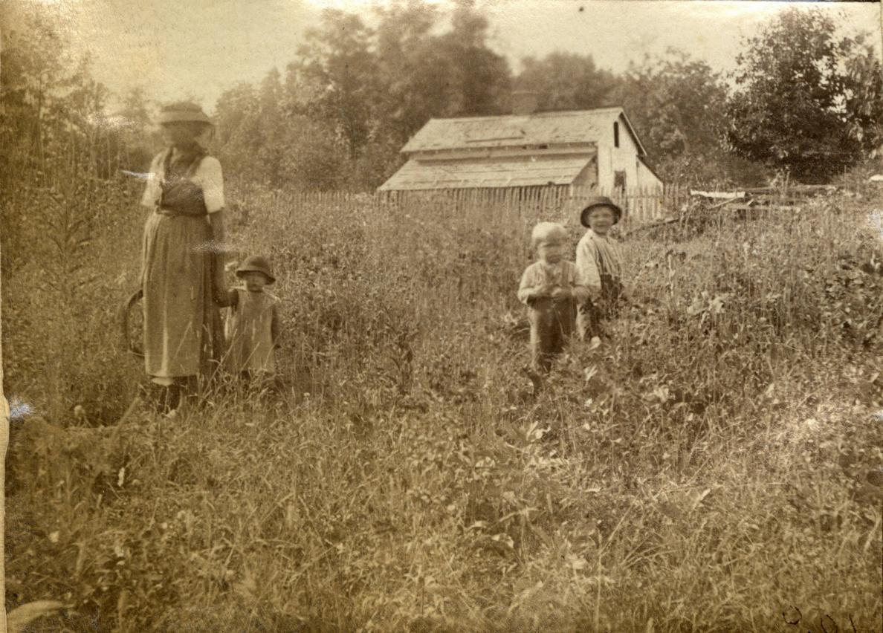
KENTUCKY’S IMMIGRANT COLONIES

Slide 12
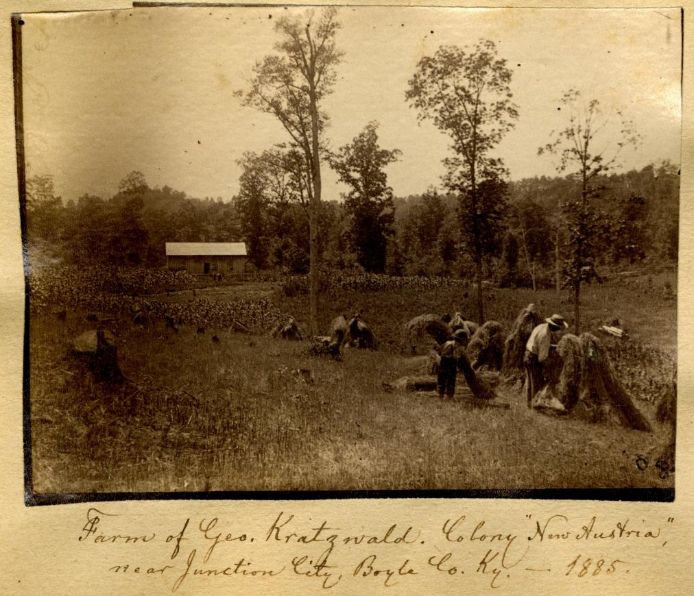
KENTUCKY’S IMMIGRANT COLONIES

Slide 13
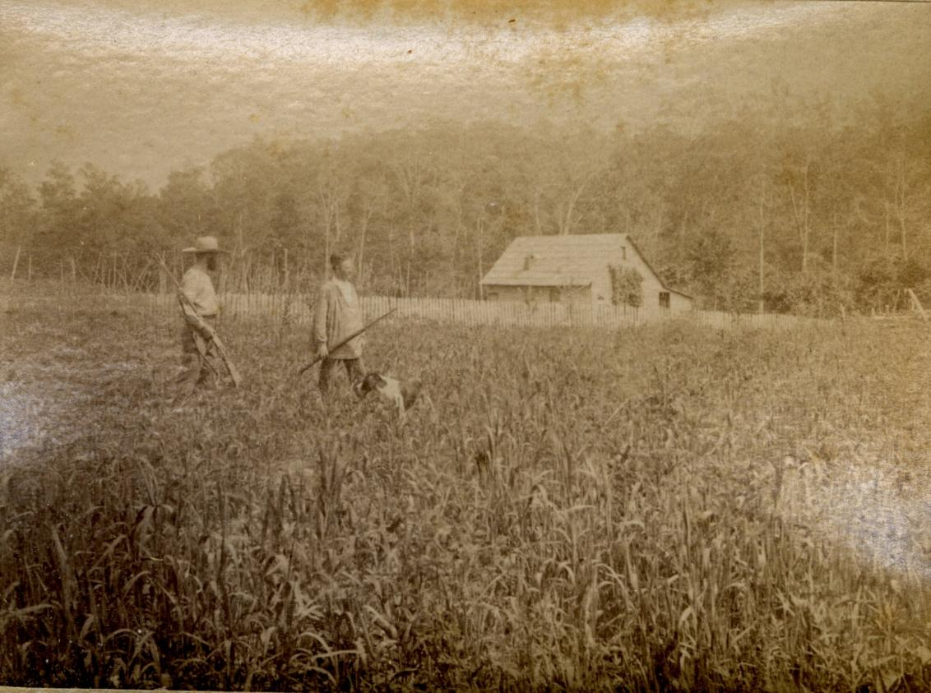
KENTUCKY’S IMMIGRANT COLONIES

Slide 14
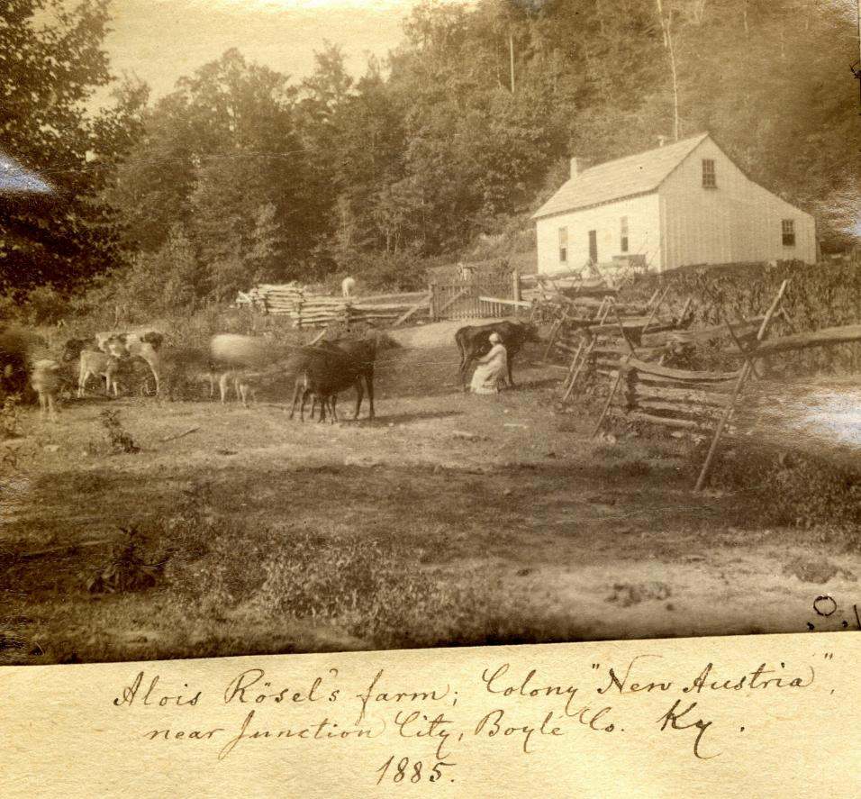
KENTUCKY’S IMMIGRANT COLONIES

Slide 15
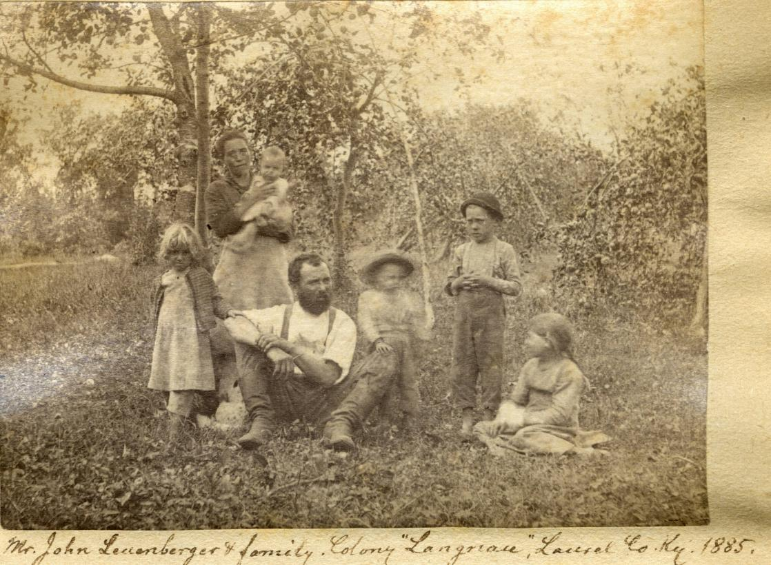
KENTUCKY’S IMMIGRANT COLONIES

Slide 16
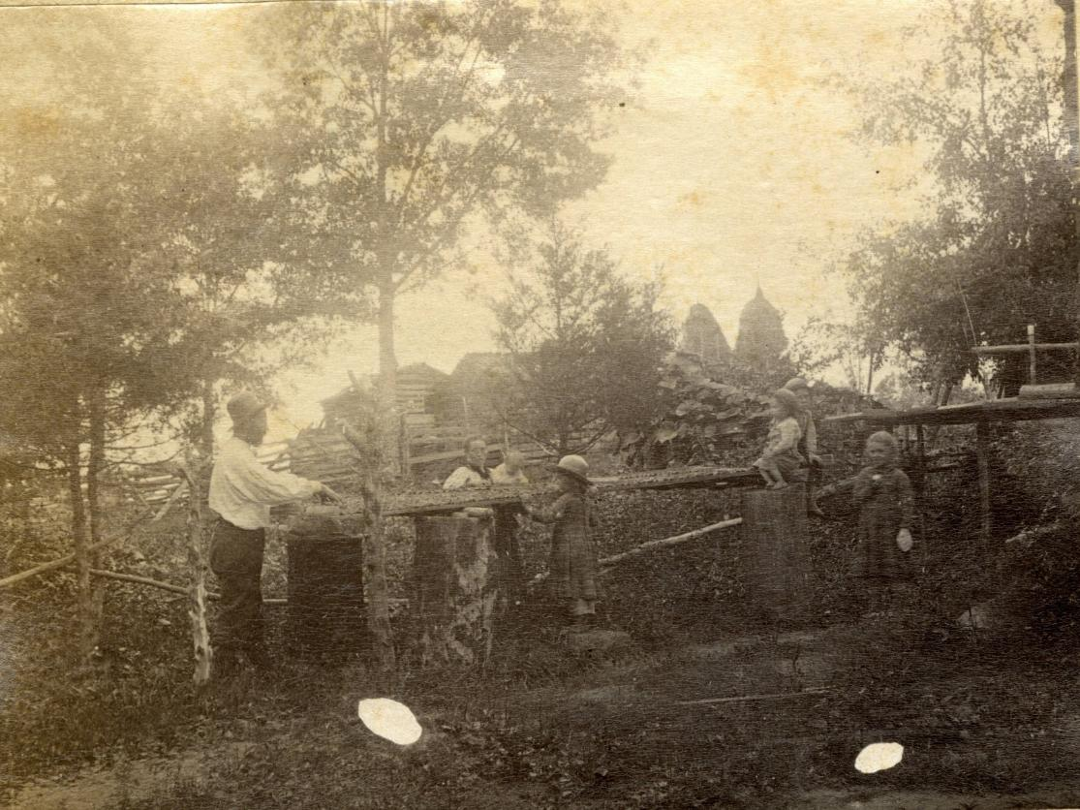
KENTUCKY’S IMMIGRANT COLONIES

Slide 17
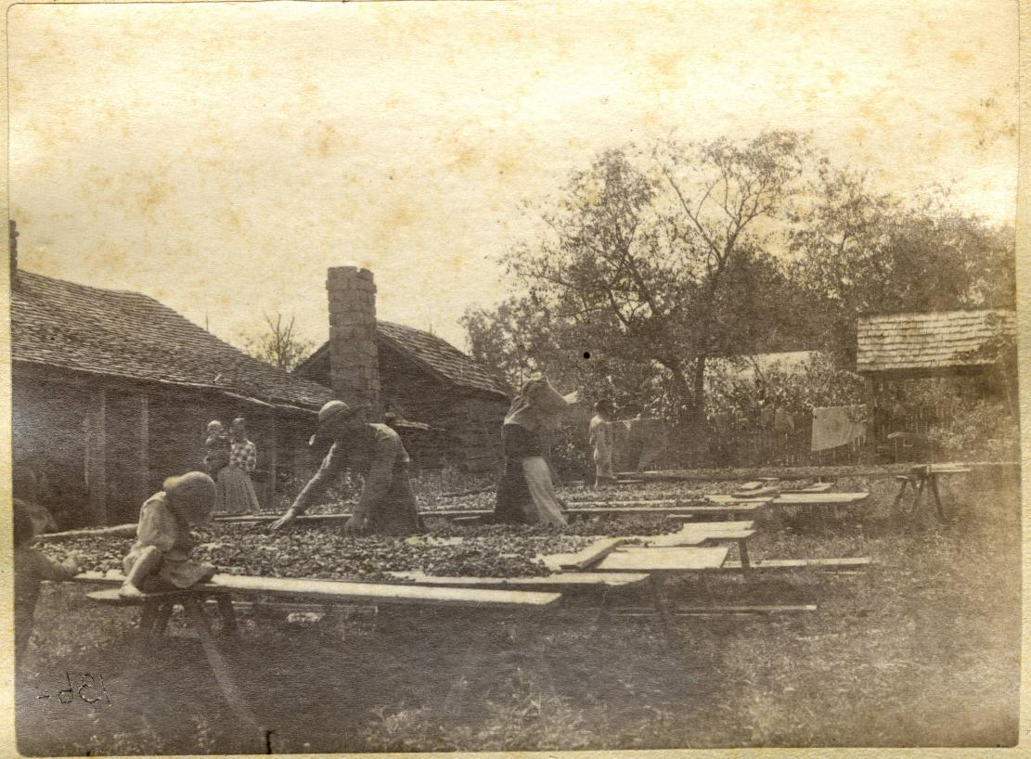
KENTUCKY’S IMMIGRANT COLONIES

Slide 18
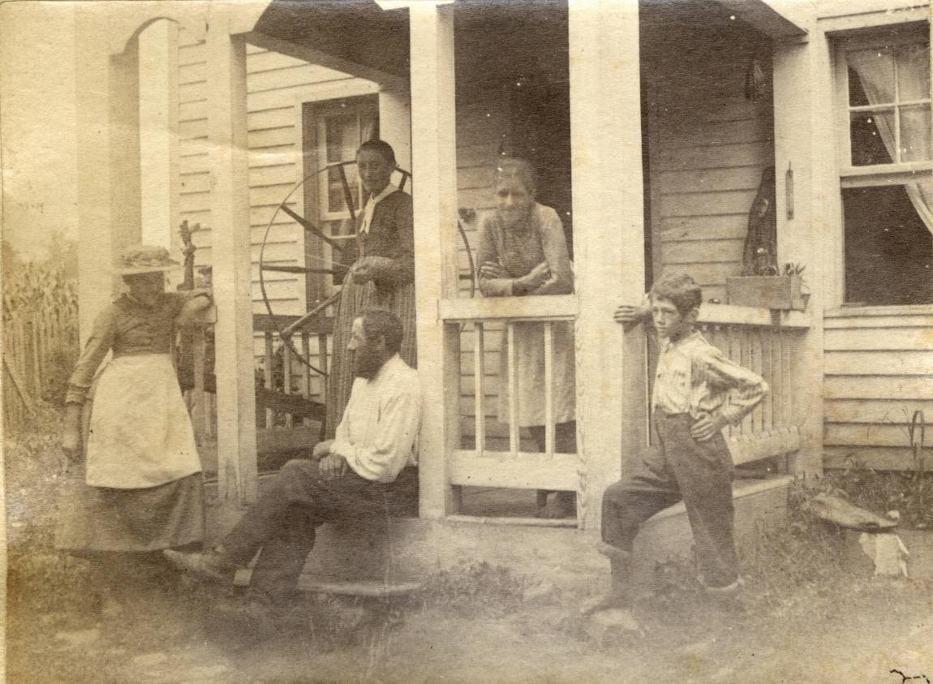
KENTUCKY’S IMMIGRANT COLONIES

Slide 19
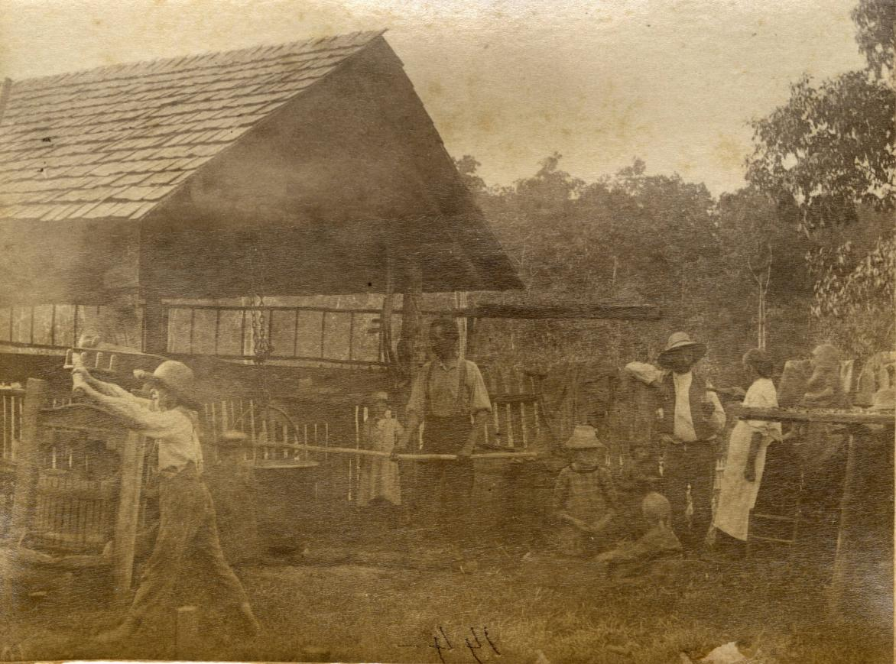
KENTUCKY’S IMMIGRANT COLONIES

Slide 20
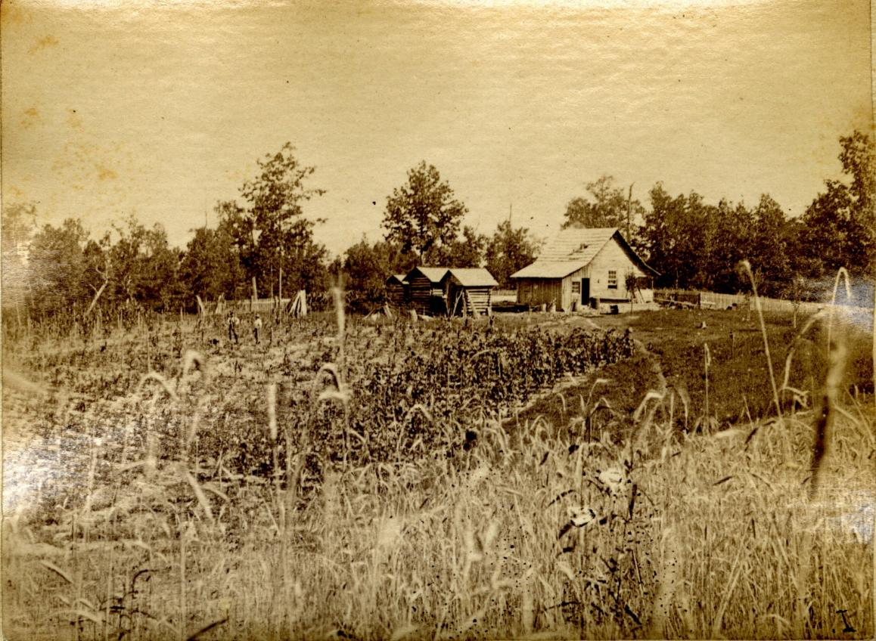
KENTUCKY’S IMMIGRANT COLONIES

Slide 21
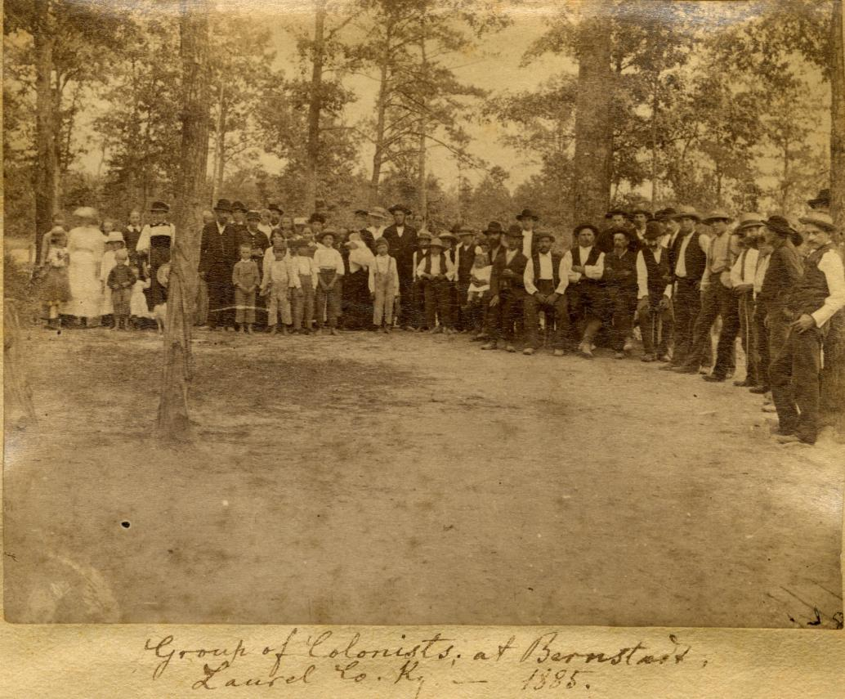
KENTUCKY’S IMMIGRANT COLONIES

Slide 22
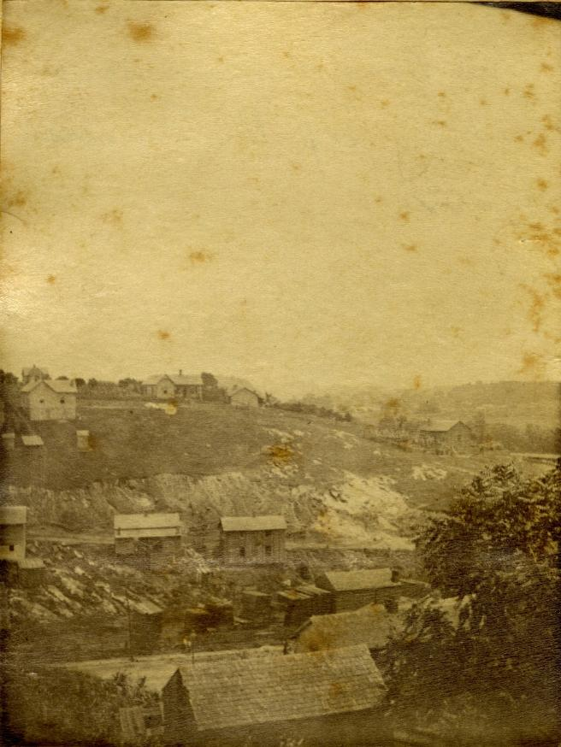
KENTUCKY’S IMMIGRANT COLONIES

Slide 23
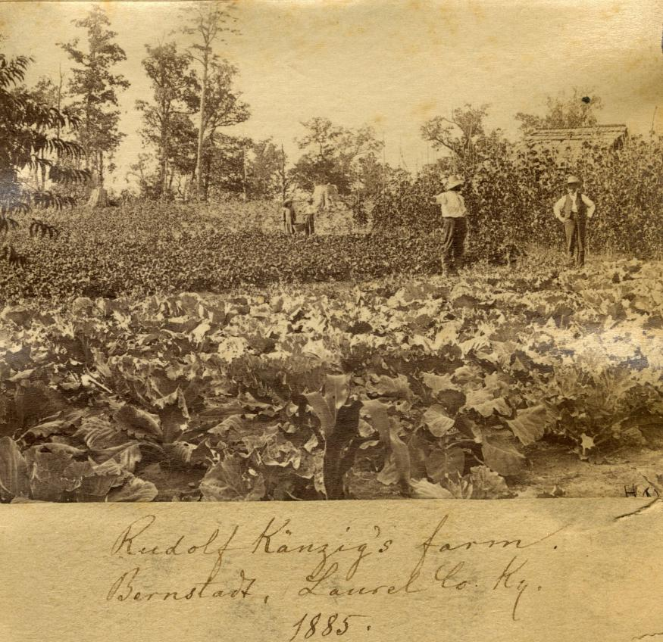
KENTUCKY’S IMMIGRANT COLONIES

Slide 24
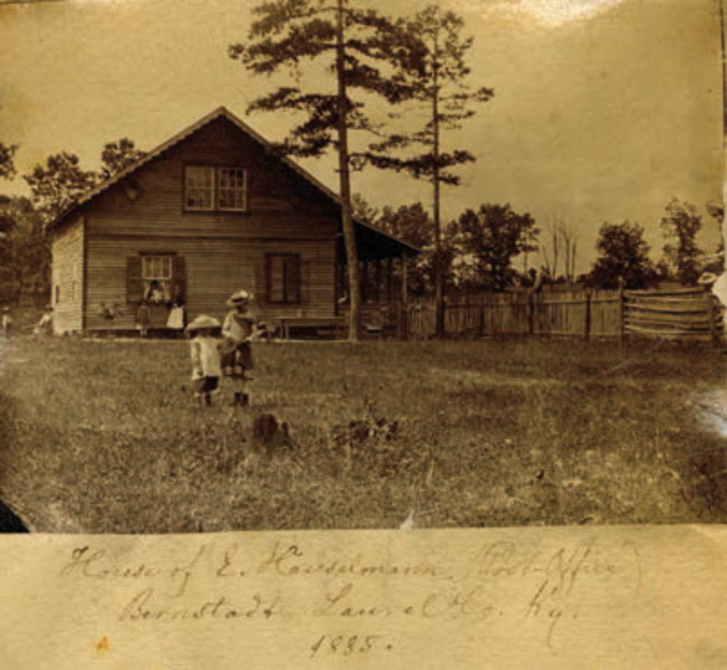
KENTUCKY’S IMMIGRANT COLONIES

Slide 25
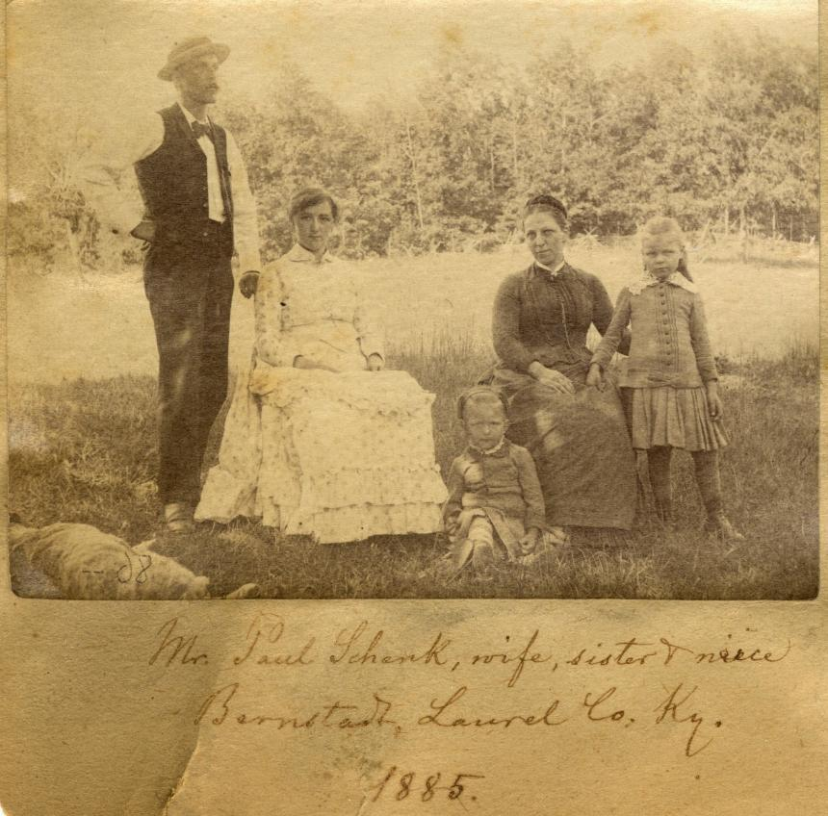
KENTUCKY’S IMMIGRANT COLONIES

Slide 26
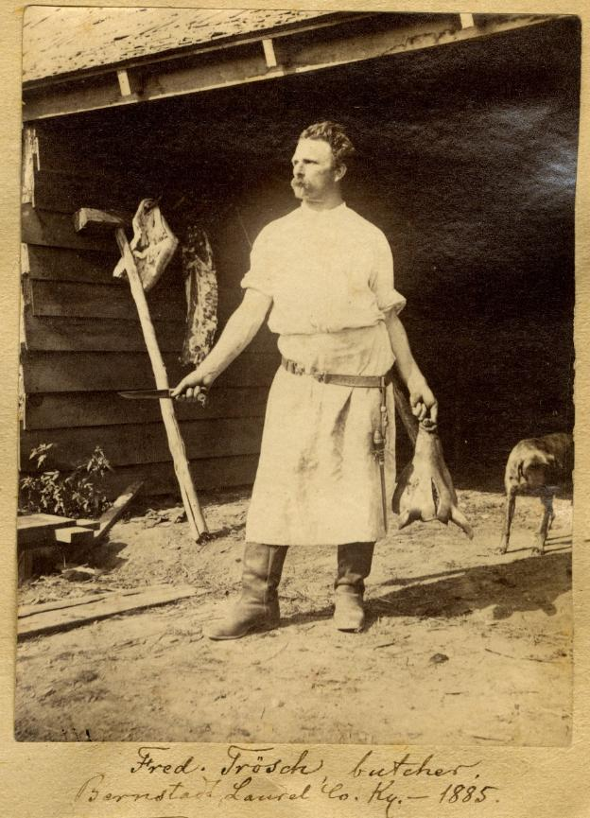
KENTUCKY’S IMMIGRANT COLONIES

Slide 27
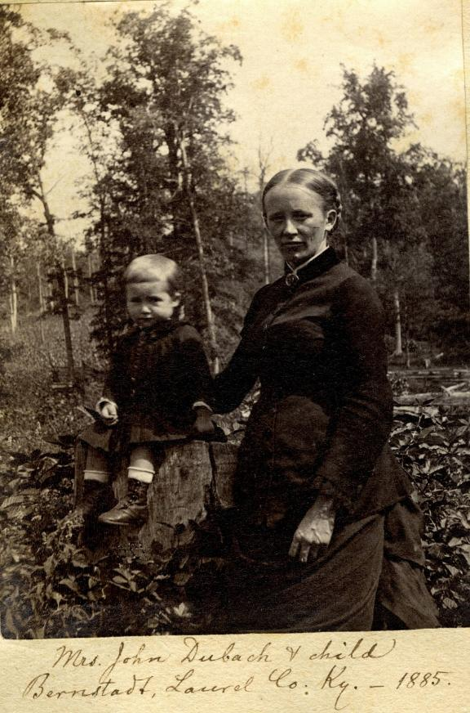
KENTUCKY’S IMMIGRANT COLONIES

Slide 28
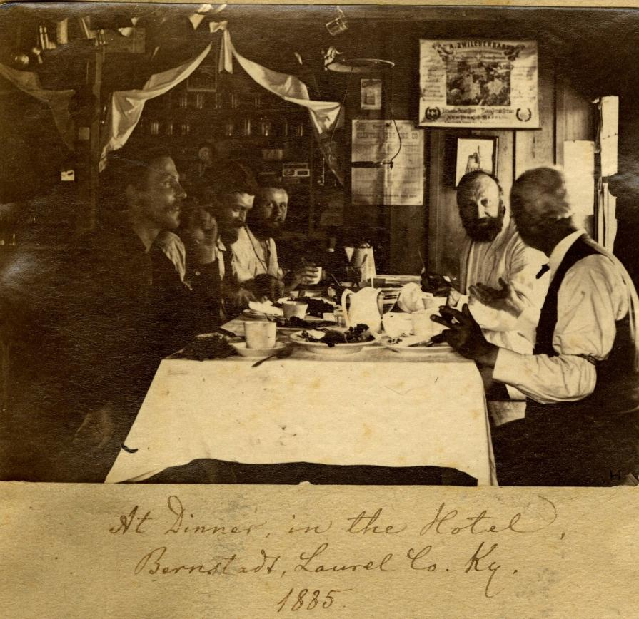
KENTUCKY’S IMMIGRANT COLONIES

