Slide 2
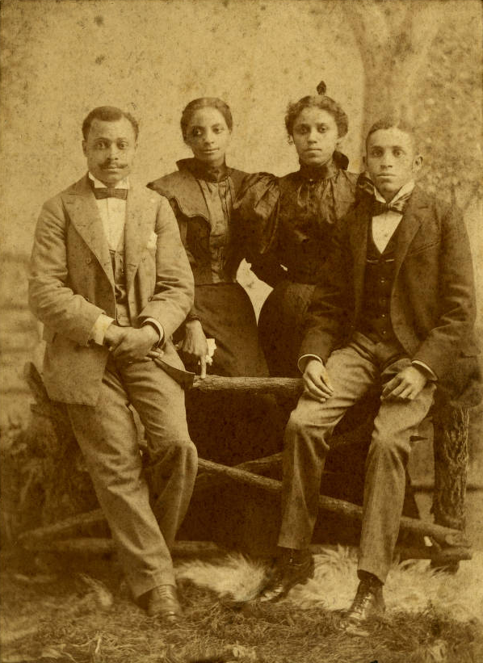
Accession Number: MSS167_Box4_F3_11

Slide 3
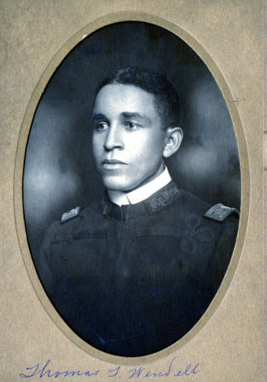
Accession Number: MSS167_Box5_F5_9

Slide 4
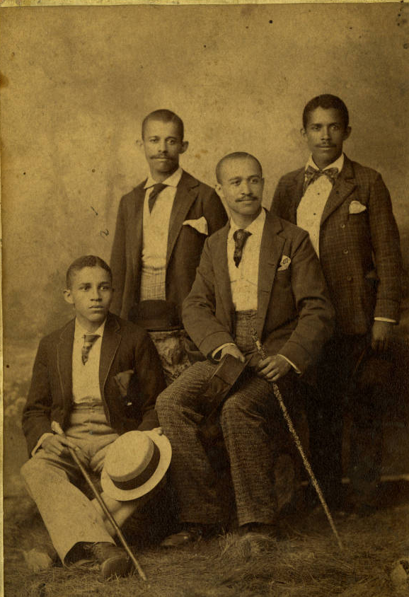
Accession Number: MSS167_Box4_F3_25

Slide 5
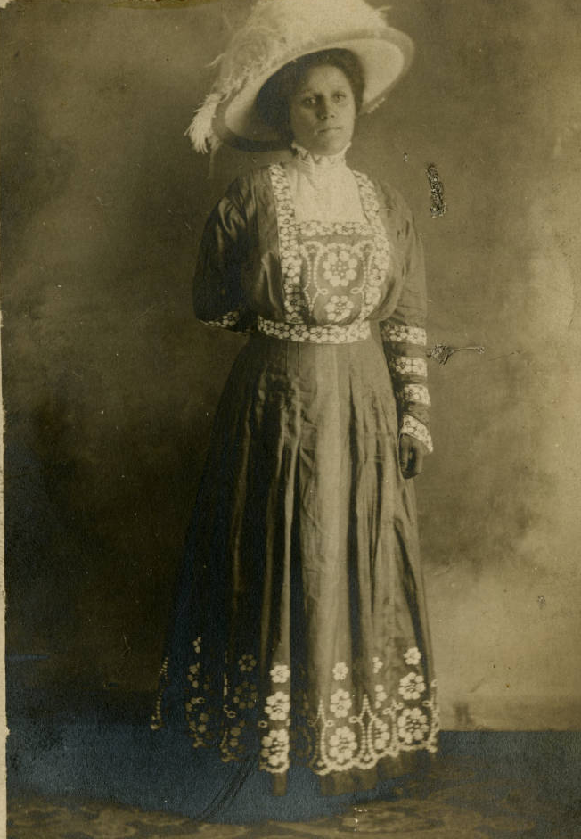
Accession Number: MSS167_Box4_F4_9

Slide 6
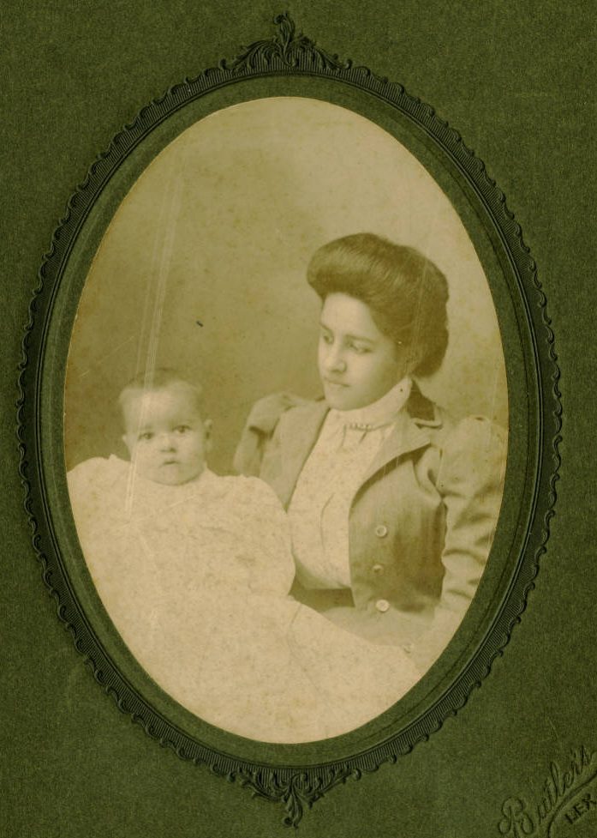
Accession Number: MSS167_Box4_F6_2

Slide 7
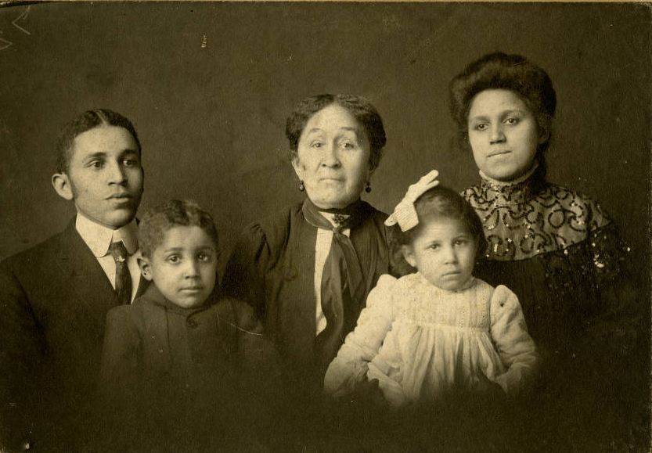
Accession Number: MSS167_Box4_F3_13

Slide 8
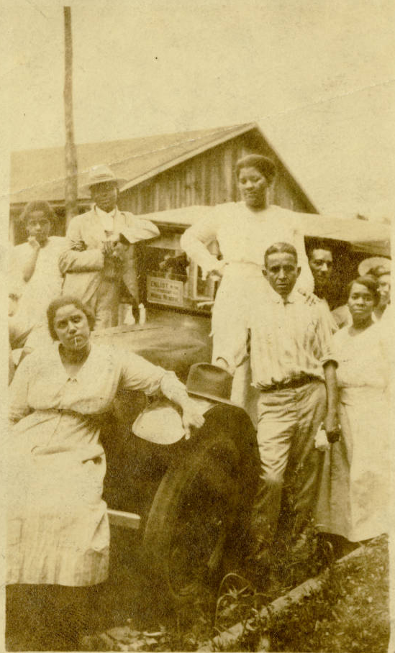
Accession Number: MSS167_Box5_F1_16

Slide 9
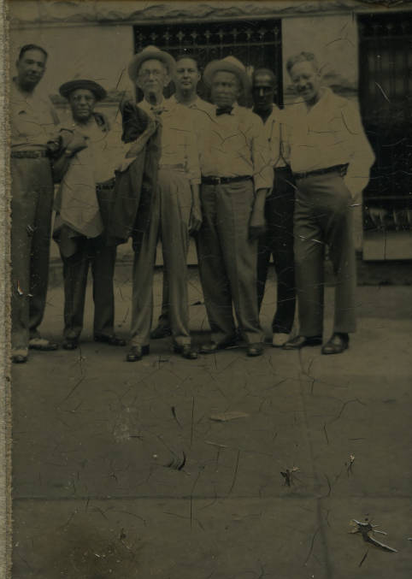
Accession Number: MSS167_Box5_F2_5

Slide 10
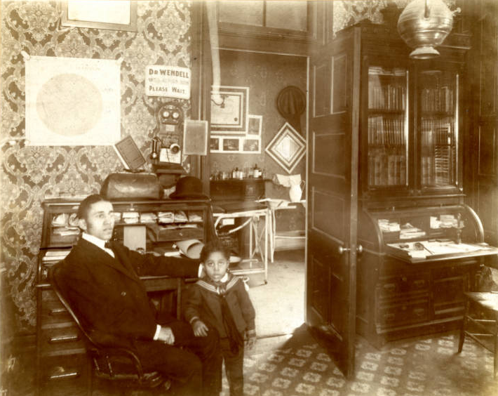
Accession Number: MSS167_Box8_F4_1

Slide 11
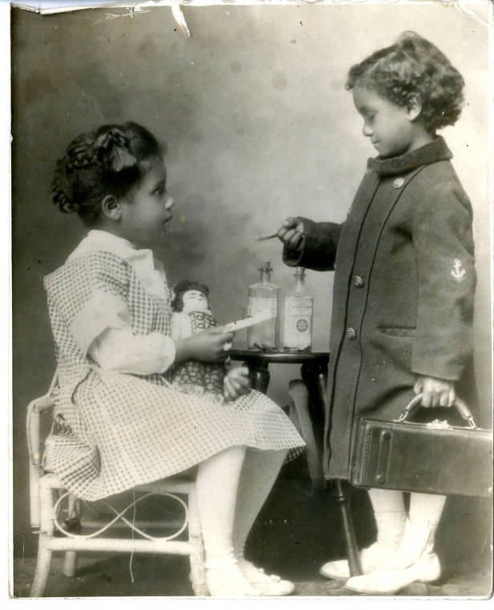
Accession Number: MSS167_Box5_F3_11

Slide 12
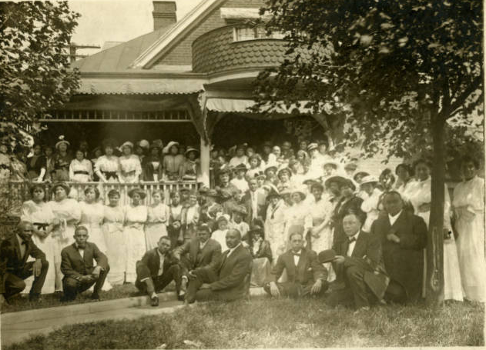
Accession Number: MSS167_Box8_F5

Slide 13
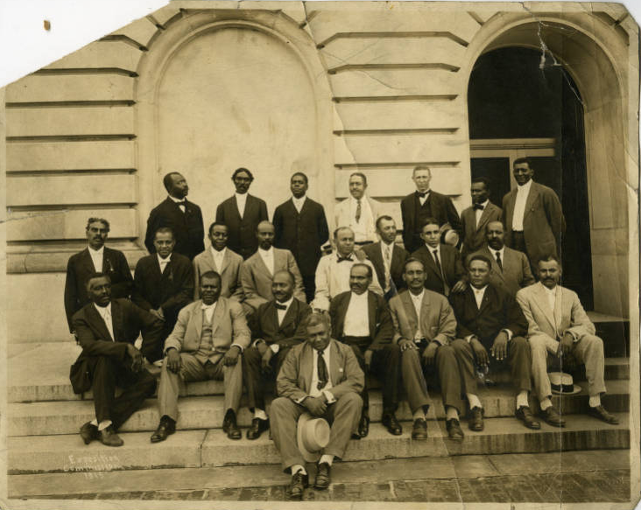
Accession Number: MSS167_Box5_F4_12

Slide 14
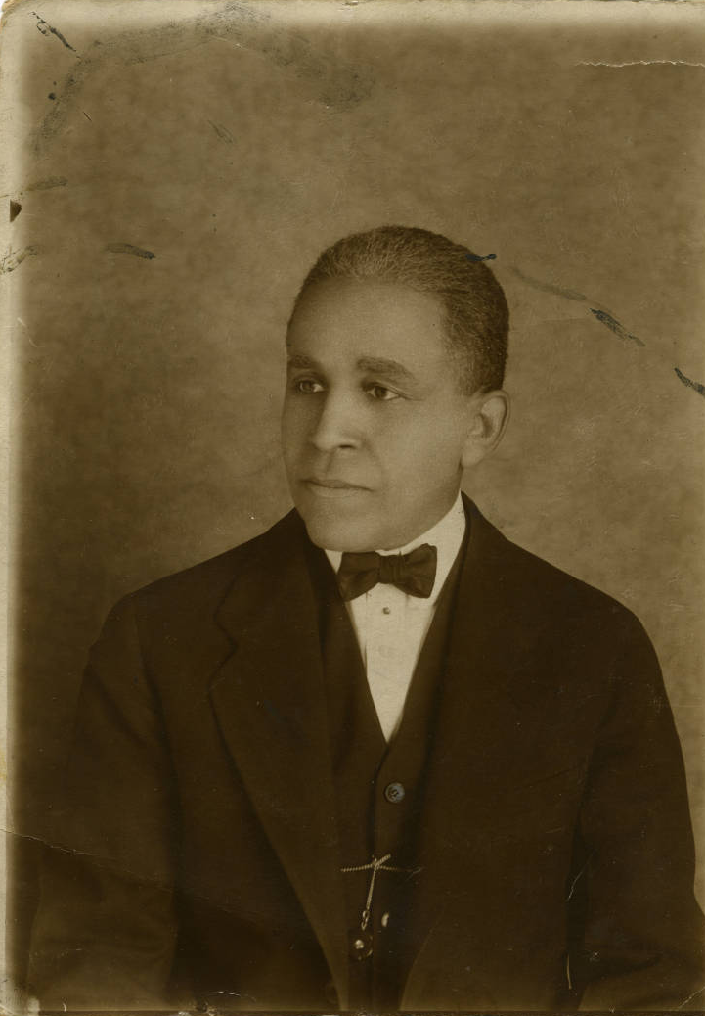
Accession Number: MSS167_Box5_F6_1

Slide 15
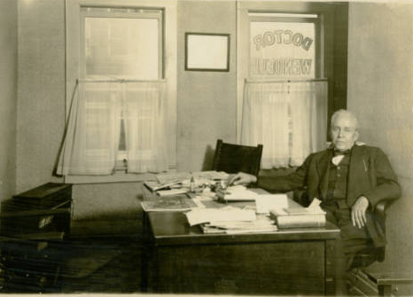
Accession Number: MSS167_Box5_F7_1

Slide 16
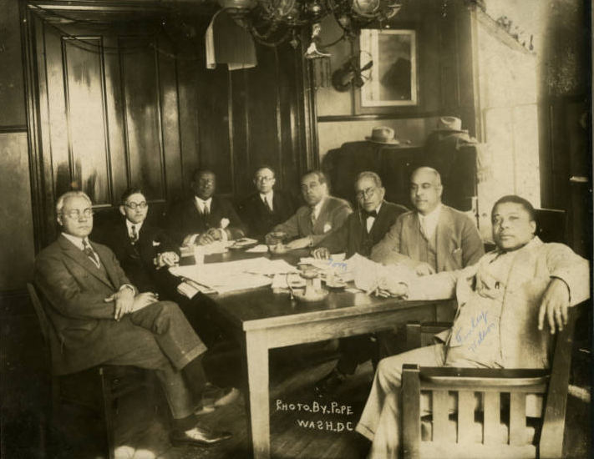
Accession Number: MSS167_Box8_F21

Slide 17
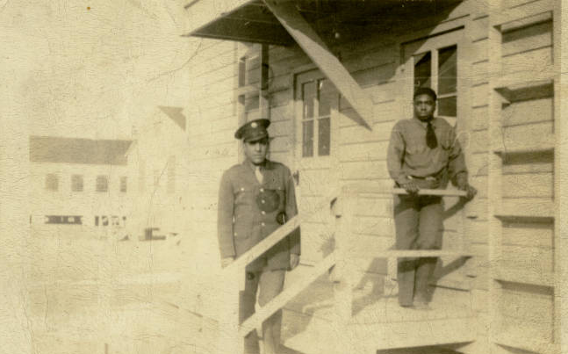
Accession Number: MSS167_Box6_F2_6

Slide 18
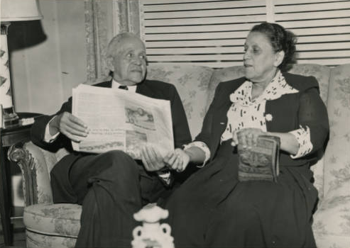
Accession Number: MSS167_Box6_F3_5

Slide 19
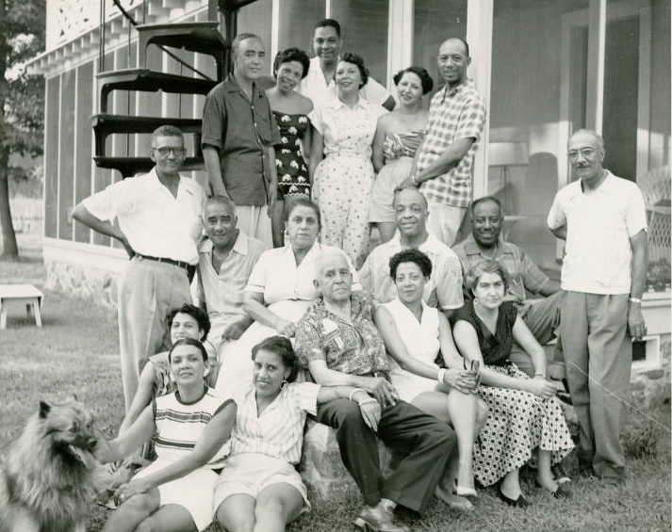
Accession Number: MSS167_Box6_F5_6

