Slide 2
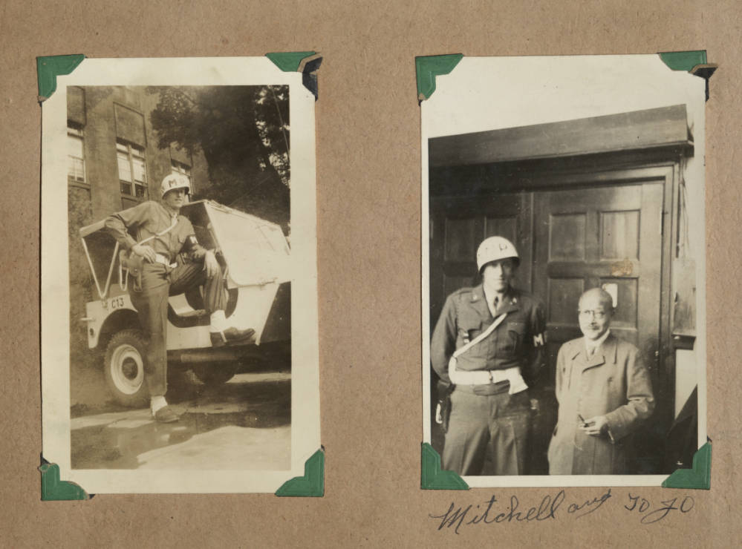
INTERNATIONAL MILITARY TRIBUNAL FOR THE FAR EAST

Slide 3
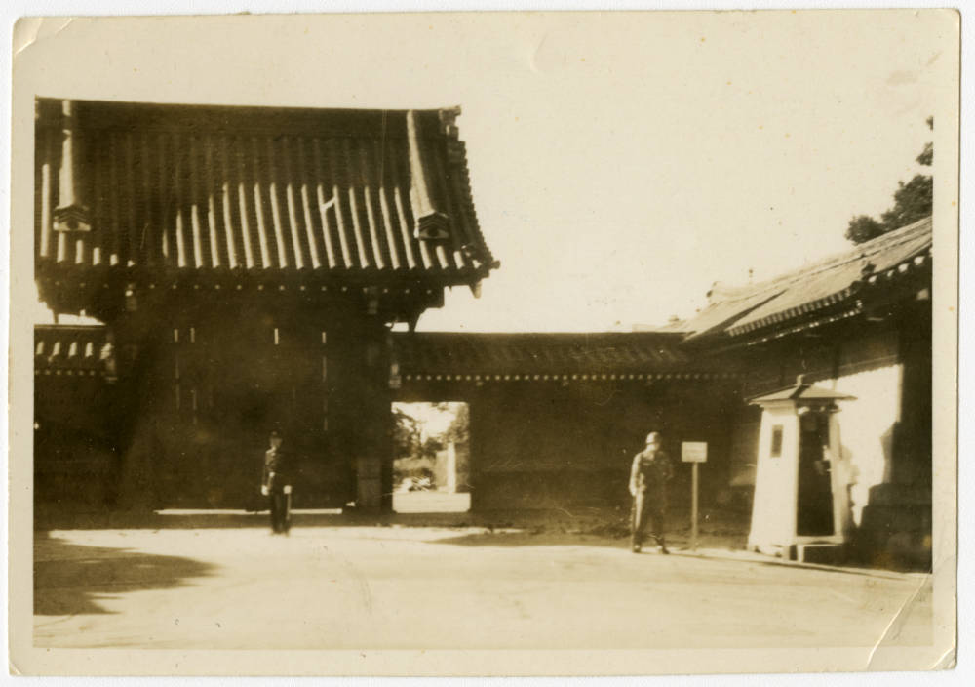
INTERNATIONAL MILITARY TRIBUNAL FOR THE FAR EAST

Slide 4
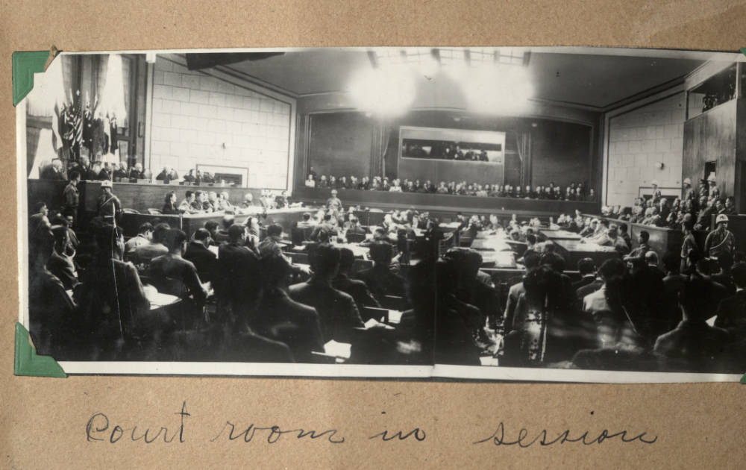
INTERNATIONAL MILITARY TRIBUNAL FOR THE FAR EAST

Slide 5
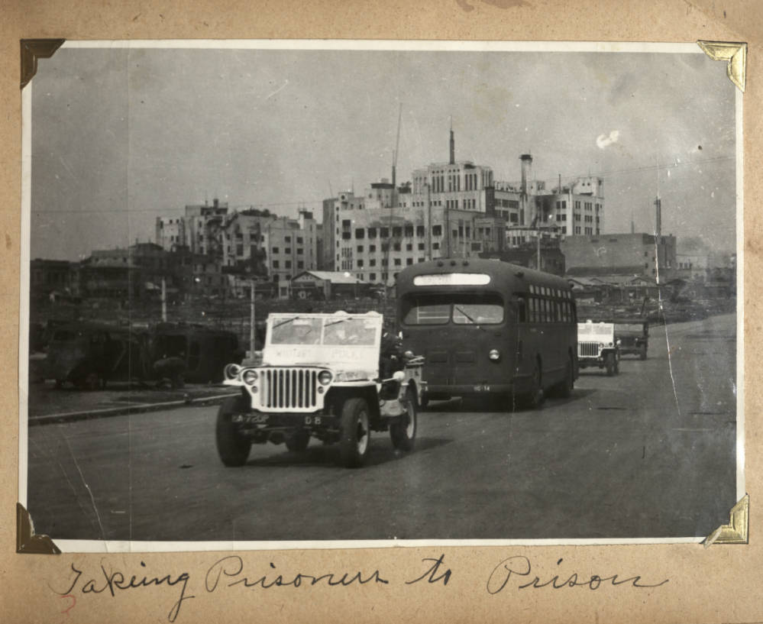
INTERNATIONAL MILITARY TRIBUNAL FOR THE FAR EAST

Slide 6
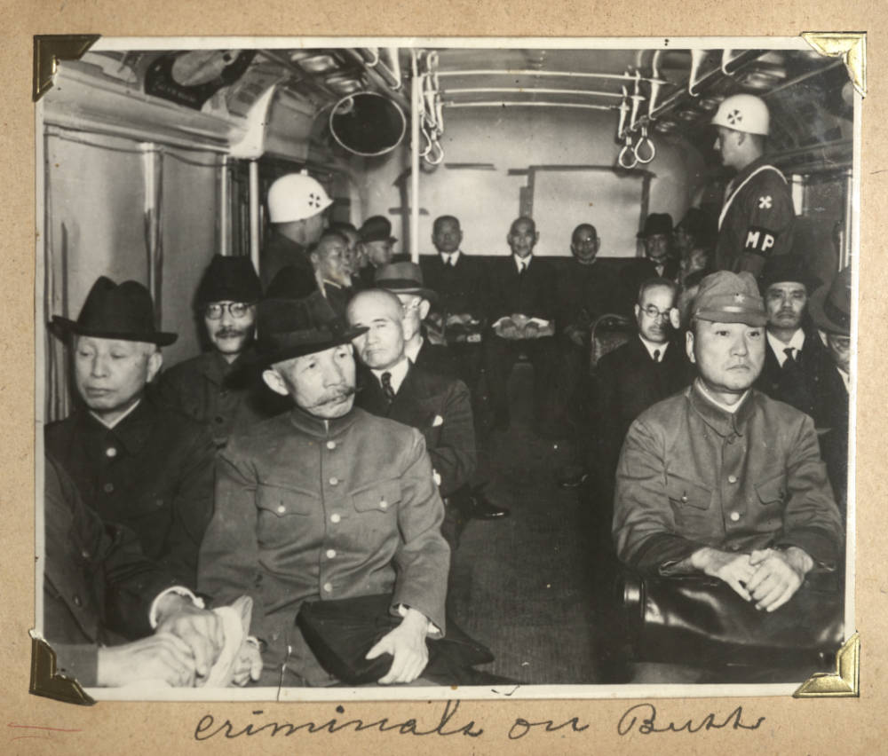
INTERNATIONAL MILITARY TRIBUNAL FOR THE FAR EAST

Slide 7
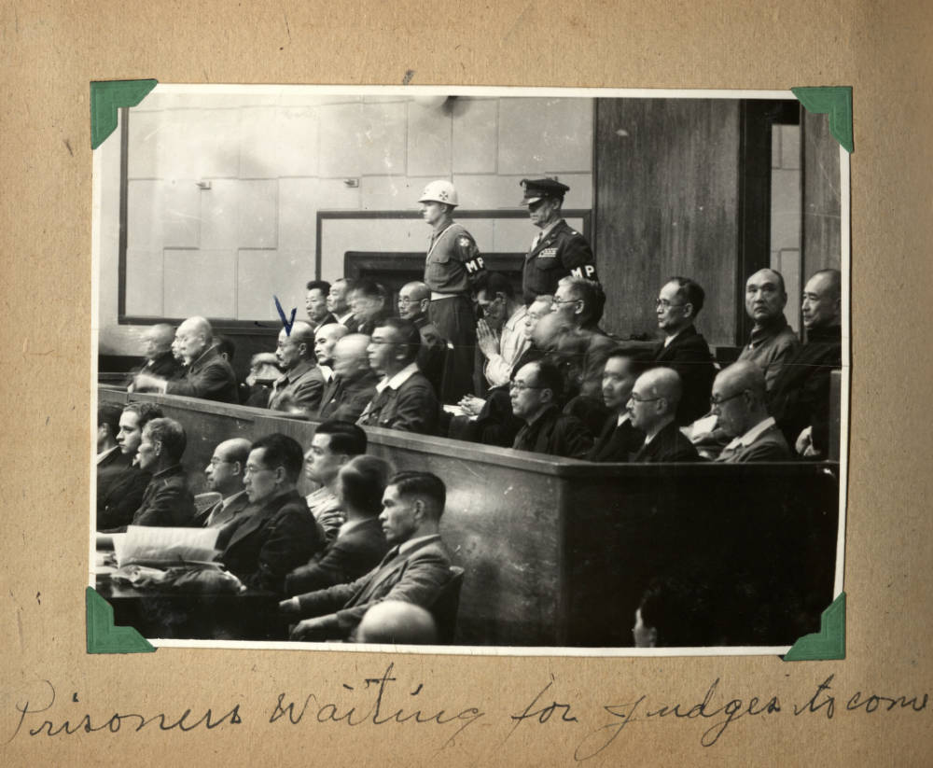
INTERNATIONAL MILITARY TRIBUNAL FOR THE FAR EAST

Slide 8
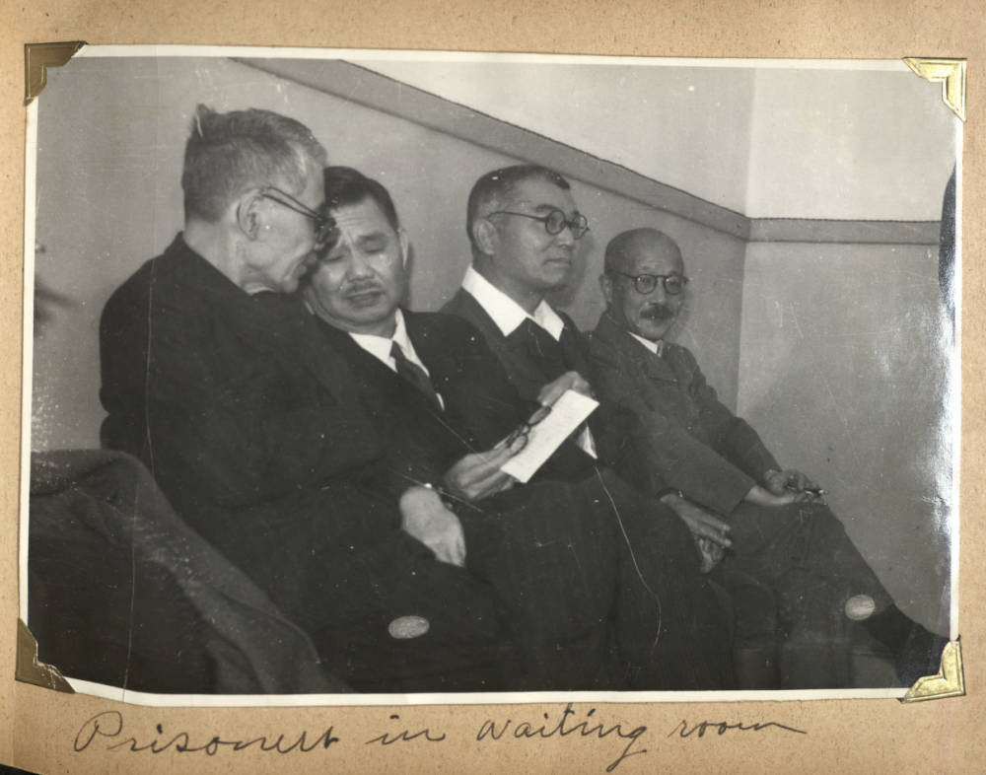
INTERNATIONAL MILITARY TRIBUNAL FOR THE FAR EAST

Slide 9
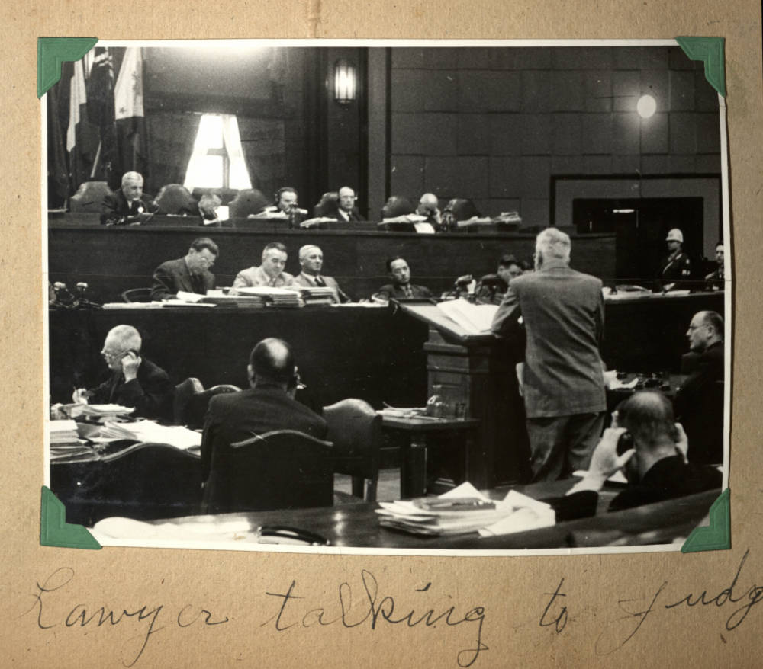
INTERNATIONAL MILITARY TRIBUNAL FOR THE FAR EAST

Slide 10
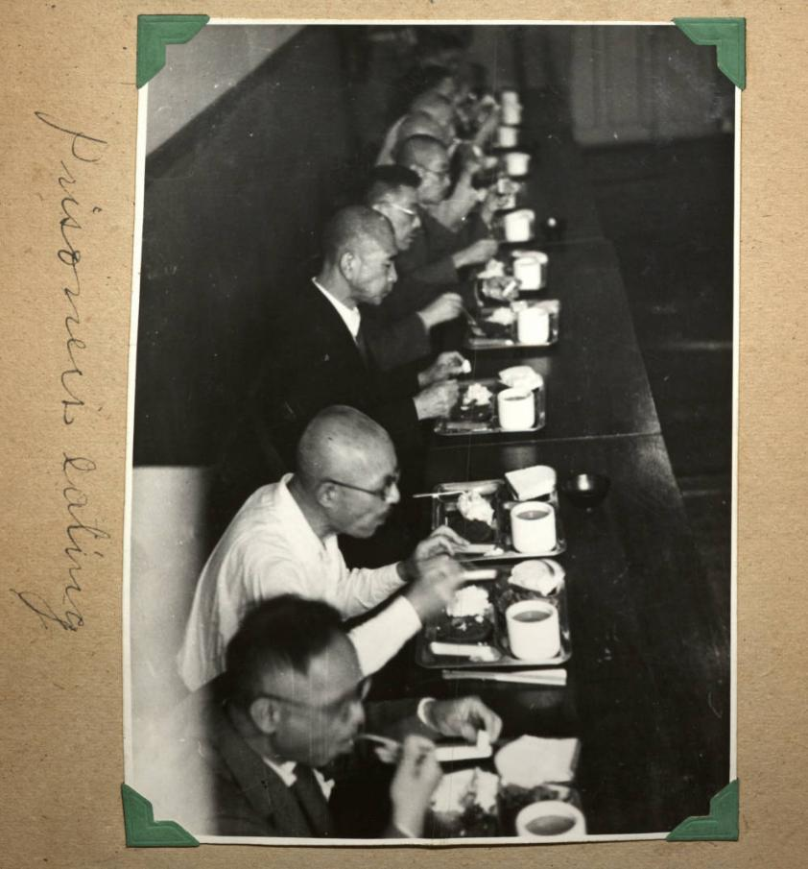
INTERNATIONAL MILITARY TRIBUNAL FOR THE FAR EAST

Slide 11
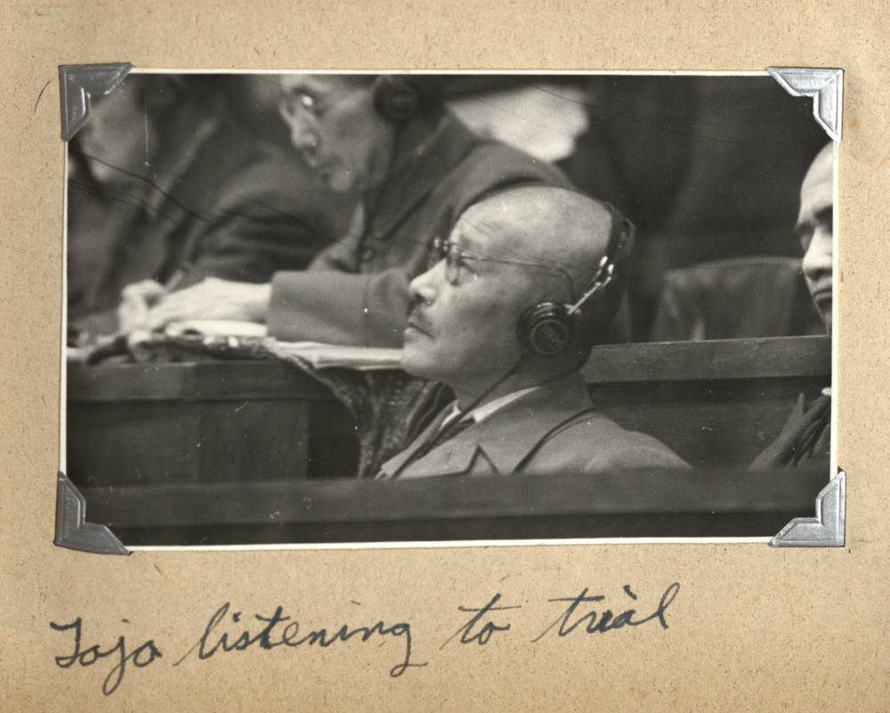
INTERNATIONAL MILITARY TRIBUNAL FOR THE FAR EAST

Slide 12
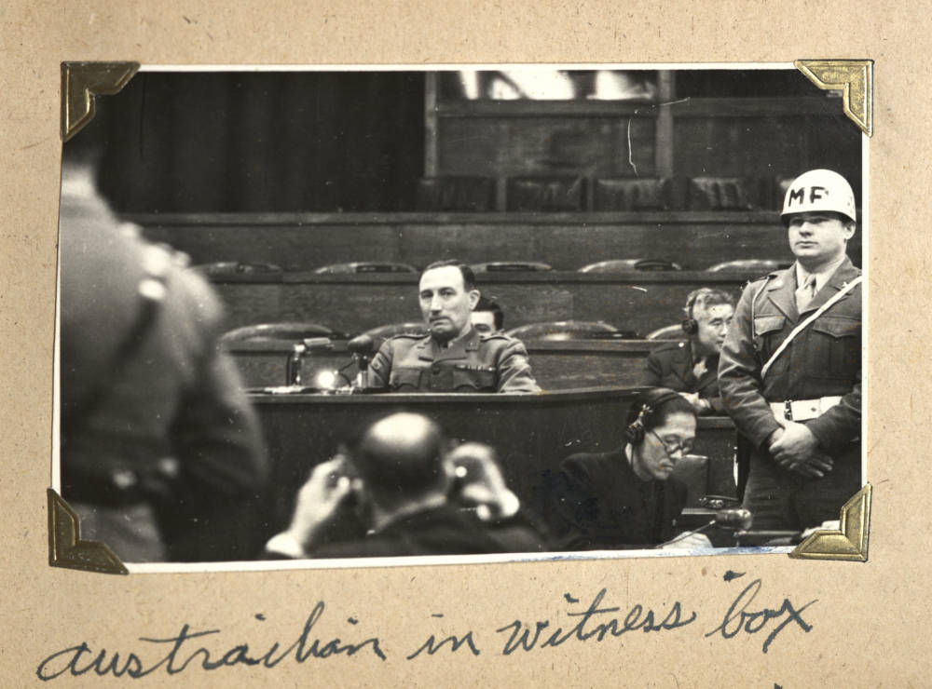
INTERNATIONAL MILITARY TRIBUNAL FOR THE FAR EAST

Slide 13
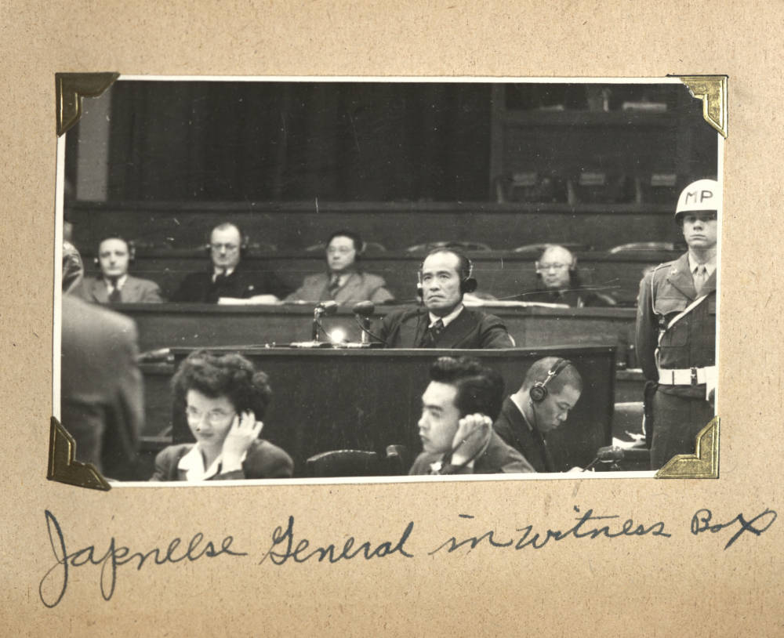
INTERNATIONAL MILITARY TRIBUNAL FOR THE FAR EAST

Slide 14
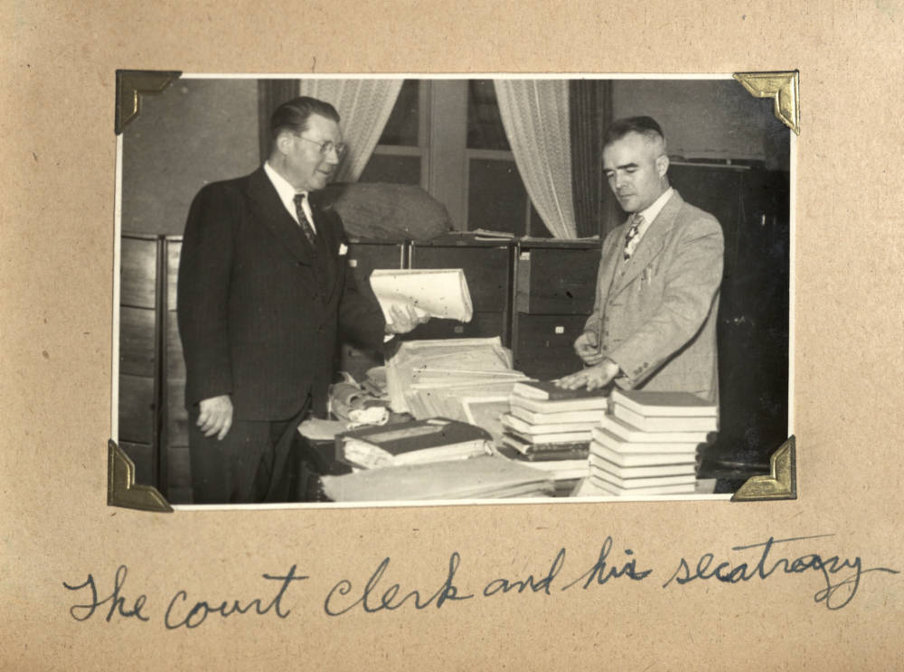
INTERNATIONAL MILITARY TRIBUNAL FOR THE FAR EAST

Slide 15
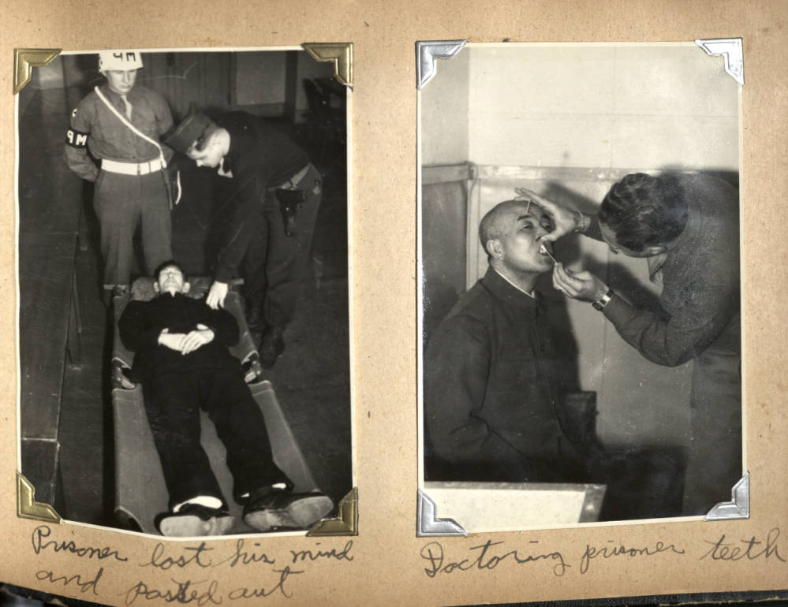
INTERNATIONAL MILITARY TRIBUNAL FOR THE FAR EAST

Slide 16
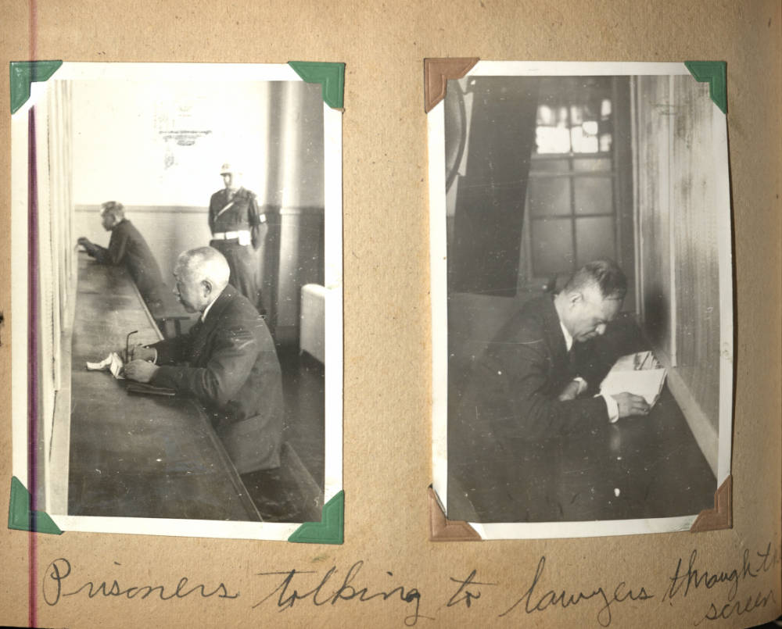
INTERNATIONAL MILITARY TRIBUNAL FOR THE FAR EAST

Slide 17
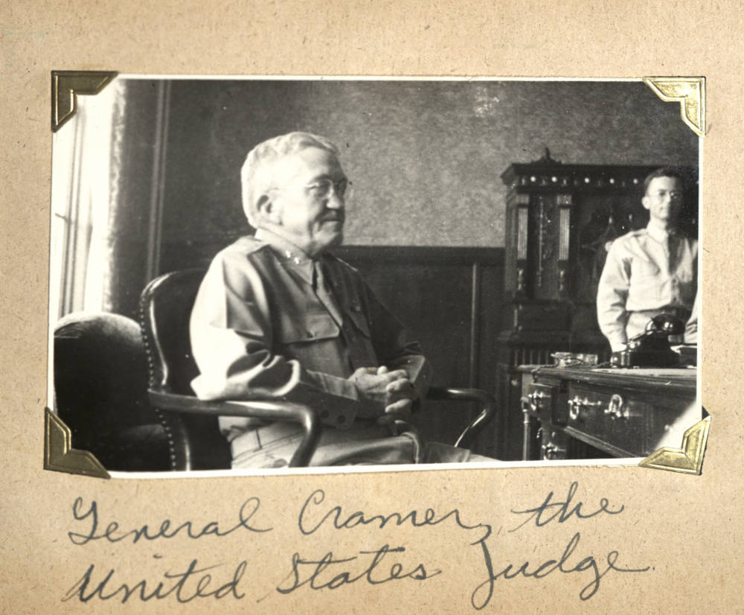
INTERNATIONAL MILITARY TRIBUNAL FOR THE FAR EAST

Slide 18
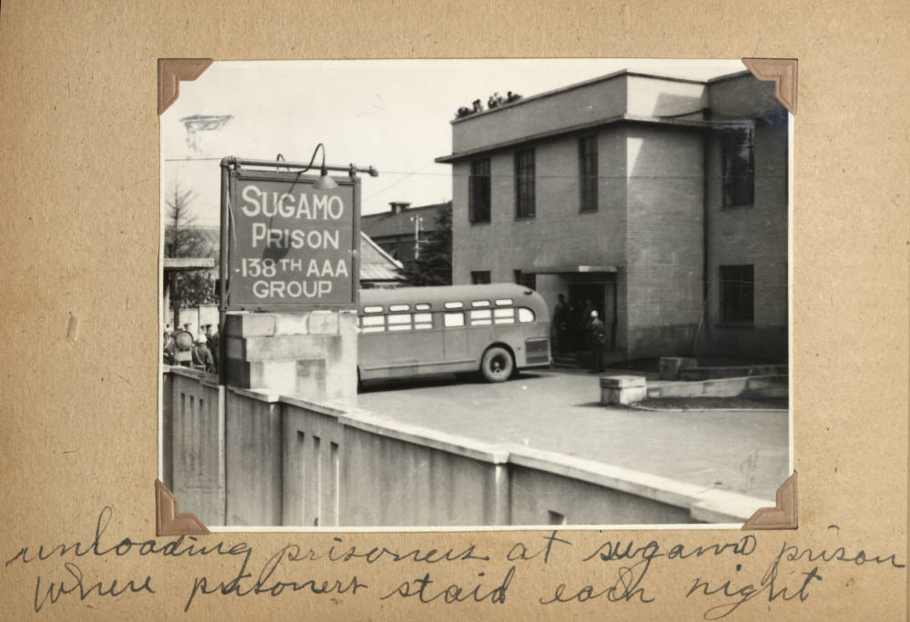
INTERNATIONAL MILITARY TRIBUNAL FOR THE FAR EAST

Slide 19
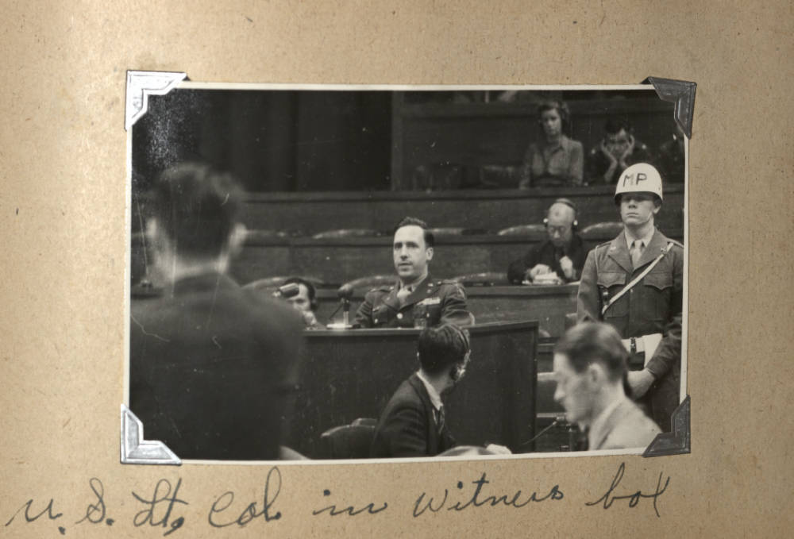
INTERNATIONAL MILITARY TRIBUNAL FOR THE FAR EAST

Slide 20
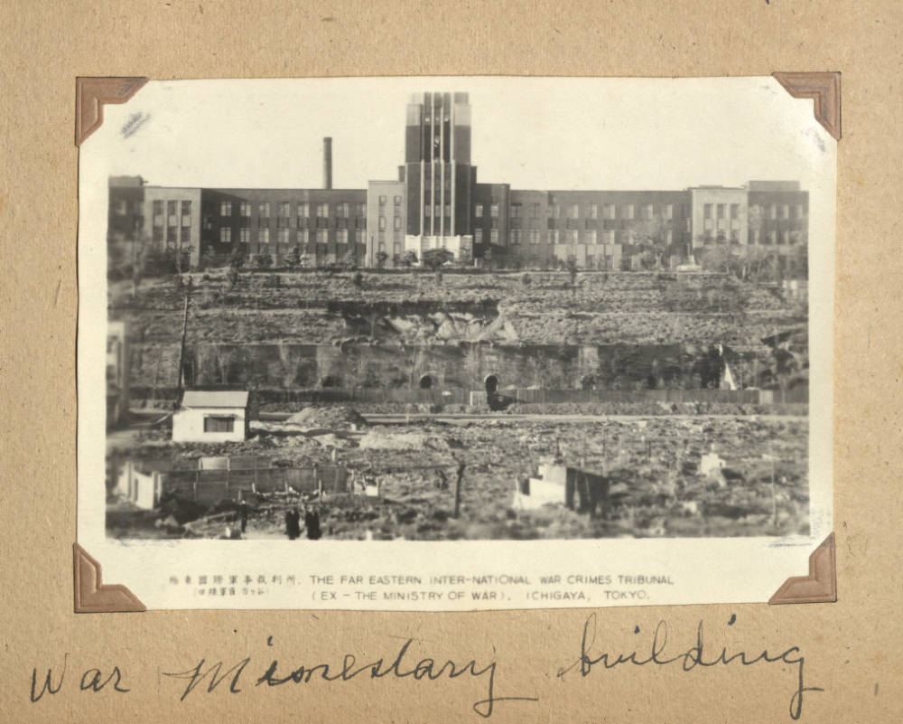
INTERNATIONAL MILITARY TRIBUNAL FOR THE FAR EAST

Slide 21
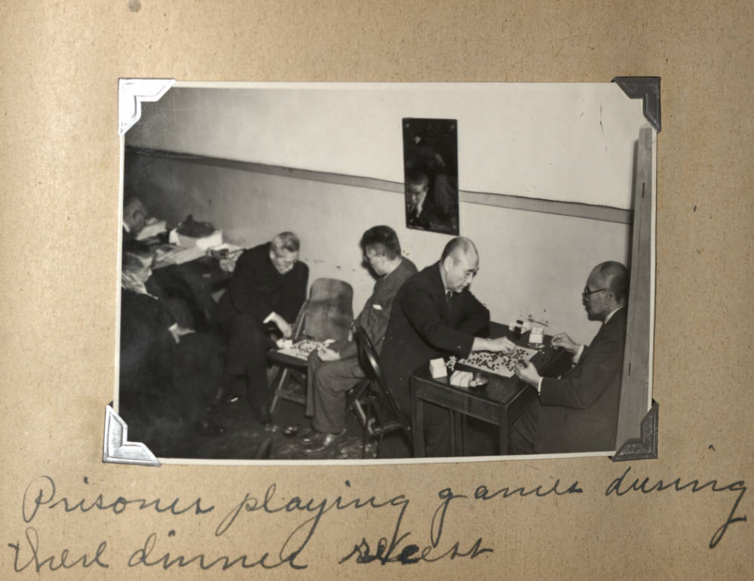
INTERNATIONAL MILITARY TRIBUNAL FOR THE FAR EAST

Slide 22
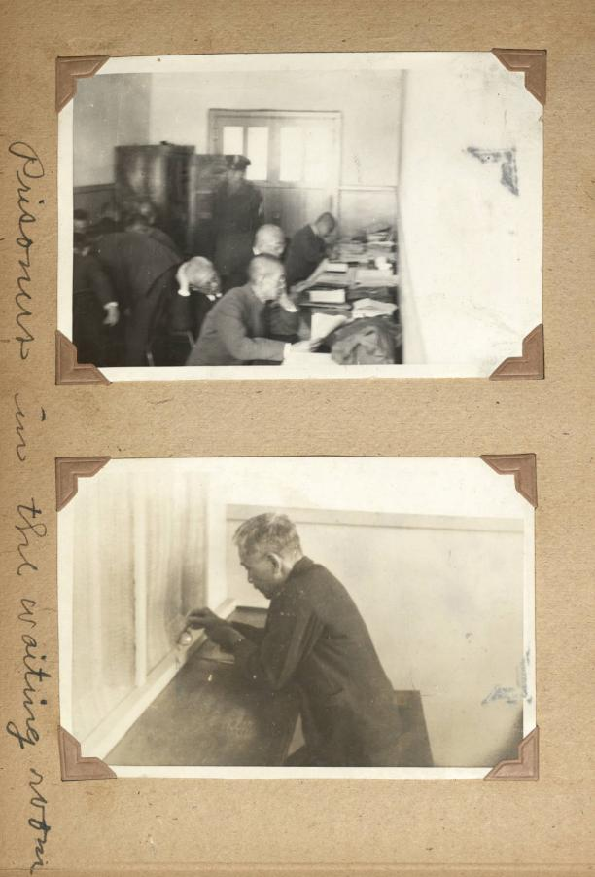
INTERNATIONAL MILITARY TRIBUNAL FOR THE FAR EAST

Slide 23
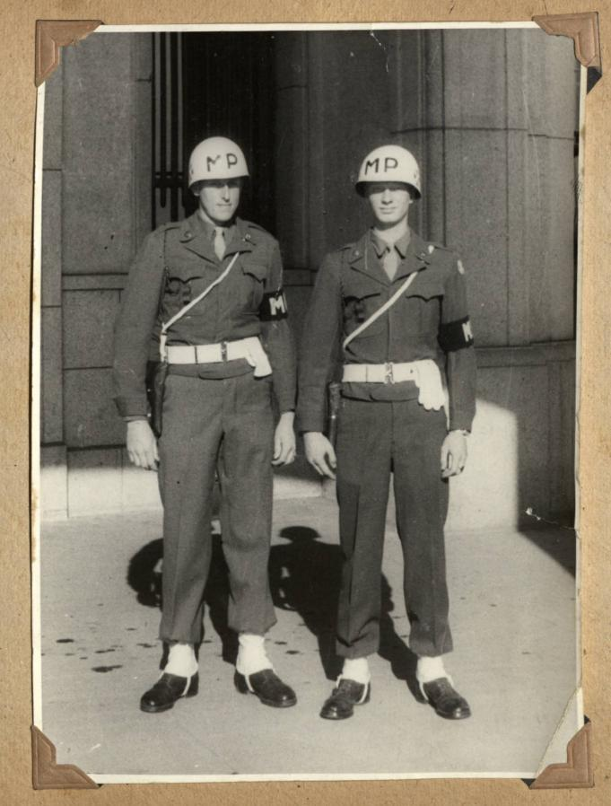
INTERNATIONAL MILITARY TRIBUNAL FOR THE FAR EAST

