Slide 2
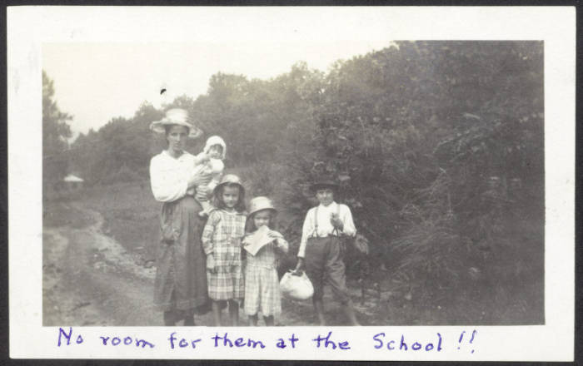
Accession Number: 2007ph01.104.album page 40

Slide 3
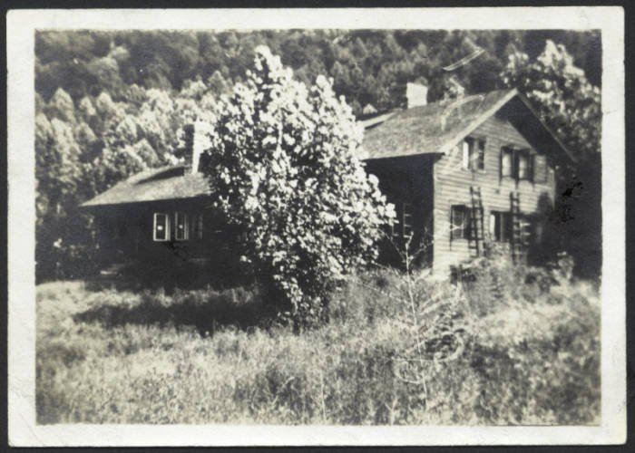
Accession Number: 2007ph01.05.album page 2

Slide 4
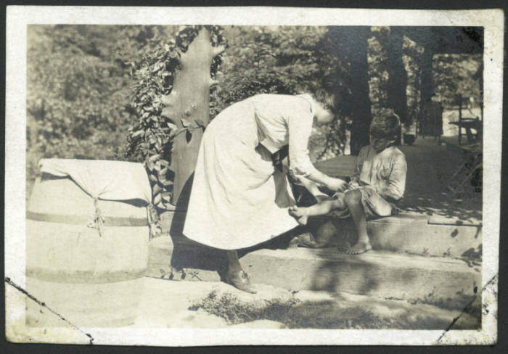
Accession Number: 2007ph01.06.album page 2

Slide 5
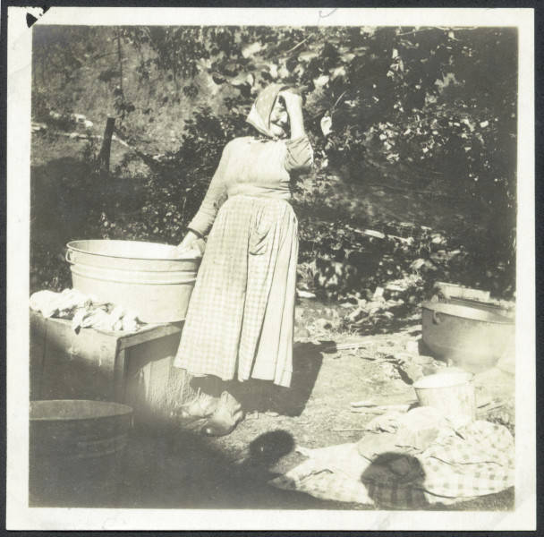
Accession Number: 2007ph01.105.album page 41

Slide 6
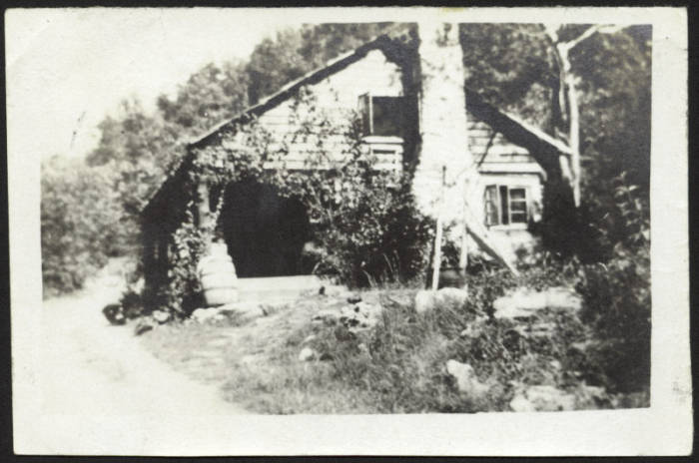
Accession Number: 2007ph01.07.album page 2

Slide 7
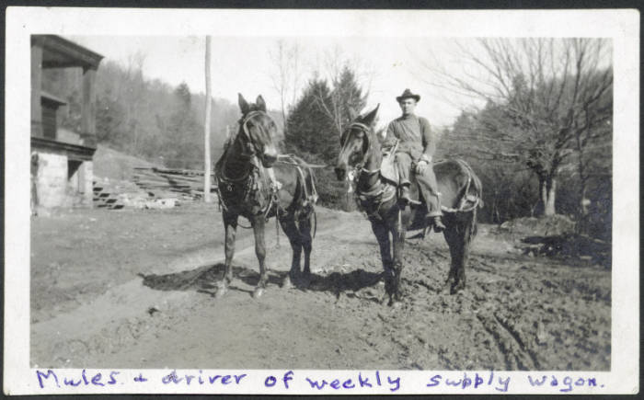
Accession Number: 2007ph01.110. album page 43

Slide 8
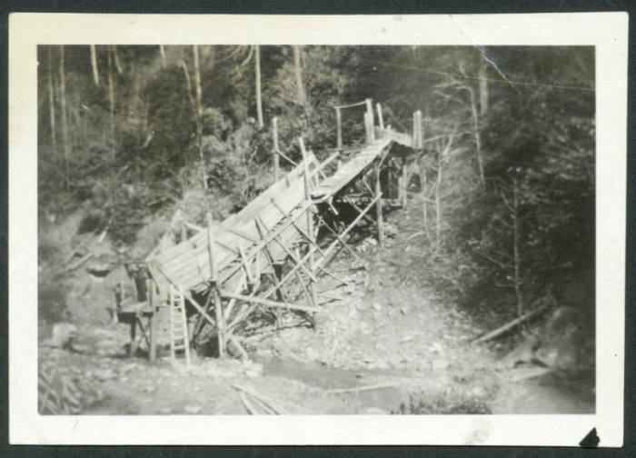
Accession Number: 2007ph01.116. album page 46

Slide 9
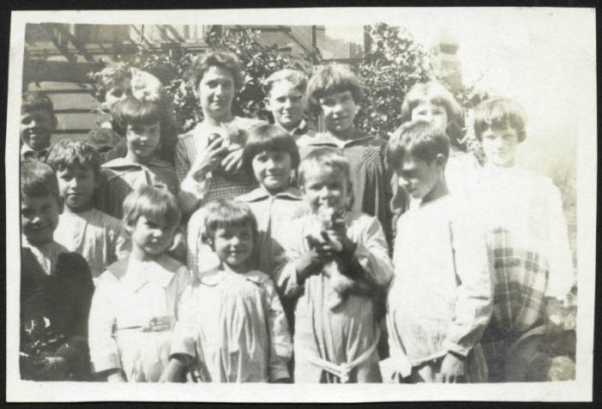
Accession Number: 2007ph01.12.album page 4

Slide 10
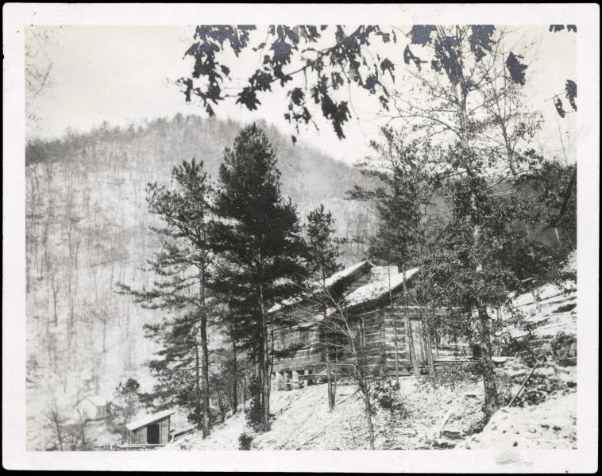
Accession Number: 2007ph01.123. album page 49

Slide 11
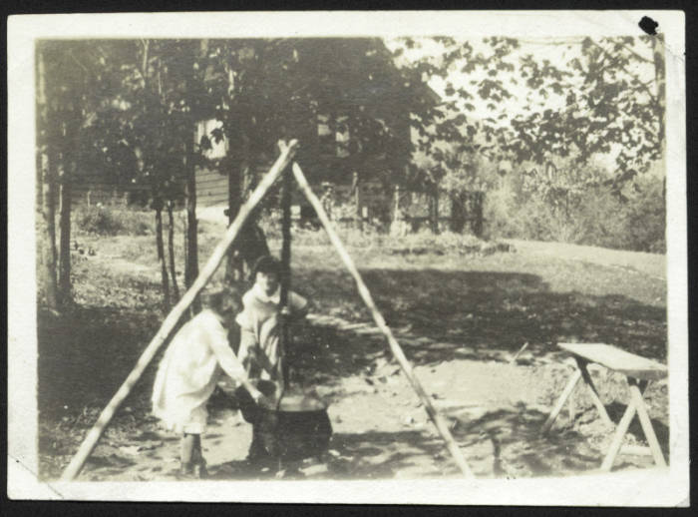
Accession Number: 2007ph01.13.album page 4

Slide 12
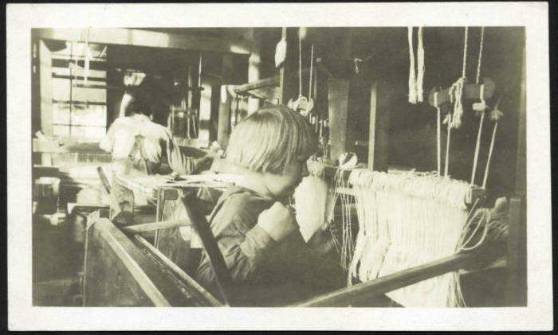
Accession Number: 2007ph01.130. album page 52

Slide 13
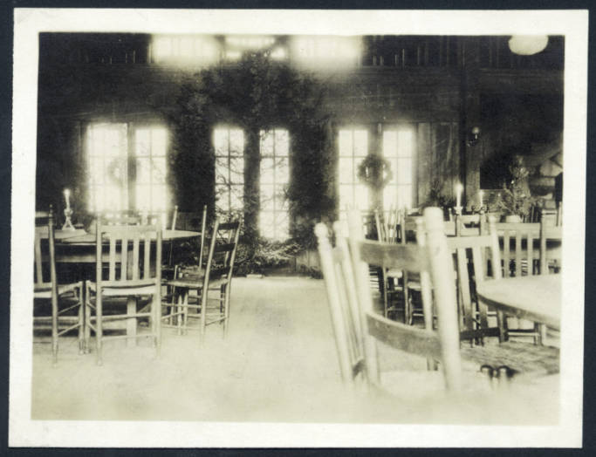
Accession Number: 2007ph01.131. album page 53

Slide 14
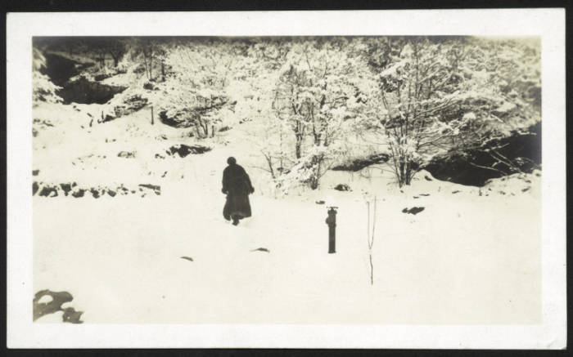
Accession Number: 2007ph01.132. album page 55

Slide 15
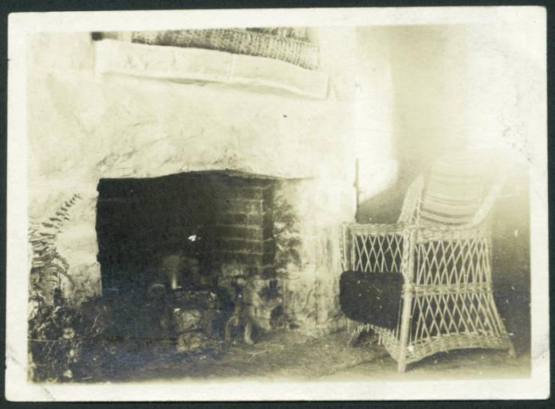
Accession Number: 2007ph01.20.album page 6

Slide 16
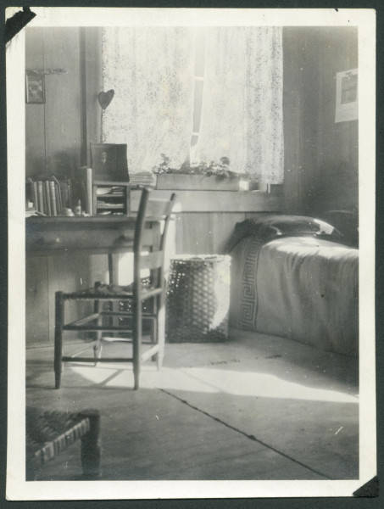
Accession Number: 2007ph01.21.album page 7

Slide 17
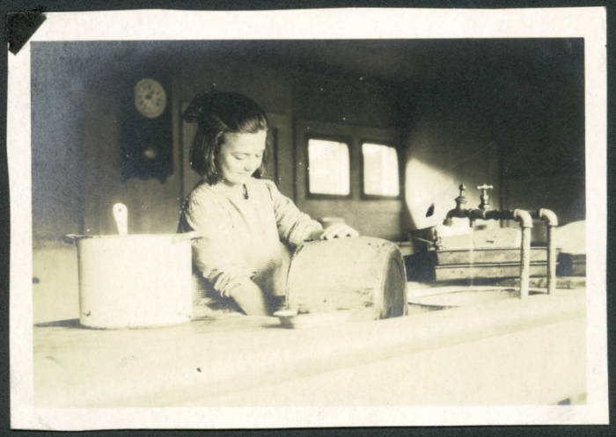
Accession Number: 2007ph01.23.album page 8

Slide 18
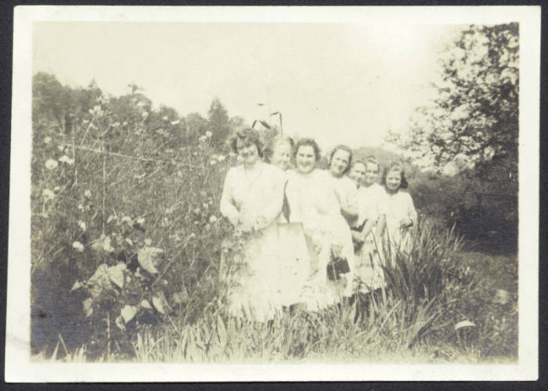
Accession Number: 2007ph01.25.album page 8

Slide 19
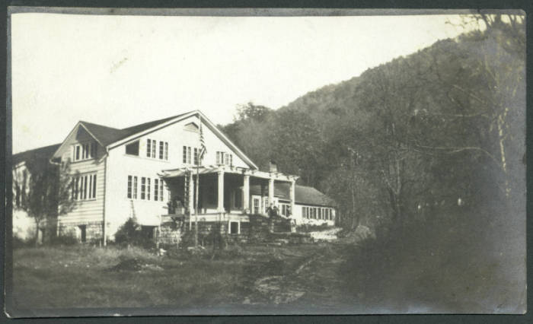
Accession Number: 2007ph01.24.album page 8

Slide 20
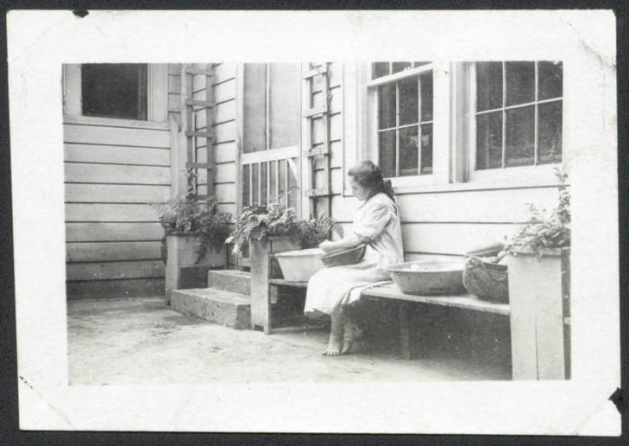
Accession Number: 2007ph01.29.album page 9

Slide 21
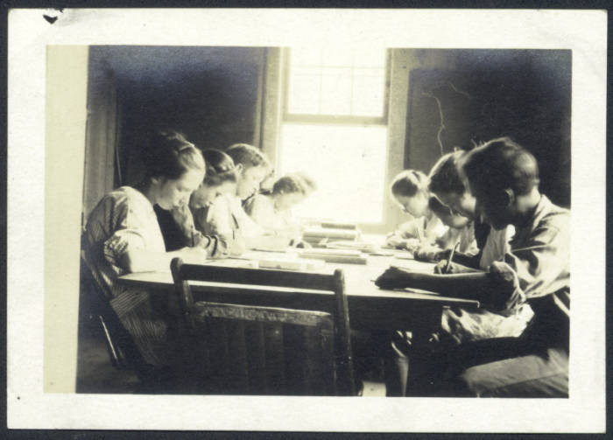
Accession Number: 2007ph01.31.album page 10

Slide 22
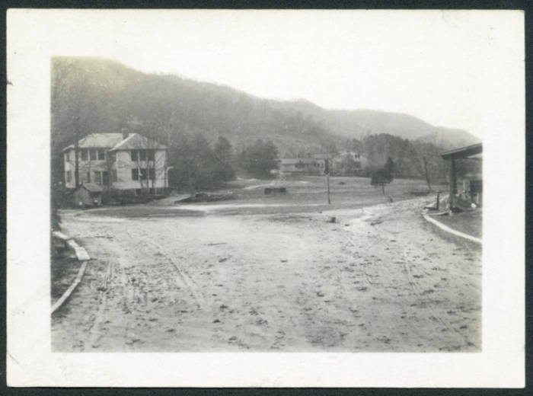
Accession Number: 2007ph01.33.album page 10

Slide 23
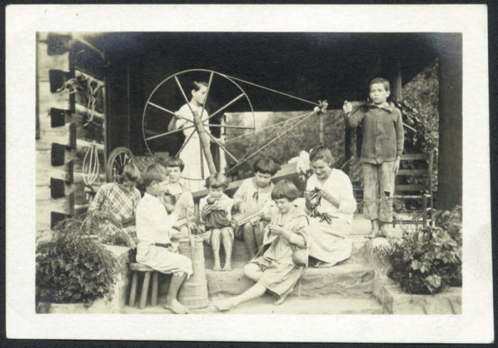
Accession Number: 2007ph01.42.album page 14

Slide 24
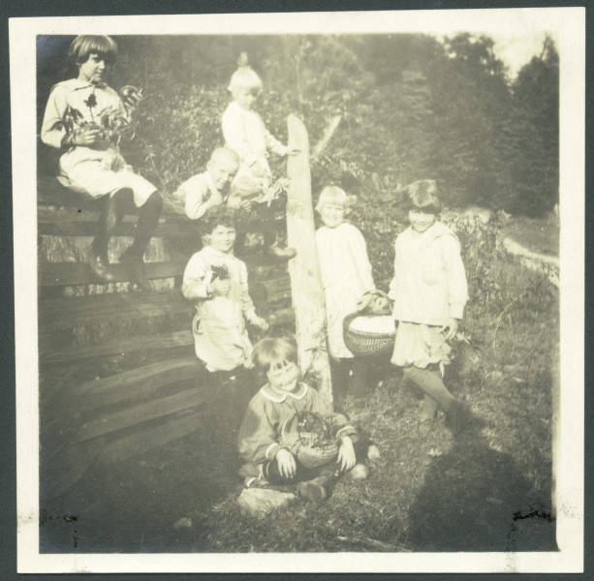
Accession Number: 2007ph01.39.album page 13

Slide 25
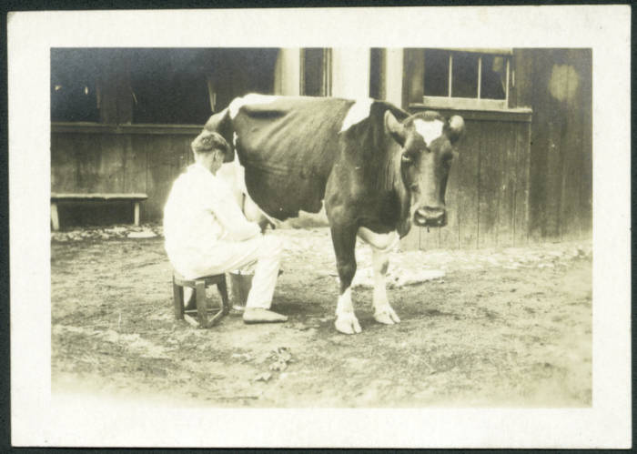
Accession Number: 2007ph01.47.album page 15

Slide 26
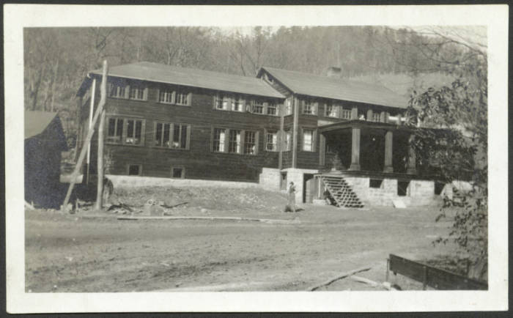
Accession Number: 2007ph01.50.album page 17

Slide 27
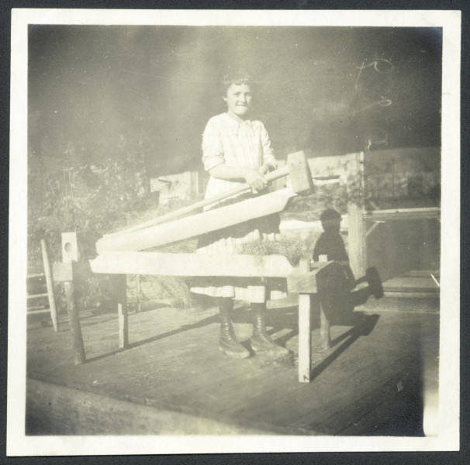
Accession Number: 2007ph01.56.album page 19

Slide 28
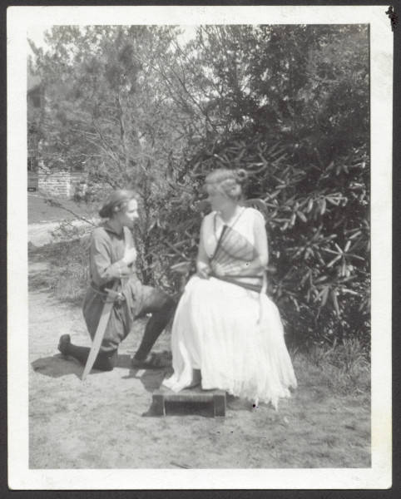
Accession Number: 2007ph01.61.album page 22

Slide 29
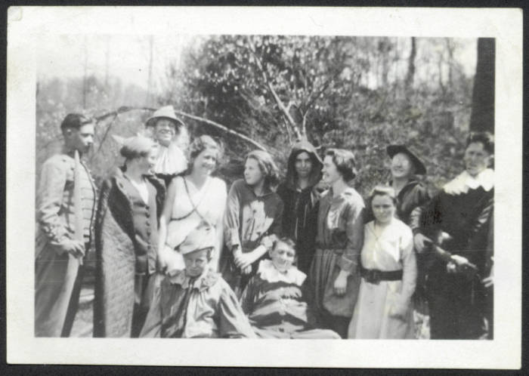
Accession Number: 2007ph01.63.album page 23

Slide 30
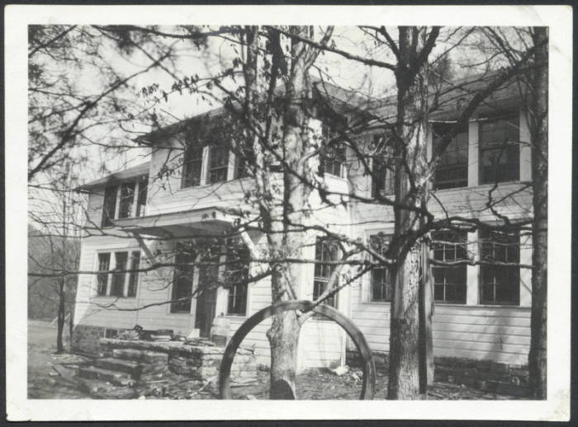
Accession Number: 2007ph01.54.album page 18

Slide 31
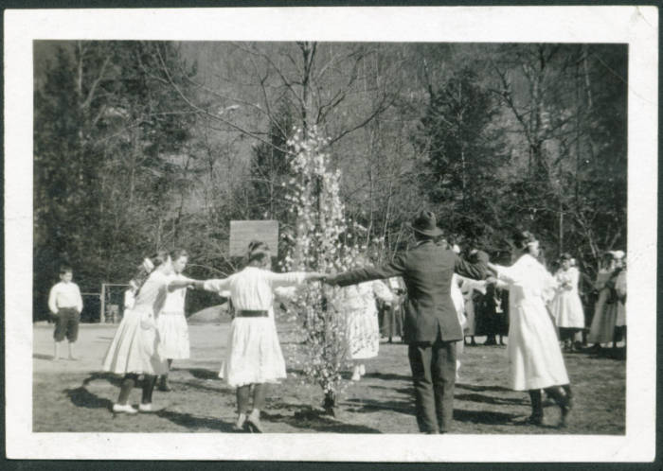
Accession Number: 2007ph01.68.album page 25

Slide 32
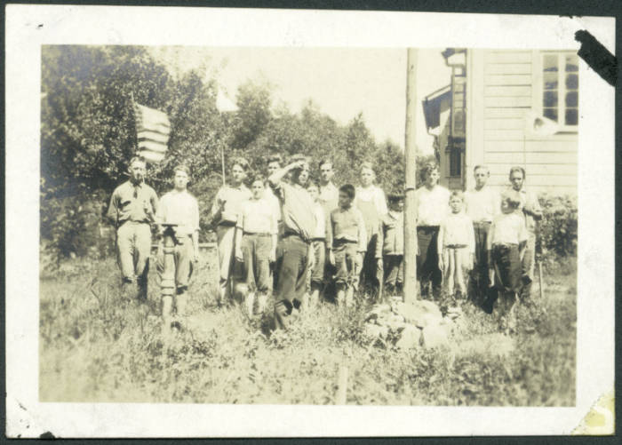
Accession Number: 2007ph01.80.album page 29

Slide 33
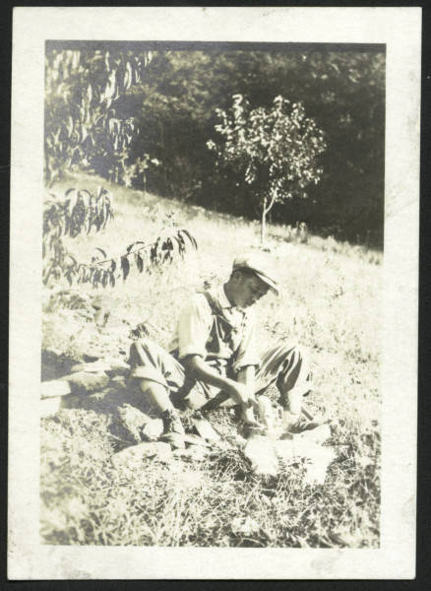
Accession Number: 2007ph01.74.album page 27

Slide 34
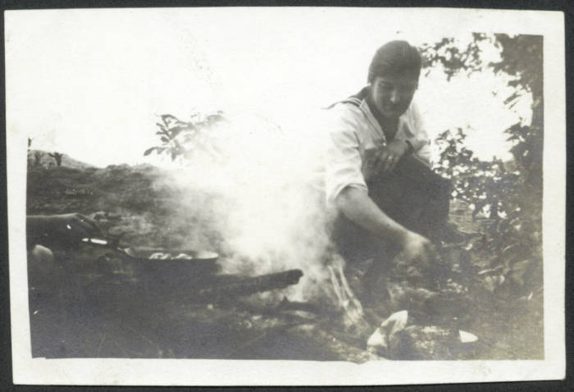
Accession Number: 2007ph01.90.album page 33

Slide 35
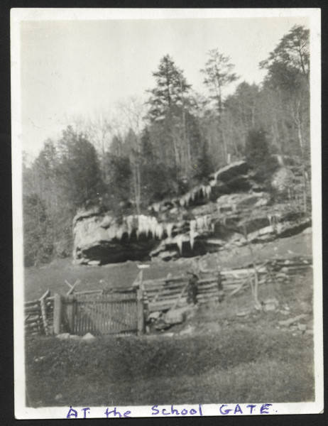
Accession Number: 2007ph01.95.album page 36

