Slide 2
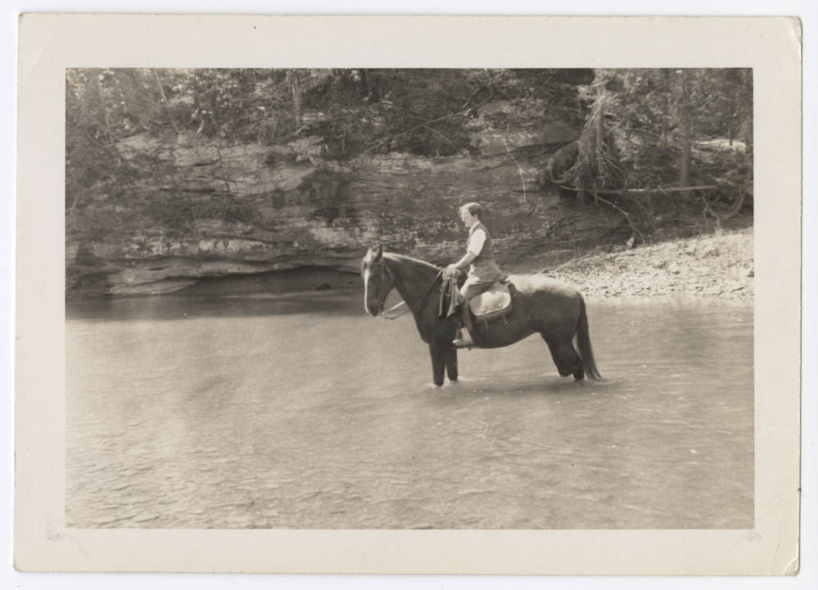
FRONTIER NURSING SERVICE

Slide 3
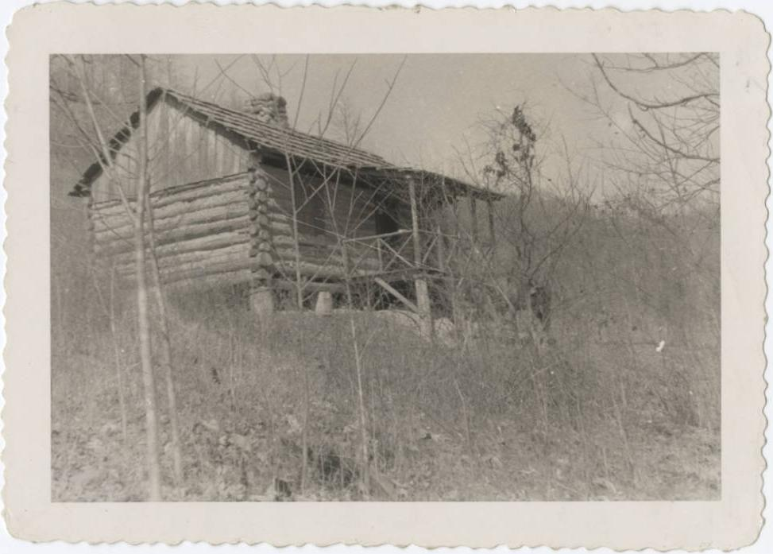
FRONTIER NURSING SERVICE

Slide 4
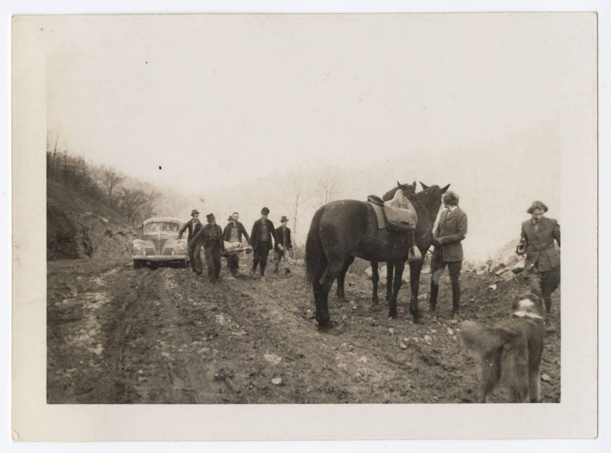
FRONTIER NURSING SERVICE

Slide 5
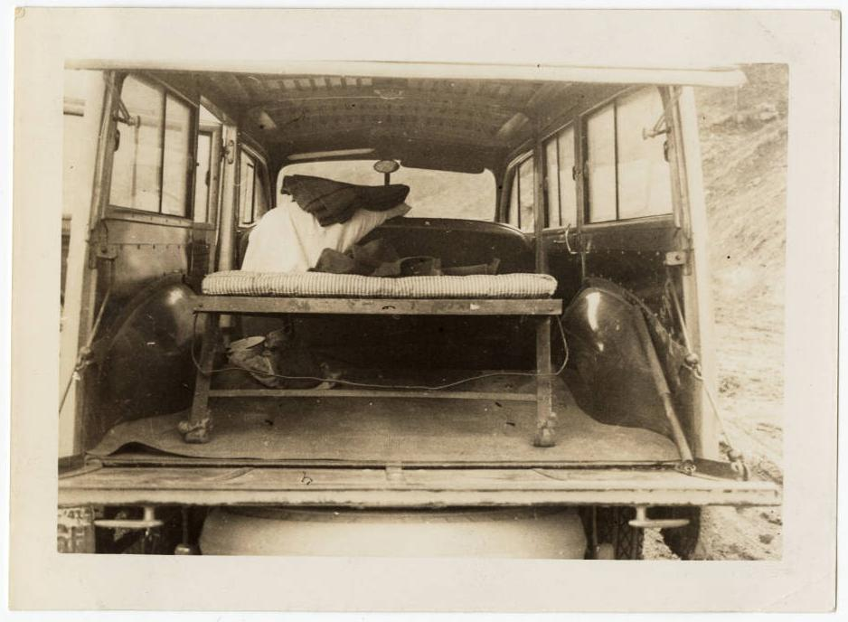
FRONTIER NURSING SERVICE

Slide 6
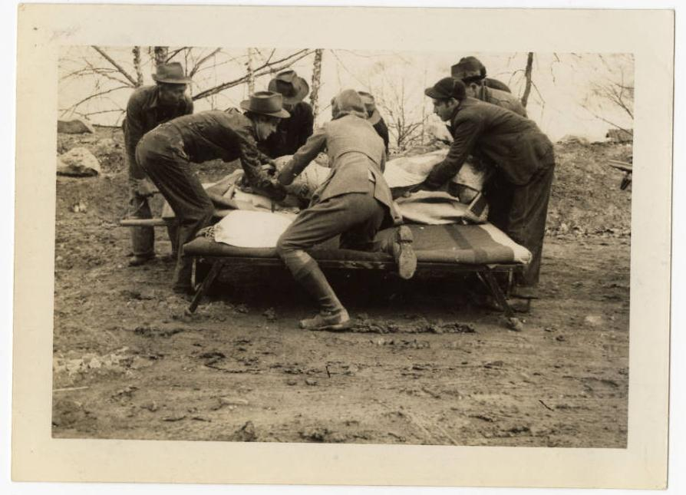
FRONTIER NURSING SERVICE

Slide 7
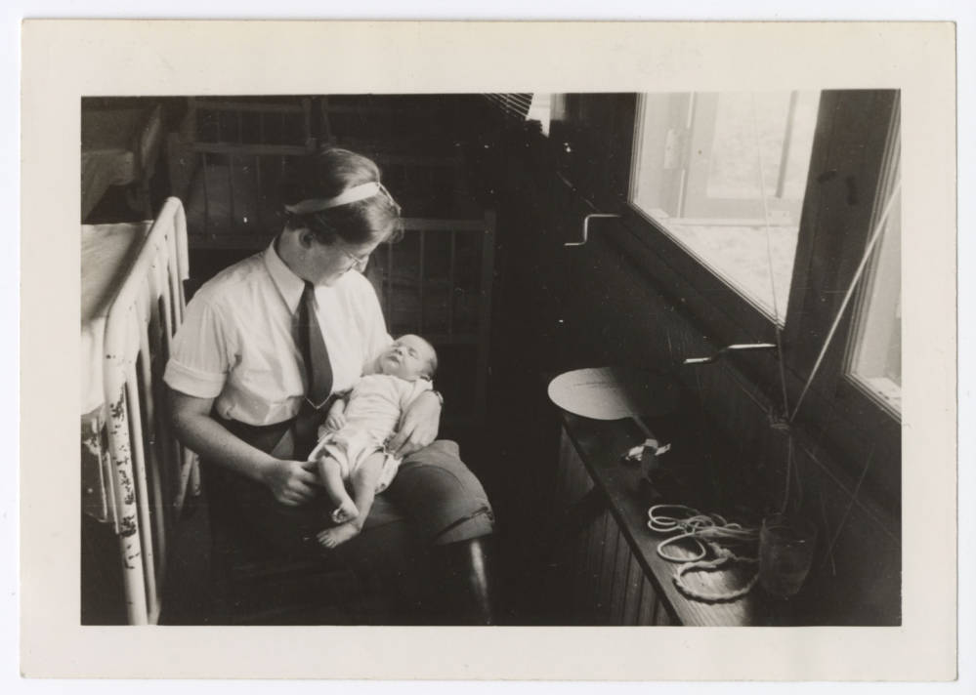
FRONTIER NURSING SERVICE

Slide 8
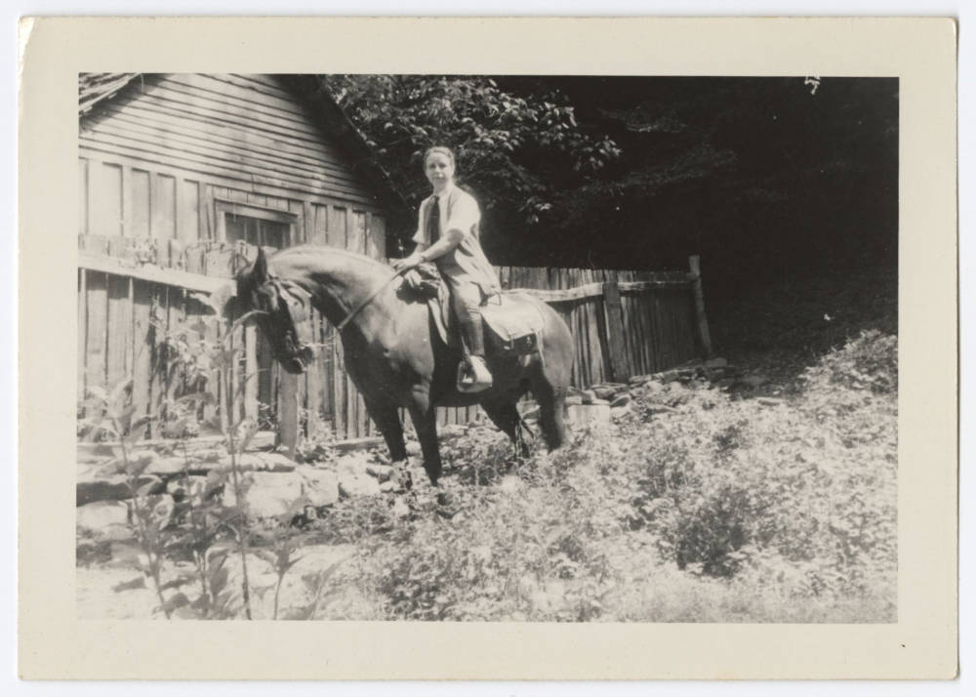
FRONTIER NURSING SERVICE

Slide 9
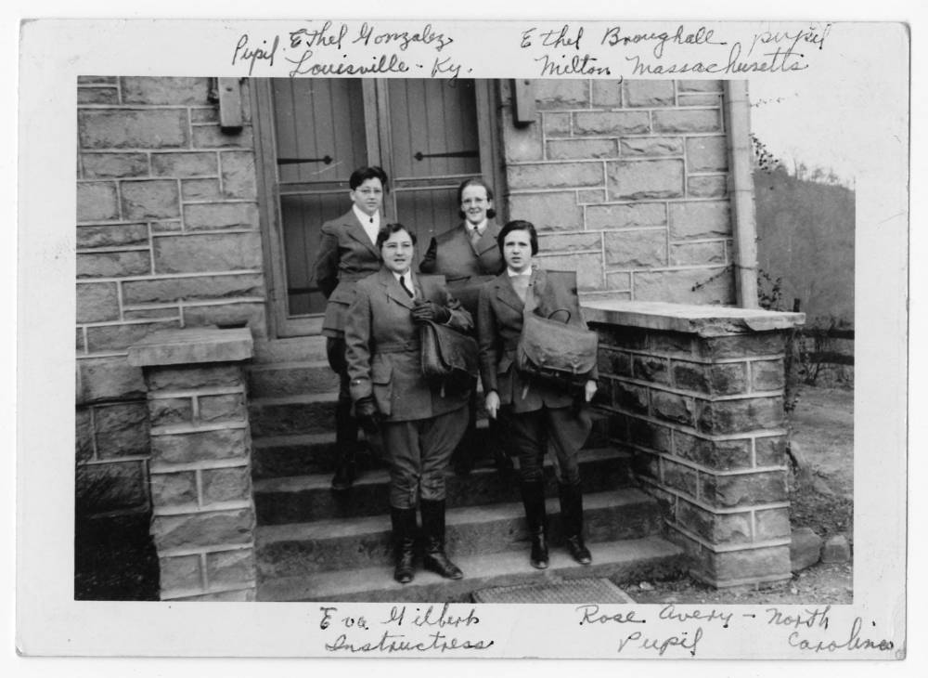
FRONTIER NURSING SERVICE

Slide 10
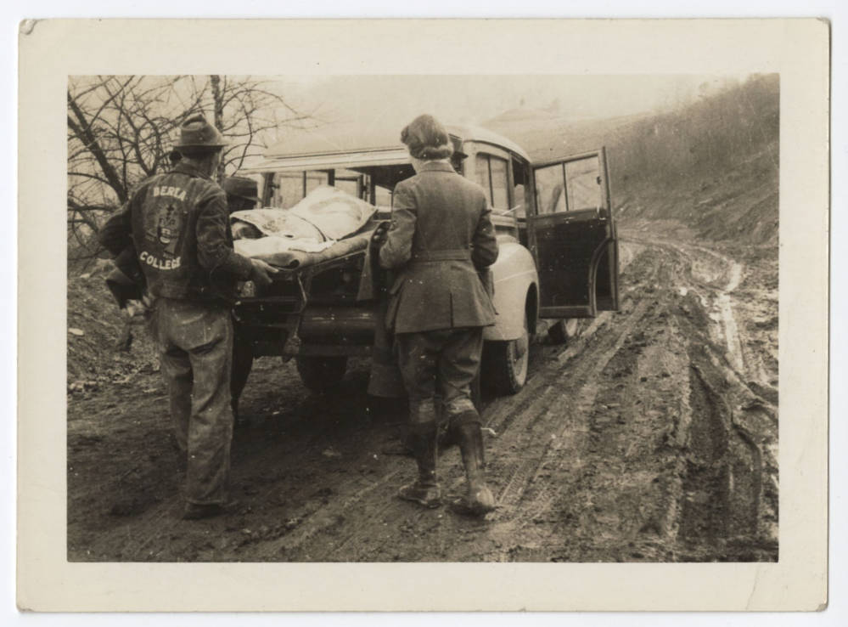
FRONTIER NURSING SERVICE

Slide 11
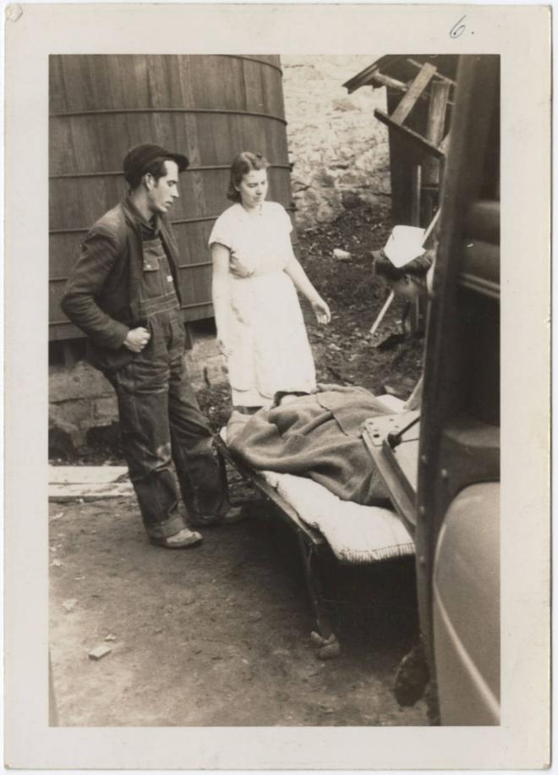
FRONTIER NURSING SERVICE

Slide 12
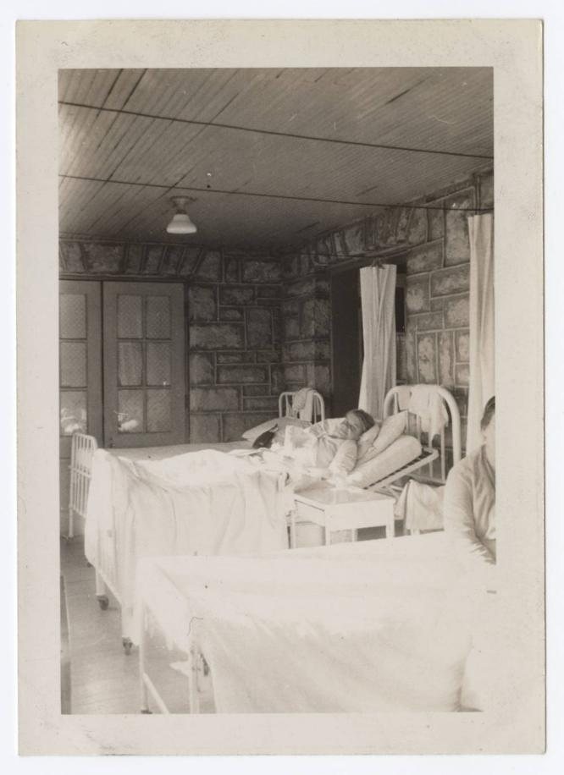
FRONTIER NURSING SERVICE

Slide 13
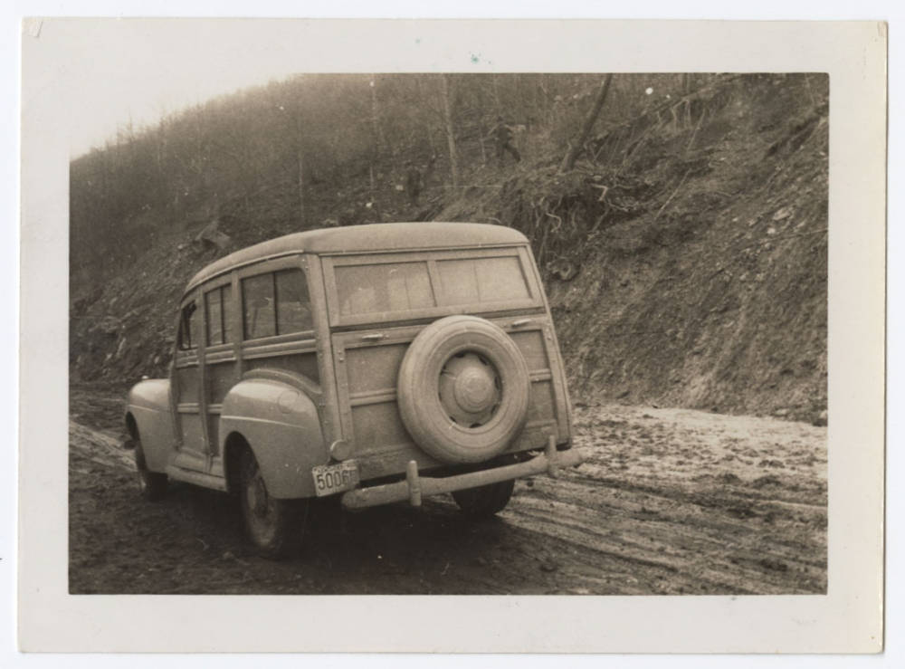
FRONTIER NURSING SERVICE

Slide 14
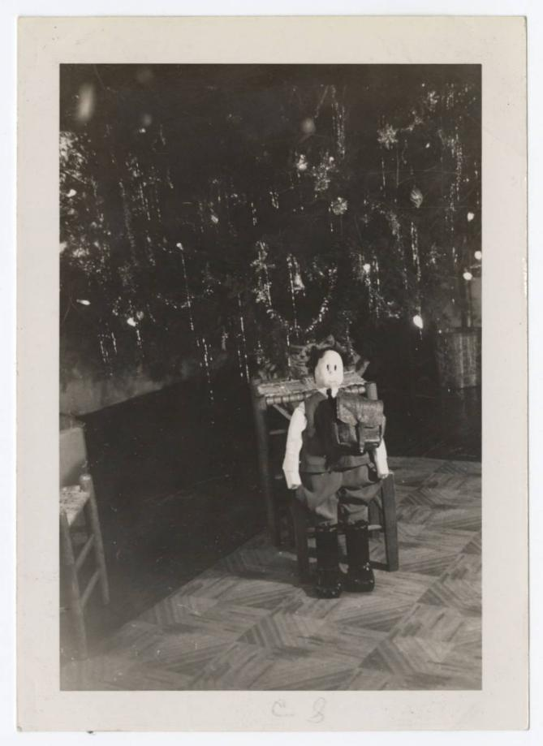
FRONTIER NURSING SERVICE

Slide 15
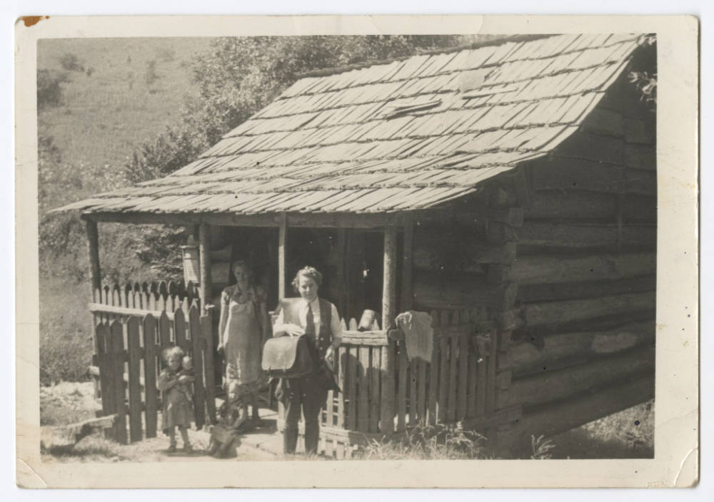
FRONTIER NURSING SERVICE

Slide 16
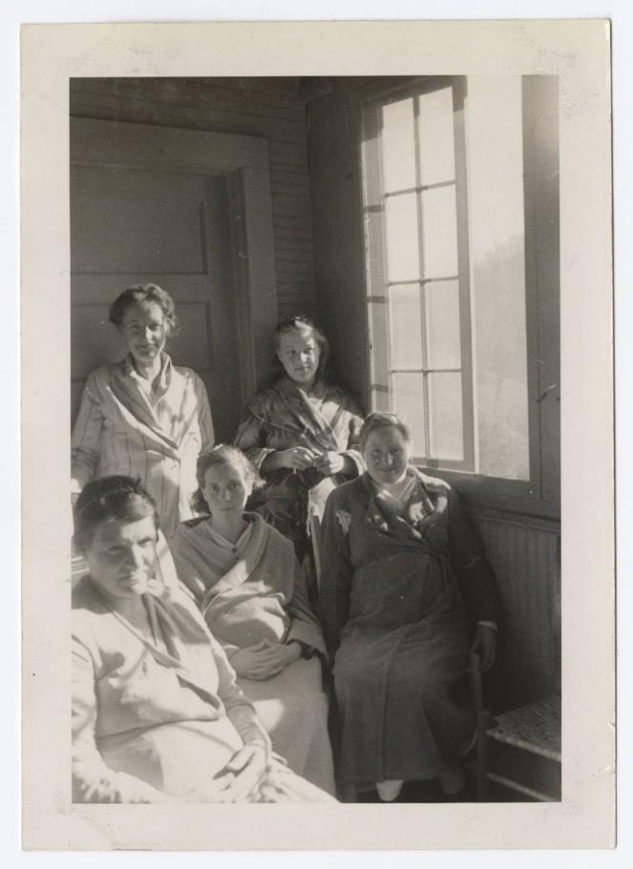
FRONTIER NURSING SERVICE

Slide 17
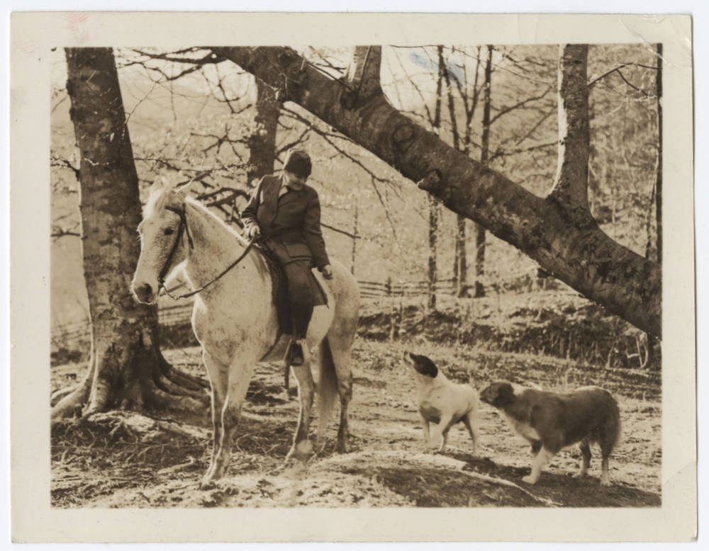
FRONTIER NURSING SERVICE

Slide 18
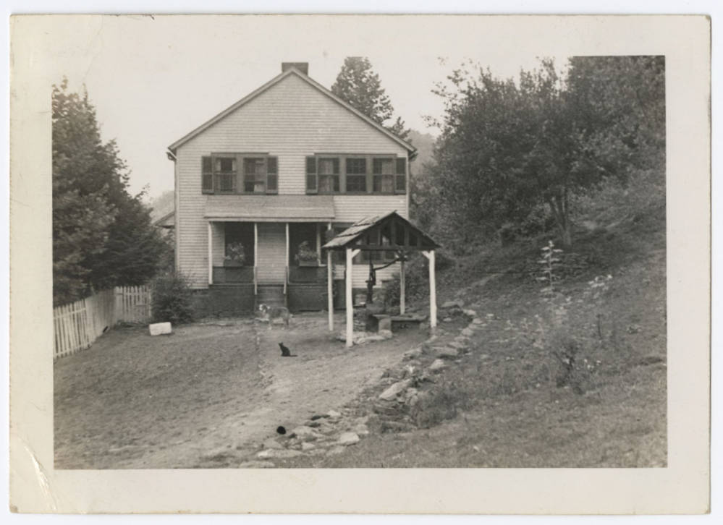
FRONTIER NURSING SERVICE

Slide 19
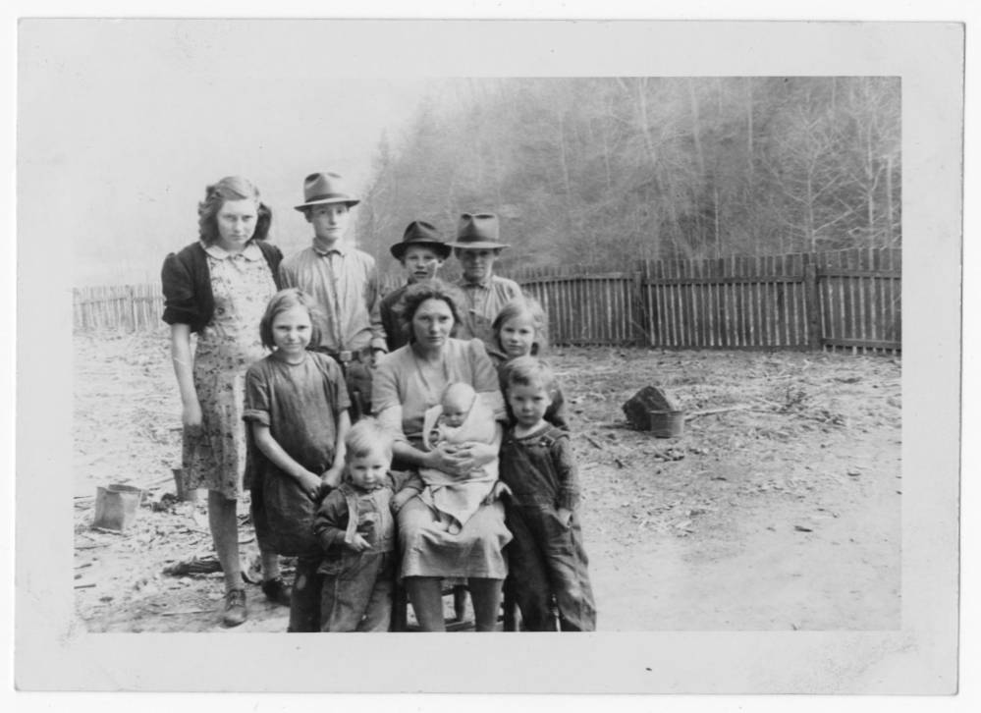
FRONTIER NURSING SERVICE

Slide 20
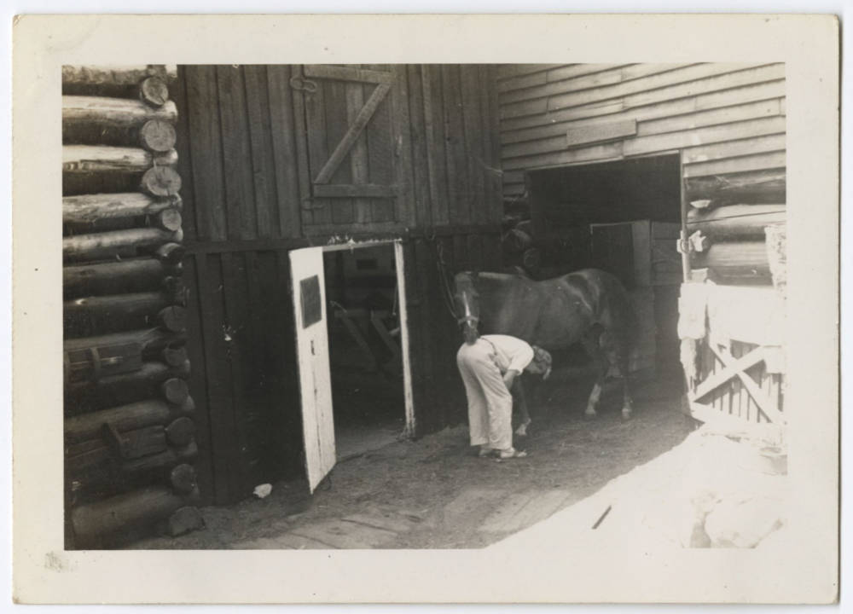
FRONTIER NURSING SERVICE

Slide 21
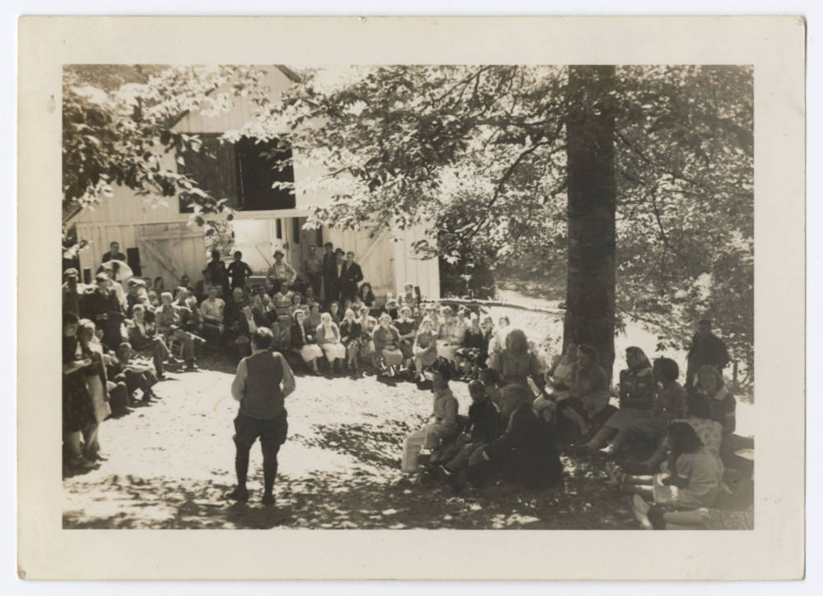
FRONTIER NURSING SERVICE

Slide 22
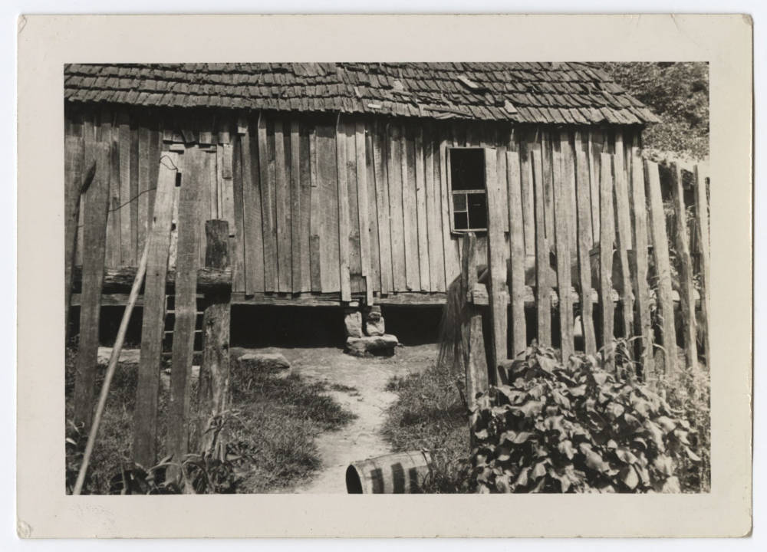
FRONTIER NURSING SERVICE

