Slide 1


Web’s Weekly Roundup
Game Theory in The Market
June 27, 2015
Presenter: Web Begole

Slide 2
RISK DISCLAIMER
Day trading, short term trading, options trading, and futures trading are extremely risky undertakings. They generally are not appropriate for someone with limited capital, little or no trading experience, and/ or a low tolerance for risk. Never execute a trade unless you can afford to and are prepared to lose your entire investment. All trading operations involve serious risks, and you can lose your entire investment. No trades are recommendations or advice and we cannot be sued for losses of capital. All trades are for educational purposes only. Contact your broker or RIA for execution, margin, and other capital requirements. Everyone watching presentation adheres to ALL disclaimers on www.optionhacker.com and www.keeneonthemarket.com

Slide 3

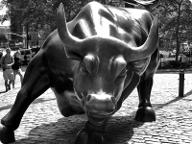
Web’s Weekly Roundup
Analysis of /ES (S&P 500 Futures) and forecast (NEUTRAL TO BEARISH)
Analysis of /DX (US Dollar Futures) and forecast (NEUTRAL)
Analysis of /6E (Euro-Dollar Futures) and forecast (NEUTRAL)
Analysis of /ZB (30-Year Bond Futures) and forecast (BEARISH)
Musings from Web’s Brain:
Applying John Nash’s Game Theory to Market Movements
How I’m using this to scalp around intraday reversals

Slide 4
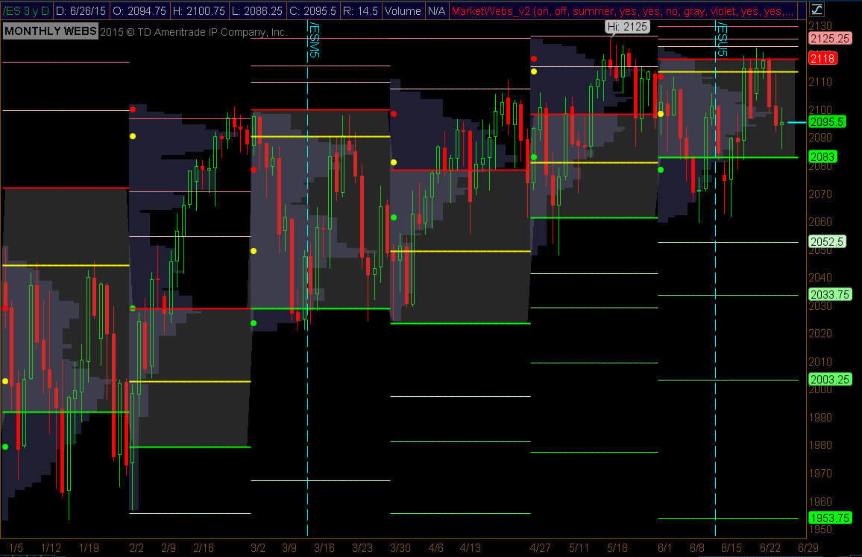
/ES Futures (S&P 500) YTD 2015
Opening Price: 2038.25
Current Price: 2095.5
High: 2125
Low: 1953.5
O/C Change: +57.25pts (+2.80%)
H/L Range: 171.50
Notable Pattern:
Last week I called for volatile movement with no lasting change. We closed the week down only 1.5pts from last week’s close.
Forecast:
Looking at previous months, I believe we start July near the bottom of value ~2078. But we could start closer to the top ~2110.

Slide 5
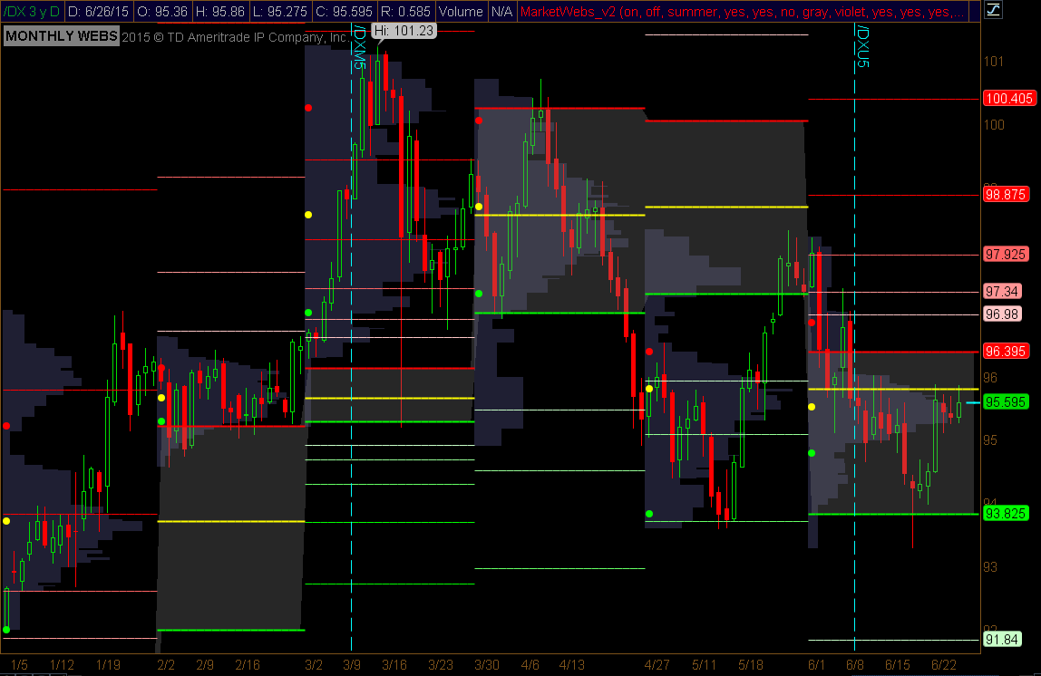
/DX Futures (USDollar Index) YTD 2015
Opening Price: 92.005
Current Price: 95.595
High: 101.23
Low: 91.995
O/C Change: +3.59pts (+3.9%)
H/L Range: 9.235pts
Notable Pattern:
As mentioned last week, the expected recovery move to 95.81 is complete.
Forecast:
Hard to predict now with Greece in the background. For the first half of July expect range-bound movement between 96.85 and 94.82

Slide 6
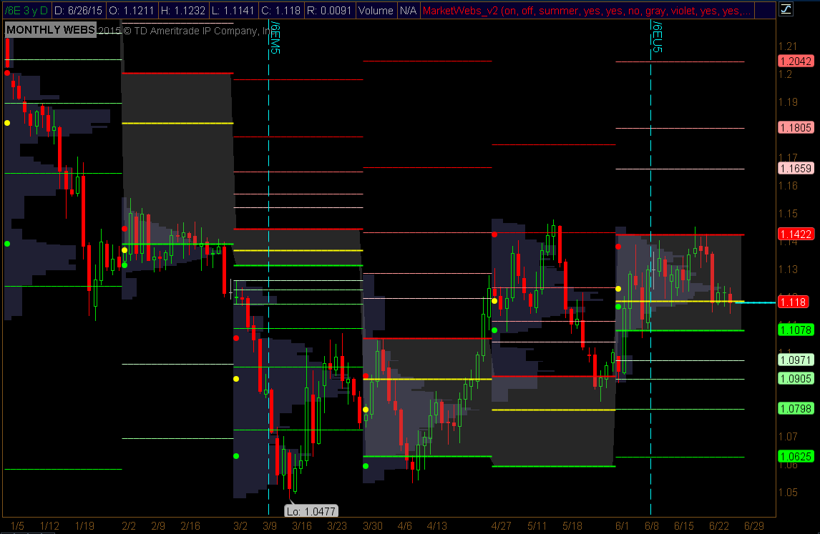
/6E Futures (Euro Futures) YTD 2015
Opening Price: 1.2124
Current Price: 1.118
High: 1.2127
Low: 1.0477
O/C Change: -0.0759pts
H/L Range: 0.165pts
Notable Pattern:
As expected last week, support and consolidation has been found around the 1.125 level (slightly lower in fact)
Forecast:
Going into July, things look indecisive as the market has positioned itself for a sharp move lower but has not made the move yet. Expect large moves in Euro soon.

Slide 7
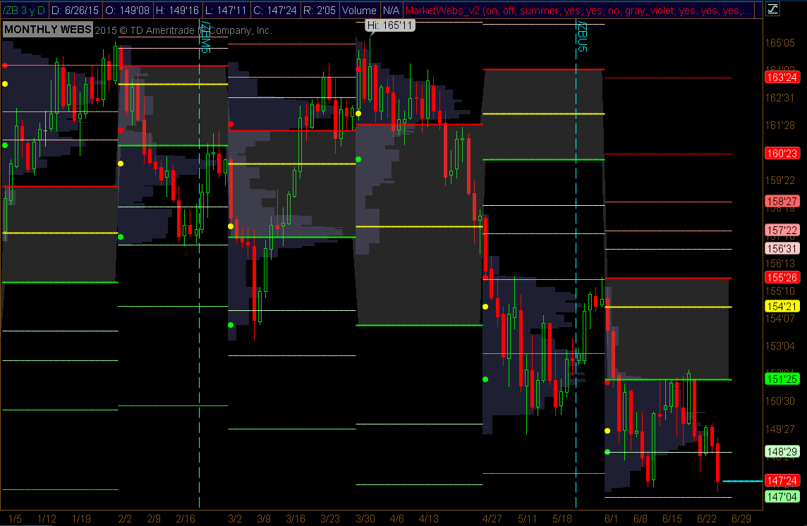
/ZB Futures (30-Year Bonds) YTD 2015
Opening Price: 157’21
Current Price: 147’24
High: 165’11
Low: 147’11
O/C Change: -9’29
H/L Range: 18’00
Notable Pattern:
The move into value did not hold and we have sharply moved lower – unexpected short term move.
Forecast:
/ZB is trading below value for July already and further downside is expected going further. Upside resistance around the 148’29 level.

Slide 8
Looking Ahead
Overall:
Most of last weeks predictions played out perfectly this week. (Except the Bonds and the Euro grew a bit weaker than expected)
It is very hard to make predictions now with a new month starting next week as well as (perhaps) some decision out of the Euro Zone.
Either next week will be a repeat of this week with little lasting movement, or the Euro could take a massive move lower below value and get the other markets to move with it.

Slide 9
John Nash’s Game Theory in Market Movement
Reading price action in terms
of the players involved.
(Scattered Musings from Web’s mind…)

Slide 10
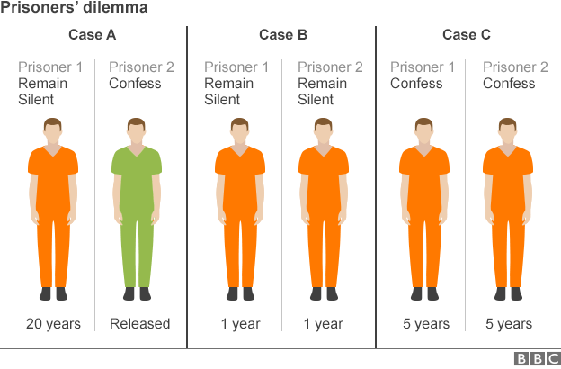
Game Theory
What is Game Theory?
In game theory, the Nash equilibrium is a solution concept of a non-cooperative game involving two or more players, in which each player is assumed to know the equilibrium strategies of the other players, and no player has anything to gain by changing only their own strategy.
Stated simply, Amy and Will are in Nash equilibrium if:
  Amy is making the best decision she can, taking into account Will's decision while Will's decision remains unchanged,
  Will is making the best decision he can, taking into account Amy's decision while Amy's decision remains unchanged.
  Likewise, a group of players are in Nash equilibrium if each one is making the best decision possible, taking into account the decisions of the others in the game as long the other party's decision remains unchanged.
The Prisoner’s Dilemma
Two members of a criminal gang are arrested and imprisoned. Each prisoner is in solitary confinement with no means of speaking to or exchanging messages with the other. The prosecutors do not have enough evidence to convict the pair on the principal charge. They hope to get both sentenced to a year in prison on a lesser charge. Simultaneously, the prosecutors offer each prisoner a bargain. Each prisoner is given the opportunity either to: betray the other by testifying that the other committed the crime, or to cooperate with the other by remaining silent. Here is the offer:
  If A and B each betray the other, each of them serves 5 years in prison
  If A betrays B but B remains silent, A will be set free and B will serve 20 years in prison (and vice versa)
  If A and B both remain silent, both of them will only serve 1 year in prison (on the lesser charge)

Slide 11
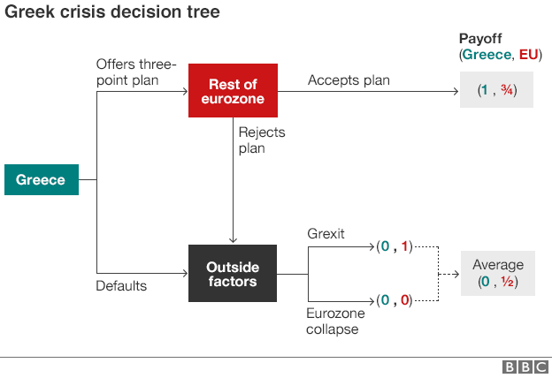
Game Theory
One may also look at Game Theory in terms of Greece (since it’s notable that Yanis Varoufakis, the Greek finance minister, spent his academic career (which included teaching posts at the University of Essex and the University of East Anglia) studying game theory.
BBC News - Can game theory explain the Greek debt crisis? http://www.bbc.com/news/magazine-33254857
Imagine Greece moves first to avoid default by putting a plan on the table. This plan involves new taxes on the wealthy and changes to pensions - avoiding spending cuts and and having some of its debts written off in exchange.
If this plan is accepted by the rest of the eurozone, then Greece is content. Let's give its payoff a score of 1.
If the eurozone accepted this deal, the monetary union would remain intact, but it would have to ease its strict rules on fiscal policy and take a loss on holdings of Greek debt. Let's give the eurozone payoff a score of ¾. So the overall payoff is (1, ¾ ).
What if the eurozone rejected the deal? Then Greece, unable to pay its creditors on time, would be in what is called "technical default".
What follows next is not at all clear. Let's look at two possibilities.
First there could be "Grexit" - Greece alone leaves the eurozone but the other members live happily ever after.
Second, Greek departure leads to the collapse of the eurozone.
The first scenario is likely to be pretty bad for Greece but not for the eurozone - a payoff of (0,1). The second is bad for everyone - the payoff is (0,0).

Slide 12
Game Theory
In market terms, Amy expects Will to be buying stock and will continue to do so over time, therefore it would be Amy’s best decision to buy stock as well as Will’s actions are likely to drive the stock higher.
Imagine also, Amy and Will are both long 1million shares of XYZ. Pre-market, Will tells Amy he is thinking about selling his position today with a market order all at once because he believes the stock is going to plummet near immediately on the open. While Amy disagrees and wants to remain long XYZ, it is in her best interest to sell her position before Will does because if Will sells all at once, surely the stock will plummet because of the other players in the market and Amy’s position will suffer.
Conversely, it is not in a single participants best interest to change their strategy if all other players remain constant. (Ex: I believe a stock is over-valued based on book value, so I sell. If all of the other participants continue to buy the stock in order to front-run or go-with-the-flow, I will be at a disadvantage.) I am best positioned in the market by doing what I believe others are or will be doing.
Prime example of Game Theory in the market from this week:
  Tuesday after the market closed, NFLX announces a 7-1 stock split.
    The price soars 24pts in extended hours trading
    Not because a stock split adds any value, but because there is possible cause for a “perceived” increase in value, therefore everyone looks to buy into because everyone is buying…. (vicious feedback loop!)
  Wednesday morning, Carl Icahn tweets that he has closed his entire stake in NFLX having doubled his money in a year.
    NFLX sells off 28pts over the course of the trading session having reached its peak of 706 just before the tweet.
    Icahn may have already closed his position unbeknownst to the market, but the announcement would likely lead to others closing their positions and therefore everyone piles into the sell-side of the stock.
  In both cases, neither effected the actual value of NFLX the company, only the actions (or expected actions) of the participants in the market affecting the decisions of all other participants.

Slide 13
Game Theory
A buyer’s curve in equilibrium.
Big money (volume) towards the lower end,
small money (low volume) towards the front.
Because there are large buy orders below that will support the price, it is in the best interest of some players (smaller) to buy at a higher price ahead of them, expecting buying to follow.
95 | 96 | 97 | 98 | 99 | 100 | 101 | 102 | 103 | 104
Volume
Price

Slide 14
Game Theory
95 | 96 | 97 | 98 | 99 | 100 | 101 | 102 | 103 | 104
Due to the advantage of being the first to buy if price is likely to move higher,
The buyers curve will always look to have a certain slope, even if certain players move their volume out of alignment.
Below are two examples of possible rebalancing of the curve based on the action of one player.
95 | 96 | 97 | 98 | 99 | 100 | 101 | 102 | 103 | 104
96 | 97 | 98 | 99 | 100 | 101 | 102 | 103 | 104 | 105
Player gets filled on their order leaving a void.
Further out orders shift up and steepen the curve temporarily.
Player does not get filled and the other players involved move their orders up accordingly to restore the buyers curve.
Note price shifts up as this is an offensive move against sellers.

Slide 15
Game Theory
95 | 96 | 97 | 98 | 99 | 100 | 101 | 102 | 103 | 104
If the curve is attacked by the other side (ie: sellers come in and sweep multiple price levels) a further disruption to the curve happens and may result in the following hypothetical movements.
92 | 93 | 94 | 95 | 96 | 97 | 98 | 99 | 100 | 101
86 | 87 | 88 | 89 | 90 | 91 | 92 | 93 | 94 | 95
Buyers in front move towards the back behind the protective volume that may cause a reversal in price movement. This is only temporary.
As large volume moves lower to choose a proper buying point, the curve is restored once again.
Note price shifts down as this is a defensive move against sellers.

Slide 16
Value Area – The Concept (Point of Control)
Understanding these curves, we can see how the two sides of the market are compelled to play offense and defense based on the actions of other players.
Offensively to stay ahead of other players on the same side, defensively to stay behind other players on the same side.
In the animation below, note the relative volume height of the cross-over point, trading volume increases as one side enacts and offensive move and decreases as the other side defends against it.
Buyers
Sellers
Volume
Underlying Price

Slide 17
Game Theory
The two curves of the market (the buyers curve and the sellers curve) will continually oscillate, moving the crossover point (the trade point) back and forth between them.
Offensive moves by one side will lead to higher volumes and increased movement in their offensive direction.
Defensive moves by one side will lead to lower volumes and decreased movement towards their direction.
Like seen in the previous animation, there can be moments where the defensive side turns offensive (as perhaps a threshold price level has been reached). When this happens, the market can reverse very quickly as the other side of the market scrambles to defend or even scrambles to unwind their position and reverse the direction themselves as well.
There can be moments where the offensive side has let up (ex: buyers will buy hard to a certain price level and then stop buying) while the defensive side has moved out of the way. These are moments of extreme lack of volume and complete market equilibrium.
These moments are often temporary (as they are typically good points to begin unwinding a position) and thus can reverse the market direction.
Volume
Underlying Price

Slide 18
Game Theory
All of this may be well and good, but how is it tradable?
Level II & III quotes are no longer as useful as they once were (large volume can be hidden by algos into many small trades, or desired orders can be hidden behind wait triggers). It is impossible to see the entire buyers/sellers curves before trades are executed, so we must imagine them theoretically.
In theory (barring a bankruptcy or extreme commodity shortage) there will always be a perfect price for buyers and a perfect price for sellers.
So, because we can’t see the quotes and orders directly, we need to look at something else.
Volume & # of Trades over a given time period.
Most traders are used to looking at volume on their charts, seeing how much volume was traded on a given bar (a given day, a given hour, a given 5minute period and so forth) but what is often neglected is looking at the number of trades. By combining the two we can see an average trade-size during the time period which can provide hints towards an offensive or defensive shift by the players in the market.
In addition this information can be used to categorize trades into three categories:
Nominal Money (Average Volume per Trade)
Big Money (Above Average Volume per Trade)
Small Money (Below Average Volume per Trade)

Slide 19
Game Theory
Big Money
Nominal Money
Each dot represents a hypothetical 5minute period in XYZ
Small Money
Volume
# of Trades

Slide 20
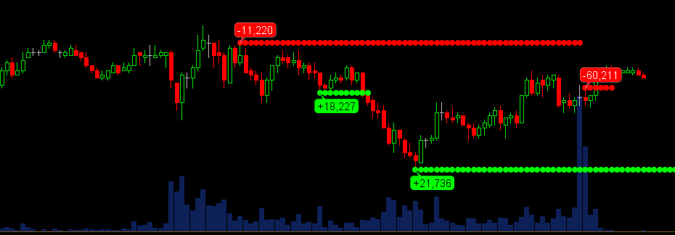
Game Theory
To find strong reversal actions in the market, we are looking for the trades made by Big Money (large volume, small number of trades)
The criteria for this is a time period during which the average trade size was larger than the overall average trade size by more than 1 standard deviation.
(Within 1sd would be all nominal money; and less than average trade size by more than 1 standard deviation will be a marker of small money only)
In order to determine where they are, it is best to think of them as very smart money, waiting for pullbacks before entering, or waiting for a predetermined price-level before acting.
In addition, we can see that the price range of the bar is typically muted as the large volume reversal action will absorb the trades in the trending direction without letting them continue, in addition the reversal action is too quick to allow smaller volumes to get ahead of the trade.
Using the typical volume bar graph is not enough to see these reversals take place but it is certainly a good starting point. A high volume but muted-range bar can be a point of reversal and is what has been looked for by traders in the past.
Keeping an eye on price action and location is key to determine if the action is buying or selling, this is completely subjective so needs a bit of interpretation.

Slide 21
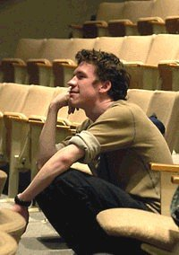

Q & A With Web

