Slide 1




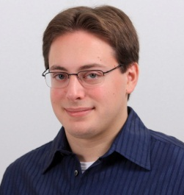



Shroud: Ensuring Private Access to Large-Scale Data in the Data Center
Jacob R. Lorch
Bryan Parno
James Mickens
Mariana Raykova
Joshua Schiffman

Slide 2
Our goal:
Let users access cloud data without revealing private information to service providers.

Slide 3



Even if you trust a service provider, you may not trust it to resist attack.
hackers
bribed employees
rogue employees
subpoenas

Slide 4
You are here
Theory Practice
Oblivious RAM
Twitter,
Facebook,
Flickr,
Bing Maps,
etc.

Slide 5





Access patterns reveal private information.
L-bycx
To: PBroadwell72@outlook.com
Deduce content from encrypted queries
(Islam, Kuzu, Kantarcioglu 2012)

Slide 6

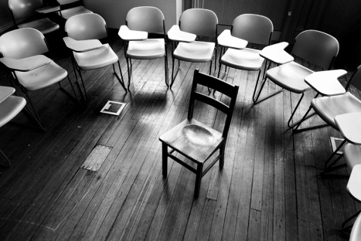





Access patterns reveal private information.
Shroud

Slide 7
Shroud: Provide a virtual disk that hides not just content, but addresses.
L-bycx
Threat model:
Controls storage
Observes all traffic
Can’t break crypto
Can’t tamper with or see inside secure hardware

Slide 8
“Oblivious RAM” protocols are slow, particularly on large data.
Data set | Number of objects | Object size
Bing map tiles (zoom level 17) | 2³⁵ | 10 KB
Twitter tweets | 2³⁵ | 0.14 KB
Facebook images | 2³⁶ | 10 KB
Flickr photos | 2³² | 5 MB
Use massive parallelism to speed up by orders of magnitude.
Hierarchical scheme (Goldreich and Ostrovsky 1996) on an $8,000 IBM 4764
Average request: 2 minutes
Every 10,000th request: 1.5 hours
Every 10,000,000th request: a week!

Slide 9
Contributions of Shroud
Challenge | Approach | Result
Oblivious RAM algorithms are slow | Adapt Binary Tree algorithm to enable massive parallelism | Worst-case access time goes from days to seconds
Inter-device communication reveals information | Use deterministic communication schedule | Privacy preserved despite parallelism
Data aggregation creates bandwidth bottleneck | Leverage cryptography with oblivious aggregation | I/O time reduced by a factor of two or more
With many components, failures are frequent | Use deterministic operations and replication | Fault tolerance
Binary Tree algorithm assumes honest-but-curious adversary | Use Merkle trees to efficiently attest to states | Can tolerate Byzantine malicious adversary

Slide 10
Talk outline
Overview
Background on oblivious RAM
Design of Shroud
Implementation
Performance evaluation
Future work
Conclusions
You are here
Theory Practice

Slide 11
Talk outline
Overview
Background on oblivious RAM
Design of Shroud
Implementation
Performance evaluation
Future work
Conclusions
A whole lotta background on Oblivious RAM

Slide 12


Oblivious RAM enables efficient oblivious access.
CAUTION!
This is not a real ORAM algorithm, just an illustration of the kinds of things ORAM does.
1
1
2
2
3
3
4
4
5
5
6
6
7
7
8
8
9
9

Slide 13
Oblivious RAM approach enables efficient access.
CAUTION!
This is not a real ORAM algorithm, just an illustration of the kinds of things ORAM does.
3
1
2
1
1
2
2
3
3
4
5
6
7
8
9

Slide 14
Oblivious RAM approach enables efficient access.
CAUTION!
8, 1, 3, 9, 2, 5, 4, 7, 6
This is not a real ORAM algorithm, just an illustration of the kinds of things ORAM does.
8
1
3
9
2
5
4
7
6

Slide 15
Oblivious RAM approach enables efficient access.
CAUTION!
Item #5 is at position #6
This is not a real ORAM algorithm, just an illustration of the kinds of things ORAM does.
Give me #6
8
1
3
9
2
5
5
4
7
6

Slide 16
Challenges: High WAN bandwidth and multi-user support.
Data center
ORAM (lots of permutation)
8, 1, 3, 9, 2, 5, 4, 7, 6
8, 1, 3, 9, 2, 5, 4, 7, 6

Slide 17
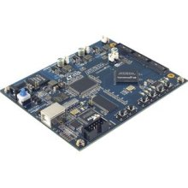
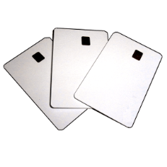
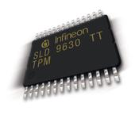



Trusted computing allows multiple users and reduces WAN use.
Iliev and Smith 2005
Data center
Trusted coprocessor
ORAM
AMD-V
Intel TXT

Slide 18
The Binary Tree algorithm offers advantages for data center operation.
“Binary Tree” ORAM algorithm properties:
Worst-case cost O(log³N) with low constant
Suitable for parallelization
Shi, Chan, Stefanov, Li 2011

Slide 19
Background: Binary Tree Algorithm
How untrusted storage is organized
How to look up a block
How to move a looked-up block so it’s accessed differently next time
Shi, Chan, Stefanov, Li 2011

Slide 20
Background: Binary Tree Algorithm
How untrusted storage is organized
How to look up a block
How to move a looked-up block so it’s accessed differently next time
Shi, Chan, Stefanov, Li 2011

Slide 21
Untrusted storage is physically an array…

Slide 22
…but logically organized as a tree with log₂N levels.

Slide 23
Each node is a bucket containing O(log N) blocks.

Slide 24
A block is inserted at the root.
Encrypted with private key
Address: 7
Block contents: “ABC…”
Designator: LRRL

Slide 25
A shuffle makes room at the top by pushing down blocks.
Selection must be random, unaffected by access pattern.

Slide 26
A shuffle makes room at the top by pushing down two blocks in each level.
Selection must be random, unaffected by access pattern.

Slide 27
A shuffle hides which way the block goes.
R

Slide 28
Background: Binary Tree Algorithm
How untrusted storage is organized
How to look up a block
How to move a looked-up block so it’s accessed differently next time
Shi, Chan, Stefanov, Li 2011

Slide 29
A block follows the path of its designator.
L
R
Encrypted with private key
Address: 7
Block contents: “ABC…”
Designator: LRRL
R
L

Slide 30
The trusted device holds a mapping from addresses to designators.
1 | 2 | 3 | 4 | 5 | 6 | 7 | 8 | 9
LLRR | LRLR | RRRL | RRRR | RLLR | RLRL | LRRL | LLRR | LLLL
…

Slide 31
The device uses the designator to find the block at that address.
L
R
R
L
1 | 2 | 3 | 4 | 5 | 6 | 7 | 8 | 9
LLRR | LRLR | RRRL | RRRR | RLLR | RLRL | LRRL | LLRR | LLLL
…

Slide 32
Background: Binary Tree Algorithm
How untrusted storage is organized
How to look up a block
How to move a looked-up block so it’s accessed differently next time
Shi, Chan, Stefanov, Li 2011

Slide 33
After a block is looked up, it needs to be reinserted with a new designator.
L
R
R
L
1 | 2 | 3 | 4 | 5 | 6 | 7 | 8 | 9
LLRR | LRLR | RRRL | RRRR | RLLR | RLRL | LRRL | LLRR | LLLL
…
RLLR

Slide 34
An oblivious insert necessitates re-encrypting all entries on path.
L
R
R
L
1 | 2 | 3 | 4 | 5 | 6 | 7 | 8 | 9
LLRR | LRLR | RRRL | RRRR | RLLR | RLRL | LRRL | LLRR | LLLL
…

Slide 35
An oblivious insert necessitates re-encrypting all entries on path.
L
R
R
L
1 | 2 | 3 | 4 | 5 | 6 | 7 | 8 | 9
LLRR | LRLR | RRRL | RRRR | RLLR | RLRL | LRRL | LLRR | LLLL
…
RLLR

Slide 36
Talk outline
Overview
Background on oblivious RAM
Design of Shroud
Implementation
Performance evaluation
Future work
Conclusions

Slide 37
Contributions of Shroud
Challenge | Approach | Result
Oblivious RAM algorithms are slow | Adapt Binary Tree algorithm to enable massive parallelism | Worst-case access time goes from days to seconds
Inter-device communication reveals information | Use deterministic communication schedule | Privacy preserved despite parallelism
Data aggregation creates bandwidth bottleneck | Leverage cryptography with oblivious aggregation | I/O time reduced by a factor of two or more
With many components, failures are frequent | Use deterministic operations and replication | Fault tolerance
Binary Tree algorithm assumes honest-but-curious adversary | Use Merkle trees to efficiently attest to states | Can tolerate Byzantine malicious adversary

Slide 38
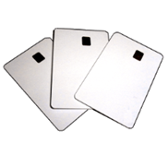
Smart cards offer massive parallelism cheaply.

Slide 39
Lookup can be parallelized.
L
R
R
L

Slide 40
Contributions of Shroud
Challenge | Approach | Result
Oblivious RAM algorithms are slow | Adapt Binary Tree algorithm to enable massive parallelism | Worst-case access time goes from days to seconds
Inter-device communication reveals information | Use deterministic communication schedule | Privacy preserved despite parallelism
Data aggregation creates bandwidth bottleneck | Leverage cryptography with oblivious aggregation | I/O time reduced by a factor of two or more
With many components, failures are frequent | Use deterministic operations and replication | Fault tolerance
Binary Tree algorithm assumes honest-but-curious adversary | Use Merkle trees to efficiently attest to states | Can tolerate Byzantine malicious adversary

Slide 41
Reporting the found block is trickier.

Slide 42
Reporting the found block creates a bottleneck.

Slide 43
An aggregation tree reduces bandwidth.

Slide 44
An aggregation tree reduces bandwidth.

Slide 45
An aggregation tree reduces bandwidth.

Slide 46
Even using an aggregation tree uses O(log log N) bandwidth.
Cryptography can let us leverage the untrusted servers!

Slide 47
Contributions of Shroud
Challenge | Approach | Result
Oblivious RAM algorithms are slow | Adapt Binary Tree algorithm to enable massive parallelism | Worst-case access time goes from days to seconds
Inter-device communication reveals information | Use deterministic communication schedule | Privacy preserved despite parallelism
Data aggregation creates bandwidth bottleneck | Leverage cryptography with oblivious aggregation | I/O time reduced by a factor of two or more
With many components, failures are frequent | Use deterministic operations and replication | Fault tolerance
Binary Tree algorithm assumes honest-but-curious adversary | Use Merkle trees to efficiently attest to states | Can tolerate Byzantine malicious adversary

Slide 48
Oblivious aggregation lets us avoid trusted component I/O

Slide 49
Oblivious aggregation uses a pseudorandom function.
A₁
A₂
A_{i} = PRF_{K}(Nonce || i)
A₂
A₃
A₃
A₄
Data
A_{n-1}
A_{n}
A₁
A_{n}

Slide 50
Oblivious aggregation uses a pseudorandom function.
A₁
A₂
A_{i} = PRF_{K}(Nonce || i)
A₂
A₃
A₃
A₄
Data
A_{n-1}
A_{n}
A₁
A_{n}
=
Data

Slide 51
Oblivious aggregation uses a pseudorandom function.
A₁
A₂
A_{i} = PRF_{K}(Nonce || i)
A₂
A₃
A₃
A₄
Data
A_{n-1}
A_{n}
A₁
A_{n}
=
Data

Slide 52
Contributions of Shroud
Challenge | Approach | Result
Oblivious RAM algorithms are slow | Adapt Binary Tree algorithm to enable massive parallelism | Worst-case access time goes from days to seconds
Inter-device communication reveals information | Use deterministic communication schedule | Privacy preserved despite parallelism
Data aggregation creates bandwidth bottleneck | Leverage cryptography with oblivious aggregation | I/O time reduced by a factor of two or more
With many components, failures are frequent | Use deterministic operations and replication | Fault tolerance
Binary Tree algorithm assumes honest-but-curious adversary | Use Merkle trees to efficiently attest to states | Can tolerate Byzantine malicious adversary

Slide 53
Parallelism means faults will be commonplace.

Slide 54
Deterministic operations make recovery feasible.
A₂
A₃

Slide 55
User accesses must be assigned increasing numbers.
# of accesses so far:
37
User request
# of accesses so far:
37
# of accesses so far:
37

Slide 56
User accesses must be assigned increasing numbers.
# of accesses so far:
38
Access38:
User request
Access38:
# of accesses so far:
38
# of accesses so far:
37

Slide 57
Failed coprocessors can be replaced via delegation.
# of accesses so far:
38
Delegation of responsibility
# of accesses so far:
38
Delegation of responsibility
# of accesses so far:
38

Slide 58
Talk outline
Overview
Background on oblivious RAM
Design of Shroud
Implementation
Performance evaluation
Future work
Conclusions

Slide 59
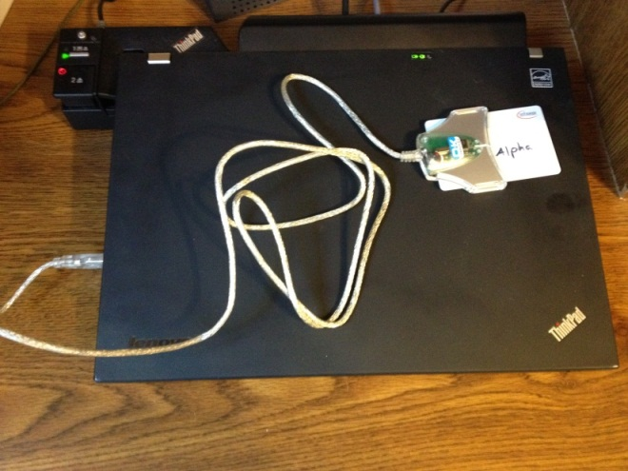
We built Shroud using smart cards as our trusted coprocessors.
Prototype
  Uses Infineon SLE 88 smart cards
  Runs on the 10 cards we have
Emulator
  Enables larger-scale tests
  Ran on 139 machines in MSR
Simulator
  Enables massive-scale simulation
Property | SLE 88
CPU | 66 MHz
Memory | 16 KB
I/O | 12 KB/s
3DES 1KB | 73 KB/s
SHA-1 1KB | 155 KB/s
Cost | $4
Physical security | FIPS 140-2 level 3

Slide 60
Workloads
Data set | Number of objects | Object size
Bing map tiles (zoom level 17) | 2³⁵ | 10 KB
Twitter tweets | 2³⁵ | 0.14 KB
Facebook images | 2³⁶ | 10 KB
Flickr photos | 2³² | 5 MB
Small-scale | 2²⁰ | 1 KB

Slide 61
System shows high parallelism.
Essentially linear speedup due to parallelism at low scales

Slide 62
System shows high parallelism.
Essentially linear speedup due to parallelism at low scales

Slide 63
Emulation on larger scale still shows high parallelism.
Essentially linear speedup due to parallelism at moderate scales

Slide 64
Emulation on larger scale still shows high parallelism.
Essentially linear speedup due to parallelism at moderate scales

Slide 65
There’s a massive amount of parallelism available.
Beyond about 10,000 cards, not much further available parallelism
Essentially linear speedup due to parallelism

Slide 66
However, performance is still poor.
Twitter tweets (2³⁵, 140 bytes each) take about 9 seconds to access
Map tiles (2³⁵, 10 KB each) take about 45 seconds to access
Flickr photos (2³², 5 MB each) take way too long to access

Slide 67
The performance bottleneck is smart card bandwidth.
I/O bandwidth just 12 KB/s!
Algorithm is O(RB + R log N)

Slide 68
Talk outline
Overview
Background on oblivious RAM
Design of Shroud
Implementation
Performance evaluation
Future work
Conclusions

Slide 69
We’re pursuing several ways to make Shroud faster.
Approach | Advantage | Challenges
Tamper-resistant FPGA | 3 GB/s bandwidth | Hardware customization, Higher cost
Secure execution infrastructure | >12 GB/s bandwidth | Low physical security, High invocation overhead
Make disk accesses trustworthy | More efficient ORAM protocol | Low physical security, Lots of code to verify
AMD-V
Intel TXT

Slide 70
FPGAs are promising.

Slide 71
Conclusions
Encryption insufficient for keeping user access patterns private
Oblivious RAM protocols can help, but are very slow
Parallelism can substantially reduce latency
  Need to carefully select and adapt algorithms
  Oblivious aggregation can add more speed
High-bandwidth trusted components are necessary for reasonable performance

Slide 72
Thank you!

