Slide 1







Memoir:
Practical State Continuity for Protected Modules
Bryan Parno
Jacob R. Lorch
John R. Douceur
James Mickens
Jonathan M. McCune

Slide 2
What is Memoir?
Memoir is a framework for building and using protected modules.
Our main challenge:
practical rollback resistance

Slide 3
An example of a protected module is an encryption key protector.
Key protector
lorch: 0905
Guess PIN
B588...
User | PIN | Recovery key | Disk key | # wrong
parno lorch johndo mickens mccune | 1111 0905 8034 9999 7654 | 90928389234 82378912837 29812982309 40954353458 32234528981 | A0FF23849083 B58890AD38E1 8293808E20CD 003827878EE3 C4358C380102 | 0 2 0 0 0
Recover

Slide 4
An example of a protected module is an encryption key protector.
Key protector
lorch: 1234?
Guess PIN
Wrong
User | PIN | Recovery key | Disk key | # wrong
parno lorch johndo mickens mccune | 1111 0905 8034 9999 7654 | 90928389234 82378912837 29812982309 40954353458 32234528981 | A0FF23849083 B58890AD38E1 8293808E20CD 003827878EE3 C4358C380102 | 0 2 0 0 0
3
Recover

Slide 5


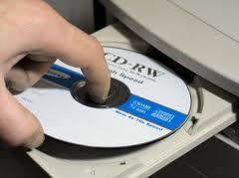
A protected module is data that’s only accessible via a small piece of code.
Code
Data

Slide 6
Protected modules are enabled by isolation architectures.
Small trusted computing base
Minimal code
Few devices
Untrusted system
Trusted system
Code
Storage
Secure execution infrastructure
Trusted hypervisor
Secure coprocessor

Slide 7
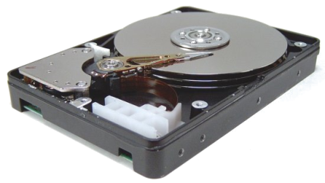
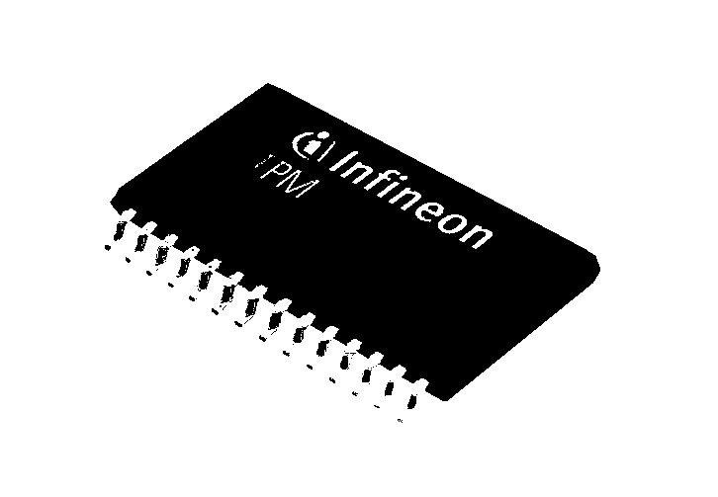
Isolation architectures have limited trusted storage.
Small trusted computing base
Minimal code
Few devices
Untrusted system
Trusted system
Disk device drivers
Code
Storage
TPM
1,280 bytes of NVRAM

Slide 8

Protected modules must leverage untrusted storage for their data.
Untrusted system
Trusted system
Bjcx
Data
Code
Signature
Storage
Data
Confidentiality
Data
Integrity

Slide 9
Cryptography is insufficient to prevent a rollback attack.
Untrusted system
Trusted system
Bjcx
Saved from 2008:
Code
Signature
Kebz
Storage
Signature

Slide 10
Encryption key protector illustrates the importance of rollback resistance.
Rolling back wrong-guess count allows dictionary attack.
Key protector
lorch: 1234?
lorch: 1235?
Guess PIN
Wrong
User | PIN | Recovery key | Disk key | # wrong
parno lorch johndo mickens mccune | 1111 0905 8034 9999 7654 | 90928389234 82378912837 29812982309 40954353458 32234528981 | A0FF23849083 B58890AD38E1 8293808E20CD 003827878EE3 C4358C380102 | 0 2 0 0 0
3
Recover

Slide 11
Rollback resistance is important for almost any stateful protected module.
Protected module | Consequences of rollback
Encryption key protector | Rolling back wrong-guess count allows a dictionary attack.
Privacy-preserving database using differential privacy | Rolling back privacy budget expenditure allows privacy safeguards to be subverted.
Monotonic counter | Rolling back counter updates makes the counter go backward.
Audit log | Rolling back the log tail subverts the append-only property of the log.
Game monitor | Rolling back recent activity lets player react to another player’s move after seeing it.
Access control list | Rolling back the removal of a user from a group restores access to the disallowed user.
… | …

Slide 12
Naive approach to rollback resilience creates problems.
Monotonic counter prevents rollback
But, it introduces new problems
  Potential for permanent unavailability after non-adversarial crash event
    OS crash or power failure
  Limited lifespan and slow operation
    due to trusted non-volatile write on each request

Slide 13
Memoir demonstrates how to make rollback resistance practical.
Memoir achieves rollback resistance yet still has...
  Crash resilience
  Long lifespan and fast operation, by avoiding writes to trusted NV storage
Non-adversarial crashes only
Adversarial attacks on availability are out of scope.

Slide 14
Talk outline
Problems with naive solutions
Design
Implementation (and what’s left out)
Evaluation
Conclusions and exciting surprise

Slide 15
A monotonic counter can provide rollback resistance.
Code
Initialize
Data
Hwpb
Signature
Tag: 1
1
NV
1

Slide 16
A monotonic counter can provide rollback resistance.
Code
Hwpb
Signature
Tag: 1
NV
1

Slide 17
A monotonic counter can provide rollback resistance.
Request
Code
Hwpb
Data
Signature
Tag: 1
1

Slide 18
A monotonic counter can provide rollback resistance.
Code
Data’
Data
Yzqr’
Signature
Tag: 2
2
1
2

Slide 19
Problem 1: The monotonic-counter solution is not crash-resilient.
Code
Yzqr’
Signature
Tag: 2
2
1
2

Slide 20
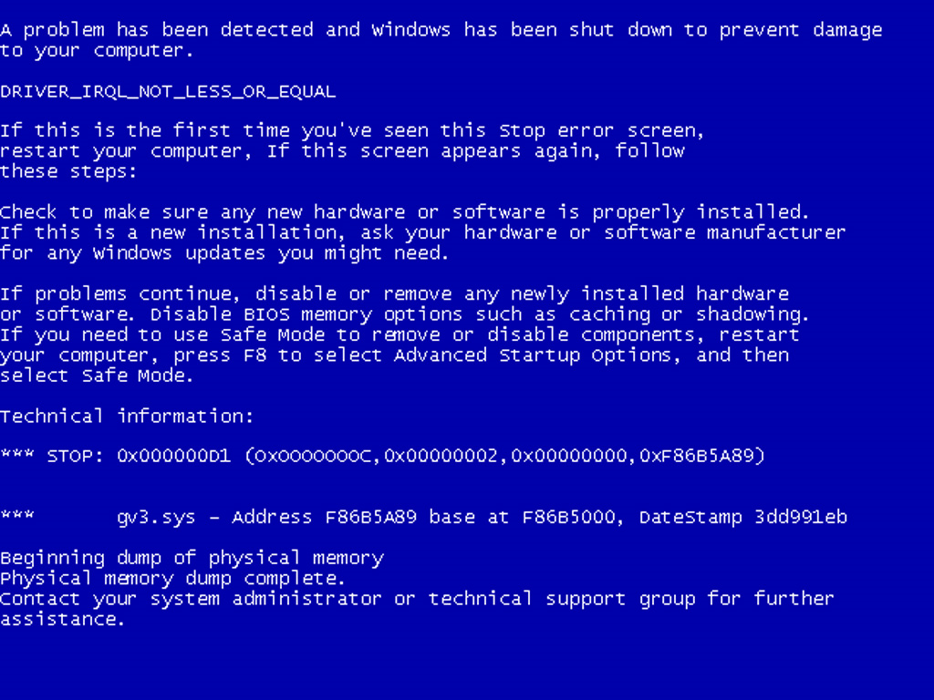

Slide 21
Problem 1: The monotonic-counter solution is not crash-resilient.
Request
Code
Yzqr
Window of vulnerability includes time to exit isolated environment, restore OS, write to disk.
Module permanently unusable
Signature
Tag: 1
2

Slide 22


Problem 2: Monotonic-counter frequently writes trusted NV storage.
1
2
3
4
an extra 30-80 ms per request
100,000 write-cycle limit
only 100,000 requests, ever!
lasts only 28 hours at
one request per sec

Slide 23
Two-phase commit also doesn’t work.
Performance problems
  Every request requires two invocations of isolation architecture, trusted randomness, an NV write
Fundamental security problem
  Adversary can observe side channels of request without performing it
For details, see paper.

Slide 24
Talk outline
Problems with naive solutions
Design
Implementation (and what’s left out)
Evaluation
Conclusions and exciting surprise

Slide 25
For crash resilience, Memoir requires request execution be deterministic.
Source of non-determinism | How to avoid it
Random numbers | Seed secure PRNG with random data during initialization
Multi-thread scheduling | Apply others’ research to make deterministic (future work)
Time | Exchange messages with a trusted time source

Slide 26
Memoir achieves crash resilience by storing a secure history summary.
Request₁
Request₂
Request₃
h
= Hash(Hash(Hash( ) || ) || ) …
Request
Deterministic code
Ewfg
Signature
Tag: h
5
h

Slide 27
Memoir achieves crash resilience by storing a secure history summary.
Request
h’
= Hash( || )
h
Request
Deterministic code
Data’
Urvi’
Data
Signature
Tag: h’
h’
5
h
h’

Slide 28
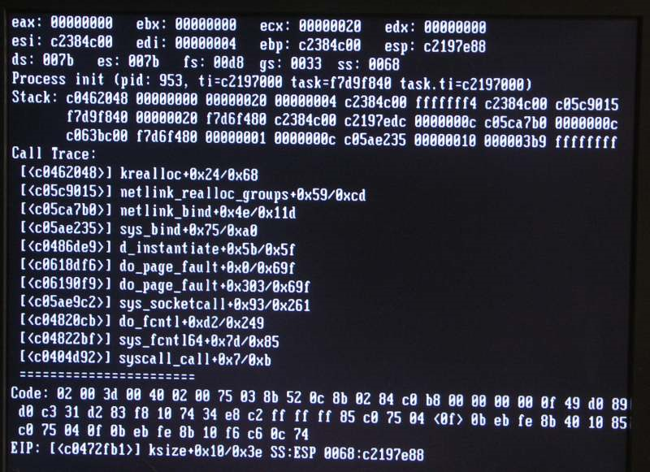

Slide 29
Memoir achieves crash resilience by storing a secure history summary.
Request
h’
= Hash( || )
h
Request
Deterministic code
Ewfg
Signature
Tag: h
Since request execution is deterministic, replaying will produce the same output.
Thus, it is safe to replay the last request.
h’

Slide 30
Memoir avoids non-volatile writes by using trusted volatile storage.
TPM
Platform
Configuration
Registers
PCR
PCR
PCR
PCR
A PCR can only be modified by extending it:
p’
= Hash( || )
p
h
or by rebooting, causing it to be zeroed.

Slide 31
Memoir avoids NV writes by using two-part history summaries.
n’
= Hash( || )
n
p
Deterministic code
At 1 reboot per day, 1 request per sec, module can last
136 years instead of the monotonic counter’s 28 hours.
Before reboot, a checkpoint routine must run, to incorporate trusted volatile state into trusted NV state.
n
Written twice per boot
n’
h
Updated on every request
p
p
0

Slide 32
Memoir must ensure correctness if an adversary doesn’t checkpoint.
Adversary can clear PCR without running checkpoint routine
  Guard bit in trusted NV storage indicates whether PCR should be non-zero
Adversary can extend PCR
  Extension secret used on each extension
For details, see paper.

Slide 33
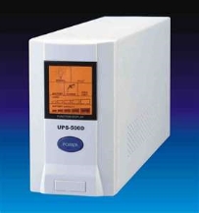
Checkpoint routine must run before a non-adversarial reboot.
For OS crashes:
System Management Interrupt Handler
Checkpoint routine
For power failures:

Slide 34
Memoir improves dramatically on the monotonic-counter solution.
Monotonic counter | Memoir
OS crash or power failure can make module permanently unusable | Non-adversarial crashes not a problem
Lasts only 28 hours at one request per sec | Lasts 136 years even with one reboot per day
Spends 30-80 ms per request to write NVRAM | Spends 15-25 ms per request to access a PCR

Slide 35
Our paper covers more than this talk!
Proof of correctness of Memoir protocols
  Machine-checked TLA+
  Full details in 390-page tech report
Supporting unlimited modules with constant NVRAM and one PCR
Suggestion for minor TPM modification to solve NVRAM issue
Obviating trusted randomness in execution

Slide 36
TLA+ High-Level Memoir Spec
CONSTANT InputType, OutputType, PublicStateType, PrivateStateType
ServiceResultType 
[ newPublicState : PublicStateType; newPrivateState : PrivateStateType; output : OutputType ]
CONSTANT Service(_, _, _)
CONSTANT InitialAvailableInputs, InitialPublicState, InitialPrivateState
VARIABLE AvailableInputs, ObservedOutputs, PublicState, PrivateState
MakeInputAvailable 
∃ input ∈ InputType :
∧ input ∉ AvailableInputs
∧ AvailableInputs' = AvailableInputs ∪ {input}
∧ UNCHANGED ObservedOutputs
∧ UNCHANGED PublicState
∧ UNCHANGED PrivateState
AdvanceService 
∃ input ∈ AvailableInputs :
LET
sResult 
Service(PublicState, PrivateState, input)
IN
∧ PublicState' = sResult.newPublicState
∧ PrivateState' = sResult.newPrivateState
∧ ObservedOutputs' =
ObservedOutputs ∪ {sResult.output}
∧ UNCHANGED AvailableInputs
Init 
∧ AvailableInputs = InitialAvailableInputs
∧ ObservedOutputs = {}
∧ PublicState = InitialPublicState
∧ PrivateState = InitialPrivateState
Next  MakeInputAvailable ∨ AdvanceService
Spec  Init ∧ □[Next]⟨AvailableInputs, ObservedOutputs, PublicState, PrivateState⟩

Slide 37
Talk outline
Problems with naive solutions
Design
Implementation (and what’s left out)
Evaluation
Conclusions and exciting surprise

Slide 38
Implementation is a framework for making and using protected modules.
Untrusted system
Trusted system, isolated by Flicker
Protected module
Memoir tools
MemoirLib
Service
Service
initialize_state
handle_request
serialize_state
deserialize_state
Client
create_module.exe
n
p
exec_request.
exe
Pseudo-random
numbers
Memoir ensures confidentiality, integrity, rollback resilience, crash resilience, and NV avoidance.
Memoir makes it easy to write protected modules.

Slide 39
Some elements of our design are not yet implemented in our prototype.
System management interrupt handler
Module management module
  Enables multiple modules to use constant NVRAM and one PCR
These are future work.

Slide 40
Talk outline
Problems with naive solutions
Design
Implementation (and what’s left out)
Evaluation
Conclusions and exciting surprise

Slide 41
Our evaluation results answer three main questions.
How much does Memoir increase TCB size?
How fast can modules run with Memoir?
In particular, how useful is NVRAM avoidance?

Slide 42
Our experimental platform is a standard PC supported by Flicker.
Isolation mechanism: Flicker 0.4 secure execution infrastructure
HP Compaq 6005 Pro PC
  3.0 GHz AMD Athlon II X2 CPU with AMD-V
  2.0 GB memory, 160 GB SATA disk, Infineon TPM
Linux 2.6.31
Only one core enabled since Flicker doesn’t support multiprocessors

Slide 43
Memoir contribution to TCB
Only some of this code is safety-critical. Bugs in the tools can only hamper availability.
TCB increase is modest, much smaller than disk drivers.
Most of the code is well-tested cryptography code publicly and widely available.
Bugs can only lead to liveness violations.
Safety depends on this code.

Slide 44
Execution time of no-op module
Avoiding NVRAM writes saves 17 ms (and also increases module lifespan).
Rollback resistance adds about 33 ms, to write trusted NVRAM.
Encrypting and signing adds about 7 ms.
On this architecture, Flicker takes about 50 ms, mostly for late-launch.
Crash resilience adds about 43 ms, due to synchronous disk write before executing request.
Flicker
baseline
+ confidentiality
and integrity
+ crash
resilience
and rollback
resistance
+ avoiding
trusted
NV writes

Slide 45
Execution time of other modules
We built several prototype protected modules with Memoir.
Similar performance to no-op service, except different amounts of time to write state to disk.
Encryption key protector
Privacy-preserving database
Trusted monotonic counter
Without NV avoidance
With NV avoidance

Slide 46
Talk outline
Problems with naive solutions
Design
Implementation (and what’s left out)
Evaluation
Conclusions and exciting surprise

Slide 47
Conclusions
Protected modules with rollback resistance are a powerful, general tool
Memoir is a practical means to achieve them
  Crash resilience: achieved via module determinism and history summary tagging
  Long lifespan: achieved by avoiding NVRAM writes with two-part history summaries
Machine-checked proof demonstrates Memoir is correct

Slide 48
Code publicly available!
Memoir
http://research.microsoft.com/memoir
Flicker, now for Linux and Windows
http://flickertcb.sourceforge.net/
Trusted platform simulator
TrustSim, available from Memoir URL above

