Slide 1
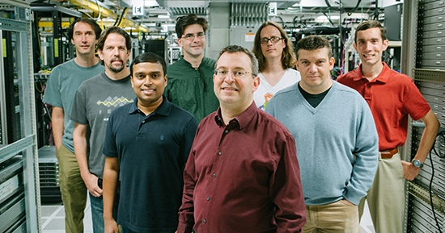

IronFleet:
Proving Practical Distributed Systems Correct
Chris Hawblitzel Jon Howell Manos Kapritsos Jacob R. Lorch
Bryan Parno Michael L. Roberts Srinath Setty Brian Zill

Slide 2
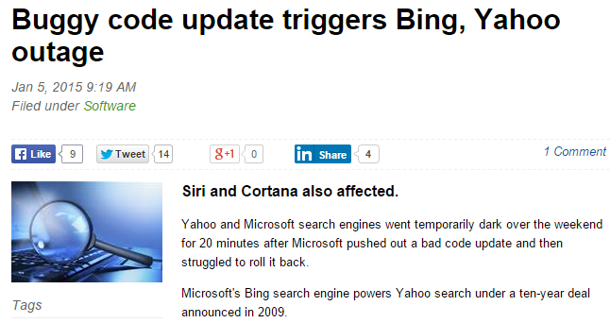
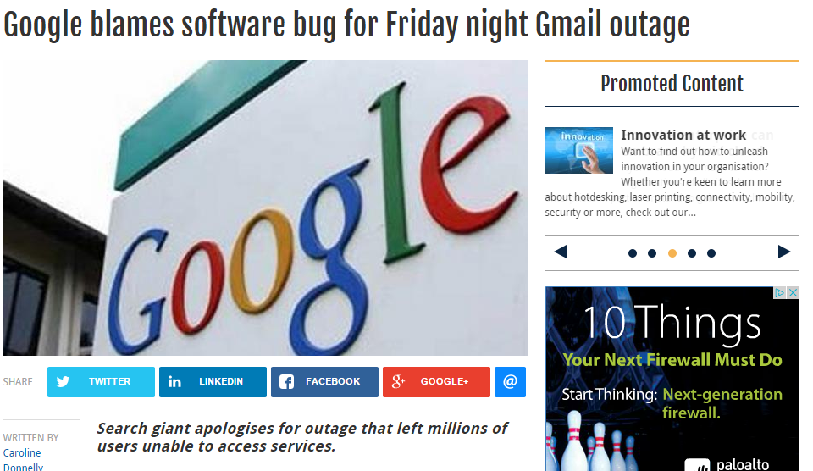
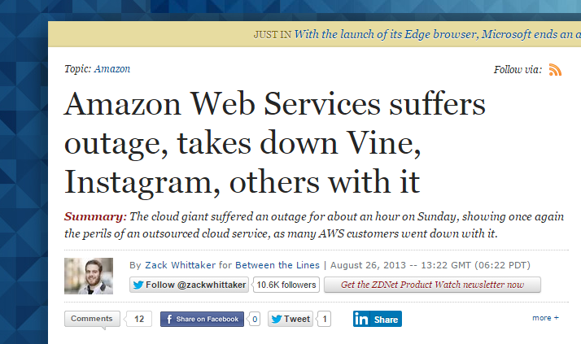

Slide 3
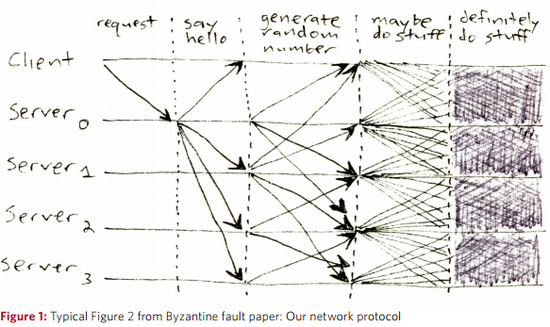
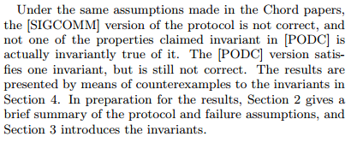
[Mickens 2013]
“not one of the properties claimed invariant in [PODC] is actually true of it.”
[Zave 2015]

Slide 4
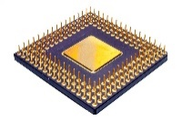
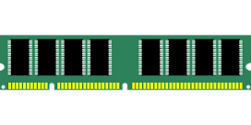
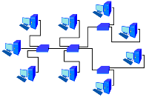



IronFleet
Implementations are correct, not just abstract protocols
We show how to build complex, efficient distributed systems whose implementations are provably safe and live.
First mechanical proof of liveness of a non-trivial distributed protocol, let alone an implementation
Proof is subject to assumptions, not absolute
Proofs are machine-checked
System will make progress given sufficient time,
e.g., it cannot deadlock or livelock
Spec

Slide 5

What we built
Paxos
IronRSL
Replicated state library
B
A
C
You can do it too!
Complex with many features:
state transfer
log truncation
dynamic view-change timeouts
batching
reply cache
IronKV
Sharded key-value store

Slide 6
IronFleet extends state-of-the-art verification to distributed systems
IronFleet
Toolset modifications
Methodology
Libraries
Key contributions of our work:
Two-level refinement
Concurrency control via reduction
Always-enabled actions
Invariant quantifier hiding
Automated proofs of temporal logic
Discussed in talk
Discussed in paper

Slide 7



IronFleet builds on existing research
Recent advances
Single-machine system verification
SMT solvers
IDEs for automated software verification
Demo: Provably correct marshalling
method MarshallMessage(msg:Message) returns (data:array<byte>)
requires !msg.Invalid?;
ensures ParseMessage(data) == msg;

Slide 8

Not writing unit tests and having it work the first time: priceless

Slide 9
Outline
Introduction
Methodology
Methodology overview
Two-level refinement
Concurrency containment
Liveness
...
Libraries
Evaluation
Related work
Conclusions

Slide 10


Running example: IronRSL replicated state library
Paxos
B
A
C
Safety property:
Equivalence to single machine
Liveness property:
Clients eventually get replies

Slide 11
Specification approach:
Rule out all bugs by construction
Invariant violations
Parsing errors
Race conditions
Marshalling errors
Integer overflow
Deadlock
Buffer overflow
Livelock
...

Slide 12
Outline
Introduction
Methodology
Methodology overview
Two-level refinement
Concurrency containment
Liveness
...
Libraries
Evaluation
Related work
Conclusions

Slide 13

Background: Refinement
[Milner 1971, Park 1981, Lamport 1983, Lynch 1983, ...]
Spec
S0
S1
S2
S3
S4
S5
S6
S7
Implementation
I0
I1
I2
I3
I4
method Main()

Slide 14
Specification is a simple, logically centralized state machine
type SpecState = int
function SpecInit(s:SpecState) : bool
{
s == 0
}
function SpecNext(s:SpecState,
s’:SpecState) : bool
{
s’ == s + 1
}
function SpecRelation(realPackets:set<Packet>,
s:SpecState) : bool
{
forall p, i :: p in realPackets &&
p.msg == MarshallCounterVal(i) ==> i <= s
}

Slide 15
Implementation
method Main()
{
var s:ImplState;
s := ImplInit();
while (true) {
s := EventHandler(s);
}
}
Host implementation is a single-threaded event-handler loop

Slide 16
Proving correctness is hard
Subtleties of distributed protocols
Complexities of implementation
Maintaining global invariants
Using efficient data structures
Dealing with hosts acting concurrently
Memory management
Ensuring progress
Avoiding integer overflow

Slide 17
Two-level refinement
Spec
S0
S1
S2
S3
S4
S5
S6
S7
Protocol
P0
P1
P2
P3
P4
Implementation
I0
I1
I2
I3
I4

Slide 18
Protocol layer
Spec
Protocol
Implementation
seq<int>
array<uint64>
function ProtocolNext(s:HostState, s’:HostState) : bool
method EventHandler(s:HostState) returns (s’:HostState)
type Message = MessageRequest() | MessageReply() | ...
type Packet = array<byte>

Slide 19
Protocol layer
Spec
Protocol
Implementation
Distributed system model

Slide 20
Protocol layer
Spec
S0
S1
S2
S3
S4
S5
S6
S7
Protocol
P0
P1
P2
P3
P4
Impl
I0
I1
I2
I3
I4
method EventHandler(s:HostState) returns (s’:HostState)
ensures ProtocolNext(s, s’);

Slide 21
Outline
Introduction
Methodology
Methodology overview
Two-level refinement
Concurrency containment
Liveness
...
Libraries
Evaluation
Related work
Conclusions

Slide 22
Cross-host concurrency is hard
Host A Step 1
Host A Step 2
Host A Step 3
Host B Step 1
Host B Step 2
Host B Step 3
Hosts are single-threaded,
but we need to reason about concurrency of different hosts

Slide 23
Cross-host concurrency is hard
Requires reasoning about all possible interleaving of the substeps

Slide 24
Concurrency containment strategy
Enforce that receives precede sends in event handler
Assume in proof that all host steps are atomic

Slide 25
Why concurrency containment works
Reduction argument: for every real trace...

Slide 26


Why concurrency containment works
Reduction argument: for every real trace...
...there’s a corresponding legal trace with atomic host steps
Constraining the implementation lets us think of the entire distributed system as hosts taking one step at a time.

Slide 27

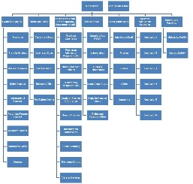

Most of the work of protocol refinement is proving invariants
S0
S1
S2
S3
S4
Complicated!
P
P
P
P
P
SystemInit(states[0]) ==> P(0)
Nearly all cases proved automatically, without proof annotations
P(j) && SystemNext(states[j], states[j+1]) ==> P(j+1)
automated theorem proving

Slide 28
Outline
Introduction
Methodology
Methodology overview
Two-level refinement
Concurrency containment
Liveness
...
Libraries
Evaluation
Related work
Conclusions

Slide 29

One constructs a liveness proof by finding a chain of conditions
...
C₀
C₁
C₂
C₃
C₄
C_{n}
Assumed starting condition
Ultimate goal

Slide 30
Simplified example
Client sends request
Paxos
B
A
Replica receives request
C
Replica suspects leader
Leader election starts

Slide 31
Some links can be proven from assumptions about the network
Client sends request
Replica receives request
Replica suspects leader
Network eventually delivers packets in bounded time
Leader election starts

Slide 32
Most links involve reasoning about host actions
Client sends request
Replica has request
Replica suspects leader
One action that event handler can perform is “become suspicious”
Leader election starts

Slide 33
Lamport provides a rule for proving links
C_{i}
C_{i+1}
Action
Enablement poses difficulty for automated theorem proving
Tricky things to prove:
Action is enabled (can be done) whenever C_{i} holds
If Action is always enabled it’s eventually performed

Slide 34

Always-enabled actions
Handle a client request
If you have a request to handle, handle it;
otherwise, do nothing

Slide 35
Always-enabled actions allow a simpler form of Lamport’s rule
C_{i}
C_{i+1}
Action
Tricky things to prove:
Action is enabled (can be done) whenever C_{i} holds
If Action is always enabled it’s eventually performed
Action is performed infinitely often

Slide 36
To execute each action infinitely often, event handler is a simple scheduler
ProtocolNext
Action 1
Action 9
Action 2
Action 8
Action 3
Action 7
Action 4
Action 6
Action 5
Straightforward to prove that if event handler runs infinitely often, each action does too

Slide 37
Always-enabled actions pose a danger we’re immune to
Always-enabled actions can create an unimplementable protocol
Handle a client request
We’ll discover this when we try to implement it!

Slide 38
Outline
Introduction
Methodology
Methodology overview
Two-level refinement
Concurrency containment
Liveness
...
Libraries
Evaluation
Related work
Conclusions

Slide 39
We built general-purpose verified libraries
Proof
Implementation
Assumptions about hardware and network
Temporal logic
Induction
Liveness
...
S0
S1
C_{i}
S2
C_{i+1}
uint64
uint64
Parsing and marshalling
P
P
P
Action

Slide 40
Much more in the paper!
Invariant quantifier hiding
Embedding temporal logic in Dafny
Reasoning about time
Strategies for writing imperative code
Tool improvements

Slide 41
Outline
Introduction
Methodology
Methodology overview
Two-level refinement
Concurrency containment
Liveness
...
Libraries
Evaluation
Related work
Conclusions

Slide 42
Line counts
Common Libraries
IronRSL
IronKV
Few lines of spec in TCB
Safety proof to code ratio is 5:1, comparable to Ironclad (4:1) and seL4 (26:1)
Including liveness, proof-to-code ratio is 8:1

Slide 43
IronRSL performance
Adding batching (~2-3 person-months) improved performance significantly
Reasoning about the heap is currently difficult
Each optimization requires a proof of equivalence
We trade some performance for strong correctness,
but no fundamental reason verified code should be slower
Separating implementation from protocol allows performance improvement without disturbing proof

Slide 44
IronKV performance
Get
Set
Throughput 25%-75% of Redis

Slide 45
Related work
Single-system verification
  seL4 microkernel [Klein et al., SOSP 2009]
  CompCert C compiler [Leroy, CACM 2009]
  Ironclad end-to-end secure applications [Hawblitzel et al., OSDI 2014]
Distributed-system verification (but no liveness properties)
  EventML replicated database [Rahli et al, DSN 2014]
    Framework with components useful for building verified distributed systems
    Proof only about consensus algorithm, not state machine replication
    Uses only one layer of refinement, so all optimizations done by compiler
  Verdi framework and Raft implementation [Wilcox et al., PLDI 2015]
    Uses interactive theorem proving to build verified distributed systems
    Missing features like batching, state transfer, etc.
    Uses system transformers, a cleaner approach to composition

Slide 46
Conclusions
It’s now possible to build provably correct distributed systems...
...including both safety and liveness properties
...despite implementation complexity necessary for features and performance
To build on our code:
https://github.com/Microsoft/Ironclad
To try Dafny: http://rise4fun.com/dafny
Thanks for your attention!

