Slide 1

Virtualize Things
Transform the Enterprise
April, 2014

Slide 2



The Internet of Things drives the 4th Industrial Revolution
Total economic IoT impact: 2,5 Trn$ - 6 Trn$ by 2025
‘Internet of Everything’ 2013 Value Index Survey:
‘Total Value at Stake’ 2013-2022: 14Trn$
7,7 Trn$: Enterprises process optimization
3,7 Trn$: improved Customer Experience;
3,0 Trn$: Innovation (new services).
4.5 Trn$ global IoT impact by 2020
Sources: postscapes.com, www.cisco.com

Slide 3
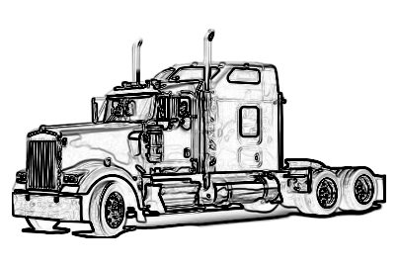
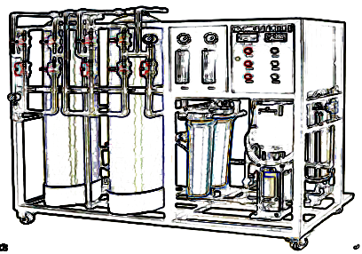
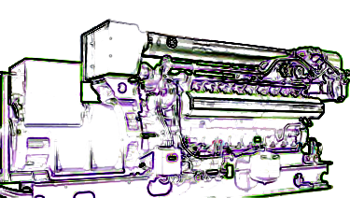
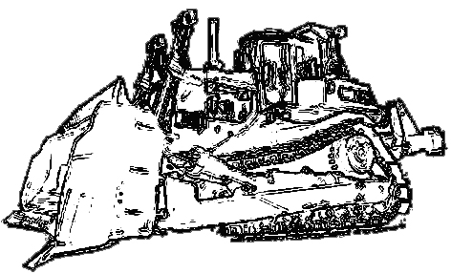
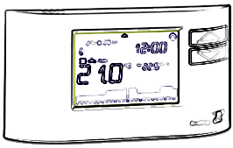

The Power of Data
Sales & MARKETING
R&D, production
service, operations
NEW BUSINESS MODELS
New product features
Things COLLABORATION

Slide 4
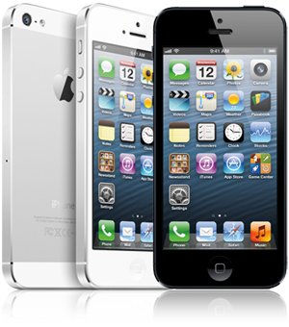

‘Things’ becomes ‘Platforms’
Communication + transactions
THINGS
SERVICES
User behavior (training)
Cost optimization
Pay-per-use

Slide 5
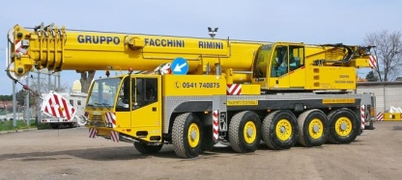


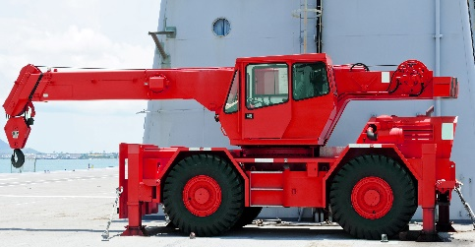
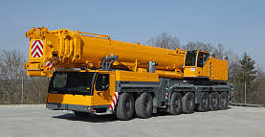
Asset Mgmt.
vendor #1
Maintenance
vendor #2
Common Data Model & Interaction Framewok
…
vendor #3

Slide 6
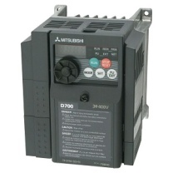
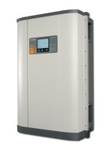
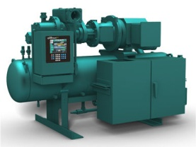
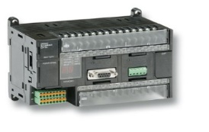
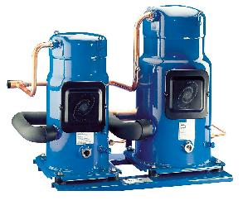
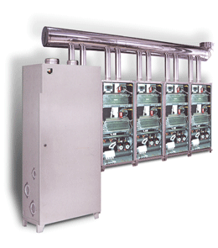
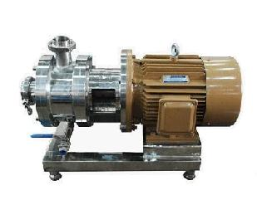
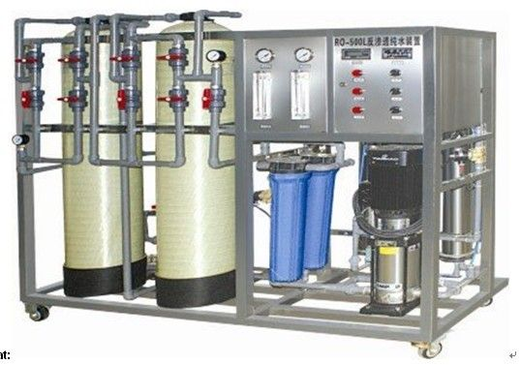
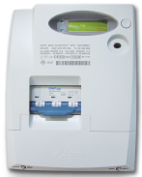
Many things already talk
many languages, different interfaces
‘things interoperability’ is the gap …

Slide 7
… and if not solved …
some Big Data
Internet of few Things

Slide 8









The Solution:
‘Virtualize’ Things by mapping its ‘DNA’ …
X-PANGO⁽¹⁾
Software Things
(1) Patenting in process

Slide 9




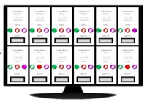
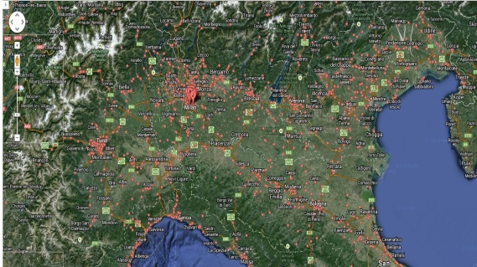
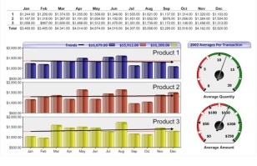




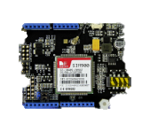

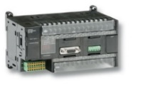

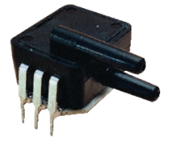
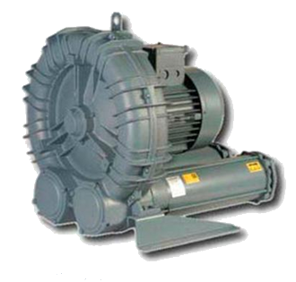

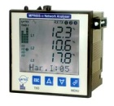
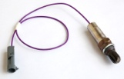
... connect within our Internet-of-Things Platform and Applications …
Applications
Dashboards
BI Tools
SN notifications
External
Applications
Integration
Alleantia Cloud Services
Gateways & Aggregators & Local Applications
MinBox
MaxBox
(Appliance)
Controllers
Devices & Sensors

Slide 10
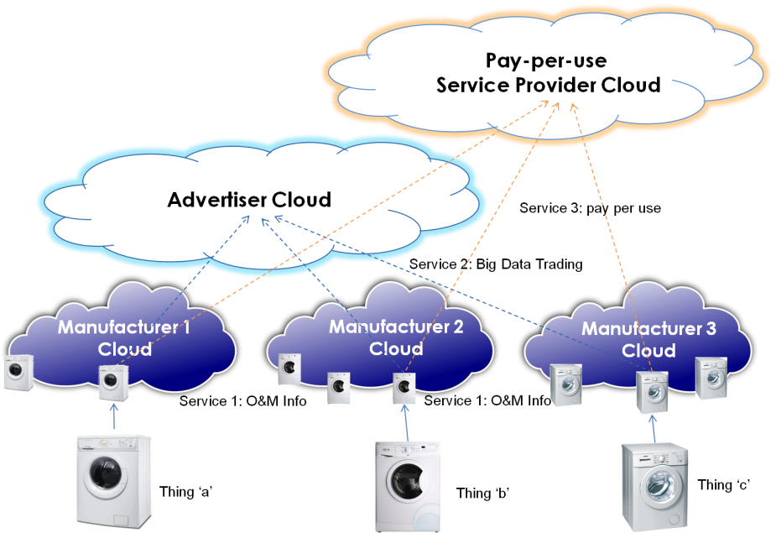
… to the Clouds of Things …
One Thing, Multiple Services
One Service, Multiple Things

Slide 11
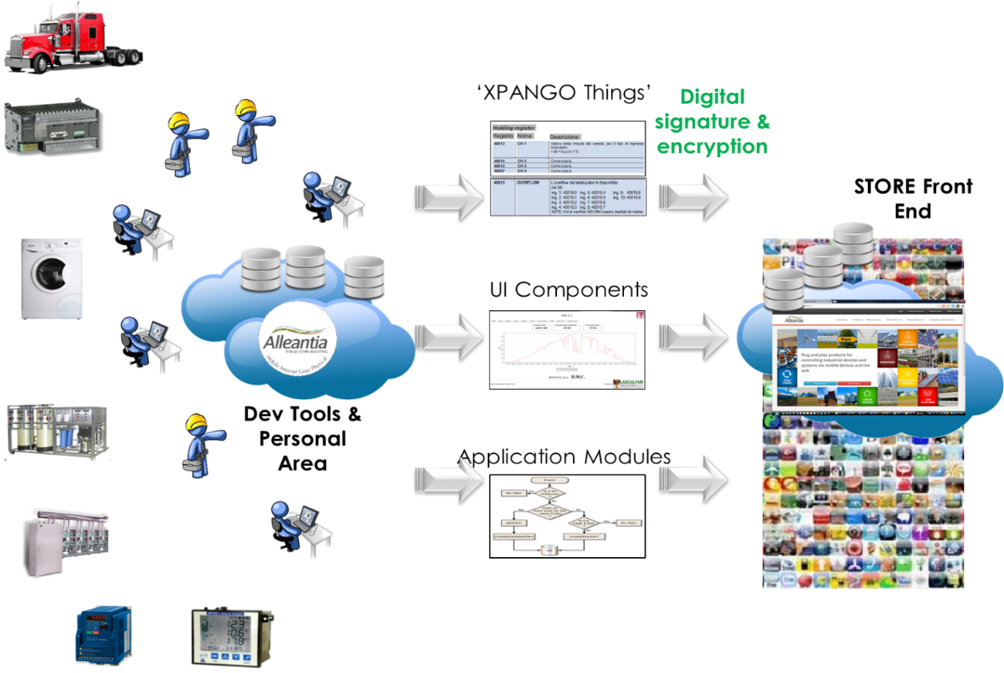
… and to the Internet of Things Store(s)
Software Things, Applications, Services, Data
Community (Open) Store
Enterprise (Private) Stores

Slide 12

Our Distinctive Advantage:
Integrating Things + OTS Products
Competitors’ Footprint
Partners’ Solutions & ad hoc integration
Local Gateway
Cloud Data & Apps
COM
UPST.
API
DWST.
API
Enterprise Apps
THINGS
Alleantia Footprint

Slide 13
The Competitors’ Common Gap:
Knowledge of Things
  The main issue that ALL such vendors are overlooking is the ‘dirty work’ of integrating Things with platform’s API. Either a proprietary strategy is implemented (e.g. SmartThings) driving sales of compliant smart devices, or a Partner strategy implementing ‘gateways’ for specific devices (e.g. Thingworx), or a project-specific integration is performed (e.g. Prosyst).
Thing
Thing
COM
Local Controller
Internet
Connect.
Cloud Apps
API
Other Apps
Thing
Alleantia
√
√
√
√
√
√
Axeda
Thingworks
ILSTech
Prosyst
Seecontrol
Evrythng
X
X
X
X
X
X
X
X
X
X
X
X
X
X
X
X
√
X
√
√
√
√
√
√
√
√
√
√
√
√
√
√
√
√
√
√

Slide 14
What we sell to whom
Engineering and O&M Contractors
System Integrators
Equipment Manufacturers
Enterprises (Facility Mgmt., Ops, ICT)
Large Telco & Cloud Providers
Applications & Appliances
Cloud Services
Platform licenses
Cloud Services
Platform licenses
Direct, indirect and Online sales channels

Slide 15
Alleantia today
150+ paid systems deployed, 20+ customers (and growing)
2,500+ connected things, 350,000+ uptime hours
2 Product lines (Industrial Automation, Renewable Energy)
1 Country (Italy), 1 Active Distributor, others to come

Slide 16







Great teams do great stuff
Strong Core Developers
Andrea, SW Boss
Davide, SW Dev
Antonio, CEO
Stefano, CTO
Gavino, Chairman
Great Advisors
20+ years in TLC, large ICT projects, new Enterprises
serial entrepreneur, 12+ years in industrial automation
12+ years in Corporate Management
Francesco Torelli, Legal
Alberto Giusti
Investor Rel.

Slide 17
Our mid-term roadmap
2014
2015
2016
COUNTRIES/REGIONS
2
5
8
DISTRIBUTORS
2
6
17
SYSTEMS / LICENSES DEPLOYED
1000+
140k
1M
REVENUES
240k€
1,5M€
7M€
EBITDA
(Neg.)
(Neg.)
2M€
Notes:
The strategy reflects in target metrics:

Slide 18
Financial Needs
International investor in key ‘Enterprise IoT’ Countries
1M€ Early Seed
Focus on Product, Partnerships, International M&S

Slide 19





WWW.ALLEANTIA.COM
www.linkedin.com/company/alleantia-s-r-l-
www.facebook.com/Alleantia
@Alleantiasrl
info@alleantia.com

