Slide 1

The Enterprise Internet of Things Company
April, 2014
Notes:
Hi, I’m ……………, …………….. of Alleantia.
Alleantia is an Internet of Things Software & Service Provider

Slide 2
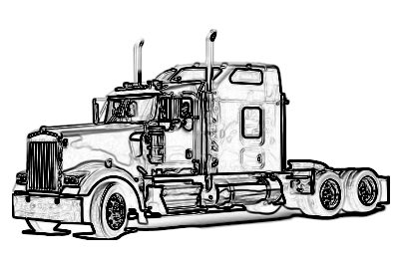
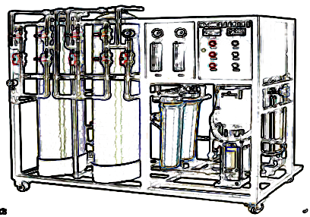
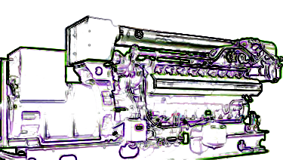
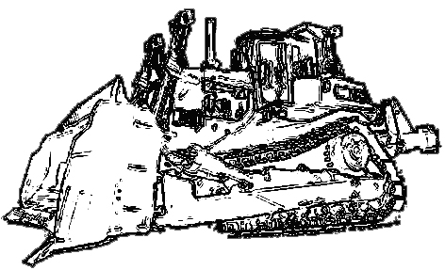
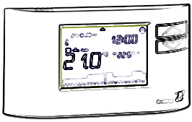

The Power of Data
Sales & MARKETING
R&D, production
service, operations
NEW BUSINESS MODELS
New product features
Things COLLABORATION
Notes:
IT-driven, optimized Operations & Maintenance, deeper business intelligence on equipment data, reliable physical asset management, new business models, full data-driven user behavior analysis

Slide 3
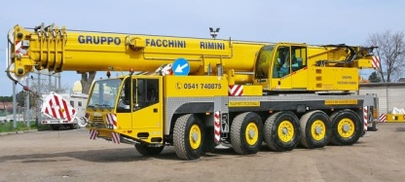


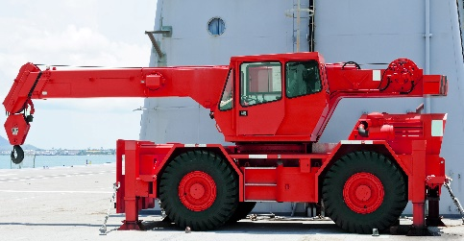
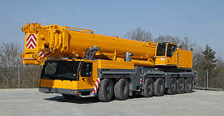
Asset Mgmt.
vendor #1
Maintenance
vendor #2
Common Data Model & Interaction Framewok
…
vendor #3
Notes:
Example: Multi-vendor heavy equipment usage

Slide 4
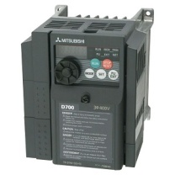
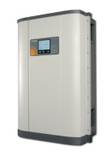
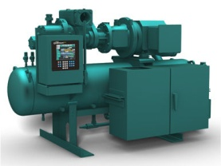
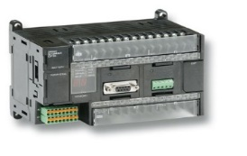
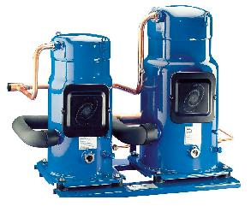
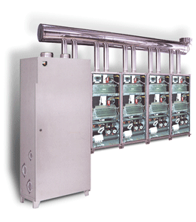
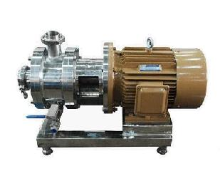
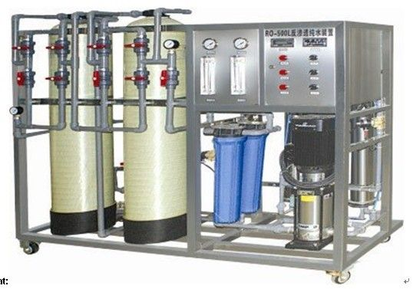
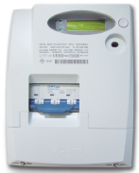
Many things already talk
many languages, different interfaces
‘things interoperability’ is the gap …
Notes:
These features could implemented today, because many existing things already talk. But, they do with their own language (there’s a huge mess), so there are two options: buy multiple proprietary solutions or build a customized solution, using expert integrators. Both options have high cost and long time to deploy, so often is not affordable.
Alleantia has THE SOLUTION for THE’ IOT PROBLEM, the Things Interoperability.
… and if not solved …

Slide 5
some Big Data
Internet of few Things

Slide 6


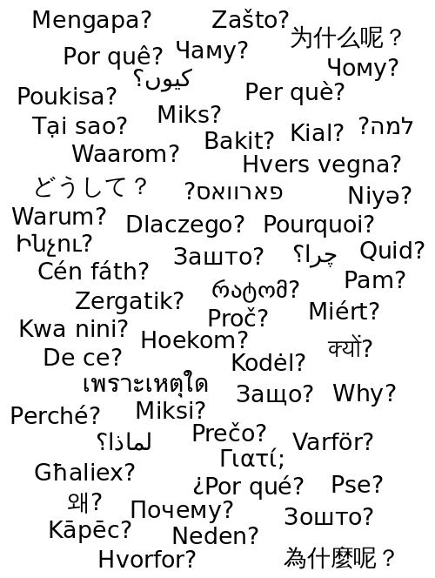







‘Virtualize’ Things by mapping its DNA …
X-PANGO⁽¹⁾
Software Things
(1) Patenting in process
Notes:
Similar to the ‘DNA’ for livings, the ‘Things DNA’ can tell anything about an Equipment and its environment, and is mapped into software objects. The ‘Software Things’, once created, are stored in libraries, ready for use and reusable, for streamlining things integration (it really takes seconds) into Applications built on Alleantia IoT Platform.
The ‘Things DNA Mapping’ method has several ‘unfair advantages’:
build once, reuse infinite times (of course);
can be implemented by anybody using our web wizards and technical information available from vendors
is applicable to any kind of object, irrespective of protocol, vendor, communication setup etc.
high communication efficiency between 'things' and with applications.
Once in the Library, the Things can be connected in few seconds to Alleantia IoT applications, with huge time and cost reduction
Any maker, technician and even end-user will be able to create and add new devices to IoT applications
Any developer can implement new IoT applications not requiring expertise on physical devices

Slide 7




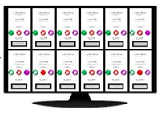
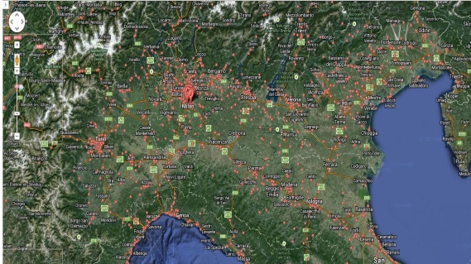
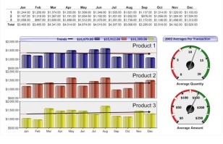




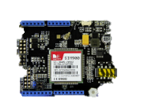

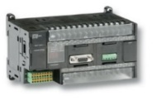

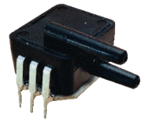
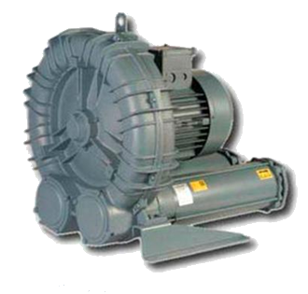

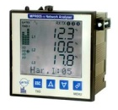
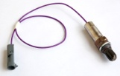
... connect within our Internet-of-Things Platform and Applications …
Applications
Dashboards
BI Tools
SN notifications
External
Applications
Integration
Alleantia Cloud Services
Gateways & Aggregators & Local Applications
MinBox
MaxBox
(Appliance)
Controllers
Devices & Sensors
Notes:
Around XPANGO, we have built a full software platform that will support many applications, devices and usage. Our objective is to enable any maker, technician and even end-user to add new devices to IoT applications, and any developer to implement new applications not needing expertise on physical devices

Slide 8
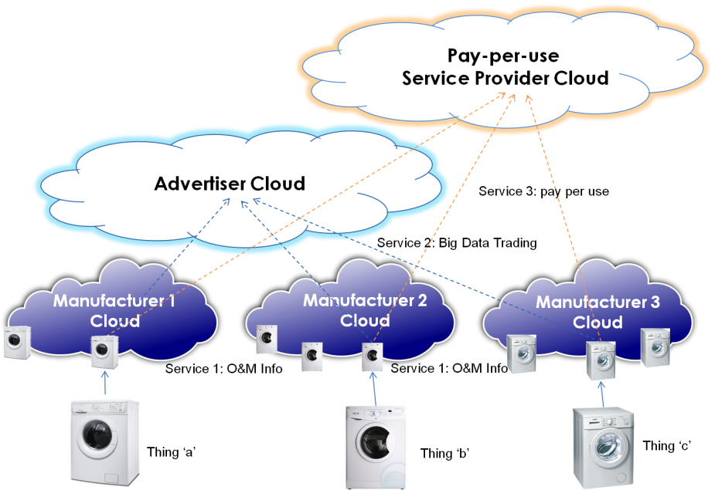
… to the Clouds of Things …
One Thing, Multiple Services
One Service, Multiple Things
Notes:
The ‘Clouds of Things’ are ‘service clouds’ where different applications and users can access the ‘Thing’ for different uses, with a managed concurrent access to
Big Data trading of information about Things usage and customer behavior;
Transactional Value Added Services on ‘Things’, such as pay machinery per use, partner- or sponsored-use
last not least, IoT Application Services for Enterprises : why each Enterprise should build and run its own IoT Platform? We do it for them!
Because, Things are made for a purpose that is not ‘communicating’ !

Slide 9
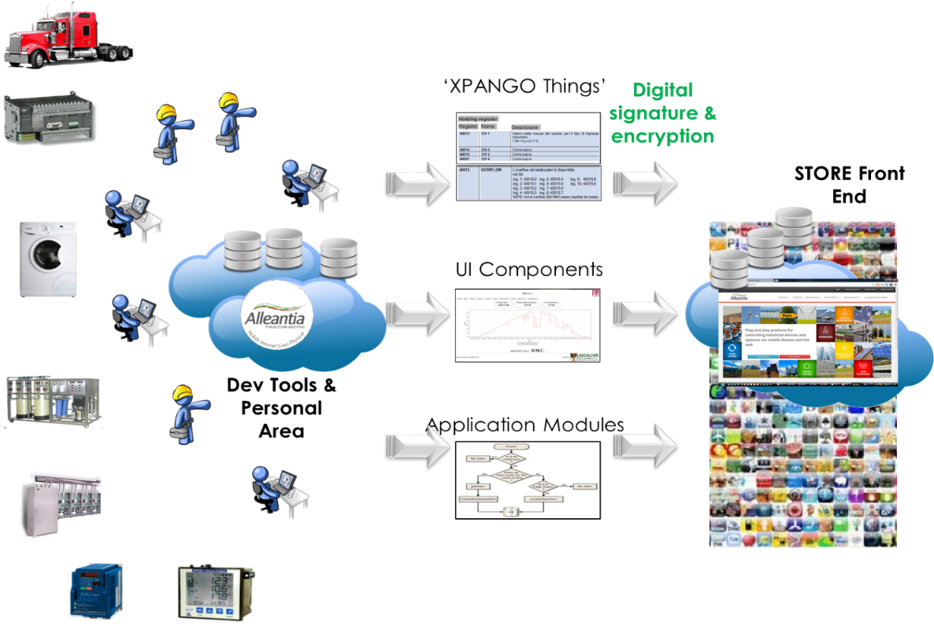
… and to the Internet of Things Store(s)
Software Things, Applications, Services, Data
Community (Open) Store
Enterprise (Private) Stores
Notes:
The IoT Store is where developers, makers and end users will be able to build, share, sell and buy Software Things and Applications to be used within Alleantia IoT Platform. Leveraging community and crowdsourcing– for Community and for Enterprises -, brings a huge advantage in terms of scalability and expandability.

Slide 10

Our Distinctive Advantage: Integrating Things + OTS Products
Competitors’ Footprint
Partners’ Solutions & ad hoc integration
Local Gateway
Cloud Data & Apps
COM
UPST.
API
DWST.
API
Enterprise Apps
THINGS
Alleantia Footprint
Notes:
2 kinds of competitors
Traditional SCADA software providers – we target a segment they can’t deal with
Key competitors are the new IoT platform providers. They focus much on API (approach is ‘use my API / Agent in your object and we’ll talk with’) and not on ‘Things’. We will beat them on ‘owning’ the Things. Alleantia commercial competitor’s map in IoT Application Platforms is growing, attracting substantial investments.

Slide 11
What we sell to whom
Engineering and O&M Contractors
System Integrators
Equipment Manufacturers
Enterprises (Facility Mgmt., Ops, ICT)
Large Telco & Cloud Providers
Applications & Appliances
Cloud Services
Platform licenses
Cloud Services
Platform licenses
Direct, indirect and Online sales channels
Notes:
Here’s our (B2B and B2B2C) business model

Slide 12

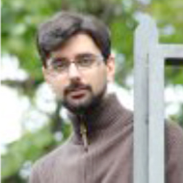
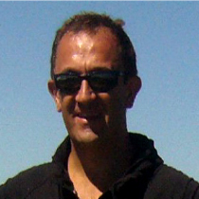
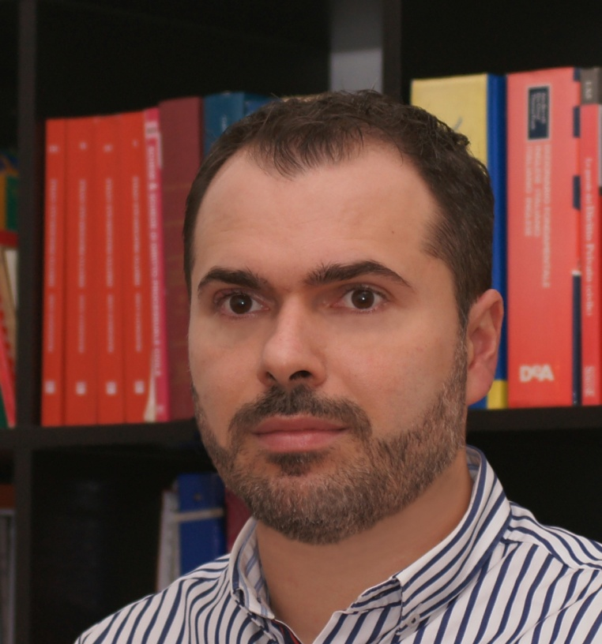
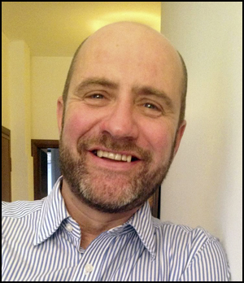
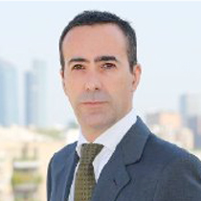
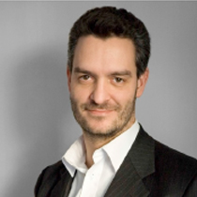
Great teams do great stuff
Strong Core Developers
Andrea, SW Boss
Davide, SW Dev
Antonio, CEO
Stefano, CTO
Gavino, Chairman
Great Advisors
20+ years in TLC, large ICT projects, new Enterprises
serial entrepreneur, 12+ years in industrial automation
12+ years in Corporate Management
Francesco Torelli, Legal
Alberto Giusti
Investor Rel.
Notes:
Alleantia has a well-diversified team with very qualified executives and board.
Indeed, the Alleantia management team has an extensive international experience on technical development, business development and business management: the team of developers is very strong and growing, advisors and board members are experts from the start‐up and venture capital sectors.

Slide 13
Alleantia today
150+ paid systems deployed, 20+ customers (and growing)
2,500+ connected things, 350,000+ uptime hours
2 Product lines (Industrial Automation, Renewable Energy)
1 Country (Italy), 1 Active Distributor, others to come

Slide 14
Our mid-term roadmap
2014
2015
2016
COUNTRIES/REGIONS
2
4
7
DISTRIBUTORS
3
9
16
SYSTEMS / LICENSES DEPLOYED
800
150k
1M+
REVENUES
300k€
2M€
10M€
Notes:
The strategy reflects in target metrics:

Slide 15







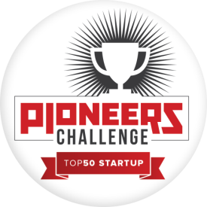





Alleantia featured at …
M2M Partner Program
2013 Startup Challenge Finalist
2013 Startup
Competition Finalist
Barca Starta 2014 Finalist
2013 Startup Challenge Finalist
2013 UK-Italy
Springboard Winner
2012 LeWeb Finalist
2012 Startup Challenge Finalist
2013 Startup Challenge Finalist
Notes:
Selected in the Europe’s most important Startup Competitions

Slide 16
Financial Needs
International investor in key ‘Enterprise IoT’ Countries: D, UK, CA/US (East Coast)
1M€ Early Seed
Focus on Product, Partnerships, International M&S
Notes:
Now we need to accelerate our growth.
The funding is required to accelerate product development, launch the Store, the Cloud of Things, recruit key people, accelerating expansion into international markets, and much more.

Slide 17





WWW.ALLEANTIA.COM
www.linkedin.com/company/alleantia-s-r-l-
www.facebook.com/Alleantia
@Alleantiasrl
info@alleantia.com

