Slide 1
iPress
DIGITAL CONTROL ROOM FOR THE INFORMATION and COMMUNICATION INDUSTRY

Slide 2
iPress Filter. Communicate. Engage.
Starting from TV, radio, paper and online clippings we "filtered" influencer for each sector.
You’ll get a dynamic profile that crosses data from Amazon on the books that he or she has written, from Twitter, Facebook, Linkedin and Google+, from Youtube …

Slide 3
COMMUNICATION & MEDIA INDUSTRY
What is the Problem?

Slide 4
Journalists against PRs and Communicators spam since ever
1998
“PR, I can’t stand you anymore. Really.
The editorial staff complains, surrounded by useless faxes and calls.”
Source: Italia Oggi
We were born for PR professionals, journalists and bloggers.
TODAY we are very important also for Marketing, Social Media Experts and Influencers of every field.

Slide 5

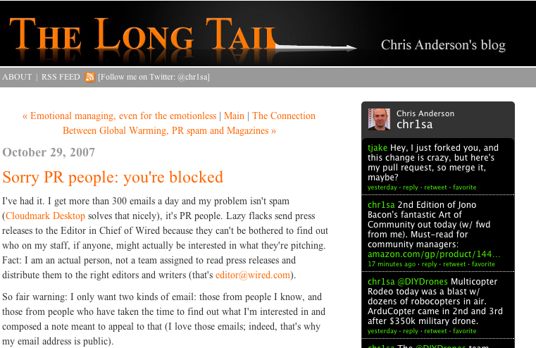

Slide 6
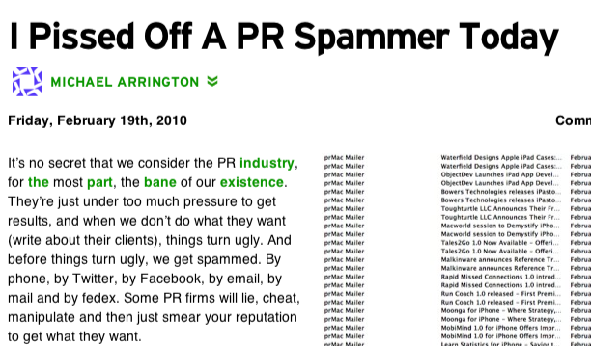

Slide 7
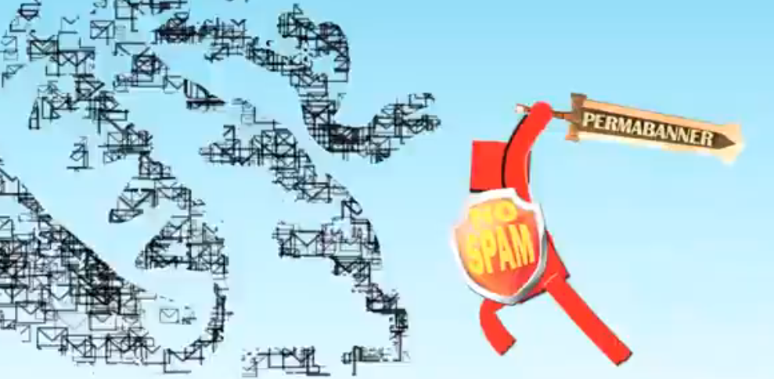
There is evidence that the traditional common methods in PR and Communication sector have always been perceived as spam from the community of journalists and influencers

Slide 8



Our lives are always connected in the world where reality and virtuality coexist
Paper, Radio, TV media
Online, Social media
the new Klout
which merges the influence from new and traditional media

Slide 9
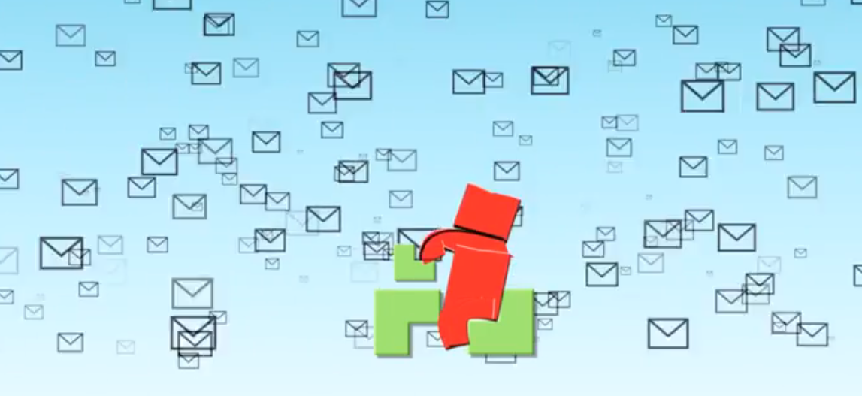
iPress is the solution for
INFORMATION OVERLOAD ...

Slide 10

…and allows you to discover and engage directly with journalists and influencers through social networks
who are really interested in your topic,
less TIME to reach more ATTENTION

Slide 11
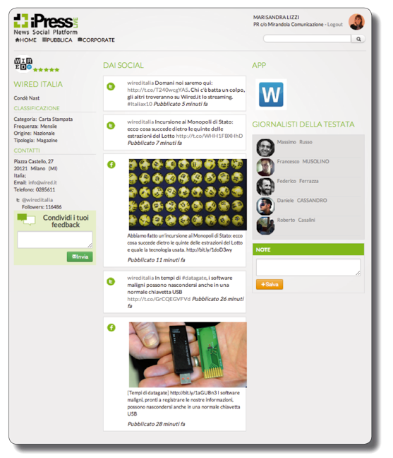
Media outlets are dynamically profiled
Today they are
More than 4.000
and constantly growing

Slide 12
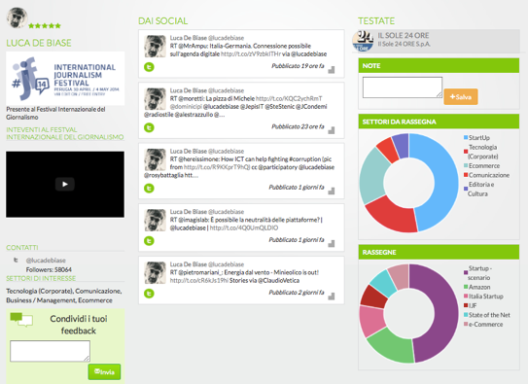
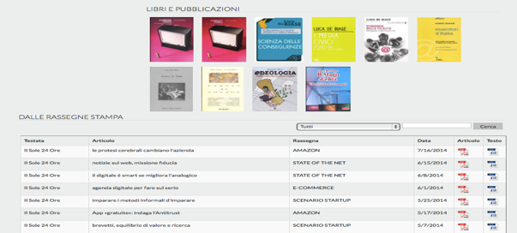
INFLUENCER PROFILE
Example of the full profile of a journalist
synchronized with the press reviews
Today they are
More than 20.000
and constantly growing

Slide 13
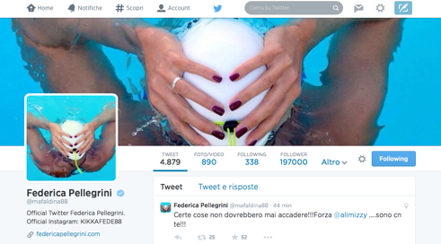
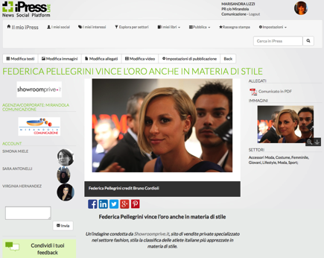

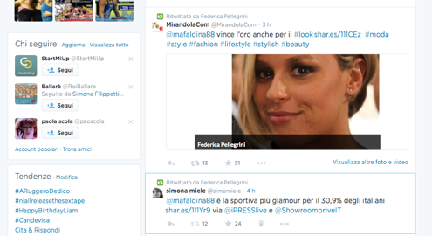
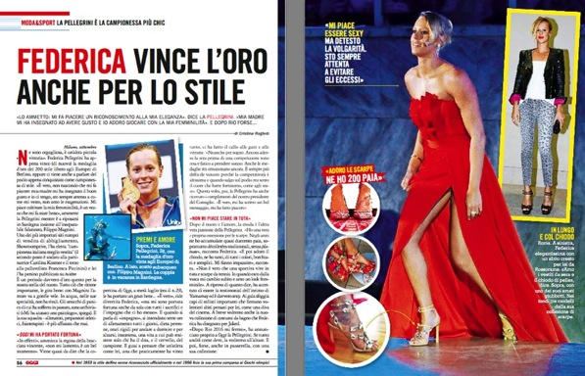
New way to engage influencer
Thanks to iPress you can reach every influencer in the world!
The story continued with publication in a national magazine. From digital to social to paper.

Slide 14
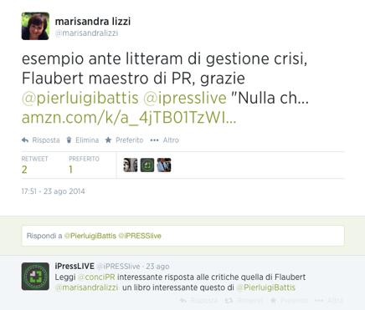
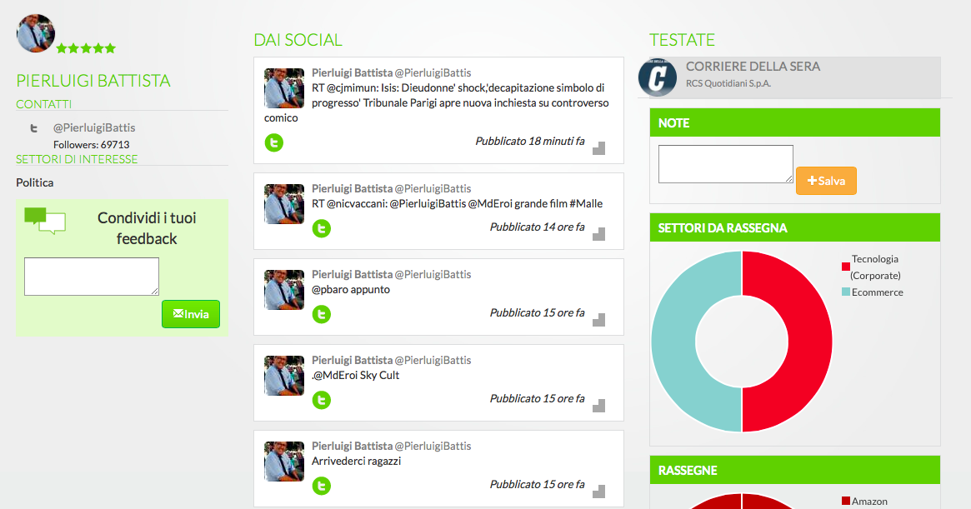
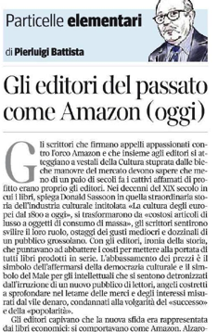
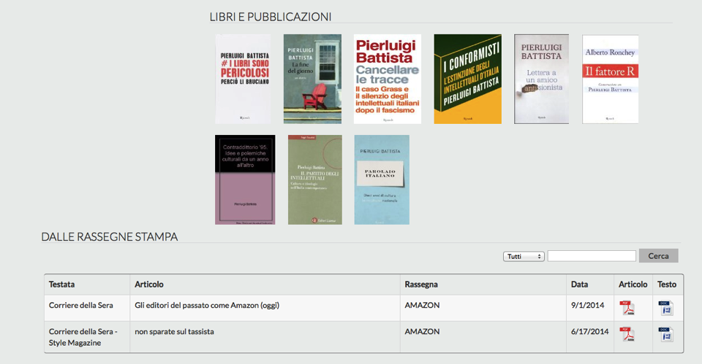
Social reading to engage writers

Slide 15
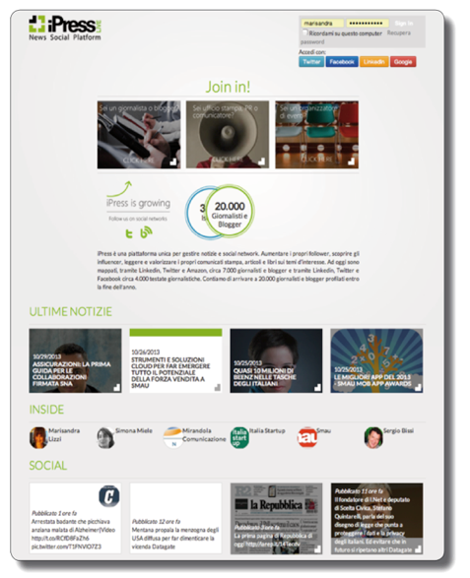
iPress Traction and
Italian Market Test
20.000 journalists and bloggers have been dynamically mapped through LinkedIn, Twitter and Amazon
4.000 outlets have been dynamically profiled through LinkedIn, Twitter and Facebook
More than 1.000 communicators (PRs, Social Media Experts and Marketing Managers) have tested the platform in beta version

Slide 16
Some of our customers

Slide 17

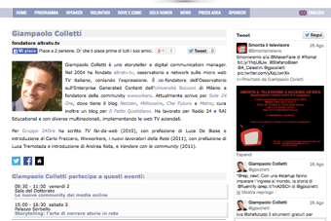
International Journalism Festival: iPress technological partner of the event
ATTENDEES
SYNCHRONIZATION WITH MAIN WEBSITE

Slide 18

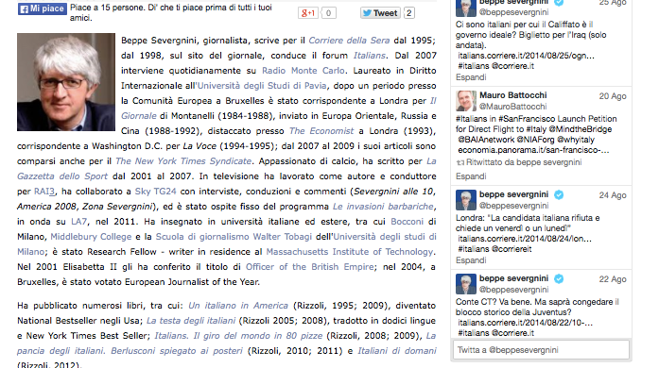
Synchronization with Books
PressLIVE synchronized from Amazon all books written by the speakers, all their conversations from Twitter and YouTube interventions.
In a real digital library, the books of more than 891.500 speakers are all available online directly from the website of the Festival.
www.festivaldelgiornalismo.com/speaker-list/2014

Slide 19
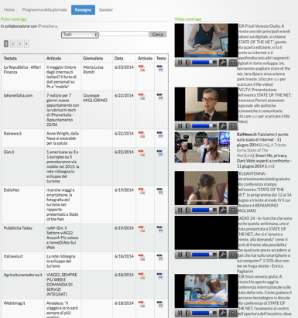
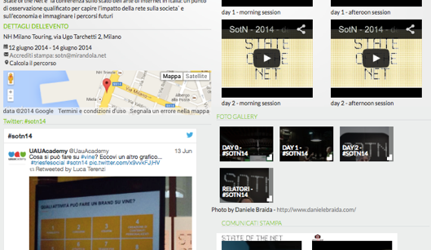
State of the Net: iPress technological partner of the event
In Trieste, over 20 journalists have personally followed the event, while over 100 did it live online and in podcasts.
http://www.ipresslive.it/Events/10/state-of-the-net
PRESS COVERAGE

Slide 20
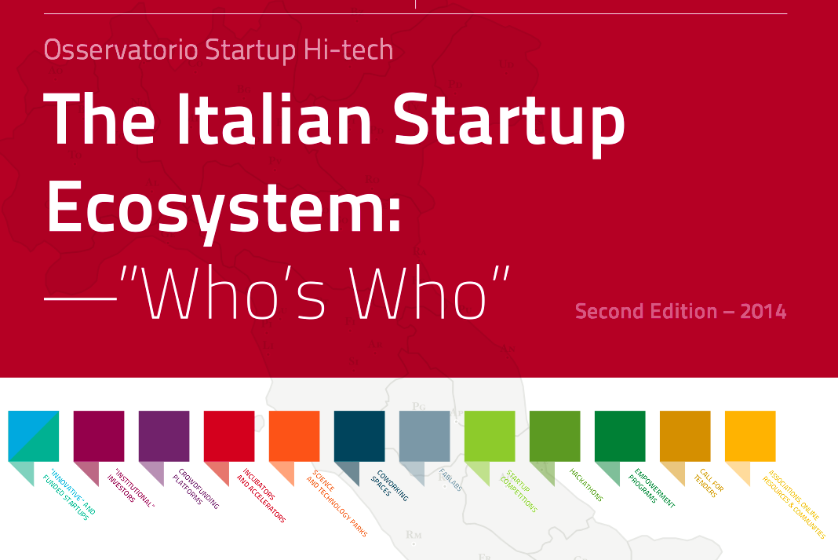
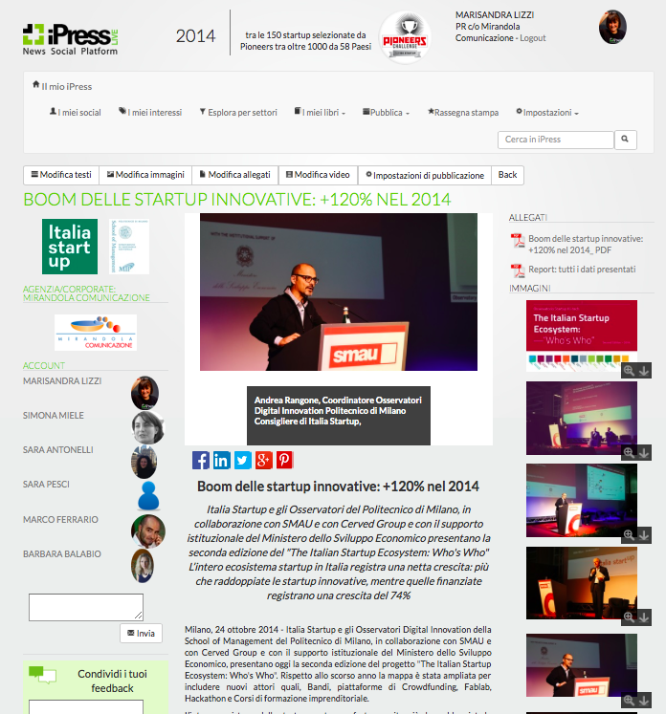
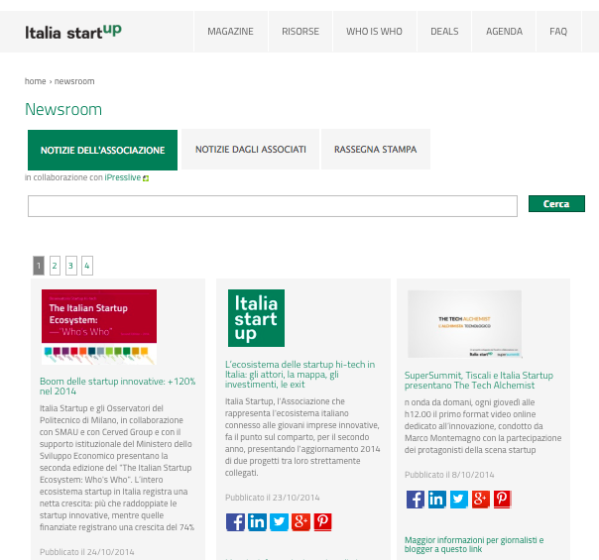
The Italian Startup Ecosystem

Slide 21
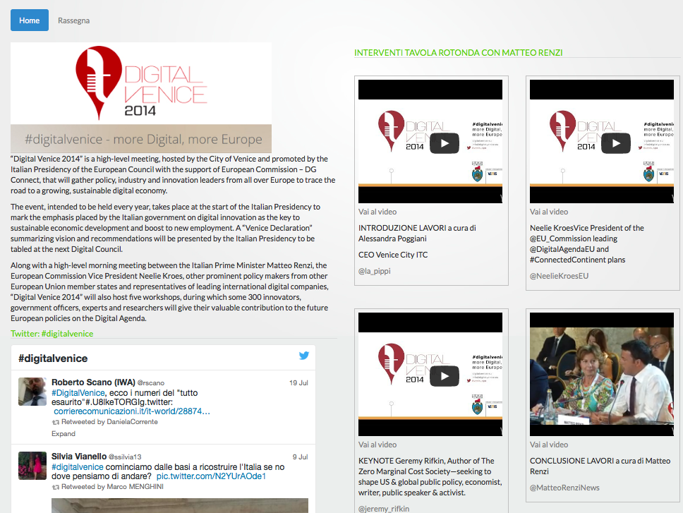
Digital Venice

Slide 22
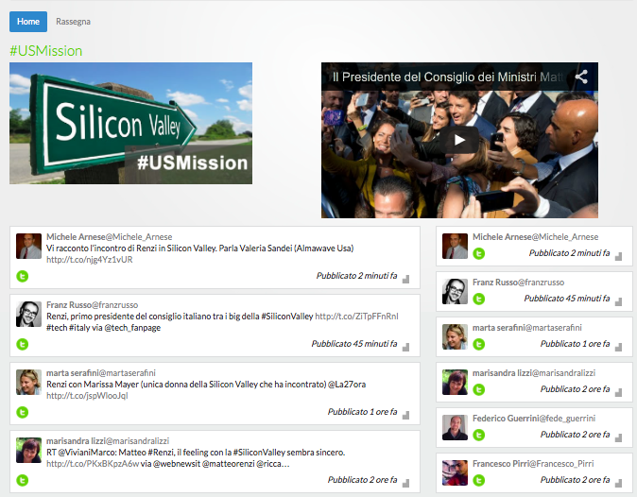
Matteo Renzi US Mission

Slide 23
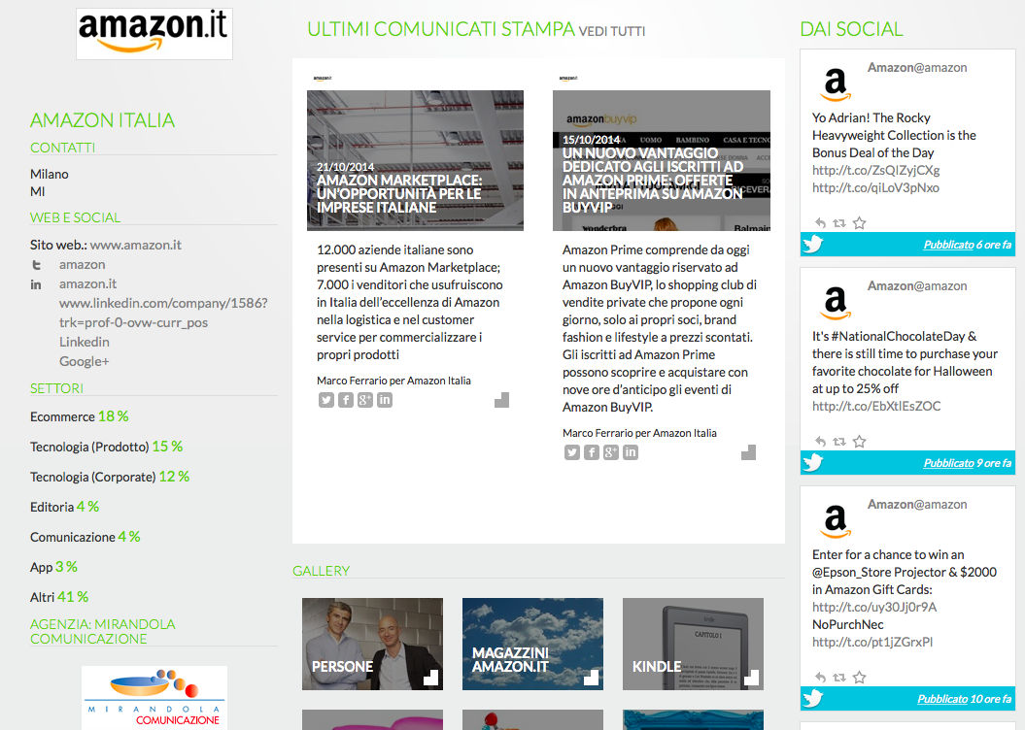
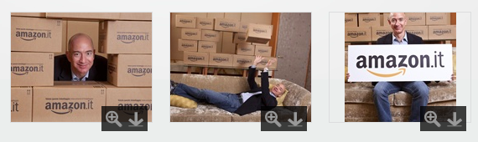
Amazon

Slide 24
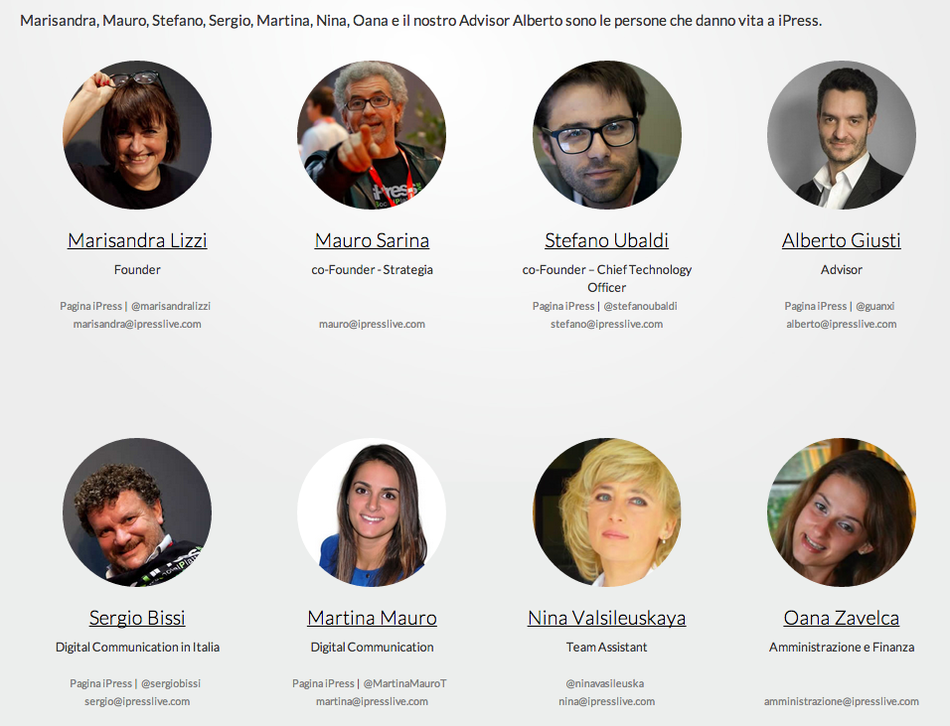
iPress Team

Slide 25
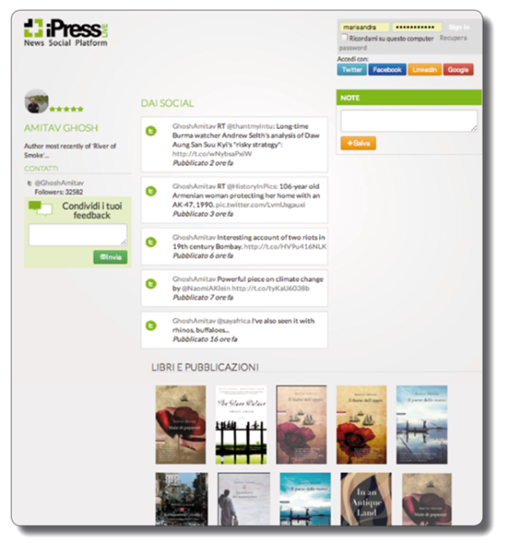
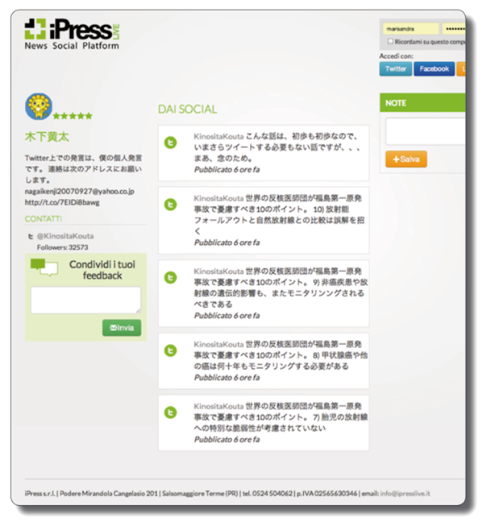
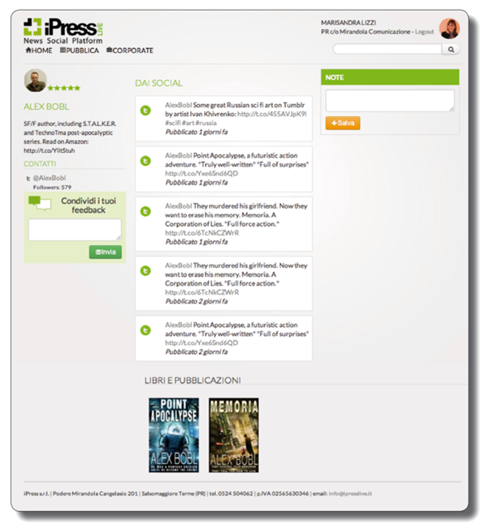
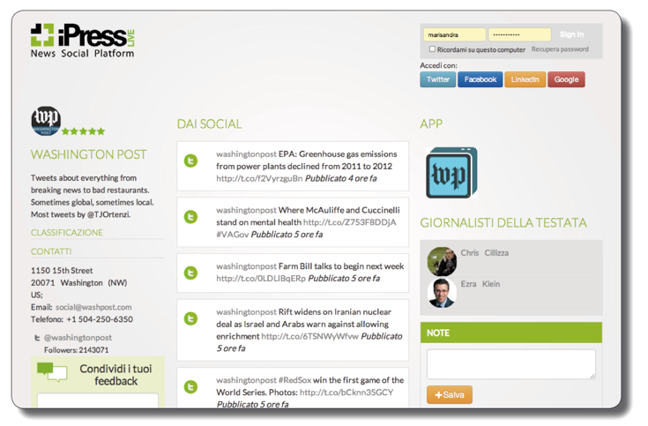
iPress works in every language
After the Italian Market Test we are ready to become global.
We need seeding for this important step.
2000 Idea
2010 Beta Version
2012 Silicon Valley Incubation
2014 Italian Market Test
2015 Global Development

Slide 26
How to reach us
Facebook, Twitter, Linkedin e Google+
Website: www.ipresslive.com
Founder: Marisandra Lizzi
marisandra@ipresslive.com
Phone: +390524574708 Mobile: +3483615042

