Slide 1
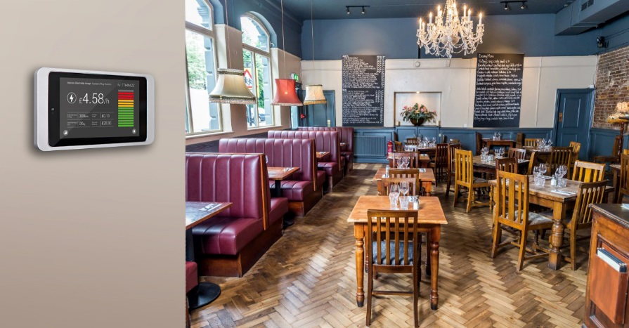
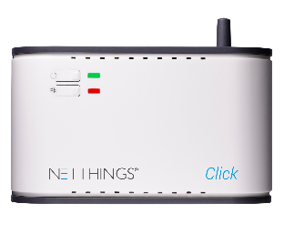
Carbon Reduction for SME Properties Using Nano BEMS IoT Solutions

Slide 2

NETTHINGS COMPANY OVERVIEW
Established 2007
24 staff
£1.5M turnover
1000’s of systems currently installed across a wide range of properties
Current projects include South Bank Tower, London UK
“We are a team of software developers, engineers, technologists and visionaries based in Edinburgh, UK delivering the ‘next big thing’ in real-time monitoring and control.”

Slide 3
SMEs AND ENERGY : GOVERNMENT VIEW (DECC)
Engaging SME businesses is fundamental to achieving UK carbon reduction targets:
65%
of all energy in the UK is consumed in
non-domestic premises
96%
of all businesses
in the UK are SMEs (4.8 million companies)
SMEs
use an average of
5 x more energy than residential customers
50%+
of these businesses have no energy efficiency practices
Total SME Premises
3M
Average Annual Energy Spend
£2.5k
£3.2k
Source : BIS

Slide 4
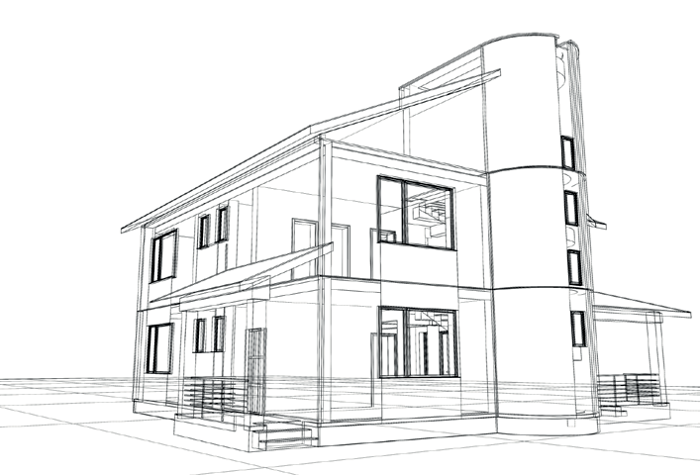

TRADITIONAL SOLUTIONS
BEMs
Building Energy Management Systems
limiting...
Traditional suppliers of Building Energy Management Systems (BEMS) primarily focus
on large buildings and campuses.
complex...
Traditional BEMS systems seen as overly complex, too expensive to install and too difficult for most SME companies to operate.
difficult...
They generate lots of data but key information is difficult to access.
costly...
Price points, even for low-end systems, range from £5 K.

Slide 5
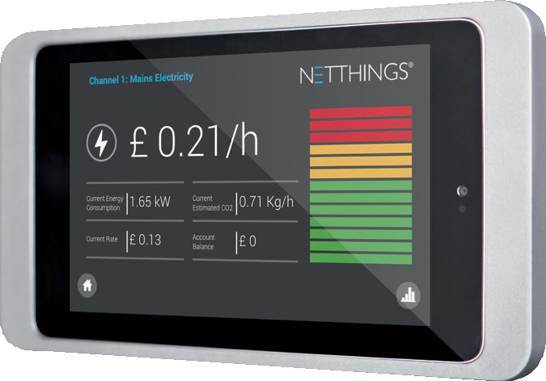
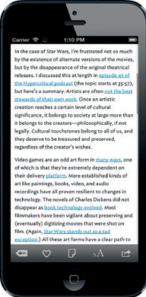
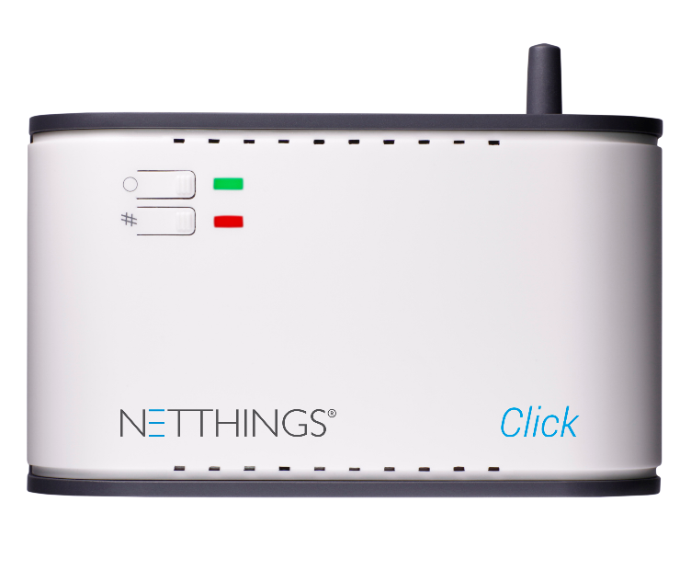
THE ALTERNATIVE
NanoBEMs
LOW COST, UNCOMPLICATED EASY TO INSTALL AND USE,
BUILDING ENERGY MANAGEMENT OR ‘NANO-BEMS’ SYSTEM.
Controlled through graphical user interfaces, IoT-enabled Nano BEMS systems can be run locally or remotely, can be configured for push alerts and more detailed energy consumption analytics reports.
WARNING
High energy levels monitored, heating is still on.
8.00pm
£1.60/h
18°C
26°C
Price points starting at <£700 and <£2K
for a fully-configured system

Slide 6
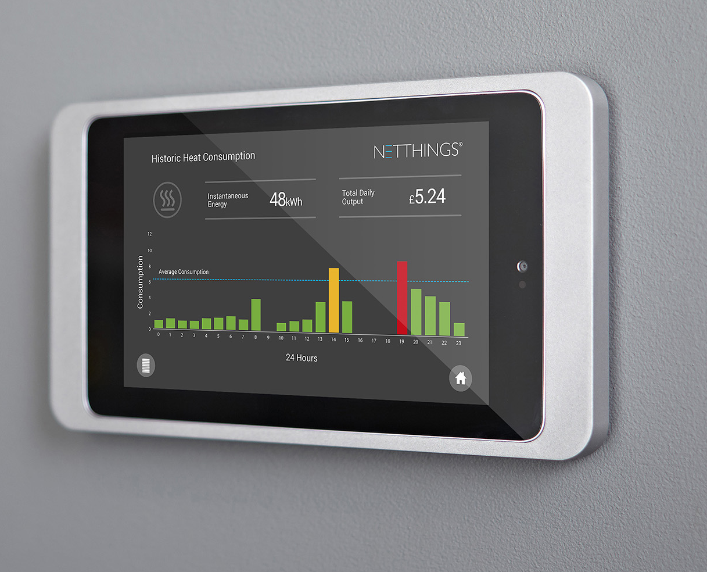
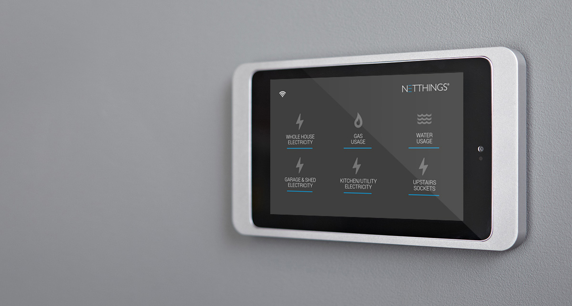
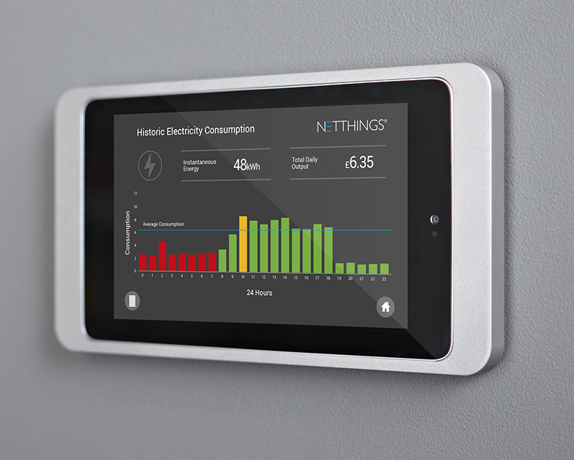
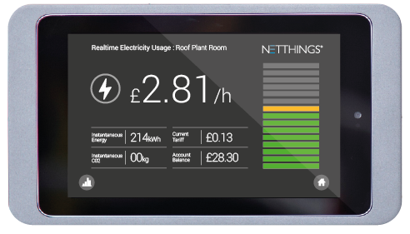
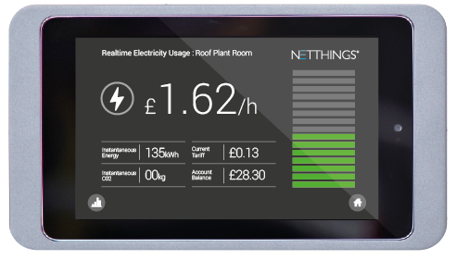
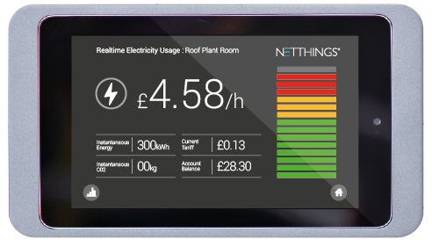
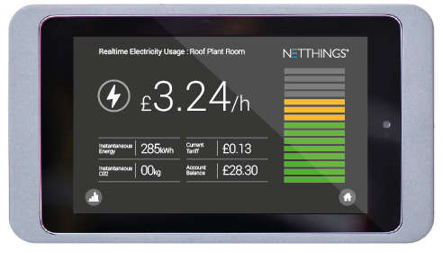
STAFF ENGAGEMENT – Behavioural Change
Live display of cost updates instantly when equipment is switched on/off
Easy to access and understand historical data without needing to logging into websites
Link between good housekeeping and cost saving quickly established and continually reinforced
Night Load reduction benchmarks are quickly established and any waste is highlighted

Slide 7
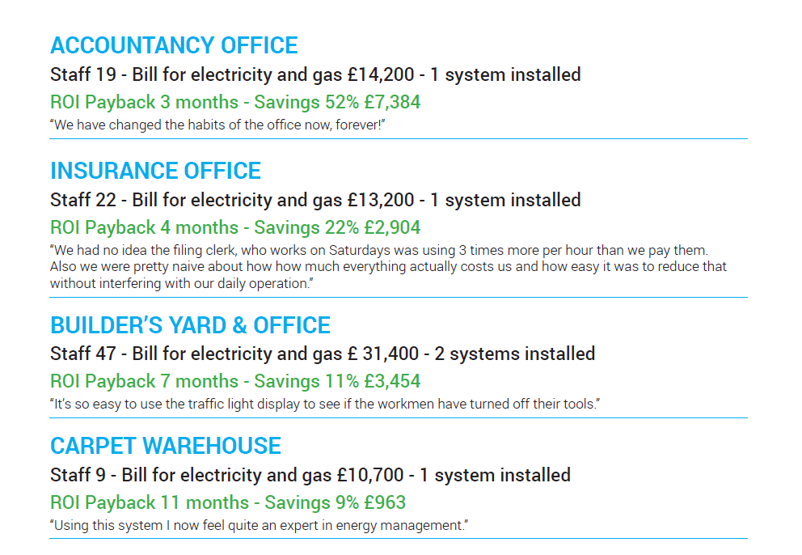
Case Studies

Slide 8
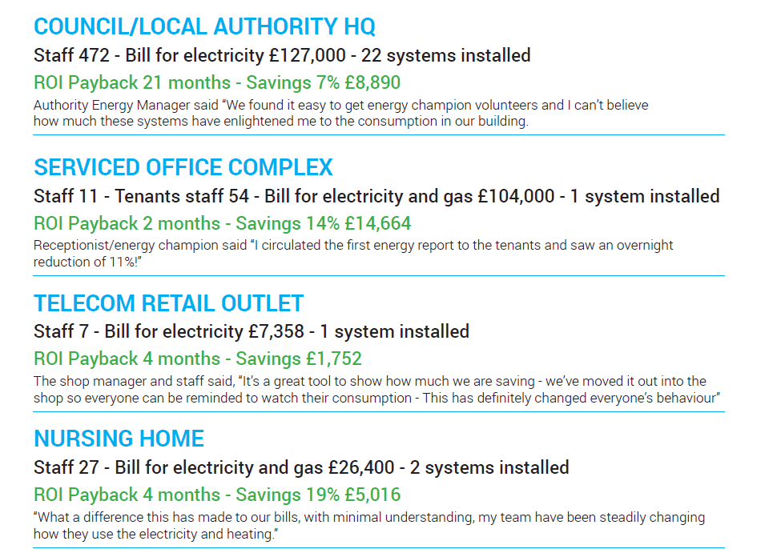
Case Studies

Slide 9



Typical SME - BAR RESTAURANTS: ENERGY FACTS
Saving Energy is one of the simplest ways for Bar Restaurants to increase profits:*
-20%
reduction in energy use can be achieved by implementing simple energy efficiency measures*
-40%
reduction in energy cost achievable if efficiency opportunities are maximised during refurbishment*
2nd
Highest controllable cost factor in the industry after labour is energy***
+33%
is the projected increase in business energy costs by 2030**
x4
left on overnight
= £600/yr
x2
left on overnight
= 1800/yr
£
£
£
Gaming Machines
Over Door Heaters
*Source : Carbon Trust
**Source : Independent Committee on Climate Change
***Source : Hospitality Carbon Reduction Forum

Slide 10
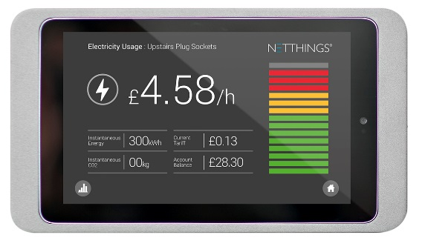
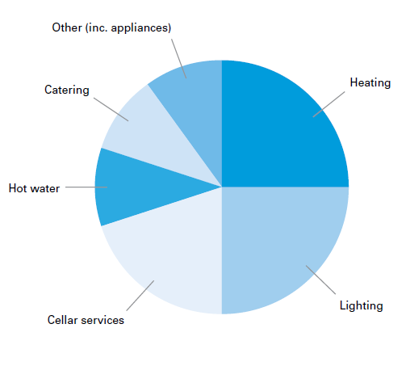
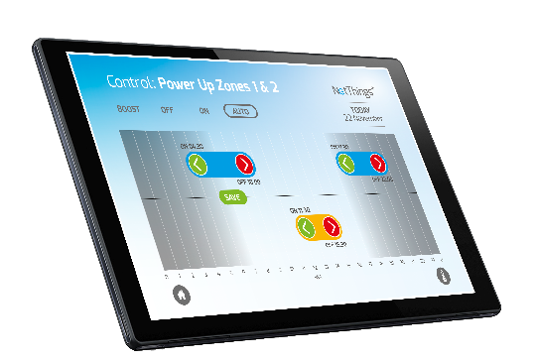
ENERGY USE AND POTENTIAL SAVINGS
Breakdown of Energy use within the average Pub*
Raising awareness (via real time energy display) and energy management training can reduce energy use by up to 30%.*
Premises with well controlled systems , heating fuel consumption is 15-30% lower.*
Lighting controls and efficient luminaires can reduce energy costs by up to 50%.*
Overcooling the cellar by 1°C can add up to 10% to cellar energy costs.*
*Source - The Carbon Trust
Notes:
According to the Carbon Trust - 65% of the energy supplied by cooking equipment will be extracted through the canopy as convected heat.
A large catering firm installed sub-meters in their kitchens and surveyed the facility to identify how energy use related to activity. Catering staff attended good housekeeping training workshops covering some of the actions in the quick wins section above. As a result, energy costs were reduced by 25% in the following year.

Slide 11
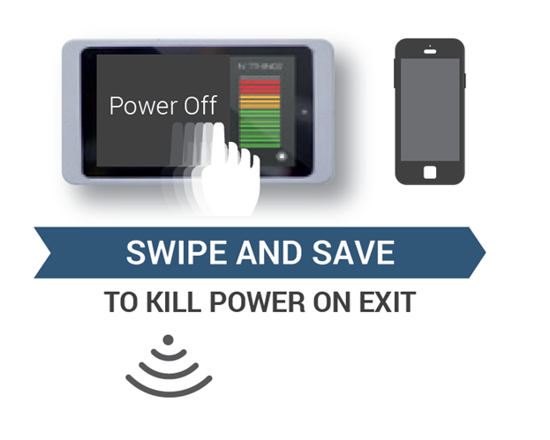
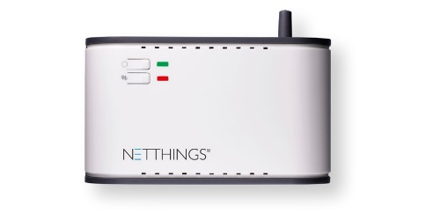










ENERGY SAVING FUNCTIONS – Night Load Reduction
46% of all business electricity is used outside of business hours*
Space
Temperature
Over Door
Heater(s)
Heating
Enable
A/C
Enable
Drinks
Coolers
Gaming
Machines
Vending
Machines
*Source – British Gas

Slide 12
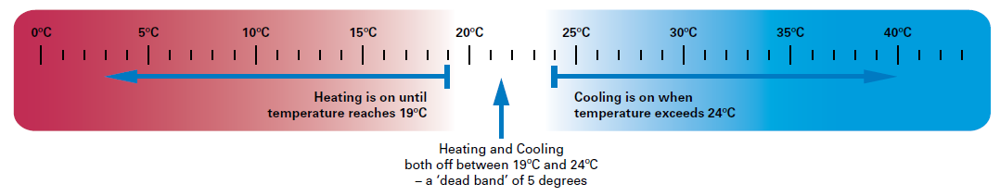
ENERGY SAVING FUNCTIONS – Dead Band Control
Heating and Cooling operating a the same time is a common problem in pubs and restaurants*
Space
Temperature
Heating
Enable
A/C
Enable
*Source - The Carbon Trust

Slide 13





ENERGY SAVING FUNCTIONS – Scheduling & Zone Control
Zoned areas will provide closer, more efficient heating control, which can improve comfort conditions and save on costs*
Space
Temperature
Hot Water
Enable
Above
13Amp
Load
Zone 1
Zone 2
Zone 3
Over Door
Heater(s)
Heating
Enable
A/C
Enable
Drinks
Coolers
Gaming
Machines
Vending
Machines
Car Park
Lighting
*Source - The Carbon Trust
*Source – British Gas

Slide 14
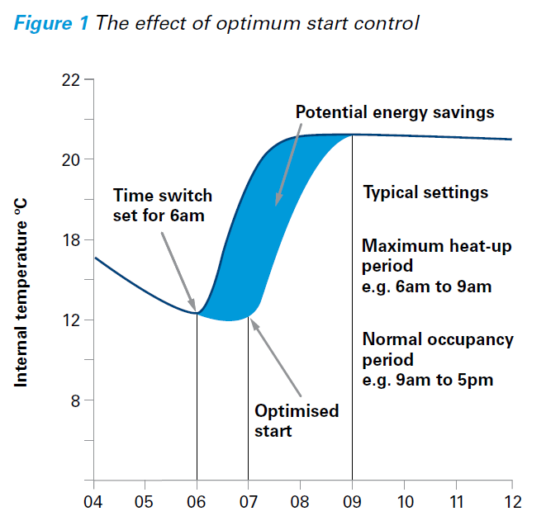
Optimum Start Control

Slide 15
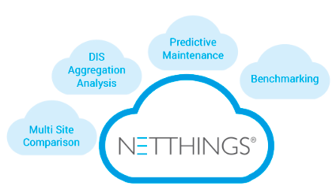
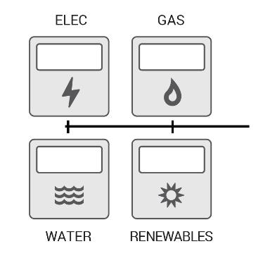
Remote Monitoring and Advanced Analytics
Space
Temperature
Cellar
Temperature
Hot Water
Enable
Above
13Amp
Load
Zone 1
Zone 2
Zone 3
Over Door
Heater(s)
Heating
Enable
A/C
Enable
Drinks
Coolers
Gaming
Machines
Vending
Machines
Car Park
Lighting
*Source – British Gas

Slide 16
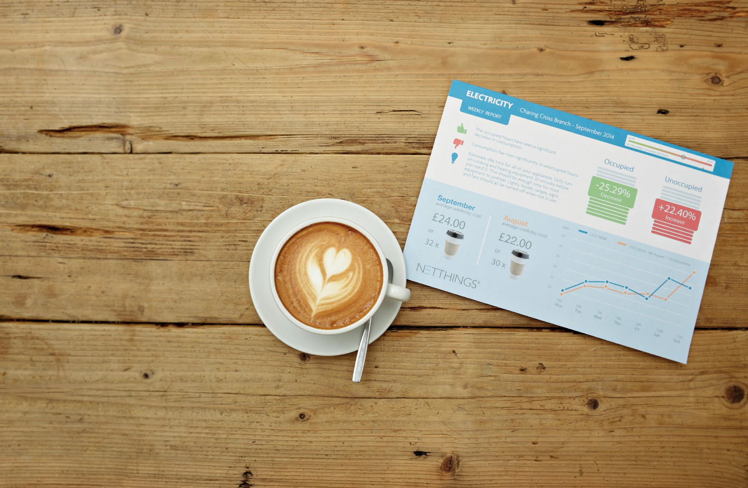
VIRTUAL ENERGY MANAGER REPORTS & DATA ANALYTICS
REPORTING
Subscription Service for Multi-Site Customers
VISUALIZE DATA FOR BENCHMARKING IN APPROPRIATE-FOR-AUDIENCE LANGUAGE - E.G. COFFEE CUPS
BESPOKE REPORTS ON ENERGY CONSUMPTION FOR INDIVIDUAL
& GROUPS OF LIKE PROPERTIES
COMPARATIVE DATA
(own site data compared to earlier data for same site)
BENCHMARKING
(own site data compared to other similar sized sites)
CONTEXTUAL DATA REPRESENTATION

Slide 17
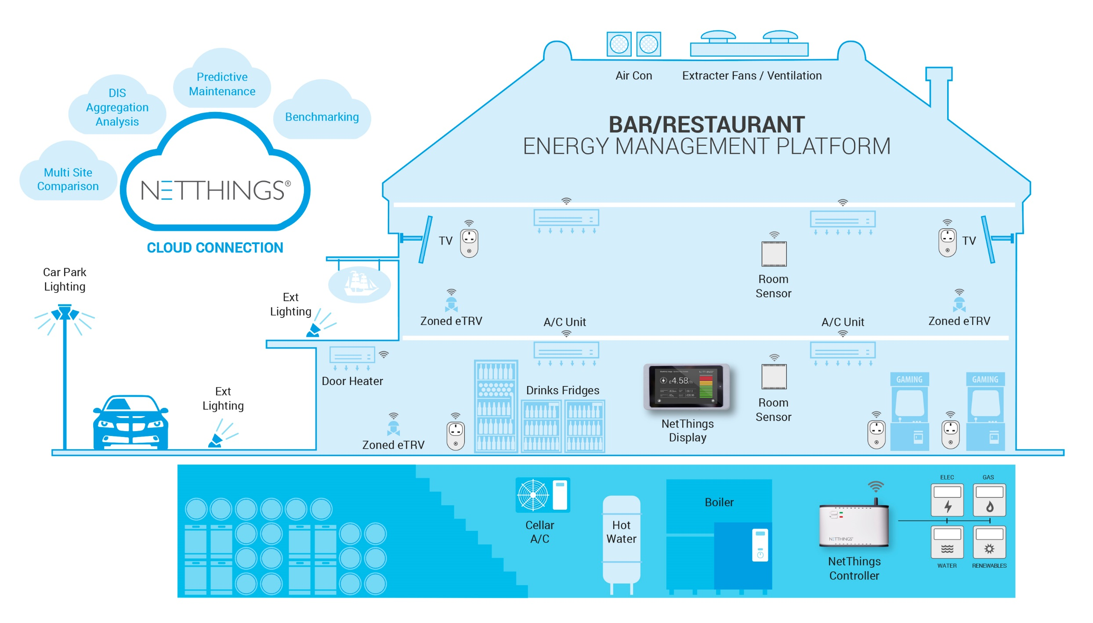
SMART ECO-PUB TECHNOLOGY INFRASTRUCTURE

Slide 18
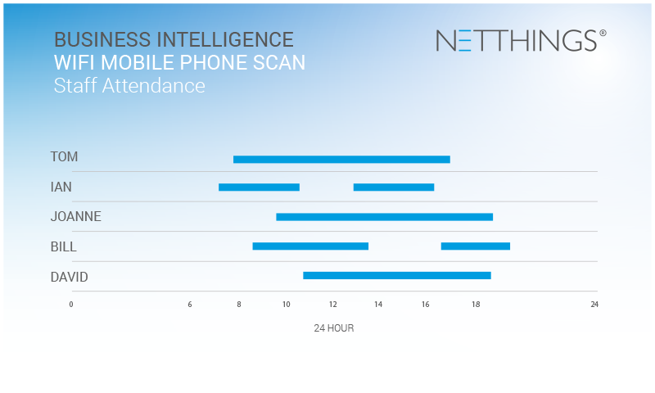
Future Business Intelligence Applications

Slide 19
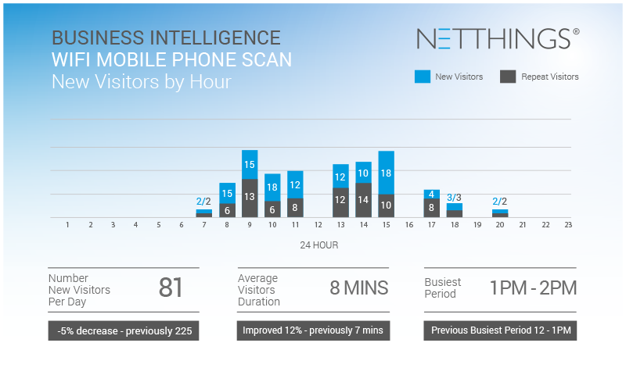
Future Business Intelligence Applications

Slide 20
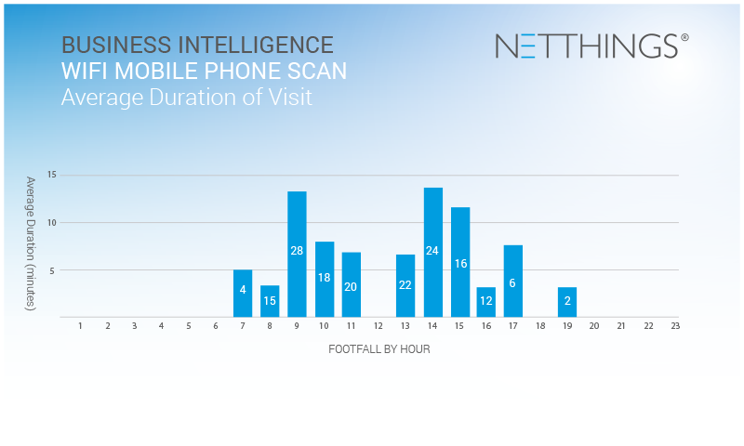
Future Business Intelligence Applications

Slide 21

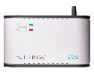
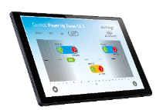


SCALABLE RETURN ON INVESTMENT < 12 months
Installed Cost (£k)
E: D + Technology Infrastructure
D: C + Remote Monitoring & Analytics
2.0
C: B + Scheduling & Zoning
1.5
B: A + Night Load Reduction
1.0
A: Energy Insight & Behavioural Change
0.5
10%
15%
20%
25%
30%
Energy Savings %

Slide 22
SUMMARY
The installation of a Nano BEMs IoT platform within properties can deliver an R.O.I of < 12 months and increase bottom line profit thereafter.
Solutions are scalable in terms of property size and functionality
A suitable Nano BEMs IoT platform can be extended and upgraded once installed
Future developments include predictive maintenance, energy dis-aggregation and business intelligence

