Slide 1

Solving the IoT Platform Challenge
Enrico Scarrone, Telecom Italia; Dr. Josef Blanz, Qualcomm; Dr. Victor Kueh, Huawei
Chair: Ultan Mulligan, ETSI & oneM2M Marcom vice-chair
IoT Slam, 9 December 2015

Slide 2
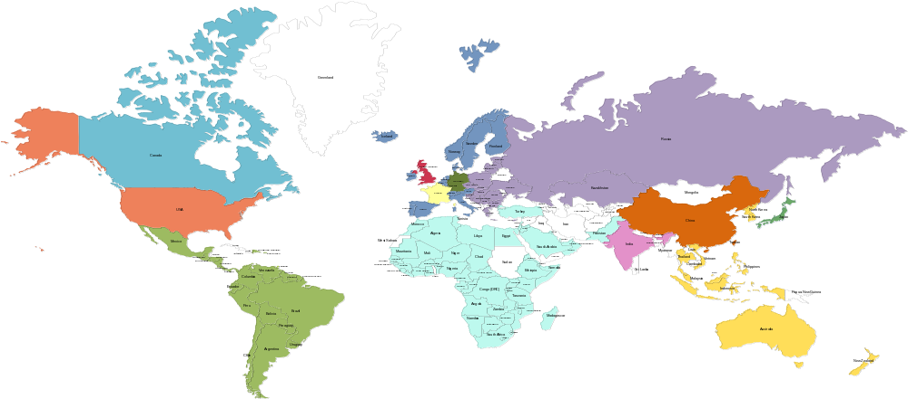














oneM2M Partnership Project
Over 200 member organizations in oneM2M
www.oneM2M.org
All document are publically available

Slide 3
Scope & Objectives
To develop: Global M2M/IoT specifications -
using common use cases and architecture principles across multiple M2M/IoT applications to connect devices and application servers worldwide with an access independent view of end-to-end services
To define: Service Layer platform supporting a service architecture including:
- Protocols/APIs/standard objects (open interfaces & protocols)
- Interoperability, test and conformance specifications
- Service Layer interfaces/APIs for:
  Applications and service semantics/ontologies
  Communication and data sharing
  Security and privacy aspects
  Authentication, encryption, integrity verification

Slide 4
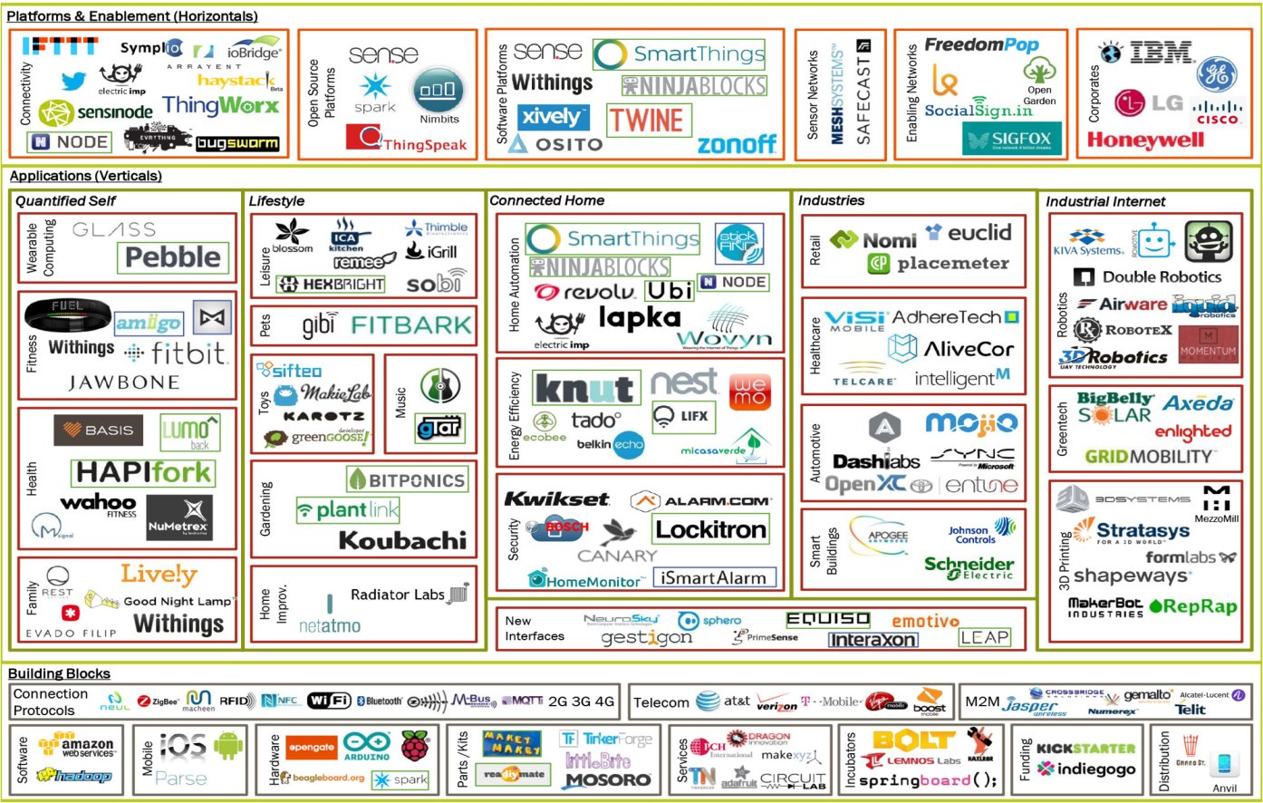
A fragmented ecosystem
Based upon: Matt Turk, Sutian Dong, FirstMark Capital, 2013

Slide 5

Deploying an IoT service today is a complex exercise
Device
Communication
Network
Data
Platform
Management
Application
System
Business model
Process
And is not a mature business….
So solutions, approaches and expertize are not consolidated
Integration
Interworking
Legacy
Regulation
IOT!!!

Slide 6



Break the silos and simplify the environment
Pipe#1
1 Application,
1 Network
1 (or few) types of Device
Pipe#2
1 Application,
1 Network
1 (or few) types of Device
Pipe#N
1 Application,
1 Network
1 (or few) types of Device
Horizontal (based on common Layer)
Applications share common infrastructure,
environments and network elements
Business
Application
Business
Application
Business
Application
Business
Business
Business
Application
#
1
Application
#
i
Application
#
N
Common Application Infrastructure
Transport Network (mobile, fixed, Powerline ..)
Transport Network (mobile, fixed, Powerline ..)
Transport Network (mobile, fixed, Powerline ..)
Transport Network 1
Transport Network 2
IP
Gateway
Gateway
Gateway
Gateway
Local NW
Local NW
Local NW
Local NW
Device
Device
Device
Device
Device
Device
Device
6
Notes:
6

Slide 7
Release 1 Specifications
Requirements
TS-0002
(WI-0001)
Functional
Architecture
TS-0001
(WI-0002)
Definitions
& Acronyms
TS-0011
(WI-0003)
Service Layer
Core Protocols
TS-0004
(WI-0009)
HTTP Protocol
Binding
TS-0009
(WI-0013)
CoAP Protocol
Binding
TS-0008
(WI-0012)
Management
Enabl^{nt} - OMA
TS-0005
(WI-0010)
Management
Enabl^{nt} - BBF
TS-0006
(WI-0010)
MQTT Protocol
Binding
TS-0010
(WI-0014)
Security
Solutions
TS-0003
(WI-0007)

Slide 8
oneM2M status highlights
Release 1 has been released in January 2015
  OneM2M standard is stable.
  It includes interworking communication support, but limited semantic support
Launch event took place on December 2014 in ETSI with more than 10 multivendor demos
There are several Open Source projects (e.g. in Ocean and Eclipse, etc…)
First commercial service launched in May 2015 in Korea
Interoperability test event was successfully run in September 2015
Release 2 is planned May-July 2016, focused on Semantic Interoperability, and the inclusion of testing specifications
Release 1
Release 2
SEPT 12
AUG 14
Early drop
DEC 14
Launch event
JAN 15
R1 Published
3Q 16
R2 Publishing

Slide 9
oneM2M in a nutshell
Main Characteristics
URI identification (and separation from IP addressing)
IP based (irrelevant the version, IPv4 or IPV6)
Network independent (but network aware!)
REST approach
Application protability
Device and subscription management
Accounting and charging
HTTP/COAP/MQTT transport
Peculiary functions
Store and share paradigm
Data management and historization
Separation among Security and Privacy
Flexible deployment (large, small, distributed, centralized)
Network functionality re-use (Location, Device Management, Security, etc)

Slide 10
Where to find info?
Web Site
www.onem2m.org
Join oneM2M
  www.onem2m.org/membership/join-onem2m
YouTube Channel
https://www.youtube.com/c/onem2morg
Webinars
www.onem2m.org/technical/webinars
Published Specifications
www.onem2m.org/technical/published-documents

