Slide 1
Solving IoT connectivity challenges
Dennis Juul Poulsen, general manager
Spirent Communications

Slide 2
An investment into the future

Slide 3
I picked up the car from the dealer
leaned back into the driver seat...

Slide 4
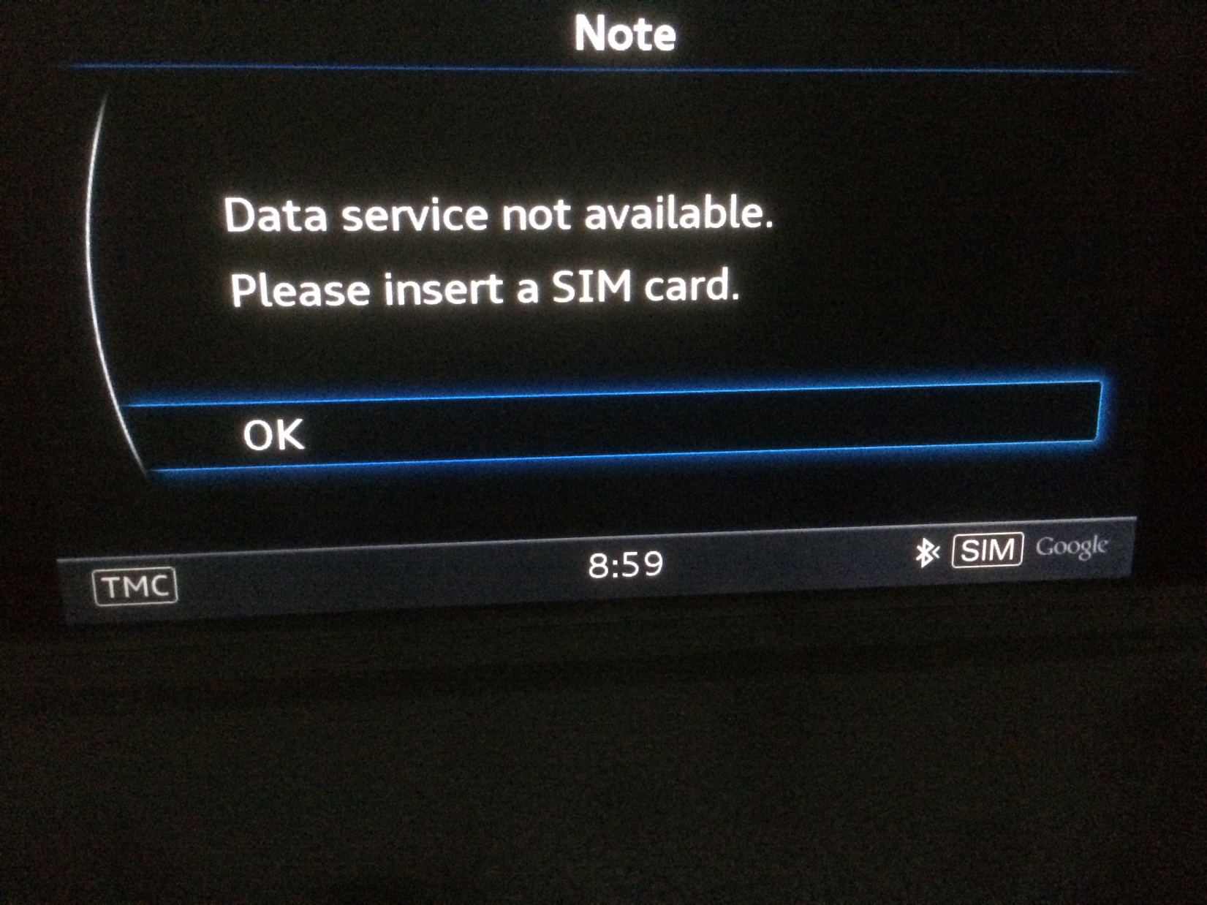

Slide 5
Called the car dealer
“my connected car is not connected!”

Slide 6
Car dealer
Carrier

Slide 7
Car dealer
Carrier

Slide 8
Car dealer
Carrier

Slide 9
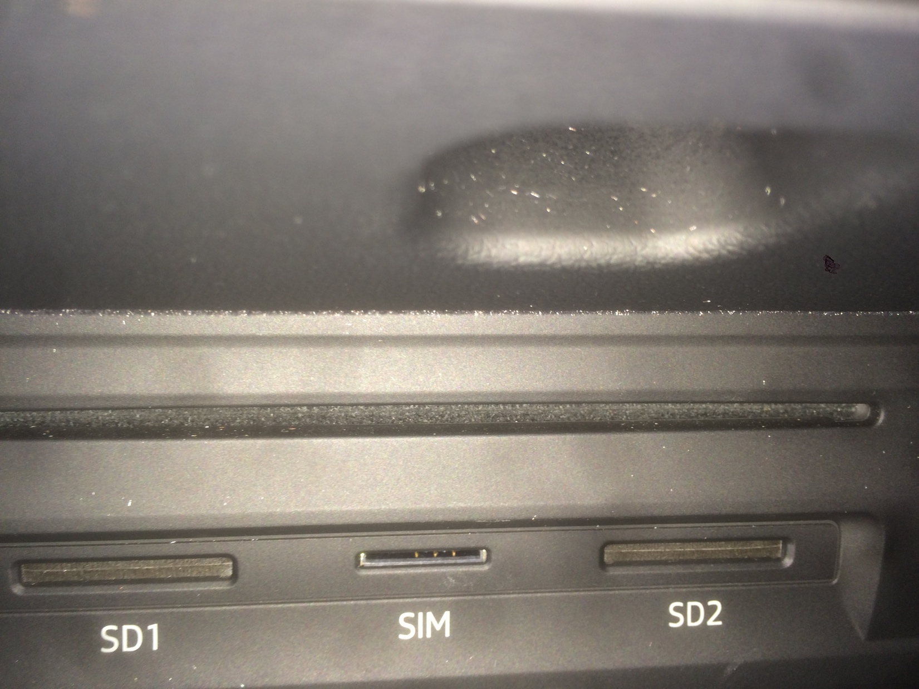

Slide 10
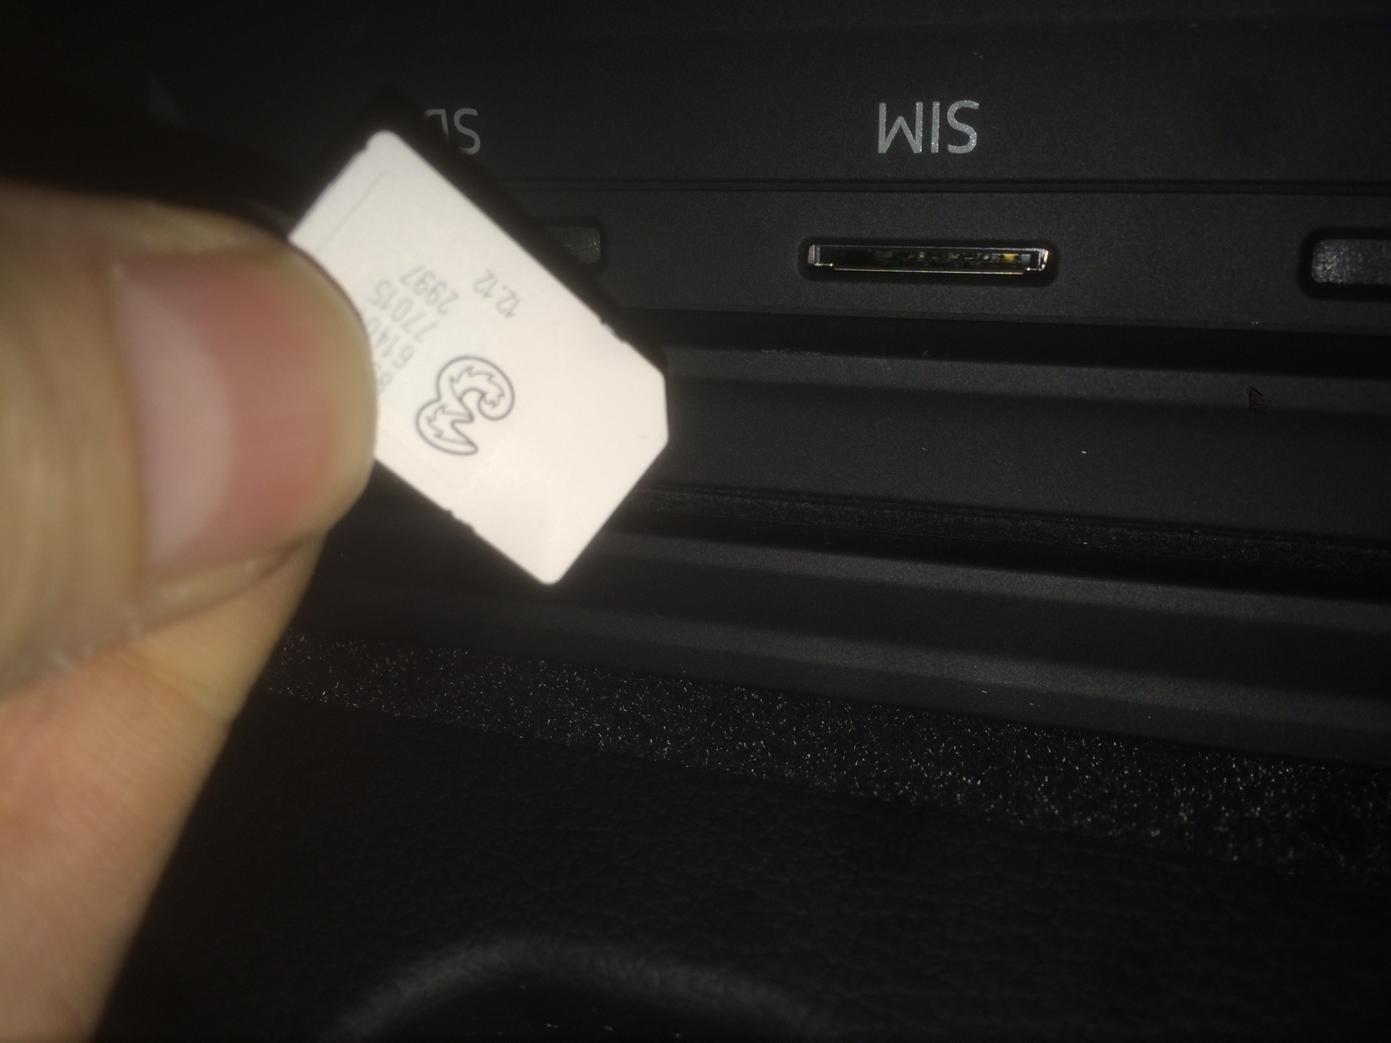

Slide 11
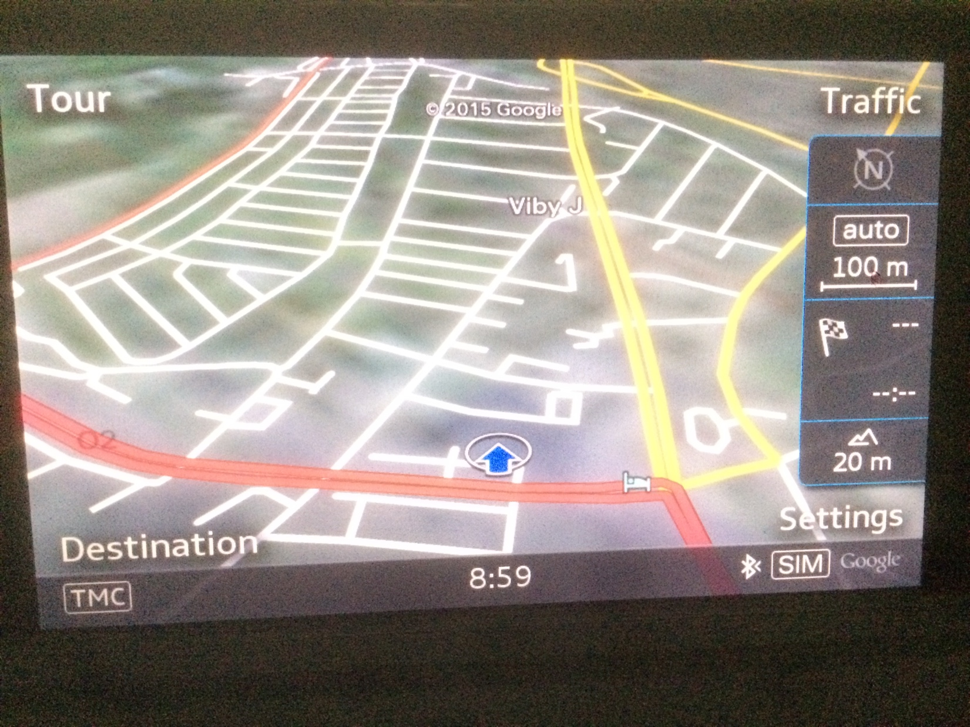

Slide 12
Still wasn’t working
“the SIM is in but still no connectivity!”

Slide 13
Car dealer
Carrier

Slide 14
“You need make sure the APN is configured”
“WHAT?!”

Slide 15
Car dealer
Carrier

Slide 16
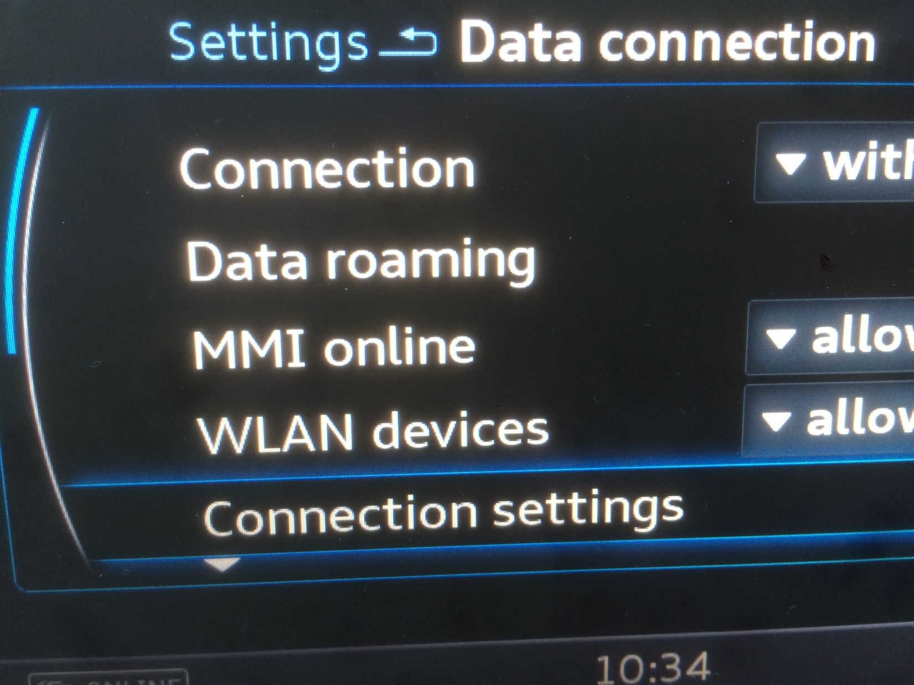

Slide 17
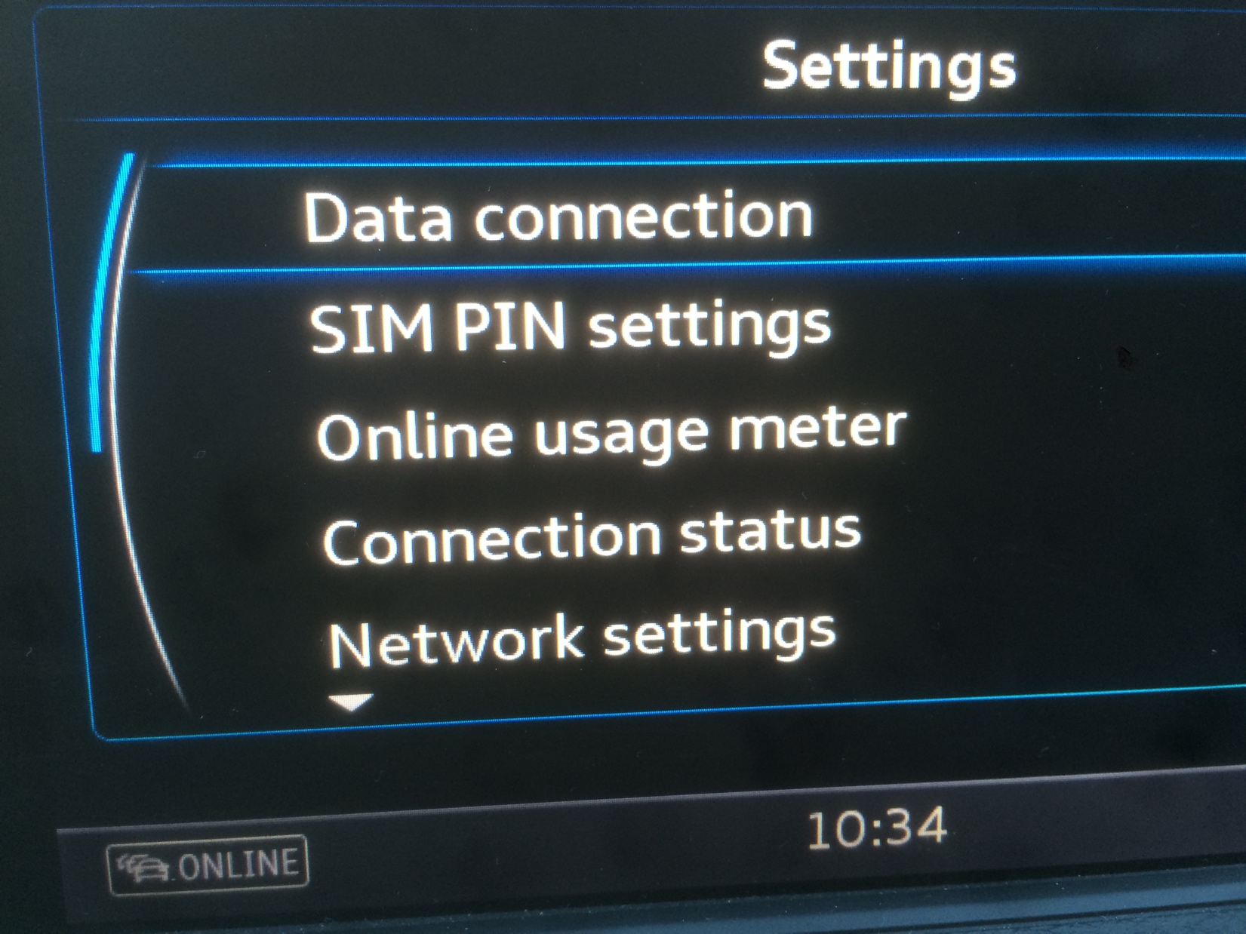

Slide 18
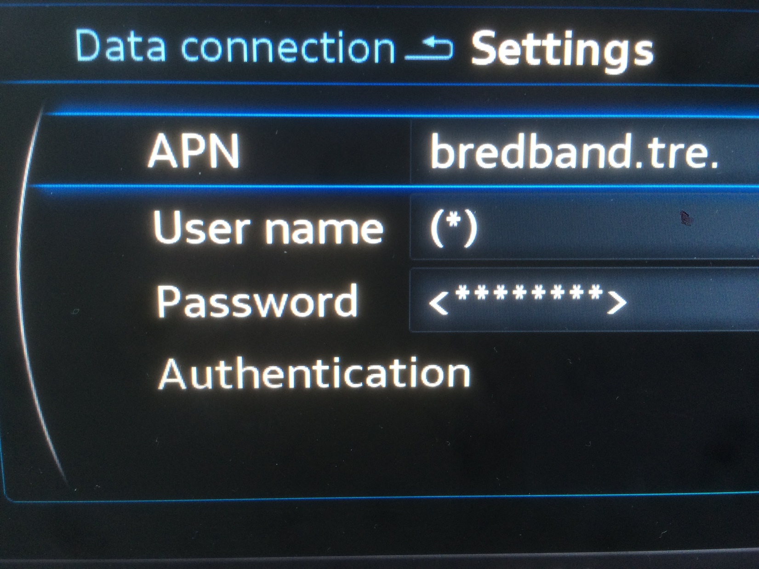

Slide 19
FINALLY !

Slide 20
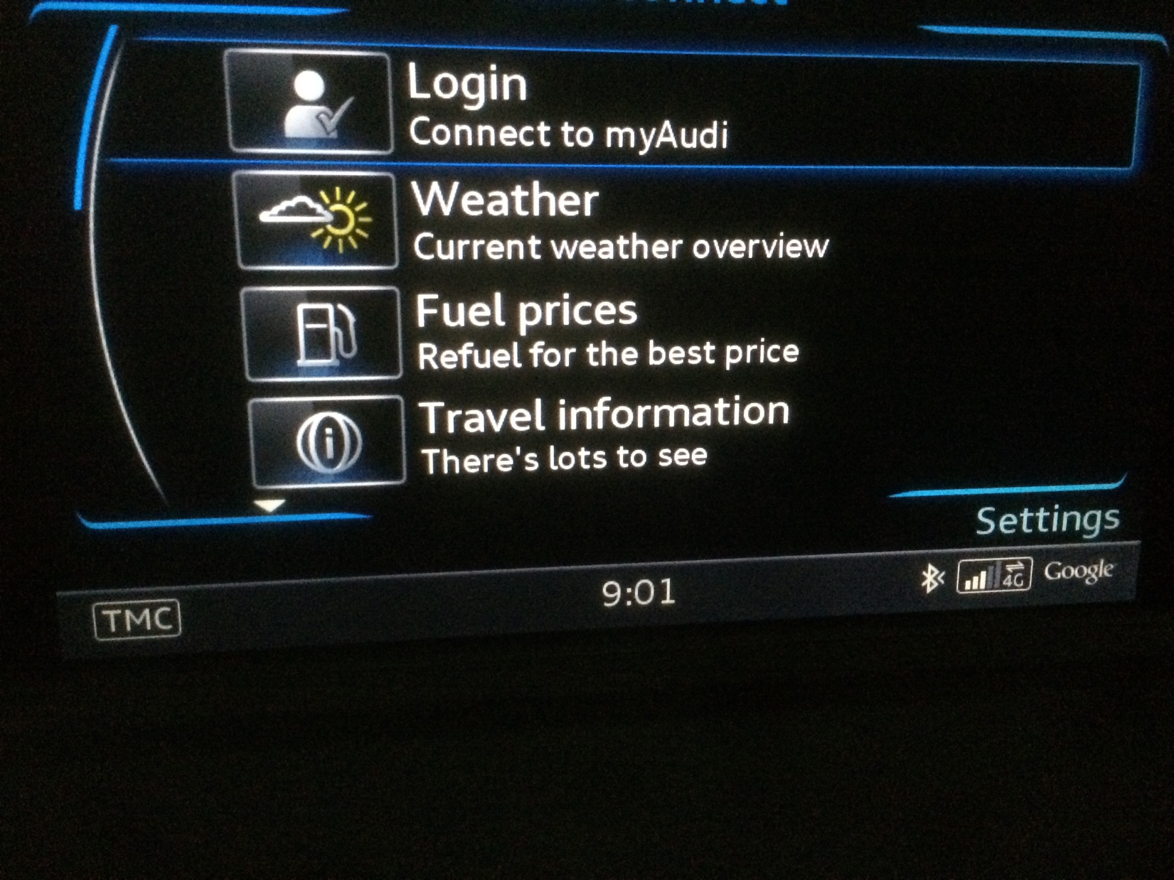

Slide 21
A terrible experience....

Slide 22


Disconnected experience
Confusing customer ownership
MNO
MNO

Slide 23
There is a solution!

Slide 24

GSMA Embedded SIM Specification for M2M devices (eUICC)
Addressing the challenges created by the SIM card in M2M
MNO

Slide 25
What are the drivers for e-SIM ?
Embedded and seamless connectivity
Supply chain simplicity
Ability to change service provider
SIM inaccessible

Slide 26



New Relationships
seamless connectivity
MNO
MNO
MNO
MNO
MNO
MNO
MNO
MNO
freedom of choice

Slide 27
The world’s best buying experience? A connected product!
Connectivity embedded
OEM – end-user relationship
MNO
MNO
MNO

Slide 28
Transformational impact on...
  Customer experience
  Economies of scale
  Business ecosystem

