Slide 1
IoT Slam
Sam George
Director Azure IoT

Slide 2
Internet of Things

Slide 3
IoT is an Inflection Point
Hardware
is cheap
Connectivity
is pervasive
Development
is easier
New Innovative Scenarios
Huge benefits
fuel demands

Slide 4

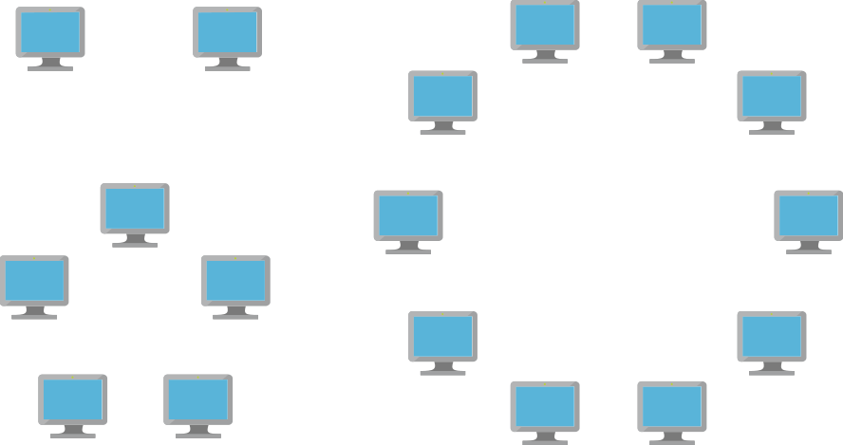

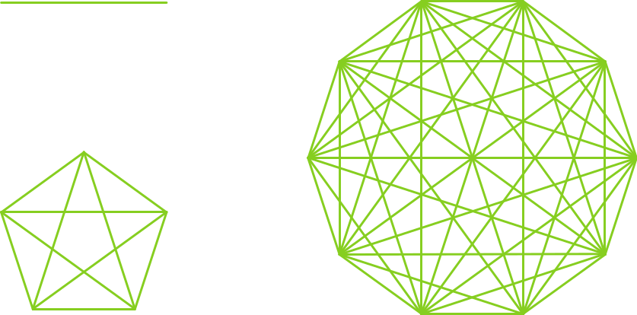

Disruptive Forces Enabling IoT
Moore’s Law
Metcalf‘s Law
Koomey’s Law
Transistors
Computations
per KWh
10,000,000,000
1.E+14
1,000,000,000
1.E+12
100,000,000
1.E+10
10,000,000
1.E+08
1,000,000
1.E+06
100,000
1.E+04
10,000
1.E+02
1,000
1.E+00
1970
1980
1990
2000
2010
1940
1975
2010
And more importantly:
what can you do by combining and analyzing signals from all of these IoT devices?

Slide 5
IoT Is Gaining Momentum
2010
Alarm clock
Refrigerator
Automobile
VoIP phone
Computer
Printer
Media player
Microwave
HOME
WORKPLACE
HOME
Coffee maker
Smart scale
Oven
Cell phone
HVAC
Vending
Security
Television

Slide 6
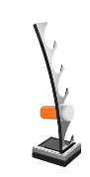
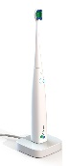

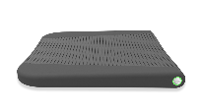

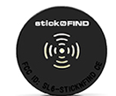


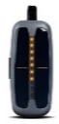

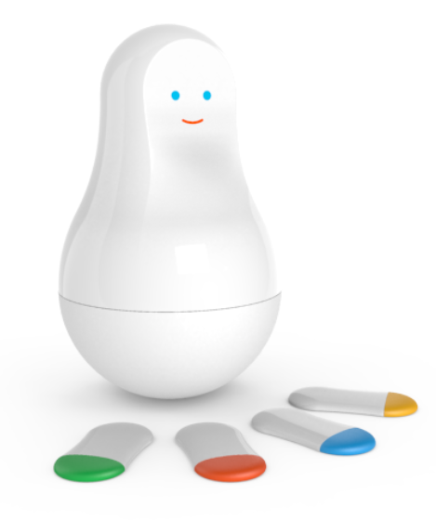
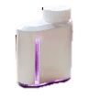

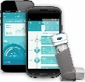




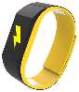



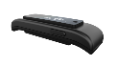



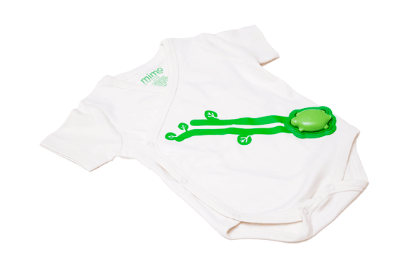
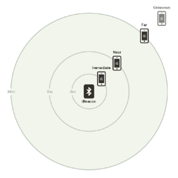
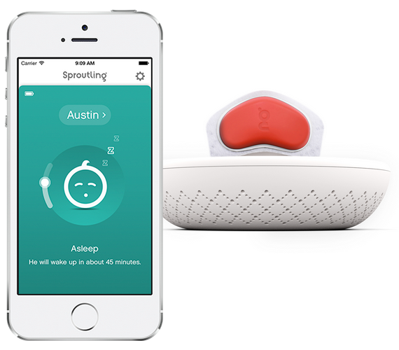


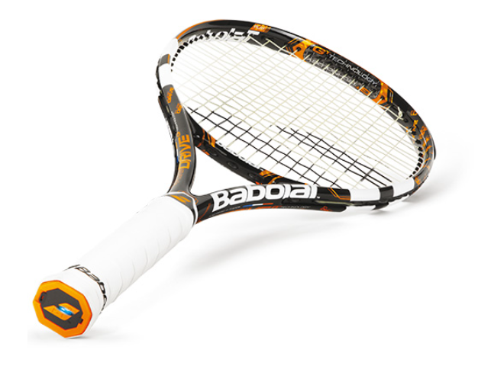

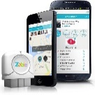





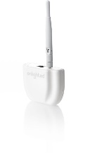




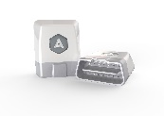
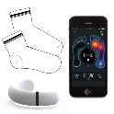
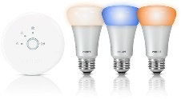




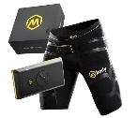
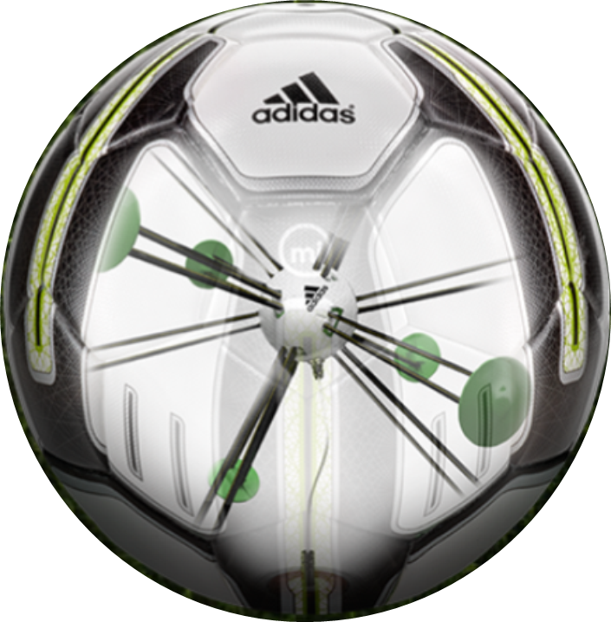


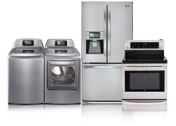
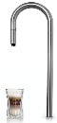
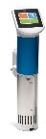
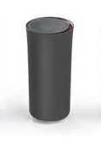

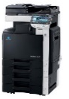
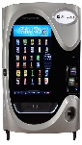
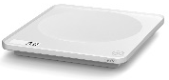

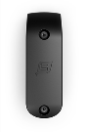
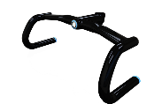
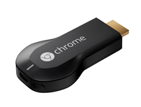




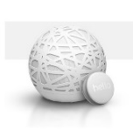
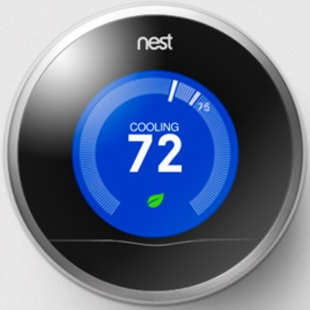
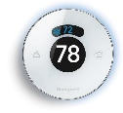
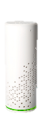

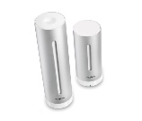
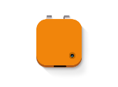
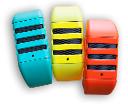
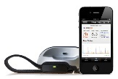




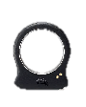


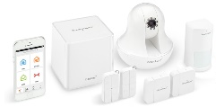
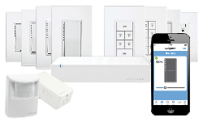
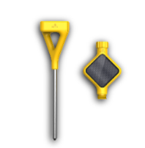
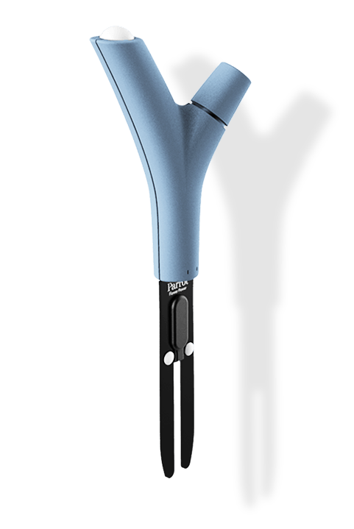

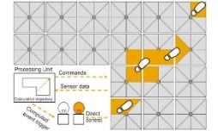
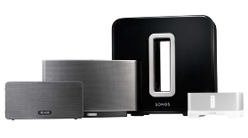



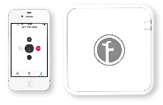
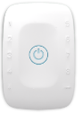




IoT Is Gaining Momentum
Medication adherence
Health monitoring
Pet tracking
Behavior modification
Object tracking
Child and elder
monitoring
Sports
and fitness
Indoor
navigation
Trip tracking and car health
Smart lighting
Beacons
and proximity
COMMUTE
COMMUTE
HOME
WORKPLACE
HOME
Smart appliances
Food and nutrition tracking
Identity
Office equipment
Smart vending machines
Bike ride stats and protection
Air conditioning and temperature control
Sleep tracking
Environmental sensors
Information capture
Control
Home security
Home automation
Leak detection
Garden, lawn and plant care
New devices and sensors
Entertainment systems

Slide 7
IoT Is Simply:
Harnessing Signals From Remote Devices

Slide 8
IoT Is Simply:
Harnessing Signals From Remote Devices
To Improve Existing Businesses
To Start New Businesses

Slide 9
IoT Is Simply:
Harnessing Signals From Remote Devices
To Improve Existing Businesses
To Start New Businesses
Though The Harnessing Part Is Tricky

Slide 10
IoT Is A New Normal

Slide 11
IoT Is A New Normal
Just Like Web, Mobile and Cloud

Slide 12
And Just Like Web, Mobile and Cloud
IoT Brings New Benefits
And New Requirements

Slide 13
Example Benefits
Cost Reduction
  Reduced Servicing Costs with Predictive Maintenance
  Reduced Maintenance Costs by Remotely Managing Devices
Increase Revenue
  New or Improved Service Offerings
  Deeper Insights for Product Innovations
  Deeper Customer Engagement Increase Retention
New Business Models
  Partnership Opportunities using IoT Data

Slide 14
Examples Requirements
End to End Cyberphysical Security & Privacy
Device Management / Remote Update of Software and Firmware
High Scale Telemetry and Command & Control
Hyperscale Cloud / Multi-Region Support
On-Premises Support
Rich Analytics / Cold and Hot Support
Support for Heterogeneous Devices & Operating Systems

Slide 15
High Level IoT Patterns
Device – Edge - Cloud

Slide 16
IoT Patterns – Edge and Cloud
Some processing is best at the edge
Some processing is best in the cloud
The two must work in harmony to realize the full benefits of IoT
Edge
Cloud
Low latency “closed loop” processing
Batching/Filtering
Network isolation
Cloud Gateway
Central monitoring & management
“Hot” and “cold” analytics
Business integration
Field Gateway

Slide 17
IoT Patterns – Stream Processing
Processing signals from sets of individual devices
“Hot path” analytics to inspect telemetry and take action
“Cold path” analytics to find patterns & insights and tune “hot path”
Balance between edge and cloud
Edge
Cloud
Cloud Gateway
Hot
Cold
Field Gateway

Slide 18
IoT Patterns – Graph Processing
Processing signals from sets of related devices
“Hot path” analytics to inspect telemetry & relationships and take action
“Cold path” analytics to find patterns & insights and tune “hot path”
Balance between edge and cloud
Edge
Cloud
Cloud Gateway
Hot
Cold
Field Gateway

Slide 19
Azure & IoT
Azure IoT Suite
  Preconfigured Solutions for IoT
  Default, customizable UX
  Provisions in minutes
  Realize end to end value quickly
  Target audience: line of business decision makers (LoBDMs)
Cloud Services for IoT
  Specialized services like Azure IoT Hub
  General purpose services: Azure Stream Analytics, Azure ML, Storage, PowerBI, Web/Logic Apps
  Target audience: cloud developers
IoT Ecosystem & Partnerships
  Azure IoT Device SDK – Open Source
  Azure Certified for IoT
  Azure Marketplace for ISV/SI Solutions

Slide 20
Final Thoughts About IoT
IoT Is A New Normal
Software is Fast, Things Are Slow
Collectively – Many Requirements To Satisfy
Interoperability and Openness Are Key
IoT Is About Partnerships and Ecosystems – Not Winner Take All

