Slide 1
Customs and Cultures
of Tribal Regions
May 2011
AFCGO Conference
Mr. Derek Harvey, Director
UNCLASSIFIED/FOR OFFICIAL USE ONLY

Slide 2
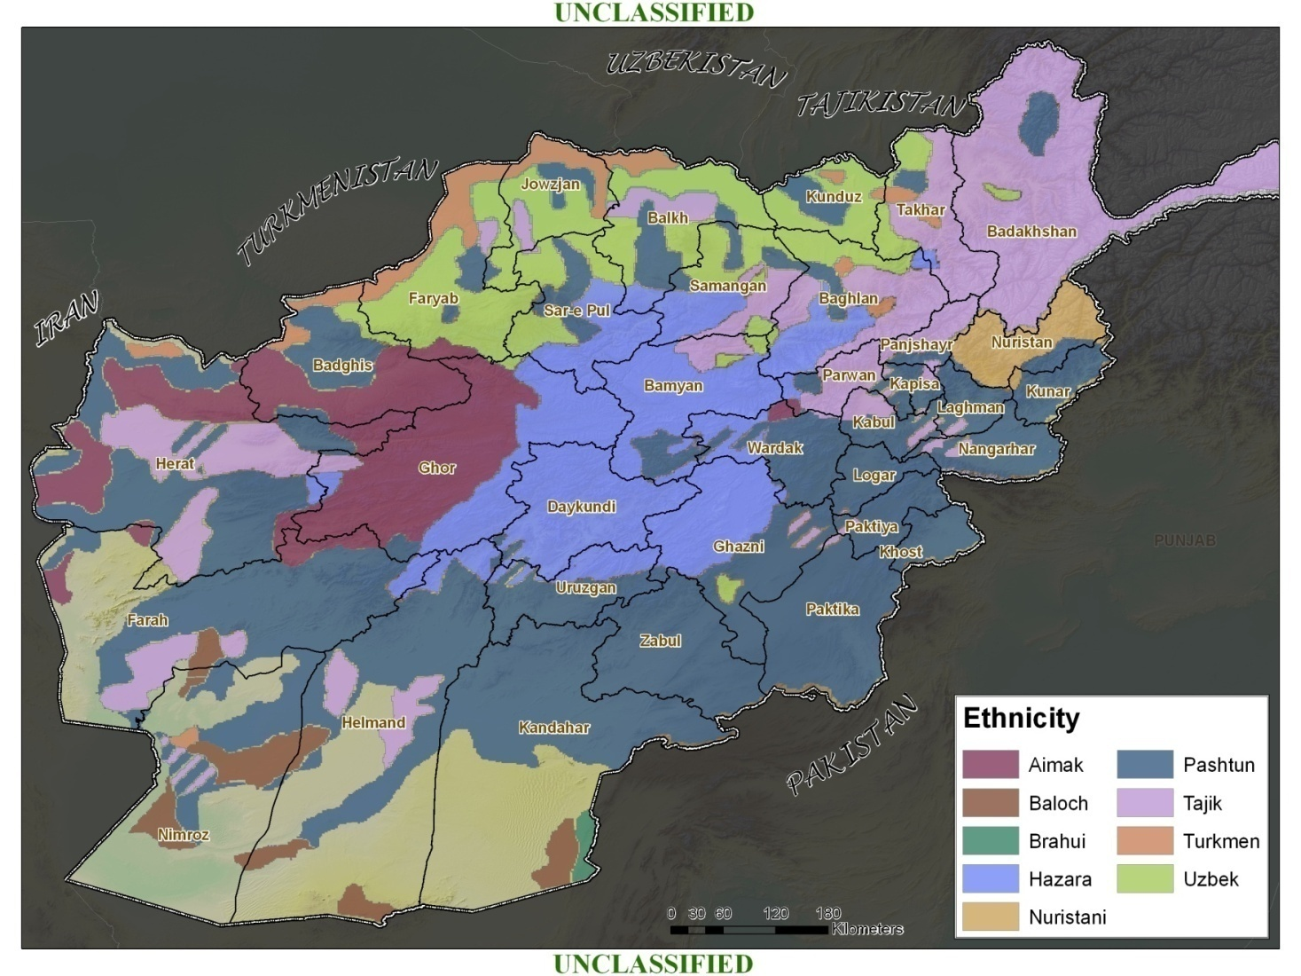
People of Afghanistan
UNCLASSIFIED
In a population-centric campaign, success requires popular buy-in.
Diversity in the population:
Poses challenge to social cohesion
Poses challenge to centralized authority
Favors locally tailored solutions
Requires village/district knowledge
UNCLASSIFIED

Slide 3
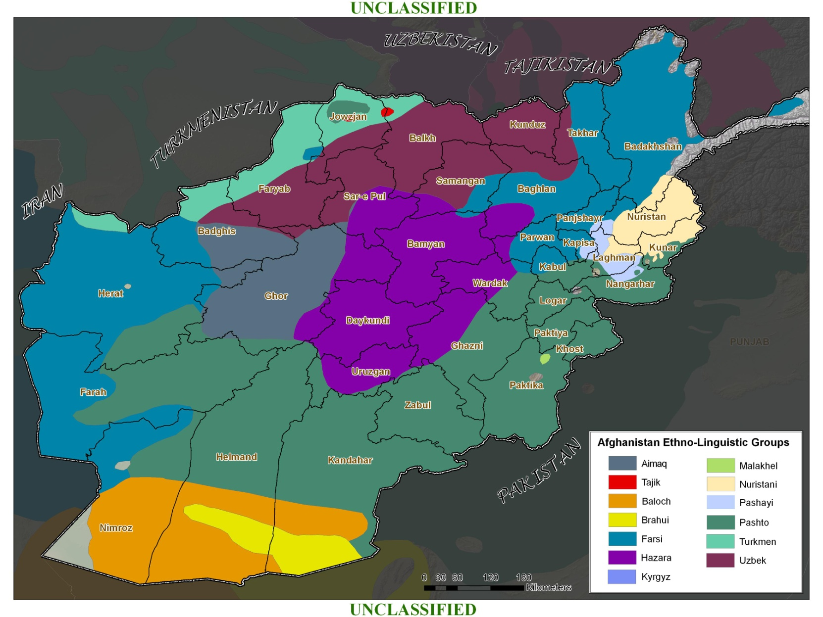
Language
UNCLASSIFIED
UNCLASSIFIED

Slide 4
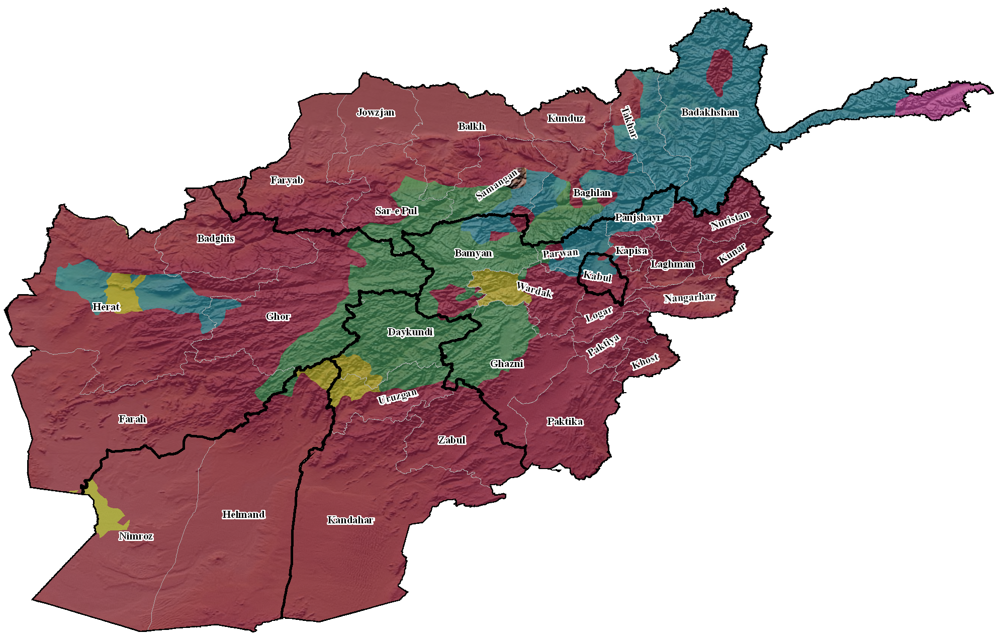
Religion
UNCLASSIFIED
Religious Demographics
Sunni Muslim (~85%)
Shi’a Muslim (~14%)
Other (~1%)
Mixed religious representation in urban centers
Majority: Sunni with heavy Sufi influence
Minority: Shia
Permeates life for all ethnic groups
For Pashtun, to be Afghan is to be Muslim
Beliefs and practices vary, are informal
LEGEND
Mixed
Shi’a Twelver
Shi’a Sevener
Sunni Hanafi
Sunni Hanbali
UNCLASSIFIED
Notes:
-The majority of Afghans are Sunnis, though there is a significant Shiite population. Sufi orders are strong and influential in Afghanistan.
-Religion is a way of life for every ethnic group in Afghanistan. It permeates every aspect of social relations, and is present in everyday conversations. To most Afghans, it is difficult to imagine a separation of religion from political, economic, moral, and legal questions because Islam is woven through every part of life.
-In Afghanistan, Islamic identity is also linked to strong, confident cultural identities. To be Turkmen, Pashtun, or Tajik is inseparable from being Muslim. Especially among Pashtuns, this self-confidence leads Afghans to see themselves as natural-born Muslims. Foreigners and foreign ideas are viewed as inferior. Even foreign Muslims are treated with suspicion. Afghans rejected doctrinal advice from foreign Muslims and resisted Taliban edicts that contradicted their traditional beliefs and practices. Because they see themselves as the purest and strongest Muslims, they believe their cultural customs and beliefs to be fully consistent with Islam.

Slide 5
Way of Life
UNCLASSIFIED
Landscape shapes lifestyles and society
  Northern and eastern societies often associated with geographic location vice ethnic/tribal identity i.e Korengal valley residents are “korengali”
  Extreme geography (mountains, vast lowlands) limits communication, development in many areas; creates strong sense of local identity and resistance to outsiders
Population primarily lives in small agricultural villages
  80 percent population is rural, avg. village is 480 people
  Limited access to education, economic opportunities, medical services
Life centers on subsistence farming and nomadism
Towns and cities serve as centers of trade
UNCLASSIFIED
Notes:
Afghanistan’s physical geography has shaped the country’s history and culture. Vast differences in climate, elevation, and water and land availability dictate trade, migration, and settlement patterns.
In subsistence farming and nomadic or semi-nomadic communities that predominate in Afghanistan’s deserts and narrow river valleys, social structures are almost flat. Most people are about as wealthy or poor as their neighbors. Village leaders earn their positions and maintain them by protecting or increasing the physical and economic security of their communities. For the overwhelming majority of Afghans, life revolves around subsistence agriculture or nomadic livestock herding. Most people live in small villages in which households work plots of agricultural land. People typically produce just enough to support themselves and their families. When extra is available, it is often invested in relationships with one’s community. Hospitality, feasts, and gift giving raise one’s status in a subsistence economy.
Society is more stratified in the irrigated river valleys and cities of Afghanistan. Wealth generated supported by agricultural surpluses and trade support a class of wealthy individuals and families. Cities and towns are centers of trade and government. As such, they are anchors for large regions throughout the country. In the Pashtun-dominated regions of Afghanistan and Pakistan, Kandahar, Kabul, Jalalabad, Ghazni, Khost, Peshawar, Quetta are some of the most important urban anchors. Maintaining control and stability in these cities has been critical for successive governments to establish influence over rural populations

Slide 6
Customs & Culture
UNCLASSIFIED
Pashtuns are the most prominent ethnicity with tribal lineages
Subscribe to Pashtunwali
  Code of conduct for an ideal way of life
  Adherence part of Pashtun identity
Core Values of Pashtunwali
  Honor
  Hospitality
  Restorative justice
  Consensus
Trust
  Measured by behavior over time
Egalitarianism
  Status is earned
  The entire community has a voice, action by community consensus vice head sheik
UNCLASSIFIED
Notes:
-Pashtunwali – the way of the Pashtun – is the foundation of Pashtun identity and culture. Its tenets form an ideal code of conduct in an ideal society. Pashtunwali is not written, and its components are stressed differently across Pashtun communities. No one ever perfectly adheres to Pashtunwali, but its core concepts are widely agreed to encompass the most important values of Pashtun society.
-The most important values of Pashtunwali are:
-Honor: Defense of family or community honor and reputation is important throughout Afghanistan. However, it is the heart of rural Pashtun culture. Offenses against one person obligate their entire family or village to seek reconciliation or retribution to restore their honor.
-Hospitality: Guests and travelers are watched and cared for.
-Restorative Justice: When losses of life, limb, property, and honor are suffered, Pashtuns emphasize restoring the victim rather than punishing the offender. This can occur through payments, exchanges of goods, or apologies, often through negotiations involving the whole community. If a suitable agreement cannot be reached, the aggrieved party may seek revenge through violence.
-Consensus: Pashtunwali prizes community consensus. Decisions that effect the entire community are made by the entire community. Peace and stability in the community trump individual concerns.
Trust is a cornerstone of personal and communal relationships among Afghans, just as it is in other places. Most Afghans live in small communities where everyone knows everyone else and their history of behavior. These relationships form a foundation of trust for social and economic interactions to take place. Outsiders need to establish a record of behaviors to build the same foundation of trust.
-Afghan – especially Pashtun – communities are highly egalitarian. On matters that affect the entire community, everyone has a voice in building a consensus. In most places, leadership is earned, rather than passed down.

Slide 7
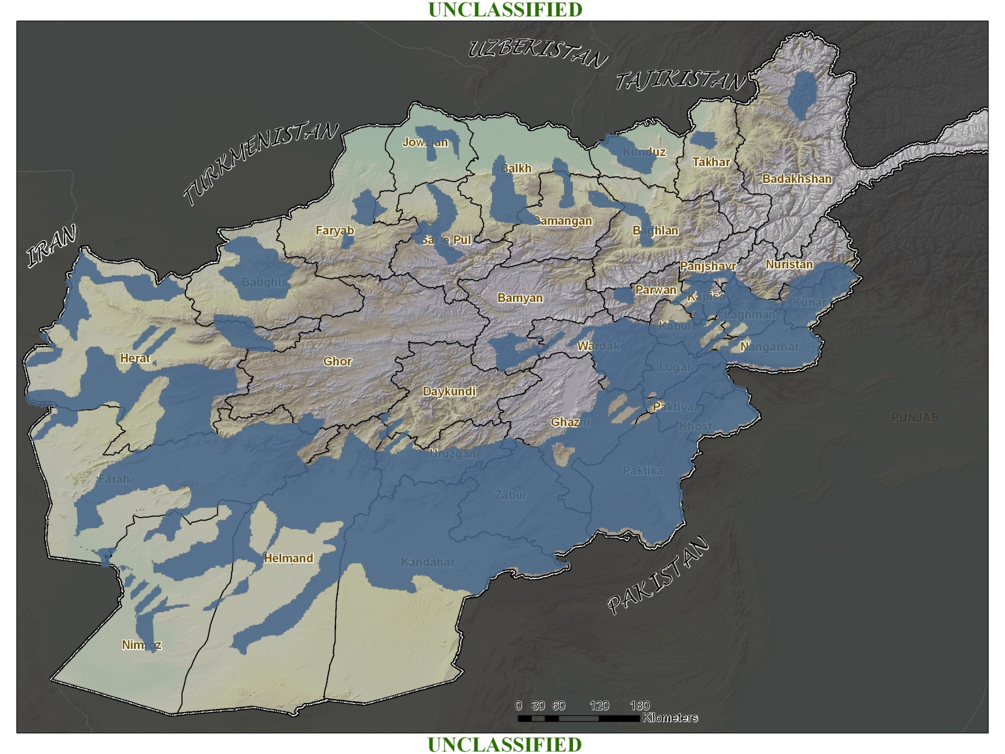
Pashtuns
UNCLASSIFIED
  Largest ethnic group
  Dominate area spanning eastern, southern, and western Afghanistan, as well as portions of Pakistan
  Predominantly Sunni Muslims
  Subscribe to Pashtunwali
  Constructed of tribal lineages, but tribal affiliation is not a single motivator for behavior or action
UNCLASSIFIED
Notes:
-Ethnicity is the fundamental basis for identity in Afghanistan. The Afghan populace divides itself into several large ethnic groups.
-The Pashtuns represent the largest ethnic group in Afghanistan. They are predominantly Sunni Muslims and subscribe to Pashtunwali, which is an overarching code of conduct and way of life. This unwritten code of honor is a system in which possession of honor guarantees membership in the society. Honor is required to maintain the rights, protection and support of the community.
-Pashtuns dominate an area that spans eastern, southern, and western Afghanistan, as well as portions of Pakistan. This area is known as Pashtunistan, the Pashtun Belt and Pakhtunkhwa.

Slide 8
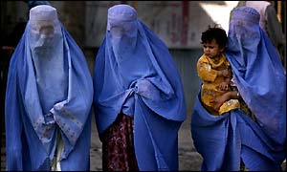
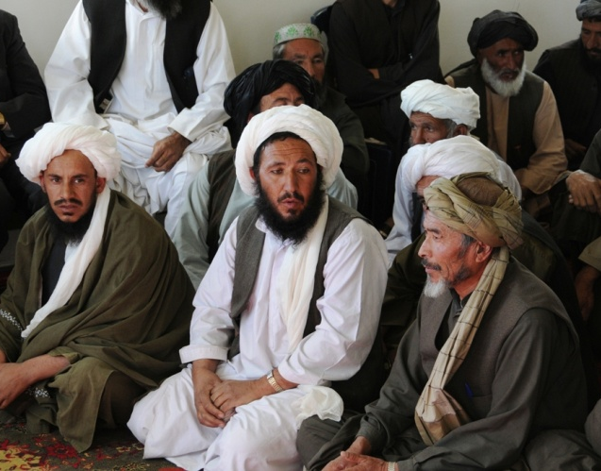
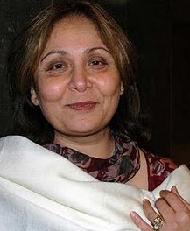
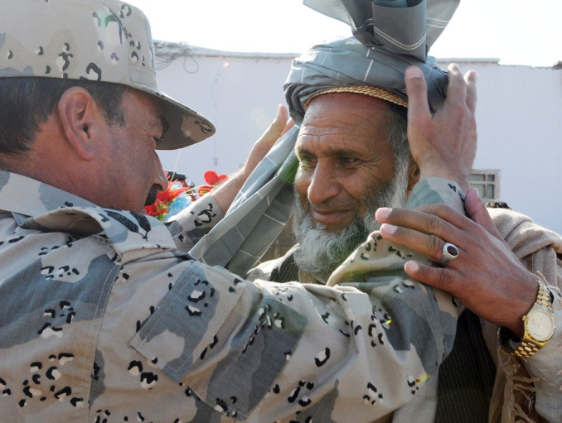
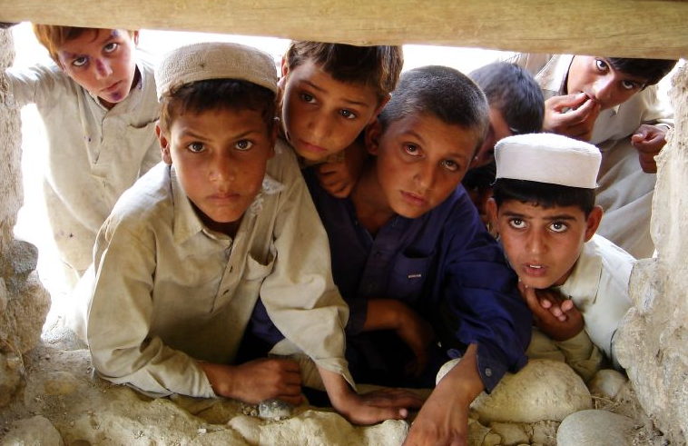
Pashtuns
UNCLASSIFIED
  Largest ethnic group
    Constructed of tribal lineages, but tribal affiliation is not a single motivator for behavior or action
  Predominantly Sunni Muslims
  Subscribe to Pashtunwali
  Dominate area spanning eastern, southern, and western Afghanistan, as well as portions of Pakistan
UNCLASSIFIED
Notes:
-Ethnicity is the fundamental basis for identity in Afghanistan. The Afghan populace divides itself into several large ethnic groups.
-The Pashtuns represent the largest ethnic group in Afghanistan. They are predominantly Sunni Muslims and subscribe to Pashtunwali, which is an overarching code of conduct and way of life. This unwritten code of honor is a system in which possession of honor guarantees membership in the society. Honor is required to maintain the rights, protection and support of the community.
-Pashtuns dominate an area that spans eastern, southern, and western Afghanistan, as well as portions of Pakistan. This area is known as Pashtunistan, the Pashtun Belt and Pakhtunkhwa.

Slide 9
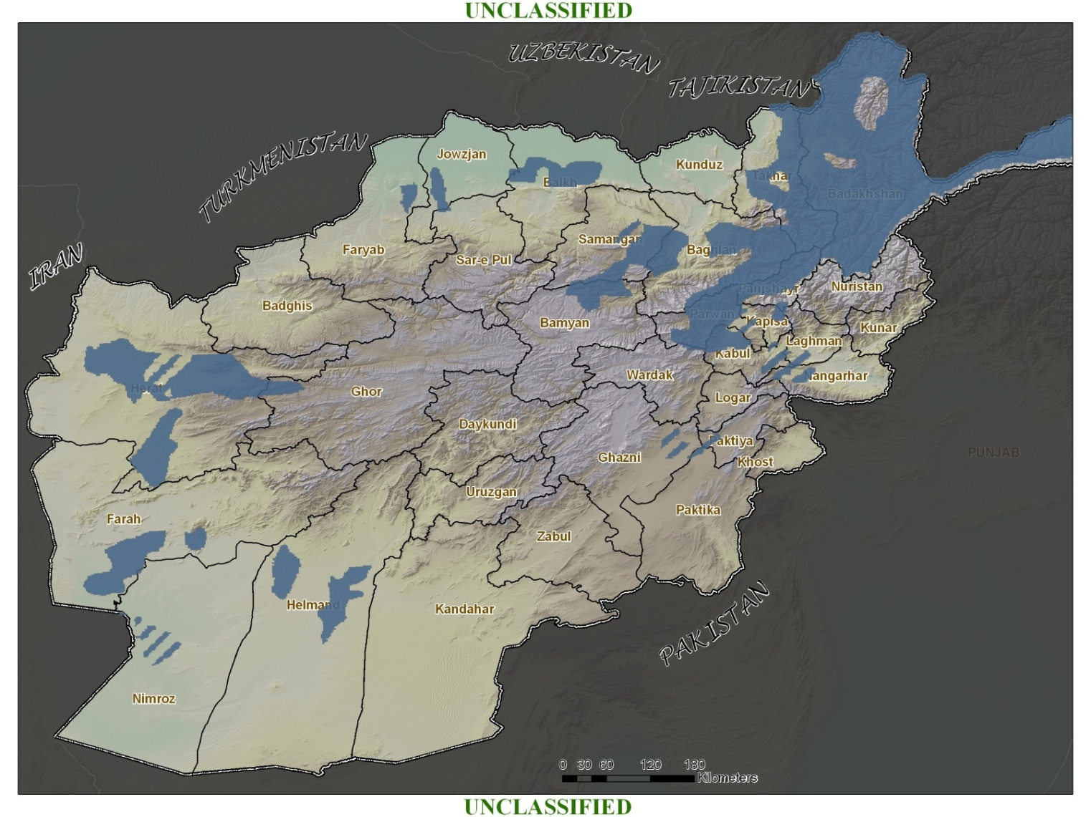
Tajiks
UNCLASSIFIED
  Second largest ethnic group
  Sunni Muslims with a Shia minority
  Most affluent and educated people in Afghanistan
  Greatest numbers in urban centers
  Main rivals of Pashtuns: vie for power and influence
UNCLASSIFIED
Notes:
-Tajiks are the second largest ethnic group in Afghanistan. They are primarily Dari-speaking Sunni Muslims with a Shia Minority (mostly in Western Afghanistan). The importance of kinship to the Tajiks does not extend much beyond the extended family or village; therefore, tribalism is weak.
-They are the most affluent and educated people in Afghanistan and are found in the greatest numbers in urban centers.
-Tajiks are the main rivals of the Pashtuns, vying for power, control and influence in Afghanistan.

Slide 10
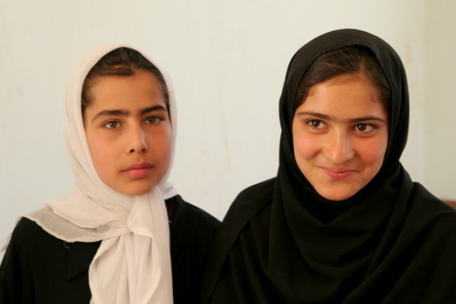
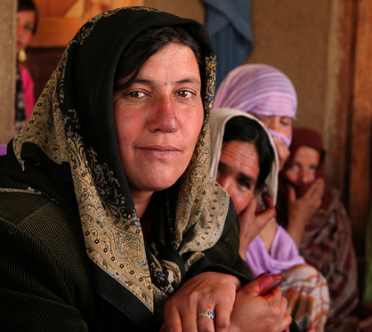
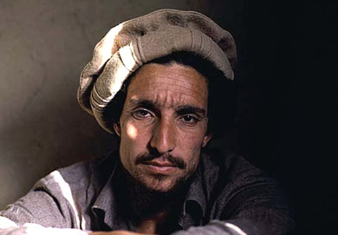
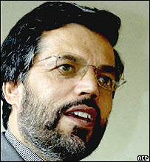
Tajiks
UNCLASSIFIED
  Second largest ethnic group
  Sunni Muslims with a Shia minority
  Most affluent and educated people in Afghanistan
  Greatest numbers in urban centers
  Main rivals of Pashtuns: vie for power and influence
UNCLASSIFIED
Notes:
-Tajiks are the second largest ethnic group in Afghanistan. They are primarily Dari-speaking Sunni Muslims with a Shia Minority (mostly in Western Afghanistan). The importance of kinship to the Tajiks does not extend much beyond the extended family or village; therefore, tribalism is weak.
-They are the most affluent and educated people in Afghanistan and are found in the greatest numbers in urban centers.
-Tajiks are the main rivals of the Pashtuns, vying for power, control and influence in Afghanistan.

Slide 11
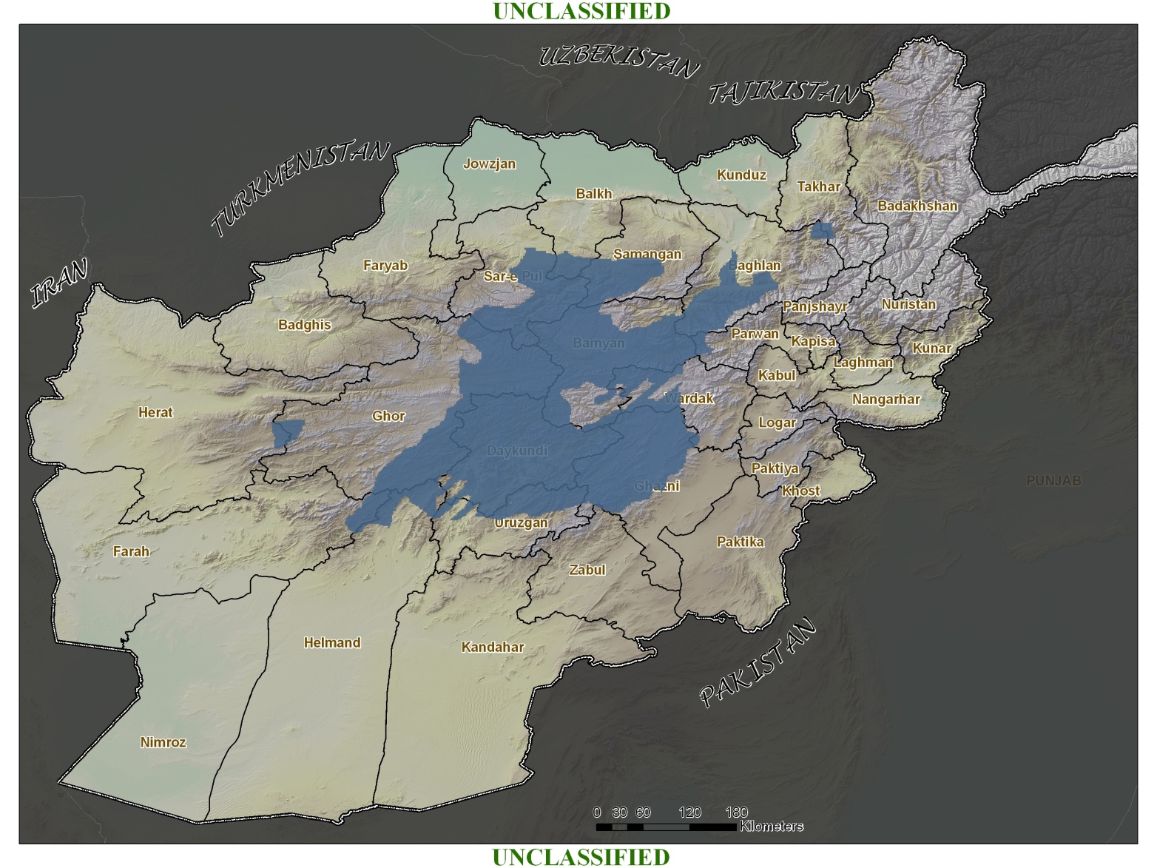
Hazaras
UNCLASSIFIED
  Imami Shia, with natural ties to Iran
  Target of discrimination and violence throughout Taliban reign
  Suspicious of Pashtun dominated government
UNCLASSIFIED
Notes:
-Hazaras are the third largest ethnic group. They are Shia and have natural ties to Iran and are mostly concentrated in Hazarajat, the mountainous area in central Afghanistan. Hazaras have been the target of punitive discrimination and violence in Afghanistan due to their perceived ethnic, Mongolian roots and religious beliefs. The persecution created a unified ethnic group. The Hazaras view the Pashtun-dominated government with suspicion.

Slide 12
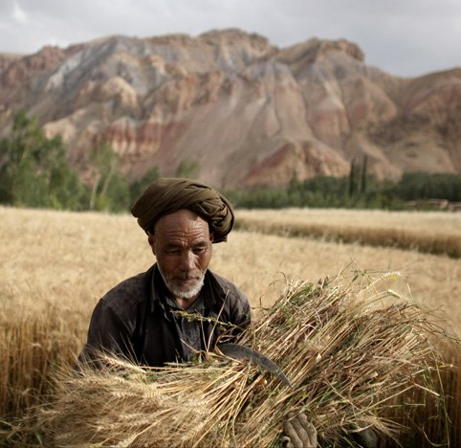
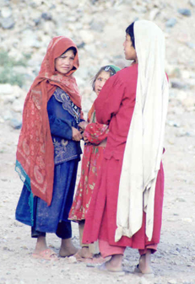
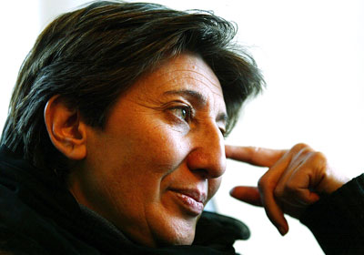
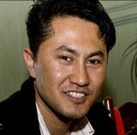
Hazaras
UNCLASSIFIED
  Imami Shia, with natural ties to Iran
  Target of discrimination and violence throughout Taliban reign
  Suspicious of Pashtun dominated government
UNCLASSIFIED
Notes:
-Hazaras are the third largest ethnic group. They are Shia and have natural ties to Iran and are mostly concentrated in Hazarajat, the mountainous area in central Afghanistan. Hazaras have been the target of punitive discrimination and violence in Afghanistan due to their perceived ethnic, Mongolian roots and religious beliefs. The persecution created a unified ethnic group. The Hazaras view the Pashtun-dominated government with suspicion.

Slide 13
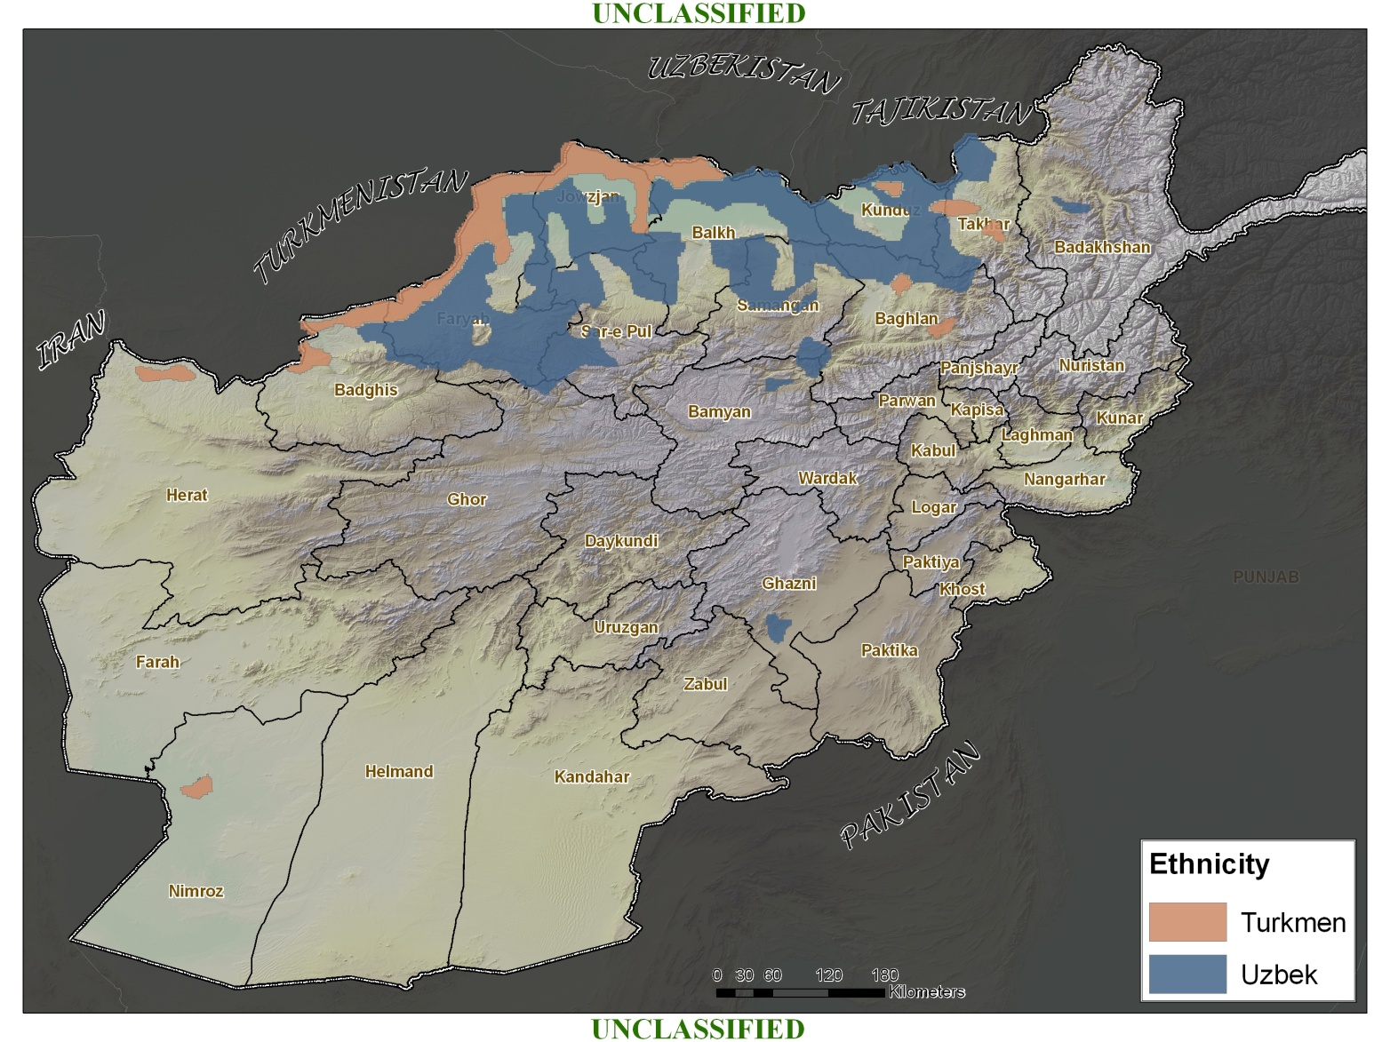
Turkmen and Uzbeks
UNCLASSIFIED
  Uzbeks and Turkmen closely related
  Sunni Muslim
  Turkmen: traditionally nomadic
UNCLASSIFIED
Notes:
-The Uzbeks and Turkmen are closely related and are largely Sunni. Uzbeks are the fourth largest ethnic group and are mainly found in the northern regions. Turkmen are the fifth largest ethnic group and are mostly found in the areas near Turkmenistan. The Turkmen are traditionally nomadic people.

Slide 14
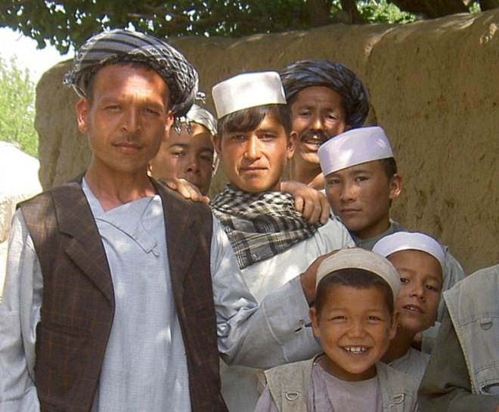
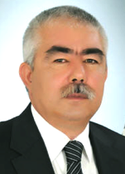
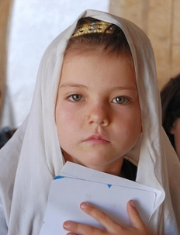
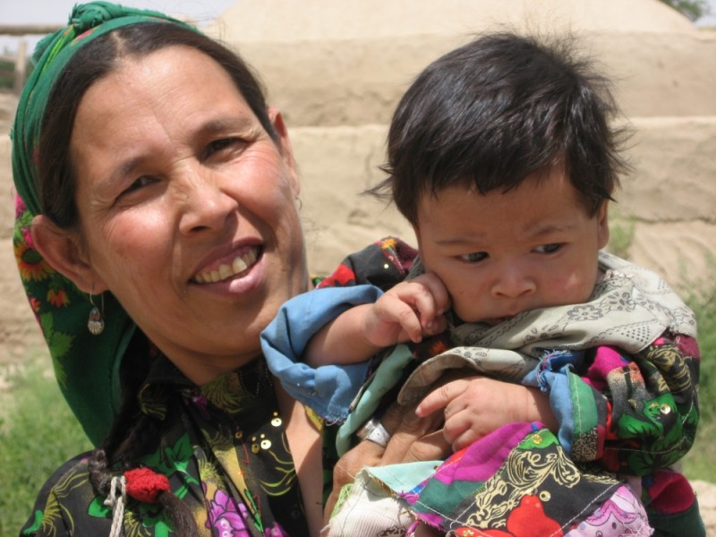
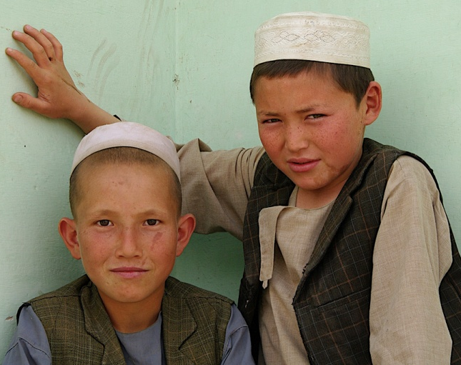
Turkmen and Uzbeks
UNCLASSIFIED
  Uzbeks and Turkmen closely related
  Sunni Muslim
  Turkmen: traditionally nomadic
UNCLASSIFIED
Notes:
-The Uzbeks and Turkmen are closely related and are largely Sunni. Uzbeks are the fourth largest ethnic group and are mainly found in the northern regions. Turkmen are the fifth largest ethnic group and are mostly found in the areas near Turkmenistan. The Turkmen are traditionally nomadic people.

Slide 15
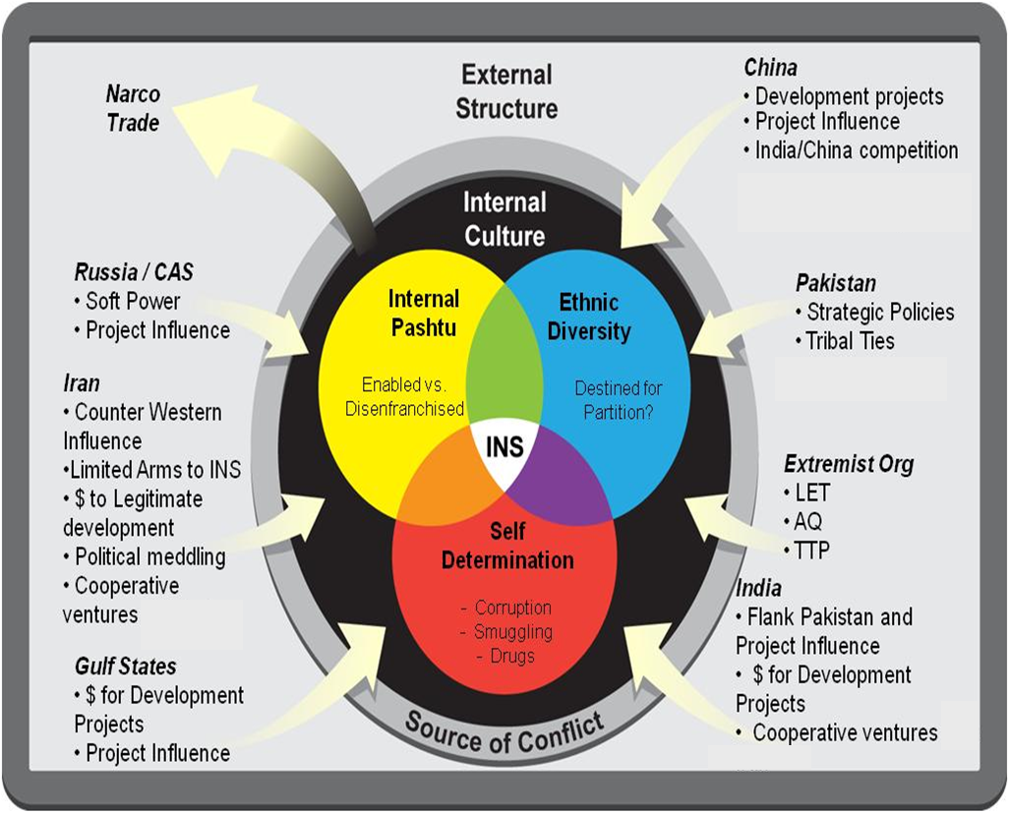
AFG State of Conflict: Regional Perspective
UNCLASSIFIED/FOR OFFICIAL USE ONLY
Afghanistan is a Struggle for a Distribution of Power, Influence and Authority
- Conflict is enabled by regional structure and internal cultures
Intra-Pashtu rivalries and power struggles
  Ethnic and Regional Competition
  Individuals/Groups seeking greater self determination
  External Influencers
  The Insurgencies are empowered not empowering -- proxy by many, representative of few
UNCLASSIFIED/FOR OFFICIAL USE ONLY

