Slide 1
Reserve Opportunities
Air Force Reserve
Col Joe N. Wilburn
Reserve Command Recruiting Service

Slide 2
OVERVIEW
  Reserve End-Strength and Locations
  Participation Opportunities
  Benefits of Reserve Service
  Contact Info

Slide 3
END-STRENGTH AND LOCATIONS
  FY11 Selected Reserve (71,200)
    Unit (59,572)
    IMA (8,636)
    AGR (2,992)
  42 Geographically Separated Wings/Groups
  IMA Training Detachments Worldwide

Slide 4
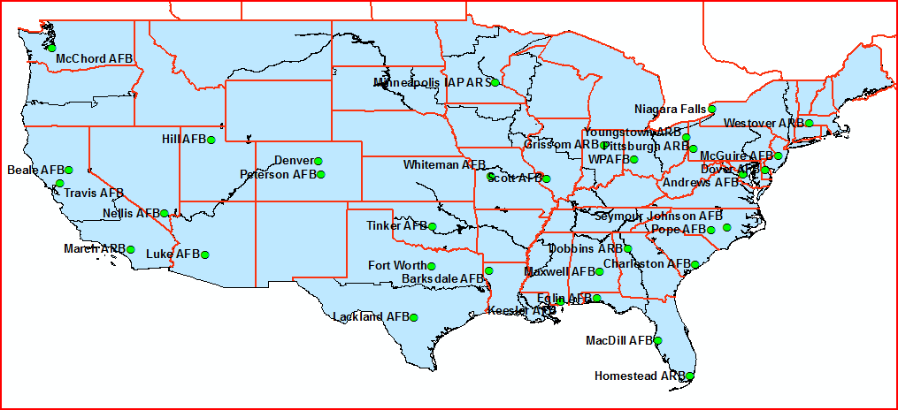
END-STRENGTH AND LOCATIONS

Slide 5
PARTICIPATION OPPORTUNITIES
  Traditional Reservist (TR)
    Unit: Minimum 1 weekend/month; 2 weeks/yr—support Reserve wing
    IMA: Same minimum participation; training schedules may be more flexible—support RegAF
  Air Reserve Technician (ART)
    Civil Service employee with monthly/annual military training requirements
  Active Guard Reserve (AGR)
    Reservists serving in active duty status
    Normally hired from TR status

Slide 6
BENEFITS OF CONTINUED SERVICE
  SERVICE

Slide 7
BENEFITS OF RESERVE SERVICE
  Retirement at Age 60
    20 “good yrs” based on total participation
    Opportunity cost—benefits!
  Low Cost Health and Dental Care (mbr/family)
    TRICARE Reserve Select
      Member $53.16
      Family $197.76
    TRICARE Dental
      Member $12.69
      Family w/1 dependent = $31.72; >1 = $79.29
  Commissary/BX privileges/MWR facilities

Slide 8
BENEFITS OF RESERVE SERVICE
  SGLI ($26/month = $400K coverage)
  Tuition Assistance
    DANTES (up to 100%; $4,500 annual)
    1-time certification $4,500 lifetime cap (57 accredited schools: Six Sigma, EMT, vocational, real estate, etc.)
  Space A Travel
  Thrift Savings Plan
  Spouse Testing Program (free CLEP at any wing)
  Potential Bonuses ($10K—10 officer AFSCs)

Slide 9
BENEFITS OF CONTINUED SERVICE
  Retirement Annuity Scenario: Capt (age 30) with 6 yrs ADAF + 14 in Reserve (retiring as Lt Col)
    6 yrs X 365 (points per day) = 2,190 pts
      2,190 pts X annuity factor (.535) = $1,170.64 (current value of retirement
    14 yrs X 75 (min good year pts) = 1,050 pts
    3,240 pts + future value of pts due to inflation
  Monthly Retirement at age 60 = $4,363.76
  Annual Retirement at age 60 = $52,377.10

Slide 10
CONTACT INFO
  67 In-Service Recruiters in major RegAF MPFs
    Should contact you before sep date
    Smaller MPFs: other recruiters asgn’d part-time
  46 Officer Accession & Health Professions Recruiters
  www.AFReserve.com or 1-800-257-1212 to reach an AFR e-Advisor

Slide 11
SUMMARY
  Reserve End-Strength and Locations
  Participation Opportunities
  Benefits of Reserve Service
  Contact Info

Slide 12
Questions ?

Slide 13
Backup Slides

Slide 14
BENEFITS OF RESERVE SERVICE
RETIREMENT ANNUITY WORKSHEET
 | FOR: | Captain America with 6 years AD, 14 min good years AFR, retiring as Lt Col
6.00 |  |  |  | X |  | 365 |  | = |  |  | 2190
Active Duty: Number of Years (current or past) |  |  |  |  |  | Points per year |  |  |  |  | Active Duty Points (total years multiple by 365)
 |  |  |  |  | Current Value of Retirement = |  |  |  |  |  | $1,170.64
 |  |  |  |  |  |  |  |  |  |  | Current Points Multiple by Annuity Point Value
14 |  |  | X | 75 |  | + | 0 |  | = |  | 3240
Years remaining in USAFR |  |  |  | Points for a good year |  |  | Current points accrued |  |  |  | Total Retirement Points
 |  |  |  |  |  |  |  |  |  |  | Points equals Years * Points per year + Current Reserve points accrued + Active duty Points
 | 30 |  |  |  |  |  | 2.5202 | Inflationary multiplier
 | Applicant Age
 | 1.045 | % |  |  |  | Future Value of points = |  |  |  |  | 1.347
Average Inflation Rate is 4.5%
 | 0.53454 |  |  | Monthly Retirement Pay at age 60 = |  |  |  |  |  |  | $4,364.76
Annuity Point Value
Using Point Valuation Chart
 | 0 |  |  | Annual Retirement Pay at age 60 = |  |  |  |  |  |  | $52,377.10
Annuity Multiplier (this is the number of years to age 60)

