Slide 1

Click anywhere to get started…

Slide 2

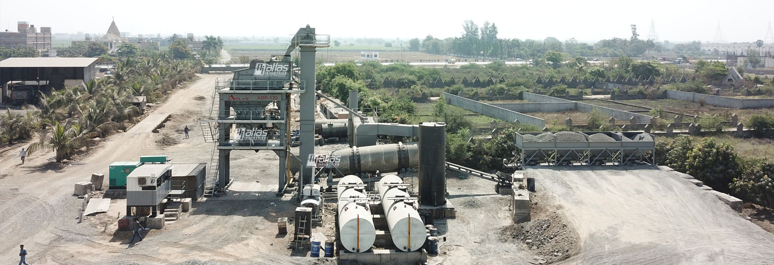

ASPHALT DRYER ENTRY TALK
Notes:
Asphalt Dryer Entry Talk

Slide 3
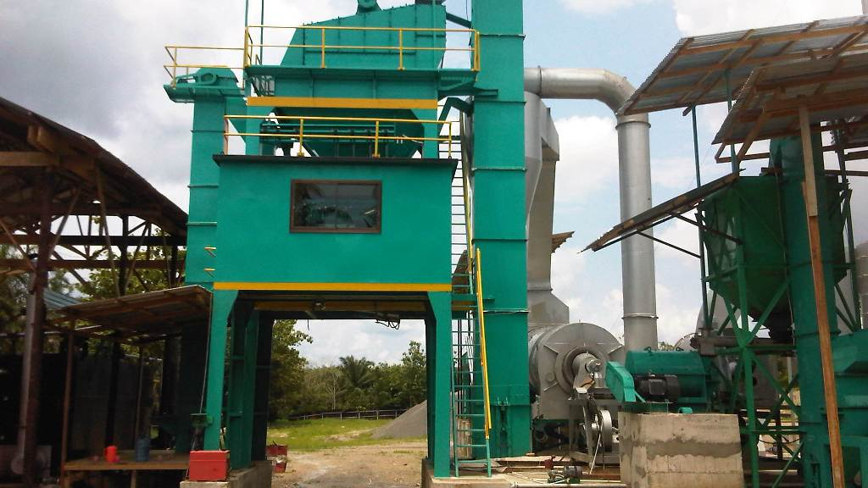
What’s at Stake?
Asphalt plants can be very dangerous places. Accidents, sometimes fatal, happen far too often. Most accidents can be traced to the same root cause; the pressure for more production supersedes common sense and normal safety protocols. A lot of safeties are by-passed in the effort to reach production quotas.
Notes:
What’s At Stake?
Asphalt plants can be very dangerous places. Accidents, sometimes fatal, happen far too often. Most accidents can be traced to the same root cause; the pressure for more production supersedes common sense and normal safety protocols. A lot of safeties are by-passed in the effort to reach production quotas.

Slide 4
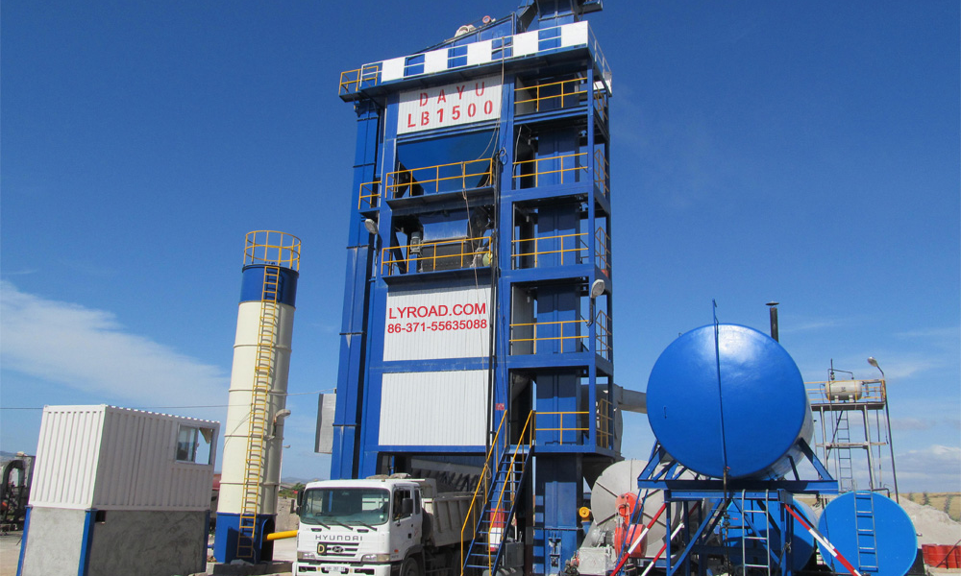
What’s the Danger?
GENERAL
When dealing with safety issues, one must keep in mind the fact that you need to be safe all the time-- you need only be careless once for tragedy to strike.
Notes:
What’s The Danger?
When dealing with safety issues, one must keep in mind the fact that you need to be safe all the time-- you need only be careless once for tragedy to strike.
Asphalt plants can be very dangerous places. Accidents, sometimes fatal, happen far too often. Most can be traced to the same root cause: the need for production superseding common sense and normal safety practices.
Under the pressure of production quotas people did things that they may not have done in ordinary circumstances, and, it ended up costing them dearly.
Asphalt plant operators often feel tremendous pressure to produce hot mix by any means possible. Unfortunately, this shifts the focus off of safety and onto money.
Another potentially dangerous activity around portable plants is the handling of hot asphalt oils. Each year a large number of people are burned when they are careless, equipment fails or hot oil is forced into plugged lines. A hose that fails explosively under high pressure can send a surprising amount of oil in a large radius, to the peril of anyone unfortunate enough to be standing near.
The flame used to heat stubborn pumps, lines and off-loading hoses can sometimes cause problems, especially in those area where housekeeping is lax.
Hazards Result From
Significant traffic movements
Conveying of raw materials
Risk of burns from hot liquids, hot materials and hot surfaces
Risk of fire from hot liquid ignition
Falls from height
Moving equipment such as skip trolleys
Screw Conveyors, drives, motors and chains
large quantities of fuel in tanks or pipe lines
Confined Space Entry during maintenance operations

Slide 5
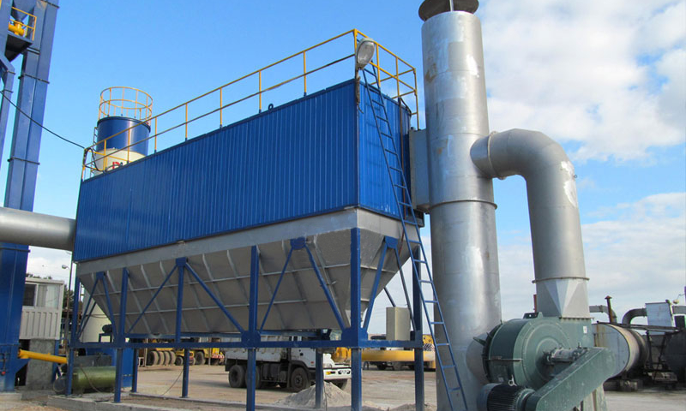
How to Protect Yourself
KEEP EVERYONE SAFE
Accidents can happen on regular days when everything seems to be working smoothly. Remember that stockpiles look more like hills and mountains than they do aggregate materials when dusk sets in, thus lighting becomes integral to safety. Truck drivers who aren’t familiar with your yard can turn a specific corner at your site, become blinded by the afternoon sun, and put ground personnel in danger. PPE becomes integral to safety.
Notes:
6 Ways To Keep Everyone Safe
Look out for one another
Look out for others. Always use machine guards when you are working on or repairing equipment. If you need to step away from the machine, lock it out and tag it out.
Let a supervisor know if a co-worker does something unsafe. If you see co-workers doing something unsafe, let them know. If they continue to work unsafely, talk to your supervisor.
Keep track of each other
Owners should have a sign-in/sign-out sheet that shows plant operators and managers who is on the site and when. If someone hasn’t been seen or heard from in a while, contact him or her by radio to make sure all is well.
Carry handheld radios or install hands-free intercoms in multiple locations on the plant.
Communicate with Passion
Owners should use a plant start-up siren and/or start-up lights to signal the commencement of production. This gives plant personnel, truck drivers, and others time to move away to a safe place prior to the plant starting.
Employ all the senses.
Look around you before you do anything at an asphalt plant. Look where you are walking, standing or climbing. Be aware of your surroundings. There is constant motion of machinery and equipment at a plant site. Watch out for trucks and loaders; they generally have the right of way.
Always use PPE
With most surfaces at the plant storing heat, personnel should wear the long sleeves, thick gloves, safety glasses, etc. Something every source agreed upon was the use of personal protective equipment (PPE). Original equipment manufacturers (OEMs) also want to see plant personnel wearing safety vests, hard hats, highly visible clothing and the gear typically reserved for the paving crew.
The Plan
If the unthinkable occurs, a well-practiced emergency plan can keep a situation from going from bad to worse. Owners should institute a clearly defined emergency plan. Make sure personnel know the phone numbers for police, ambulance, hospital, etc. Owners should add evacuation routes and an assembly area to that plan. You want to meet in an agreed-upon area where all personnel can be counted, and accounted for, if a serious accident takes place.

Slide 6
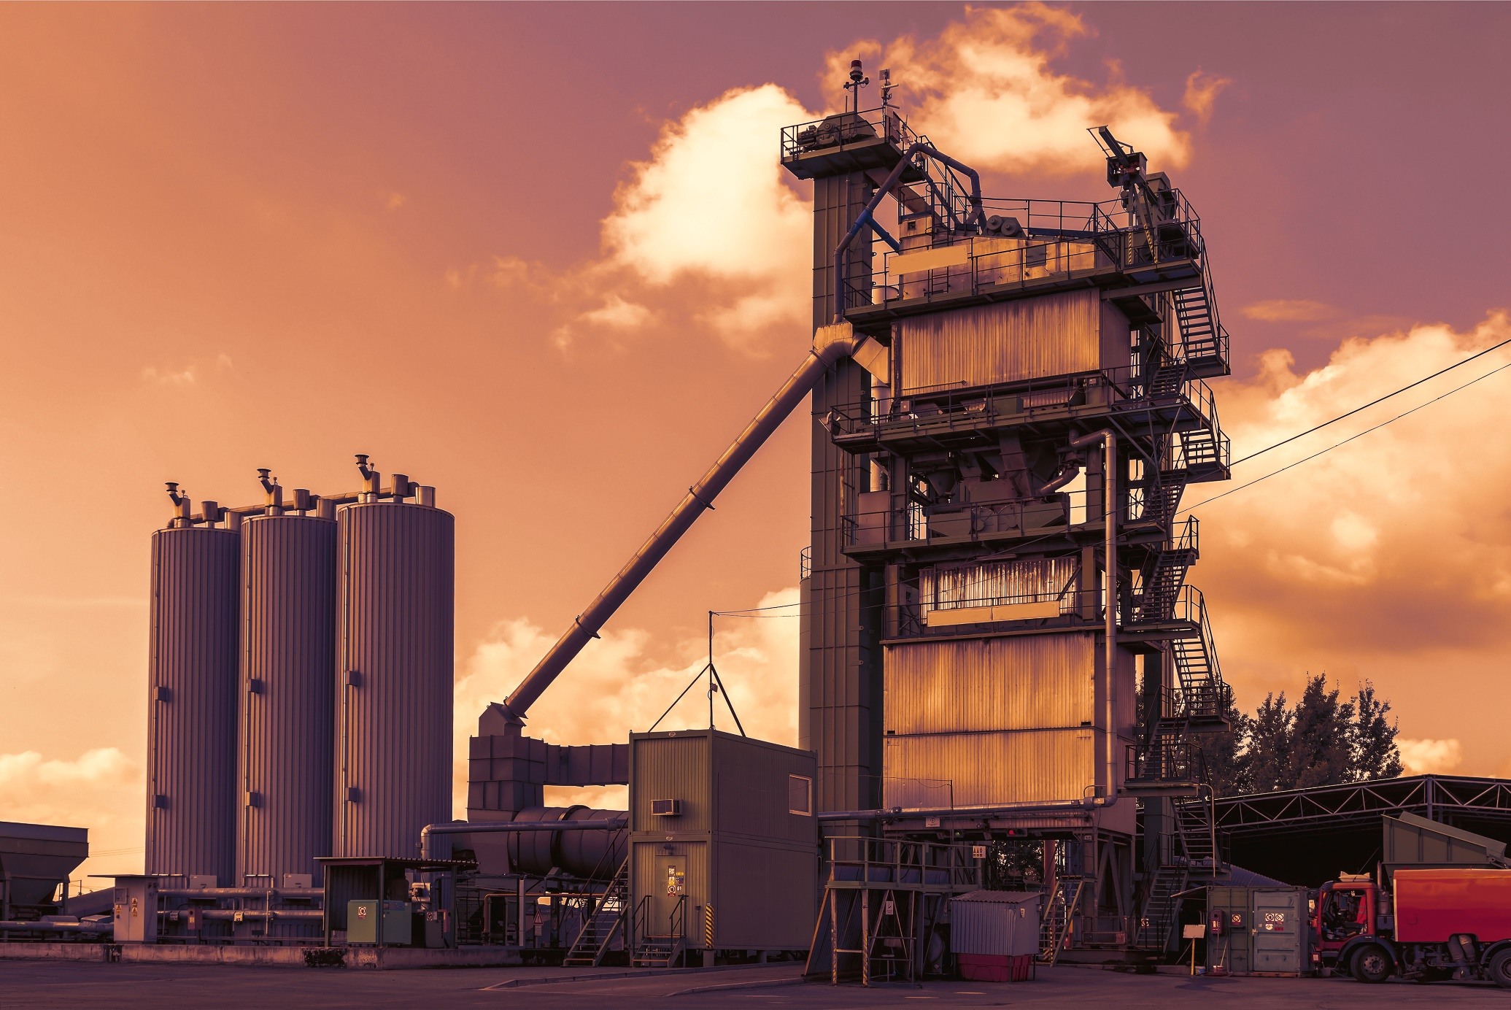
How to Protect Yourself
SPECIFIC SAFETY MEASURES
Asphalt Fires
Asphalt oil fires are difficult to extinguish, once they get going.
Truck Traffic and the Loader
One area of safety that is routinely compromised at many asphalt plants is the conflict between truck traffic and the needs of the loader operator to access his stockpiles.
Notes:
How to Protect Yourself
Specific Safety Measures
Asphalt Fires
Asphalt oil fires are difficult to extinguish, once they get going. The best way to prevent these fires is to deny them a chance to get started in the first place. Oil messes should be cleaned up immediately. Any leaking fittings, hoses or shaft seals should be repaired or replaced at once. In addition, a liberal sprinkling of five and ten pound fire extinguishers around the off-loading area will go a long way toward minimizing the damage should an incident occur. A shovel and a modest pile of sand can also provide some insurance, and are useful in cleaning up oil spills. If a person is consistently careless and puts themselves and others at risk, perhaps it's time to replace that person.
Truck Traffic and the Loader
One area of safety that is routinely compromised at many asphalt plants is the conflict between truck traffic and the needs of the loader operator to access his stockpiles. Small pits, filled with the aggregate for coming jobs, sometimes offer precious little space to set-up a plant.
It seems obvious that the utmost care must be exercised during the time the trucks are vulnerable, yet each year trucks are wrecked and their drivers hurt from loader/truck encounters. One method of combating this problem is to have weekly safety meetings prior to the start-up of operations each Monday. The loader man and all truck drivers should discuss the ways to keep their respective activities safe for the others and work out a plan that is acceptable to everyone involved. A common C.B. (citizen band) radio in the loader and one in each of the trucks can go a long way toward eliminating conflicts.

Slide 7
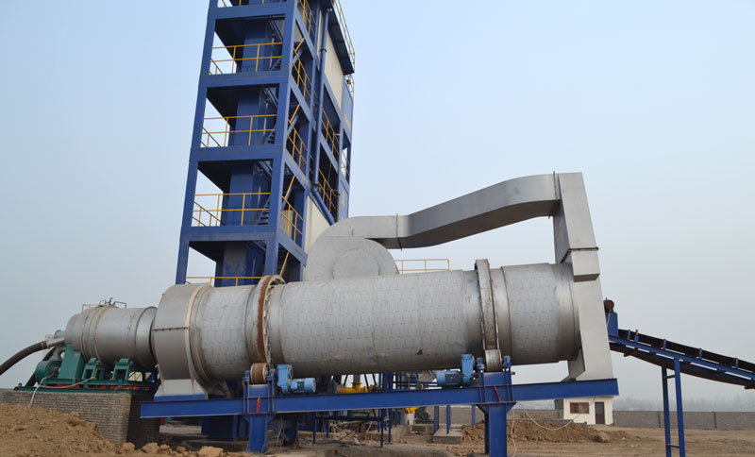
How to Protect Yourself
Climbing
People routinely climb around on asphalt plants when they are being torn down, and surprisingly
Common Sense/ Rigid Safety Program
Notes:
How to Protect Yourself
Climbing
People routinely climb around on asphalt plants when they are being torn down, and surprisingly, few of them are even aware that OSHA regulations require the use of an approved safety restraint belt whenever a person is over 6 ft from the ground. Other people shy away from their use because the devices are awkward and uncomfortable.
Common Sense/Ridgid Safety Program
Two things can work together at your asphalt plant to increase safety: common sense and a rigid safety program that includes mandatory meetings to discuss safety protocols. Effort should be made to discuss other issues in addition to the basic things like the need for hard hats, eye protection and proper clothing. Everyone should have a voice, from the top down. Even the truck drivers, who spend a lot of time around plants. And if anyone has a concern, it needs to be recognized and addressed.

Slide 8
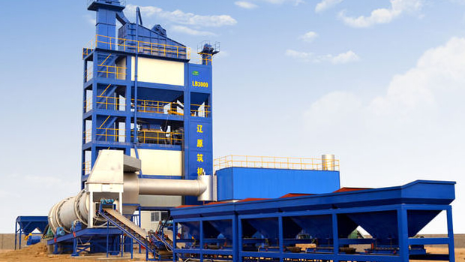
Final Word
Asphalt plant operators often feel tremendous pressure to produce hot mix by any means possible. Unfortunately, this shifts the focus off of safety and onto money.
Notes:
Final Word
Asphalt plant operators often feel tremendous pressure to produce hot mix by any means possible. Unfortunately, this shifts the focus off of safety and onto money. Perhaps a clear-cut set of guidelines dealing with company policy on safety issues should be drawn up and distributed to everyone involved with the plant. Be sure to include the Paving Superintendent. This individual can exert enormous pressure on the plant operator without even realizing that he is doing it.

