Slide 1

Click anywhere to get started…

Slide 2

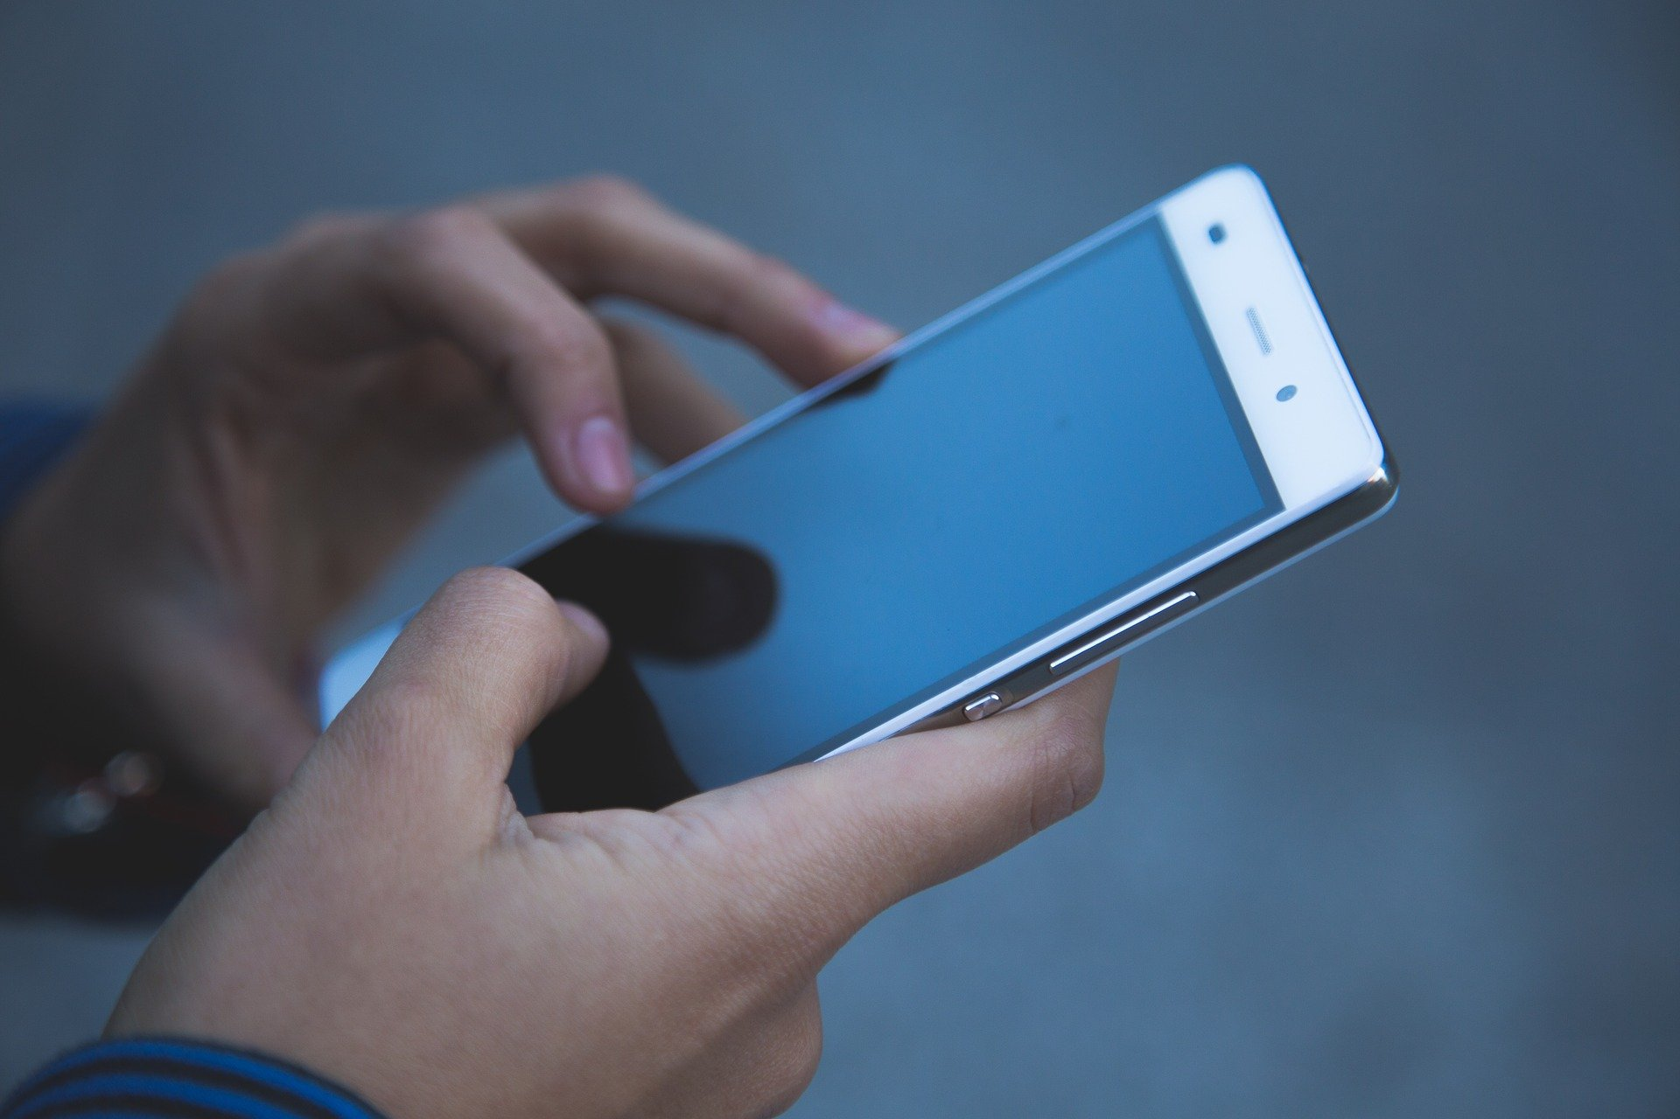

Cellphones
Notes:
Cellphones

Slide 3
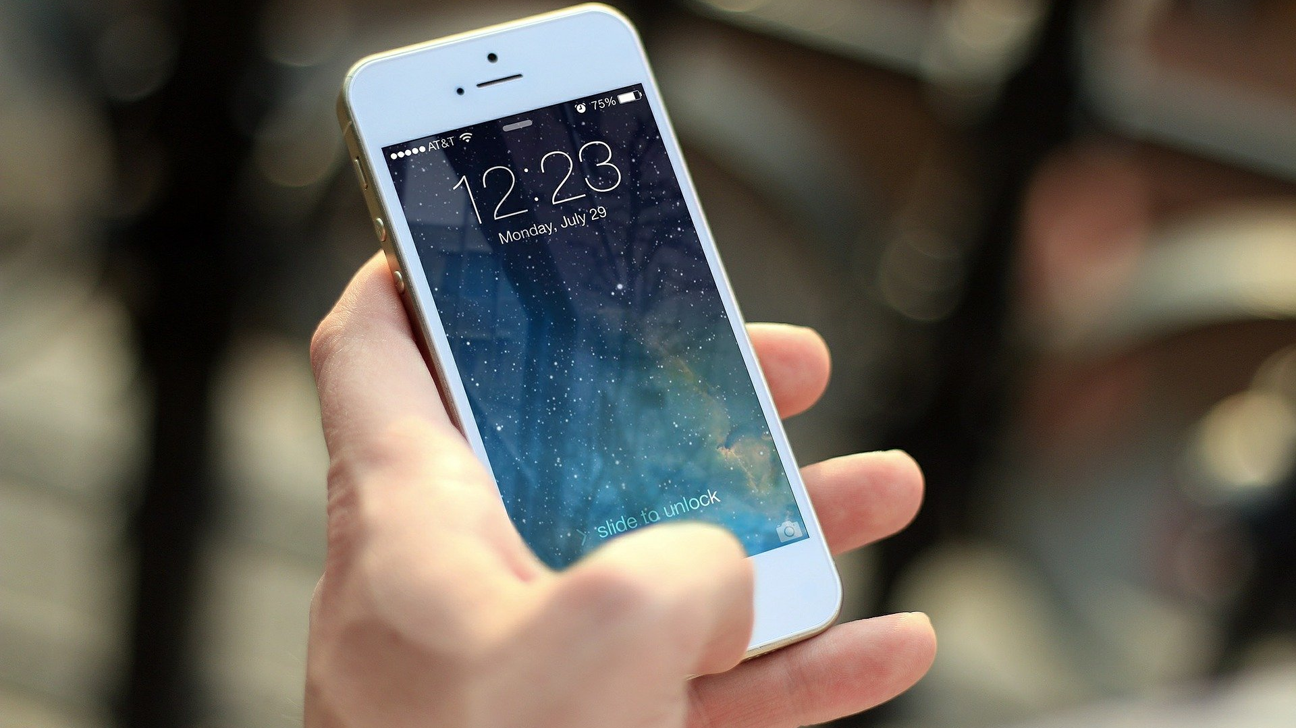
What’s at Stake?
Cell phones are driving many of us to distraction—and taking a toll on productivity in the workplace. Nineteen percent of employers think their workers are productive for less than five hours a day, and more than half believe that cell phones are to blame.
Notes:
WHAT’S AT STAKE?
Cell phones are driving many of us to distraction—and taking a toll on productivity in the workplace. Nineteen percent of employers think their workers are productive for less than five hours a day, and more than half believe that cell phones are to blame.
Indeed, every beep, buzz and glow emanating from our personal devices are designed to lure us in while hijacking our time and disrupting our concentration. A short call or text message here or there may not harm productivity in a noticeable way, but excessive use can become a big problem.
According to a recent study, the average person checks their cellphone 100 times a day. While there is a time and a place for cellphones, using it at the job site can be extremely dangerous.

Slide 4
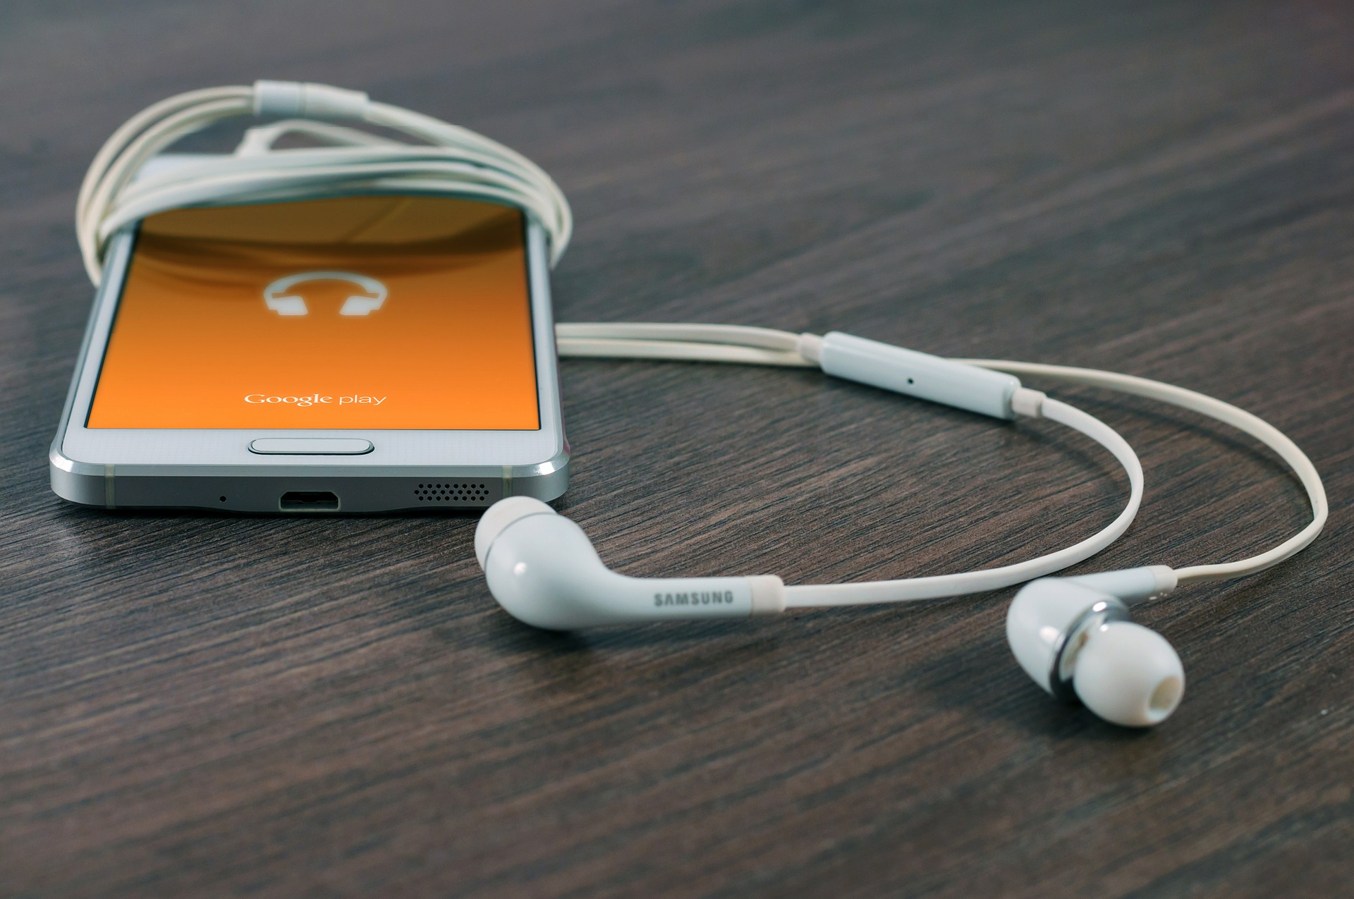
What’s the Danger?
HAZARDS OF CELL PHONE USE
Lost Productivity
Equipment Accidents
Auto Accidents
Privacy Issues
Notes:
What’s The Danger?
Hazards Of Cell Phone Use
Lost Productivity
One of the most pressing issues for employers when it comes to the use of cell phones in the work place is loss of productivity. Cell phones all users the ability to surf the internet, send text messages, take pictures as well as interact with downloaded apps and games, such distractions can lead to a huge loss of productivity on the job causing many employers to ban cell phone usage while at work.
Equipment Accidents
When employees have access to equipment such as forklifts, bulldozers, and other heavy machinery using a cell phone on the job could be disastrous and cost someone their life. An employee could be glancing down to read a text message and accidentally run over another employee or into another vehicle or building. These accidents are costly for an employer and very dangerous for other employees.
Auto Accidents
Some positions allow employee access to a company vehicle, the privilege of a company vehicle for an employee should never be taken lightly as it leaves the employer vulnerable to liability should the employee cause an accident in the vehicle. Many people have been injured in cell phone related auto accidents, if this happens on company time or within a company vehicle the employer is a risk for the serious liability issues that coincide with an employee injuring someone because of distracted driving.
Privacy Issues
Often overlooked issue regarding the use of cell phones in the workplace is a violation of privacy rights. Most cell phones are equipped with the capability of taking and sending pictures to other phones and email addresses, this put important business information and confidential operating processes at risk of being exposed. An employee could unintentionally violate another employees privacy rights by sending them picture of them or their property. This could lead to lawsuits or other forms of problems for the employer.

Slide 5

How to Protect Yourself
CELL PHONE USE POLICY
An employer who wants to implement an effective cell phone policy should consider the following:
Cell phone policies should be applied and enforced consistently. An employer should consider how it will monitor employee compliance with the policy, and how it will handle policy violations to ensure employees are not treated differently based on race, sex or any other protected class (even unintentionally).
Notes:
How To Protect Yourself
Cell Phone Use Policy
An employer who wants to implement an effective cell phone policy should consider the following:
Cell phone policies should be applied and enforced consistently. An employer should consider how it will monitor employee compliance with the policy, and how it will handle policy violations to ensure employees are not treated differently based on race, sex or any other protected class (even unintentionally).
Cellphone Use Is Prohibited Under the Following Circumstances
During meetings, training sessions and conferences
When employees are interacting with customers
In production areas and kitchens or while operating heavy equipment as a cell phone can present a safety hazard
While driving, except when a Bluetooth connection is available or when the driver is pulled over to the side of the road.

Slide 6
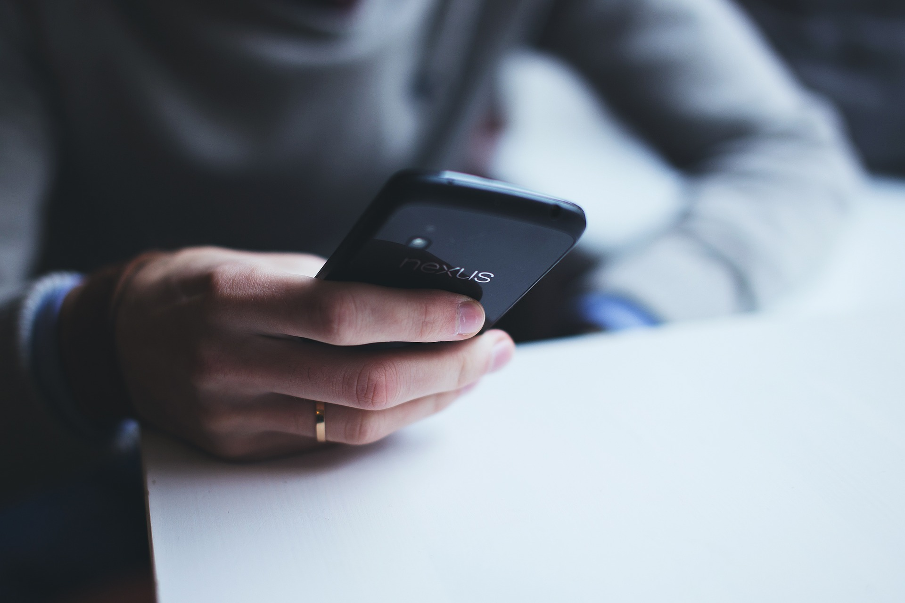
How to Protect Yourself
Cell Phone Policy Could Also Define:
When it’s acceptable to use a cell phone during the work day, such as during breaks and lunchtime
The frequency and length of calls permitted during working hours
If headsets are permitted
Where to store personal devices. Keeping phones out of sight, such as in a desk drawer, is an effective way to keep distractions to a minimum.
Appropriate use during business hours. For example, business calls and brief conversations or texts with family members may be okay, but playing games or downloading music is not.
Notes:
How to Protect Yourself
Cell Phone Policy Could Also Define:
When it’s acceptable to use a cell phone during the work day, such as during breaks and lunchtime
The frequency and length of calls permitted during working hours
If headsets are permitted
Where to store personal devices. Keeping phones out of sight, such as in a desk drawer, is an effective way to keep distractions to a minimum.
Appropriate use during business hours. For example, business calls and brief conversations or texts with family members may be okay, but playing games or downloading music is not.

Slide 7

How to Protect Yourself
RULES OF CELL PHONE USE AT WORK
Put Your Phone Away
Turn Off Your Ringer
Use Your Cell Phone for Important Calls Only
Let Voicemail Pick Up Your Calls
Find a Private Place to Make Cell Phone Calls
Don't Bring Your Cell Phone Into the Restroom
Don't Look at Your Phone During Meeting
Notes:
How to Protect Yourself
Rules Of Cell Phone Use At Work
Follow These Rules If Your Employers Does NOT Forbid Cell Phone Use at Work.
1. Put Your Phone Away
Excessive cell phone use at work can interfere with productivity. Even if your employer doesn't ban their use, it's a good idea to limit yourself.
2. Turn Off Your Ringer
Silence your ringer. If family members often have to get in touch during the workday, set your phone on vibrate and put it in your pocket.
3. Use Your Cell Phone for Important Calls Only
Should you chitchat with your friend, mom, or significant other while at work? Save those casual conversations for your drive home (hands-free, of course) or your break. There are very few calls that can't wait.
4. Let Voicemail Pick Up Your Calls
Instead of answering calls immediately, set up your phone to have them all go to voicemail. Check your messages regularly and respond to them based on their urgency.
5. Find a Private Place to Make Cell Phone Calls
Although making personal calls during a break is fine, find a private place to do it.
6. Don't Bring Your Cell Phone Into the Restroom
Whether at work or anywhere else for that matter, this is an essential rule of cell phone etiquette. Why? Well, if you must ask—it is rude to both the person on the other end of the phone and anyone using the bathroom.
7. Don't Look at Your Phone During Meetings
While you are sitting at a meeting, do not text, check your social media news feeds, post your status, or play games. Don't bury your nose in your phone. Keep your eyes up and stay engaged. Doing anything else will be a clear signal to your boss that your mind isn't completely on the business at hand.

Slide 8

Final Word
Business is conducted regularly through cell phones and employers benefit from their employees’ ability to access e-mail and digital remotely. On the other hand, employee access to cell phones, including text messaging and social media, during work hours might present distractions that employers want to eliminate by restricting or fully prohibiting cell phone access.
Notes:
Final Word
Business is conducted regularly through cell phones and employers benefit from their employees’ ability to access e-mail and digital remotely. On the other hand, employee access to cell phones, including text messaging and social media, during work hours might present distractions that employers want to eliminate by restricting or fully prohibiting cell phone access. The trick is the strike a balance between the former and the latter.

