Slide 1

Click anywhere to get started…

Slide 2

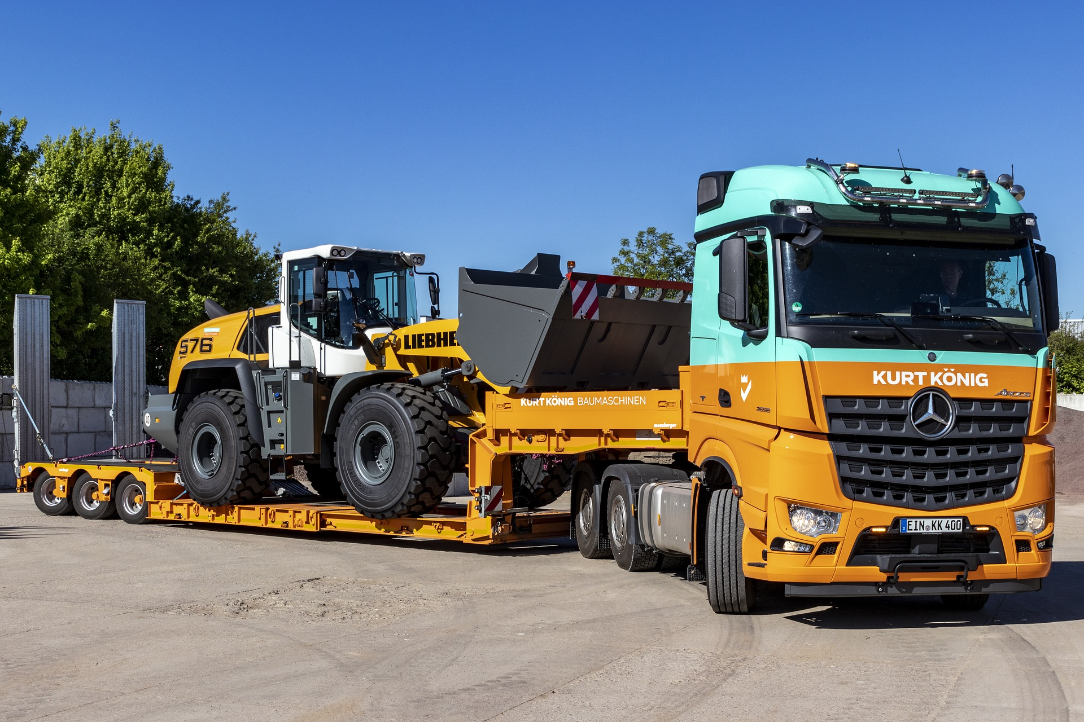

Load & Unload Equipment Safely
Notes:
Load & Unload Equipment Safely

Slide 3

What’s at Stake?
Loading and unloading equipment should only be done by people with the relevant knowledge and experience. Heavy loads can be extremely dangerous if not handled correctly.
To ensure equipment is loaded and unloaded safely, personnel must have the appropriate training and experience.
Notes:
What’s at Stake?
Loading and unloading equipment should only be done by people with the relevant knowledge and experience. Heavy loads can be extremely dangerous if not handled correctly.
To ensure equipment is loaded and unloaded safely, personnel must have the appropriate training and experience.

Slide 4
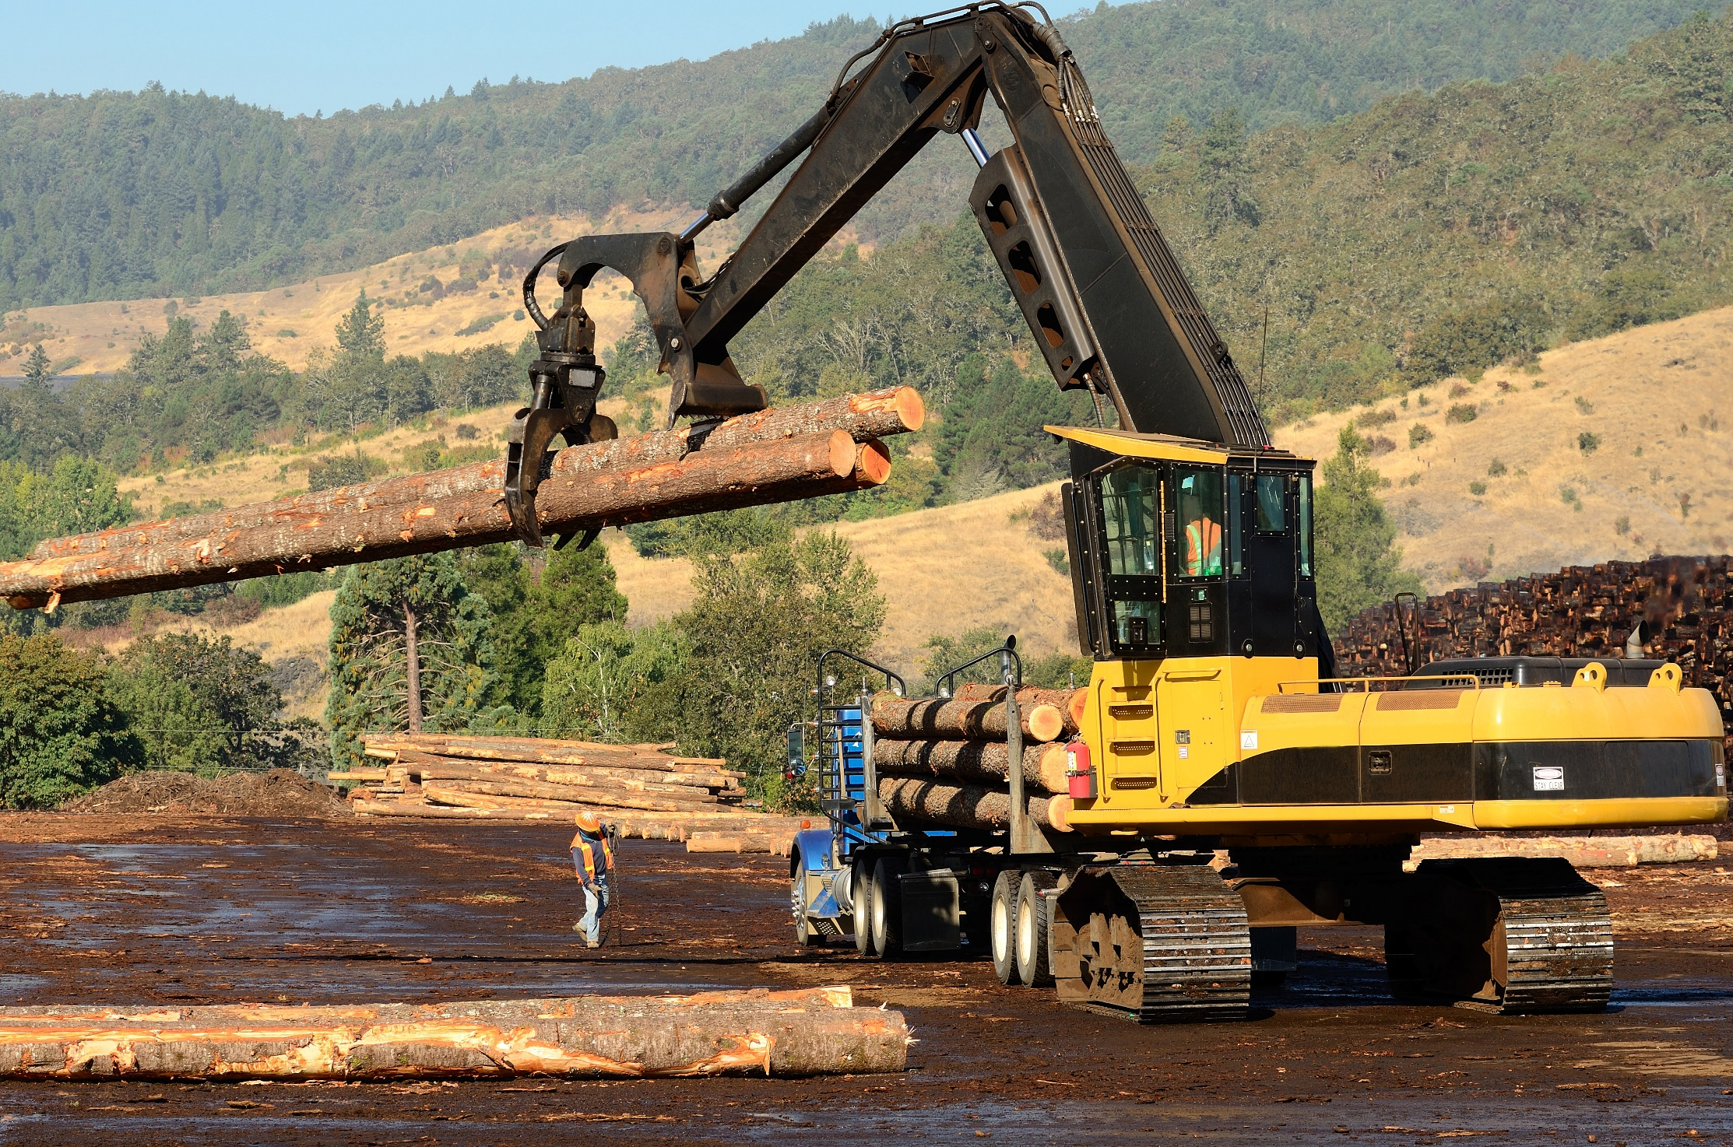
What’s the Danger?
RISK ASSESSMENT
Before loading and unloading equipment, a thorough risk assessment should be carried out which considers every step of the job, including site risks and hazards, loading, transport, and unloading. This is particularly necessary in the case of an unfamiliar commodity or location and/or where there are unfavorable weather conditions.
If a specific risk or hazard that cannot be eliminated is identified, operations should not take place until control measures have been determined and implemented.
Notes:
What’s the Danger?
Warning
Loading, unloading, and transporting cargo can cause serious injury and even fatality.
In 2018, there were a reported 221,400 workplace related injuries in the transportation and warehousing industry reported to the Bureau of Labor Statistics.
Workers loading and unloading cargo are exposed to serious danger in that heavy objects may hit or fall on them if they don’t follow the right loading and unloading safety procedures. Following the proper safety procedures will keep your warehouse organized and employee conditions safe.
RISK ASSESSMENT
Before loading and unloading equipment, a thorough risk assessment should be carried out which considers every step of the job, including site risks and hazards, loading, transport, and unloading. This is particularly necessary in the case of an unfamiliar commodity or location and/or where there are unfavorable weather conditions.
If a specific risk or hazard that cannot be eliminated is identified, operations should not take place until control measures have been determined and implemented.
Safe Loading/Unloading Areas
Before any load or unload commences, all drivers must complete a situational risk assessment and implement the necessary controls.
Designated loading/unloading areas should be sectioned off where required, a check should be done for overhead electric cables, the area should be cleared of debris, and any uneven surfaces should be identified.

Slide 5
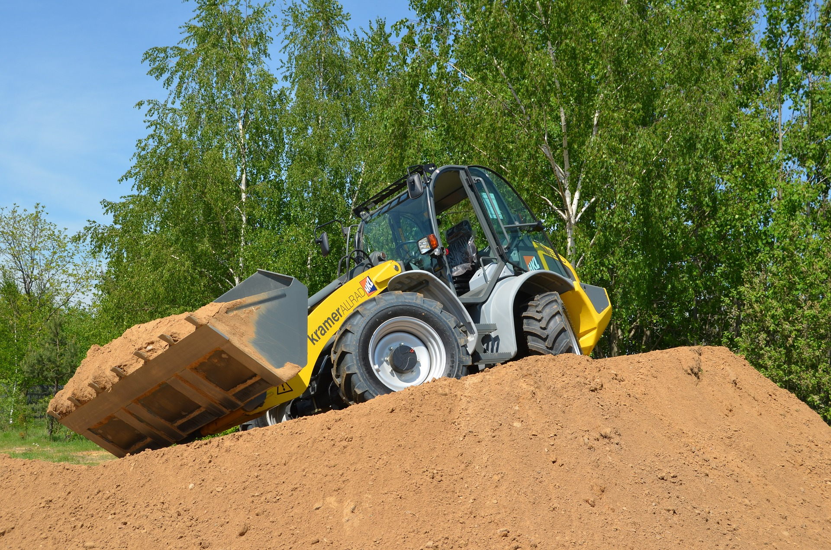
How to Protect Yourself
HOW TO LOAD HEAVY EQUIPMENT SAFELY
1. Designate Duties
2. Clean the Ramp and Trailer
3. Clear and Level the Loading Area
4. Begin the Machine/Ramp Line-Up
5. Start Chaining Down Heavy Equipment
Notes:
HOW TO PROTECT YOURSELF
Pedestrians and workers not involved in the loading/unloading process should vacate the area, there should be no chance of vehicles coming into contact with stray cables or wires.
Trailers must be parked on firm level ground so the load can be positioned evenly.
A safe waiting place should also be available to all persons on a site that are not involved in the loading / unloading until the operation is completed and loads are appropriately restrained.
All equipment should be loaded, positioned and secured in a safe and logical manner that eliminates the risk of movement and in a way that ensures no unnecessary risk while unloading.
Load restraints should be checked periodically to ensure that there has not been any movement of the load during the journey and that there has not been any wear on the restraints themselves.
HOW TO LOAD HEAVY EQUIPMENT SAFELY
A load is only as strong as its weakest link. And those weak links often come not because a basic heavy equipment loading procedure wasn't followed, but because it was—just in a rushed, halfhearted, or passive way.
1. Designate Duties
Before actual loading occurs, the team should have a clear understanding of who's in charge of what. You'll need someone to drive the equipment onto the deck, but you'll also need a spotter to deliver hand signals and direct the driver up the ramp and onto the trailer bed. It's likely they won't have a clear line of site to do so themselves.
2. Clean the Ramp and Trailer
Ramps and trailer decks should be as dirt, oil, and debris-free as possible, especially if they are metal. This ensures the piece of loading equipment has as much traction as possible to move up its ramp. A clean ramp and trailer bed also means a dry one, clear of ice, snow, and water.
3. Clear and Level the Loading Area
Pick an uninhabited and even space to set up the ramp and perform loading.
You'll also want to ensure the actual ground in the loading area is compact enough to bear the full weight of your loaded trailer. After rain or during seasons with thaw, the combined weight of these two vehicles has the potential to cause sinkage.
4. Begin the Machine/Ramp Line-Up
With the driver in the cab and a spotter positioned in plain view, begin driving the heavy equipment up the cleared ramp and onto the transportation vehicle's deck.
Note that during this ramp movement, the machine's center of gravity will shift. This is the most dangerous part of the loading process, with the equipment's weight caught momentarily in a point of limbo. Just keep moving gradually.
Also note that when appropriately positioned at final rest on deck, the majority of the equipment's weight should be distributed toward the front of the trailer. This avoids fishtailing while en route.
5. Start Chaining Down Heavy Equipment
With the heavy equipment safely positioned on deck, you can initiate one of the most critical steps in the loading and unloading procedure — tying it down.

Slide 6
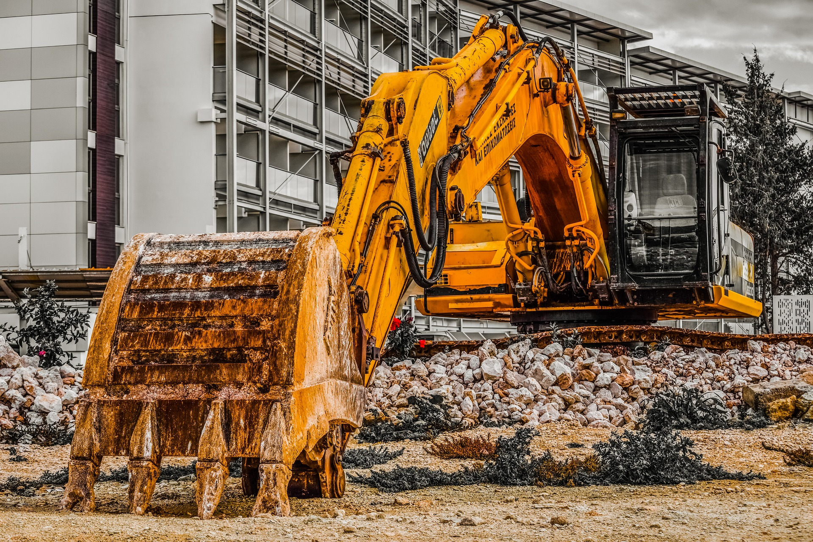
How to Protect Yourself
Three predominant concerns with chaining down:
Reminders to achieve the proper way to chain down an excavator, loader, and more:
Notes:
How to Protect Yourself
Reminders to achieve the proper way to chain down an excavator, loader, and more:
All chains fastened linearly, with downward force, with no horizontal twists, bends, or angles
No slack. Wrap excess chain around the rest of the link so it won't come loose.
At least four chains in use. Use two connecting to the trailer's front corners and two connecting to the trailer's back corners. The tension from these opposing forces should keep the equipment in place.
Always review chain and hook sizes. You need to guarantee they're complementary and tight, not mismatched.

Slide 7
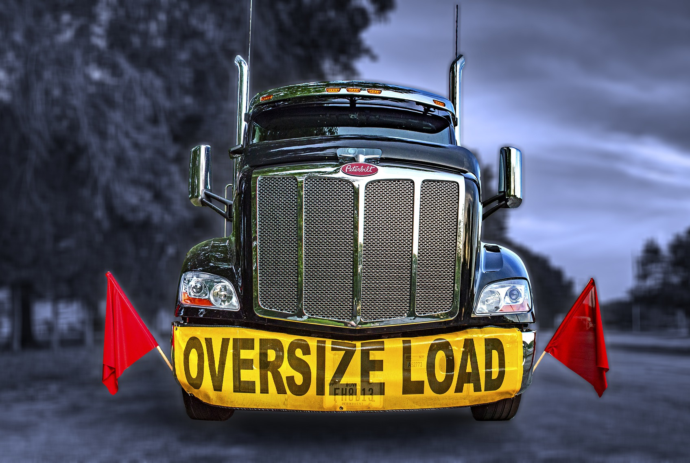
How to Protect Yourself
HOW TO SAFELY UNLOAD HEAVY EQUIPMENT
Clear and Level the Unloading Site
Do a Walk Through
Free the Load
Slowly Back the Heavy Equipment Down the Ramp
Wrap It Up
Notes:
How to Protect Yourself
HOW TO SAFELY UNLOAD HEAVY EQUIPMENT
There are key steps and risk-mitigation strategies to assure the success of this final step.
1. Clear and Level the Unloading Site
Before the transportation vehicle even arrives, take the time to review and clear the designated unloading area in the receiving yard. Wet and muddy ramps and uneven unloading ground make this part of the operation much harder than necessary.
This doesn't stop at clearing away dirt and debris, either. Alert personnel of cargo schedules so only relevant crew members are in the area when the transport vehicle arrives.
2. Do a Walk Through
Guide the transport vehicle to its exact unloading area. Once the vehicle is parked, have the ramp clean and ready for deployment. Line it up with the rear of the trailer bed as methodically as possible, taking time to match joints and eliminate any gaps between the trailer and the ramp.
With everything in place, conduct a final condition survey. Look over the equipment's tires and hitches to ensure their health. Review roles with personnel, appointing a spotter and an equipment operator just like during the loading process and before you begin breaking down the chain tie points.
3. Free the Load
Release chains and tie bounds one at a time, beginning with the rear corners. Unravel excess chain that may have been wrapped around the links, then start loosening tie downs with their ratchet-style wrench boomers. Do so carefully, as chains and binders have been wound and should still be tight and pressurized. You don't want a metal chain unexpectedly snapping up because joints and tension weren't adequately reduced with the ratchet boomer.
4. Slowly Back the Heavy Equipment Down the Ramp
Maintain a safe distance between the piece of equipment and its spotter. The equipment operator's visibility may become hindered, so position the spotter in a way where they're accessible but out of harm's way. Keep the rest of personnel away from the unloading site while the heavy machinery is in reverse. All attention should remain on safely ushering it down the ramp.
5. Wrap It Up
Do a final ground inspection of all equipment, the transport vehicle, anchor points, and tools before sending everyone on their way.

Slide 8
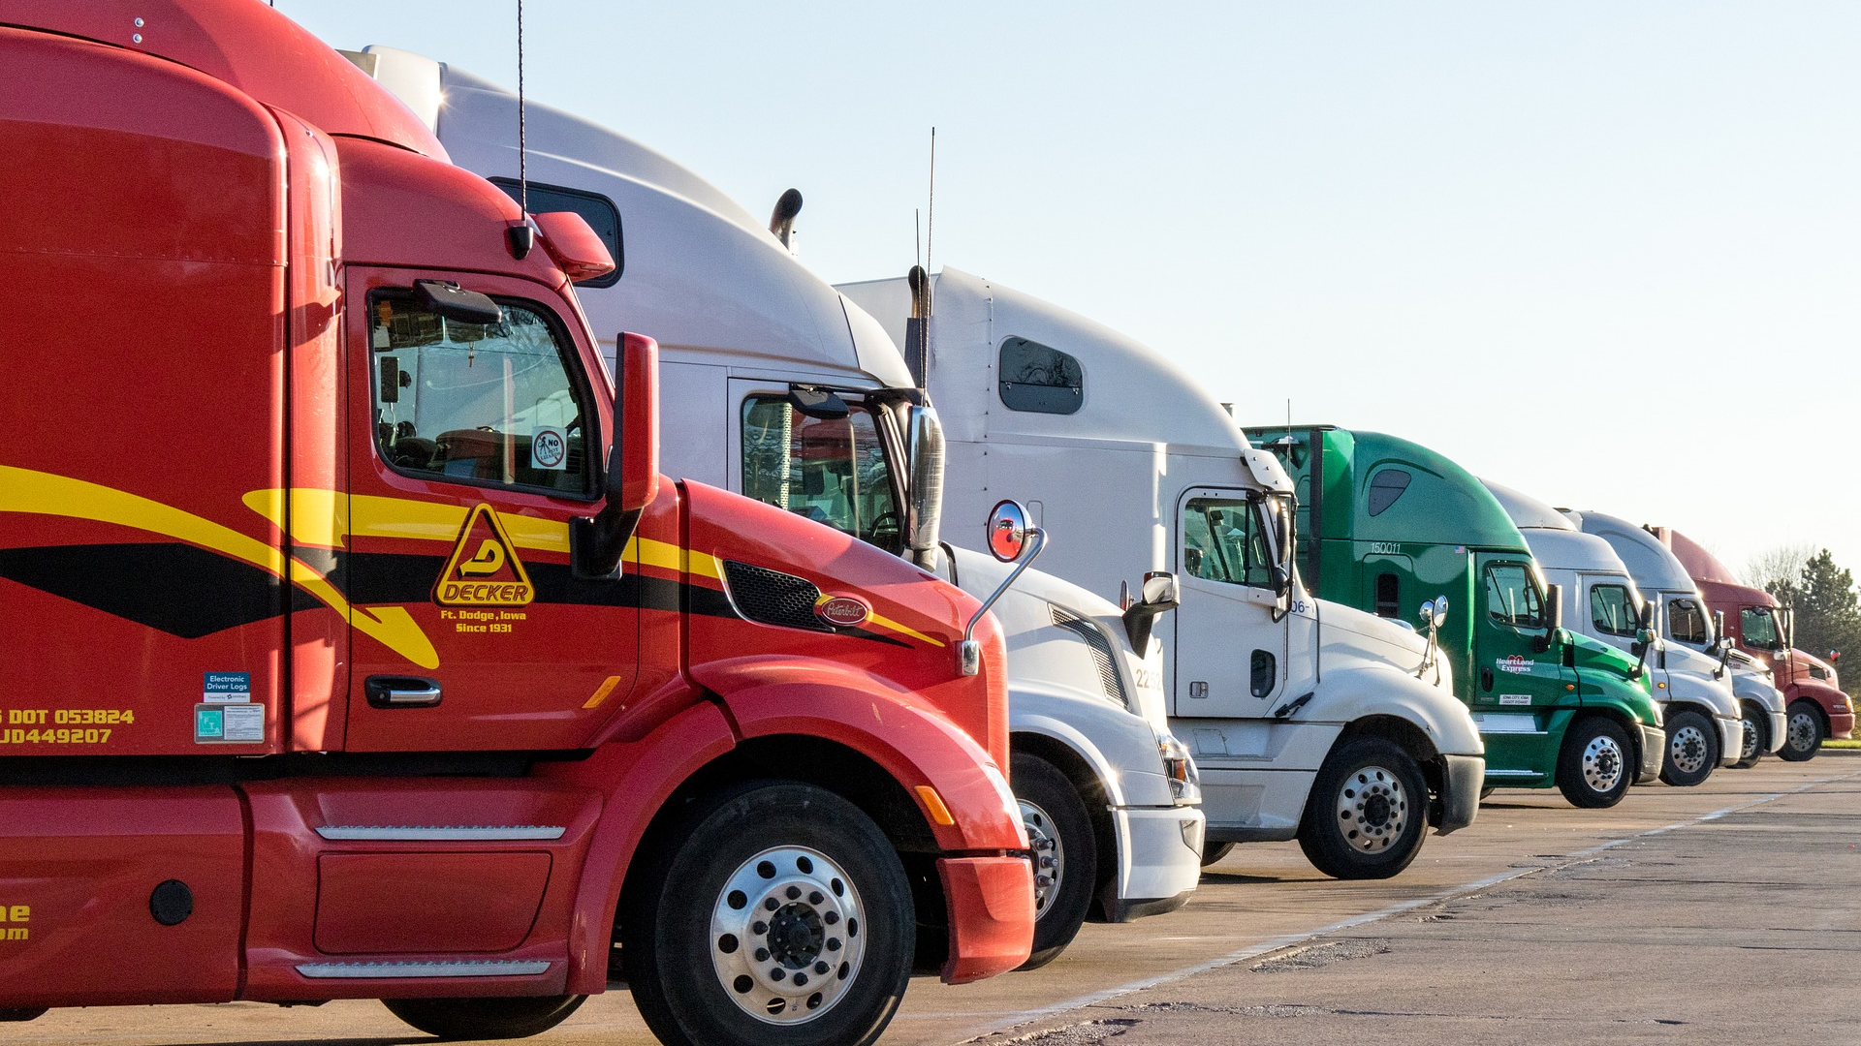
Final Word
Workers loading and unloading cargo are exposed to serious danger in that heavy objects may hit or fall on them if they don’t follow the right loading and unloading safety procedures. Following the proper safety procedures will keep your warehouse organized and employee conditions safe.
Notes:
Final Word
Workers loading and unloading cargo are exposed to serious danger in that heavy objects may hit or fall on them if they don’t follow the right loading and unloading safety procedures. Following the proper safety procedures will keep your warehouse organized and employee conditions safe.

