Slide 1

Click anywhere to get started…

Slide 2



RISK ASSESSMENT
Notes:
RISK ASSESSMENT

Slide 3

What’s at Stake?
Risk assessment is a process that identifies possible hazards to people, product and property—and what to do about it.
Notes:
What’s at Stake?
Risk assessment is a process that identifies possible hazards to people, product and property—and what to do about it. There are four main areas where hazards exist:
People: improper training, poor supervision, not paying attention, not working safely, etc.
Equipment: poorly maintained, no guards, using the wrong equipment for the task.
Materials: flammable or dangerous substances, handling hazards, special storage, etc.
Environment: wet floor, poor lighting, loud noise, inclement weather, etc.
For every task that you do a risk assessment on, think about how it is usually done and how a hazard may be caused by people, the equipment, materials and the environment.

Slide 4

What’s the Danger?
RATIONALE
ASSETS AT RISK FROM HAZARDS
VULNERABILITIES OF ASSETS
MITIGATION
Notes:
What’s the Danger?
RATIONALE
A business impact analysis or risk assessment!!! Take your pick. Either mean substantially the same. Both determine the potential impacts resulting from the interruption of time sensitive or business processes. In other words, identify hazards and analyze what could happen if a hazard occurs.
ASSETS AT RISK FROM HAZARDS
First and foremost, injuries to people should be the first consideration of the risk assessment. Hazard scenarios that could cause significant injuries should be highlighted to ensure that appropriate emergency plans are in place. Many other physical assets may be at risk. These include buildings, information technology, utility systems, machinery, raw materials and finished goods. The potential for environmental impact should also be considered. Consider the impact an incident could have on your relationships with customers, the surrounding community and other stakeholders. Consider situations that would cause customers to lose confidence in your organization and its products or services.
VULNERABILITIES OF ASSETS
In conducting a risk assessment, canvas for vulnerabilities/weaknesses that would make an asset more susceptible to damage from a hazard. Vulnerabilities include deficiencies in building construction, process systems, security, protection systems and loss prevention programs. They contribute to the severity of damage when an incident occurs. For example, a building without a fire sprinkler system could burn to the ground while a building with a properly designed, installed and maintained fire sprinkler system would suffer limited fire damage.
MITIGATION
This process reduces the impacts from the hazards.
Once you have established the priorities, the organization can decide on ways to control each specific hazard. Hazard control methods are often grouped into the following categories:
Elimination (including substitution).
Engineering controls.
Administrative controls.
Personal protective equipment.

Slide 5

What’s the Danger?
HAZARDS
Natural Hazards
Technological Hazards
Notes:
What’s the Danger?
HAZARDS
Natural Hazards
Meteorological -Flooding, Dam/Levee Failure, Severe Thunderstorm (Wind, Rain, Lightning, Hail), Tornado, Windstorm, Hurricanes and Tropical Storms, Winter Storm (Snow/Ice)
Geological -Earthquake, Tsunami, Landslide, Subsidence/Sinkhole, Volcano
Biological -Pandemic Disease, Foodborne Illnesses
Human-Caused Hazards
Accidents -Workplace Accidents, Entrapment/Rescue (Machinery, Water, Confined Space, High Angle), Transportation Accidents (Motor Vehicle, Rail, Water, Air, Pipeline), Structural Failure/Collapse, Mechanical Breakdown
Intentional Acts - Labor Strike, Demonstrations, Civil Disturbance (Riot), Bomb Threat, Lost/Separated Person, Child Abduction, Kidnapping/Extortion, Hostage Incident, Workplace Violence, Robbery , Sniper Incident, Terrorism (Chemical, Biological, Radiological, Nuclear, Explosives), Arson, Cyber/Information Technology (Malware Attack, Hacking, Fraud, Denial of Service, etc.)
Technological Hazards
Information Technology - Loss of Connectivity, Hardware Failure, Lost/Corrupted Data, Application Failure
Utility Outage - Communications, Electrical Power, Water, Gas, Steam, Heating/Ventilation/Air Conditioning, Pollution Control System, Sewage System
Fire/Explosion - Fire (Structure, Wildland), Explosion (Chemical, Gas, or Process failure)
Hazardous Materials -Hazardous Material spill/release, Radiological Accident, Hazmat Incident off-site, Transportation Accidents, Nuclear Power Plant Incident, Natural Gas Leak Supply
Chain Interruption - Supplier Failure, Transportation Interruption

Slide 6

How to Protect Yourself
DEFINITIONS/TERMINOLOGY
Risk
Hazard
Safety
Risk assessment
Risk analysis
Risk management
Notes:
How to Protect Yourself
Risk is the likelihood and severity of a harmful incident.
Hazard is a source or circumstance that can cause a severe accident.
Safety refers to a condition where prohibited risks are at an acceptable level.
Risk assessment is a process in which one evaluates the risk to the worker’s health and safety as a result of a dangerous situation at the workplace.
Risk analysis is part of the risk assessment. In the risk analysis the marginal values for the object is stipulated, the risks are identified and the extent of the risk is evaluated.
Risk management
Risk management is an overall view to approach hazards and measures to reduce and eliminate injuries. Before an effective risk assessment is possible the hazards needs to be identified and estimated. The estimation of the likelihood and severity of harm as well as choosing and accomplishing sufficient safety measures are also part of the risk management process.

Slide 7
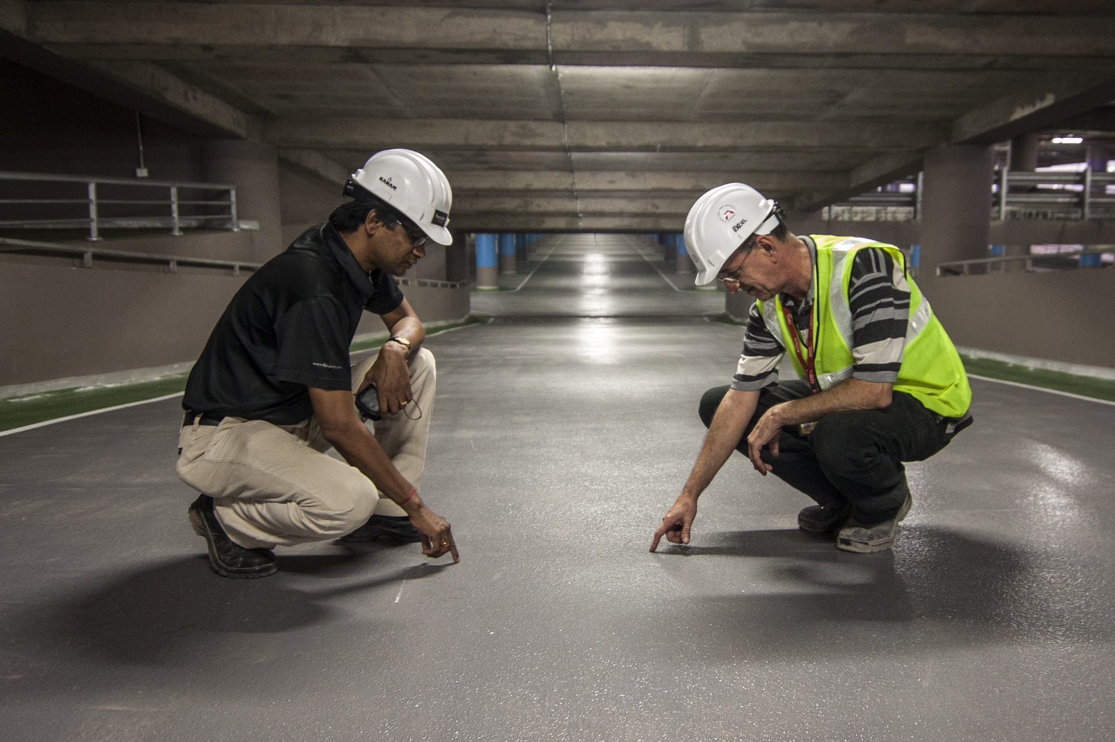
How to Protect Yourself
When Should a Risk Assessment be Conducted?
How to Plan for Risk Assessment
Notes:
How to Protect Yourself
QUESTIONS
Fundamental questions must be posed to understand risk assessment.
When Should a Risk Assessment be Conducted?
Before new processes or activities are introduced.
Before changes are introduced to existing processes or activities, including when products, machinery, tools, equipment change or new information concerning harm becomes available.
When hazards are identified.
How to Plan for Risk Assessment
What the scope of your risk assessment will be (e.g., be specific about what you are assessing such as the lifetime of the product, the physical area where the work activity takes place, or the types of hazards).
The resources needed (e.g., train a team of individuals to carry out the assessment, the types of information sources, etc.).
What type of risk analysis measures will be used (e.g., how exact the scale or parameters need to be in order to provide the most relevant evaluation).
Who are the stakeholders involved (e.g., manager, supervisors, workers, worker representatives, suppliers, etc.).
What relevant laws, regulations, codes, or standards may apply in your jurisdiction, as well as organizational policies and procedures

Slide 8
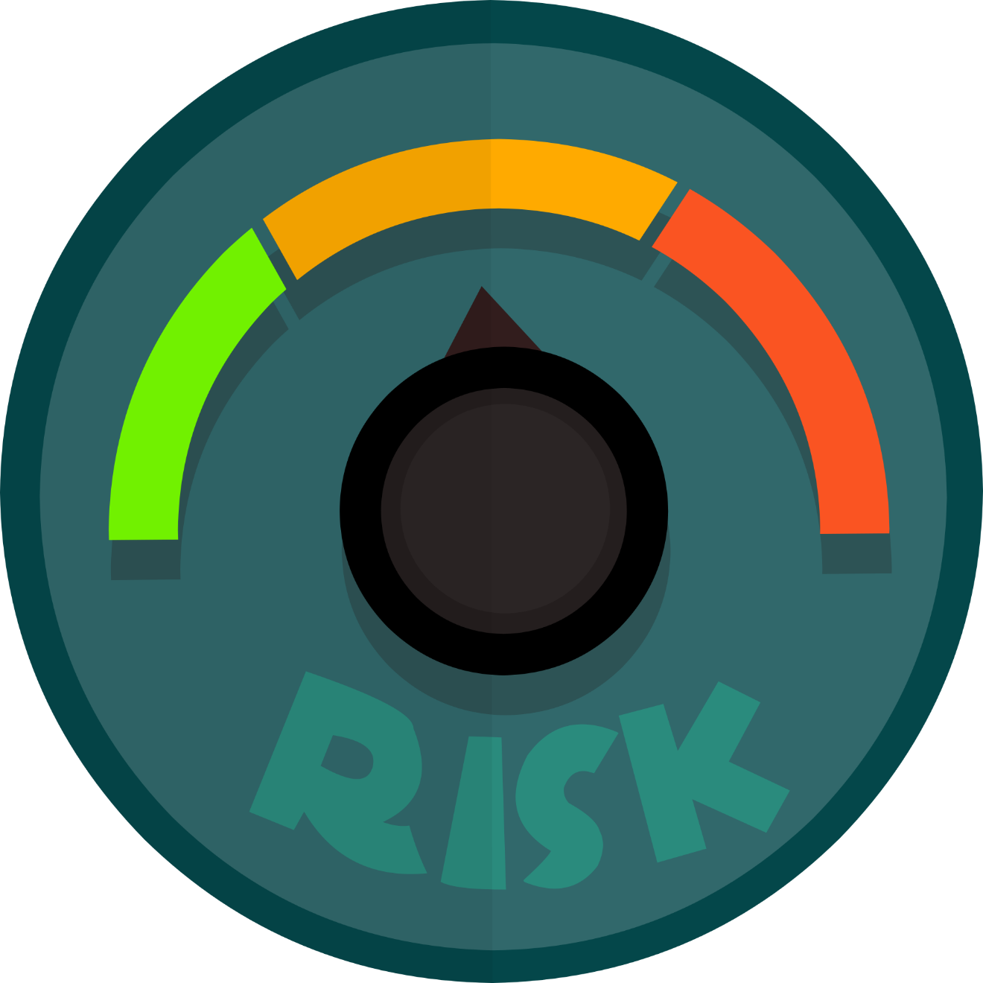
How to Protect Yourself
How to Conduct A Risk Assessment
Step 1: Identify hazards, i.e. anything that may cause harm.
Step 2: Decide who may be harmed, and how.
Step 3: Assess the risks and take action.
Step 4: Make a record of the findings.
Step 5: Review the risk assessment.
Notes:
How to Protect Yourself
Step 1: Identify hazards, i.e. anything that may cause harm.
Employers have a duty to assess the health and safety risks faced by their workers. Your employer must systematically check for possible physical, mental, chemical and biological hazards.
This is one common classification of hazards:
Physical: e.g. lifting, awkward postures, slips and trips, noise, dust, machinery, computer equipment, etc.
Mental: e.g. excess workload, long hours, working with high-need clients, bullying, etc. These are also called 'psychosocial' hazards, affecting mental health and occurring within working relationships.
Chemical: e.g. asbestos, cleaning fluids, aerosols, etc.
Biological: including tuberculosis, hepatitis and other infectious diseases faced by healthcare workers, home care staff and other healthcare professionals.
Step 2: Decide who may be harmed, and how.
Identifying who is at risk starts with your organization’s own full- and part-time employees. Employers must also assess risks faced by agency and contract staff, visitors, clients and other members of the public on their premises.
Employers must review work routines in all the different locations and situations where their staff are employed. For example:
Home care supervisors must take due account of their client's personal safety in the home, and ensure safe working and lifting arrangements for their own home care staff.
In a supermarket, hazards are found in the repetitive tasks at the checkout, in lifting loads, and in slips and trips from spillages and obstacles in the shop and storerooms. Staff face the risk of violence from customers and intruders, especially in the evenings.
In call centres, workstation equipment (i.e. desk, screen, keyboard and chair) must be adjusted to suit each employee.
Employers have special duties towards the health and safety of young workers, disabled employees, night workers, shift workers, and pregnant or breastfeeding women.
Step 3: Assess the risks and take action.
This means employers must consider how likely it is that each hazard could cause harm. This will determine whether or not your employer should reduce the level of risk. Even after all precautions have been taken, some risk usually remains. Employers must decide for each remaining hazard whether the risk remains high, medium or low.
Step 4: Make a record of the findings.
Employers with five or more staff are required to record in writing the main findings of the risk assessment. This record should include details of any hazards noted in the risk assessment, and action taken to reduce or eliminate risk.
This record provides proof that the assessment was carried out, and is used as the basis for a later review of working practices. The risk assessment is a working document. You should be able to read it. It should not be locked away in a cupboard.
Step 5: Review the risk assessment.
A risk assessment must be kept under review in order to:
ensure that agreed safe working practices continue to be applied (e.g. that management's safety instructions are respected by supervisors and line managers); and
take account of any new working practices, new machinery or more demanding work targets.

Slide 9

Final Word
For every task or job you undertake to do risk assessment, think how it is usually done and how a hazard maybe caused by people, the equipment, materials, and the environment.
Notes:
Final Word
For every task or job you undertake to do risk assessment, think how it is usually done and how a hazard maybe caused by people, the equipment, materials, and the environment.

