Slide 1

Click anywhere to get started…

Slide 2

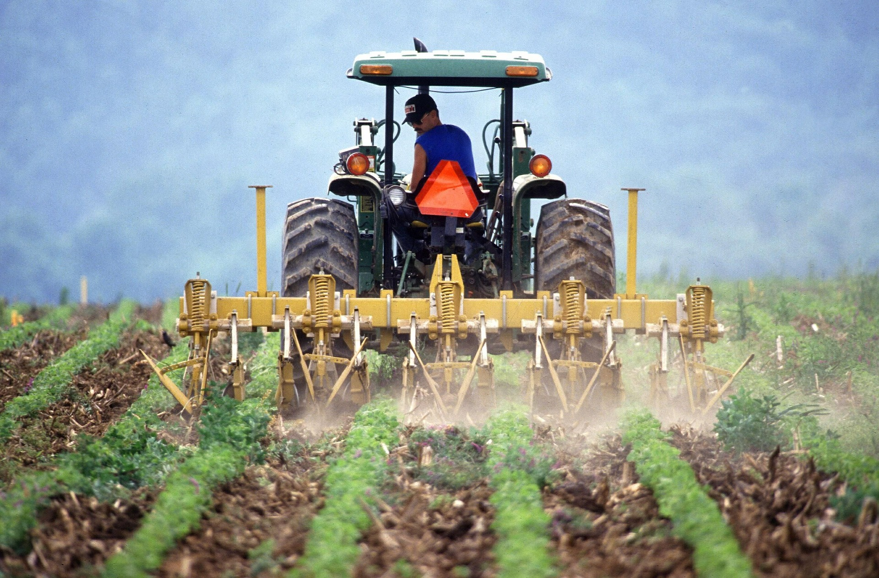

FARMERS WORKING ALONE
Notes:
Farmers Working Alone

Slide 3
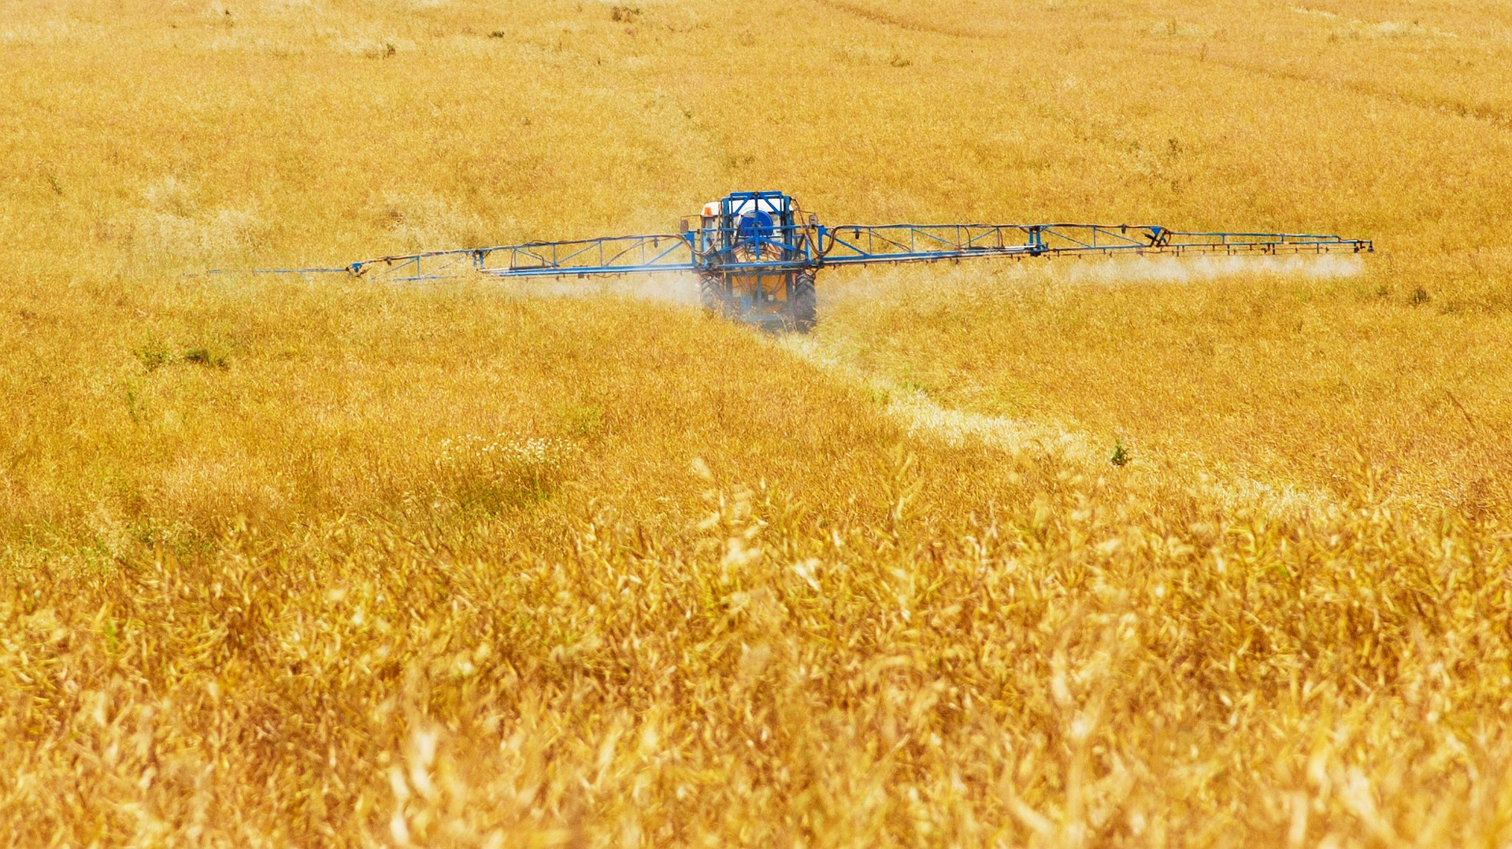
What’s at Stake?
One of the most relaxing parts of a work day can be some alone time – doing, your work you love in peace and quiet.
Notes:
What’s at Stake?
One of the most relaxing parts of a work day can be some alone time – doing, your work you love in peace and quiet. It sounds idyllic sitting on your tractor with your favorites tunes blowing in your ear and no one is bothering or harassing you. You are in your own world. But that is just the tip of an iceberg.

Slide 4
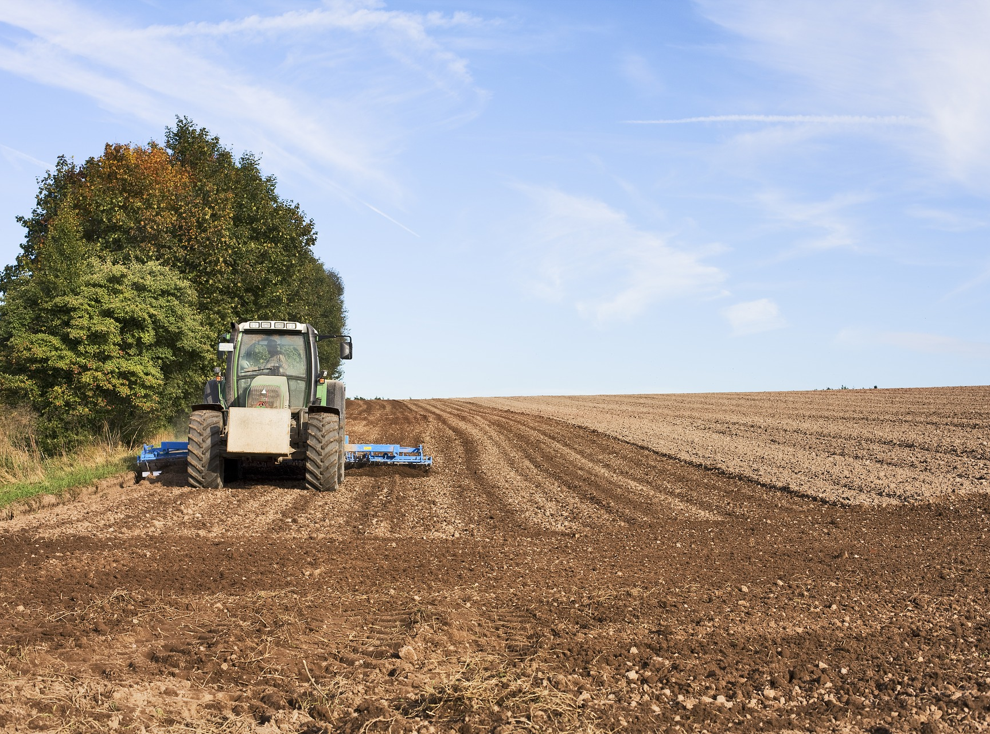
What’s the Danger?
WORKING ALONE IN AGRICULTURE – THE DANGER
The Dangers of Working Alone in Agriculture
Time and time again, the farming industry is coined “America’s most dangerous occupation.” Yet, most people are unaware of the humbling statistics that come with the American agriculture industry.
Vulnerable
According to the National Institute for Occupational Safety and Health (NIOSH), the production agriculture industry employed about 2,038,000 workers in 2018. There were 416 recorded farm-related fatalities in 2017, resulting in a rate of 20.4 deaths per 100,000 farm workers.
Notes:
What’s the Danger?
WORKING ALONE IN AGRICULTURE – THE DANGER
The Dangers of Working Alone in Agriculture
Did you know that one in 12 jobs in the United States is dependent on the agriculture industry in some way? According to PayScale, more than 22 million workers were employed in an agriculture-related field in 2018. With contributions of over $100 billion to the US economy, the agriculture industry is a key driver of economic growth in the United States. There over approximately 2 million farms in total in the US, each employing its own family of agriculture workers, laborers, animal breeders, graders, sorters, maintenance workers, animal caretakers, and agriculture inspectors. When we select our produce, we seldom think of those workers who are responsible for the broad selection that we’re greeted with in the grocery store. Time and time again, the farming industry is coined “America’s most dangerous occupation.” Yet, most people are unaware of the humbling statistics that come with the American agriculture industry.
Vulnerable
According to the National Institute for Occupational Safety and Health (NIOSH), the production agriculture industry employed about 2,038,000 workers in 2018. There were 416 recorded farm-related fatalities in 2017, resulting in a rate of 20.4 deaths per 100,000 farm workers. Furthermore, nearly 100 agriculture laborers endure a work-related injury that requires time off. These statistics are serious, troubling, and call for more extensive safety measures to be implemented. Many of the injuries suffered are a result of the isolated nature of working on a farm. Agriculture workers are often required to work alone or in a remote location. Thus, if something goes wrong, the worker does not have any immediate help available. When you add in the fact that farm work often requires the use of heavy machinery in the presence of large animals, the risk of injury or death is magnified.

Slide 5
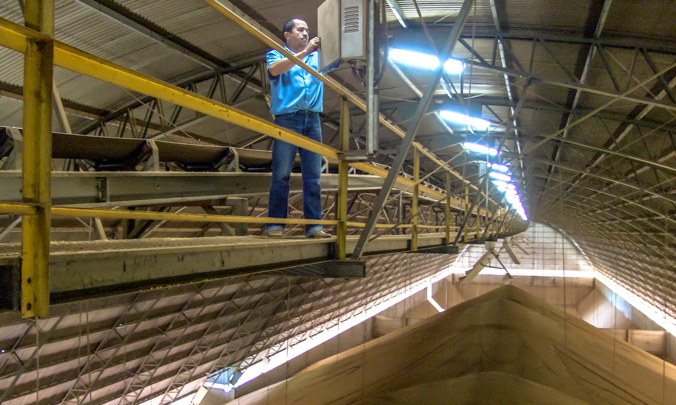
What’s the Danger?
Identify the Hazards
Grain bins pose a significant safety risk.
After grain bin-related deaths, is electrocution.
Heavy machinery such as combines and corn pickers have conveyor belts that can be deadly if a worker gets caught.
According to the International Labor Association, tractor rollovers are responsible for more than half of all fatalities that occur on the farm.
Notes:
What’s the Danger?
Identify the Hazards
Grain bins pose a significant safety risk. The average time required to rescue a worker from a grain bin can be upwards of 4 hours, resulting in a fatality rate of 62%. It takes only 20 seconds for a grown man to become entirely buried by grain, with the most common cause of death being suffocation, according to the OSHA.
After grain bin-related deaths, is electrocution. The National Agricultural Safety Database (NASD) reported that around 62 farmers die each year from severe burns or heart failure as a result of electrocution. Many of these incidents occur because of contact with overhead power lines, which can quickly happen if farm equipment comes in contact.
Heavy machinery such as combines and corn pickers have conveyor belts that can be deadly if a worker gets caught. The NASD also reported that ‘virtually every farmer knows of a family member, friend, or neighbor who has been injured in a corn picker.
According to the International Labor Association, tractor rollovers are responsible for more than half of all fatalities that occur on the farm. The heaviness of the tractor, in combination with uneven surfaces, increases the probability of the machine flipping. Even though more modern tractors must have rollover protection systems, more than 50% of the tractors in the US do not.

Slide 6
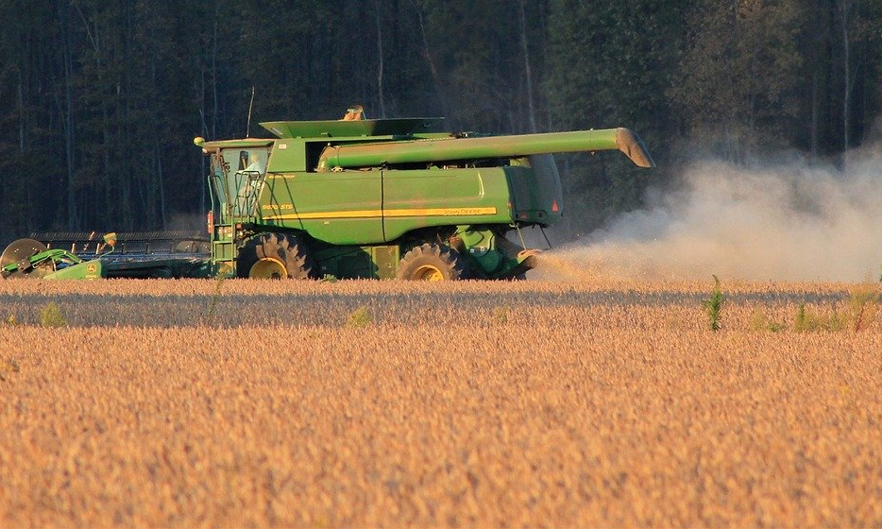
What’s the Danger?
POTENTIAL HEALTH AND SAFETY HAZARDS
Health and Safety Issues for Farmers
WORKING ALONE ON FARMS
Each year many people lose their lives in agricultural workplaces. Often these deaths are associated with working alone.
Operating machinery is particularly dangerous, Solo Agricultural Workers also face additional risks when working:
Notes:
What’s the Danger?
POTENTIAL HEALTH AND SAFETY HAZARDS
Health and Safety Issues for Farmers
Standing for long hours.
Sitting for long hours, especially on moving or vibrating vehicles.
Working in awkward postures, performing repetitive tasks, lifting.
Working in or around confined spaces.
Risks from animals including kicks, bites, steps, strikes, being squeezed against a wall or fence, etc.
Falls from heights, down shafts, etc.
Working long hours, or shifts.
Stress.
Slips, trips and falls from wet, untidy and obstructed floors.
Work in extreme temperatures and UV radiation.
Exposure to hazardous materials including fuel, lubricants, antifreeze, fertilizers, pesticides, herbicides, insecticides, veterinary preparations, paints, varnishes and etc.
Exposure to hazardous gases in and around manure pits that may cause asphyxiation and/or explosions.
Exposure to hazardous gases in silos during grain storage, as well as the risk of engulfment by flowing grain.
Needlestick or sharps injuries.
Risk of respiratory disorders, including lung disorders from inhaling moulds.
Fire and explosion hazards, including combustible dusts and decaying manure.
Exposure to zoonotic diseases from various sources, including animals (e.g., toxoplamosis, Q fever, rabies), poultry (e.g., histoplasmosis, psittacosis), insects (e.g., West Nile, Lyme), rodents (e.g., hantavirus), soil, manure, etc.
Exposure to noise.
Working alone.
Working at heights.
Various hazards from machinery and equipment (e.g., tractors, pickups, ATVs, front-end loaders, implements, attachments/power take-offs, etc.).
Risk of accidental start up when working on equipment or machinery.
WORKING ALONE ON FARMS
Each year many people lose their lives in agricultural workplaces. Often these deaths are associated with working alone.
Farmers know that agricultural work can be dangerous. When you work alone, the risks increase. If people don't know where you are when an accident happens, you may not be found for a long time. You may be trapped, injured and not in a position to help yourself.
About 75% of deaths in Victorian agricultural workplaces are associated with farm machinery (based on WorkSafe data). Some of these deaths could have been prevented if the person had received earlier emergency care, and if better emergency procedures were in place.
While operating machinery is particularly dangerous, Solo Agricultural Workers also face additional risks when working:
in confined spaces
around dams or power lines
at height
on hot work (particularly grinding)
with farm animals
under a machine (doing mechanical work), or changing heavy equipment tyres or running belts
with hazardous chemicals

Slide 7
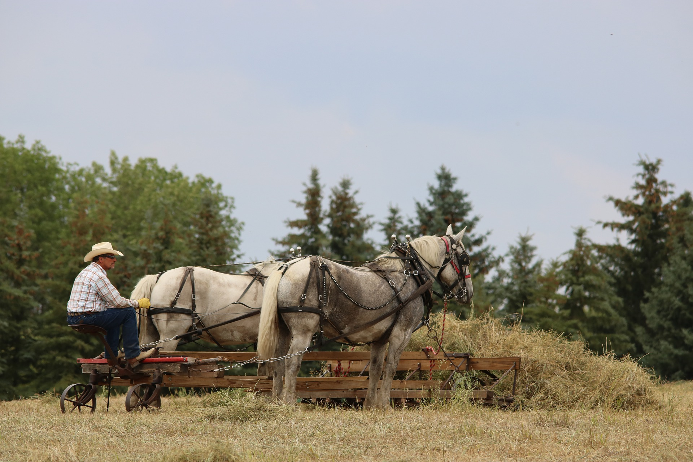
How to Protect Yourself
FARM JOBS ARE OFTEN DONE BY ONE PERSON, ALONE. KNOW HOW TO BE SAFE IN THAT SITUATION.
When you consider that the job involves heavy machinery and large animals, the increased risk of injury is easy to see.
If you become ill or injured while working alone, what’s your plan?
MAKE A PLAN
The following safety tips can prevent working-alone incidents and minimize the damage should an incident occur:
Safety
Notes:
How to Protect Yourself
FARM JOBS ARE OFTEN DONE BY ONE PERSON, ALONE. KNOW HOW TO BE SAFE IN THAT SITUATION.
Farming is Dangerous
The isolated nature of agriculture means that farmers are often working on their own In a remote location. When you consider that the job involves heavy machinery and large animals, the increased risk of injury is easy to see.
One of the most relaxing parts of a work day can be some alone time. It can also be one of the most deadly parts of the work day. If you become ill or injured while working alone, what’s your plan?
MAKE A PLAN
If you are working alone in a remote location, like in a field, you need to let someone know before you go and establish an agreed upon check-in time and what will happen if contact cannot be made.
The following safety tips can prevent working-alone incidents and minimize the damage should an incident occur:
Don’t work alone without the means to communicate – cell phones, pagers or two-way radios.
Check in regularly while you’re alone in the field.
Know who will assist you if something goes wrong.
Leave tough or hazardous tasks to be completed when help is available.
Incidents can happen during low-risk work also, so you should have a check-in schedule regardless of the type of work when you are working alone.
Safety
Make your safety part of the plan. Do you have a first aid kid, charging cord, change of clothes and all the tools and fuel you may need for the job? Have you reviewed your safety protocols for the task?

Slide 8
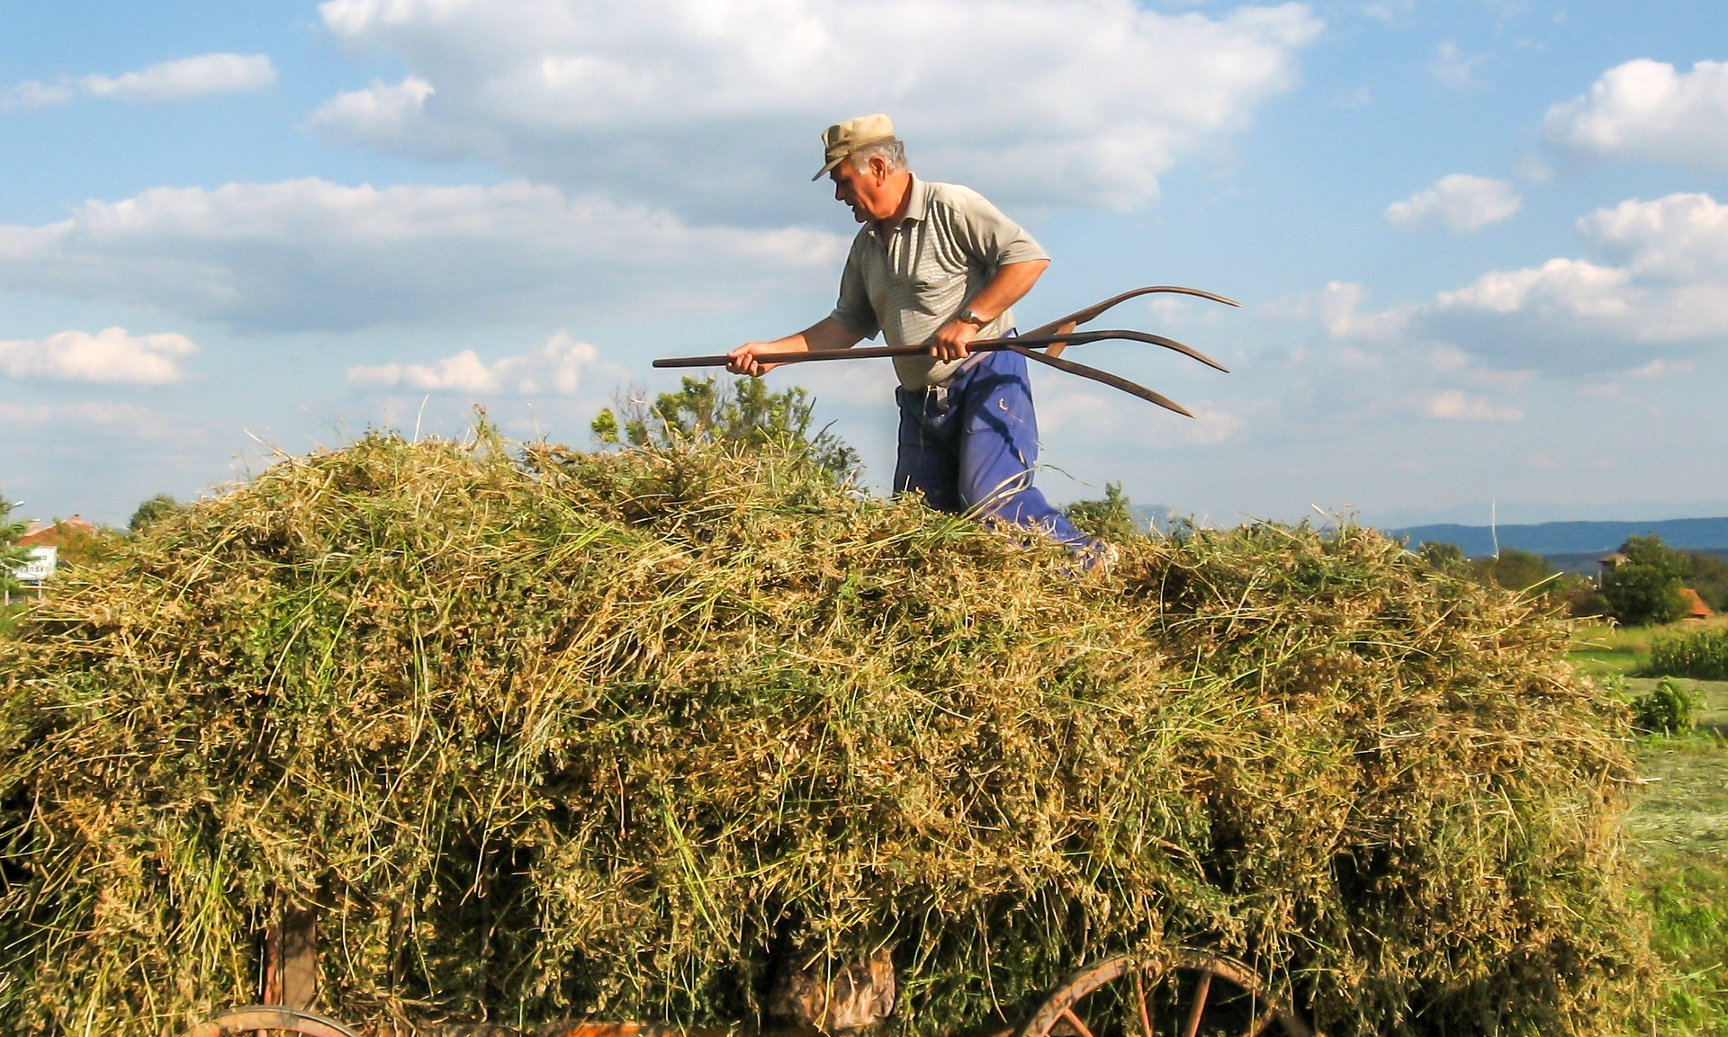
How to Protect Yourself
Equipment
Most injuries, including those leading to death, happen when the farm operator is working alone with equipment. It is critical to have safety procedures and plans in place. Be sure all equipment is well maintained and in good repair.
Working with livestock
Working with livestock can be hazardous, especially for someone working alone.
Never put yourself in a position without an escape plan — whether working outdoors or in a barn.
Notes:
How to Protect Yourself
Equipment
Most injuries, including those leading to death, happen when the farm operator is working alone with equipment. It is critical to have safety procedures and plans in place. Be sure all equipment is well maintained and in good repair. Ensure it is the right piece of equipment for the task at hand.
If operating the equipment requires you to enter and leave the cab frequently, do not short cut your safety procedures to save time. Always ensure the equipment is fully stopped and in park or turned off before exiting. Do not attempt to unplug or repair equipment that is moving or still running.
If you are using any straps, chains or additional equipment like post pounders, blades, buckets or grapples understand the safety requirements for their use. Assess whether this is a safe task to perform alone, and if help is needed wait until you have some.
Short cuts can be deadly. Do not be tempted to take unnecessary risks in the name of supposed efficiency. From the start of the task to completion be sure to be safe at all times. Reduce distractions while driving and performing tasks.
Working with livestock
Working with livestock can be hazardous, especially for someone working alone. Mitigate as much risk as possible by making safe choices.
Never put yourself in a position without an escape plan — whether working outdoors or in a barn. Be sure to know well in advance what tasks you may be performing and have the correct personal protective equipment with you, and that you are following the standard operating procedures established for the work.
Don’t assume that an animal will react a certain way. Animals can be unpredictable, even the ones you feel you know well. Understand the basics of “fight or flight,” the “flight zone” and “blindspots.” Use low-stress handling techniques and be willing to stop and get help if the situation becomes dangerous.
Understand the hazards of each situation and with each animal interaction. Don’t assume a chute, for example, eliminates the hazards from being struck or kicked, or that a head gate will prevent a bite or head swing. Be aware that hazards may not be a result of stress or a reaction from the animal but from you being “in the wrong place at the wrong time.” Understand the danger zones of the animals you are working with and respect them.

Slide 9
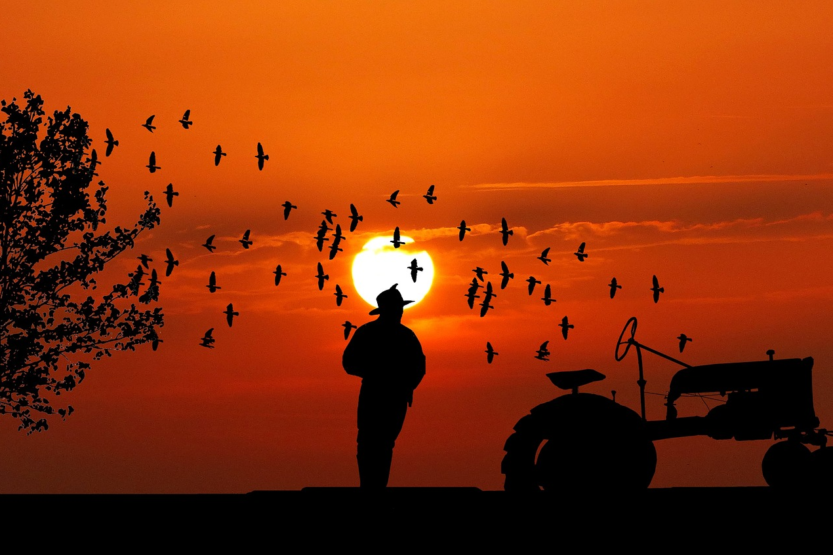
How to Protect Yourself
Emergency procedures
A workplace emergency procedure should be developed for all farms.
Agricultural Workplaces Must Also Consider:
Be Flexible
Conditions can change quickly, especially when you’re working outside. Be prepared for potential weather changes and assess whether work should stop or can safely continue.
Notes:
How to Protect Yourself
Emergency procedures
A workplace emergency procedure should be developed for all farms to consider the following:
provision of information, training and instruction on what to do in an emergency, to relevant employees, contractors and people living in the agricultural workplace
using systems (e.g. buddy, personal locator systems) as previously discussed
clearly marking entry and exit points at the site for emergency services
obtaining a map of the property that can be sent to the emergency services via phone or email
the nature of workplace hazards, and potential risks
emergency services contact details being available in a prominent location
rehearsal and testing of emergency procedures
introducing safeguards such as high visibility clothing and additional powered plant and machinery guarding
Agricultural Workplaces Must Also Consider:
who should be responsible for notifying emergency service organizations
designating and training a first aider in the workplace
emergency contact details for people with key roles in an emergency response plan
post-incident follow up – who is going to notify the regulator, investigate the incident, organise family, and provide employee support, etc.
keeping a record of employee movements around the workplace
Be Flexible
Conditions can change quickly, especially when you’re working outside. Be prepared for potential weather changes and assess whether work should stop or can safely continue.
If you have addressed all the hazards you can be prepared to surrender to the ones you can’t influence. Make safe choices.
Do not do anything risky to save time. Remember that a near miss is an indication of a hazard that hasn’t been addressed and hasn’t caused an injury yet.

Slide 10
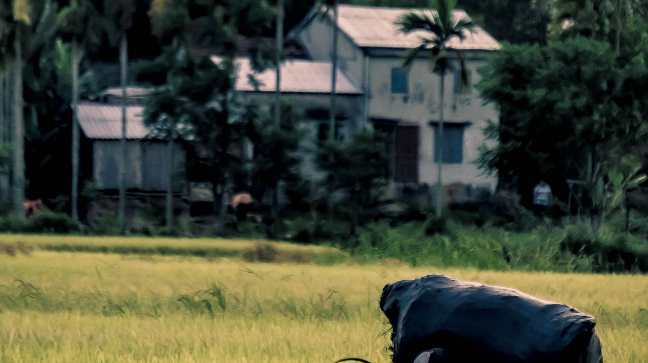
Final Word
There are many farm tasks that require you to work alone. Preventive measures can reduce the risk while you are working alone. The hazards of working alone are broader than you may think. You could be injured, have a medical emergency, experience a mechanical breakdown, become stuck or other adverse conditions. A major risk of working alone is the delay between an incident happening and help coming.
Notes:
Final Word
There are many farm tasks that require you to work alone. Preventive measures can reduce the risk while you are working alone. The hazards of working alone are broader than you may think. You could be injured, have a medical emergency, experience a mechanical breakdown, become stuck or other adverse conditions. A major risk of working alone is the delay between an incident happening and help coming.

