Slide 1

Click anywhere to get started…

Slide 2

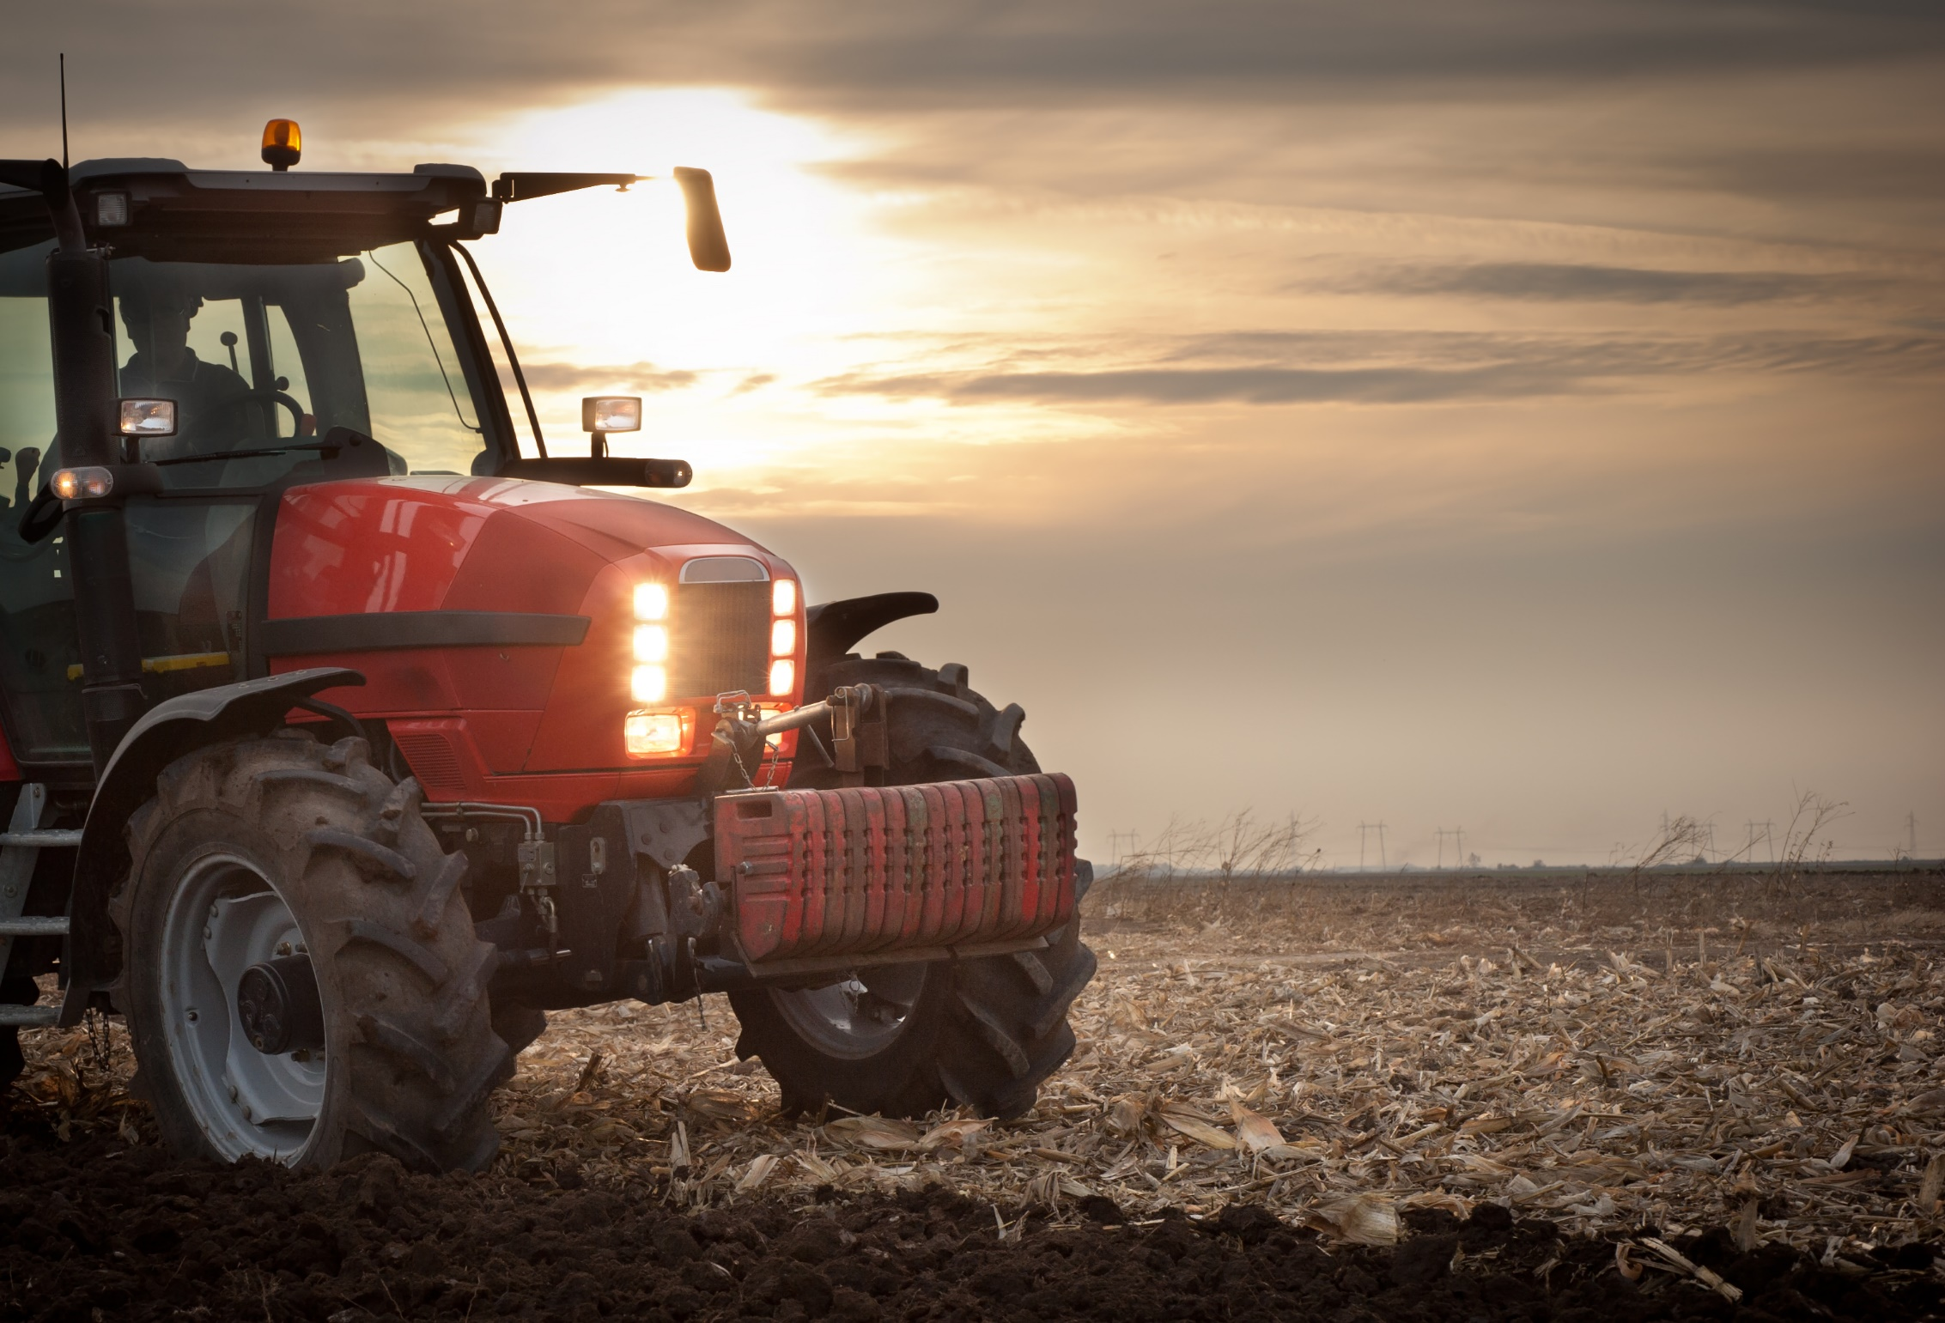

LIGHTING AND MARKING SELF-PROPELLED EQUIPMENT
Notes:
LIGHTING AND MARKING SELF-PROPELLED EQUIPMENT

Slide 3
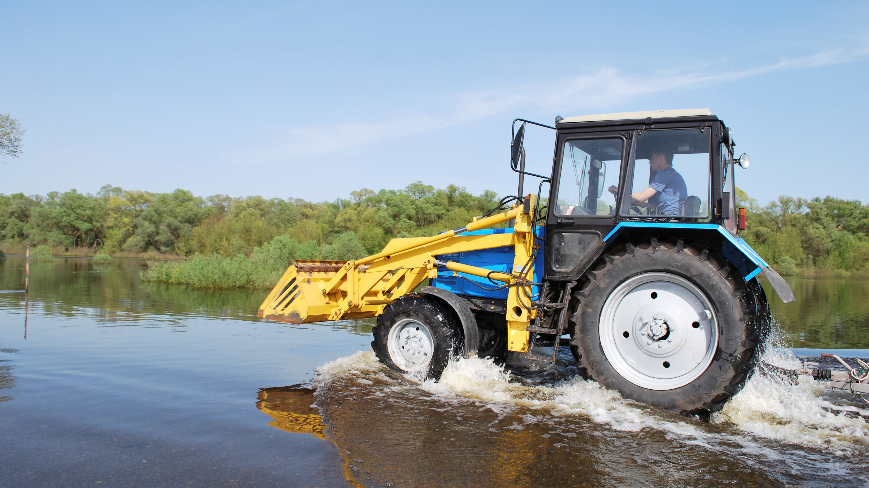
What’s at Stake?
Everyone plays a vital role in helping to prevent roadway collisions by insuring that equipment is as visible as possible to other motorists.
Notes:
What’s at Stake?
Everyone plays a vital role in helping to prevent roadway collisions by insuring that equipment is as visible as possible to other motorists. The more visible you are, the less likely you are to be involved in a collision. It is the difference between life and death.

Slide 4
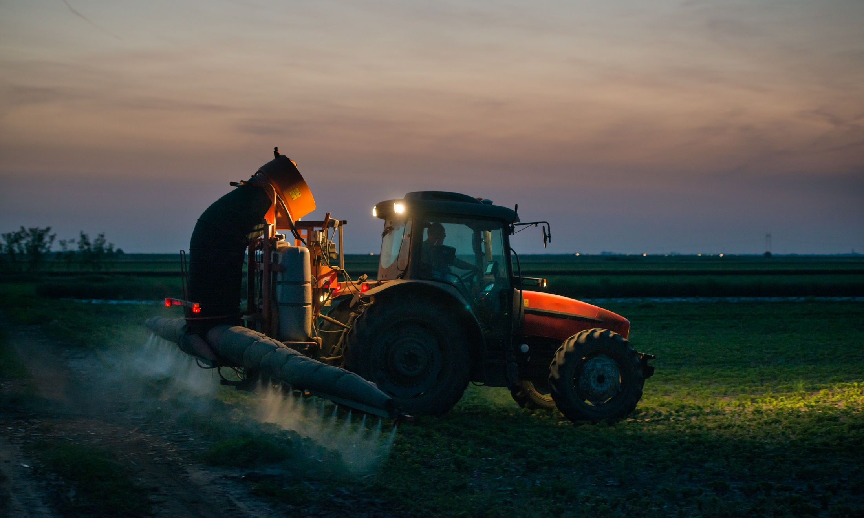
What’s the Danger?
According to the National Safety Council, approximately 15,000 farm vehicles are involved in highway crashes annually. Studies of collisions between slow moving vehicles and motor vehicles conclude that nearly 90 percent occur on dry roads during daylight hours and two thirds are rear-end collisions.
Notes:
What’s the Danger?
According to the National Safety Council, approximately 15,000 farm vehicles are involved in highway crashes annually. Studies of collisions between slow moving vehicles and motor vehicles conclude that nearly 90 percent occur on dry roads during daylight hours and two thirds are rear-end collisions.
When a fatality occurs, the victim is usually the tractor operator.
Tractors, with or without trailed equipment, and self-propelled implements are large enough to be clearly visible on the highway, especially during daylight hours. But there are many accidents involving farm vehicles.
Many rural residents have no experience with farming, yet they share the roads with tractors and implements. Lack of familiarity with farm equipment may be responsible for their poor judgment when gauging distances and speeds of slow moving vehicles. Additionally, the recognition of “something different” on the roadway may not be apparent due to poor lighting and marking. Tractors generally travel at less than 20 miles per hour (mph), compared with cars cruising at 55+ mph. A typical driver does not instantly recognize this difference in speed and may apply the brakes too late to avoid a collision.
Scope
But there are other dangers from the Self-propelled Equipment apart from tractors with or without trailed equipment.
Self-propelled vehicles are those automobiles motorcycles, aircraft, boats, snowmobiles, trucks, tractors jet skis, lawn mowers, golfcarts, etc., that convert their own energy supply into motive power used for propulsion. Batteries do so by converting electrochemical energy; engines do so by burning fuels to release their chemical energy. The majority of this equipment uses internal combustion engines such as a jet, diesel, or gasoline engines that consume flammable gases or liquids. Machinery may also employ engines to do other work such as turning crankshafts or generating electricity. External combustion engines include the steam engine which burns fuel to heat water, which on conversion to steam provides motive force.

Slide 5
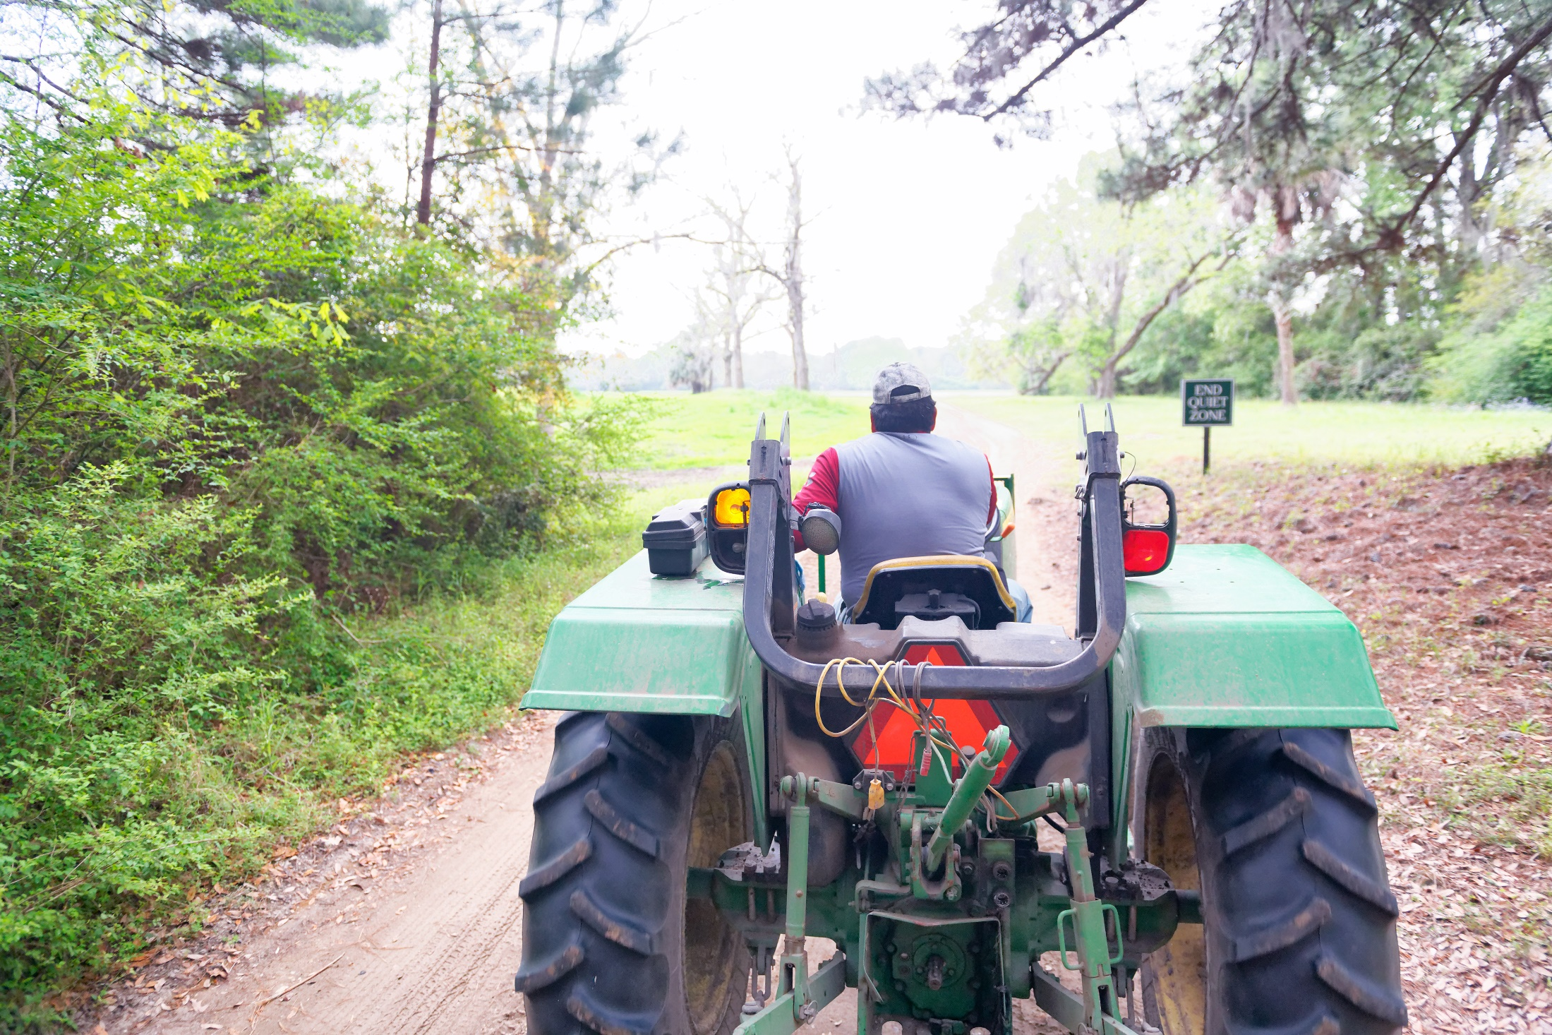
How to Protect Yourself
GENERAL
Motor vehicle drivers need to be able to identify slow moving vehicles in time to react safely.
Lighting
Extremity lighting and reflective material marking combined can be a very effective guard against roadway collisions.
Marking
Reflective marking material is a low cost effective tool to identifying agricultural equipment
Notes:
How to Protect Yourself
GENERAL
Motor vehicle drivers need to be able to identify slow moving vehicles in time to react safely. Protect yourself by installing the proper lighting and marking to your agricultural equipment. A small investment in materials and time can help to prevent common roadway collisions.
Lighting
Extremity lighting and reflective material marking combined can be a very effective guard against roadway collisions. Used together, other motorists can quickly and accurately identify that a large, slow moving piece of equipment is on the road. Without this type of effective protection farm equipment operators may be more at risk of injury or even death. It should be noted that when rearward facing work lamps or general service lamps are present, that they should be aimed downward and that they shall not be illuminated during highway travel. Motorists can be blinded and confused by the illumination of rearward facing white lights, thus becoming a detriment to safety.
Marking Reflective marking material is a low cost effective tool to identifying agricultural equipment. Properly placed reflective material helps the equipment stand out on the roadway. This conspicuous feature leads the naming of this material to be called “conspicuity material”. Ideally, agricultural equipment on the roadway should be conspicuous since other motorists will notice the equipment immediately and have sufficient time to avoid a collision.

Slide 6
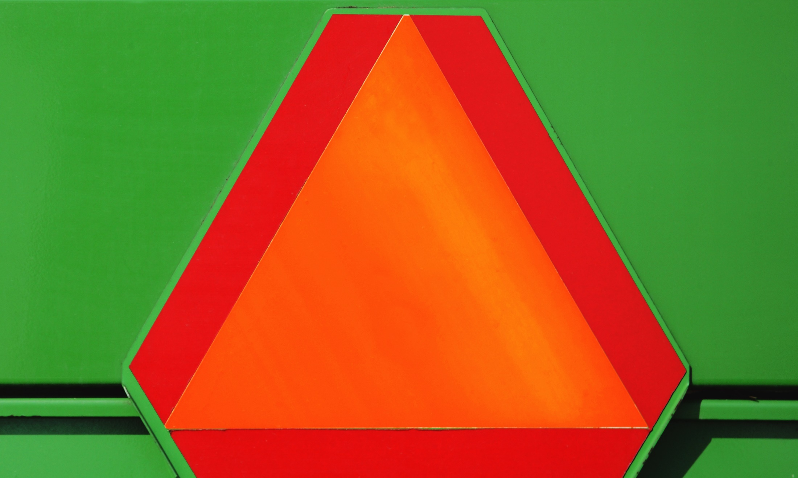
How to Protect Yourself
Reflective Materials
Fluorescent material which is visible in both daytime and low-light conditions. The fluorescent orange material in the center of the new ASAE standard SMV emblems is visible at twice the distance as the former material.
Responsibility Recap
Tractor Lighting and Marking Recommendations
Notes:
How to Protect Yourself
Reflective Materials
Fluorescent material which is visible in both daytime and low-light conditions. The fluorescent orange material in the center of the new ASAE standard SMV emblems is visible at twice the distance as the former material. Fluorescent color materials are comprised of fluorescent dyes which are bright, but unfortunately decompose and lose their brilliance (fading) over time. Fluorescent materials, such as the center of SMV emblems, should be replaced when their brilliance fades thus reducing their effectiveness.
Retroreflective material is designed to redirect light directly back towards its’ source. In the case of an SMV sign, the triangular border is made of red retroreflective tape that reflects the light of motorists’ headlights directly back, creating a visible warning effect. The retroreflective border of the new SMV signs is over 10 times brighter than the design of the older SMV signs. Typically the older style SMV reflective tape was only visible from a few hundred feet where as the new retroreflective tape used on SMV emblems is visible for over a mile. Retroreflective tape can also be used as reflectors and conspicuity material to meet ASAE standard recommendations at the equipment extremities. This retroreflective material is very durable and generally more weather resistant than the fluorescent materials.
Responsibility Recap
•Inspect machinery for proper lights and reflective materials.
•Retrofit older equipment with new retroreflective tape, extremity lighting, and new SMV signs.
•Be certain that every slow moving vehicle and piece of trailed equipment has a properly placed slow moving vehicle emblem that is clean and not faded. Replace-worn, damaged, and faded emblems as soon as possible.
•Do not use SMV emblems for stationary markers, such as for a driveway or mailbox; it is illegal and can cause confusion and collisions. Extended misuse can cause the symbols to lose their effectiveness as a warning device.
•Anticipate problems that motorists might have because of their limited experience with slow moving vehicles and give them extra room on the roadway.
Tractor Lighting and Marking Recommendations
A Slow Moving Vehicle (SMV) emblem is required at all times.
The Ohio Revised Code requires tractors (non multi-wheeled) and other self-propelled equipment to display the following lighting sunset to sunrise or when there is insufficient light to render discernible persons, vehicles, and substantial objects at a distance of 1000 feet ahead.
One white headlight on the front of the vehicle, visible from at least 1,000 feet in front of the vehicle.
Two red lamps as wide apart as possible on the rear of the vehicle, visible from at least 1,000 feet behind the vehicle or one light and two red reflectors.

Slide 7
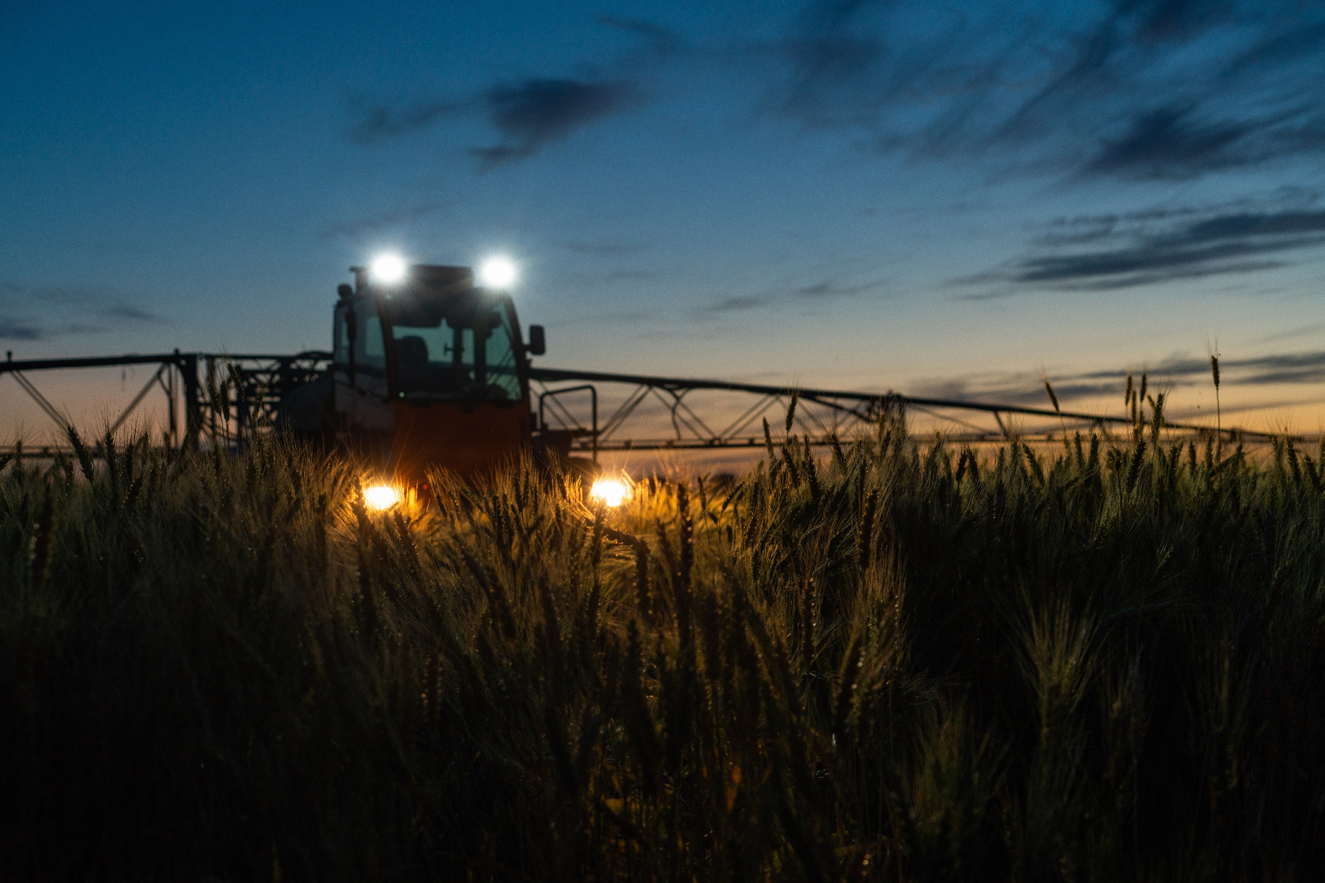
How to Protect Yourself
Slow Moving Vehicle (SMV) Emblems
Headlamps
Tail Lamps
Amber Flashing Warning Lamps
Turn Signals
Reflectors and Reflective Tape
Flood Lamps
Notes:
How to Protect Yourself
OVERVIEW/KEY ISSUES
Slow Moving Vehicle (SMV)
Emblems are triangular, bright-orange signs with red borders. These must be securely mounted at the centre or to the left-of-centre of all slow-moving farm vehicles and equipment. Be sure it is clean and visible. If it is faded or damaged, have it replaced.
Headlamps. Tractors and other self-propelled equipment must have at least two headlamps visible from the front.
Tail Lamps. Tractors and other self-propelled equipment should have two red tail lamps visible from the rear of the machine, mounted symmetrically no more than 1.5 m (5 ft.) to the left and right of the machine centre and between 1 and 3 m (3.3 and 12 ft.) high.
Amber Flashing Warning Lamps. Tractors and self-propelled equipment must have at least two flashing amber warning lamps, visible from both the front and rear of the machine, and located at least 1 m (39 in.) high. On machines more than 3.7 m (12 ft.) wide, warning lamps must be mounted within 400 mm (16 in.) of the outside edges of the machine, including dual wheels, wide axles and headers. The amber flashing warning lamps are to be on when driving on public roads.
Turn Signals. When driving on public roads, always use turn signals. Proper turn signals have a two-part action. First, the amber flashing warning lamp opposite the direction of the turn becomes steady burning and then the rear-facing red tail lamp flashes in the direction of the turn. If your equipment does not allow other drivers to see your signals, then arrange for an escort vehicle(s).
Reflectors and Reflective Tape indicate to motorists the width of your load and help them judge their actions. Ensure all reflectors and reflective tape are in good condition and replace as needed.
•Red reflectors or reflective tape must be mounted to indicate the extreme left and right rear edges of all machines.
•On machines over 3.7 m (12 ft.) wide, yellow reflective tape, visible from the front and rear of the unit, must mark the extreme left and right projections of the machine.
•All tape and reflectors must be visible and capable of being seen at night from a distance of 305 m (1,000 ft.).
•When buying reflective tape and lights we only use the kind that meet the CSA and ANSI standards for reflective material.
Flood Lamps or general service lamps are designed to light up the machine or field work. Front-facing flood lamps must be aimed downward during travel on public roads so as not to blind oncoming traffic. Rear facing service or flood lamps must be turned off.

Slide 8
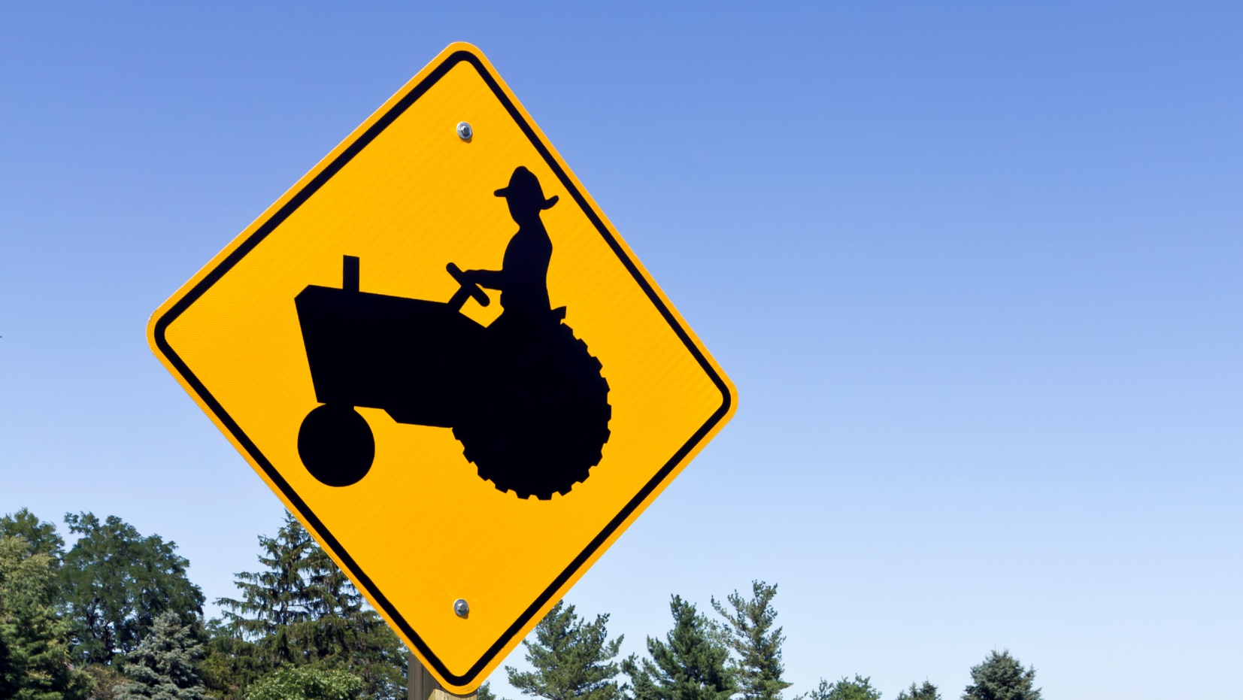
Final Word
Whether you are doing field work, transporting farm machinery, operating any machinery, the key to safety is to “see and be seen”. Every light and reflector on a tractor, self-propelled vehicle, or implement has a specific purpose. It is the operator’s responsibility to ensure the correct use of lighting and marking in each instance.
Notes:
Final Word
Whether you are doing field work, transporting farm machinery, operating any machinery, the key to safety is to “see and be seen”. Every light and reflector on a tractor, self-propelled, or implement has a specific purpose. It is the operator’s responsibility to ensure the correct use of lighting and marking in each instance.

