Slide 1

Click anywhere to get started…

Slide 2
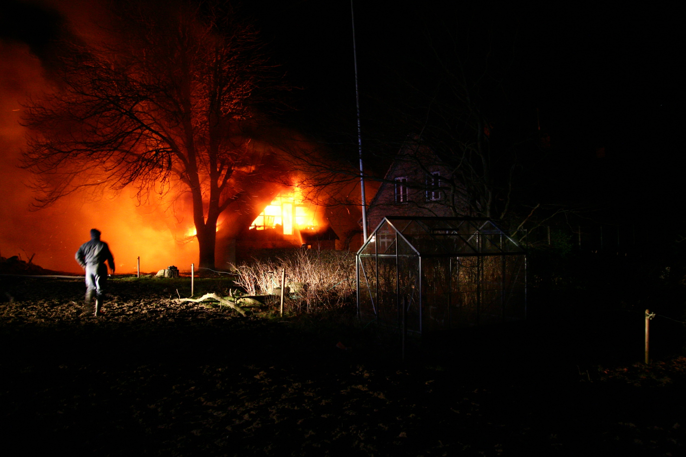


FARM MACHINERY FIRE PREVENTION
Notes:
Farm Machinery Fire Prevention

Slide 3
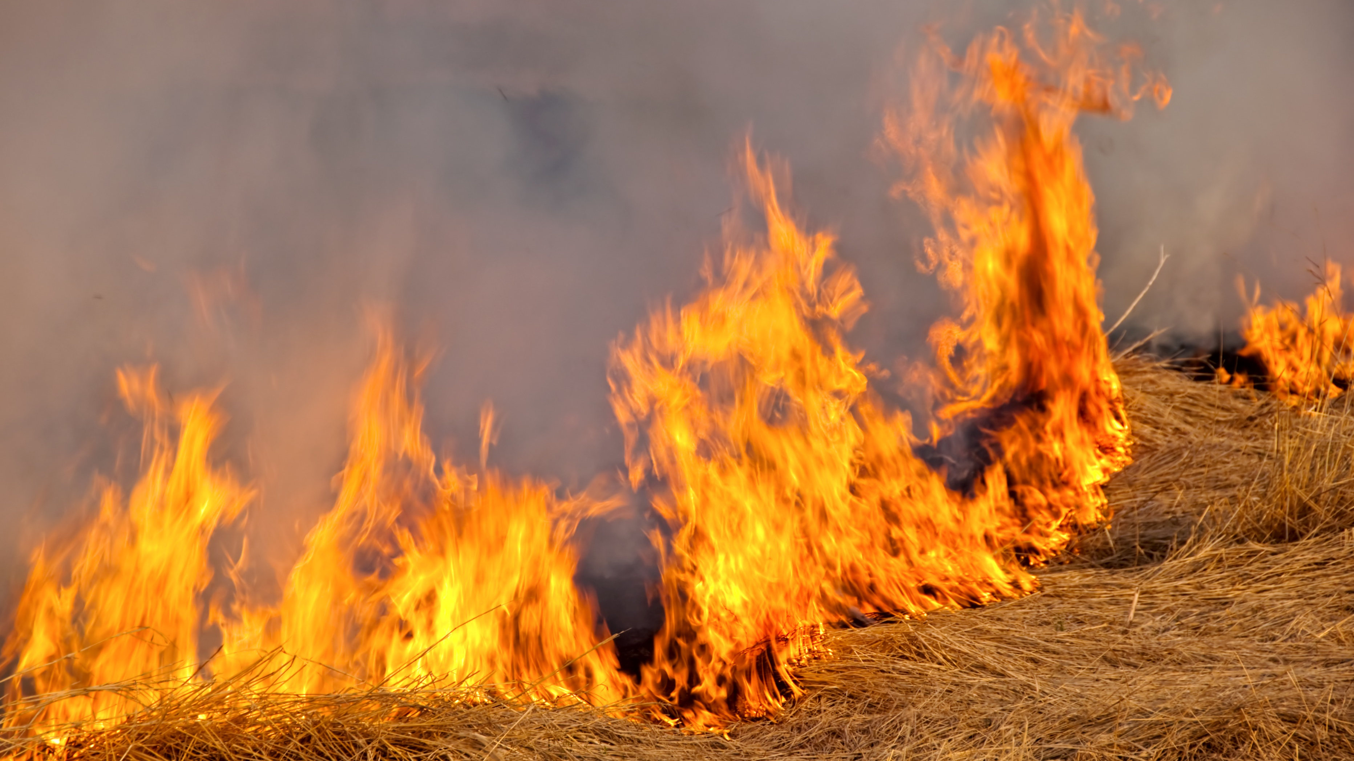
What’s at Stake?
Farm machinery is essential to farm daily work. Machinery can be a fire hazard when it is not properly maintained. A fire on the farm is a major concern.
Notes:
What’s at Stake?
Farm machinery is essential to farm daily work. Machinery can be a fire hazard when it is not properly maintained. A fire on the farm is a major concern. Long distances from the fire department mean longer emergency response times. A fire on our farm could be extremely costly and potentially dangerous.

Slide 4
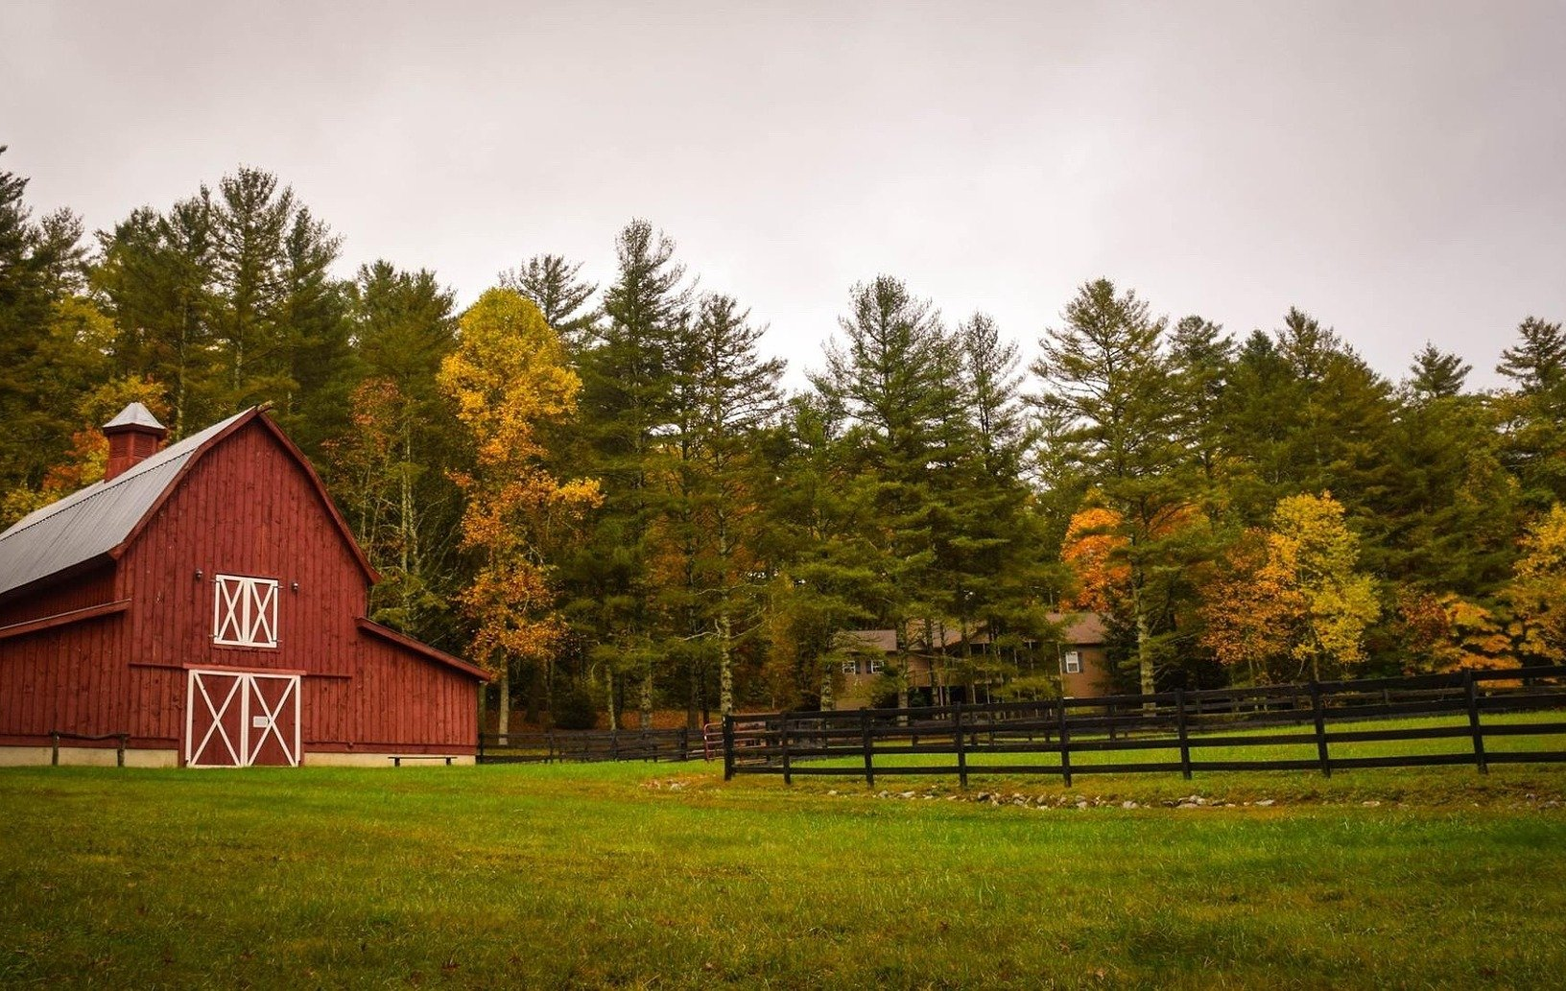
What’s the Danger?
With organic materials like hay and feed, plus large mechanical equipment that generates heat and exhaust gasses, a typical farm has several potential fire hazards.
The leading cause of agriculture fires is open flame caused by candles, matches, bonfires, sparks, static electricity, friction, welding and equipment. Other causes of fires may include natural resources such as spontaneous combustion and lightning.
How Fires burn
The elements necessary to create a fire are Fuel, Heat and Oxygen.
Notes:
What’s the Danger?
With organic materials like hay and feed, plus large mechanical equipment that generates heat and exhaust gasses, a typical farm has several potential fire hazards. Losing property, livestock and equipment in a fire can lead to long-periods of downtime that can be devastating to your farming operation. It can also result in insurance premium increases in the future.
The leading cause of agriculture fires is open flame caused by candles, matches, bonfires, sparks, static electricity, friction, welding and equipment. Other causes of fires may include natural resources such as spontaneous combustion and lightning.
How Fires burn
The elements necessary to create a fire are Fuel, Heat and Oxygen. These elements constitute the fire triangle. Removal or control of one element will remove or control a fire hazard.

Slide 5
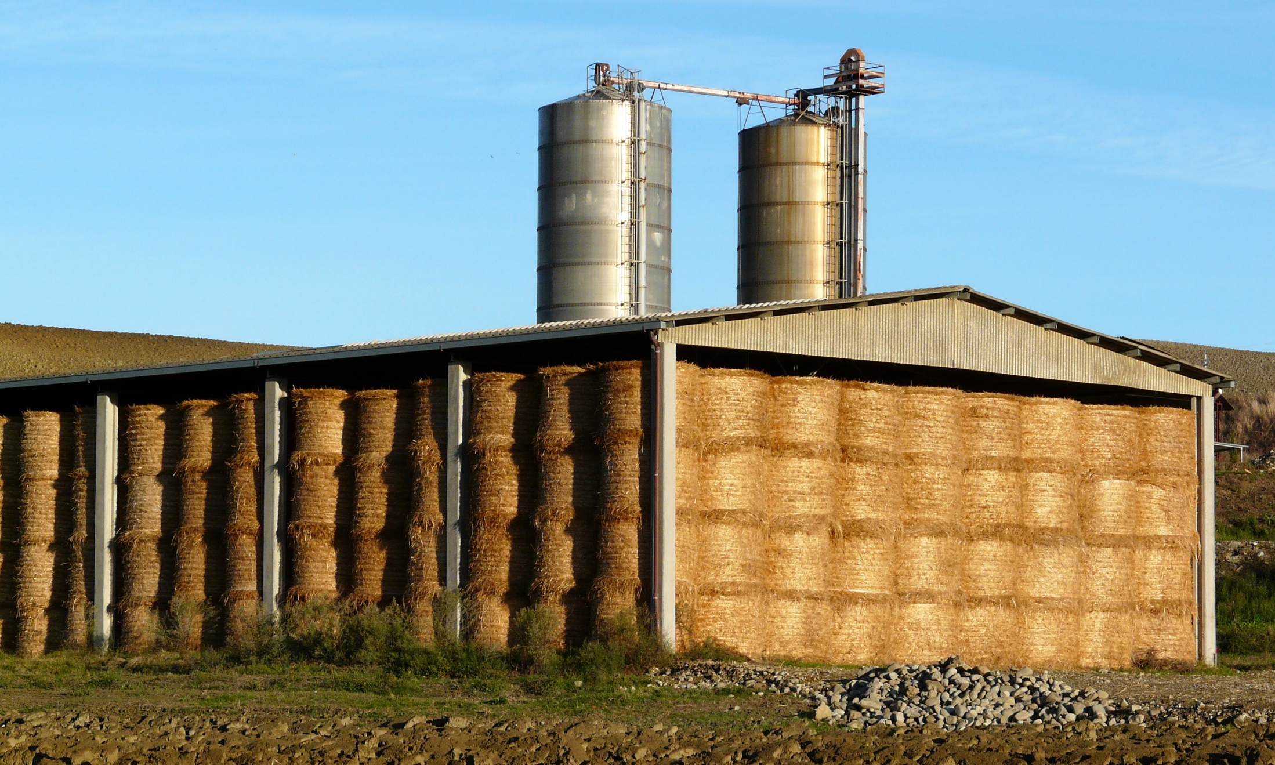
How to Protect Yourself
GENERAL SAFETY MEASURES
Minimize Hazards on Site
Machinery
Hotwork
Spontaneous Combustion
Control of Fire Hazards
Check the Heating System.
Know your Fire Extinguishers
Notes:
How to Protect Yourself
GENERAL SAFETY MEASURES
A. Minimize Hazards on Site
Strictly enforce a no smoking rule inside a building or areas where flammable and combustible materials are stored or near storage, shipping or receiving areas where boxes or other containers can easily start a fire. Keep flammable liquids away from open flames and motors that might spark. Never smoke when refueling.
When transferring flammable liquids from metal containers, bind the containers to each other and ground the one being dispersed from to prevent sparks from static electricity. Clean up spills right away and put oily rags in a tightly covered metal container. Change your clothes immediately if you get oil or solvents on them.
Flammable liquids should be clearly marked and stored in approved containers in well ventilated areas away from heat and sparks. Keep above ground fuel storage tanks at least 40 feet from buildings.
Store compressed gases in a secure upright position, away from heat sources in an outdoor location. Keep different gases separately and full cylinders apart from empty cylinders, When heating with propane, keep 45-kg (100 LB) cylinders at least 4.5 metres (15 feet) away from heaters; keep large tanks at last 7.6 metres (25 feet) away.
B. Machinery
Re-fuel machinery with care. Watch for and repair leaks in fuel lines, carburetors, pumps and filters. Keep engines properly tuned and timed to avoid back firing and exhaust systems in good condition to avoid sparks. Keep machinery properly lubricated to minimize friction.
C. Hotwork
Always have a fire extinguisher on hand during hot work. Watch for molten metal as it can ignite flammables or fall into cracks and start a fire that might not erupt until hours after the work is completed. Use portable cutting and welding equipment in clean work areas.
Keep flammables at least 35 feet from a hot work area. Be sure other tanks and other containers that have held flammable liquids are completely naturalized and purged before you do any hot work on them
D. Spontaneous Combustion
Many materials under certain conditions heat spontaneously. Store vegetable and animal oils and paints or linseed - soaked rags in sealed containers in cool, well ventilated places away from other combustibles. Avoid storing wet hay and check stored hay for warm spots. If hay temperature is noticeably warmer than when it was put in, watch it closely. If the temperature reaches 175 degrees F, get the hay out or divide it into small, shallow stacks.
Watch for silage danger signs - heat, release of moisture, vapor or steam, smoke, a charred tobacco smell. A fine chop permits the material to be packed more firmly in both trench and upright silos. Also, a silo designed to be sealed should be kept closed, except for loading or unloading.
E. Control of Fire Hazards
Cut down and remove weeds and brush from around buildings. In buildings, check for excessive accumulation of dust, feathers, cobwebs, and other potential combustibles. Reduce and keep away from heat unneeded items that will burn. Arrange shops and barns so that flammables are safely away from ignition sources. Use approved electrical installations including proper fuses or circuit breakers, waterproof outlets, enclosed electric motors and similar equipment in any buildings which are cleaned periodically with high-pressure equipment.
Inspect all wiring and electric motors and appliances for exposed wires, broken insulation, improper grounding and incorrect installations.
F. Check the Heating System.
See that air shafts are clean of dust and debris, motors are cleaned and oiled (if necessary) each season, and pulley belts are in good working order. Check gas and fuel oil system for leaks and unsafe installations.
G. Know your Fire Extinguishers
Fire extinguishing equipment can be classified into two types; portable and fixed. However, a portable, ABC rated fire extinguisher is more practical for agricultural use, capable of extinguishing Class A, B or C fires.
Fire classes
Class A - Combustibles such as wood, paper textiles, where a quenching, cooling effect is required
Class B - flammable liquids, gasoline, oils, fats, paint, where oxygen exclusion or flame interruption is essential.
Class C - live electrical wiring, motors, appliances, where non-conductivity of the extinguishing agent is crucial.
Class D - combustible materials, magnesium, sodium, and potassium.

Slide 6
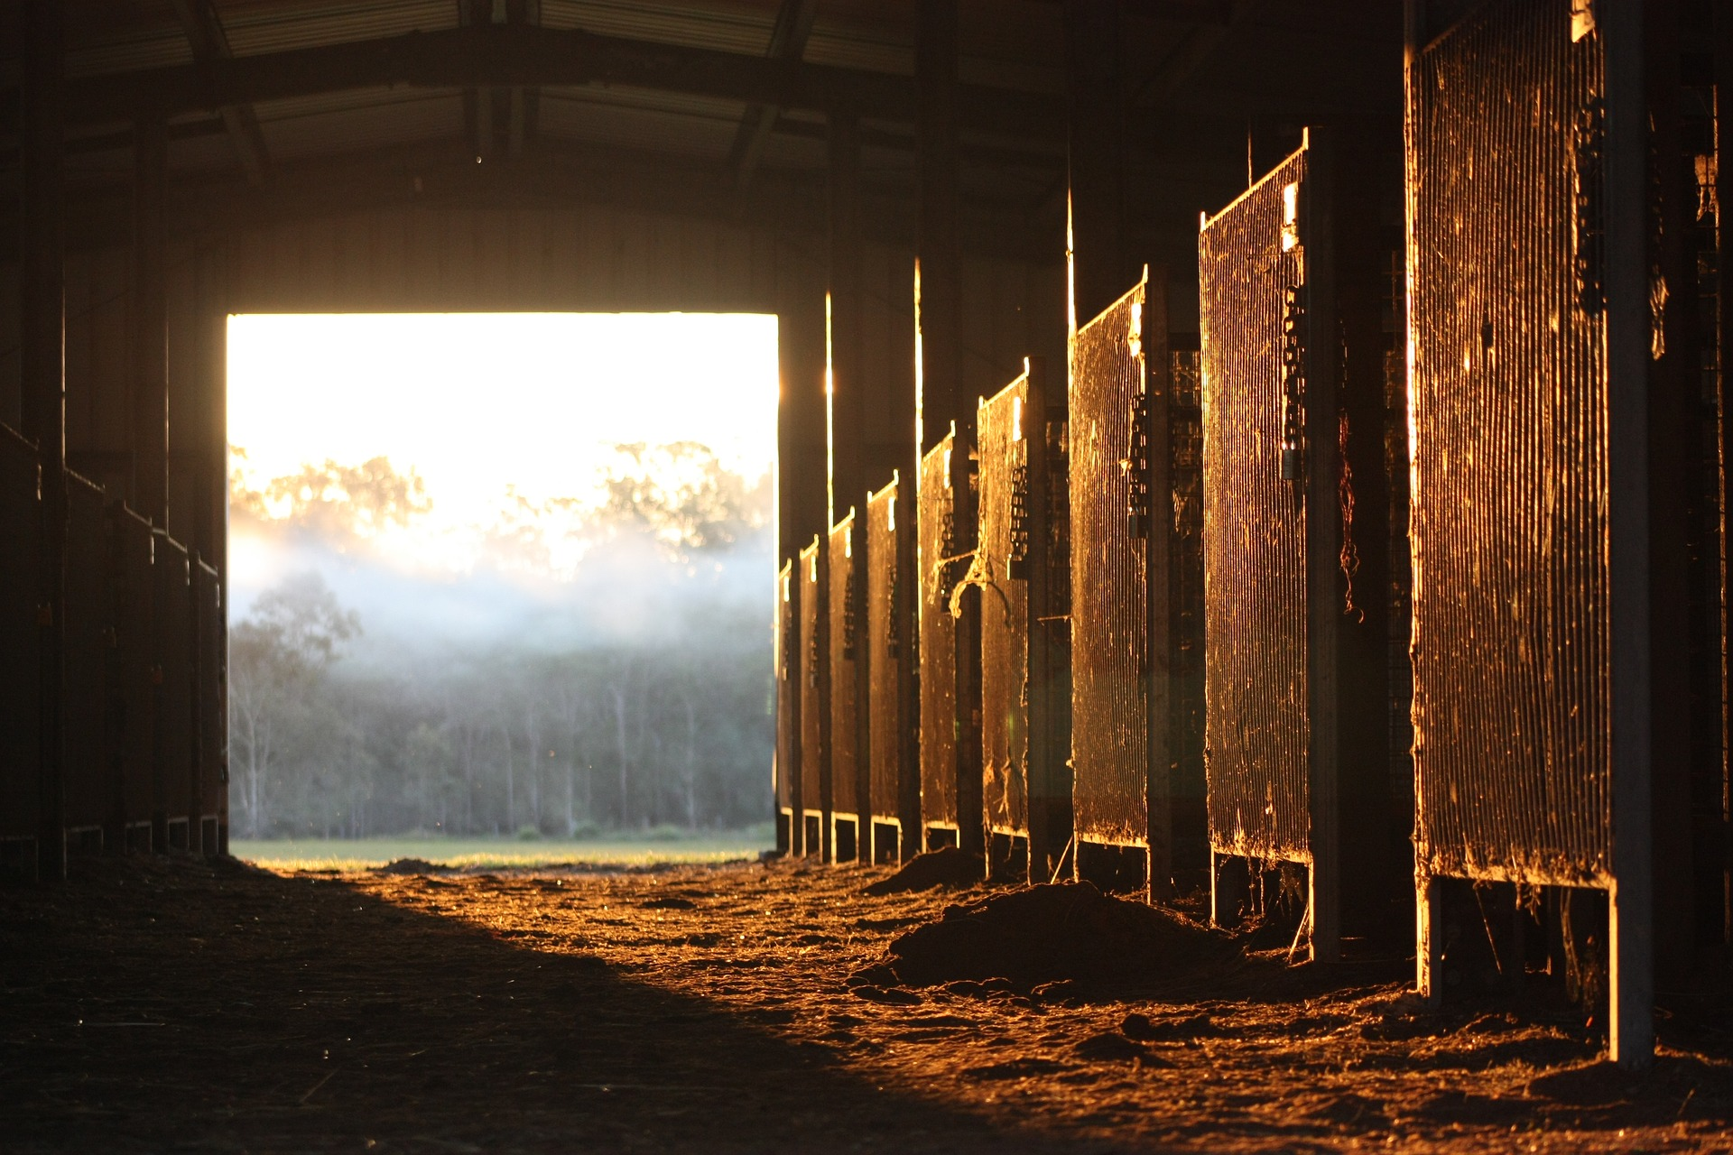
How to Protect Yourself
FARM FIRE PREVENTION HI-LITES
Preventative Measures for Barns and other Farm Buildings
No smoking
Clear the clutter
Let the air flow
Inspect electrical equipment
Refuel outside
Heat with care
Keep extinguishers ready
Notes:
How to Protect Yourself
FARM FIRE PREVENTION HI-LITES
Preventative Measures for Barns and other Farm Buildings
No smoking: Never allow smoking in farm buildings. Discarded cigarettes should not be left on the ground or in potted plans. Potting soil becomes combustible in dry conditions.
Clear the clutter: Keep barns and yard areas clear of brush and other flammable debris. Move flammable items away from heat sources, and clear away dirt and dust buildup from appliances and equipment to prevent overheating.
Let the air flow: Provide adequate ventilation to prevent buildup of chemical vapors, silo gases, and other hazardous byproducts. Proper airflow helps dissipate flammable gas and vapors, preventing heat buildup.
Inspect electrical equipment: Maintain electrical equipment and keep wires safely enclosed in metal or PVC pipes to protect them from exposure to weather and animals. Once per year, have a licensed electrician inspect the electrical equipment in your farm buildings.
Refuel outside: Refuel equipment outdoors, away from open flames and as far from any buildings as possible. Make sure engines are not running or still hot before refueling. Keep fuel and other combustibles away from livestock in a different building.
Heat with care: Keep heaters out of the reach of livestock and well away from bedding and other combustible materials. Avoid using heat or solar lamps, trouble lights, heated watering bowls or other heated devices to warm outdoor pet shelters. Instead, use borrowed heat that provides warmth from a separate building – such as through a hot water heating system that circulates water with potable antifreeze to buildings via underground piping.
Keep extinguishers ready: Portable fire extinguishers should be properly maintained, regularly inspected and easy to find in each building, especially near mechanical equipment and storage areas that contain flammable materials. Train your employees how to properly use extinguishers and where to find them.

Slide 7
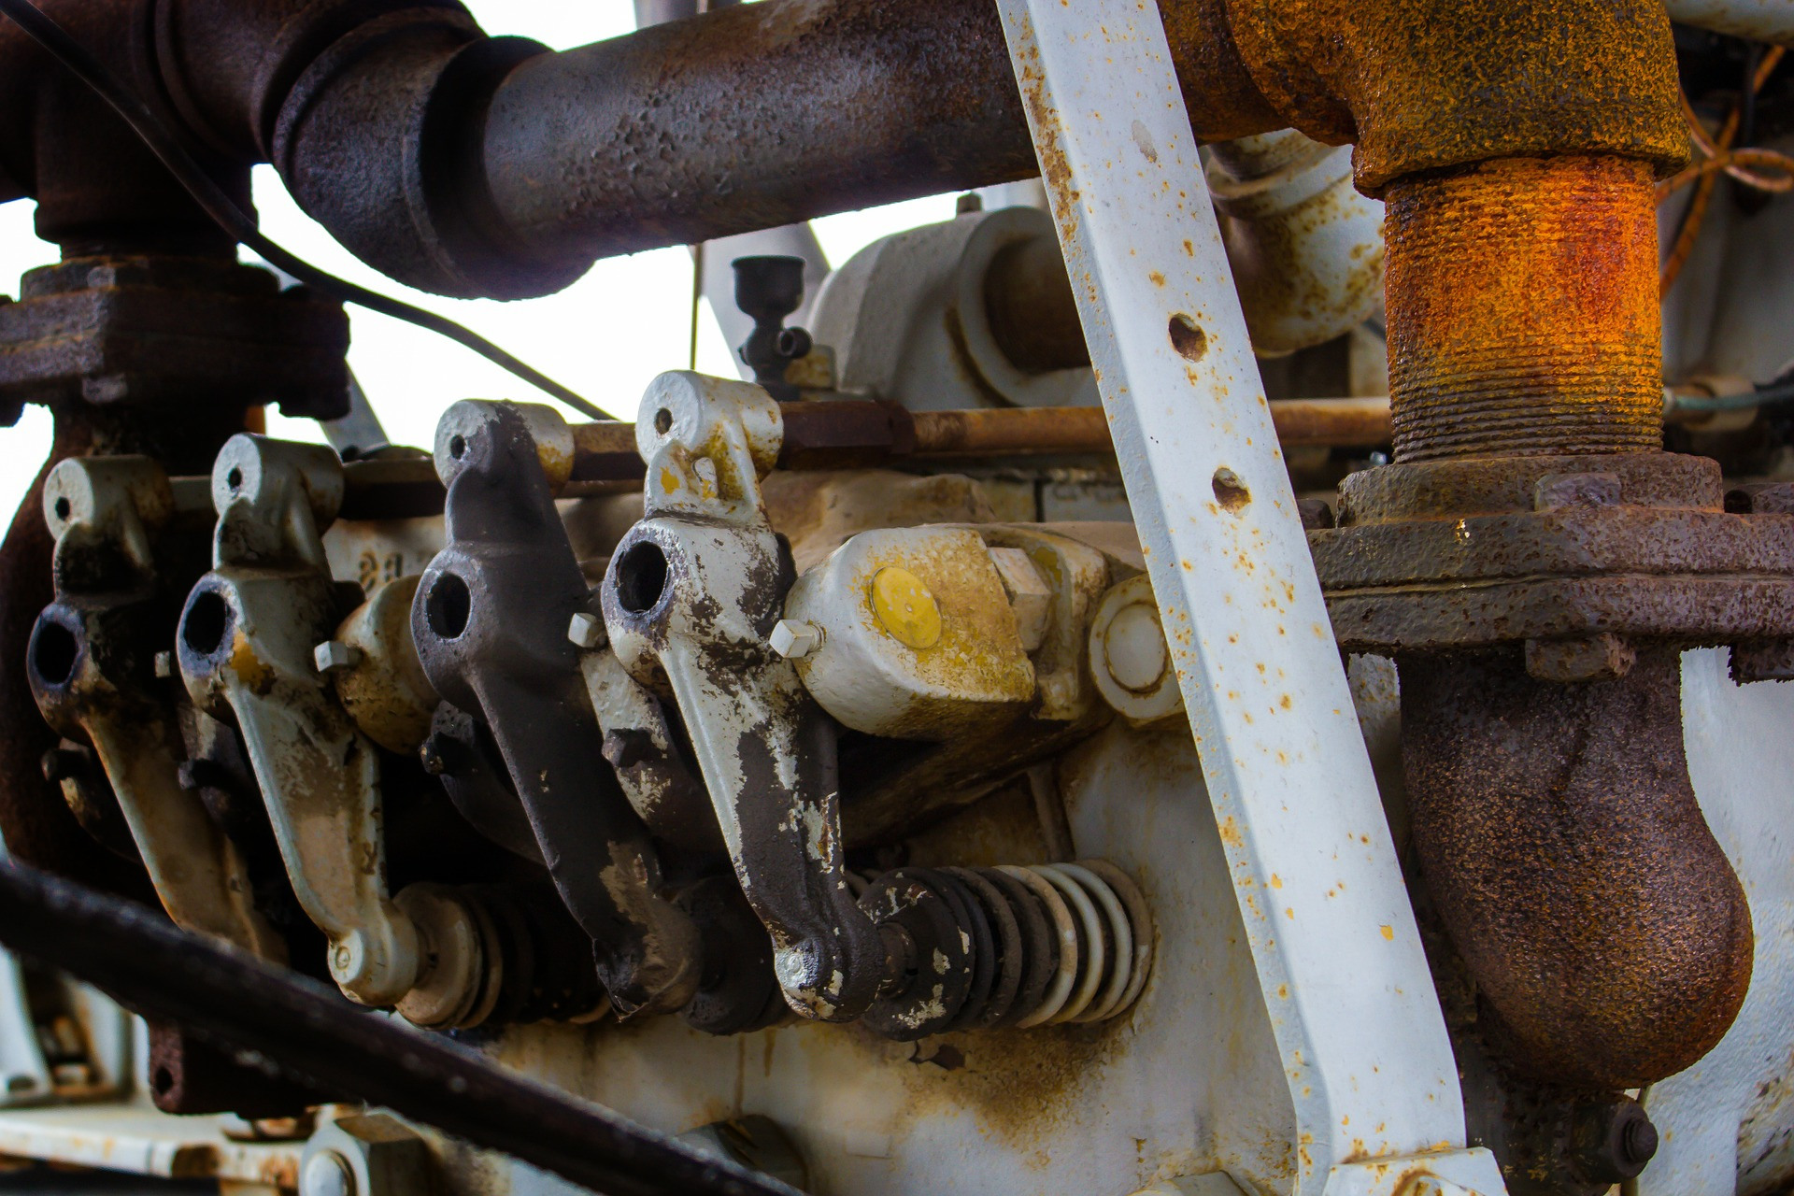
How to Protect Yourself
MACHINERY FIRE PREVENTION
Preoperational inspections must be done prior to using any equipment on a daily basis. If you notice any fire hazards, please correct them or inform a supervisor.
SAFE FUELING
Improper Fueling can result in a costly fire.
IN CASE OF FIRE
Notes:
How to Protect Yourself
MACHINERY FIRE PREVENTION
Preoperational inspections must be done prior to using any equipment on a daily basis. If you notice any fire hazards, please correct them or inform a supervisor.
Look for:
Any build-up of crop residue around the engine, exhaust systems and belts and chains.
Any damage or worn parts on the exhaust system, drive belts, electrical wiring, moving parts
Any signs of leaking fluids, oils and fuel.
Any odor of burning electrical wiring
SAFE FUELING
Improper Fueling can result in a costly fire.
Never refuel equipment with the engine running.
Allow hot engines to cool down before refueling.
Do not use electronic devices like cell phones while fuelling.
Do not enter the equipment. Doing so could create static electricity that could create a spark and ignite fuel vapors.
Absolutely no smoking while refueling. Smoking is only to be done in the designated areas.
Clean up minor spills and allow any spilled fuel on the engine to evaporate before starting.
IN CASE OF FIRE
If a fire does break out on a machine you’re operating, quickly shut off the engine, grab your extinguisher, get out, and get help.
Approach any fire with extreme caution. Even a small fire can flare up dramatically when doors, hatches, or other areas are opened.
If possible, use the extinguisher’s flexible hose to shoot the chemical from a safe distance at the base of any flames you see.
Remember that it may not be possible to put out every fire. If it’s in a difficult-to-reach area or seems out of control, don’t risk it, wait for help to arrive.

Slide 8
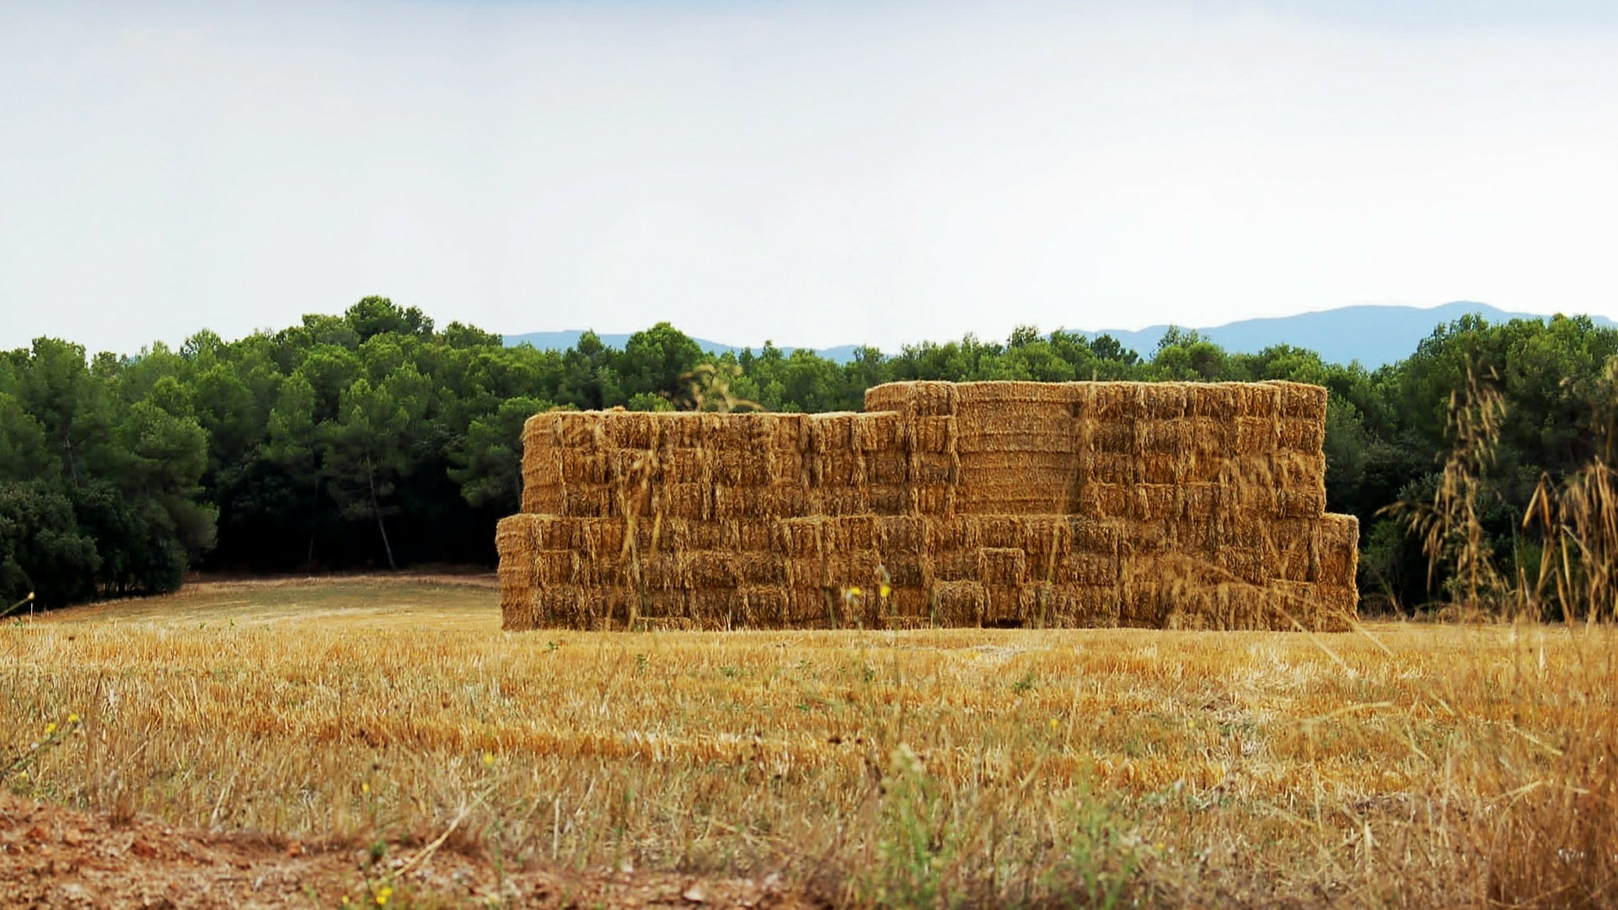
Final Word
There are the three major elements that combine to create fire. They are air, heat, and fuel. It’s impossible to eliminate air from around farm machinery. Farm machinery fire prevention focuses on keeping the machinery clean of possible fire causing materials (fuel) and eliminating all possible sources of heat that could lead to a fire.
Notes:
Final Word
There are the three major elements that combine to create fire. They are air, heat, and fuel. It’s impossible to eliminate air from around farm machinery. Farm machinery fire prevention focuses on keeping the machinery clean of possible fire causing materials (fuel) and eliminating all possible sources of heat that could lead to a fire.

