Slide 1

Click anywhere to get started…

Slide 2

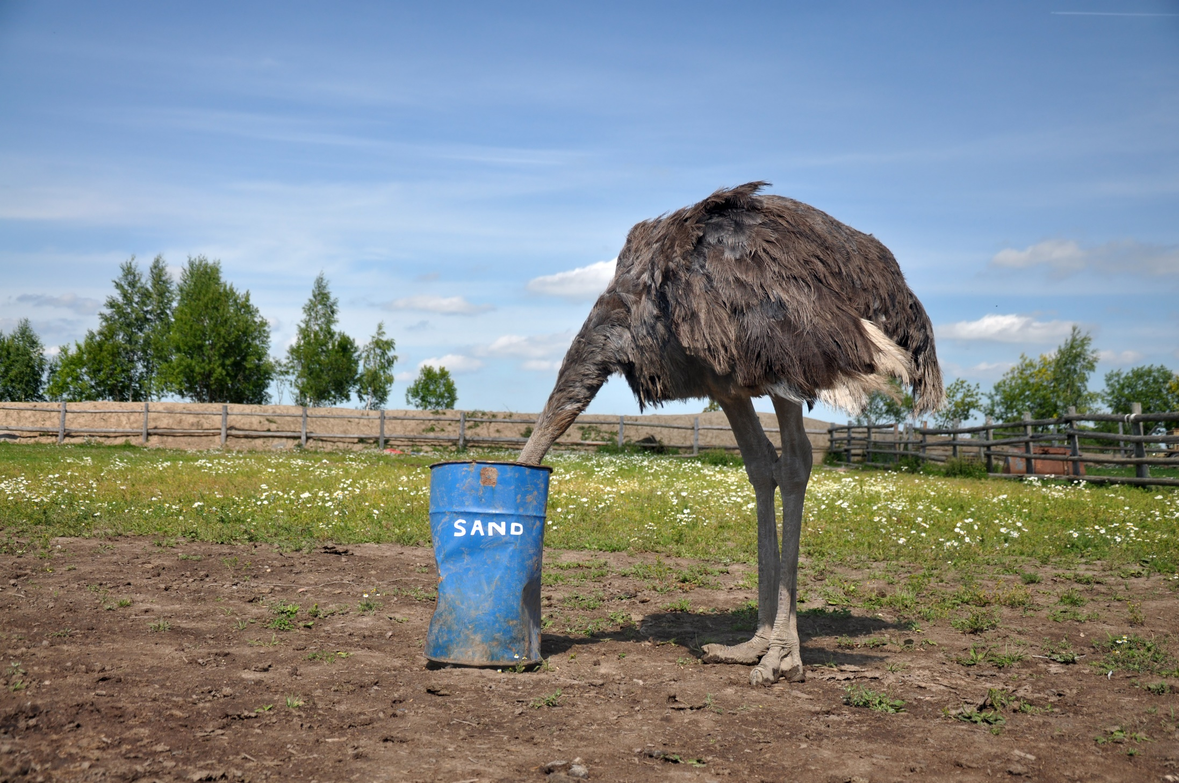

FARM STRESS MANAGEMENT
Notes:
Farm Stress Management

Slide 3
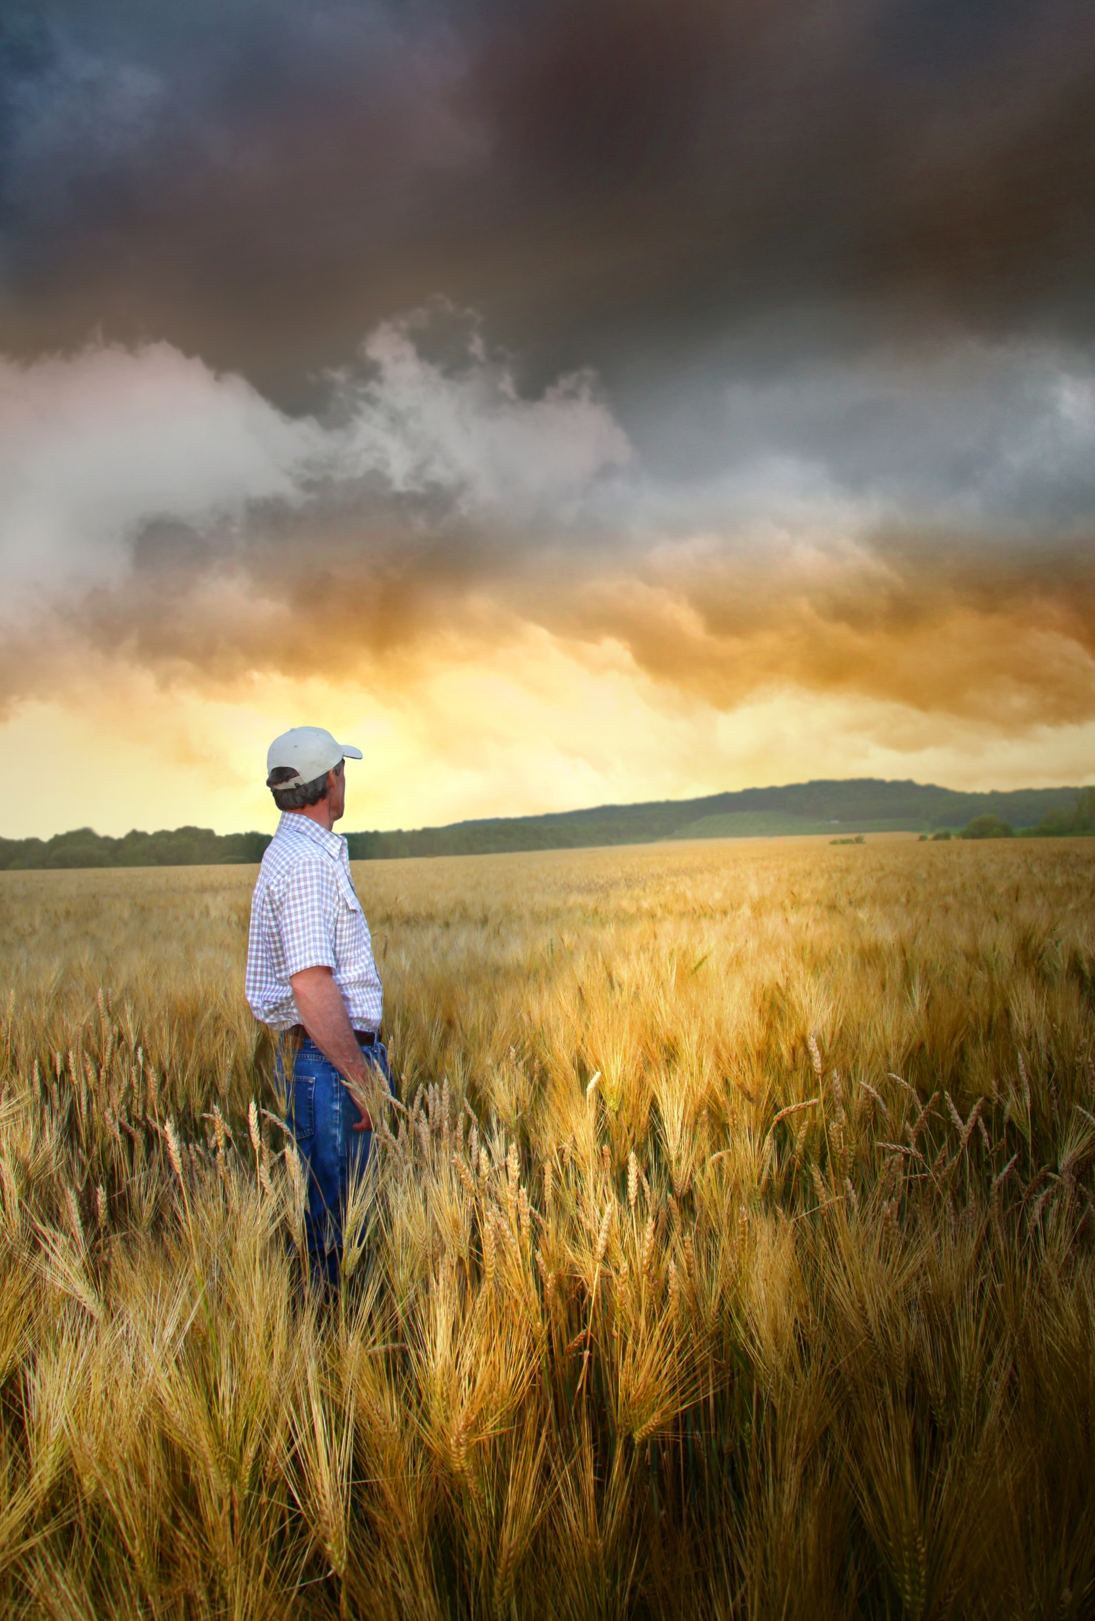
What’s at Stake?
Perhaps you have wondered how other farmers can go on in spite of the stress load they carry.
Notes:
What’s at Stake?
Perhaps you have noticed that some farmers struggle under the pressures of events that you find easy to handle. Or perhaps you have wondered how other farmers can go on in spite of the stress load they carry.

Slide 4
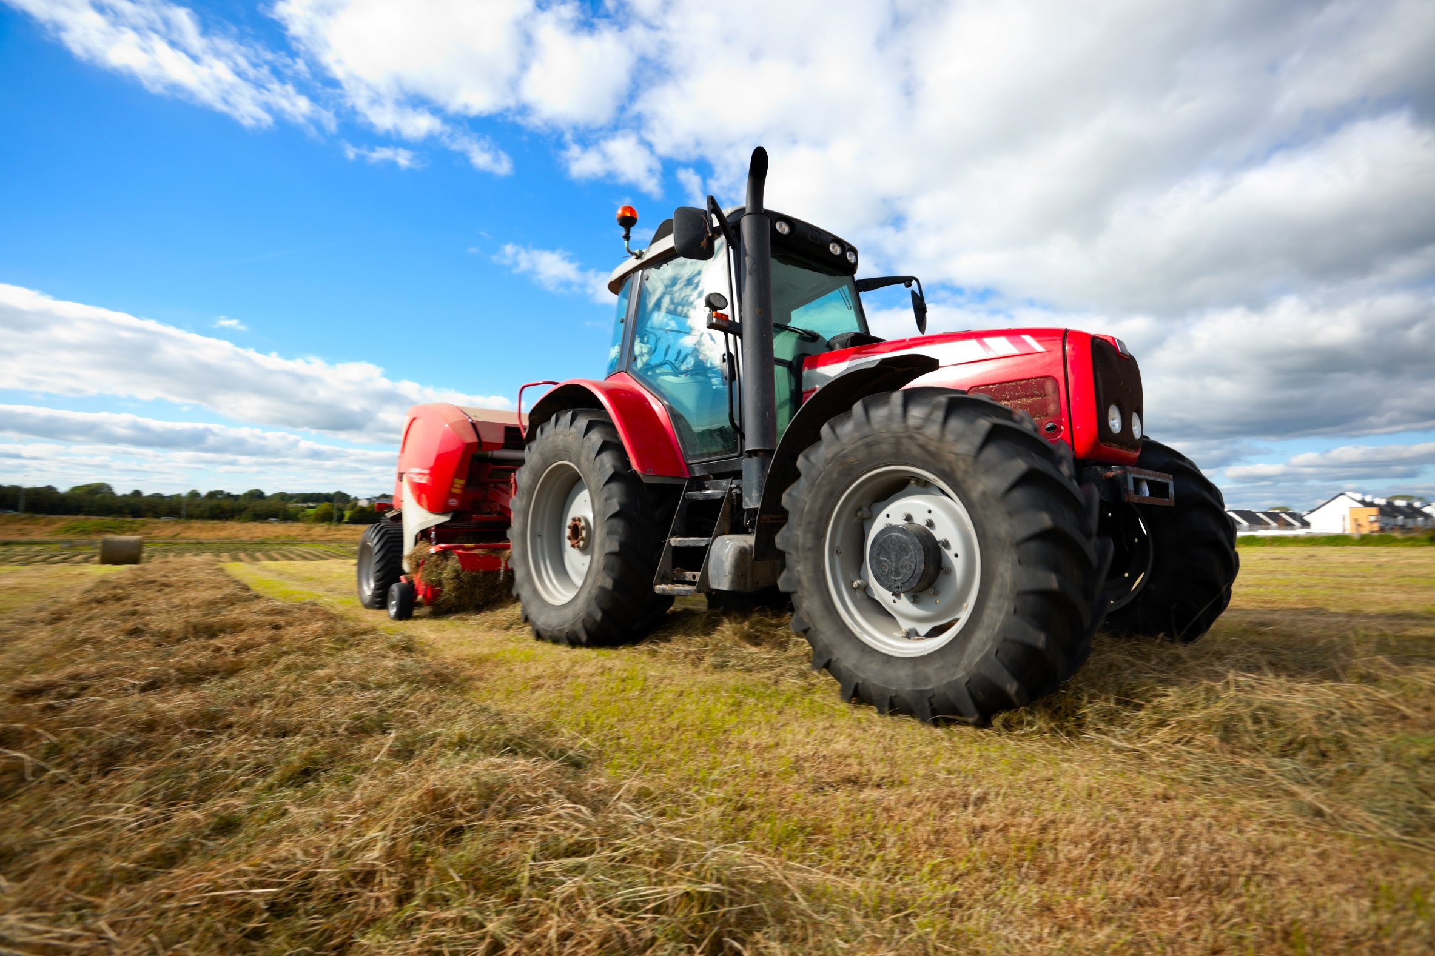
What’s the Danger?
STRESS – GENERALLY
Common Stressors
Uncertainty of things that can be stressors.
Types of Stress
Acute stress is also known as the fight-or flight response.
Chronic stress is more subtle than acute stress, but the effects may be longer and more problematic.
Some symptoms of chronic stress can include:
Why is it that some farmers can handle lots of stress and others very little?
Researchers who have examined differences between successful and unsuccessful stress and have identified three key factors.
Notes:
What’s the Danger?
Why is it that some farmers can handle lots of stress and others very little?
Researchers who have examined differences between successful and unsuccessful stress managers have identified three key factors.
Individuals vary in their capacity to tolerate stress. For example, prolonged exertion and fatigue that would be only mildly stressful to a young farmer may prove very difficult for an older farmer or someone with a heart defect.
Emergencies on the farm, delays and other problems that a confident farmer takes in stride may be a stumbling block for one who feels inadequate. While part of an individual’s stress tolerance is inborn, a crucial part depends on the quality of coping skills practiced. Learning to cope successfully with a stressor once makes it easier the next time.
2. A second factor is feeling in control. Successful stress managers know how to accept those stressors out of their control – the weather, their height, stock market fluctuations – and how to effectively manage those stresses within their control – such as neck tension, temper flare-ups or record keeping.
3. The attitudes, perceptions, and meanings that people assign to events determine a large part of their stress levels. A person has to perceive a situation as stressful or threatening in order to experience stress. If you think your dog is barking in the middle of the night because of a vandal, you will experience more stress than if you suspect a skunk has wandered into your yard.

Slide 5
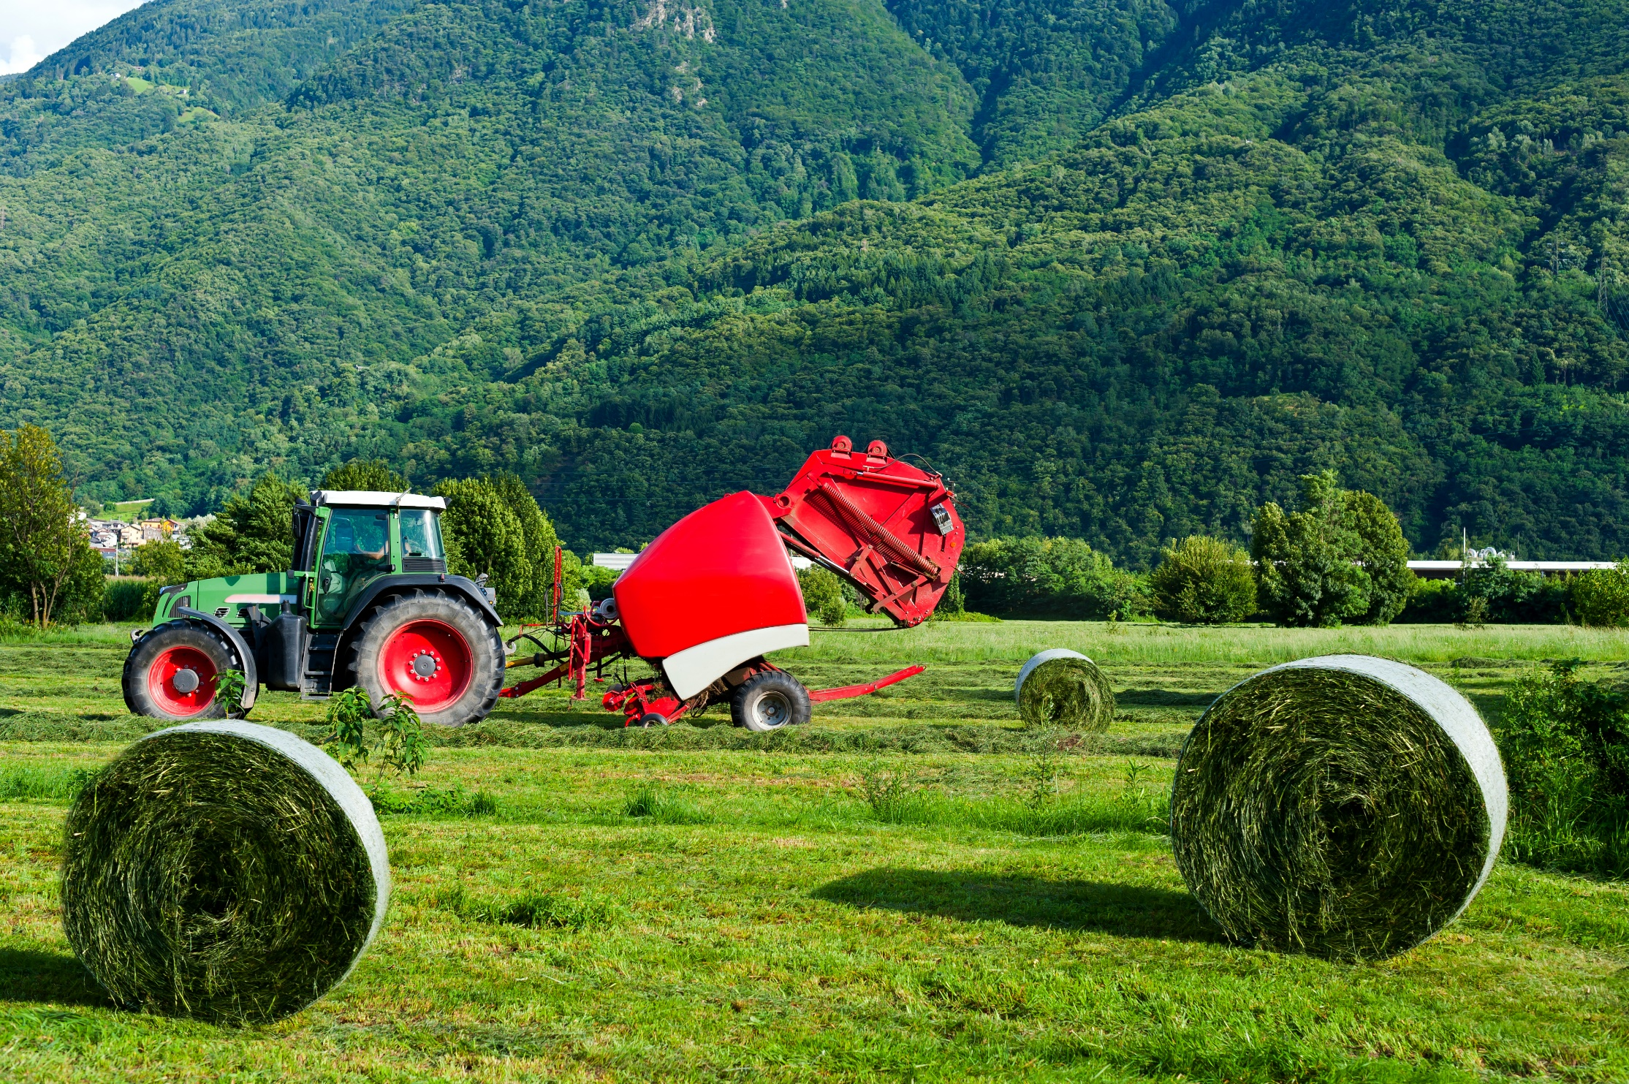
What’s the Danger?
To relax and manage stresses well during peak farm stress seasons – planting and harvesting – takes discipline and daily practice at controlling events, attitudes and responses.
STRESS OVERVIEW
Many factors that influence a farm’s viability are out of a farmer’s control.
Often what we cannot control causes us to feel the most stress:
Stress for farmers continues as rural communities change - some shrink and fewer services are conveniently available, others are witnessing a changing landscape through urban sprawl and mining.
Notes:
What’s the Danger?
To relax and manage stresses well during peak farm stress seasons – planting and harvesting – takes discipline and daily practice at controlling events, attitudes and responses.
STRESS OVERVIEW
Many factors that influence a farm’s viability are out of a farmer’s control.
Often what we cannot control causes us to feel the most stress:
The weather
Increased input costs
Large debt loads
Livestock health
Erratic markets
Government regulations and complicated paper work
Long working hours
Disagreements with other family members in the farm operation
Uncertain crop yields and fodder production
Machinery breakdowns
Handling dangerous goods e.g. farm chemicals
Stress for farmers continues as rural communities change - some shrink and fewer services are conveniently available, others are witnessing a changing landscape through urban sprawl and mining. As members of these communities, farmers work to fill the gaps in order to keep their communities functioning. Rural communities in turn are affected by the high stress farm environment.

Slide 6

How to Protect Yourself
The “OPERATIVE” word in discussing stress is CONTROL.
Control Events
Control attitudes
Control responses
Notes:
How to Protect Yourself
The “OPERATIVE” word in discussing stress is CONTROL.
Control Events
Plan ahead. Don’t procrastinate. Replace worn machinery parts during the off season.
Before the harvest discuss who can be available to run for parts, care for livestock, etc.
Set priorities about what has to be done today and what can wait until tomorrow. Plan your time.
Say no to extra commitments that you do not have time to do.
Simplify your life. If possible, reduce your financial dependence on others.
Schedule stressful events within your control, such as elective surgery.
Control attitudes
See the big picture: “I’m glad that tire blew out here rather than on that next hill.”
List all the stresses you now have. Identify those you can change; accept the ones you cannot change.
Shift your focus from worrying to problem solving.
Think about how to turn your challenges into opportunity.
Notice what you have accomplished rather than what you failed to do.
Set realistic goals and expectations daily. Give up trying to be perfect.
Control responses
Focus on relaxing your body and mind. Whether you are walking, driving or phoning, do it slowly and relax. Keep only that muscle tension necessary to accomplish the task.
Tune in to your body. Notice any early signs of stress and let them go.
Take care of your body. Exercise regularly and eat well-balanced meals. Limit your intake of stimulants such as coffee, sodas and tea.
Avoid smoking cigarettes, using alcohol or other drugs, or using tranquilizers or sleeping pills.
If your health allows, tense and then relax each part of your body from toes to head, one part at a time.

Slide 7
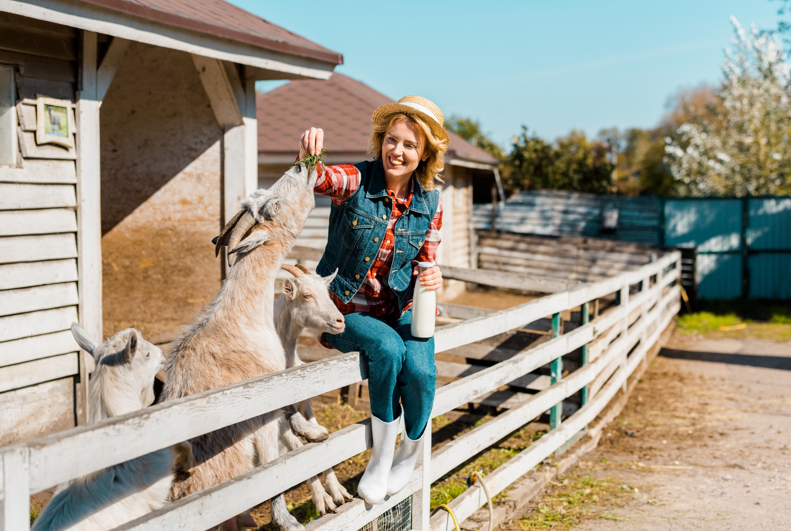
How to Protect Yourself
Shake away tension as you work by vigorously shaking each of your limbs.
Take a break. Climb down from your tractor and do a favorite exercise.
Take three deep breaths – slowly, easily. Let go of unnecessary stress.
Stop to reflect or daydream for 10 minutes. Close your eyes and take a short mental vacation to a place you really enjoy. See the sights; hear the sounds; smell the smells. Enjoy. Then go back to work feeling refreshed.
Think positive thoughts: “I can and will succeed.”
Notes:
How to Protect Yourself
Shake away tension as you work by vigorously shaking each of your limbs.
Take a break. Climb down from your tractor and do a favorite exercise.
Take three deep breaths – slowly, easily. Let go of unnecessary stress.
Stop to reflect or daydream for 10 minutes. Close your eyes and take a short mental vacation to a place you really enjoy. See the sights; hear the sounds; smell the smells. Enjoy. Then go back to work feeling refreshed.
Think positive thoughts: “I can and will succeed.”

Slide 8
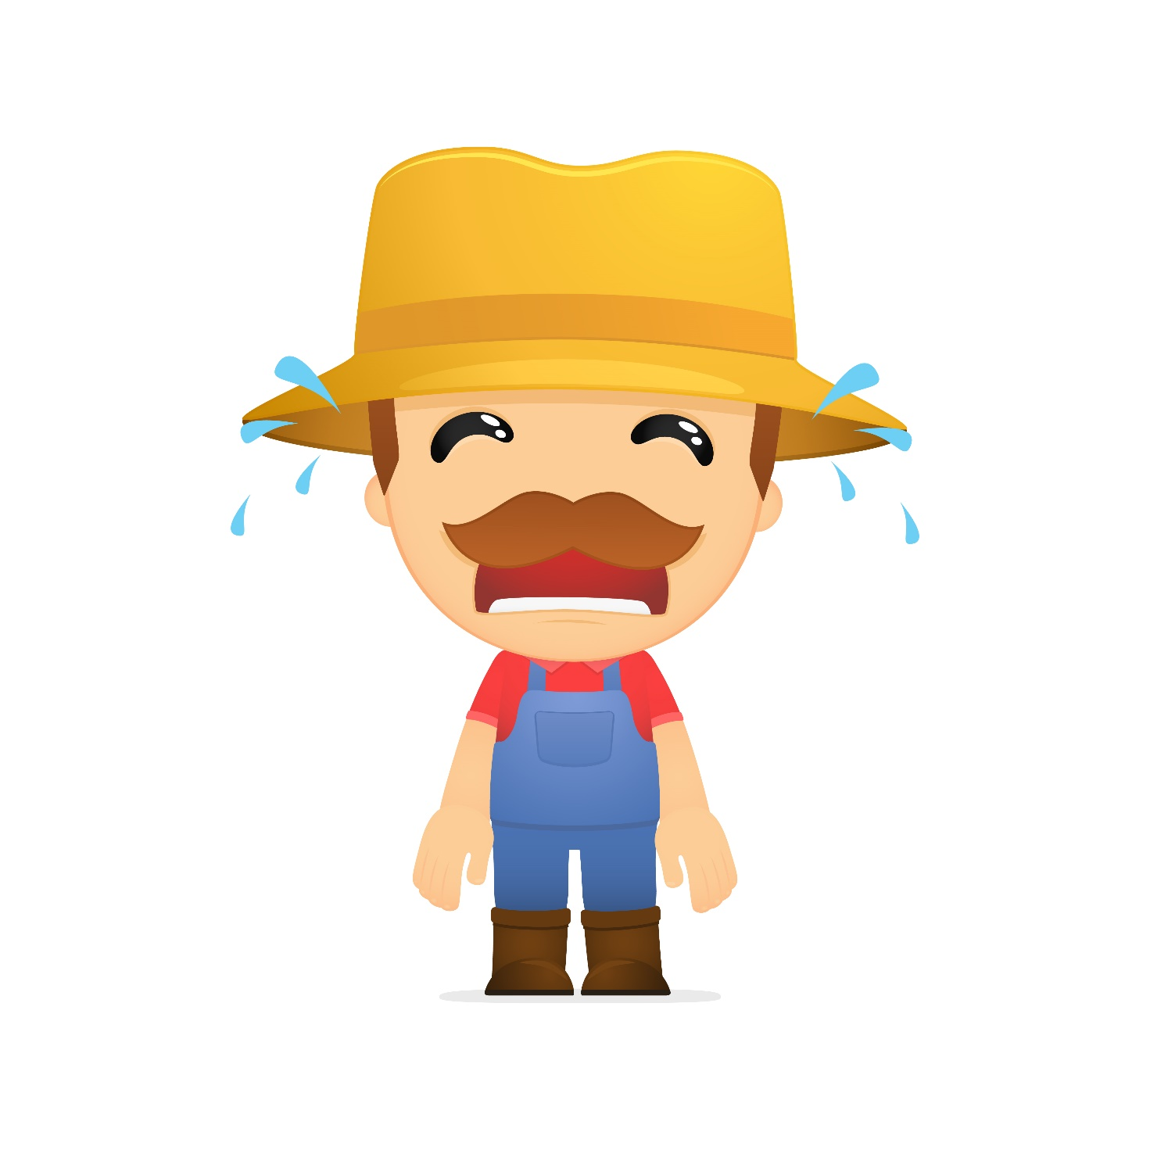
How to Protect Yourself
Look for the humor in things that you do.
Balance your work and your play. Do both well.
Find someone with whom you can talk about your worries and frustrations.
Seek help when you need it. There are times when all of us can benefit from professional help or support.
Unwind before bedtime. Do stretching exercises, listen to soothing music, practice rewinding deeply, and be thankful for any blessings received today. Then sleep well.
Notes:
How to Protect Yourself
Look for the humor in things that you do.
Balance your work and your play. Do both well.
Find someone with whom you can talk about your worries and frustrations.
Seek help when you need it. There are times when all of us can benefit from professional help or support.
Unwind before bedtime. Do stretching exercises, listen to soothing music, practice rewinding deeply, and be thankful for any blessings received today. Then sleep well.

Slide 9
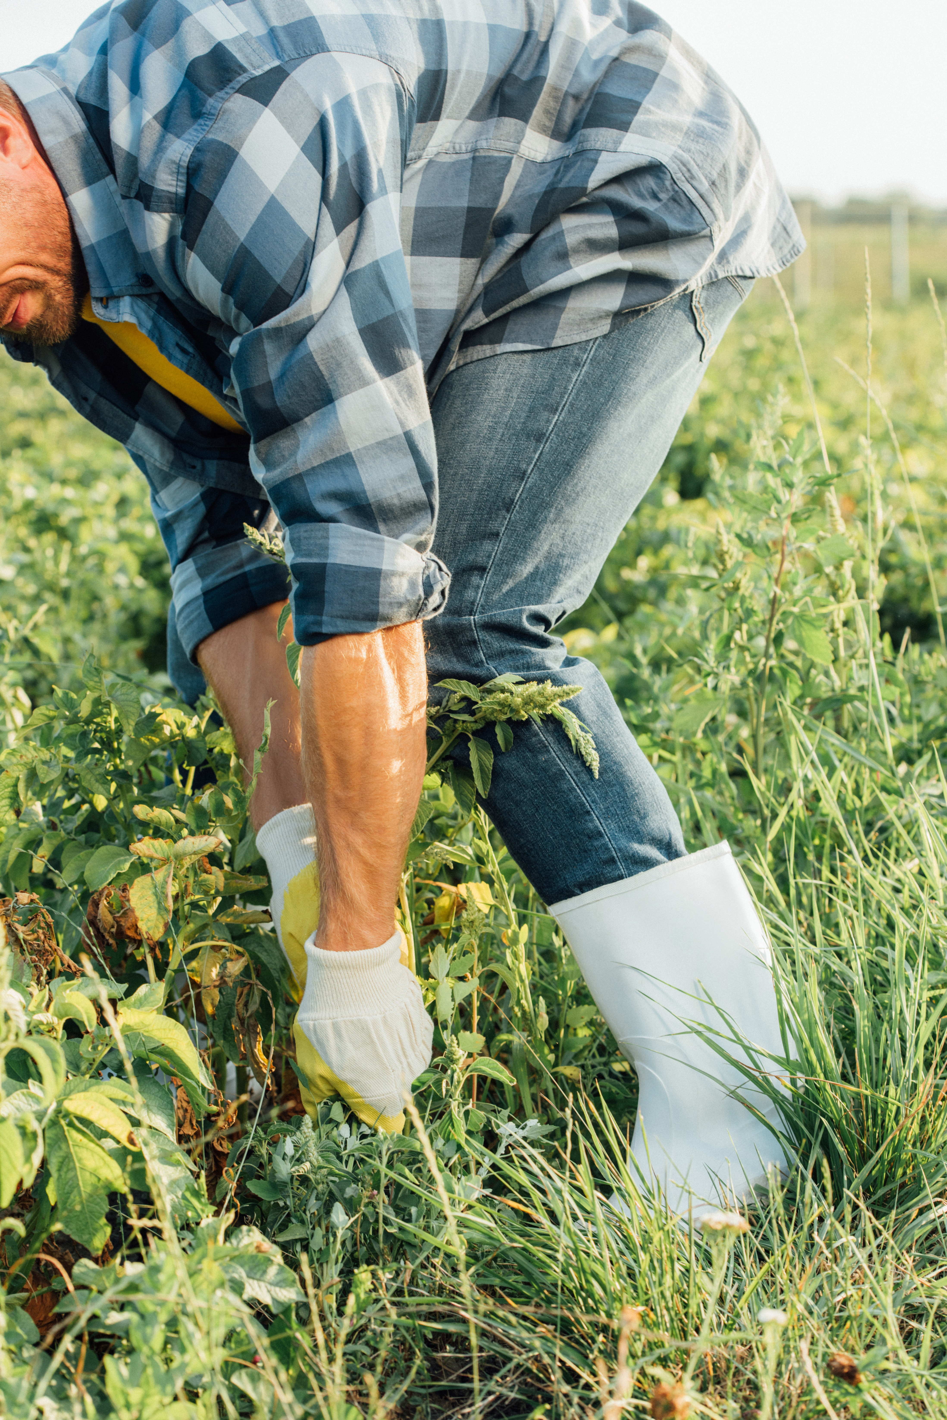
Final Word
Farming can be a very stressful occupation. Stress that goes unrecognized and is not managed well can cause you to make risky choices and can result in a farm incident. Unrelieved stress can take an emotional as well as a physical toll, in the form of anxiety or depression, or high blood pressure and heart disease. If unattended, stress can seriously damage physical health; psychological well-being; and relationships with friends, family, and coworkers.
Notes:
Final Word
Farming can be a very stressful occupation. Stress that goes unrecognized and is not managed well can cause you to make risky choices and can result in a farm incident. Unrelieved stress can take an emotional as well as a physical toll, in the form of anxiety or depression, or high blood pressure and heart disease. If unattended, stress can seriously damage physical health; psychological well-being; and relationships with friends, family, and coworkers.

