Slide 1

Click anywhere to get started…

Slide 2



FARM SAFETY- WRITE IT RIGHT
Notes:
Farm Safety - Write it Right

Slide 3

What’s at Stake?
You have farming knowledge, love to work outside, and enjoy getting your hands dirty. Your job now is to let farmers know you are an available and skilled farm hand, and with all the competition out there you may need more than your resume to do it. A professional farm hand cover letter sharing details about your background appeals to a potential employer and can help you reach your farming goals.
Farm Hand Cover Letter Must-Haves
Cover letters in the farming industry are not as common as they are in many other occupations. The farmer will want to know you can be relied upon to produce the best crop or product possible, with minimal direction.
Notes:
What’s at Stake?
You have farming knowledge, love to work outside, and enjoy getting your hands dirty. Your job now is to let farmers know you are an available and skilled farm hand, and with all the competition out there you may need more than your resume to do it. A professional farm hand cover letter sharing details about your background appeals to a potential employer and can help you reach your farming goals. Having a cover letter will certainly distinguish you from the pack of other applicants, and may even present you with the opportunity to do the type of work you most favor on the farm.
Farm Hand Cover Letter Must-Haves
Cover letters in the farming industry are not as common as they are in many other occupations. However, this presents you with an excellent opportunity to catch the attention of your potential employer and highlight your most impressive skills. The farmer will want to know you can be relied upon to produce the best crop or product possible, with minimal direction. Apply the format of the professional farm hand cover letter sample to your own background to provide details not forthcoming in your resume.

Slide 4
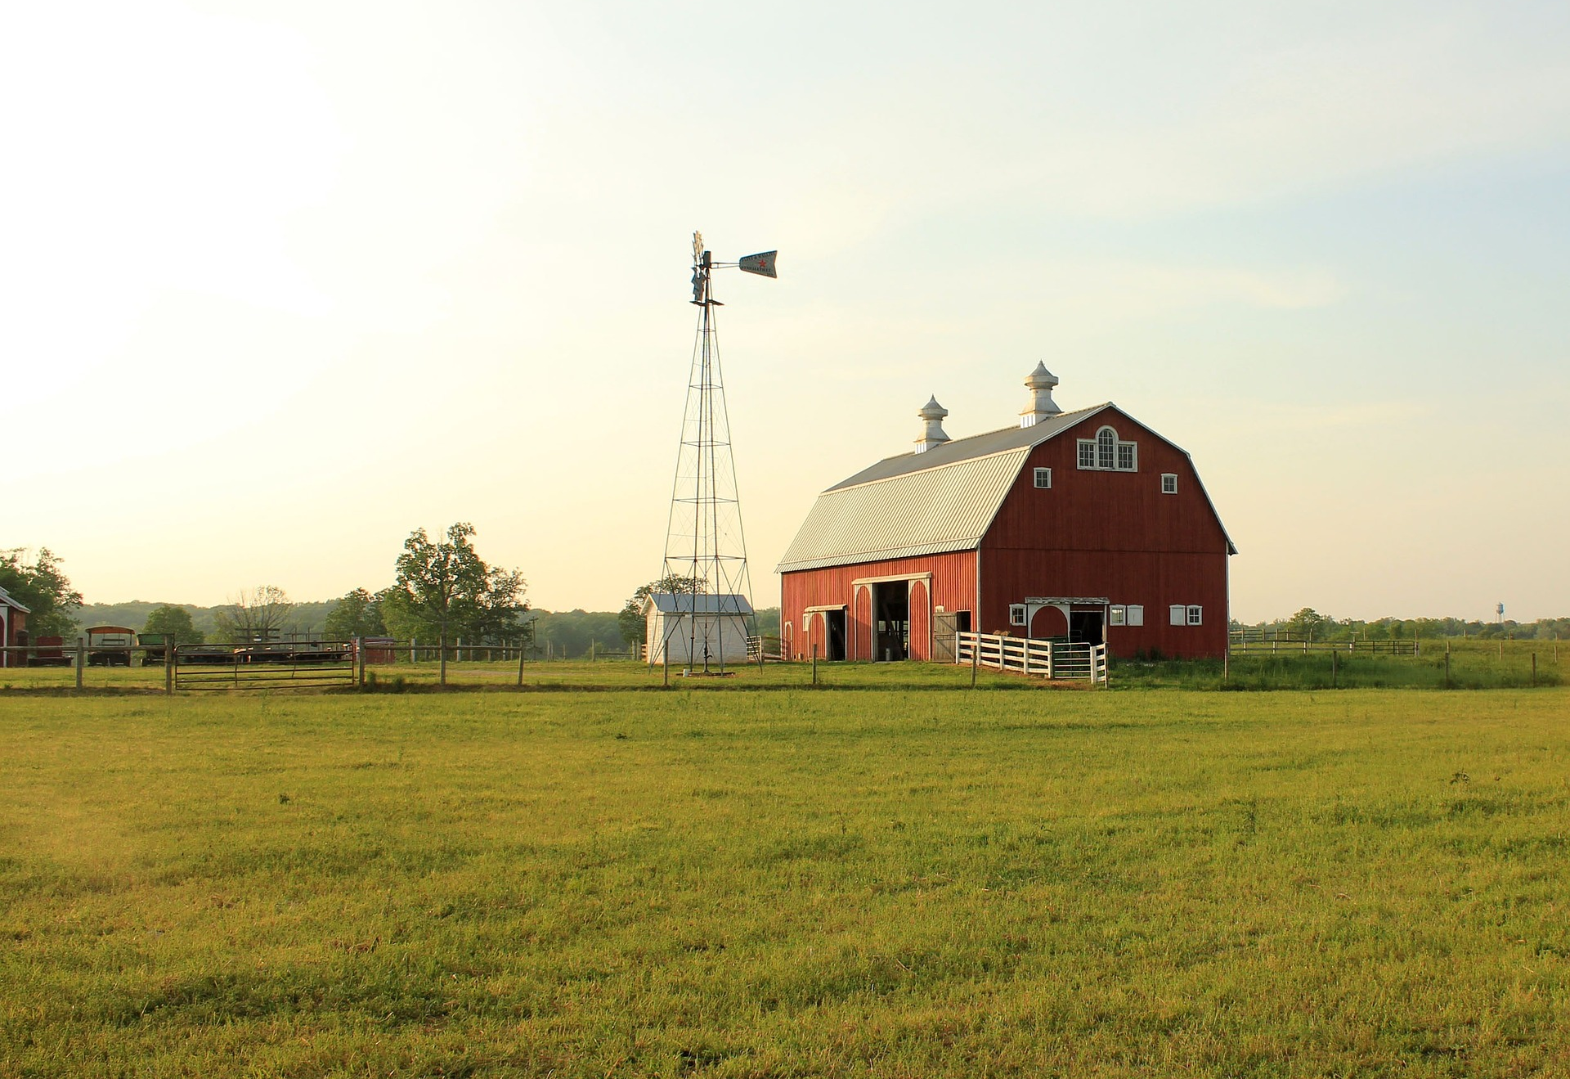
What’s the Danger?
Use Action Verbs/Transitive Syntax
Use active words, such as generated, benefited, handled, scheduled, operated, adapted, expanded, and performed.
By taking the opportunity to first ask the organization questions, you’ll have the information that you want to create a letter which gets positive outcomes.
In the agricultural industry, farmers need to carry out lots of duties daily.
The employer is not going to be interested in your skills besides the ones applicable to farming, therefore it’s prudent to conserve space and adhere to the position.
Notes:
What’s the Danger?
Use Action Verbs/Transitive Syntax
Use active words, such as generated, benefited, handled, scheduled, operated, adapted, expanded, and performed.
Cover letters are advised for internet applications. Before you begin, it’s important that you know as much as possible regarding the sort of letter you’re writing. It is very important that the letter be sent on the business letter head. Writing a perfectly phrased letter is not quite as difficult as it’s made out to be. In actuality, however, you can readily equip yourself to compose a winning letter. If it comes to writing a winning cover letter it’s frequently the little things which make a huge difference.
By taking the opportunity to first ask the organization questions, you’ll have the information that you want to create a letter which gets positive outcomes. Make sure that you get the info you’re looking for. Also, be certain that your contact information is accurate.
In the agricultural industry, farmers need to carry out lots of duties daily. The farmer would likewise require a much more elaborate irrigation system to feed crops water over a bigger span of land. Depending on the type of animals he raised, he might need a variety of different tools. Pig farmers must watch over pigs and make certain they’re healthy. A farmer could have just one tomato patch for a monoculture and understand how to work with that 1 monoculture well. Family farmers often do all of the work themselves.
The employer is not going to be interested in your skills besides the ones applicable to farming, therefore it’s prudent to conserve space and adhere to the position. Employees have to be trained so that they can take on greater responsibilities. Most importantly, they should know exactly where each item is located. The employee will tell the company how much training which he has had at each work skill and it’ll help the enterprise to determine where to set the employee.

Slide 5
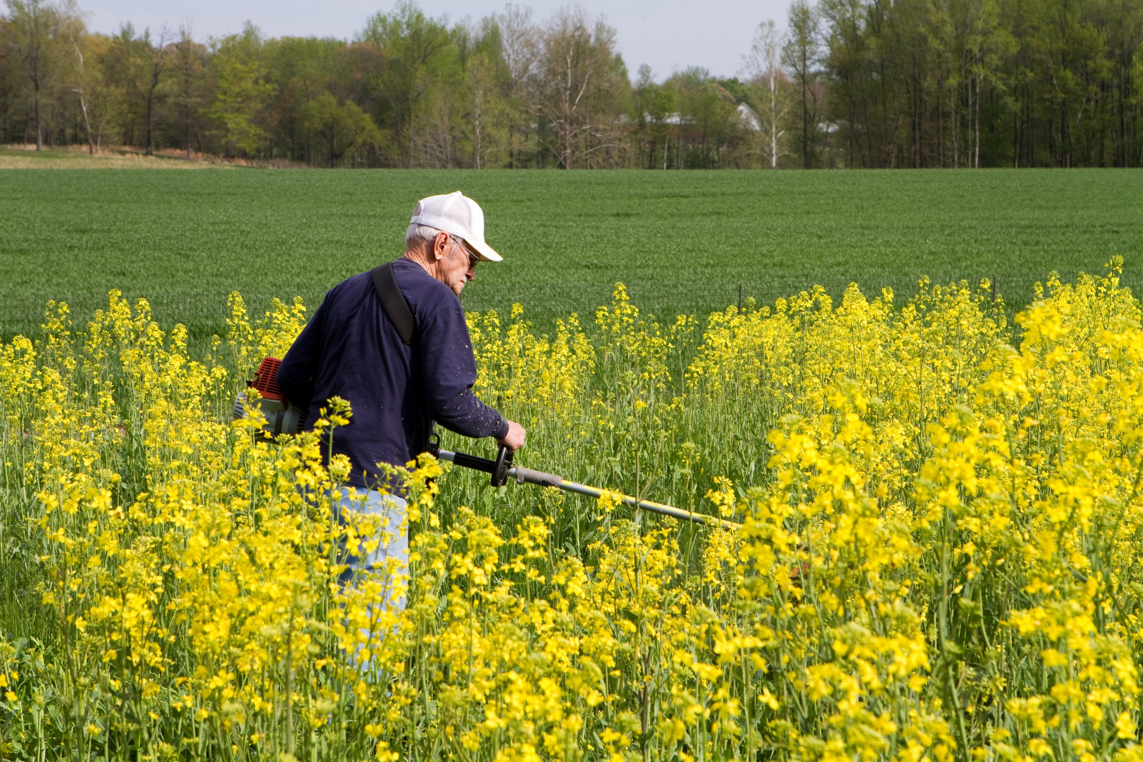
How to Protect Yourself
THE NEED FOR A COVER LETTER
A perfect resume is only as strong as its first impression, which is why a farmer cover letter is so important to not only being seen but getting your resume the second look it deserves.
Job Description & Responsibilities
Education & Training
Salary Range
Notes:
How to Protect Yourself
THE NEED FOR A COVER LETTER
A perfect resume is only as strong as its first impression, which is why a farmer cover letter is so important to not only being seen but getting your resume the second look it deserves. That single piece of paper is your best chance to convince an employer that you are the perfect person for the job. Well written, polished and professional, your farmer cover letter could very well be the key that secures your next farming job.
Job Description & Responsibilities
Employment in the fields of agriculture and environment entail two specific, but distinctive, categories that involve improvement, support and offering solutions. The first is the technical category. If this is the candidate specialty, the agricultural and environment cover letter will quickly discuss how they provided services to better agronomy, livestock, nutrition, conversation, waste management and other applications. The other field involves business and industry. In this case, hiring managers want to know about the candidate involvement in personnel management, business planning, and financial and estate management for agricultural farms and businesses.
These specialists work with growers and farmers, landowners and public bodies, conservation organizations, services and manufacturing, and other entities. Whichever side of the table they work on, the candidate has to have a working knowledge of any legislative and business implications of their advice and programs. The exact nature of any operation performed by these candidates will depend on the service they offer and the type of business they are engaged in. But they all have one overall function, to help clients improve operations responsibly.
Education & Training
The agricultural and environment cover letter will need to mention a strong educational background in one of the related fields, such as biotechnology, farming, oenology, or viticulture. A minor in some form of business would be beneficial. The candidate should be computer literate and have a more than impressive grasp of mathematics and English, as well as good communication skills.
Hiring managers will be looking for candidates that have strong personal skills. A good agricultural and environment cover letter shows the candidate is efficiently organized, staying current with relevant advancements in their field as they could be preparing newsletter, leaflets, press releases, notes, and articles. They will collect and analyze information to measure performance and monitor programs. From livestock to pest control to waste management, the candidate must be innovative coming up with solutions that improve productivity and protect the environment.
Salary Range
These fields of expertise are too broad to pinpoint any specific salary. Candidates can end up in the private or public sector, at a university or manufacturing warehouse, in a consultancy or in-house position. The agricultural and environment cover letter and resume will determine value, alongside industry and desired job.

Slide 6
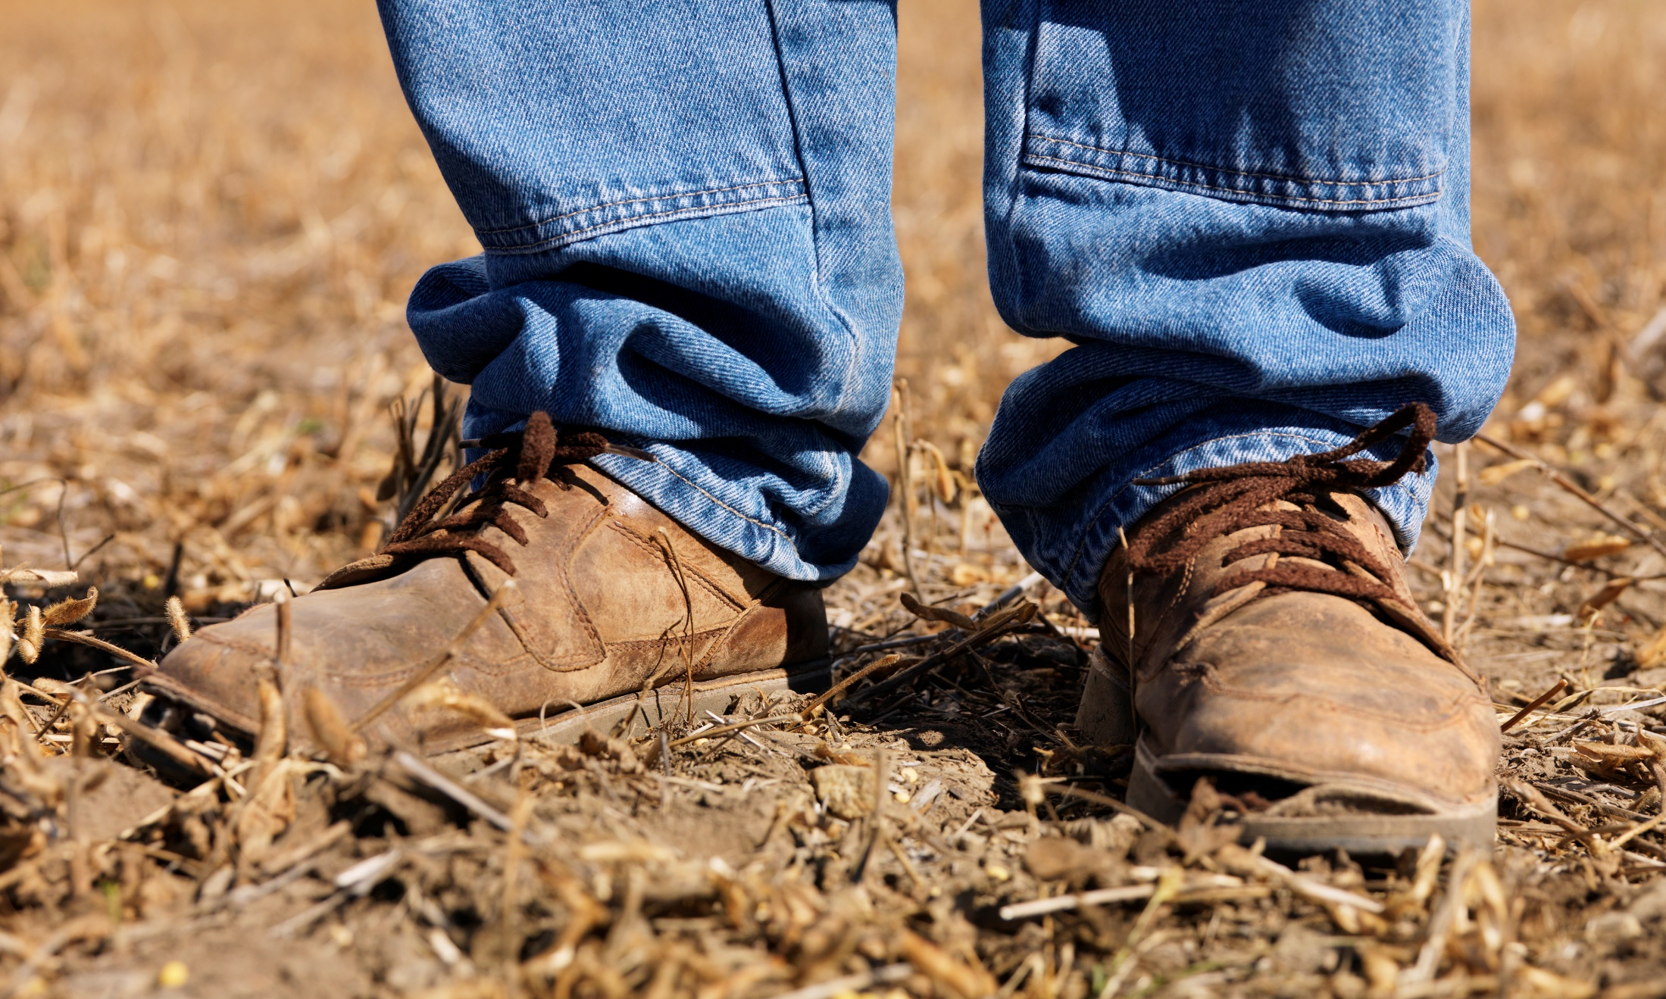
How to Protect Yourself
COVER LETTERS
There’s a nasty rumor that cover letter writing is irrelevant and won’t help you secure that dream job you’ve been after, but that is just wrong!!!
Next to your resume, a well written cover letter is the most valuable document you have in your job seeker toolkit and when written correctly, can help your application stand out amongst the rest.
Notes:
How to Protect Yourself
COVER LETTERS
There’s a nasty rumor that cover letter writing is irrelevant and won’t help you secure that dream job you’ve been after, but that is just wrong!!!
Next to your resume, a well written cover letter is the most valuable document you have in your job seeker toolkit and when written correctly, can help your application stand out amongst the rest.

Slide 7

How to Protect Yourself
A cover letter is a concise document that outlines why your skills and experiences make you the best candidate for the job, in four paragraphs or less. It complements your resume and is a place to highlight important and relevant skills or accomplishments. But, before you begin crafting your cover letter, carefully read through the employer job description; this will help you understand your audience, and allow you to better tailor your cover letter to the reader.
Notes:
How to Protect Yourself
A cover letter is a concise document that outlines why your skills and experiences make you the best candidate for the job, in four paragraphs or less. It complements your resume and is a place to highlight important and relevant skills or accomplishments. But, before you begin crafting your cover letter, carefully read through the employer job description; this will help you understand your audience, and allow you to better tailor your cover letter to the reader.

Slide 8
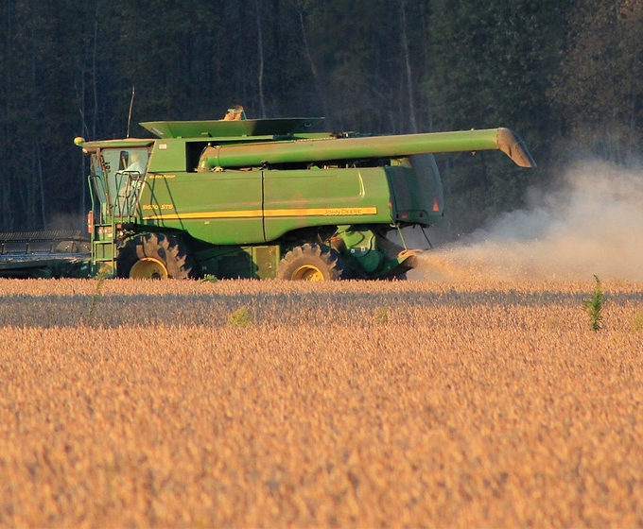
How to Protect Yourself
IMPORTANT WRITING TIPS
Tailor your cover letter to each job you’re applying to, always!
Don’t rehash your resume in your cover letter.
Identify keywords within the job description and include them in your cover letter.
Make the reader’s job easy by including the job title and the reference number in the reference line.
Keep the font style and size consistent with your resume.
Include where you heard about the job opening,
Show, don’t tell.
Don’t overcomplicate the sentences within your cover letter by utilizing descriptive diction.
Avoid including meaningless, overused adjectives like:
Notes:
How to Protect Yourself
IMPORTANT WRITING TIPS
The following tips will enable you to write Effective cover letters.
Tailor your cover letter to each job you’re applying to, always! This cannot be stressed this one enough. Your cover letter is a personalized document that you’re using to convince the reader to look at your enclosed resume. Take some time to make sure you clearly state why you’re the best candidate for the job, based on the qualifications the job description is asking for.
Don’t rehash your resume in your cover letter. Your cover letter is a complimentary document and a place for you to establish a voice and target why your skills and experiences are a good fit for the role you’re applying to.
Identify keywords within the job description and include them in your cover letter. This will help you when applying through a company’s applicant tracking system (ATS) or talent management system (TMS).
Make the reader’s job easy by including the job title and the reference number in the reference line. Include the date, your name and contact details in case your cover letter is separated from your resume during the application process.
Keep the font style and size consistent with your resume. It is recommended to use an easy-to read, sans serif font, like Arial.
Include where you heard about the job opening, whether you saw the position on AgCareers.com, heard about the position through a friend or found the job on the employer’s corporate career site. If you were referred by an existing employee, include their name, this will help to set you apart.
Show, don’t tell. Use concrete examples to demonstrate to the reader how you developed a relevant skill or exceeded expectations in your current role.
Don’t overcomplicate the sentences within your cover letter by utilizing descriptive diction.In other words, use plain language.
Avoid including meaningless, overused adjectives like: aggressive, creative and independent. Instead, use action verbs like: wrote, managed, and collaborated with, to describe exactly what you accomplished.

Slide 9

How to Protect Yourself
FORMATTING TIPS
First Paragraph:
Second and Third Paragraphs:
Fourth Paragraph:
Notes:
How to Protect Yourself
FORMATTING TIPS
First Paragraph: Introduce yourself, what job you’re applying to and state where you heard about the position.
Second and Third Paragraphs: This is the meat of your cover letter. In paragraph two, highlight any skills or experiences you’ve gained that fit with the qualifications in the job description. Use concrete examples and evidence to show the reader why you’re a strong contender for the job. State growth numbers wherever possible. If you have a considerable amount of experience related to the position, it might be a good idea to break this section up into two separate paragraphs to make your cover letter easier to read.
Fourth Paragraph: Thank the reader for their time and consideration and express again your interest in the position you’re applying to. Let the reader know you look forward to being reached at their earliest convenience to further discuss your interest and qualifications in the position. It’s a good idea to list your contact information again in this paragraph.

Slide 10
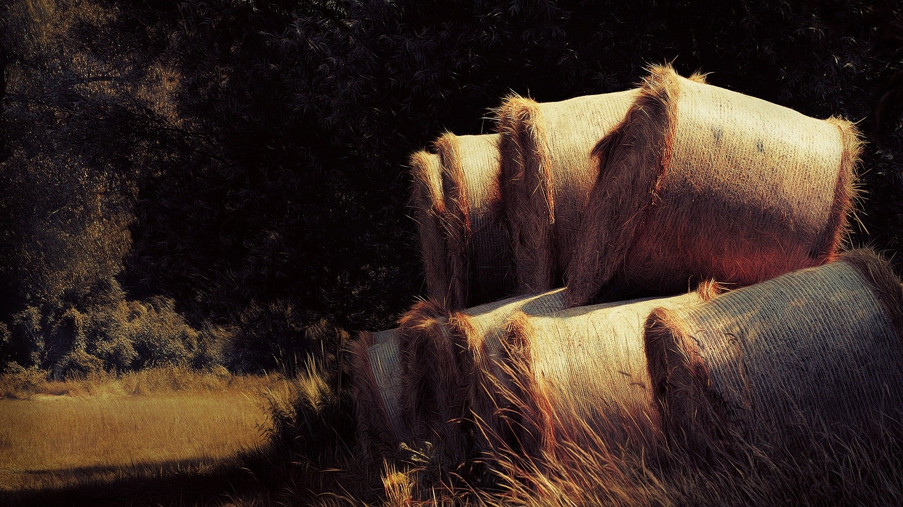
Final Word
A properly drafted cover letter is your most valuable document and correctly written could enable you to attain the dream job that always seemed beyond your grasp.
Notes:
Final Word
A properly drafted cover letter is your most valuable document and correctly written could enable you to attain the dream job that always seemed beyond your grasp.

