Slide 1

Click anywhere to get started…

Slide 2



HANDLING AND ADMINISTRATION OF VETERINARY MEDICINES
Notes:
Handling and Administration of Veterinary Medicines

Slide 3

What’s at Stake?
The risk of exposure for veterinary health care workers is similar to that of human health care settings. Administration of medications to animals presents additional exposure opportunities for workers not encountered with human patients.
Notes:
What’s at Stake?
Most hazardous drugs in veterinary medicine are used to treat animal illnesses such as cancer.
The risk of exposure for veterinary health care workers is similar to that of human health care settings. Administration of medications to animals presents additional exposure opportunities for workers not encountered with human patients.

Slide 4
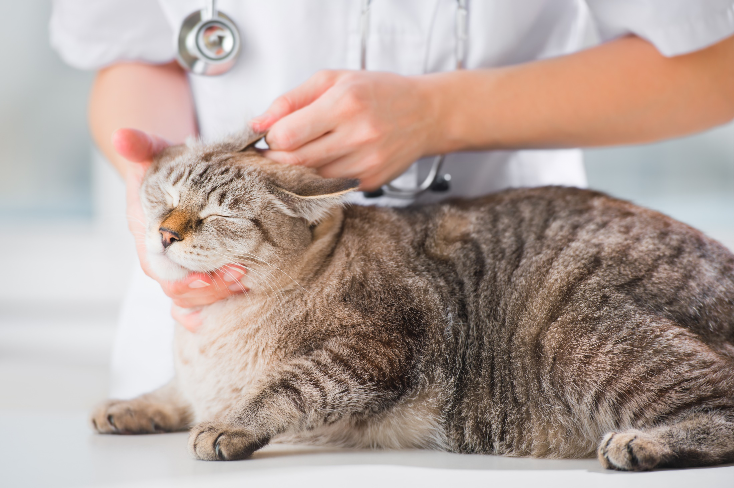
What’s the Danger?
In the United States, an estimated 500,000 veterinary healthcare workers are potentially exposed to hazardous drugs or drug waste at their worksites. These workers include veterinarians, technicians, kennel workers, cleaning and maintenance workers, and office staff.
Veterinary workers may suffer exposure to hazardous drugs when:
Skin absorption, inhalation, and ingestion are the most likely ways these workers may be exposed.
Notes:
What’s the Danger?
In the United States, an estimated 500,000 veterinary healthcare workers are potentially exposed to hazardous drugs or drug waste at their worksites. Many are women of reproductive age. These workers include veterinarians, technicians, kennel workers, cleaning and maintenance workers, and office staff.
Veterinary workers may suffer exposure to hazardous drugs when:
They handle drug vials;
compound, administer, or dispose of hazardous drugs; clean up spills;
touch surfaces that are contaminated with these drugs;
clean bedding, cages, kennels, or waste of treated animals.
Skin absorption, inhalation, and ingestion are the most likely ways these workers may be exposed. Needlestick or sharps injuries pose a risk of exposure in veterinary health care settings.

Slide 5
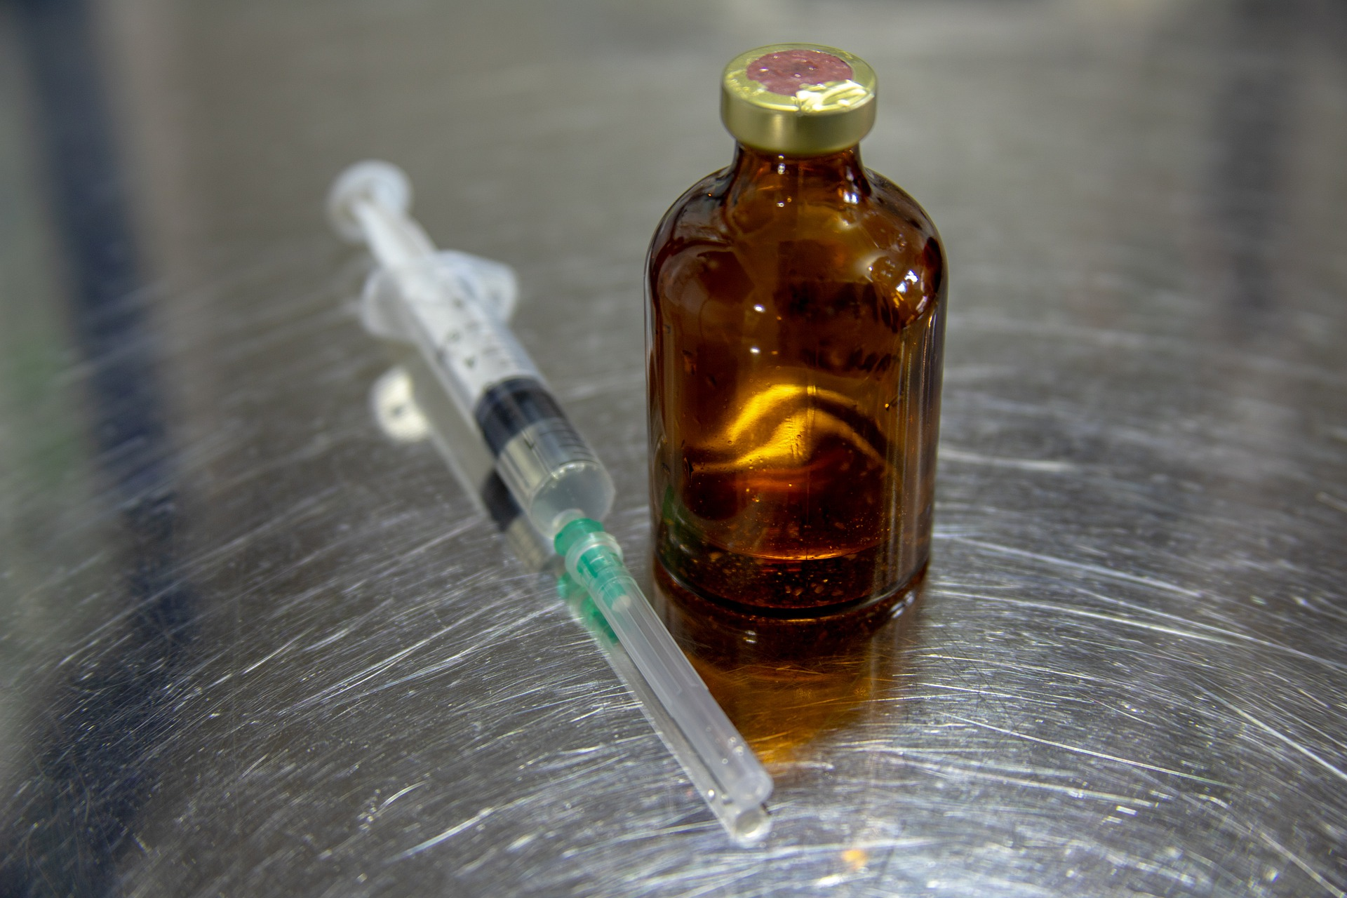
How to Protect Yourself
Policies and Procedures
Training Requirements
Receiving and Storage
Drug Preparation
Notes:
How to Protect Yourself
Policies and Procedures
Ensure that hazardous drugs are prepared or administered only by trained personnel in designated areas that are limited to authorized personnel.
Post a sign to warn employees that they are working in an environment where hazardous drugs are handled.
Warn employees who are pregnant, breastfeeding, or of reproductive age of the potential health effects, especially during the first trimester when a woman may not know she is pregnant.
Document and retain evidence that workers have been trained in and understand these procedures.
B. Training Requirements
Train workers to recognize and understand the risks of working with hazardous drugs, and the risks of working in an environment where these drugs are handled.
Train workers how to care for and use personal protective equipment.
C. Receiving and Storage
Begin exposure control when hazardous drugs enter the facility.
Ensure that all personnel are able to identify hazardous inventory upon arrival. Handle all hazardous inventory with gloves. Label clearly with a hazardous designation.
Store hazardous drugs separately from other inventory, and separate from food/drink.
Keep a spill kit available in case inventory arrives damaged.
D. Drug Preparation
Prohibit eating, drinking, chewing gum, applying cosmetics, or storing food or drinks within the hazardous drug preparation area.
Use PPE, including chemotherapy gloves, non-permeable gowns, respiratory protection, underpads, eye and/or splash protection, shoe covers and spill kit.
Use a proper containment device: preferably a 100% vented biological safety cabinet or compounding aseptic containment isolator. A horizontal laminar flow hood (clean bench) only protects the drug and not the worker.
Use a proper closed-system drug transfer device (CSTD) in low-volume facilities (e.g. 2 or less drug preparations per week) without a clean room.
Properly clean all equipment, counters, and other surfaces. No universal cleaner exists for all chemotherapy drugs. Bleach solution can be used to disinfect and a strong detergent and water rinse may remove most drug residues. Repeating the cleaning steps should provide addition drug removal.
Wash hands with soap and water after drug compounding.

Slide 6

How to Protect Yourself
Drug Transportation
Drug Administration
Waste Cleaning and Disposal
Spill Control
Medical Surveillance Program
Notes:
How to Protect Yourself
E. Drug Transportation
When drug preparation is complete, seal the final product in a plastic bag or other sealable container before taking it out of the ventilated cabinet.
Seal and wipe all waste containers inside the ventilated cabinet before removing them from the cabinet.
Store and transport hazardous drugs in closed containers that minimize the risk of breakage.
F. Drug Administration
Use dedicated cages, kennels or stalls with dedicated drains for animals undergoing treatment with hazardous drugs.
Use proper PPE and technique during administration.
Attach drug administration sets to the IV bag, and prime them before adding the drug to the bag. Prime tubing in the containment device or with non-toxic solution whenever possible.
Remove the IV bag and tubing intact, dispose of items directly in a chemotherapy waste container, and close the lid.
Remove outer gloves and gowns, and bag them for disposal in the chemotherapy waste container at the location where drug administration was performed.
Wash hands with soap and water after administering the drug.
G. Waste Cleaning and Disposal
PPE should be worn during waste cleanup and disposal procedures, and footwear should not be worn outside the facility.
Dispose of all hazardous drug waste according to Federal, State, and local regulations (separately from regular waste).
Double-bag all chemotherapy waste including partially filled vials, undispensed products, unused IVs, needles and syringes, gloves, gowns, mats, and contaminated materials from spill cleanups or animal bodily fluids/waste.
Place materials with trace wastes (those that contain less than 3% by weight of the original quantity of hazardous drugs)—such as needles, empty vials and syringes, gloves, gowns, and tubing—in chemotherapy waste containers. Assure that such containers protect from sharps injuries. Do not use red sharps containers for drug disposal.
Dispose of P-listed arsenic trioxide and its containers and any bulk amounts of U-listed drugs in hazardous waste containers at an EPA/Resource Conservation and Recovery ACT (RCRA)- permitted incinerator. Consider disposing of other bulk hazardous drugs (expired or unused vials, ampoules, syringes, bags, and bottles of hazardous drugs or solutions of any other items with more than trace contamination) in a manner similar to that required for RCRA-defined hazardous wastes.
Avoid using sprayers or pressure washers to clean the cages, kennels or stalls of treated animals to minimize the aerosolization of hazardous wastes.
Clean the cages and kennels of treated animals with disposable towels if possible and use disposable towels to clean bodily waste from treated animals.
H. Spill Control
Manage hazardous drug spills according to the established, written policies and procedures for each workplace.
Ensure that the written policies and procedures address PPE required for various spill sizes, the possible spreading of material, restricted access to hazardous drug spills, and signs to be posted.
Ensure that cleanup of a large spill is handled by workers who are trained in handling hazardous materials.
As required by OSHA, follow a complete respiratory protection program, including fit-testing, if you wear respirators such as those contained in some spill kits. Use NIOSH-certified respirators. Surgical masks do not provide adequate protection.
Dispose of all spill cleanup materials in a hazardous chemical waste container, in accordance with EPA/RCRA regulations regarding hazardous waste—not in a chemotherapy waste or biohazard container.
I. Medical Surveillance Program
Conduct reproductive and general health questionnaires at the time of hire and periodically thereafter.
Conduct physical examination at the time of hire and then as needed for any worker whose health questionnaire or blood work indicates an abnormal finding.
Conduct followup for those workers who have shown health changes or have had a significant exposure (substantial skin contact, cleaning a large spill a broken bag, leaking IV line etc.).

Slide 7
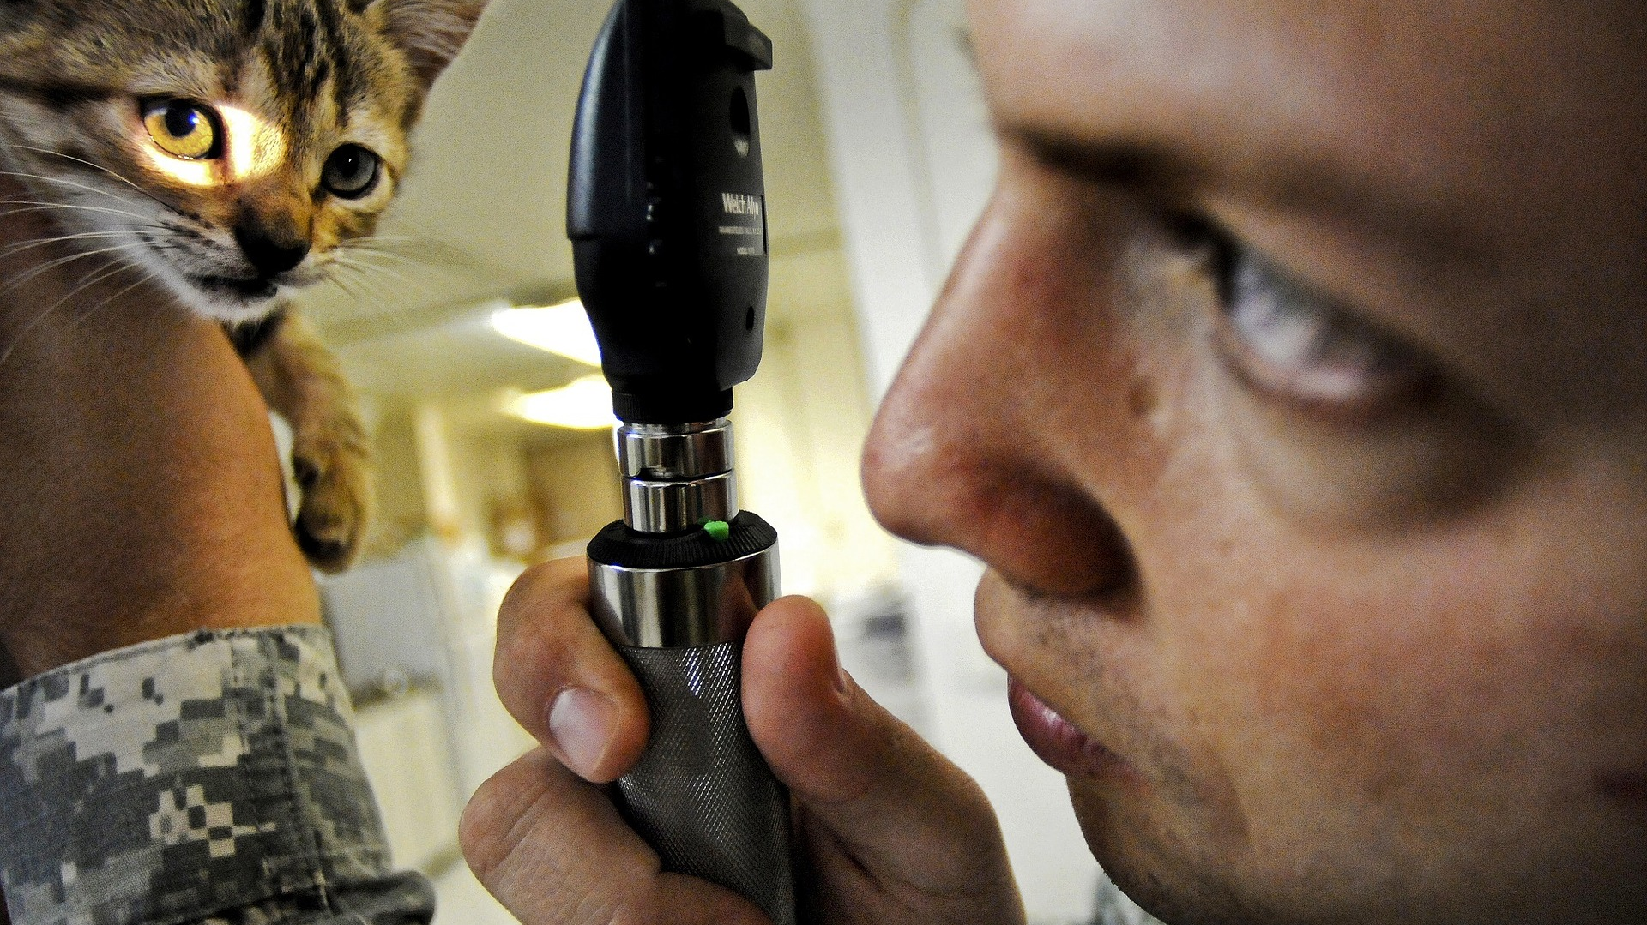
Final Word
Whether you work in a human health setting or in a veterinary health center, the need to have safe and effective hygienic practices and protocols followed strictly is of utmost importance.
Notes:
Final Word
Whether you work in a human health setting or in a veterinary health center, the need to have safe and effective hygienic practices and protocols followed strictly is of utmost importance.

