Slide 1

Click anywhere to get started…

Slide 2

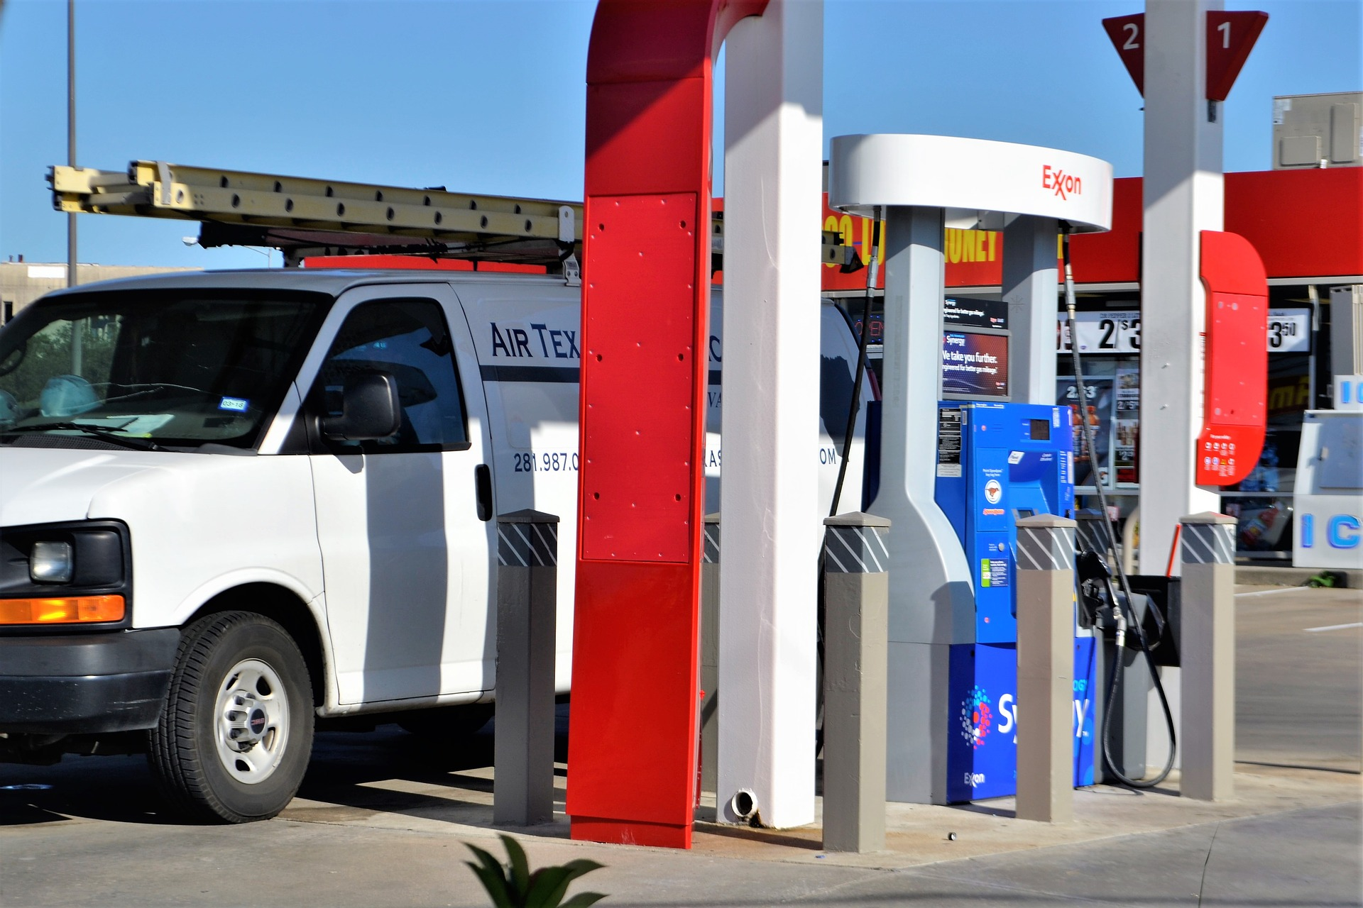

FILLING UP DIESELING EQUIPMENT
Notes:
Filling Up Dieseling Equipment

Slide 3
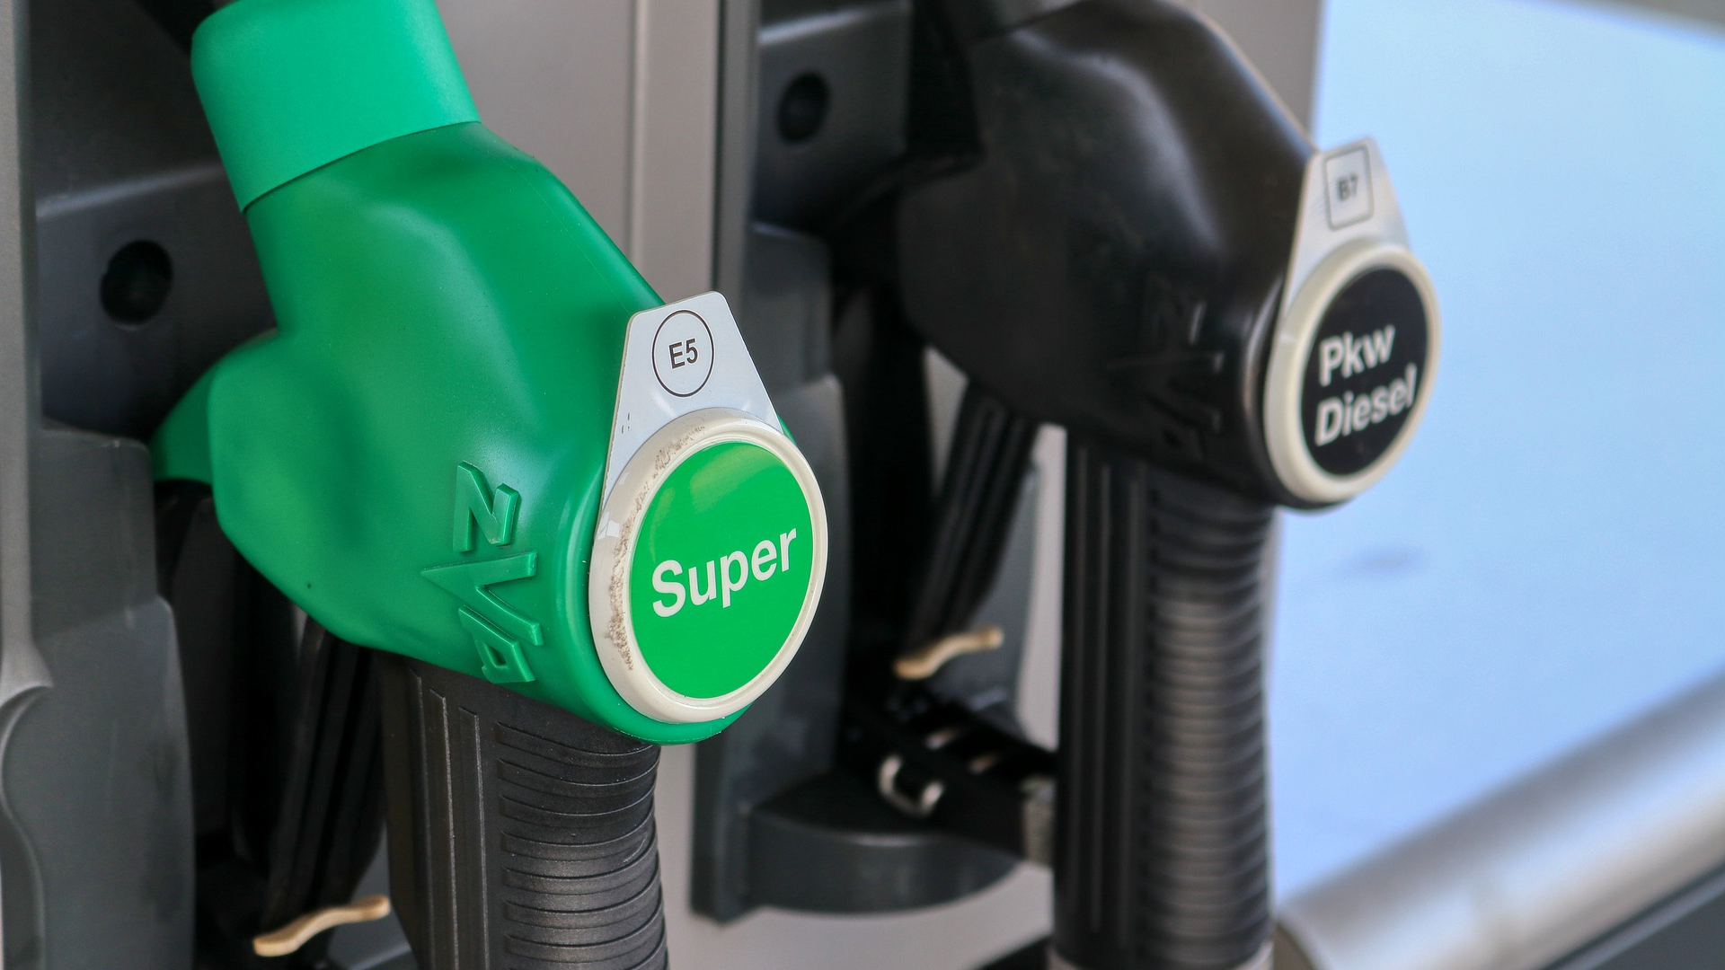
What’s at Stake?
Refueling is a hazardous activity. The hazards are greater when highly flammable fuels such as petrol are being dispensed, because petrol releases flammable vapors that expand into the atmosphere.
Notes:
What’s at Stake?
Refueling is a hazardous activity. The hazards are greater when highly flammable fuels such as petrol are being dispensed, because petrol releases flammable vapors that expand into the atmosphere.

Slide 4
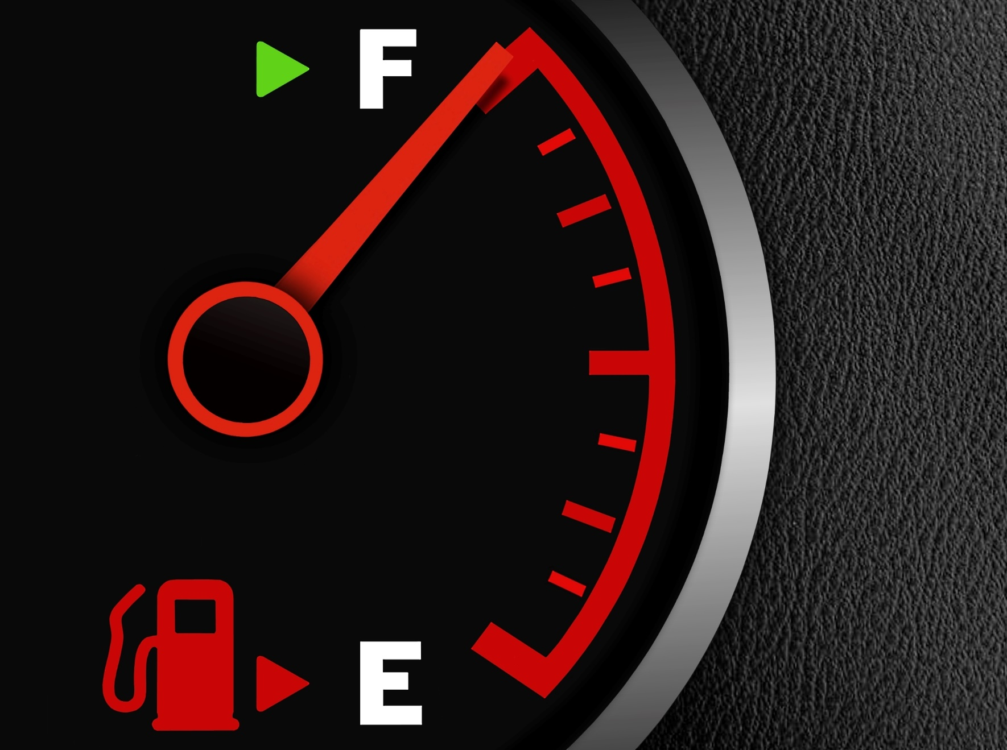
What’s the Danger?
When a flammable liquid flows, static electricity is generated from the friction between dissimilar materials (e.g. the fuel and the metal fuel filler neck). When the static electricity discharges, it produces sparks which can ignite the fuel vapors.
The Dangers of Static Electricity
Notes:
What’s the Danger?
When a flammable liquid flows, static electricity is generated from the friction between dissimilar materials (e.g. the fuel and the metal fuel filler neck). When the static electricity discharges, it produces sparks which can ignite the fuel vapors. The fuel dispensing pumps found at service stations and the fuel filler necks of motor vehicles are earthed to minimize and control the static electricity produced during normal vehicle refueling.
The Dangers of Static Electricity
invisible and unpredictable.
discharged in the form of a spark which can ignite flammable materials.
a natural phenomenon that cannot be prevented but can be controlled.
rarely understood by most people.

Slide 5
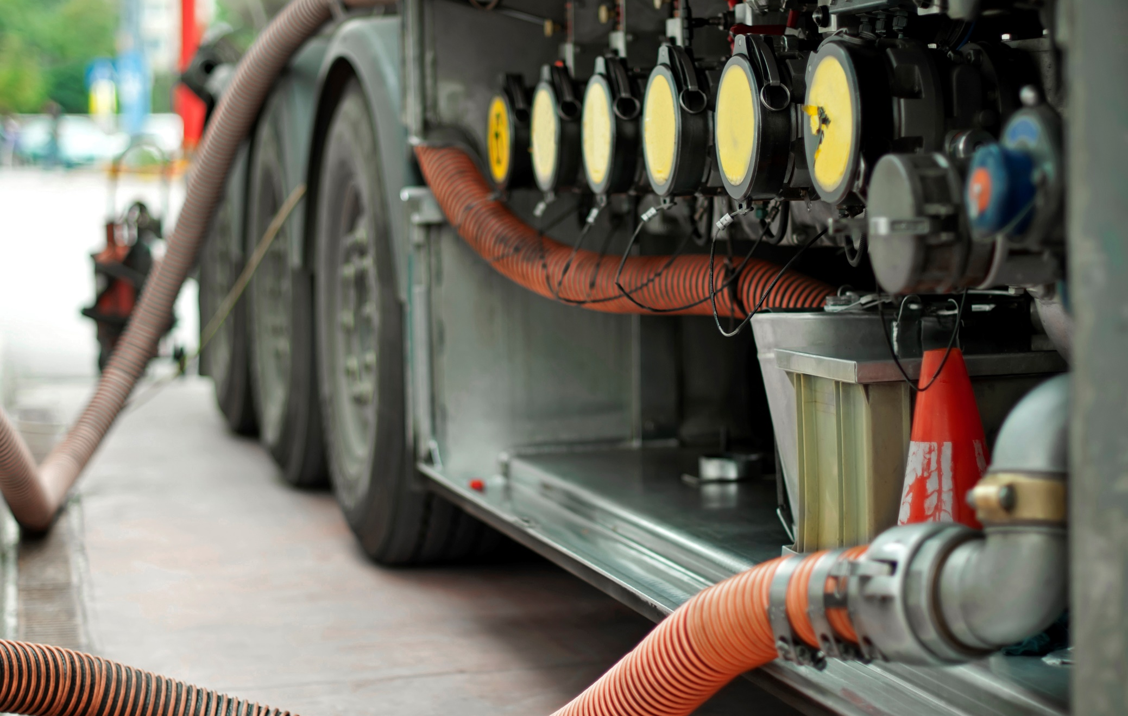
How to Protect Yourself
The following should be observed to control the effects of static electricity and to control the risk of fire when refueling portable containers.
Always read and observe the safety signs at service stations.
Never use unapproved containers to store fuel.
Always use a plastic fuel container that complies with AS2906 or an appropriate metal container with a well-sealed lid.
Notes:
How to Protect Yourself
The risk of refueling fires is greater when fuel is dispensed into portable containers. The following should be observed to control the effects of static electricity and to control the risk of fire when refueling portable containers.
Always read and observe the safety signs at service stations.
Never use unapproved containers to store fuel.
Always use a plastic fuel container that complies with AS2906 or an appropriate metal container with a well-sealed lid.
Use only containers with serviceable caps / lids and seals.
Always place the fuel container on the ground before filling with flammable liquid. This will discharge any static electricity prior to refueling.
Never fill a container in the boot of a car, or in the tray, or on the tailgate of a utility, particularly if it is fitted with a plastic tray liner.
Fill containers slowly to avoid overflow and spillages.
Do not lock the refueling trigger “on”.
Do not fill portable containers to more than 95% full; this allows for expansion.
Secure portable fuel containers against transit damage.
Avoid refueling petrol operated equipment (mowers, generator sets, jet skis, etc.) while located within a utility tray.

Slide 6
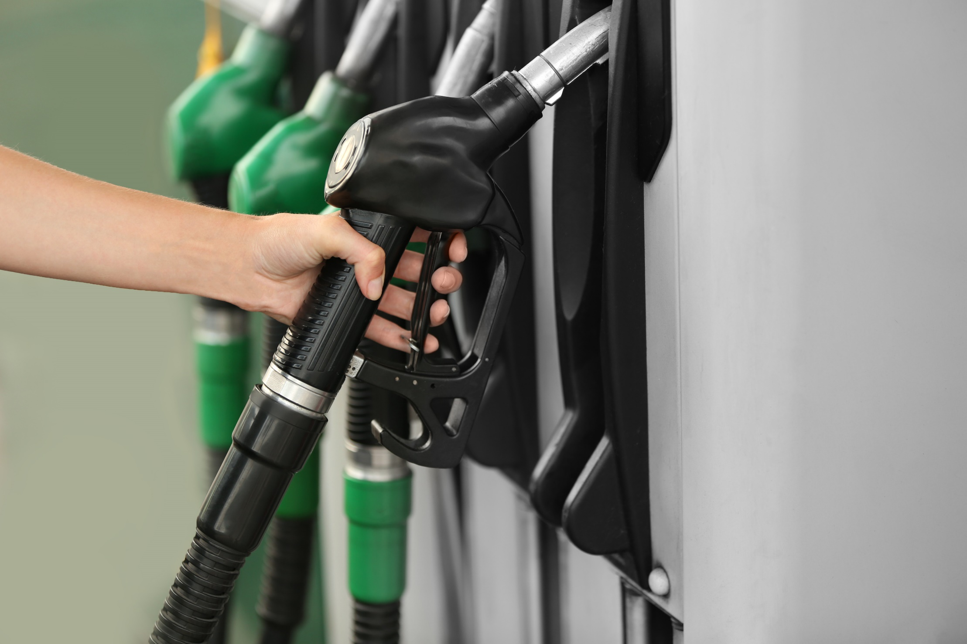
How to Protect Yourself
HANDBOOK OF FUELING/DIESELING PRACTICES
DO’s
DONT’S
Notes:
How to Protect Yourself
HANDBOOK OF FUELING/DIESELING PRACTICES
DO’s
Turn off vehicle ignition.
Place vehicle in gear and engage brake.
Note the location of fire extinguishers.
Put nozzle and hose back in the proper place.
Report all leaks as soon as possible. If a vehicle or piece of machinery leaks diesel, contain the spill using proper spill control procedures.
Guard against over-dieseling.
DONT’S
Do not smoke, within 7.5 meters (25’) of fuel.
Do not cause spillage of any amount.
Do not leave nozzle unattended while fueling.
Do not fully top up fuel tank.
Do not diesel equipment near waterways.
Do not diesel on asphalt.
Do not diesel where a source of ignition is present.
a hill, always block the wheels, lower forks and set the parking brake.

Slide 7

Final Word
The storage of petrol may pose several risks: Fire/explosion, environmental damage, health effects when handled by individuals.
Notes:
Final Word
The storage of petrol may pose several risks: Fire/explosion, environmental damage, health effects when handled by individuals.

