Slide 1

Click anywhere to get started…

Slide 2
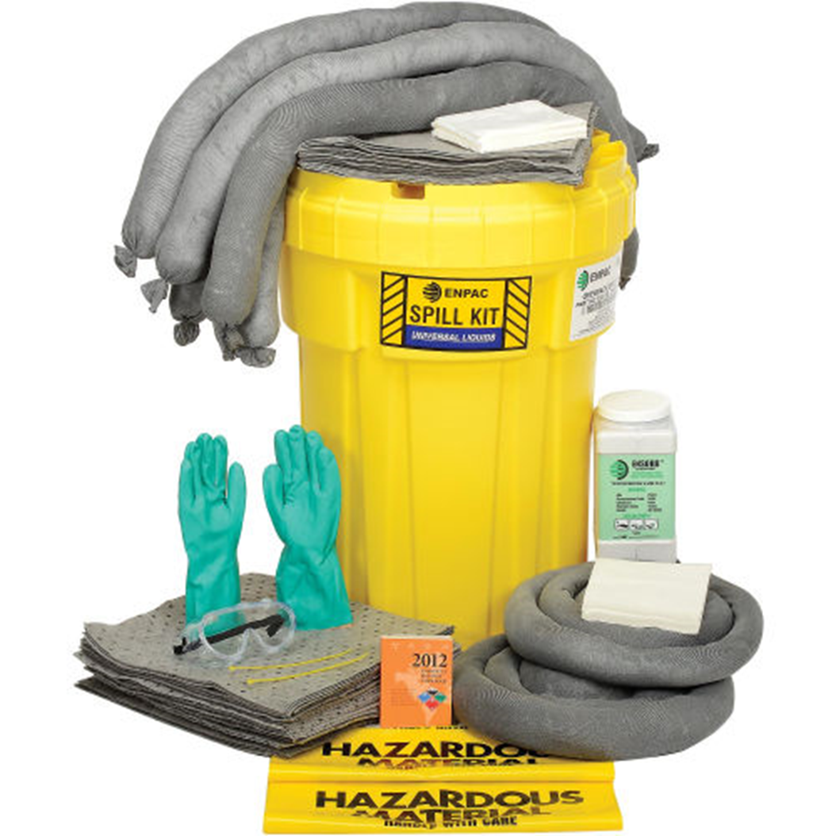


General Housekeeping in the Workplace

Slide 3
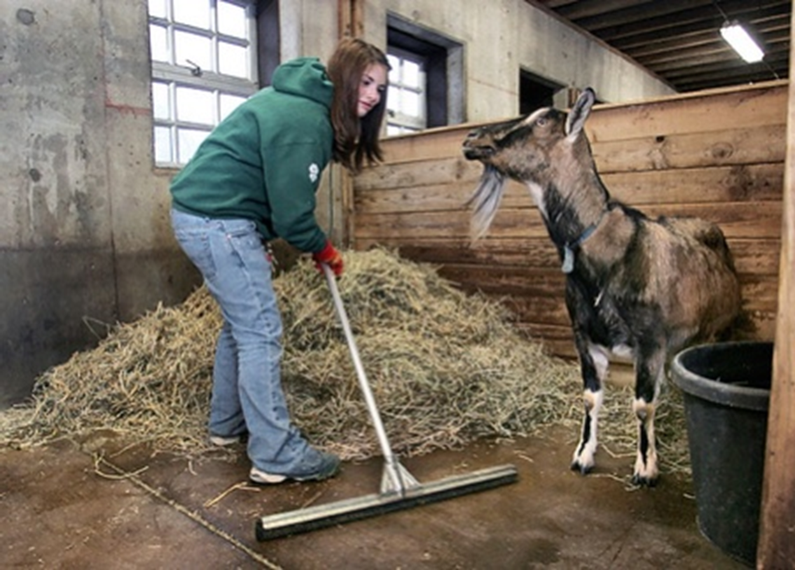
What’s at Stake?
Housekeeping programs are an important element to running a safe and accident-free workplace. If a good plan is set in place, the possibility of slips, fall, fires or other dangers can be avoided, and work can be done effectively, clearing a safe place for storage and an unobstructed path for movement.

Slide 4
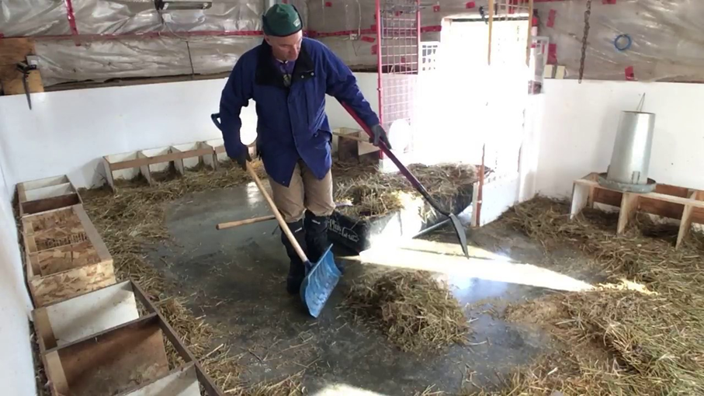
What’s the Danger?
If you and your workers do not incorporate and follow a plan to eliminate the hidden hazards, the results could range from minor accidents to disastrous consequences that no one would see coming.
The possibilities are many: hay chutes without proper guards or cages could cause falls, neglecting to inspect or repair tools could put your worker at risk of injury, if flammable materials aren’t stored properly, you risk the possibility of a fire or an explosion in the workplace, which puts you and your workers at extremely high risk.

Slide 5
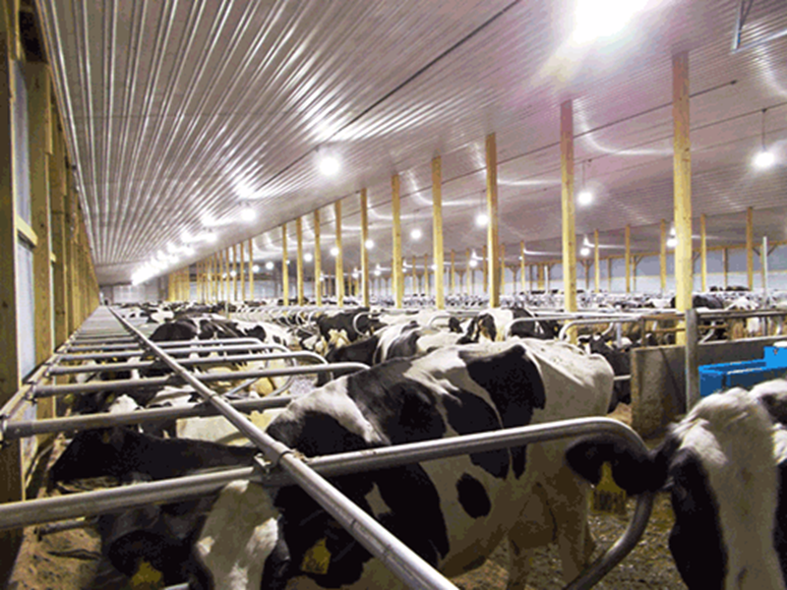
How to Protect Yourself
Floors and Other Areas
Floors should be clean, in good condition and free of debris. Entranceways and areas that cannot be continuously cleaned should have anti-slip flooring.
Trap doors, cages and railings should be in place and in good condition in areas where fall incidents may occur.
Maintain overgrowth around buildings to prevent tripping.
Maintain Light Fixtures
Change bulbs often to ensure adequate light in every work area.
Explosion proof fixtures should be installed in areas containing combustible materials.
Maintain even lighting to prevent shadows, which could inflict fear and tension in animals, putting them and your workers at risk.

Slide 6
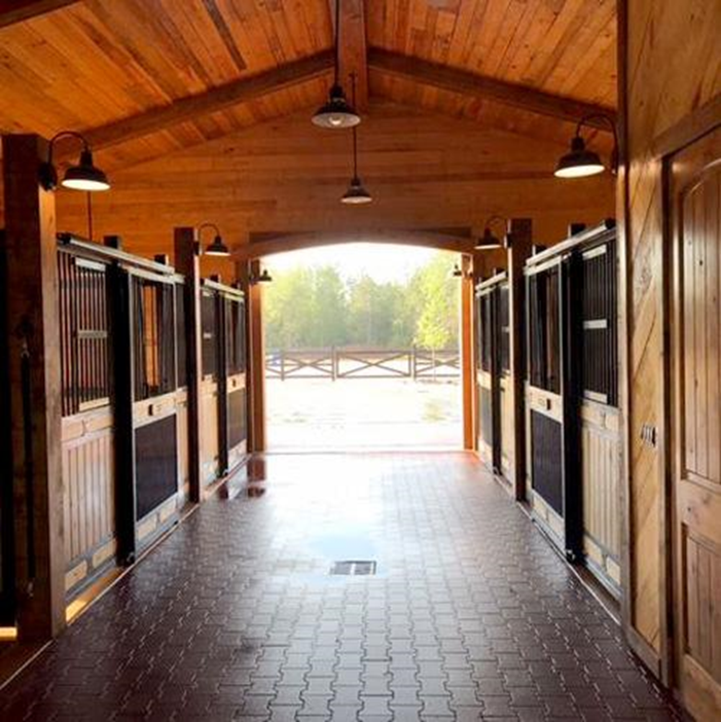
How to Protect Yourself
Aisles and Stairways
Remove objects that obstruct movement and cause tripping hazards.
Ensure aisles and stairways are clearly marked.
Aisles should be wide enough to allow people and vehicles a clear passage.
Blind corners can be marked with signage and fixed with mirrors to allow optimal awareness.
Spill Control
Stop spills before they start with well-maintained machines and equipment and placing drip pans and guards where spills could potentially happen.
Clean spills following the procedures in the Material Safety Data Sheet and dispose of the clean-up material safely.

Slide 7
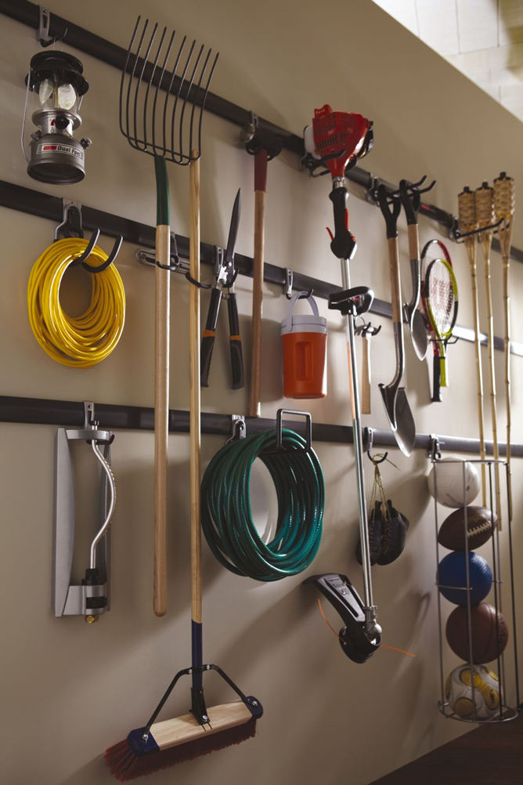
How to Protect Yourself
Tools and Equipment
Ensure tools are kept in their designated area. After use, put them away immediately.
Tools should be inspected and cleaned frequently. Any tool that requires repair should be tended to or taken out of service if they are beyond repair.
Maintenance
Perform the inspection and maintenance of tools, equipment and machines regularly.
This also includes the maintenance of sanitary facilities, regularly painting and cleaning walls, maintaining windows, damaged doors, defective plumbing and broken surfaces.

Slide 8
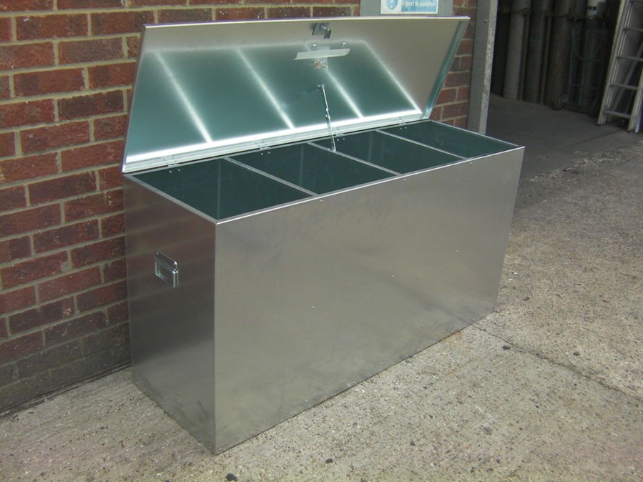
How to Protect Yourself
Waste Disposal
Disposing of waste immediately in designated areas is important.
Sort and grade scrap accordingly as you work to prevent a buildup in the work area.
Storage
The storage of containers and bins should be stacked neatly on a solid foundation and cross-tied to secure them.
They should have at least one metre (approximately 3 feet) of clearance from sprinkler heads.
Keep stored materials out of aisles, stairs, exits, fire equipment and emergency stations.
Ensure storage areas are visibly marked.

Slide 9
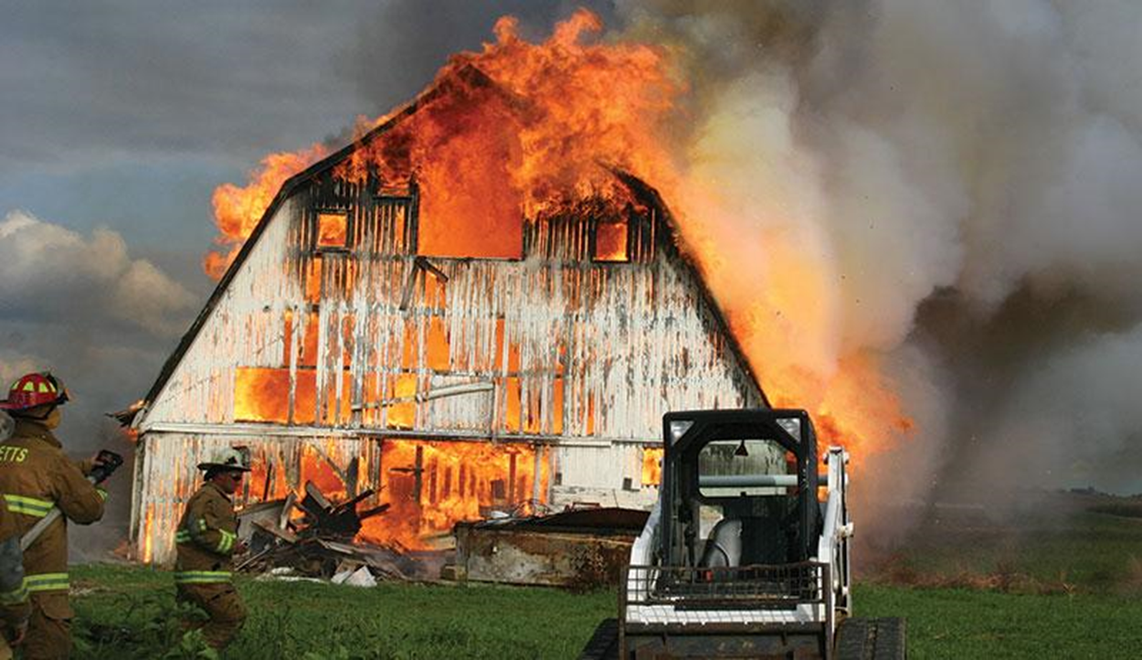
How to Protect Yourself
Fire Prevention
Ensure that all combustible, flammable, toxic and other hazardous materials are kept in containers that are approved and appropriate for the material they contain.
When using flammable material, take only as much as is needed for the job and keep in safety cans while using.
Do not leave greasy rags laying around. keep them in metal containers and be sure to dispose of them regularly.

Slide 10
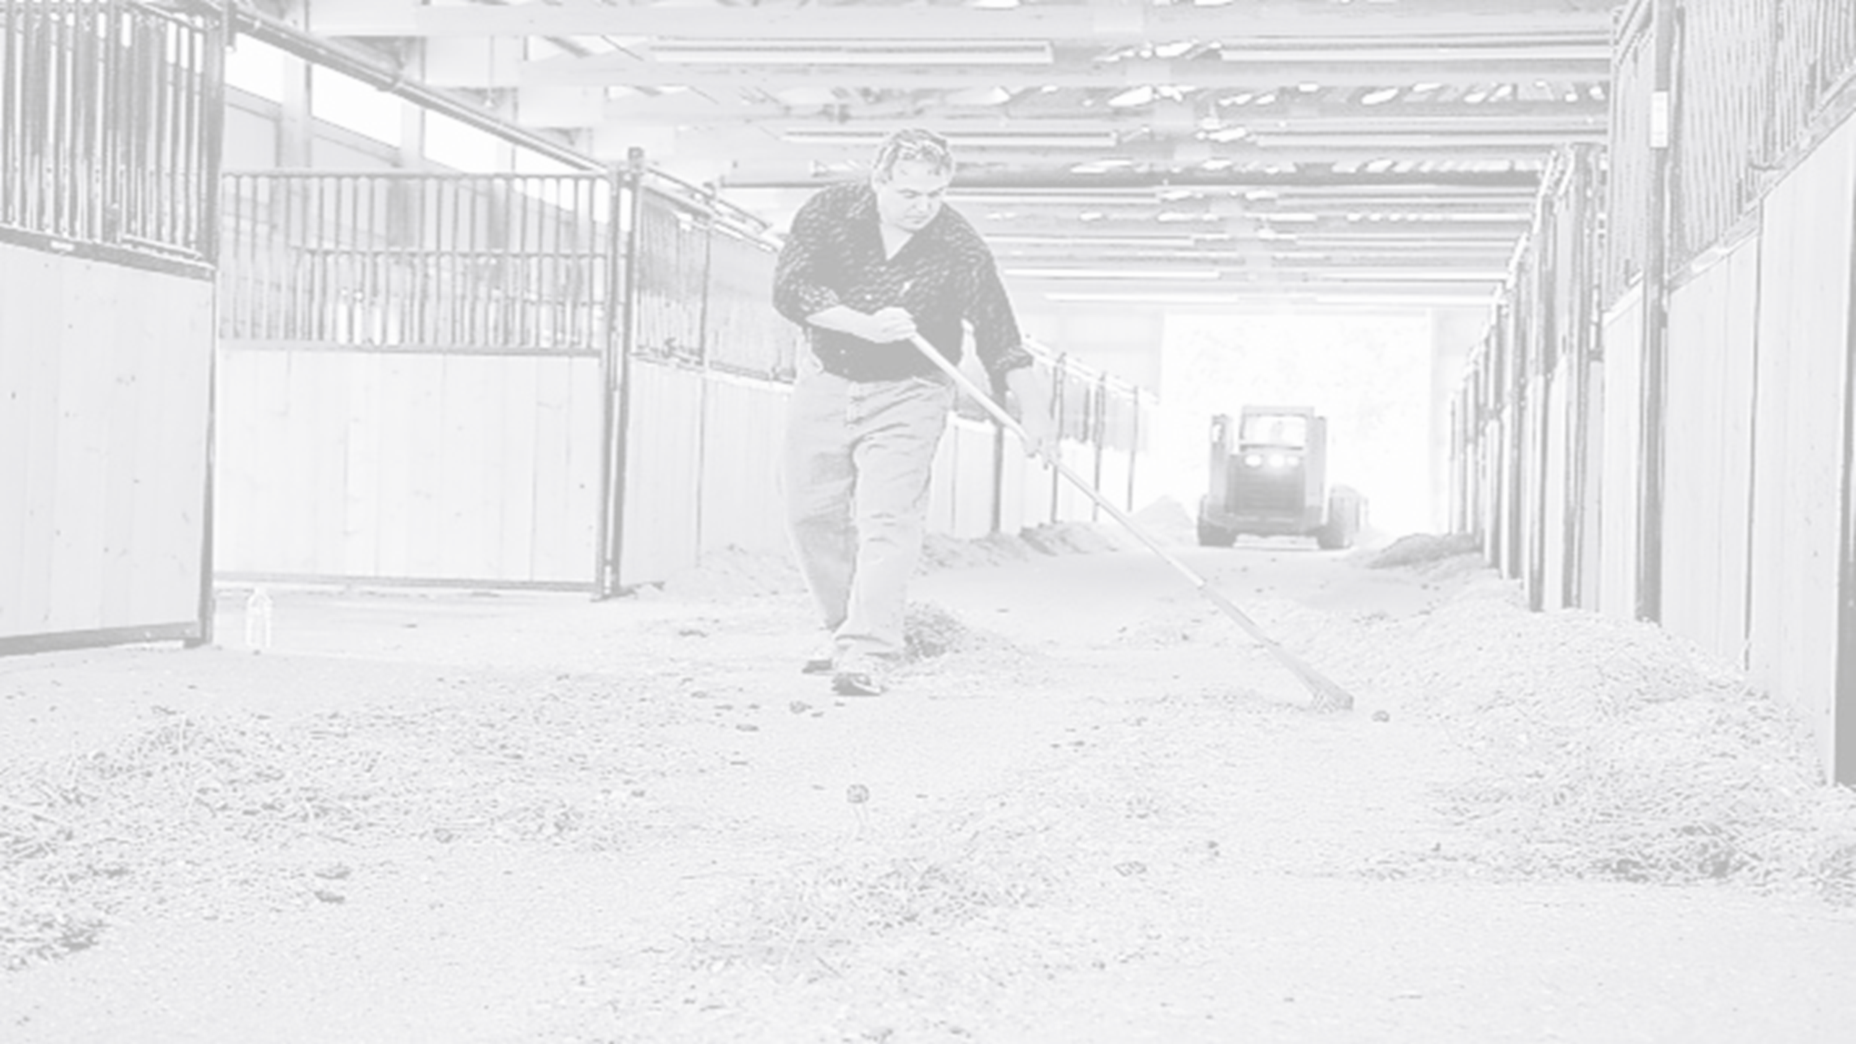
Final Word
Make general housekeeping a regular practice. There are countless hidden dangers that everyone should be made aware of. Education and enforcing scheduled inspections, maintenance and conscientious workers will prevent the unexpected injuries that occur when housekeeping is neglected.

