Slide 1

Click anywhere to get started…

Slide 2
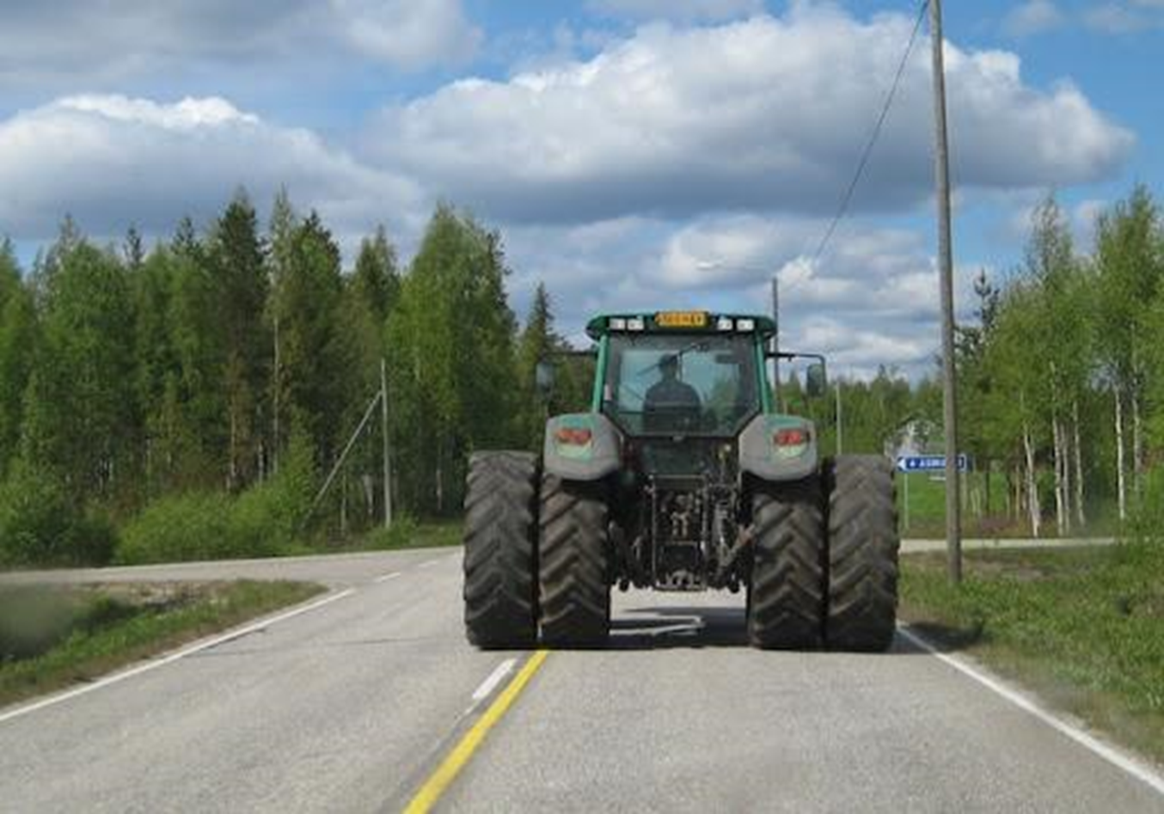


Farm Machinery Safety on Public Roads

Slide 3
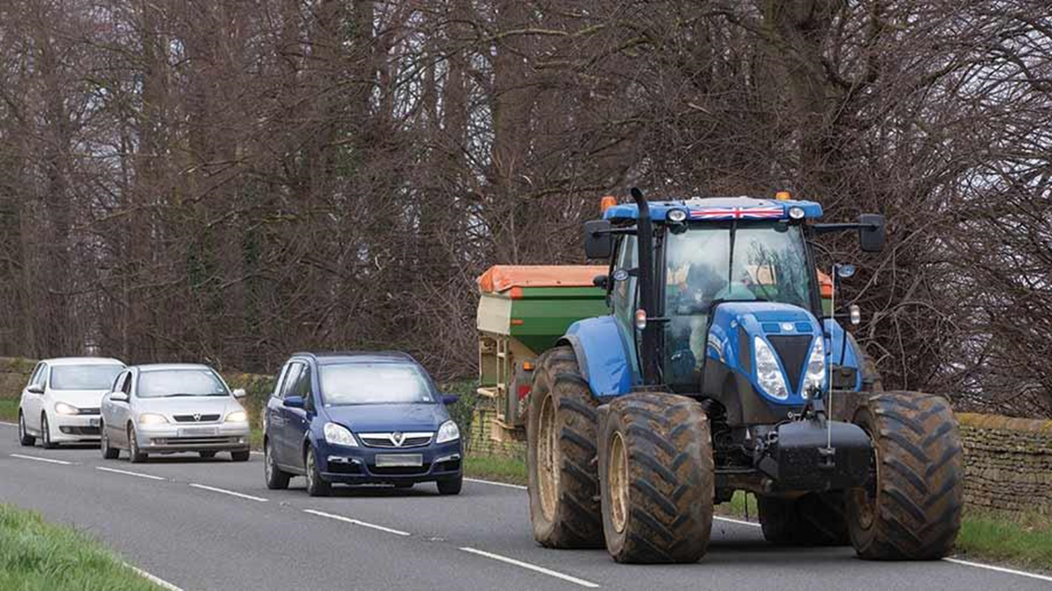
What’s at Stake?
Occasionally, farm machinery has to travel on public roads to transport loads or move from property to property.
If the proper measures are taken to ensure safety, this can be done smoothly and safely.
However, due to highway motorists neglecting to pay attention or getting impatient behind the slower moving vehicles, accidents can happen quicker than expected.

Slide 4
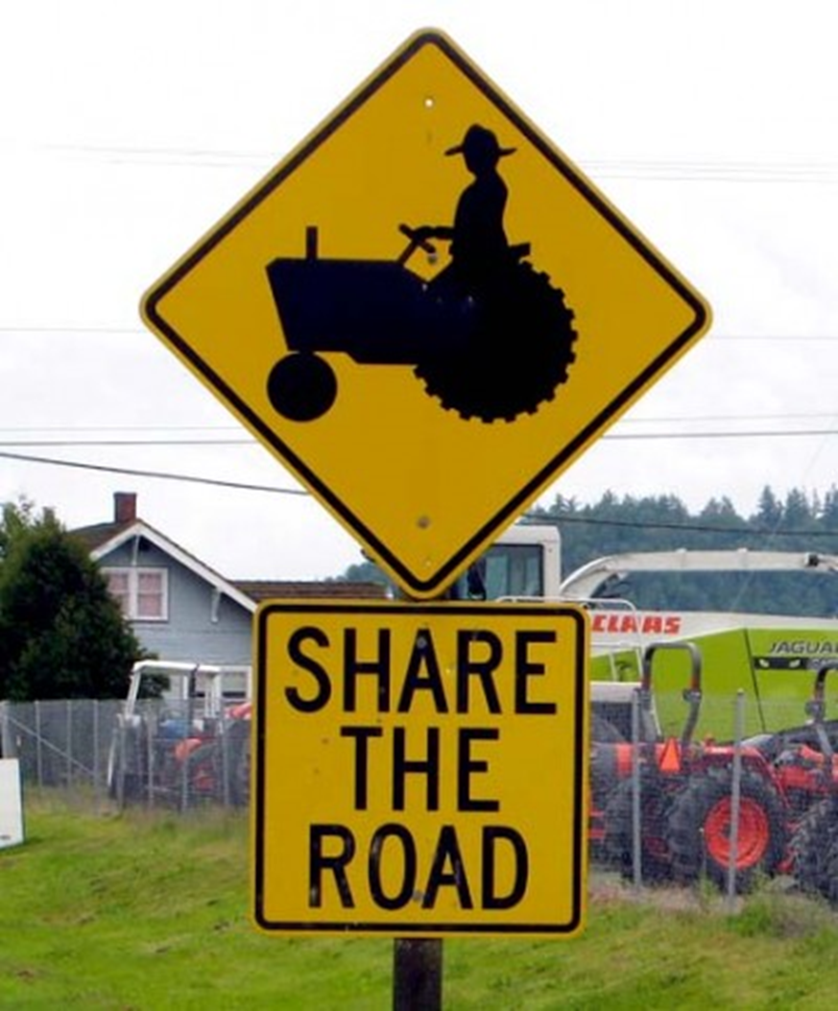
What’s the Danger?
One of the biggest reasons that accidents involving traveling farm equipment happen is because of the unexpected and miscalculated speed of this machinery.
Oftentimes, highway drivers come across farm machinery at fast speeds, and their reaction time has to be quick. If not, a collision is most certainly bound to happen.

Slide 5
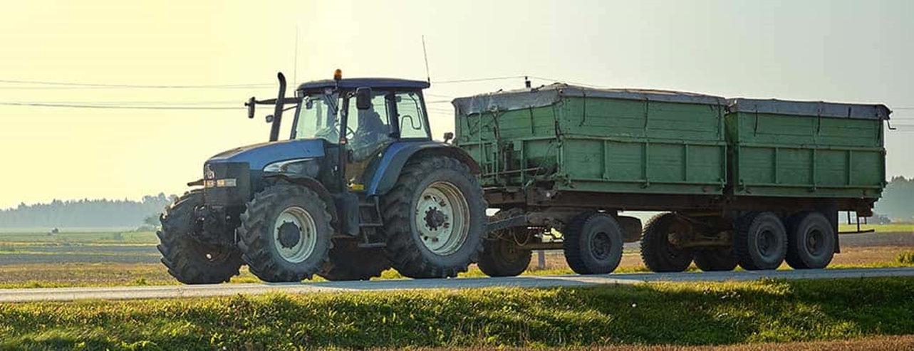
How to Protect Yourself
Make sure safety-type hitch pins are securely fastened.
Use a safety chain between the tractor to the frame of the towed equipment.
Check all tires for proper air pressure.
Ensure you have locked brake pedals together before hitting the road.
Make sure you’re equipped with rear-view mirrors, flares and fire extinguishers. Check that all your lights are in good working order.
Affix a slow-moving vehicle (SMV) sign on the center-rear of your machine. Keep it clean and new, and clearly visible from 150 metres (500 feet).
If you have towed equipment, make sure it’s properly balanced, secured and light enough to be pulled safely with your machine.

Slide 6
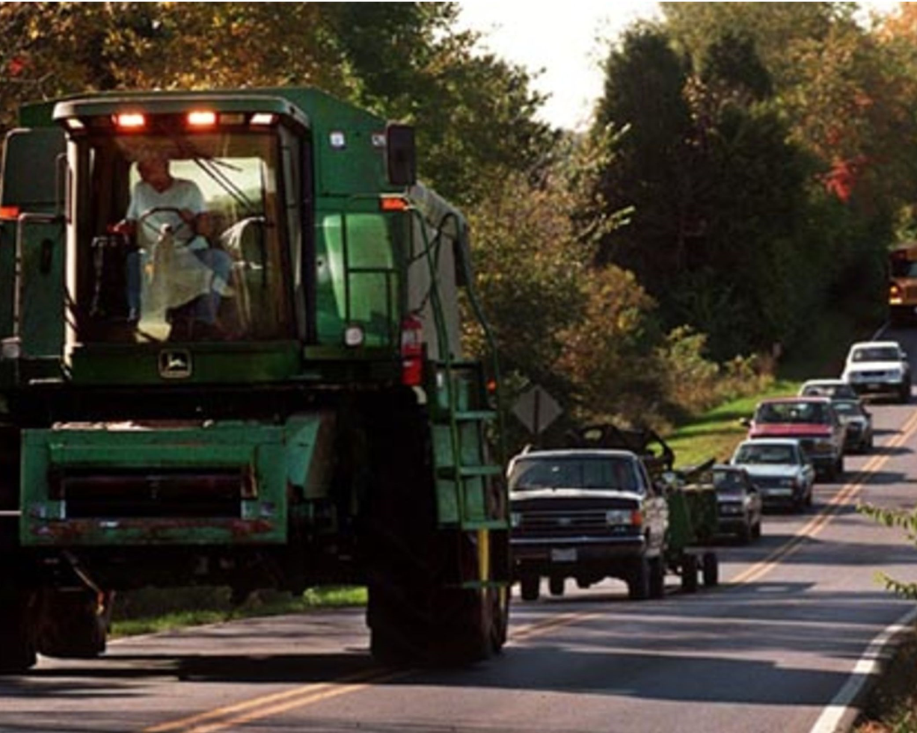
How to Protect Yourself
If possible, avoid busy roads.
Keep the speed slow and steady, and slower still when rounding corners.
Keep the machine in a lower gear when ascending or descending a hill, as some machines free-wheel in higher gears. Check your manual.
Keep as far into the shoulder of the road as is safely possible but avoid driving with one half on the pavement and the other on the shoulder.
Keep watch for hazards (i.e. narrow bridges, loose gravel, potholes), anything that could cause an accident.

Slide 7
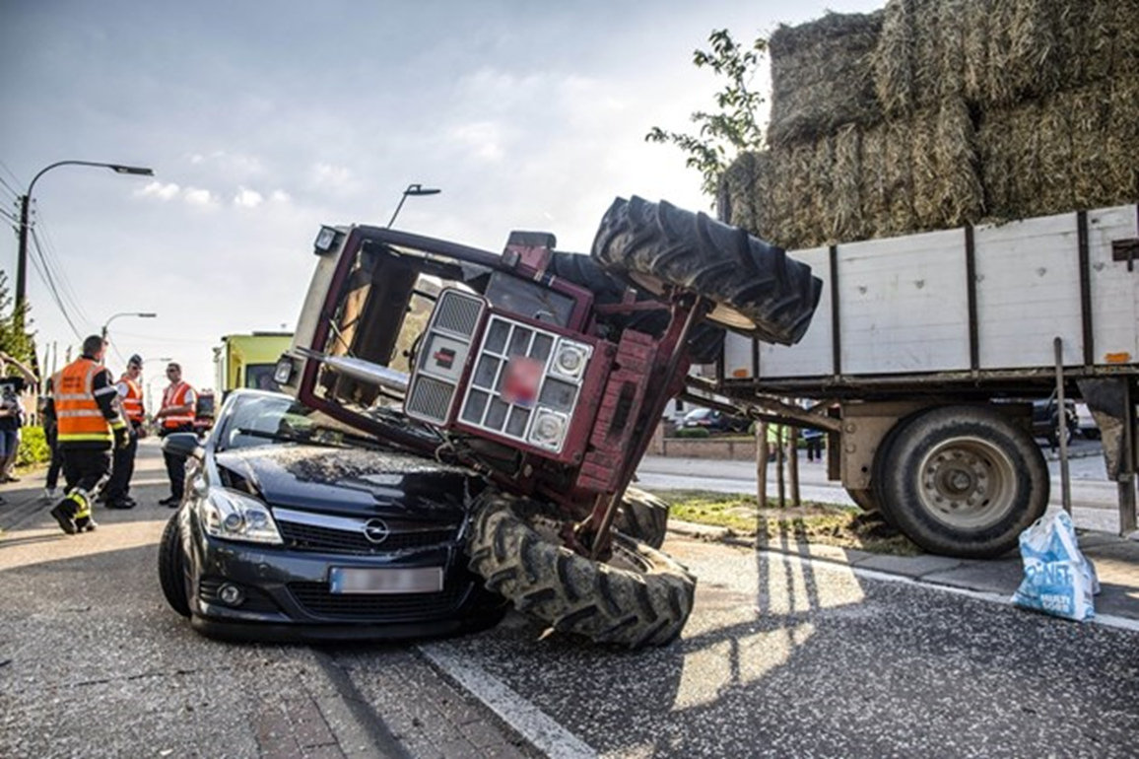
How to Protect Yourself
Have courtesy for highway travelers. To avoid impatience and any hasty, dangerous passes, pull over and allow people to go around whenever possible.
Try to travel during the day as often as you can. If you must travel at night, ensure you have the proper lighting: headlights, red taillights, reflectors and, if possible, flashing amber lights.
Take your time when crossing a road or pulling onto one.
And, as always, obey all traffic signs and lights.

Slide 8
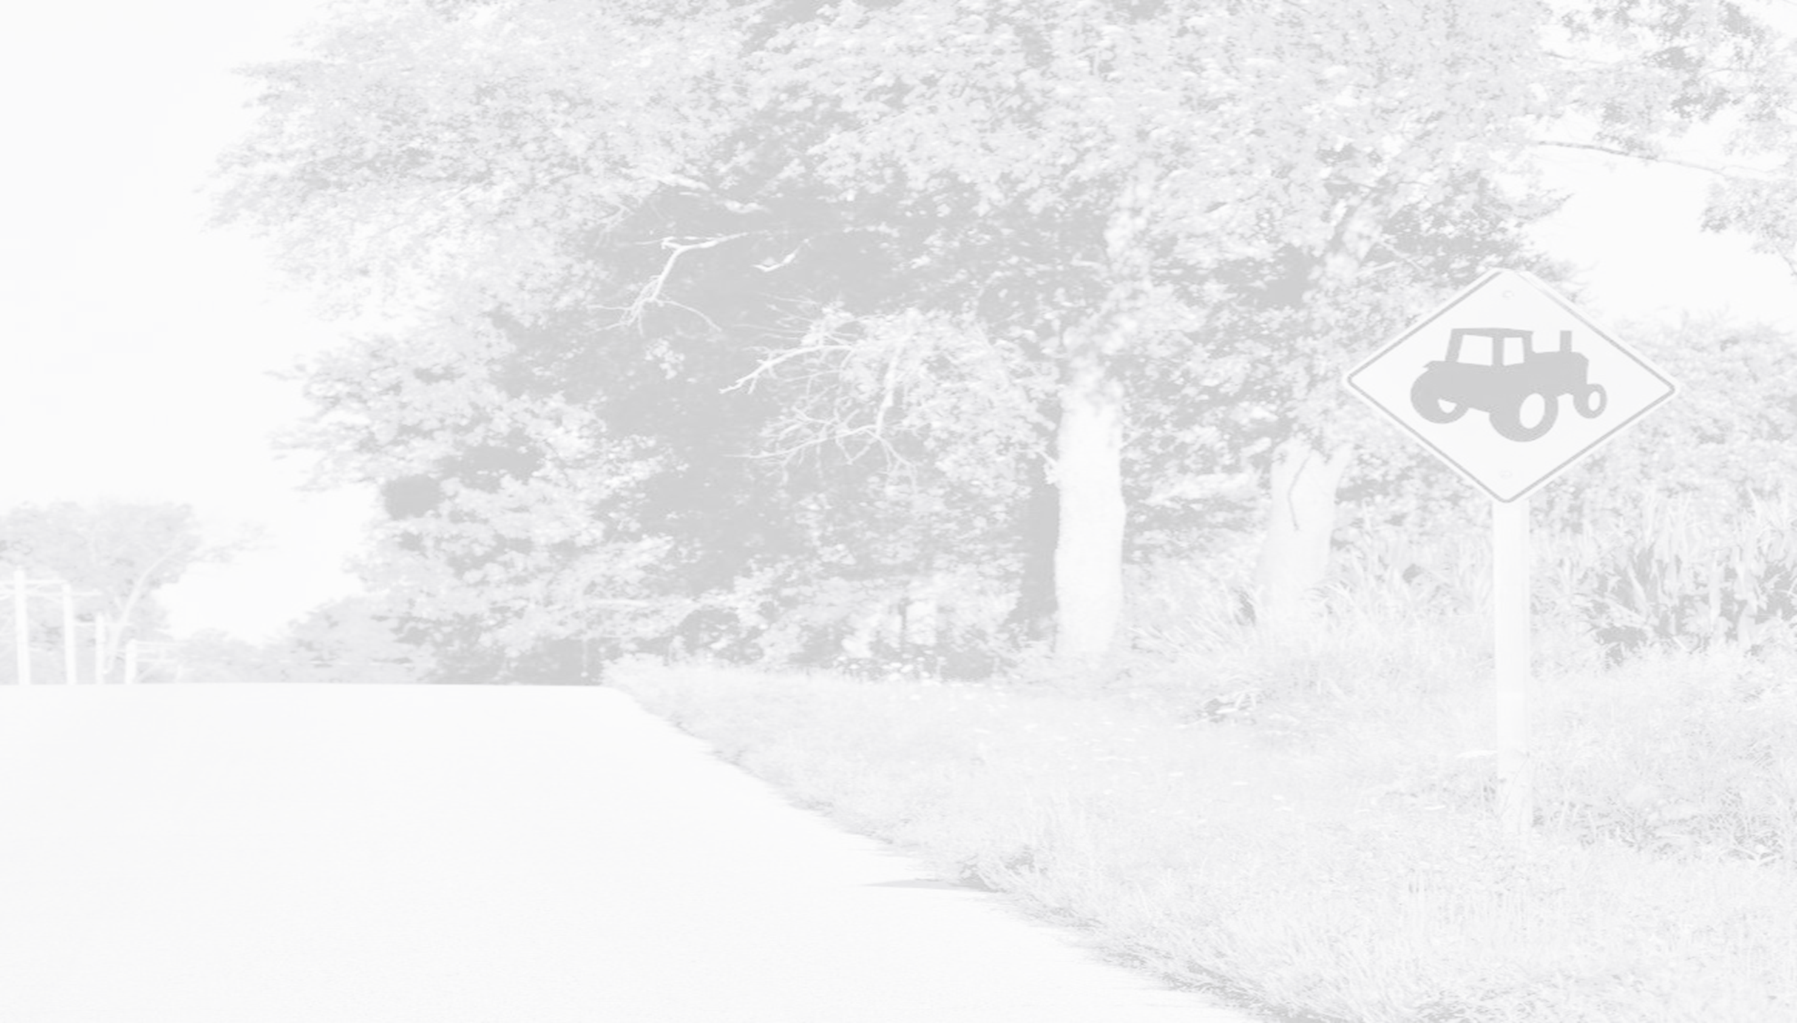
Final Word
Agricultural work has its many dangers, taking a slow-moving machine onto a public road may be one of the bigger ones. So, slow down and be exceptionally aware, considering any potential hazard and making yourself as visible as possible.

