Slide 1

Click anywhere to get started…

Slide 2



WHMIS - Workplace Hazardous Material Information System

Slide 3
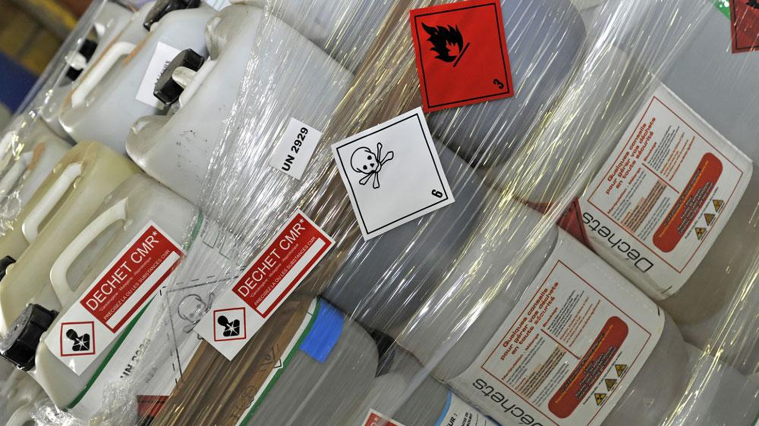
What’s at Stake?
When working with hazardous material, it’s important to understand what threats each material can pose. Many factors play a part in the potential risk of injury: incorrect handling of material, a lack of knowledge of the dangers of each material, lack of or improper labeling and neglecting to update and obtain the safe handling documents of each material.

Slide 4
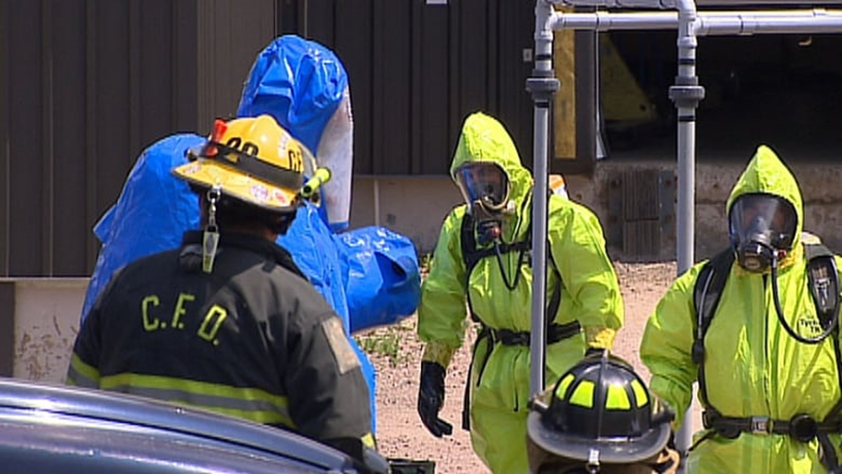
What’s the Danger?
Many workers can be neglectful, complacent or simply untrained when working with hazardous materials. A lack of caution or knowledge can cause dangers such as: respiratory or skin sensitization, skin corrosion, damage to the eye, explosions, fire, acute toxicity or long-term effects like carcinogenicity. Diligence and awareness comes with proper education and updated, documented information on the hazards of each material.

Slide 5
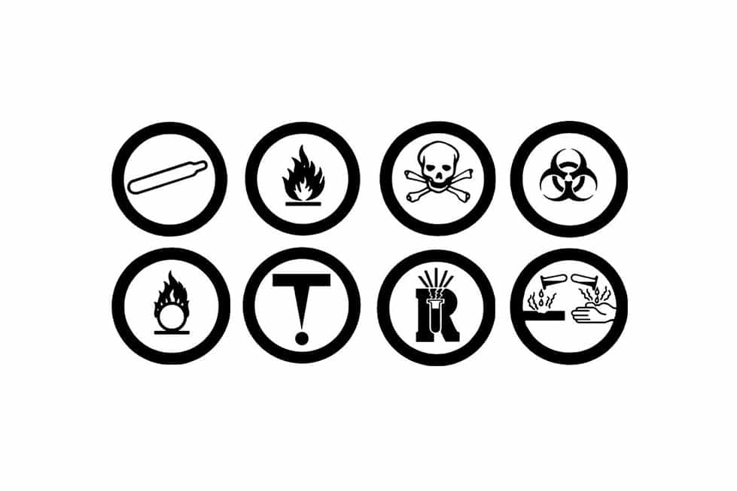
How to Protect Yourself
Workplace Hazardous Material Information System (WHMIS) was designed to educate all employees on the dangers of working with hazardous materials.
WHMIS has compiled a guideline to inform workers of the risks and safety methods of many different classes of dangerous material.
You should be able to read and understand the WHMIS classifications and the specific dangers they cause.

Slide 6
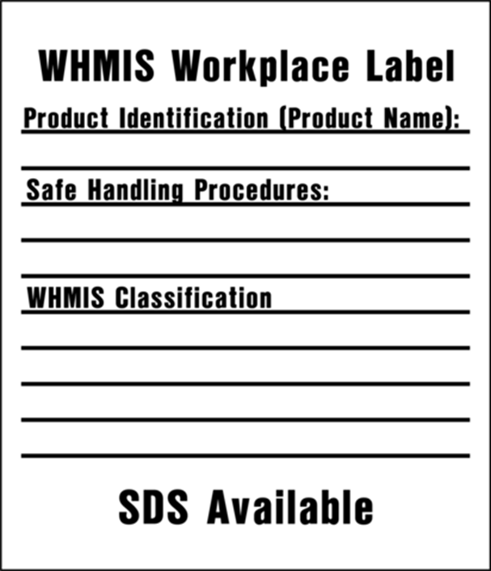
How to Protect Yourself
Labels
All hazardous products must be properly labelled. Here are the two types of labels:
A supplier label must be affixed to the product when delivered to the workplace. It will have a WHMIS hatched border.
A workplace label must be legible and affixed to containers that have been filled by workers with material from supplier containers, to containers that have arrived from the suppliers without a label or to replace supplier labels that have become illegible or are missing.
Workplace labels must contain the following:
Product identifier
Information on the safe handling of the product
A statement that informs the user that a MSDS is available.

Slide 7
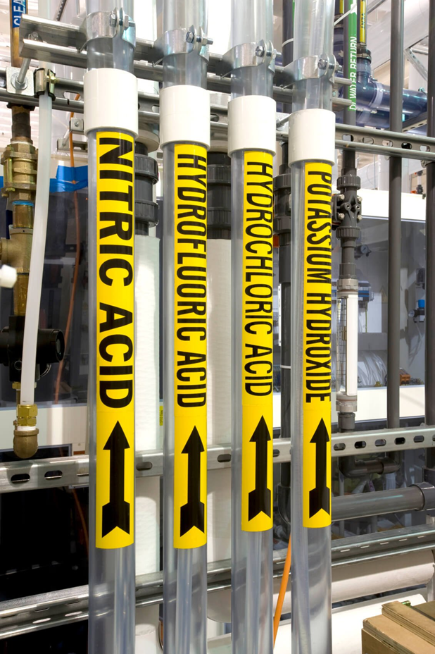
How to Protect Yourself
Workplace Identifiers can be used in situations where a workplace label isn’t possible (i.e. controlled substances pipes). The content of a workplace label can be colour coding, warning signs and pictures that convey the necessary information.
Material Safety Data Sheets (MSDS)
An MSDS is a document compiled by the supplier of the product. It contains the information of each specific hazardous material. This includes the risks and the safe handling practices.
The employer must update the MSDS of each product every three years and must obtain any new and updated information for the MSDS.

Slide 8

How to Protect Yourself
Training
Employees should be routinely trained and informed of the following information:
The content, purpose and importance of labels and MSDS.
Safe handling storage procedures, types of identification and their uses and the proper usage and disposal of controlled products.
Training in emergency situations and the correct procedures to follow in the presence of stray emissions.

Slide 9

Final Word
You must take the time to learn the many hazardous materials in your workplace. This includes labelling, reading and understanding the different classifications and their dangers, the material’s purpose and safe handling methods, where the MSDS documents are and referring to them when necessary, and what you should do in the event of an emergency caused by a hazardous material.

