Slide 1

Click anywhere to get started…

Slide 2
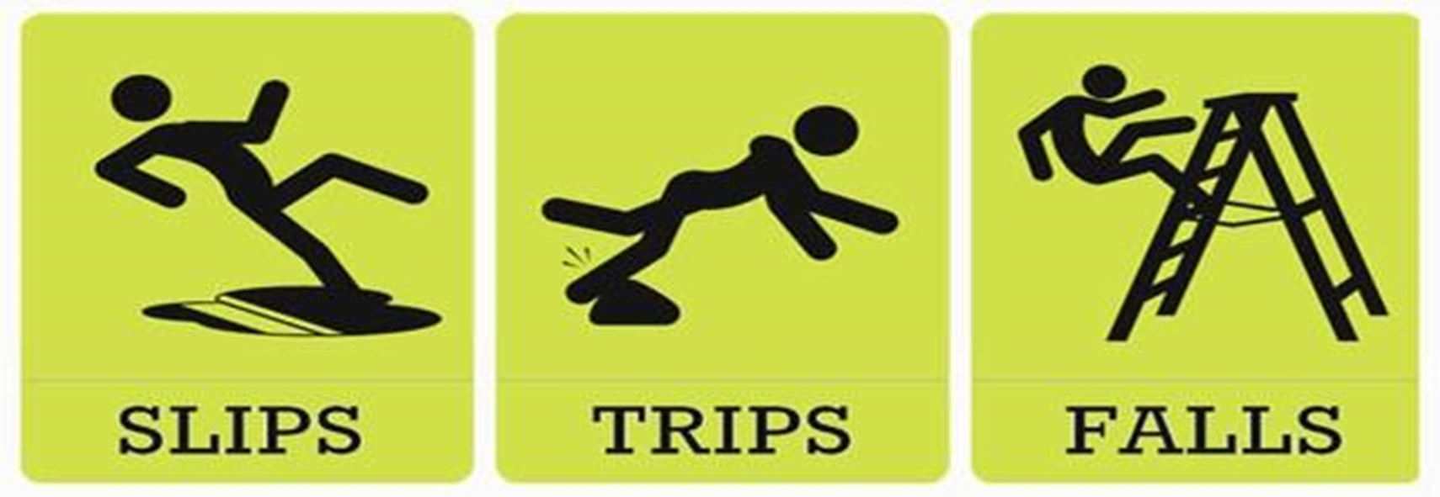


Slips, Trips and Falls

Slide 3
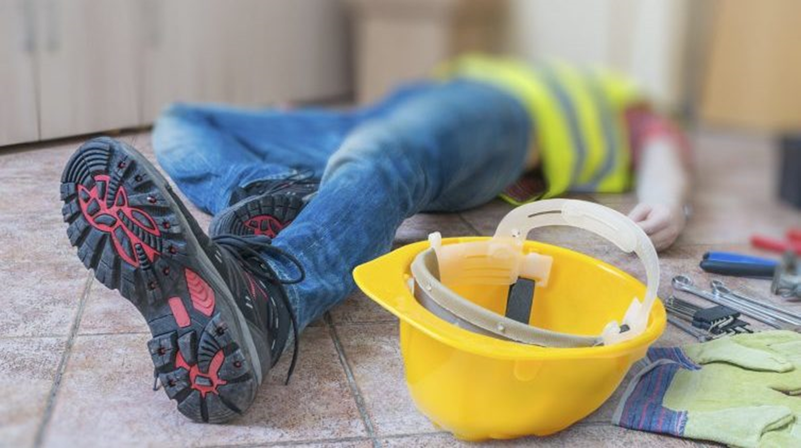
What’s at Stake?
The number of injuries and fatalities caused by slips and trips on the farm is significant, most of which could be prevented with simple housekeeping techniques and a watchful eye. It takes only a moment for a seemingly simple spill to result in a dangerous fall.

Slide 4
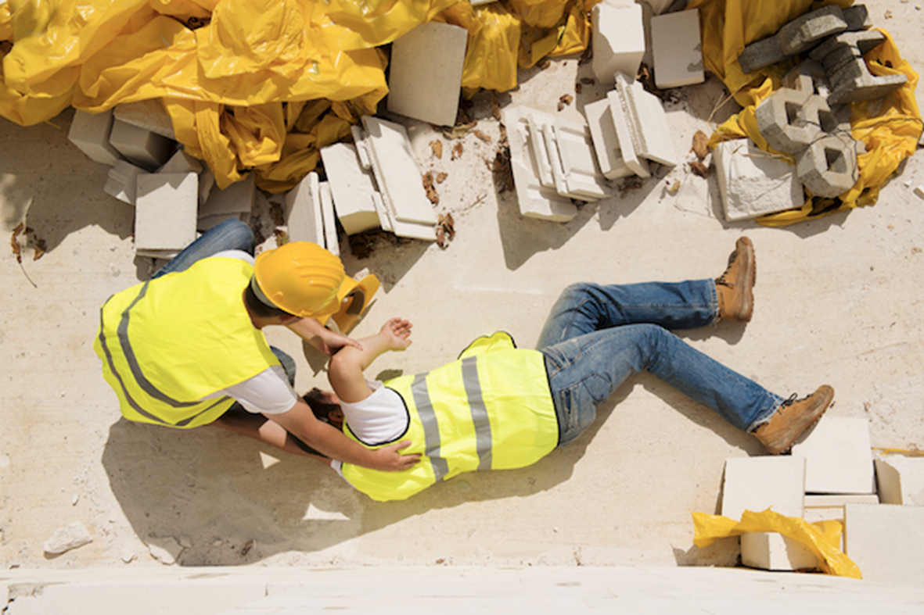
What’s the Danger?
If workplace conditions are not cleared of slip and trip hazards, workers are subject to countless situations that could lead to serious injury and even death. Broken bones, falling into rotating parts of machinery, brain injuries and broken necks are just a few potential risks when working in the unsafe conditions that can go unnoticed at your feet. Neglecting to clean a tractor step of mud, ice, grease or other built-up debris could lead to disaster. Yet, oftentimes, hazards such as these are completely overlooked.

Slide 5
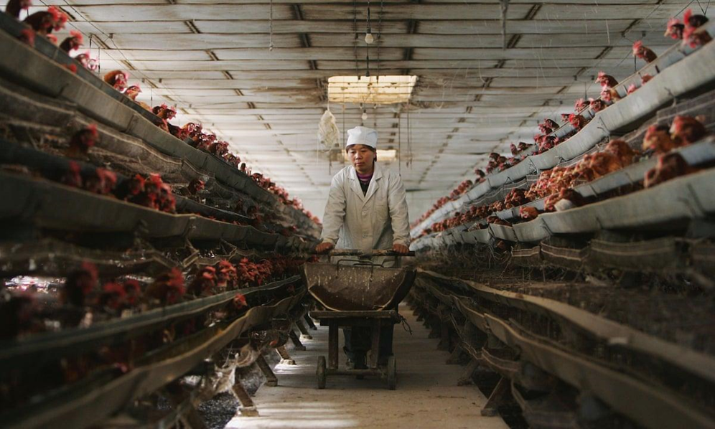
How to Protect Yourself
Clear aisles. walkways, steps and platforms of objects and debris, and make it a habit of putting tools back when you’ve finished with them. This will keep the work area clean, organized and free of tripping hazards.
Ensure all spills are cleaned immediately.
Keep openings, such as throwdown holes, closed when not in use and install guard rails around any area a worker could fall through.
If the work area is particularly icy due to weather and the job can’t be held off until conditions improve, spread sand and/or salt to provide traction and avoid slips.
Wear slip-resistant footwear.

Slide 6
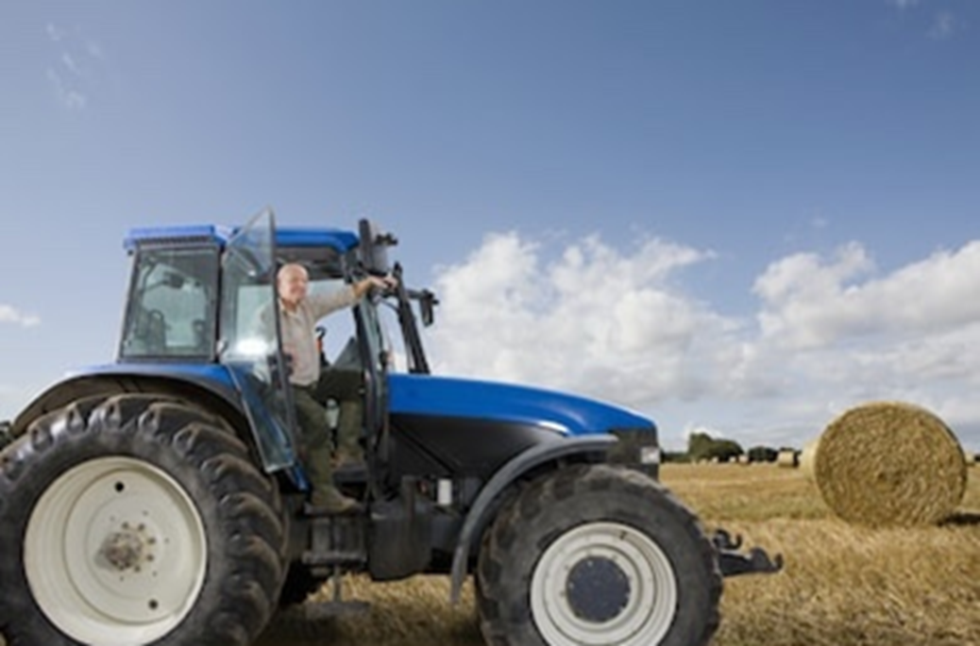
How to Protect Yourself
Never jump from machinery or other raised platforms. Your clothes could catch on objects that protrude from ledges or walls, or you could land on uneven ground.
Use the 3-point system when stepping up or down from self-propelled machinery:
  Always use the handrails, handholds and footholds.
  Ensure that either one hand and two feet, or two hands and one foot are on the machine.

Slide 7
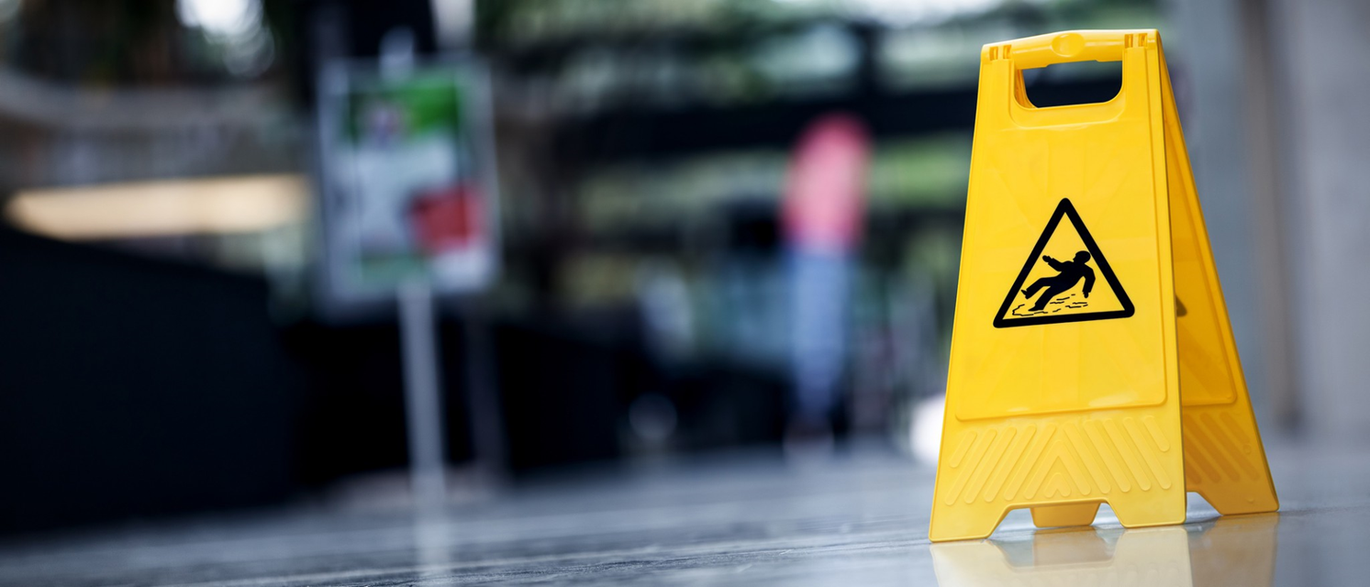
How to Protect Yourself
Operate machinery only when you are safely secured in the seat.
Never allow passengers.
Drive slowly and avoid driving if tired.
Use caution when around stationary equipment (e.g. grain augers, grind mixers) by maintaining good footing and staying clear of them while they are running.
Ensure equipment is shut-off and the key is removed when making repairs or adjustments. This will avoid entanglement in any moving parts if you or someone else were to fall onto the equipment.

Slide 8
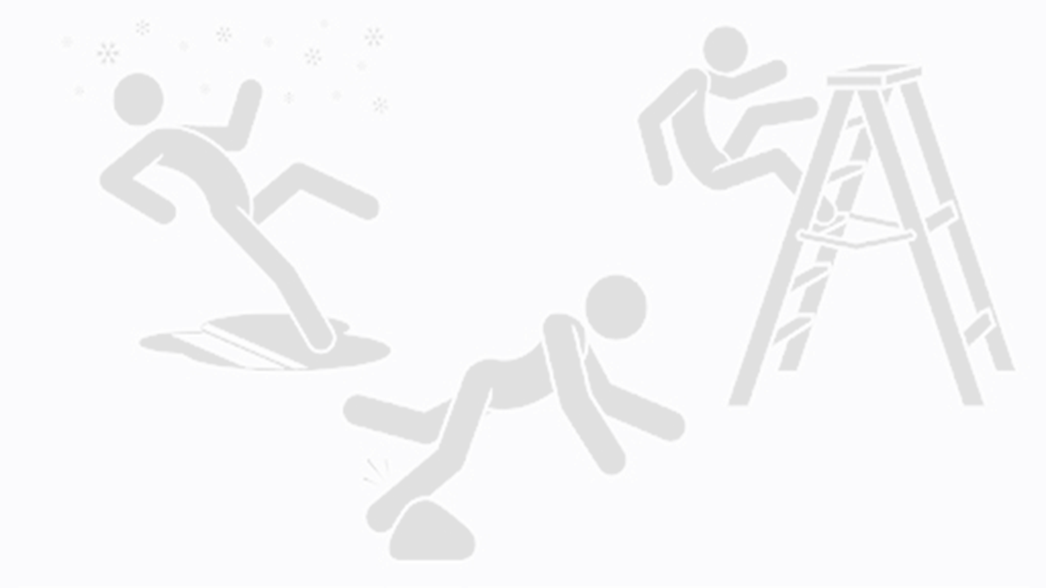
Final Word
Diligence and an observant eye in your workplace can help avoid the risks of slips, trips and falls. It will ensure that hazards have been noted and removed. Astute workers pay attention to the small details that may otherwise be overlooked, thus saving themselves and other workers from harm. Be sure you spot the potential risks before they happen and address them immediately.

