Slide 1

Click anywhere to get started…

Slide 2
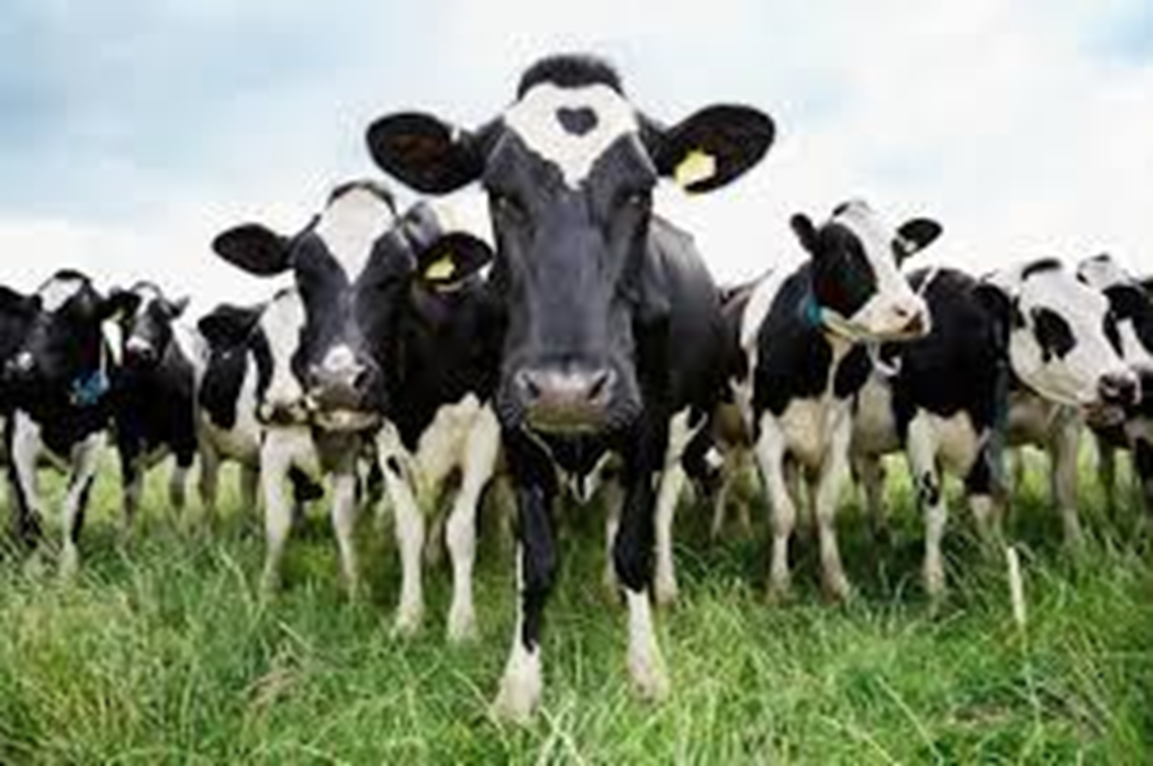


Safe Handling of Farm Animals

Slide 3
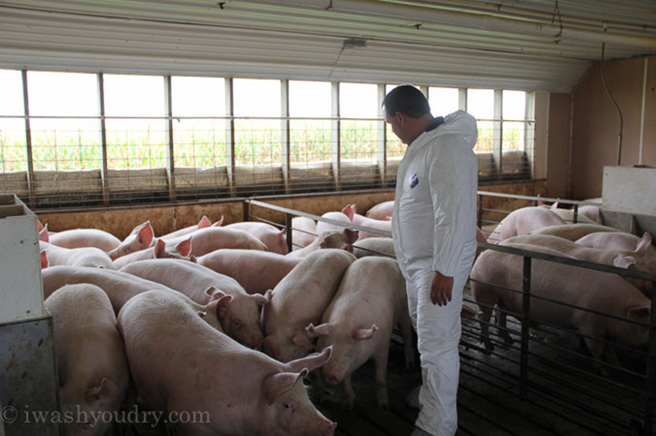
What’s at Stake?
Animals are unpredictable, so handling them should be done with care, preparation and respect. Many workers become complacent when dealing with animals, forgetting that they pose as much a hazard as any piece of machinery or equipment. Learning what these hazards are and developing a great deal of respect will go a long way in keeping you and livestock safe.

Slide 4
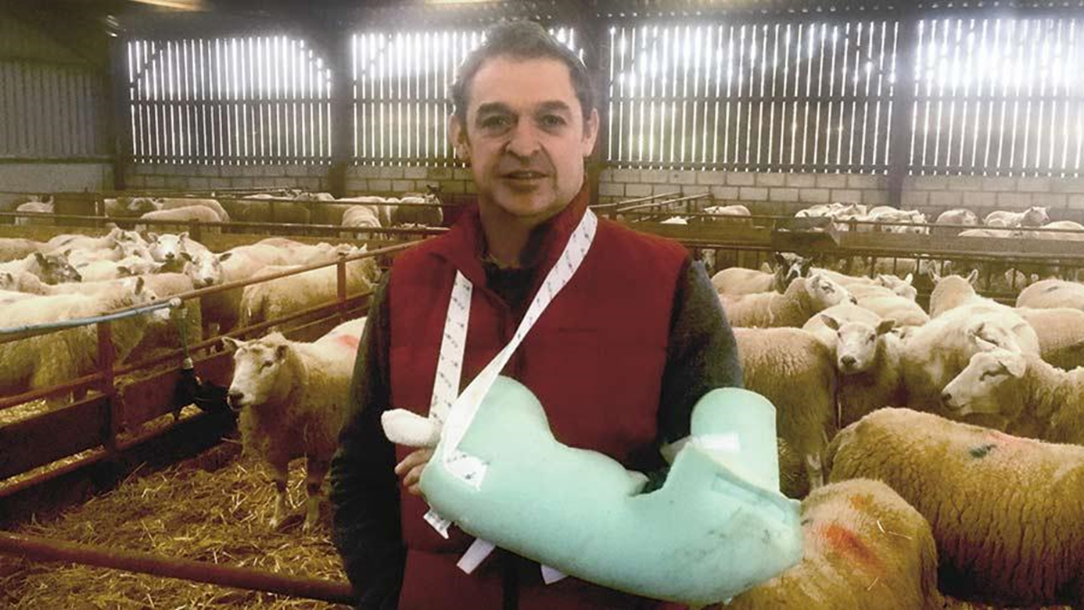
What’s the Danger?
Handlers must be made aware that the potential risks each task poses are many. If handlers are too comfortable and don’t consider the possible risks of the jobs they are carrying out, they may find themselves trampled, crushed, pinned, stepped on, bit, rammed or thrown off. The dangers happen quickly, as animals can injure their handlers both deliberately and accidentally. These accidents are more than likely due to a worker who failed to follow safe animal-handling practices.

Slide 5
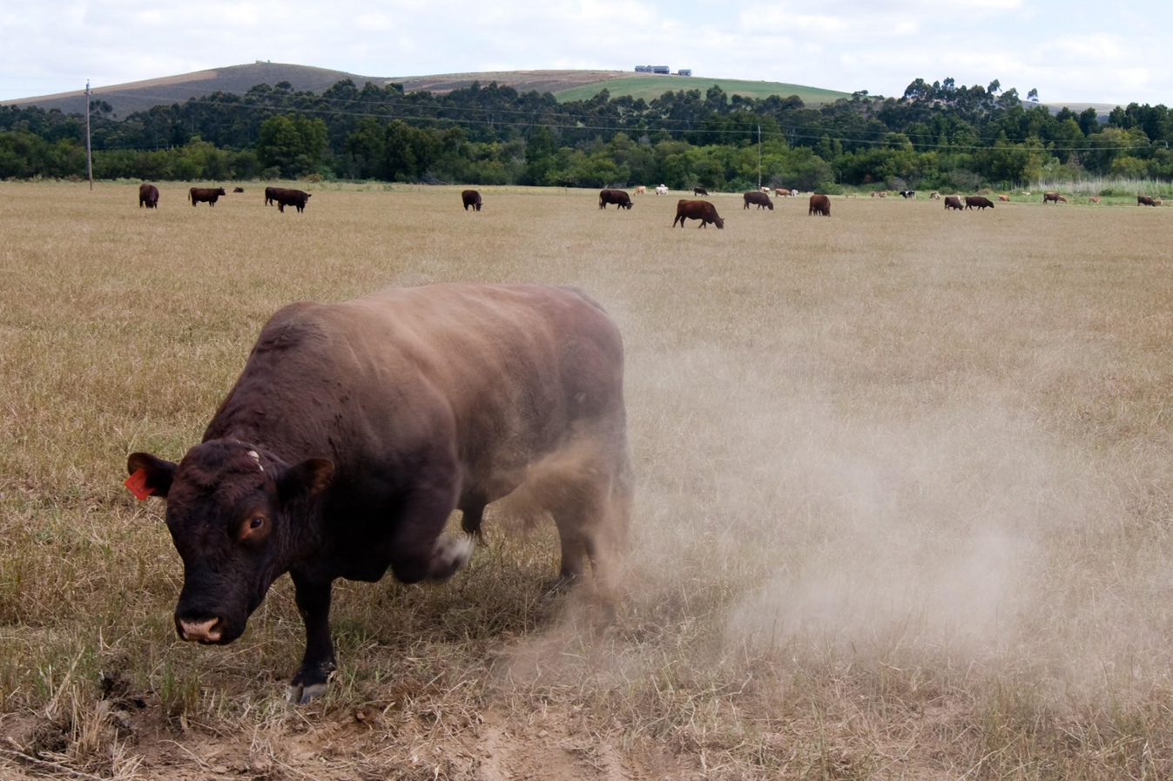
How to Protect Yourself
Heed the Warnings Signs of Animals
Many animals exhibit clear characteristics that will assist the handler in their decision to proceed or back away. The following signs are a clear warnings that you should avoid approaching the animal:
Raised or pinned ears
Raised tail
Raised back hair
Bared teeth
Pawing the ground and/or snorting

Slide 6
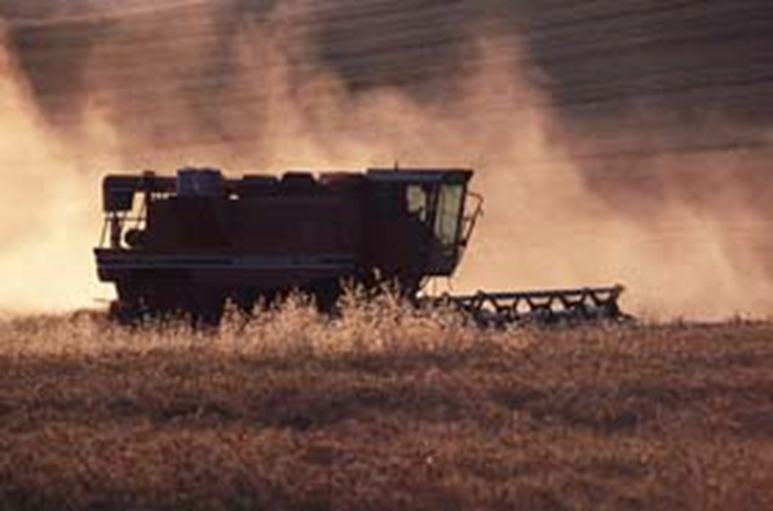

How to Protect Yourself
Handling Methods
Move calmly, slowly and deliberately, and announce your approach with a soft touch to their front end where you are in full view.
Avoid loud noises.
Give new animals time and space to adjust to the surroundings.
Never prod an animal if it has no place to go.
Most animals fiercely protect their young. Avoid getting between a cow and her calf. If work must be done on the calf, be sure it’s done in an area separated from the cow.
Be wary of male animals, as they tend to be more aggressive.

Slide 7
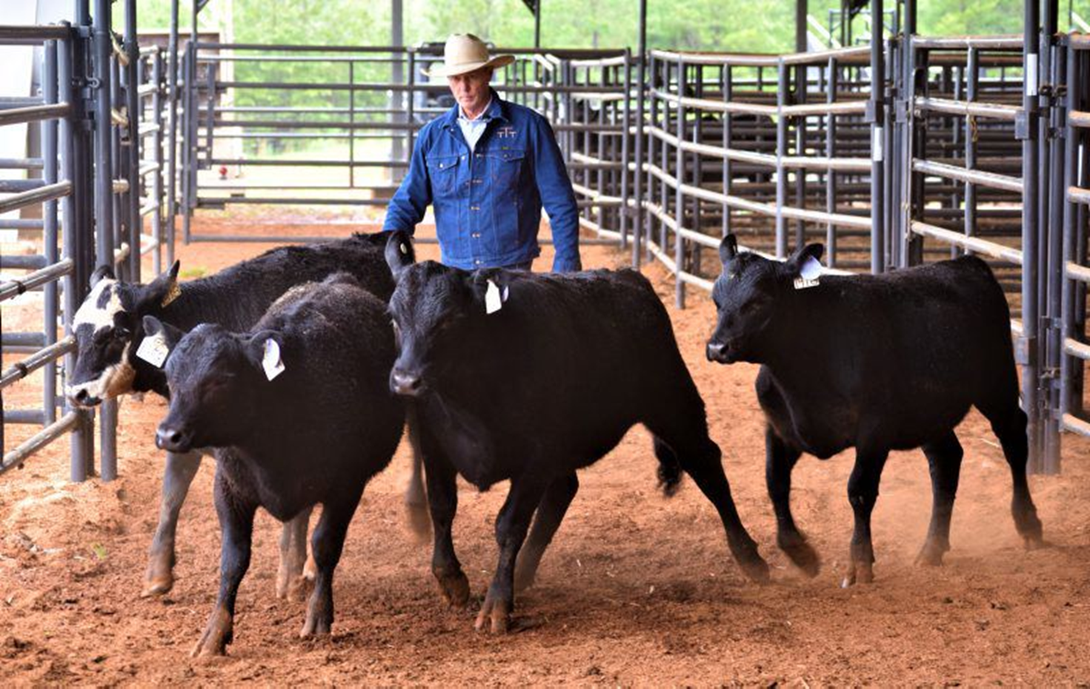
How to Protect Yourself
Do not work in close quarters with no escape route, when you are working with animals who are sick or injured, or there are outside elements, like a storm, that may spook them.
When working in an enclosed space with large animals, ensure there is a man gate you can easily access.
When working with new animals or if strangers must be in the space, exercise extreme caution.
Cattles and horses have a blind spot. When you approach a horse, approach from the left, and from the front. If approaching from behind, speak softly and gently stroke their shoulder or rump before moving toward the head. When working with cattle, work from their hip, do not stand directly behind, and try to keep out of view. Sudden movements from behind may spook them.
Be patient.

Slide 8
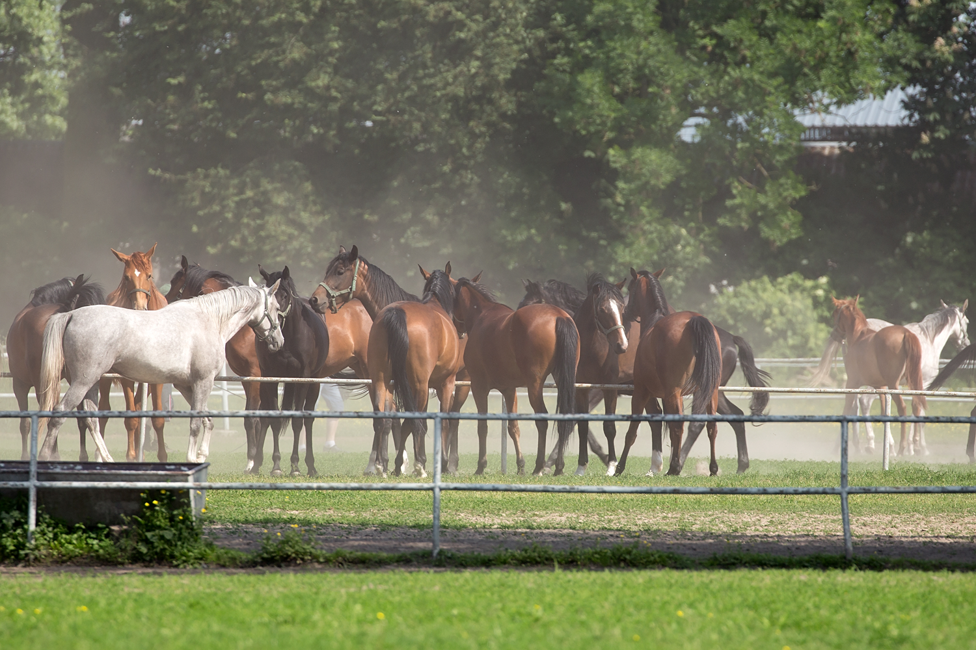
How to Protect Yourself
Flooring
Exercise caution when working in areas with tripping hazards.
Use concrete floors for livestock.
Floor ramp and step finishes should be roughened to prevent slips.
High traffic areas should be grooved.
Ensure water drains quickly with appropriately constructed floors.
Use slatted floors for animals in a confined space to keep them dry.
Fencing and Gates
Must be strong and durable.
Alleys should be wide enough to allow passage but narrow enough to keep them from turning around.
Animals will be more cooperative in chutes made with solid walls.

Slide 9
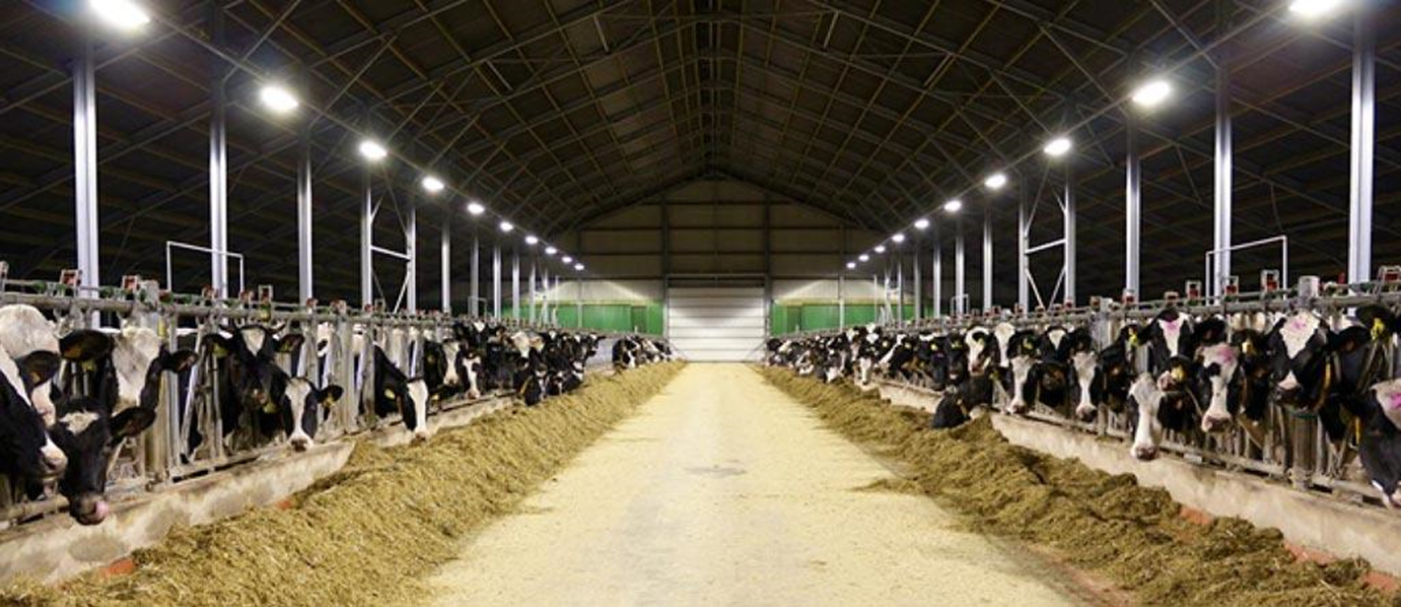
How to Protect Yourself
Lighting
Keep lighting even to ensure the animals remain calm. Shadows can spook animals and they will be less likely to move smoothly if the area is dotted with light and shadows.
Ensure facilities are structured in such a way that prevents sun from shining directly into their eyes.
Equipment
Poor quality equipment affects animal’s safety and sense of security, which in turn affects yours.
If your equipment isn’t in the best condition possible, you will likely find time and labour are negatively affected.

Slide 10
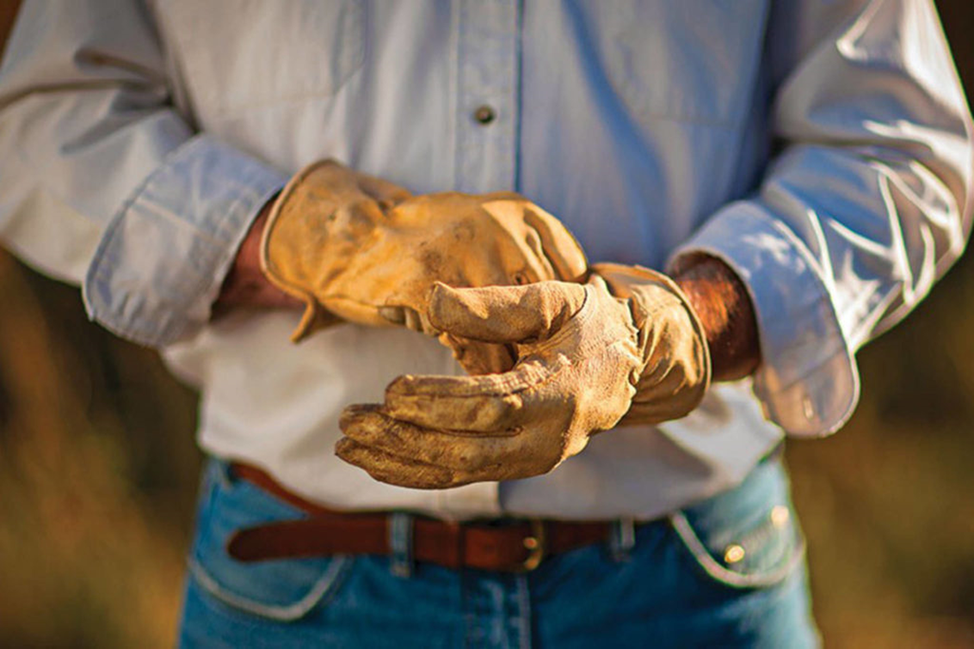
How to Protect Yourself
Personal Protective Equipment
Handlers must always wear steel-toed boots, gloves and other protective clothing.
A dust filter should be used when working with grains and in other situations where fine particles enter your breathing zone. This will prevent respiratory hazards down the road.

Slide 11
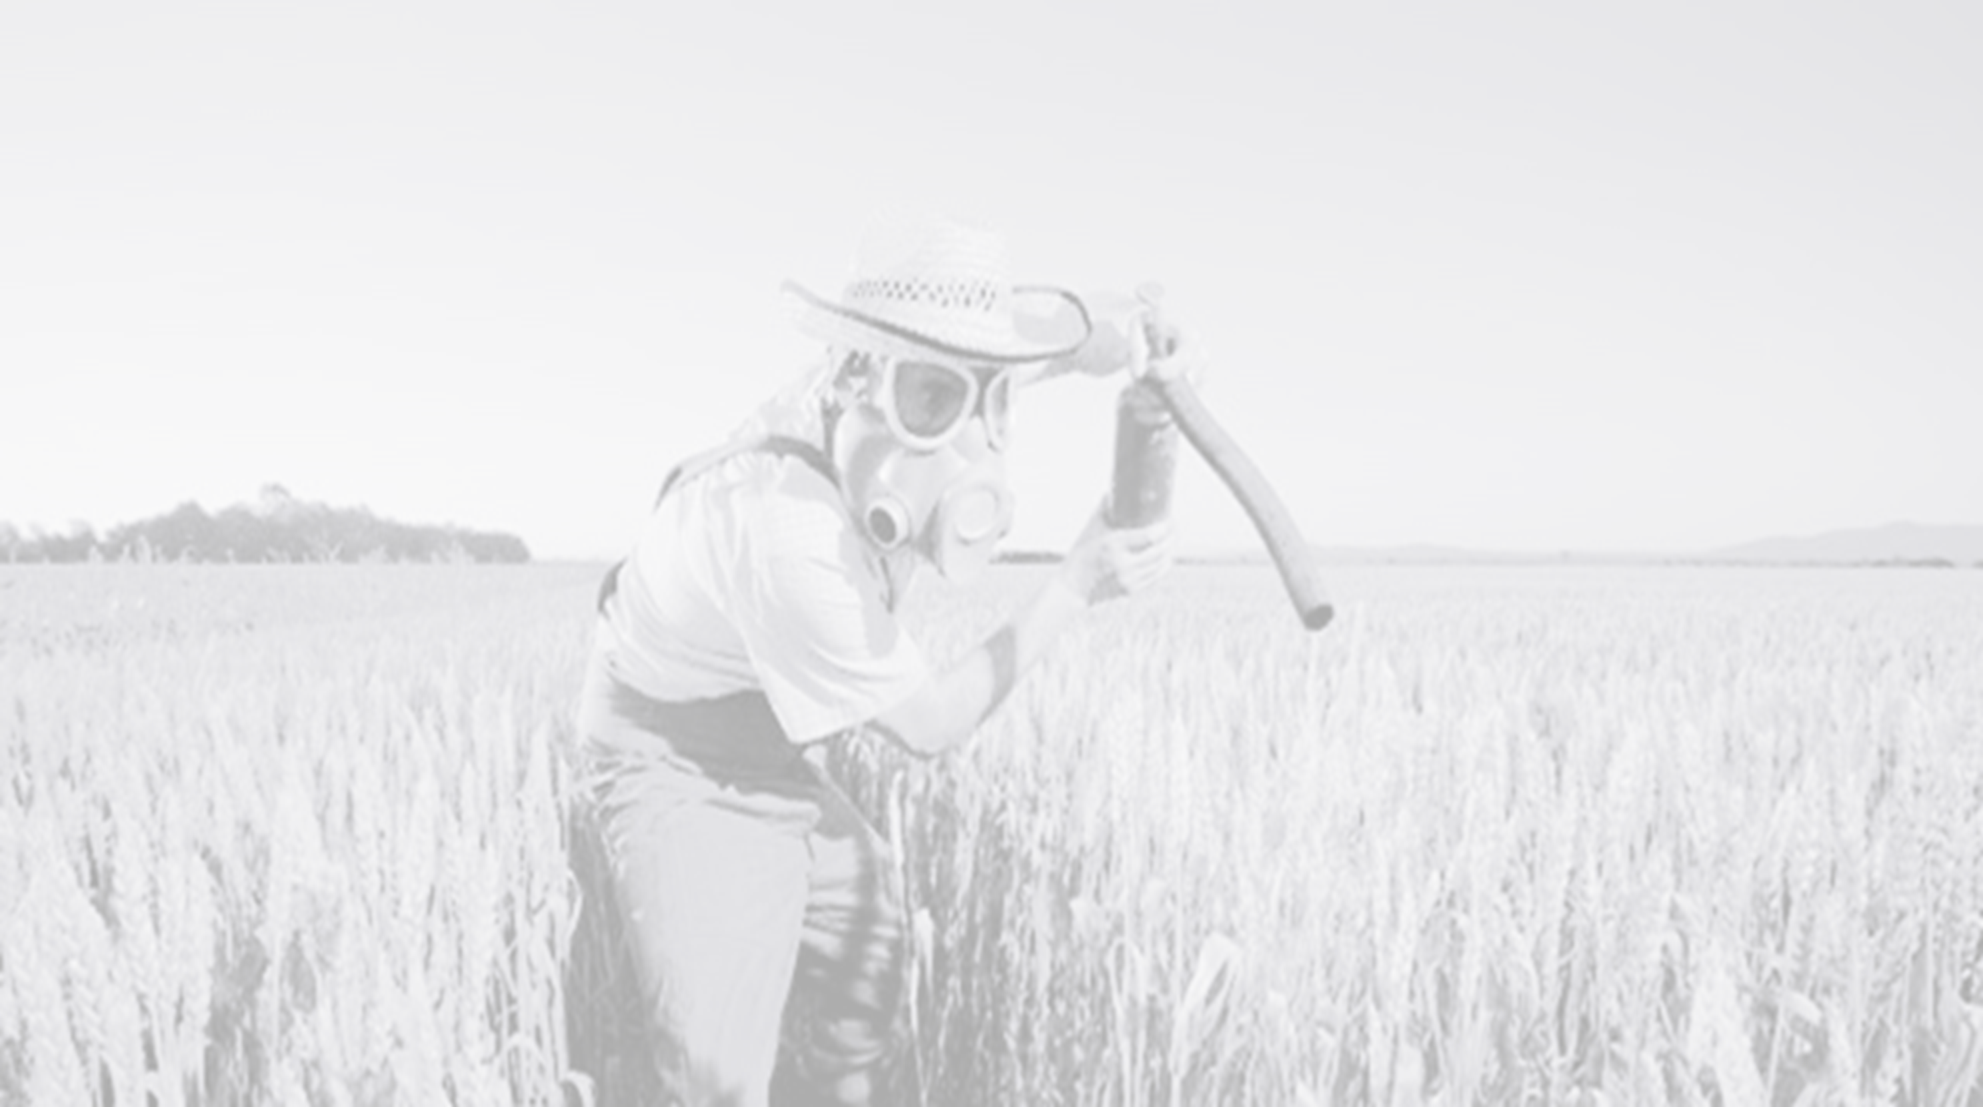
Final Word
Handling animals must be done with respect for the appropriate methods and the animals themselves. Understanding how to read the warning signs of animals in a state of fear or aggression, keeping the spaces where animals are held and directed through in good working order and wearing the proper protective gear, are all ways to maintain a safe working environment with very unpredictable animals.

