Slide 1

Click anywhere to get started…

Slide 2
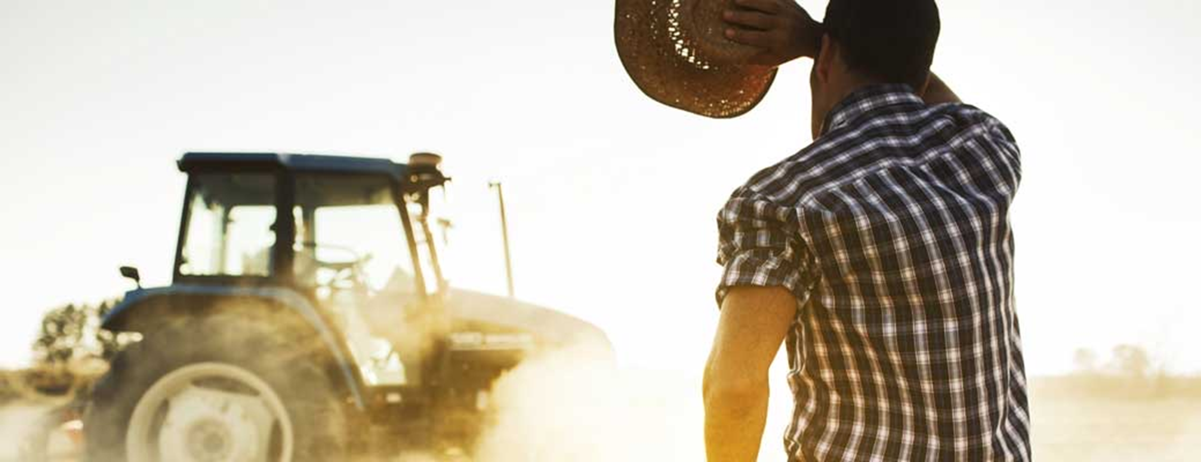


Protect Yourself From the Sun

Slide 3
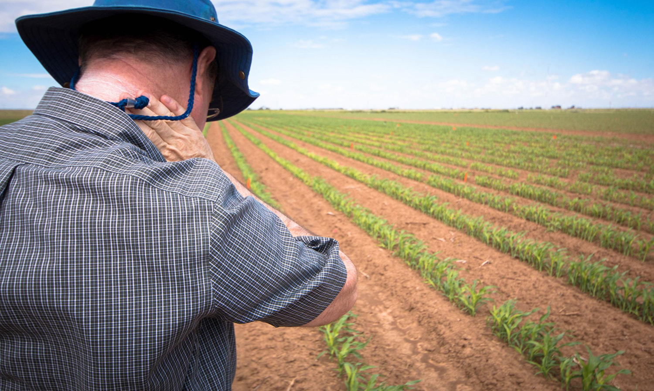
What’s at Stake?
Increased exposure to the sun’s dangerous UV rays is a serious hazard for farm workers. Most of the hours in a typical shift are spent in the window of time where the sun is most dangerous, between 11:00 A.M. and 3:00 P.M.
It’s important to take the proper precautions to prevent falling victim to the harmful effects of the sun.

Slide 4
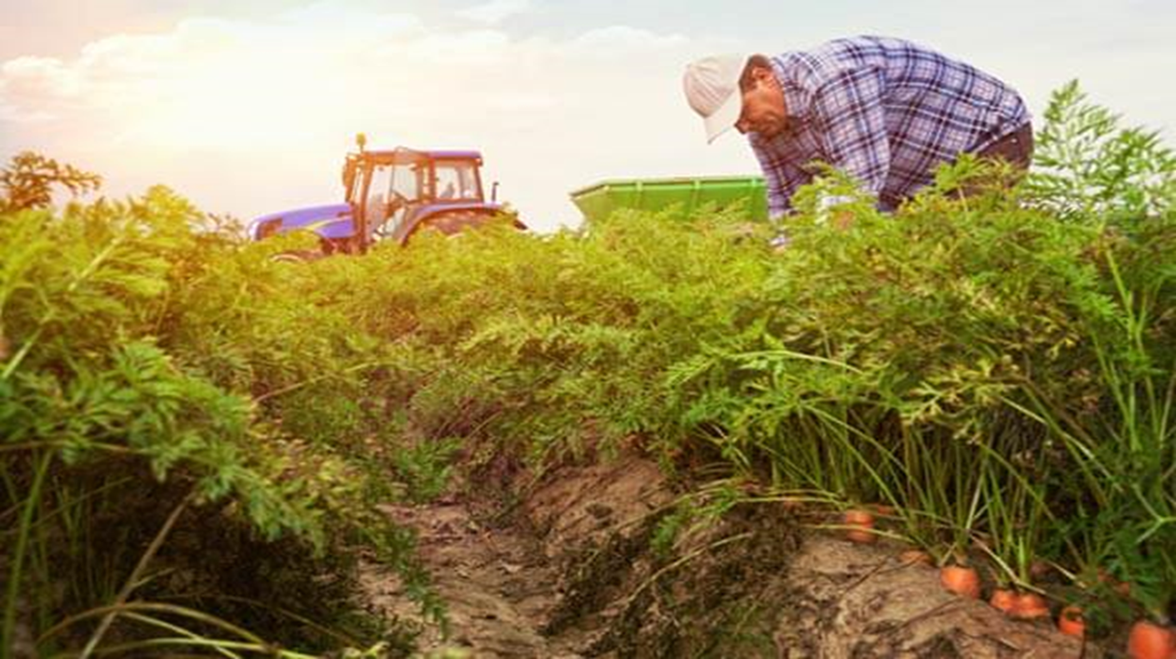
What’s the Danger?
Repeated exposure to sun can cause anywhere from aging, wrinkling and drying out of the skin, to damaged eyes and even skin cancer. It’s not necessarily about avoiding work on sunny days, UV rays can burn your skins on a cloudy day as well.
Though it’s more common for fair-skinned people to be more sensitive to the damage the sun can cause, extensive exposure to the sun is bound to harm people with dark hair and skin. Everyone is susceptible to the effects of the sun and must take the steps to protect themselves from it.

Slide 5

How to Protect Yourself
Limit your time in the sun. If you work outdoors for long periods of time, try to take your breaks indoors.
Apply sunscreen with a broad-spectrum sun protection factor (SPF) of at least 30. Be sure to apply evenly and liberally and reapply as necessary throughout the day.
Always wear sunglasses to avoid the damage UV rays can cause to the eyes.
Wear the right clothing. Light coloured, breathable, loose-fitting clothes are best. It’s important to note, wearing loose-fitting clothes isn’t advised when working near or around machinery.
Wear a wide-brimmed hat that will fully protect your ears, neck, face, temples and the top of your head.

Slide 6
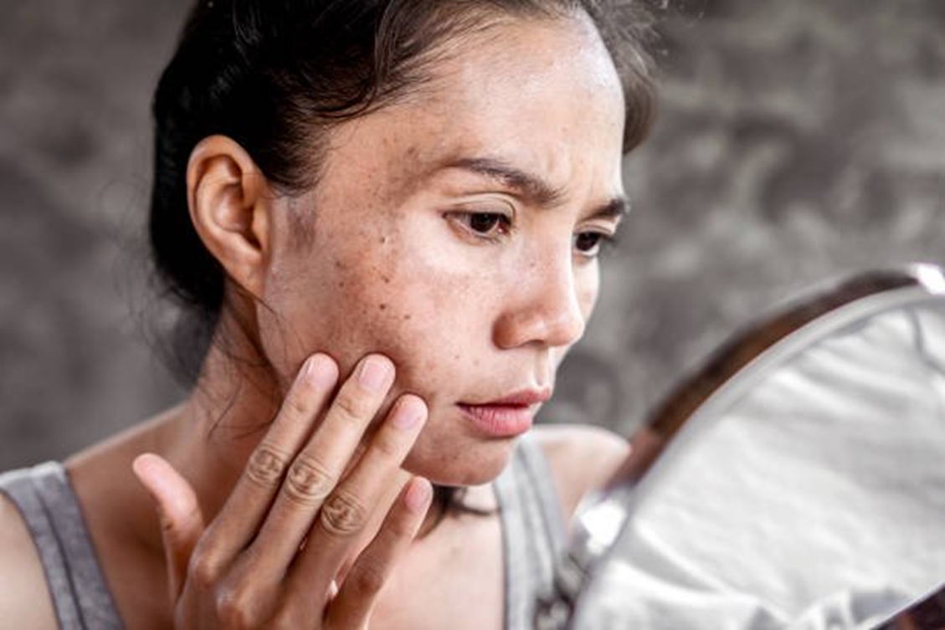
How to Protect Yourself
Inspect your skin regularly. Have someone you know inspect areas you can’t see, like behind the ear or the top of the head. Here are some things you should look out for:
Changes in the size, shape or colour of moles (i.e. ragged, blurred edges, moles that aren’t symmetrical, colours that aren’t uniform, moles that are bigger than a pencil eraser).
Sores that bleed and don’t heal.
Itchiness or pain in a mole.
Red patches or lumps.
New, suspicious looking moles.

Slide 7
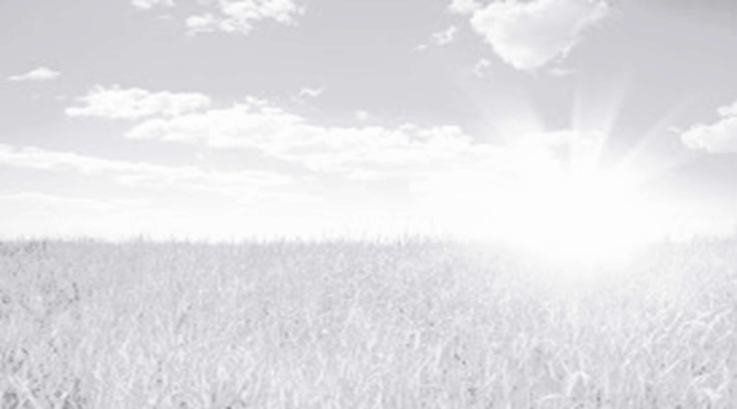
Final Word
Protecting yourself from the sun takes no time at all. With proper clothing, sunglasses, the application of sunscreen, and taking frequent breaks from the sun, you will significantly minimize your chances of sun damage. Regular inspection of your skin will give you the opportunity to treat it.

