Slide 1

Click anywhere to get started…

Slide 2



Protect Your Hearing

Slide 3

What’s at Stake?
Farm work is an incredibly loud business. Different kinds of noises, like grain dryers, tractors and power tools to name a few, all take their toll on our ears. However, hearing is something we can take for granted.
If you don’t understand how hearing is negatively affected by excessive noise, you could suffer permanent hearing loss over time and to varying degrees.

Slide 4

What’s the Danger?
Occupational hearing loss is incredibly common for farmers. The constant noise of equipment, machinery, tools and even animals affects hearing at a pace that goes undetected. You have experienced the temporary discomfort of ringing ears that feel like they’re full of cotton. But eventually your hearing returns and you think nothing more of it. What is happening is a slow deterioration of your sense of hearing.
It’s a gradual process, a person adapts to the decrease in hearing overtime, but overtime, they are exposing themselves to the same damaging noise. It’s not acknowledged until the hearing threshold is shifted upward and the individual has a hard time hearing anything that isn’t at a high volume. At that point, the damage to hearing can’t be reversed.

Slide 5
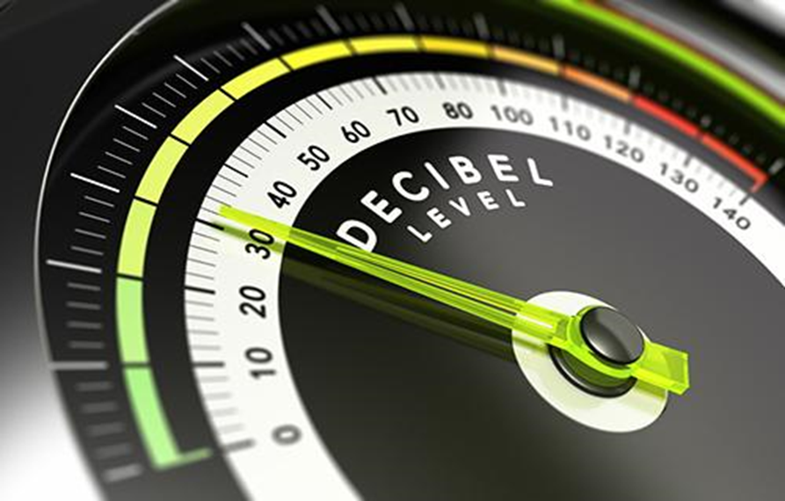
How to Protect Yourself
Sound is measured in logarithmic units of sound pressure, known as decibels, and range from zero to 140. It’s surprising to learn what can cause damage to your ears. Experts suggest that 85 decibels are the maximum noise level a person can safely be exposed to in an 8-hour day. Standard machines like an un-cabbed tractor or snowmobile are upwards of 100 decibels of sound pressure. Livestock barns during feeding time are possibly louder than that.

Slide 6
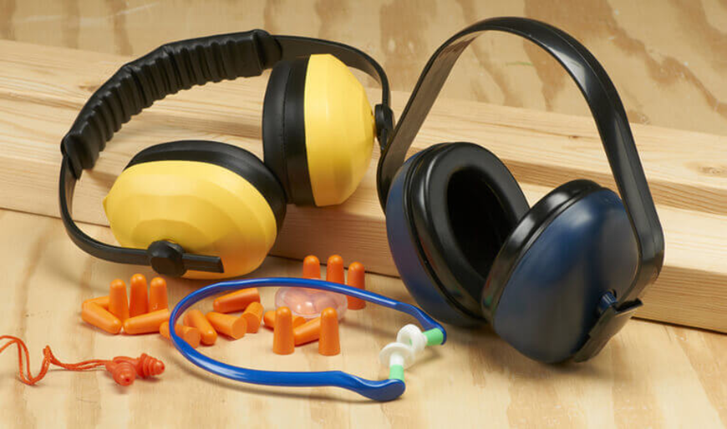
How to Protect Yourself
If possible, try to limit the amount of time you expose yourself to noise.
Double your distance from the sound of high decibels, this reduces the sound pressure by one-fourth.
Use hearing protection. Be sure you do every job. Ear plugs offer protection from noise, but acoustical earmuffs are ideal.
Test your hearing! Even if you think your hearing is fine. As mentioned earlier, it’s difficult to be aware of the damage.

Slide 7
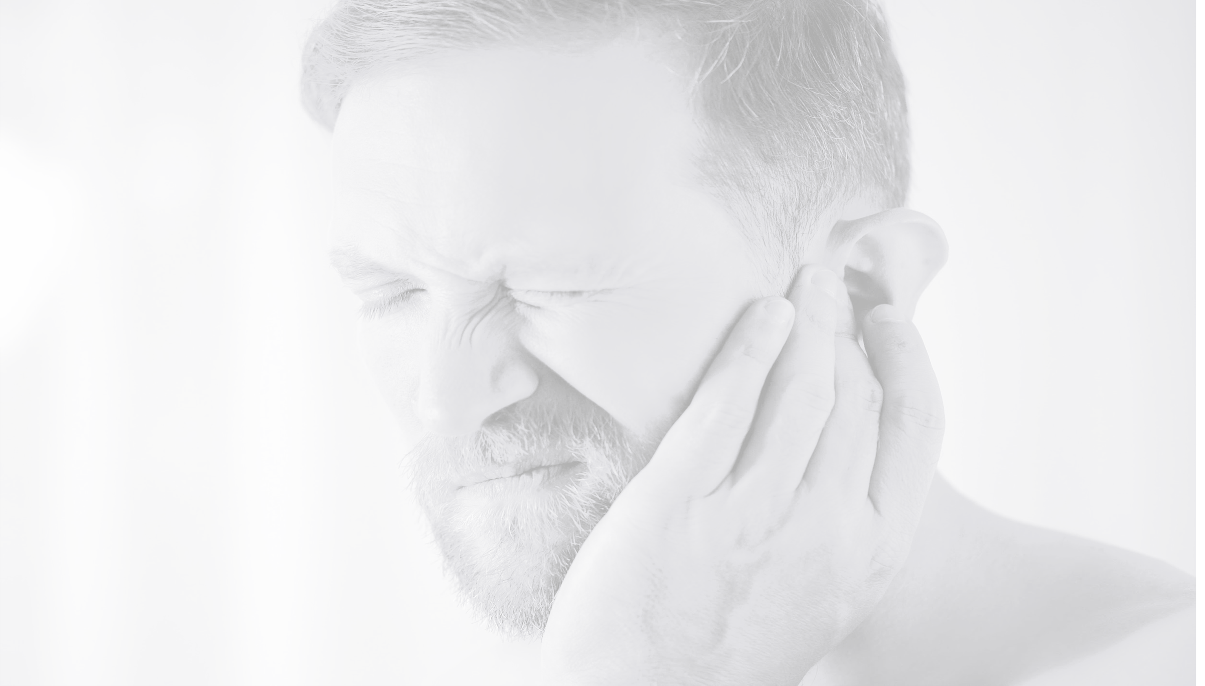
Final Word
Hearing is a precious thing. It can be easily damaged in gradual, undetected ways and it can’t be undone. You can choose to protect your hearing now. With proper ear plugs or muffs, getting to know the sounds that can be damaging in your workplace and being diligent in distancing yourself from noise, further damage can be prevented.

