Slide 1

Click anywhere to get started…

Slide 2
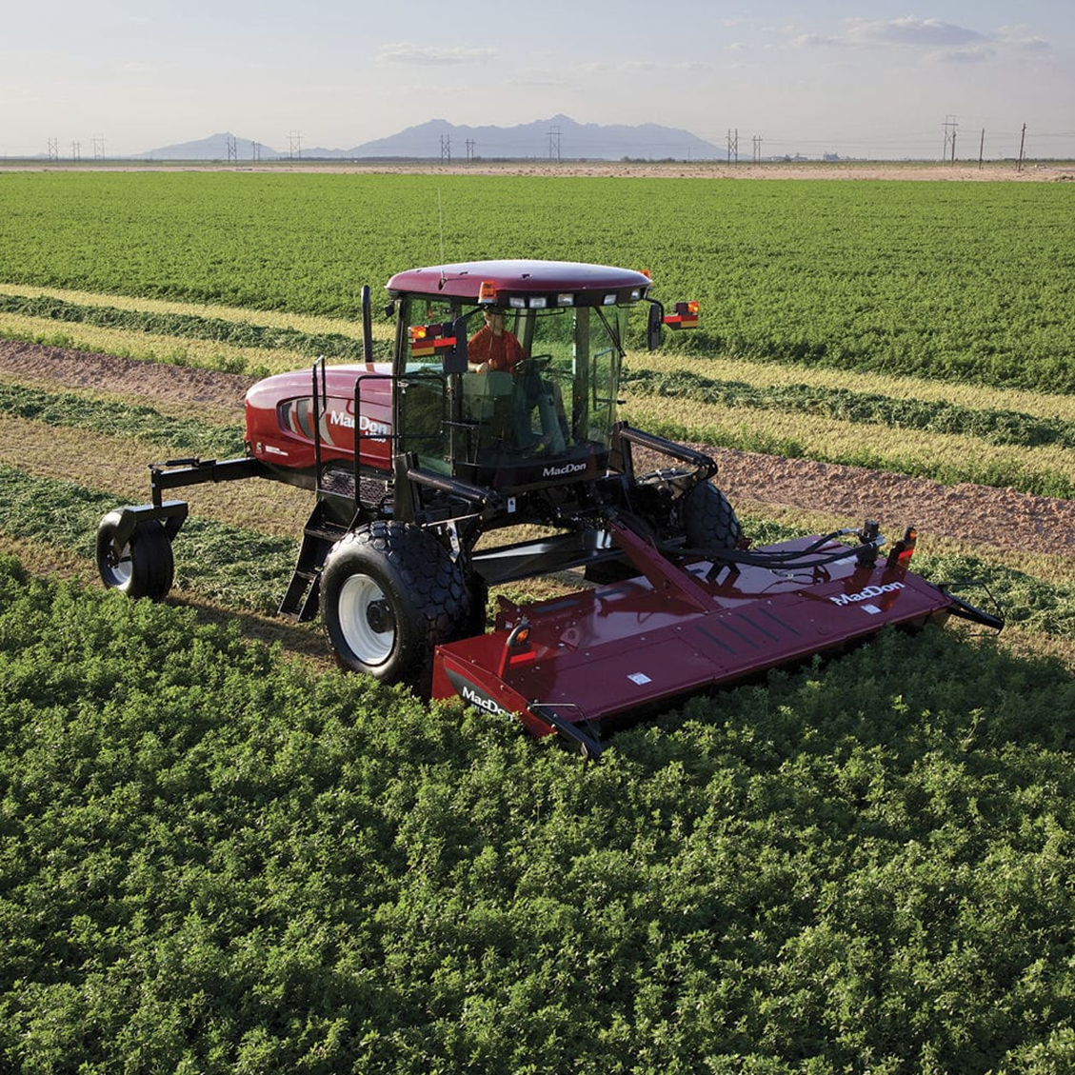


Agricultural/Industrial Mower Safety

Slide 3
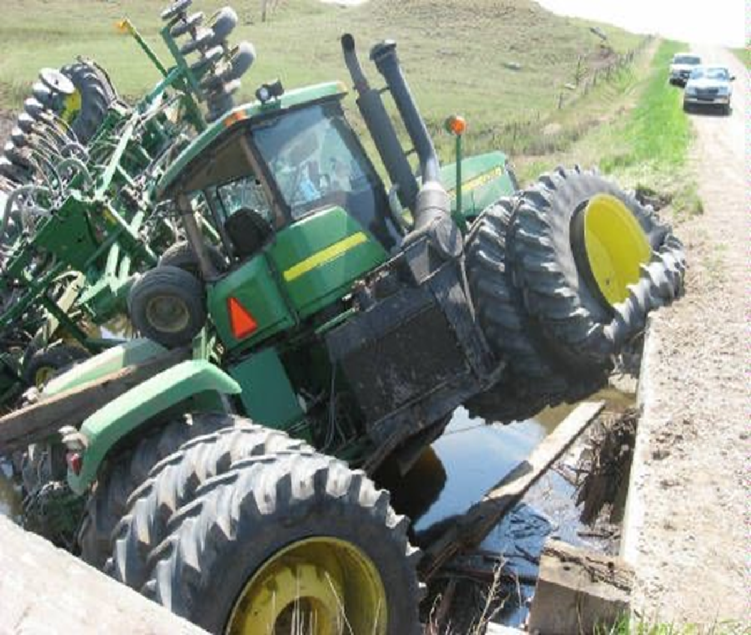
What’s at Stake?
Neglecting to ensure all elements of mower safety are considered, and that each job has been thoroughly planned out beforehand, could lead to the injury or fatality of yourself or a bystander.
Many operators don’t understand the dangers or fail to respect the risks to save time and/or extra work. It’s important to avoid cutting corners by adhering to the proper safety measures and ensuring the necessary maintenance of equipment.

Slide 4
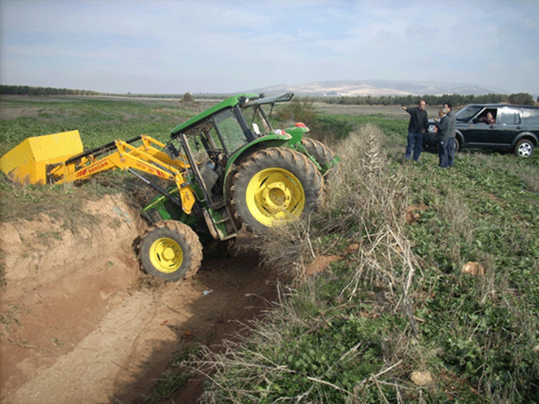
What’s the Danger?
Agricultural mower safety is a multi-faceted system. Without familiarizing yourself with a mower’s operating characteristics (i.e. its mowing capacity, the purpose of its control features and correct operating procedures, and its safety features) you risk the many hazards caused by machine failure.
Neglecting to prepare the work area by removing objects or being aware of obstacles, could cause the hazards of thrown-objects or tractor roll-over.
Failing to wear the proper protective gear increases the chances of suffering serious injury.

Slide 5
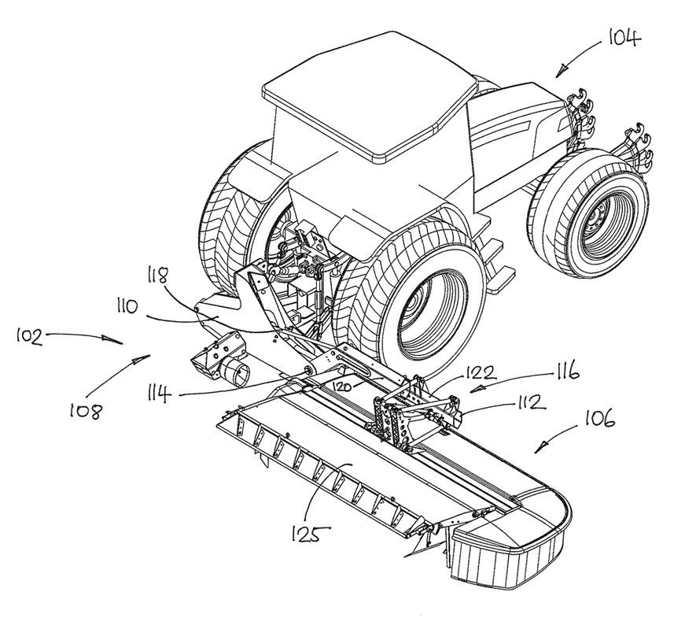
How to Protect Yourself
Understand what each piece of machinery is equipped to handle.
Develop a thorough understanding of the controls, gauges and dials of your machine as well the safe speed, slope capabilities, braking and steering characteristics, turning radius and operating clearances.
Ensure all guards, shields and safety signs are in place and that you have studied all danger, warning and caution decals on your machine.

Slide 6
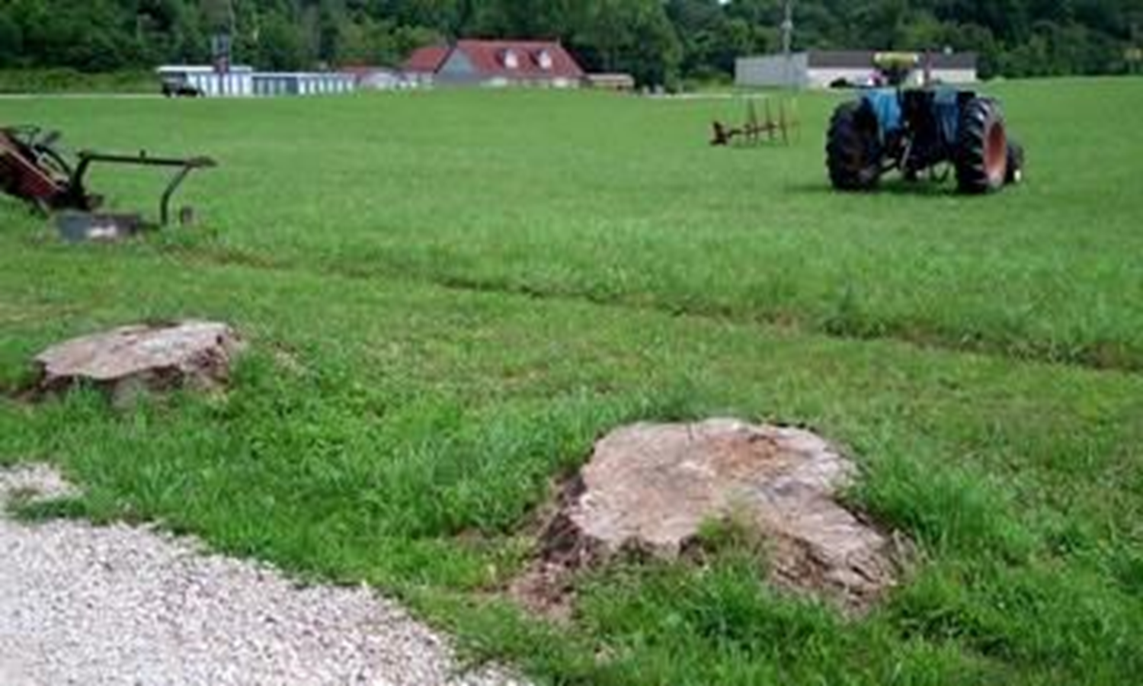
How to Protect Yourself
Seek out any potential hazards (i.e. ditches, potholes, drop-offs, steep slopes, etc.) that could cause your fall or mower over-turn.
Remove all objects that could be thrown by the mower.
Map out the safest route, considering terrain and the type of material you are mowing, and make sure you choose a pattern that allows you to travel as straightforward as you possibly can.
Wear the proper PPE: safety glasses, steel-toed boots, close-fitting clothes, hat, hearing protection and gloves.
Do not allow passengers.

Slide 7
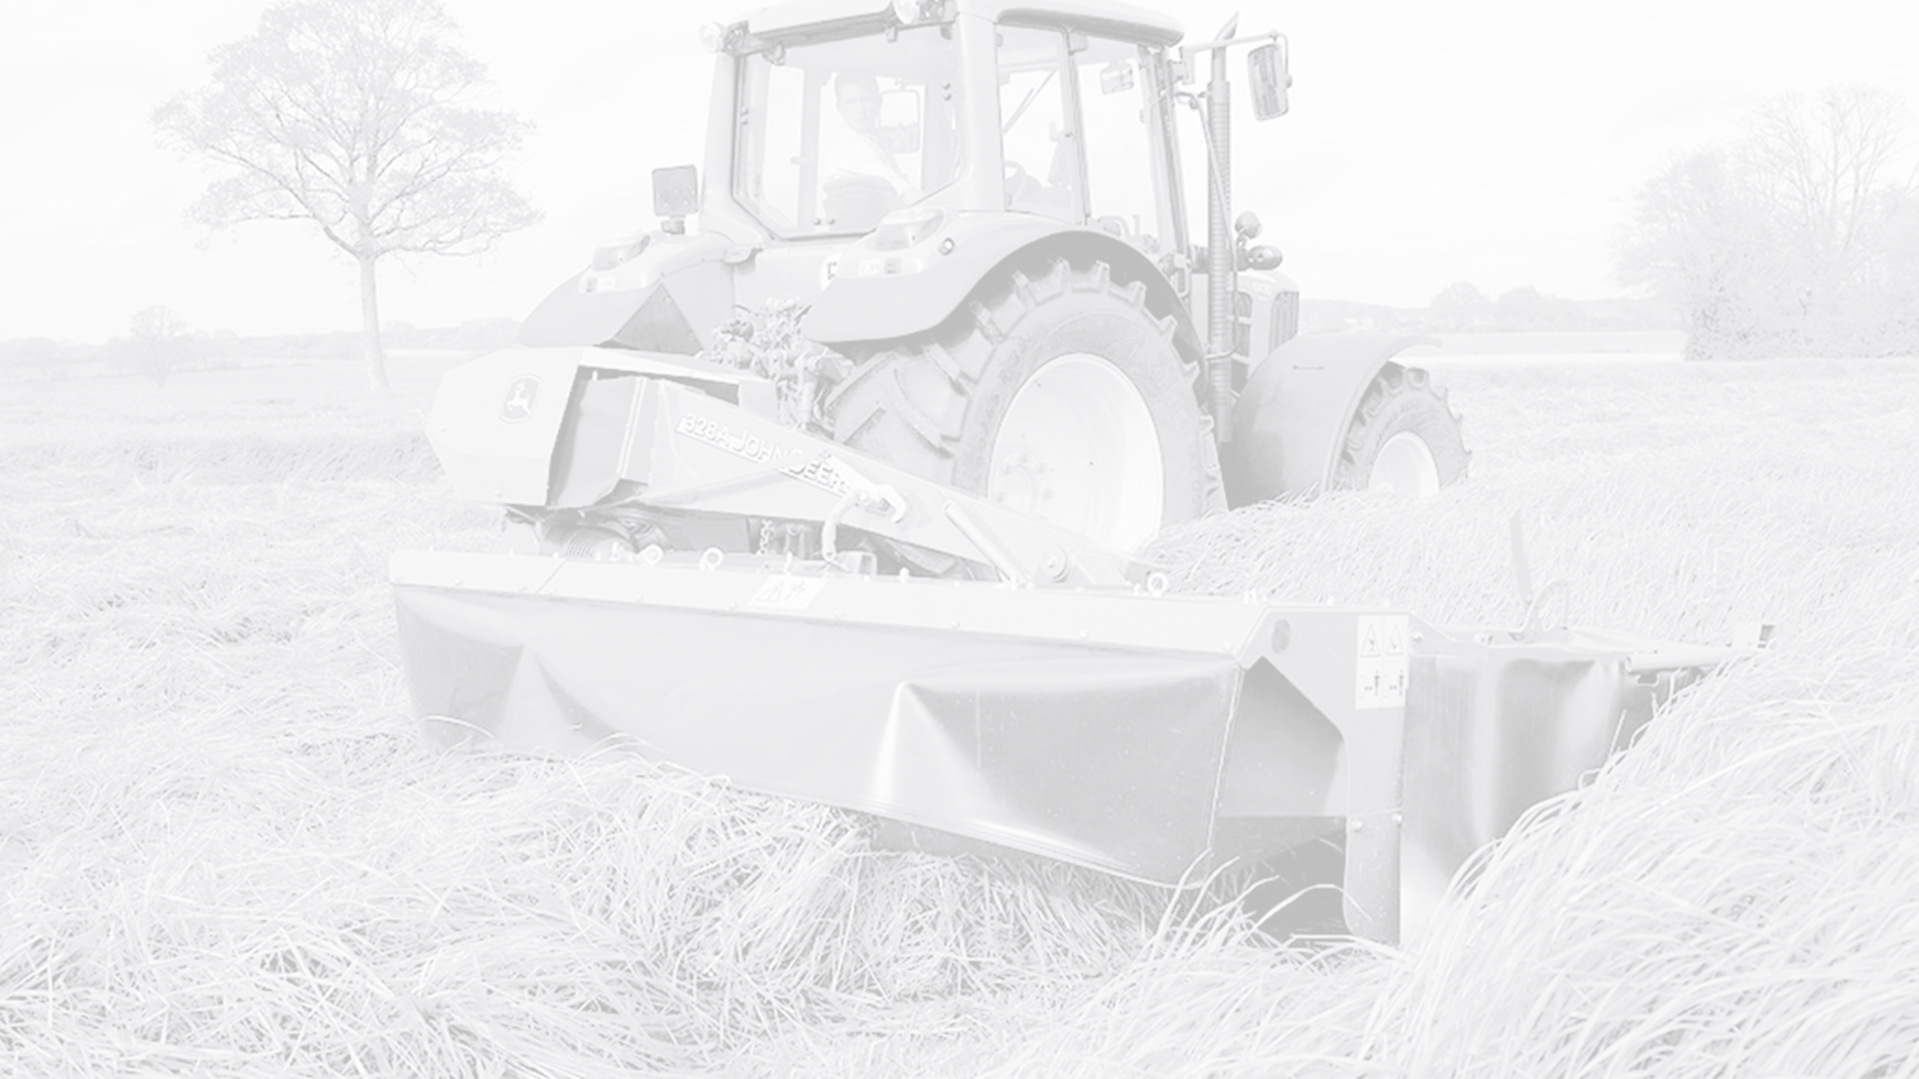
Final Word
There are many hidden dangers to operating agricultural mowers. It’s strongly advised to get to know your machine inside and out and ensure your working area is in the safest condition possible. It may mean a little more time, but not taking that time could result in life-threatening consequences.

