Slide 1
Proper Paragraph
What makes a proper paragraph?

Slide 2
How long is a paragraph?
I often get asked, “how long is a paragraph?” Is it about 4 or 5 lines? “Is it ‘this’ big?”

Slide 3

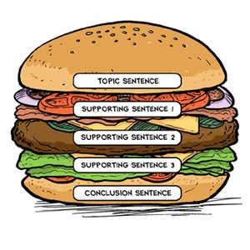
Think of the Hamburger Model

Slide 4
There are 3 types of sentences in a paragraph:
Topic Sentence: the topic sentence states one main idea. Everything in your paragraph must be related to the topic sentence.
Supporting Sentence: a supporting sentence supports the ideas presented in the topic sentence. Supporting sentences include concrete details, facts, examples, opinions etc. Include as many supporting sentences as necessary, but not more than you need.
Transitional/Concluding Sentence: provides a link to the next paragraph or ends the current paragraph by finishing the main thought.

Slide 5
Where is the topic sentence? What is the paragraph about?
It was a gorgeous morning that first day of fifth grade.With the sun happily peeking over the
slight wind, my new dress shone with radiance. My heart was pounding deep inside my chest as I walked into the class. I poked my head nervously through the door and surveyed the chaotic scene that lay before me. Kids were rushing about, kids I’d never seen before.

Slide 6
It was a gorgeous morning that first day of fifth grade. With the sun happily peeking over the
slight wind, my new dress shone with radiance. My heart was pounding deep inside my chest as I walked into the class. I poked my head nervously through the door and surveyed the chaotic scene that lay before me. Kids were rushing about, kids I’d never seen before.

Slide 7
Where are the supporting sentences?
It was a gorgeous morning that first day of fifth grade. With the sun happily peeking over the
slight wind, my new dress shone with radiance. My heart was pounding deep inside my chest as I walked into the class. I poked my head nervously through the door and surveyed the chaotic scene that lay before me. Kids were rushing about, kids I’d never seen before.

Slide 8
Does the last sentence transition or conclude?
It was a gorgeous morning that first day of fifth grade. With the sun happily peeking over the
slight wind, my new dress shone with radiance. My heart was pounding deep inside my chest as I walked into the class. I poked my head nervously through the door and surveyed the chaotic scene that lay before me. Kids were rushing about, kids I’d never seen before.

Slide 9

Now I want you to show me what you know!
I want you to write your own paragraph on a topic of your choice. If you have trouble thinking of one, you can choose from the following:
Things students need to know for school
I would have liked to live during ______ time
My idea of a fun weekend
Something fun I do outside of school
Don’t forget to use ALL 3 types of sentences!

