Slide 1
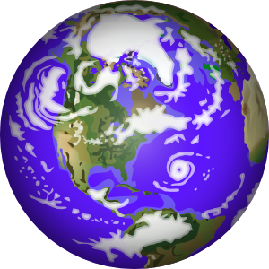

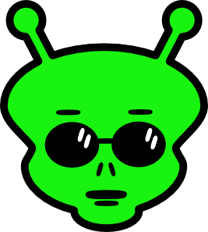
Mr. Greenway
Science Fiction

Slide 2

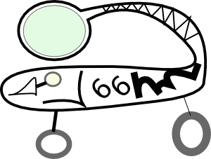
Definition
Science fiction is a genre of fiction in which the stories often tell about the science and technology
of the future.

Slide 3
Characteristics
Has BOTH science and fiction.
…Can have…
Time travel to the past and future
Space travel
Changes to humans or
animals brought about by
scientific changes
Aliens

Slide 4
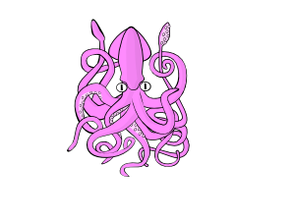
Science Fiction VS. Fantasy
In Science Fiction, there needs to be some possibility that the events could possibly happen.
In Fantasy, the author can use
far-fetched assumptions.
ie; unicorns, three-legged creatures, things that have no scientific explanation, etc.

Slide 5

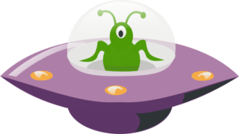

Why should we study Science Fiction?
Makes the audience wonder :
“What If?”
Encourages creativity in writing
Introduces students to a new literary genre
Teaches lessons about the value and dangers of advanced technology
Enhances imagination
Entertaining

Slide 6
The first true science fiction novel was Frankenstein by Mary Shelley.
She used a scientific rationale to persuade the reader that her story took place in the realm of the possible.

Slide 7
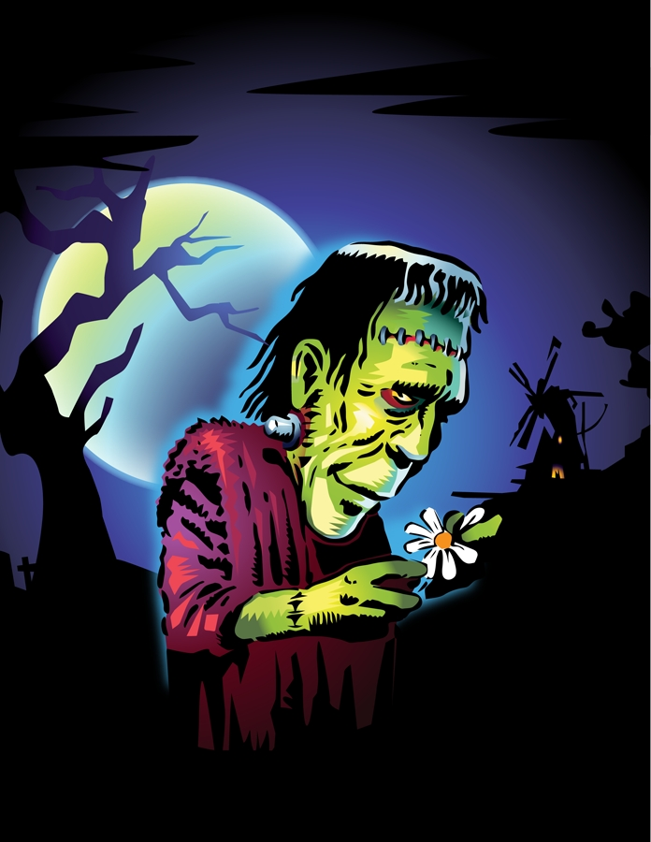
Frankenstein was the first novel written in English to propose the possibility that science can create a monster that may destroy science, and possibly mankind.
Mary Shelley made the main character a scientist, Dr. Frankenstein.

Slide 8
Remember: You must start within the realm of science and technology. Then, use that as a spring board or jumping off point to dive into the realm of fiction.

Slide 9
What is Extrapolation?
Extrapolation is when a writer takes a known scientific fact and imagines
what might happen if
certain events or circumstances evolve.
I.e.: Man can build space shuttles. So…
Man can travel to faraway planets.

Slide 10
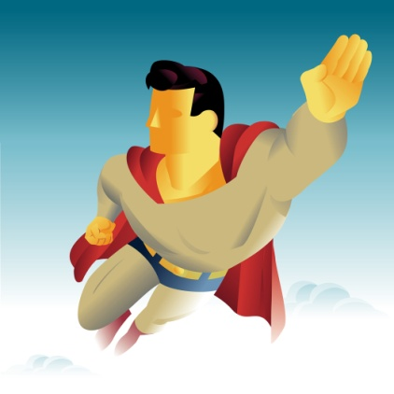

Important!!!!!
Science fiction authors should not contradict known scientific fact (humans flying on their own without the use of devices),
but may do what they wish with commonly-accepted scientific theory (humans flying to distant planets in a shuttle).

Slide 11

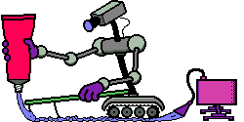
Possible Writing Topics
Examples of Story Ideas:
The Last Man/Woman on Earth
Robots
Time Travel
An Alternate World
A Lost Civilization

Slide 12
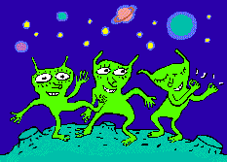
Possible Writing Topics
An Alien Encounter
The Colonization of a New Planet
The End of the World
A Long Spaceship Voyage
From the point of view of an alien

Slide 13
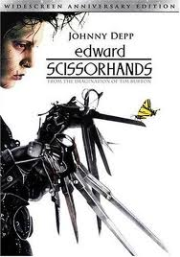
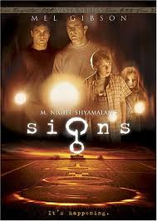
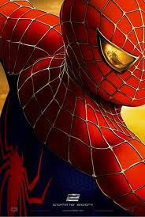
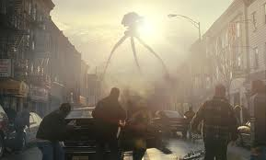
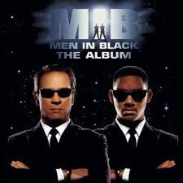
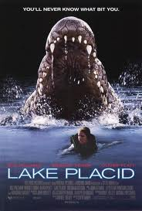
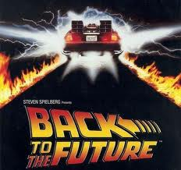
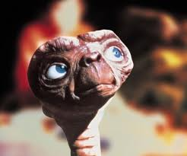
Sci Fi Movies

Slide 14

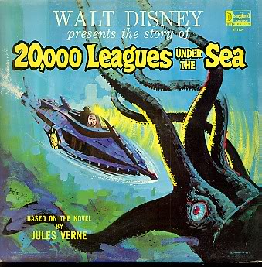
Sci Fi Books
Older kids will relate to sci-fi book about a misfit teen.
A ship sent to investigate a wave of mysterious sinkings encounters the advanced submarine, the Nautilus, commanded by Captain Nemo.

Slide 15
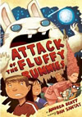
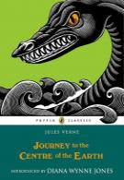
Sci Fi Books
Instead of a summer of campfires and hiking and ghost stories, they find themselves in the middle of an invasion by big, giant bunnies from outer space!
Professor Lindenbrock and his nephew Axel discover an old document that shows the entrance in an extinct volcano to a series of caverns leading to the Earth's center.

Slide 16
Potential Idea For Sci-Fi Story
I woke up on a metal table staring up at a bright light and the face of a creature I assumed must be an alien.

Slide 17
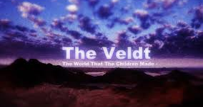
Let’s Read a Sci-Fi Short Story:

