Slide 1
Changes in Ecosystems
Learning Goals
I am learning How invasive species disrupt and ecosystem
I am learning how competition and Sustainability impact and ecosystem.

Slide 2
Think and Share
Examine your food web that you created. Think about if one of the elements were removed how it would impact the entire food web? What is your most critical biotic element?

Slide 3
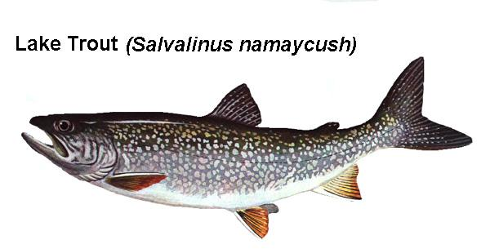
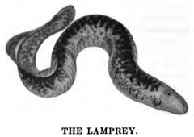
Limiting Factors
Lake Trout
Lamprey

Slide 4
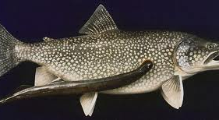
Limiting Factors

Slide 5
Critical Thinking
When or how will the Lamprey population stop growing?
What do you think happened to the fish populations the lake trout used to eat?

Slide 6
Factors that affect population size in an Ecosytem
The amount of:
Oxygen
Water
Food
Energy
Suitable habitat

Slide 7
Bioinvasion
An introduced species that brought to an environment where it did not live before Many of these species are stronger than the native species or have no natural enemies.
Invasive Species
https://www.youtube.com/watch?v=rPeg1tbBt0A
https://www.youtube.com/watch?v=abImqGDzXBo

Slide 8
Sustainability
An ecosystem is described as being sustainable when it can maintain a balance of needs and resources over time.
Industry has changed the quality of abiotic elements such as air and water. Development has destroyed habitat and the qualities of waste have overwhelmed the process of cycling organic matter
https://www.youtube.com/watch?v=B5NiTN0chj0

Slide 9
Exit Card
Complete questions on Page 54
Key Concept Review
#1-4

