Slide 1
Parts of the Plant and Animal Cells
Learning Goals
I am learning the name and function of the organelles of a plant cell and animal cell.
I am able to communicate creatively the function of each cell organelle
I am able to communicate why it is important to understand cell theory.
https://www.youtube.com/watch?v=Rxq0Kqw327s

Slide 2
Review of Cell Organelles
Endoplasmic Reticulum
Golgi Apparatus
Mitochondria
Vacuole
Cytoplasm
Cloroplasts
Nucleus
Cell Wall
Cell Membrane
Ribosomes
https://www.youtube.com/watch?v=-zafJKbMPA8

Slide 3
Organelle Assignment- Due Next Wednesday
You will be required to create a poster of both the plant cell and the animal cell with all of the organelles neatly drown and labelled.
You will need to use your organelle dictionary to write a brief description of each organelle.

Slide 4
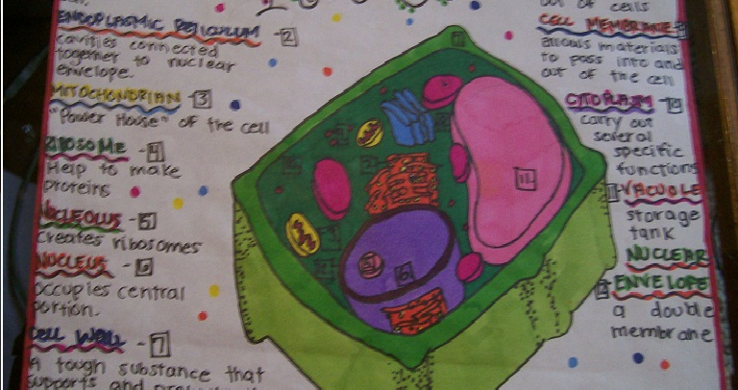
Example of the Plant cell poster

Slide 5
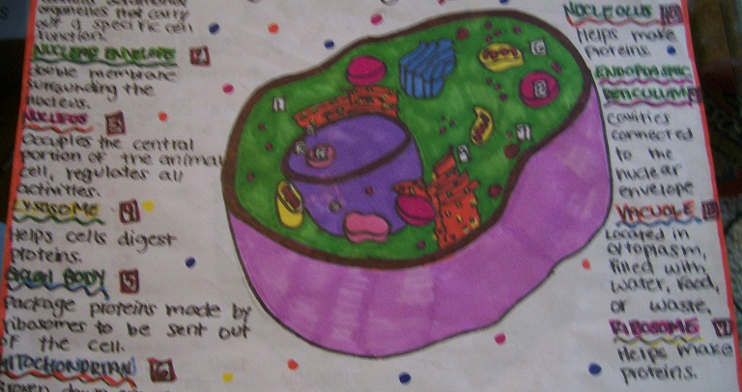
Example of the Animal Cell Poster

Slide 6
Reading for Next Week
Pages 24-27- The Flow of Materials into and out of cells
Be sure to have your cell posters completed as well as the reading for next Science Class.

