Slide 1
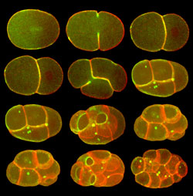
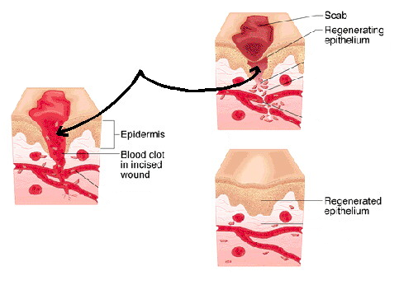
Cell Division—Mitosis Notes
Cell Division — process by which a cell divides into 2 new cells
Why do cells need to divide?
Living things grow by producing more cells, NOT because each cell increases in size
Repair of damaged tissue
If cell gets too big, it cannot get enough nutrients into the cell and wastes out of the cell

Slide 2
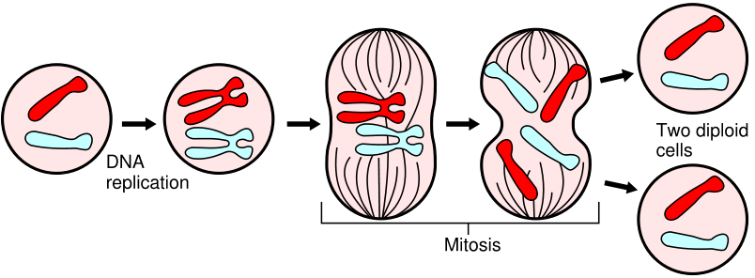
The original cell is called the parent cell; 2 new cells are called daughter cells
Before cell division occurs , the cell replicates (copies) all of its DNA, so each daughter cell gets complete set of genetic information from parent cell
Each daughter cell is exactly like the parent cell – same kind and number of chromosomes as the original cell
2 Daughter Cells
Parent Cell

Slide 3
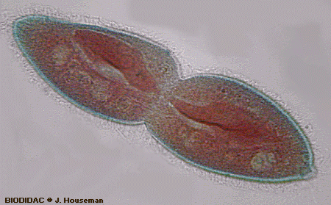
Many organisms, especially unicellular organisms, reproduce by means of cell division – called asexual reproduction – Ex: bacteria

Slide 4
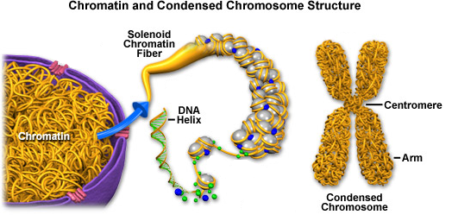
DNA
DNA is located in the nucleus and controls all cell activities including cell division
Long and thread-like DNA in a non-dividing cell is called chromatin
Doubled, coiled, short DNA in a dividing cell is called chromosome
Consists of 2 parts: chromatid and centromere

Slide 5
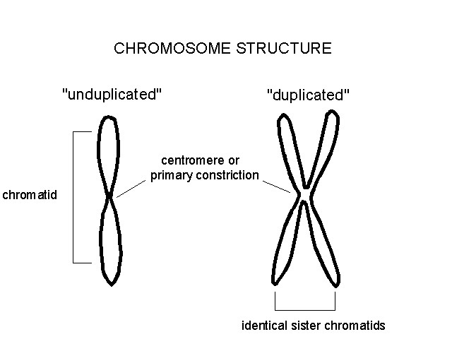
2 identical “sister” chromatids attached at an area in the middle called a centromere
When cells divide, “sister” chromatids separate and 1 goes to each new cell

Slide 6
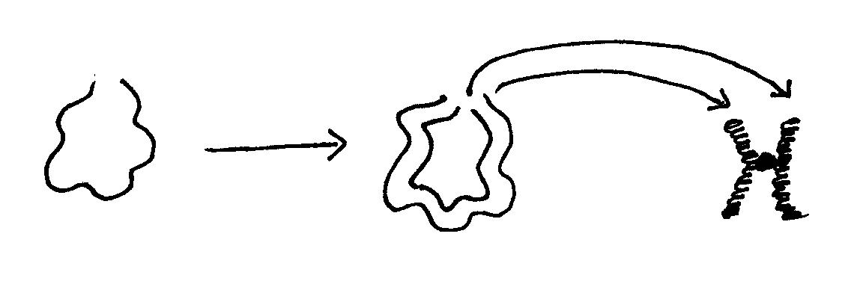
Chromatin to chromosomes illustration:
Chromatin
Coils up into chromosomes
Duplicates itself
Why does DNA need to change from chromatin to chromosome?
More efficient division

Slide 7
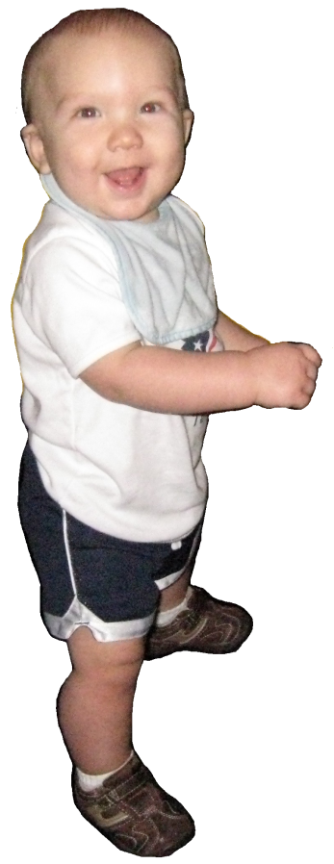
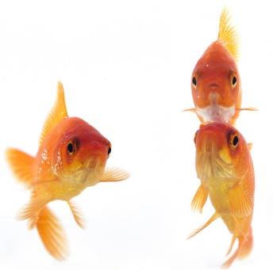
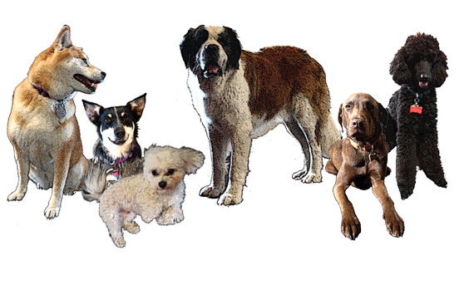
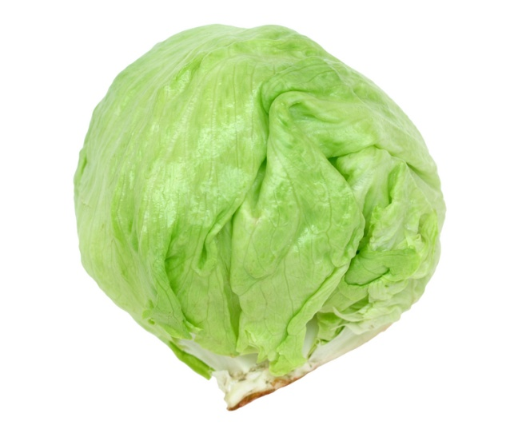
Chromosome number
Every organism has its own specific number of chromosomes
Examples: Human = 46 chromosomes or 23 pairs
Dog = 78 chromosomes or 39 pairs
Goldfish = 94 chromosomes or 47 pairs
Lettuce = 18 chromosomes or 9 pairs

Slide 8
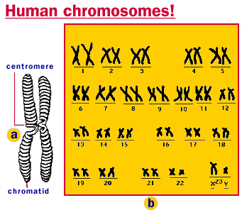
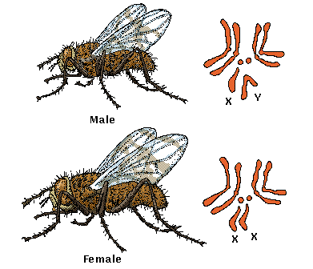
All somatic (body) cells in an organism have the same kind and number of chromosomes
Examples: Human = 46 chromosomes
Human skin cell = 46 chromosomes
Human heart cell = 46 chromosomes
Human muscle cell = 46 chromosomes
Fruit fly = 8 chromosomes
Fruit fly skin cell = 8 chromosomes
Fruit fly heart cell = 8 chromosomes
Fruit fly muscle cell = 8 chromosomes

Slide 9
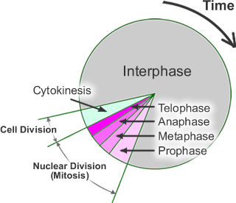
Cell Cycle -- series of events cells go through as they grow and divide
Cell grows, prepares for division, then divides to form 2 daughter cells – each of which then begins the cycle again

Slide 10
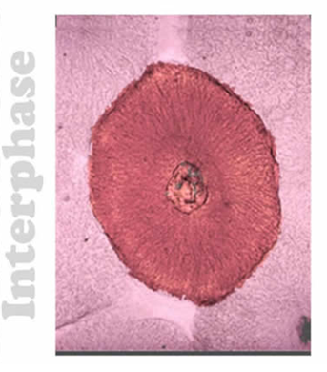
Interphase—period of cell growth and development
DNA replication (copying) occurs during Interphase
During Interphase the cell also grows, carries out normal cell activities, replicates all other organelles
The cell spends most of its life cycle in Interphase

Slide 11
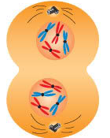
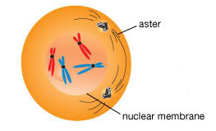
Mitosis – division of the nucleus into 2 nuclei, each with the same number of chromosomes
Mitosis occurs in all the somatic (body) cells
Why does mitosis occur?
So each new daughter cell has nucleus with a complete set of chromosomes

Slide 12
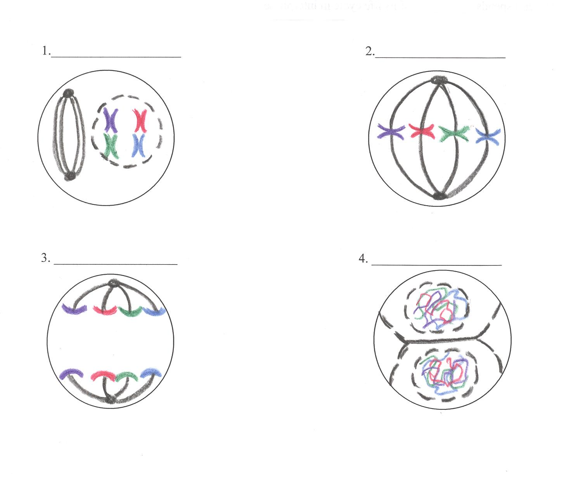
4 phases of nuclear division (mitosis), directed by the cell’s DNA (PMAT)
Prophase
Metaphase—(Middle)
Anaphase—(Apart)
Anaphase—(Apart)
Telophase—(Two)

Slide 13
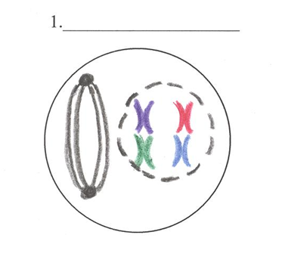
Prophase
Chromosomes coil up
Nuclear envelope disappears
Spindle fibers form

Slide 14
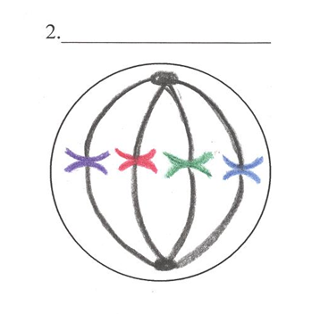
Metaphase—(Middle)
Chromosomes line up in middle of cell
Spindle fibers connect to chromosomes

Slide 15
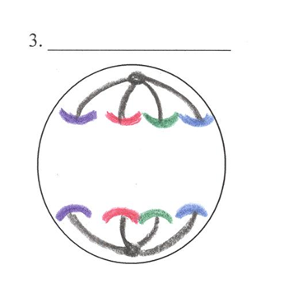
Anaphase—(Apart)
Chromosome copies divide
Spindle fibers pull chromosomes to opposite poles

Slide 16
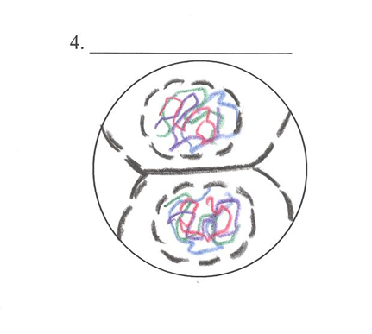
Telophase—(Two)
Chromosomes uncoil
Nuclear envelopes form
2 new nuclei are formed
Spindle fibers disappear

Slide 17
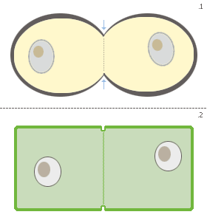
Cytokinesis — the division of the rest of the cell (cytoplasm and organelles) after the nucleus divides
In animal cells the cytoplasm
pinches in
In plant cells a cell plate forms
After mitosis and cytokinesis, the cell returns to Interphase to continue to grow and perform regular cell activities

Slide 18
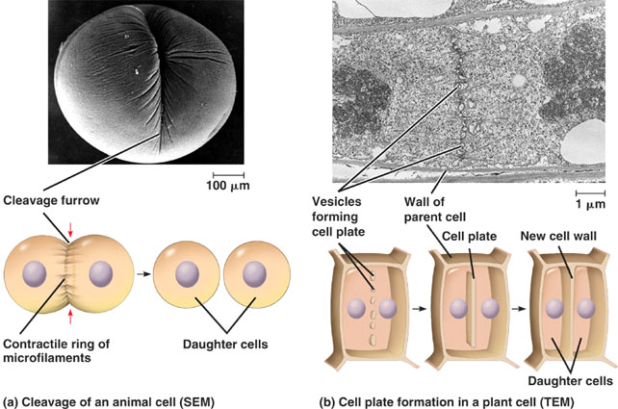

Slide 19
Summary: Cell Cycle
Interphase Mitosis (PMAT) Cytokinesis
When cells become old or damaged, they die and are replaced with new cells

Slide 20
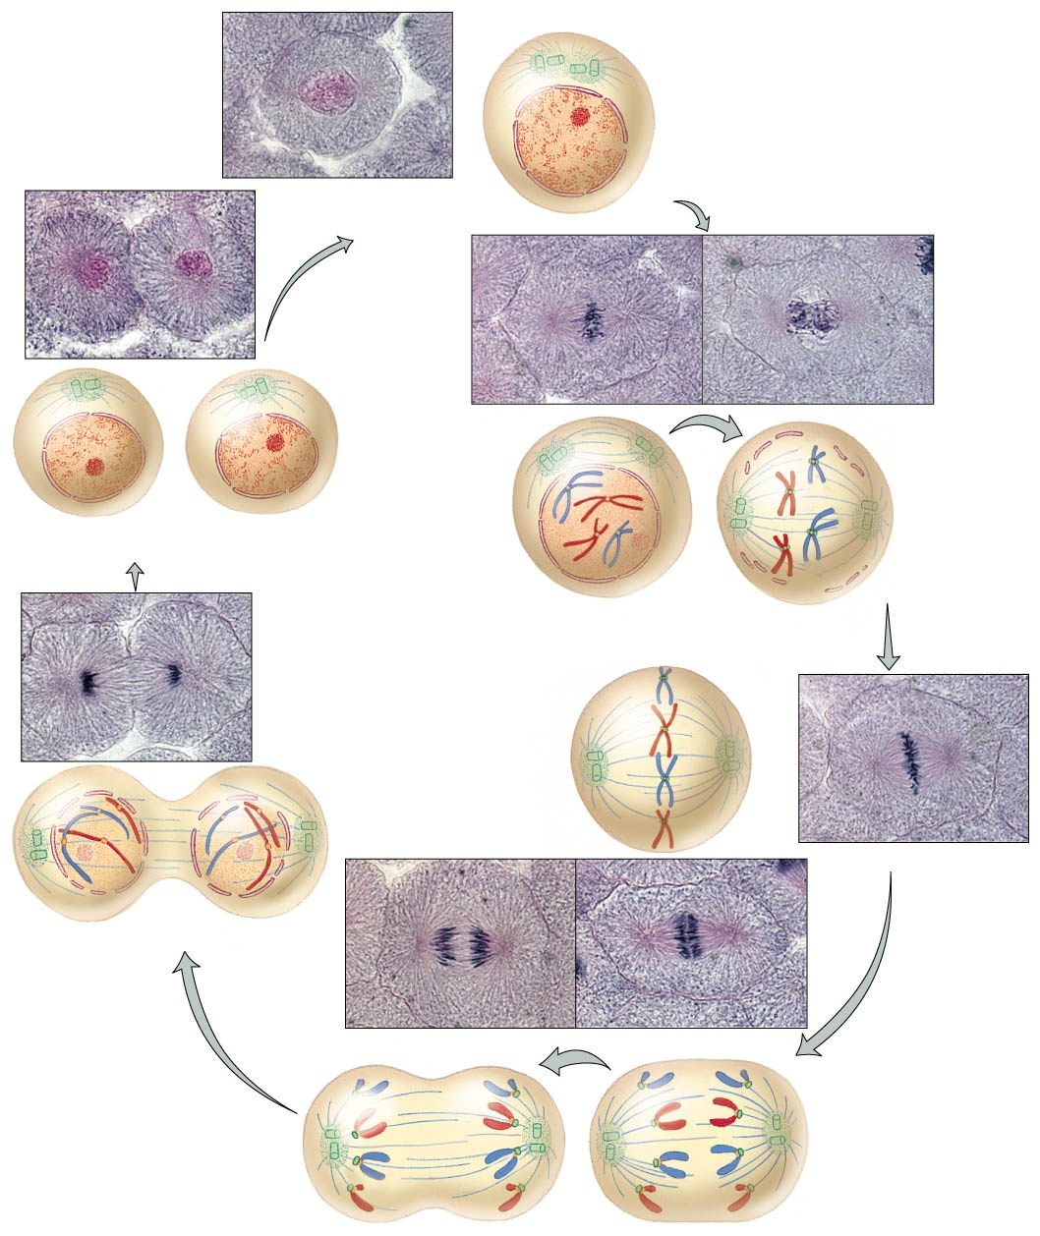

Slide 21
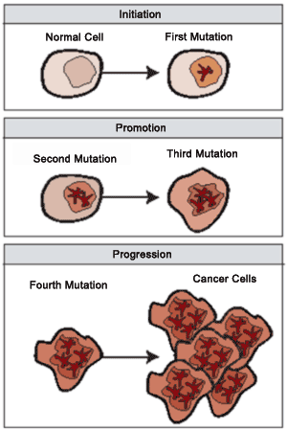
Cell Division Control
DNA controls all cell activities including cell division
Some cells lose their ability to control their rate of cell division – the DNA of these cells has become damaged or changed (mutated)
These super-dividing cells form masses called tumors

Slide 22
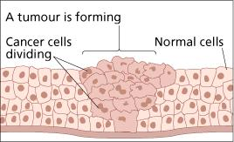
Benign tumors are not cancerous – these cells do not spread to other parts of the body
Malignant tumors are cancerous – these cells break loose and can invade and destroy healthy tissue in other parts of the body (called metastasis)

Slide 23
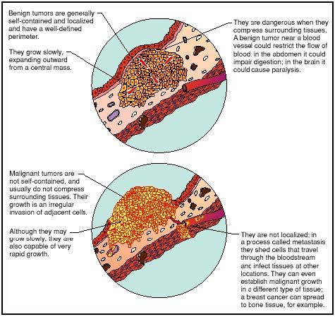

Slide 24
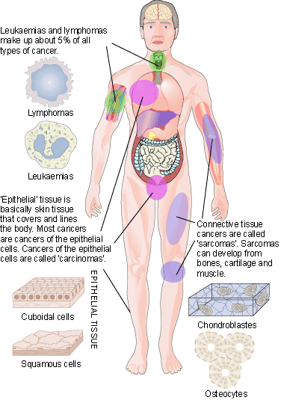
Cancer is not just one disease, but many diseases – over 100 different types of cancers

Slide 25
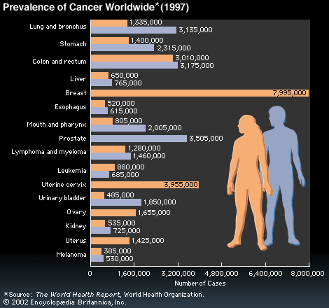

Slide 26
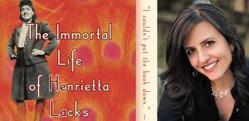
http://www.youtube.com/watch?v=wRrNjHYxP_o
http://www.bbc.co.uk/blogs/adamcurtis/2010/06/the_undead_henrietta_lacks_and.html

Slide 27
Phase | Chromosome Appearance & Location | Important Events
Interphase
Prophase
Metaphase
Anaphase
Telophase
Cytokinesis
DNA replication, cell grows and replicates organelles
DNA copies itself; chromatin
Nuclear envelope disappears, spindle fibers form
Chromosomes coil up
Chromosomes line up in the middle
Spindle fibers connect to chromosomes
Chromosome copies divide and move apart
Spindle fibers pull chromosome copies apart to opposite poles
Nuclear envelopes reform, 2 new nuclei are formed, spindle fibers disappear
Chromosomes uncoil back into chromatin
Division of the rest of the cell: cytoplasm and organelles
Chromatin

