Slide 1
The Impact of Research in Cell Biology
Learning Goals:
I am learning how advancement in cell biology will have an impact on human health.

Slide 2
Microscope technologies
Research projects in cell biology
Stop the development of cancers
Regenerate nerve cells to repair spinal cord injuries.
Develop vaccines to prevent disease
Discover biological tools to clean up pollution
Prepare to stop the spread of infectious diseases not yet know.
Increase world food production

Slide 3
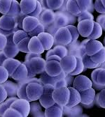
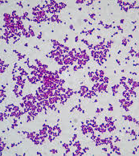
Staphyloccus aureus A common bacteria that lives in many places, including on human skin and in nostrils.

Slide 4
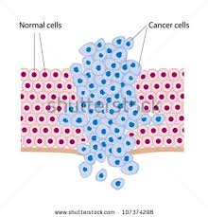
Working to stop cancers
Cancer- is a disease related to the uncontrolled and rapid reproduction of cells through cell division.
Tumour- a mass of cells that are continually reproducing and are non functional

Slide 5
Preparing for New Infectious Diseases
Recent solved mysteries
West Nile disease
Lyme disease
3. SARS
Scientist around the world struggled to discover how these diseases were transmitted from one human to another. Until they understood that, it was difficult to control.
https://www.youtube.com/watch?v=TT3ARhpUum4

Slide 6
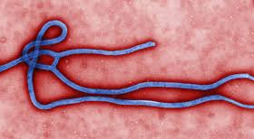
Ebola
https://www.youtube.com/watch?v=TGyFhwdtCMk

Slide 7
Assessment
Complete pages 46-49

