Slide 1


ZOHO ANALYTICS: BUILDING BLOCKS
QUERY TABLES
WELCOME!

Slide 2


TODAY’S AGENDA
  Zoho Foundations (pre-requisite)
  Hands-On Report Building
  Build Chart from Query
  Q&A
This webinar is being recorded and will be posted in our Help Center, and we will share a link in an email to all who registered.

Slide 3
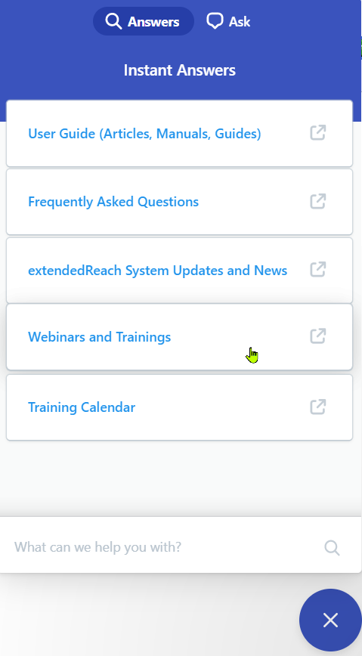
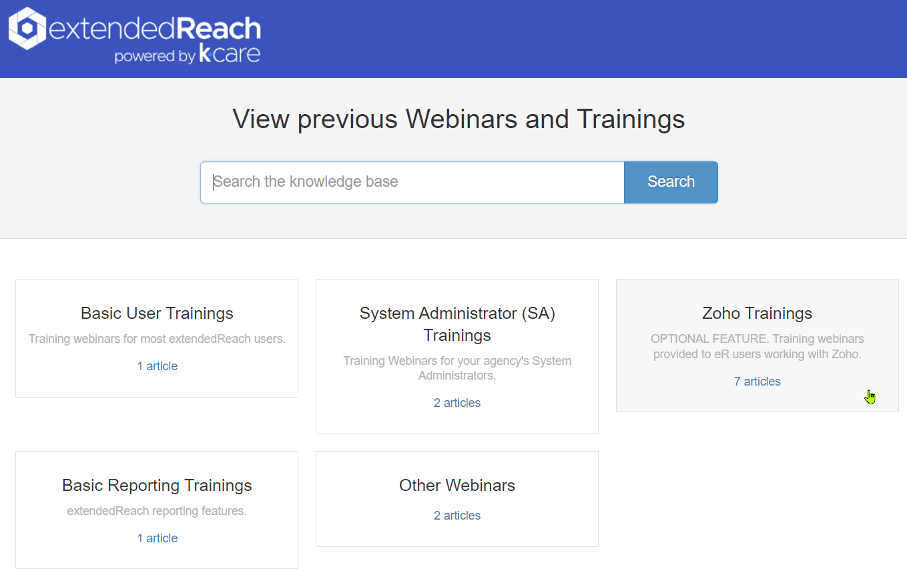


ZOHO FOUNDATIONS

Slide 4
WHAT IS ZOHO ANALYTICS?
Zoho is a 3rd party custom report and dashboard builder included in our Plus and Enterprise packages*
*Other package levels may add on
Allows you to quickly build charts, tables, and dashboards using an intuitive drag-and-drop interface.
Uses data from extendedReach and updates the data automatically each night - so your reports are always up to date.

Slide 5
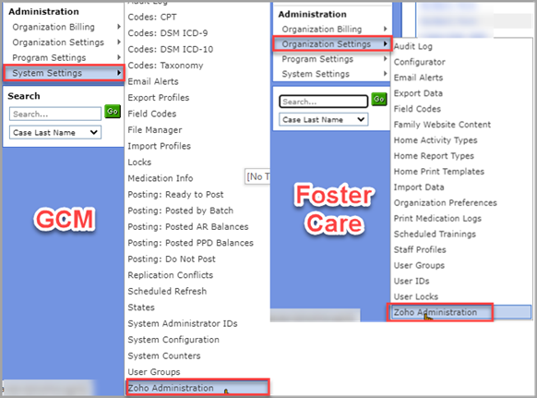
HOW DO I ACCESS ZOHO ANALYTICS?

Slide 6
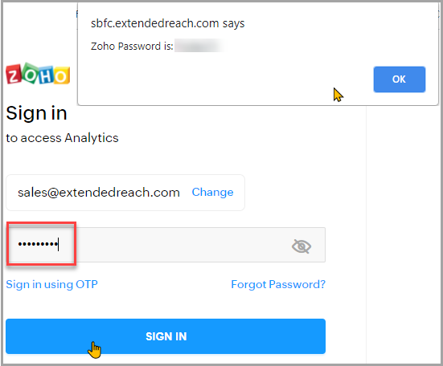
HOW DO I ACCESS ZOHO ANALYTICS?

Slide 7
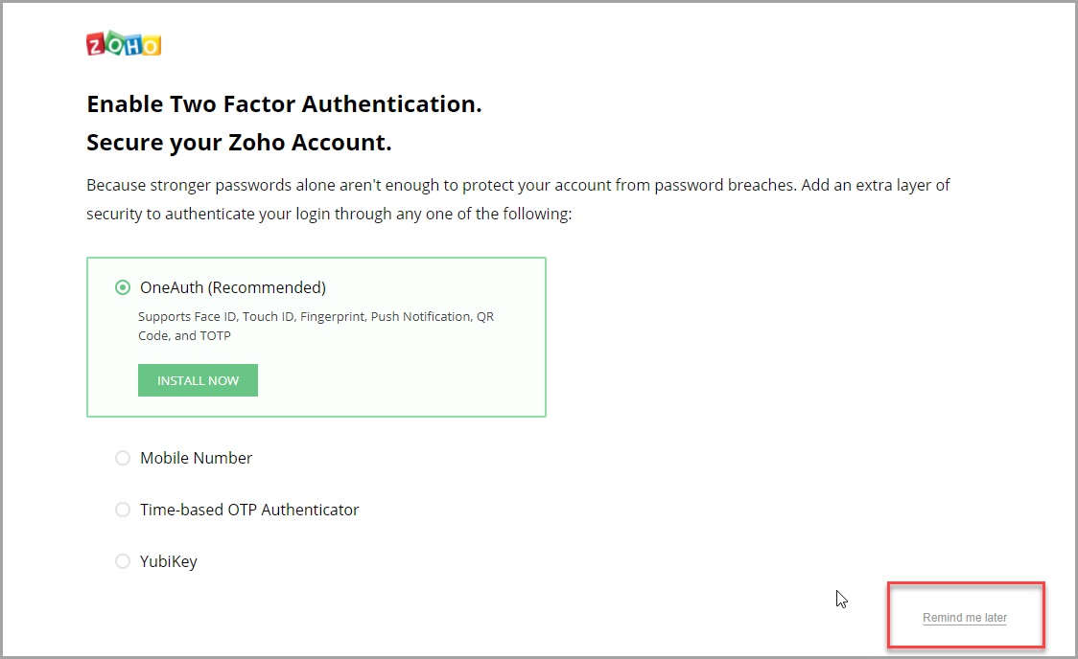

MULTI-FACTOR AUTHENTICATION
Click Remind me later in the bottom right corner to continue logging in.
Notes:
Zoho sometimes prompts users to enable two factor or multi-factor authentication.
Please keep in mind that if multi-factor authentication is set up, the person whose phone number is provided will always have to relay the one-time password to all others who try logging into your agency's Zoho Analytics workspace. If the staff person who sets up MFA leaves the agency, we do not have a way to unlock your Zoho account.

Slide 8
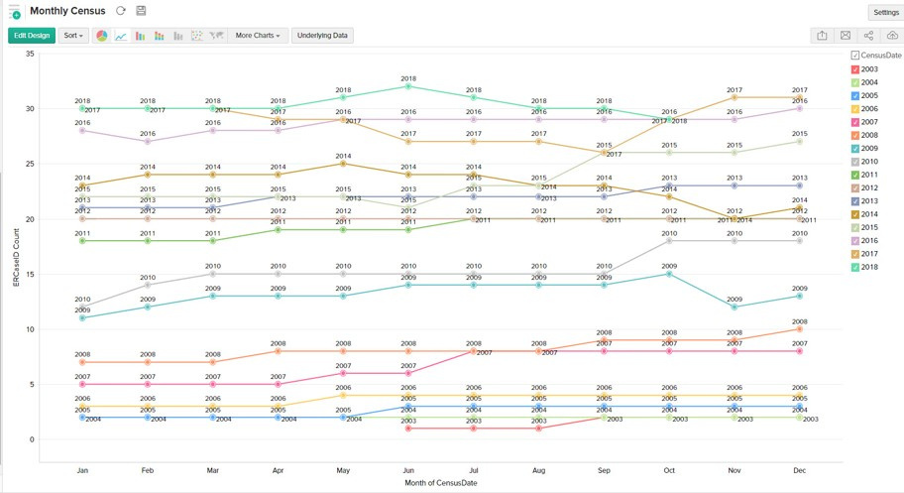
TYPES OF REPORTS
Charts
Bar charts, pie charts, line charts, funnels – there are 12 chart types to choose from as well as variations of these charts. Charts are the best way to visually display your extendedReach data.
Notes:
There are a variety of charts available, and Zoho helps you choose the right one based on the data you bring in. It’s easy to switch between them and customize things like labels, colors, headers, and legends.

Slide 9
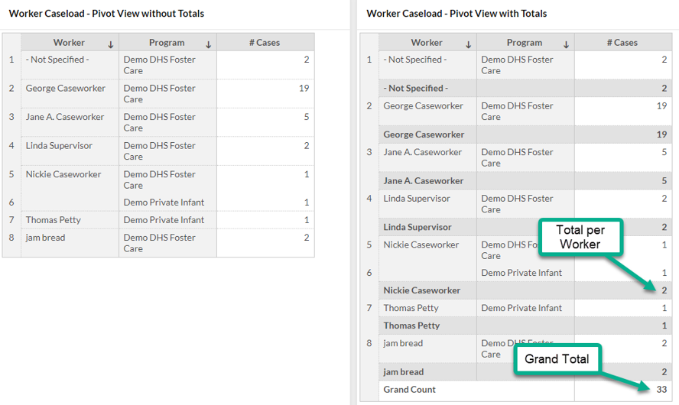
TYPES OF REPORTS
Pivot Table
Organize your extendedReach data utilizing combinations of columns, rows, and data. Similar to a table in Excel, pivot tables are ideal for viewing data from various tables side by side.
Notes:
Pivot views are the reports most commonly used by our customers. They allow you to view data in a grid with totals and subtotals.

Slide 10
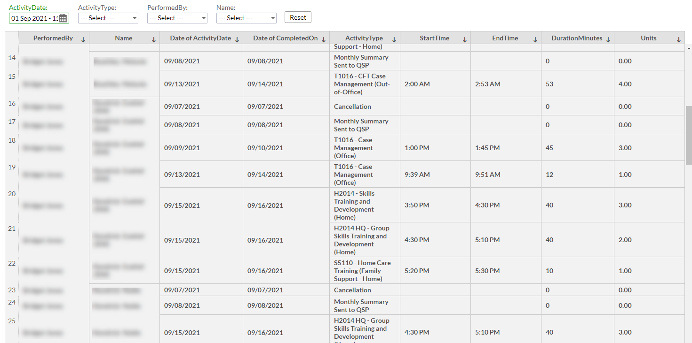
TYPES OF REPORTS
Summary View
A simplistic version of the Pivot Table, the Summary View allows you to quickly group and summarize sets of data.
Notes:
Aside from Charts, there are a few other views that you can choose from. Summary views are great if you need to aggregate or group data.

Slide 11
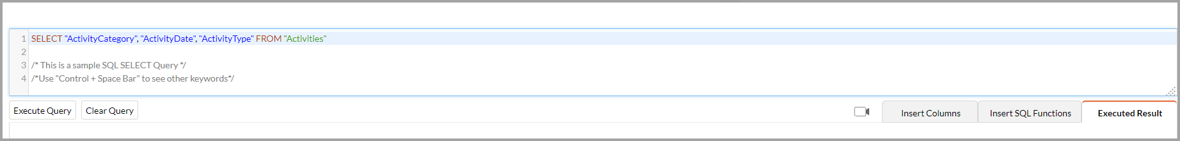
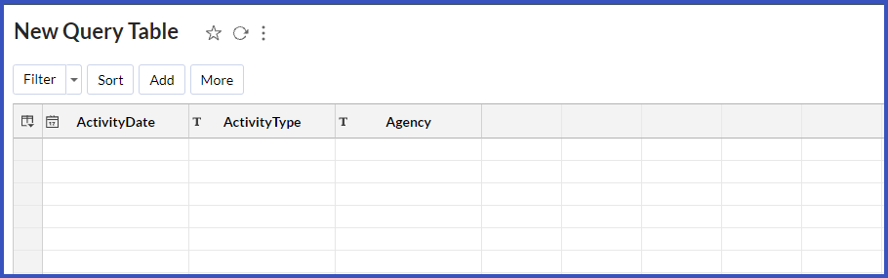
QUERY TABLE
The more advanced version of Pivot Tables, utilize SQL skills to create customized data tables.

Slide 12


Slide 13
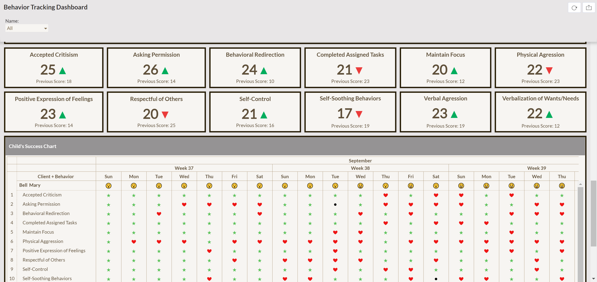
TYPES OF REPORTS
Dashboards
View all your charts and tables in a customized dashboard, where you can add images, text, widgets, and much more!
Notes:
You can think of Dashboards as a collection of related reports. You have the ability to set up filters that apply to every report on the page, so they’re really useful if you want to report quarterly or annually to your board, for example.

Slide 14

LET’S DIVE IN!
Notes:
Before I start building the report(s) with you, I’d like to give you a tour around Zoho so you can understand what we’re doing and why.
Show the link between eR and Zoho, where does it live, what is the information coming from?
Zoho Layout (first page and the side view)
TABLES
Build the report
Emailing and Sharing
Add to the eR Custom Tab (make sure to click “Access without Login” and show options, also “Show Toolbar”)
This is troubleshoot-able!! You can check if it looks right and adjust! ☺

Slide 15
SELECT
Name,
eRReportID,
eRCaseID,
ReportType,
ReportDate,
CustomField1,
CASE
WHEN CustomField1 LIKE '%Got up on time%' THEN 1
ELSE 0
END AS Awake,
CASE
WHEN CustomField1 LIKE '%Brushed hair%' THEN 1
ELSE 0
END AS Hair,
CASE
WHEN CustomField1 LIKE '%Brushed teeth%' THEN 1
ELSE 0
END AS Teeth,
CASE
WHEN CustomField1 LIKE '%Ate breakfast%' THEN 1
ELSE 0
END AS Breakfast,
CASE
WHEN CustomField1 LIKE '%Rode the bus%' THEN 1
ELSE 0
END AS Bus
FROM "Reports"
WHERE ReportType = 'Daily Log'
QRY BUILT:
Copy and paste this into your query table to modify for your agency's needs!
Notes:
Before I start building the report(s) with you, I’d like to give you a tour around Zoho so you can understand what we’re doing and why.
Show the link between eR and Zoho, where does it live, what is the information coming from?
Zoho Layout (first page and the side view)
TABLES
Build the report
Emailing and Sharing
Add to the eR Custom Tab (make sure to click “Access without Login” and show options, also “Show Toolbar”)
This is troubleshoot-able!! You can check if it looks right and adjust! ☺

Slide 16

Frequently Asked Questions

Slide 17

Please submit a ticket to support@extendedreach.com
What if I need to change my
custom field numbers?

Slide 18
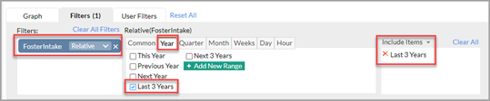
Filter: always in use & cannot be edited by the end user
User Filter: manual filter that can be used by the end user. They can change as their needs for the data change
Example: date filter
What’s the difference between a
filter &
user filter?

Slide 19
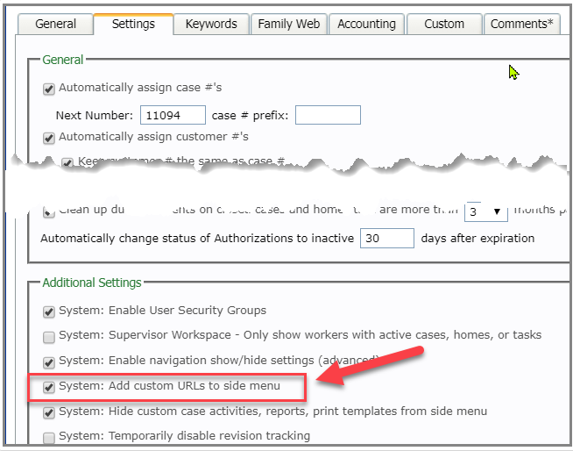
What if I don’t have a
custom side menu?

Slide 20
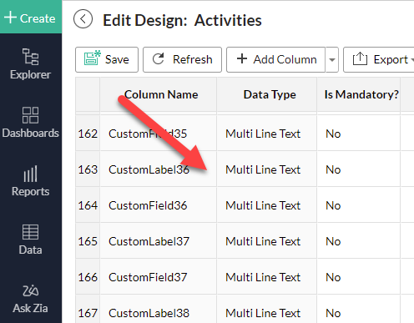
You may need to change from plain text (100 characters) to multi line text
Why can’t I see all the text in a
custom field column?

Slide 21
Data for year, fiscal year, quarter, month, and active cases on the first day of the month.
There is no daily census.
It also pulls home and case information.
What does the CENSUS
capture?

Slide 22
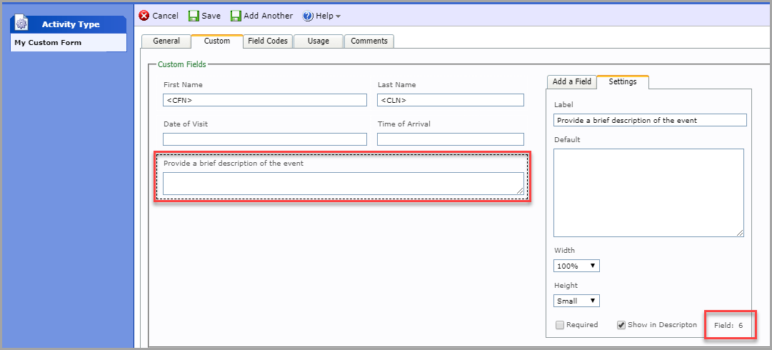
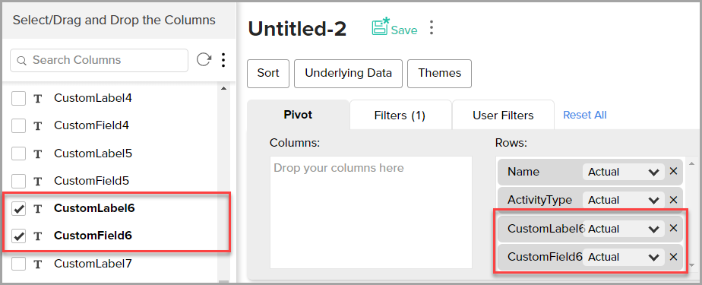
What’s the difference between a
custom field & custom label?

Slide 23
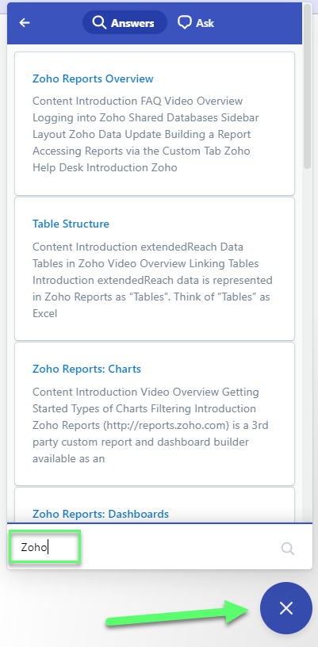
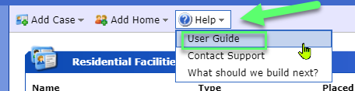
ACCESSING SUPPORT
Review eR’s Help Center for Zoho support articles, videos, previous trainings
If you still need assistance, email support@extendedreach.com

Slide 24
eR ZOHO HELP RESOURCES
eR Can
Troubleshoot issues
eR Cannot
Cannot design, create, and build new reports or dashboards for you.
If needed, eR has a company that we can recommend to you that would be able to provide these services.
Provide general guidance on your Zoho questions
Review a report or dashboard you created to answer specific questions.

Slide 25
SUPPORT REQUEST CONTENTS
What are you trying to accomplish?
What are you having issues with?
As much information as possible
Name of the report
Screenshot
URL to the report

Slide 26
THANK YOU FOR YOUR TIME!
Q & A

