Slide 1

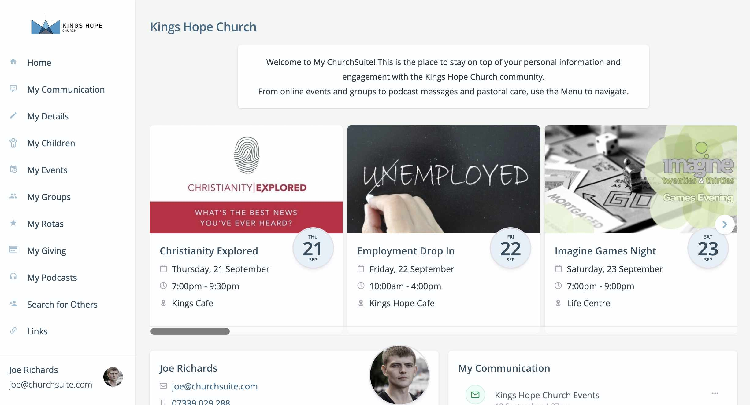
My ChurchSuite
Launch

Slide 2

Lots of reasons, but vision is key!
To reduce unnecessary office admin
To help move people on in discipleship
To ensure up-to-date and better data
To improve communication
To facilitate relationships and community
Why My ChurchSuite?

Slide 3

To help newcomers connect more quickly
To work more collaboratively e.g. rotas
To strengthen pastoral care
To identify one another more easily
To ensure children and youth leaders are working with the latest child info
Why My ChurchSuite?

Slide 4
To more easily comply with the GDPR
To enable personal control of privacy settings
To have systems and processes that scale and grow as we grow
To be wise stewards using a tool that saves time and money
Why My ChurchSuite?

Slide 5
S
My ChurchSuite
is our member-facing system
What is
My ChurchSuite?

Slide 6
Keep up-to-date with everything that’s going on in one place

Slide 7
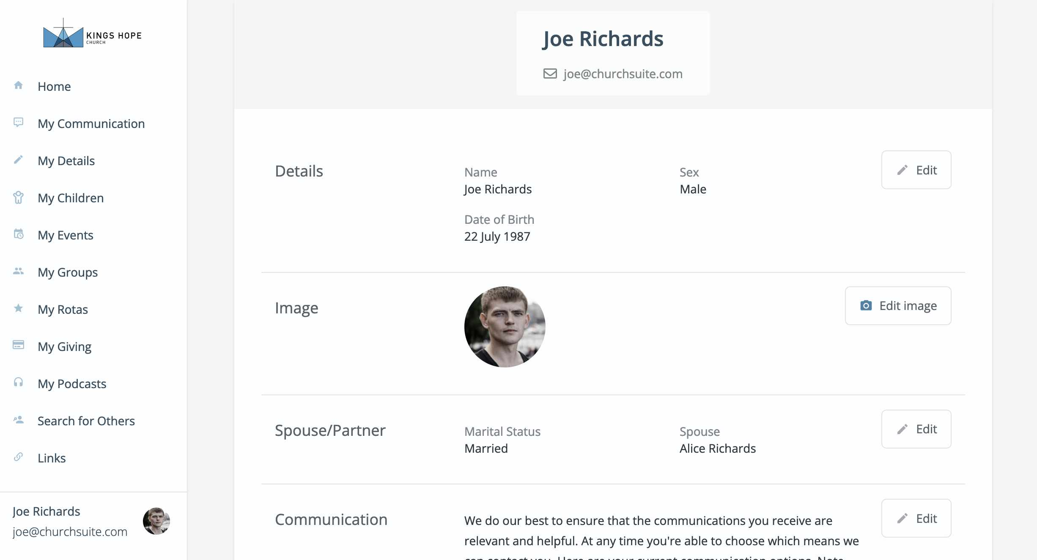
Manage your own
personal information

Slide 8
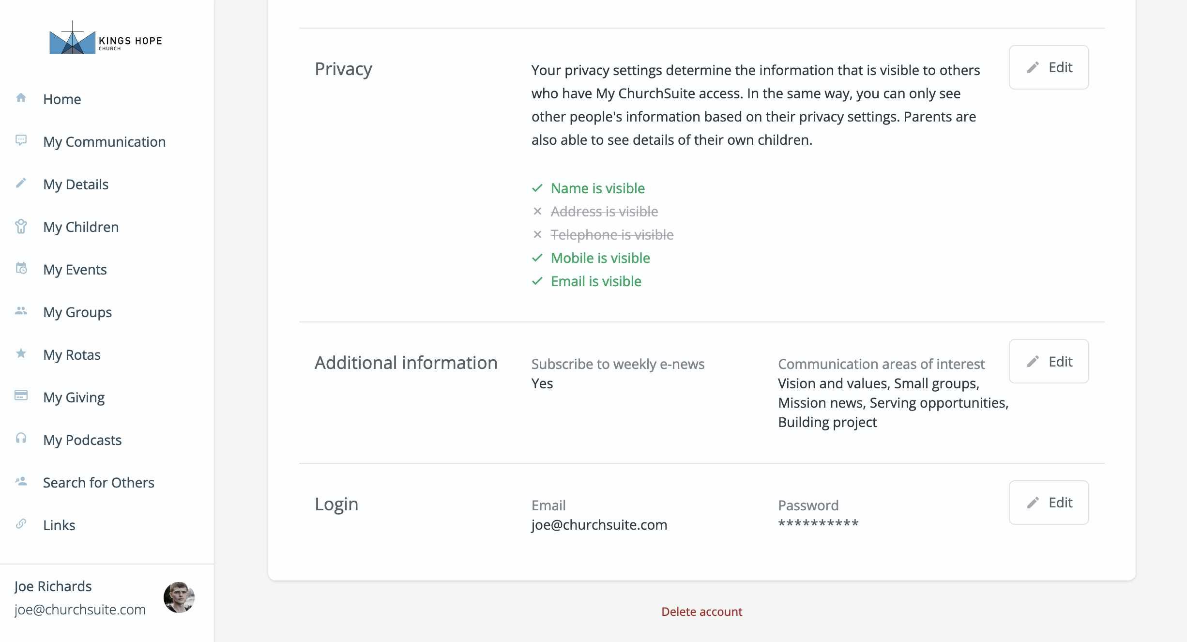
Manage your
privacy settings

Slide 9
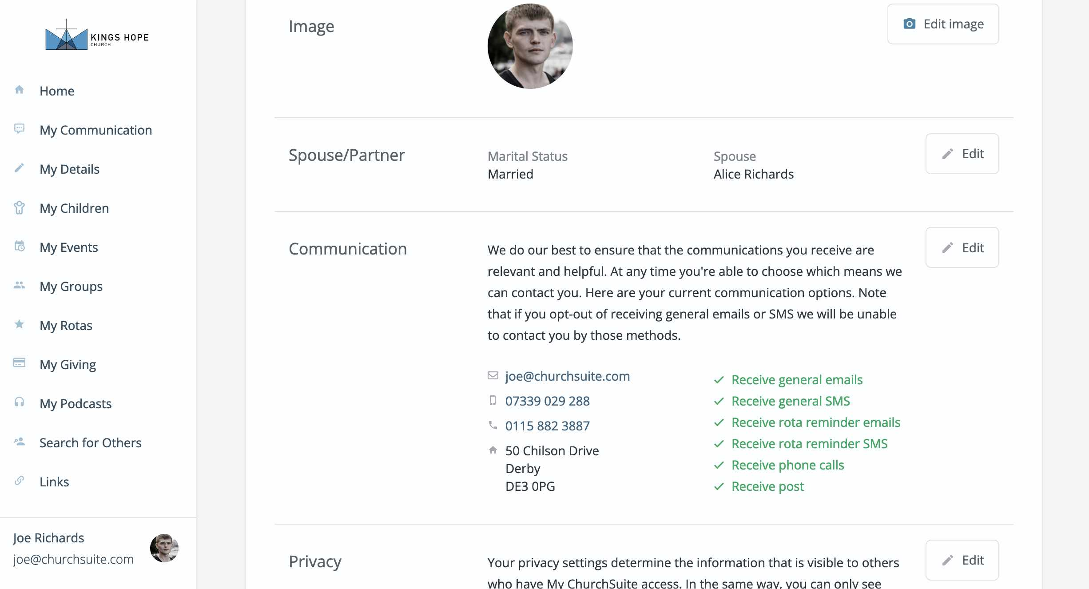
Stay in control of how you wish to receive church communications

Slide 10
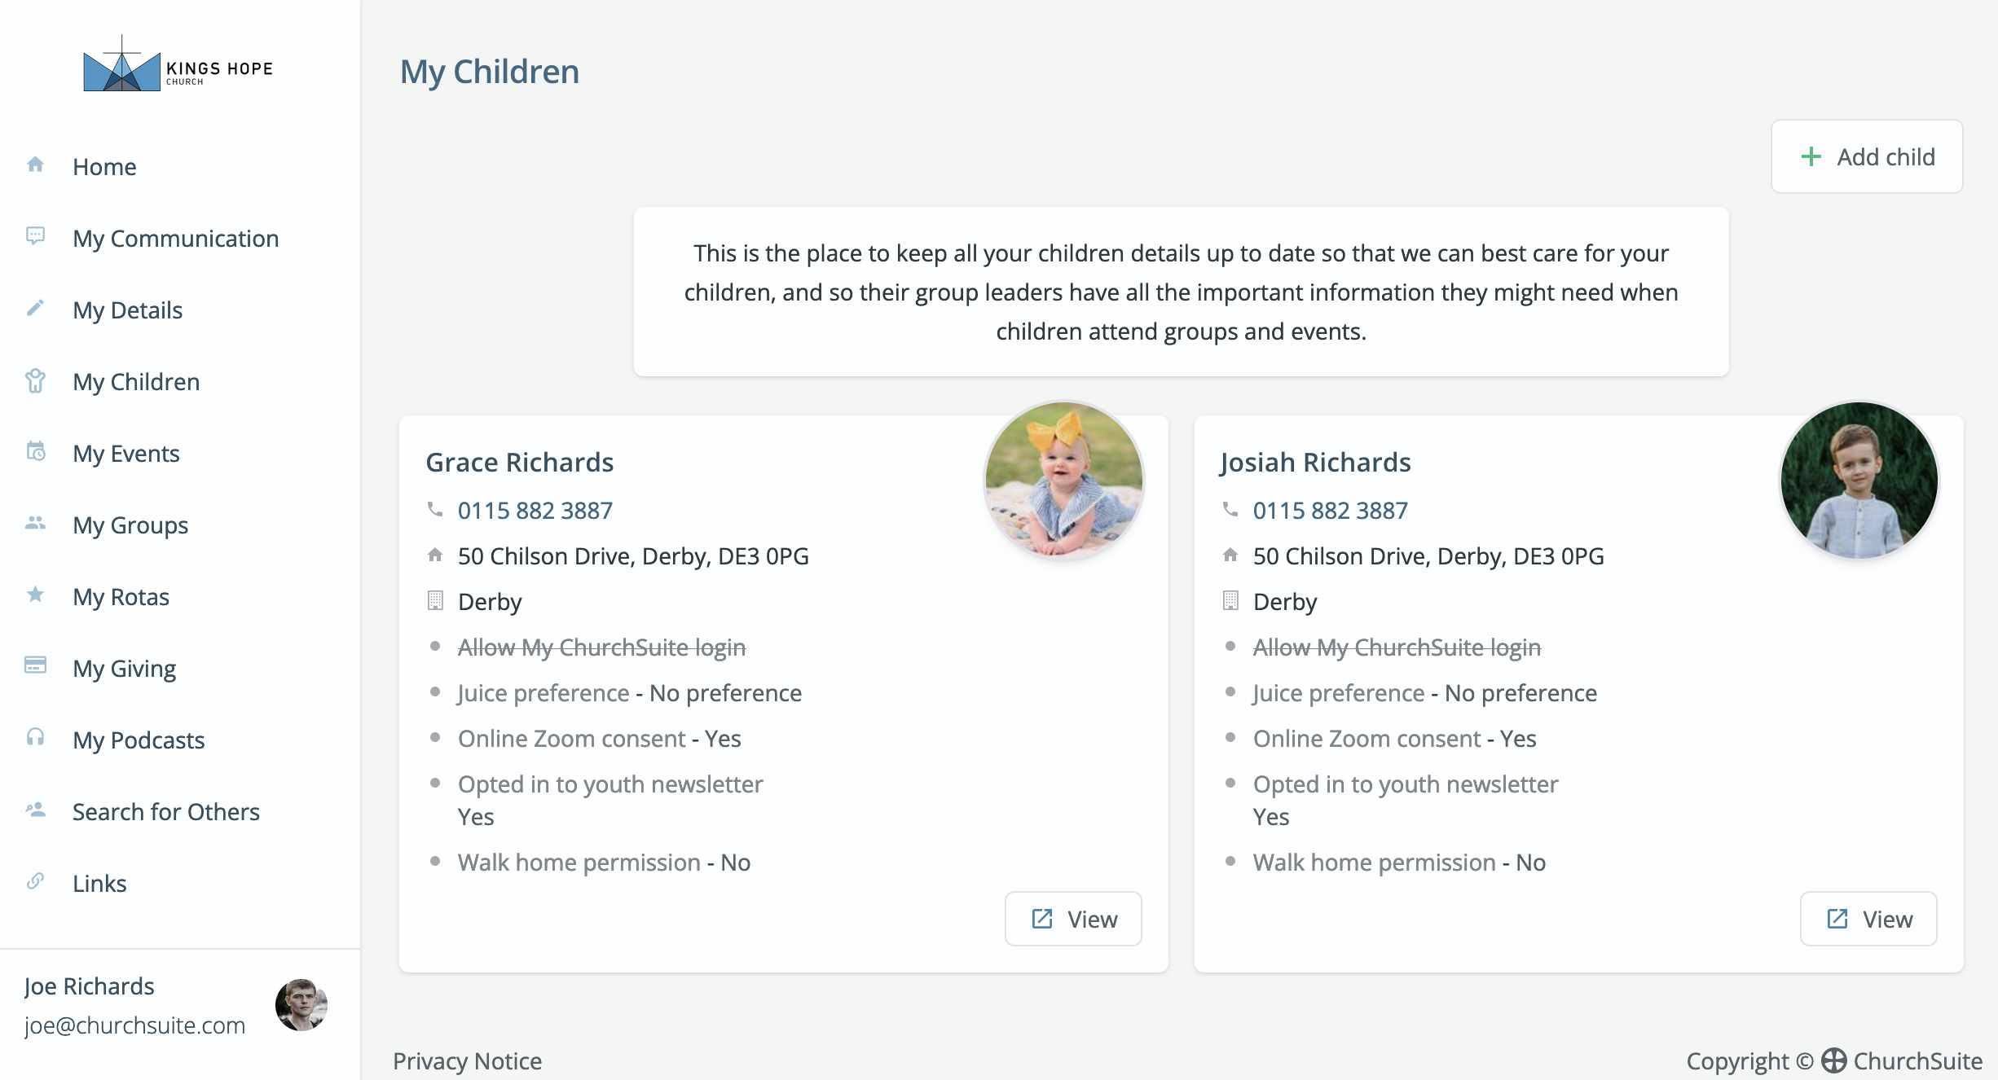
Parents can easily
manage their own
children’s details…

Slide 11
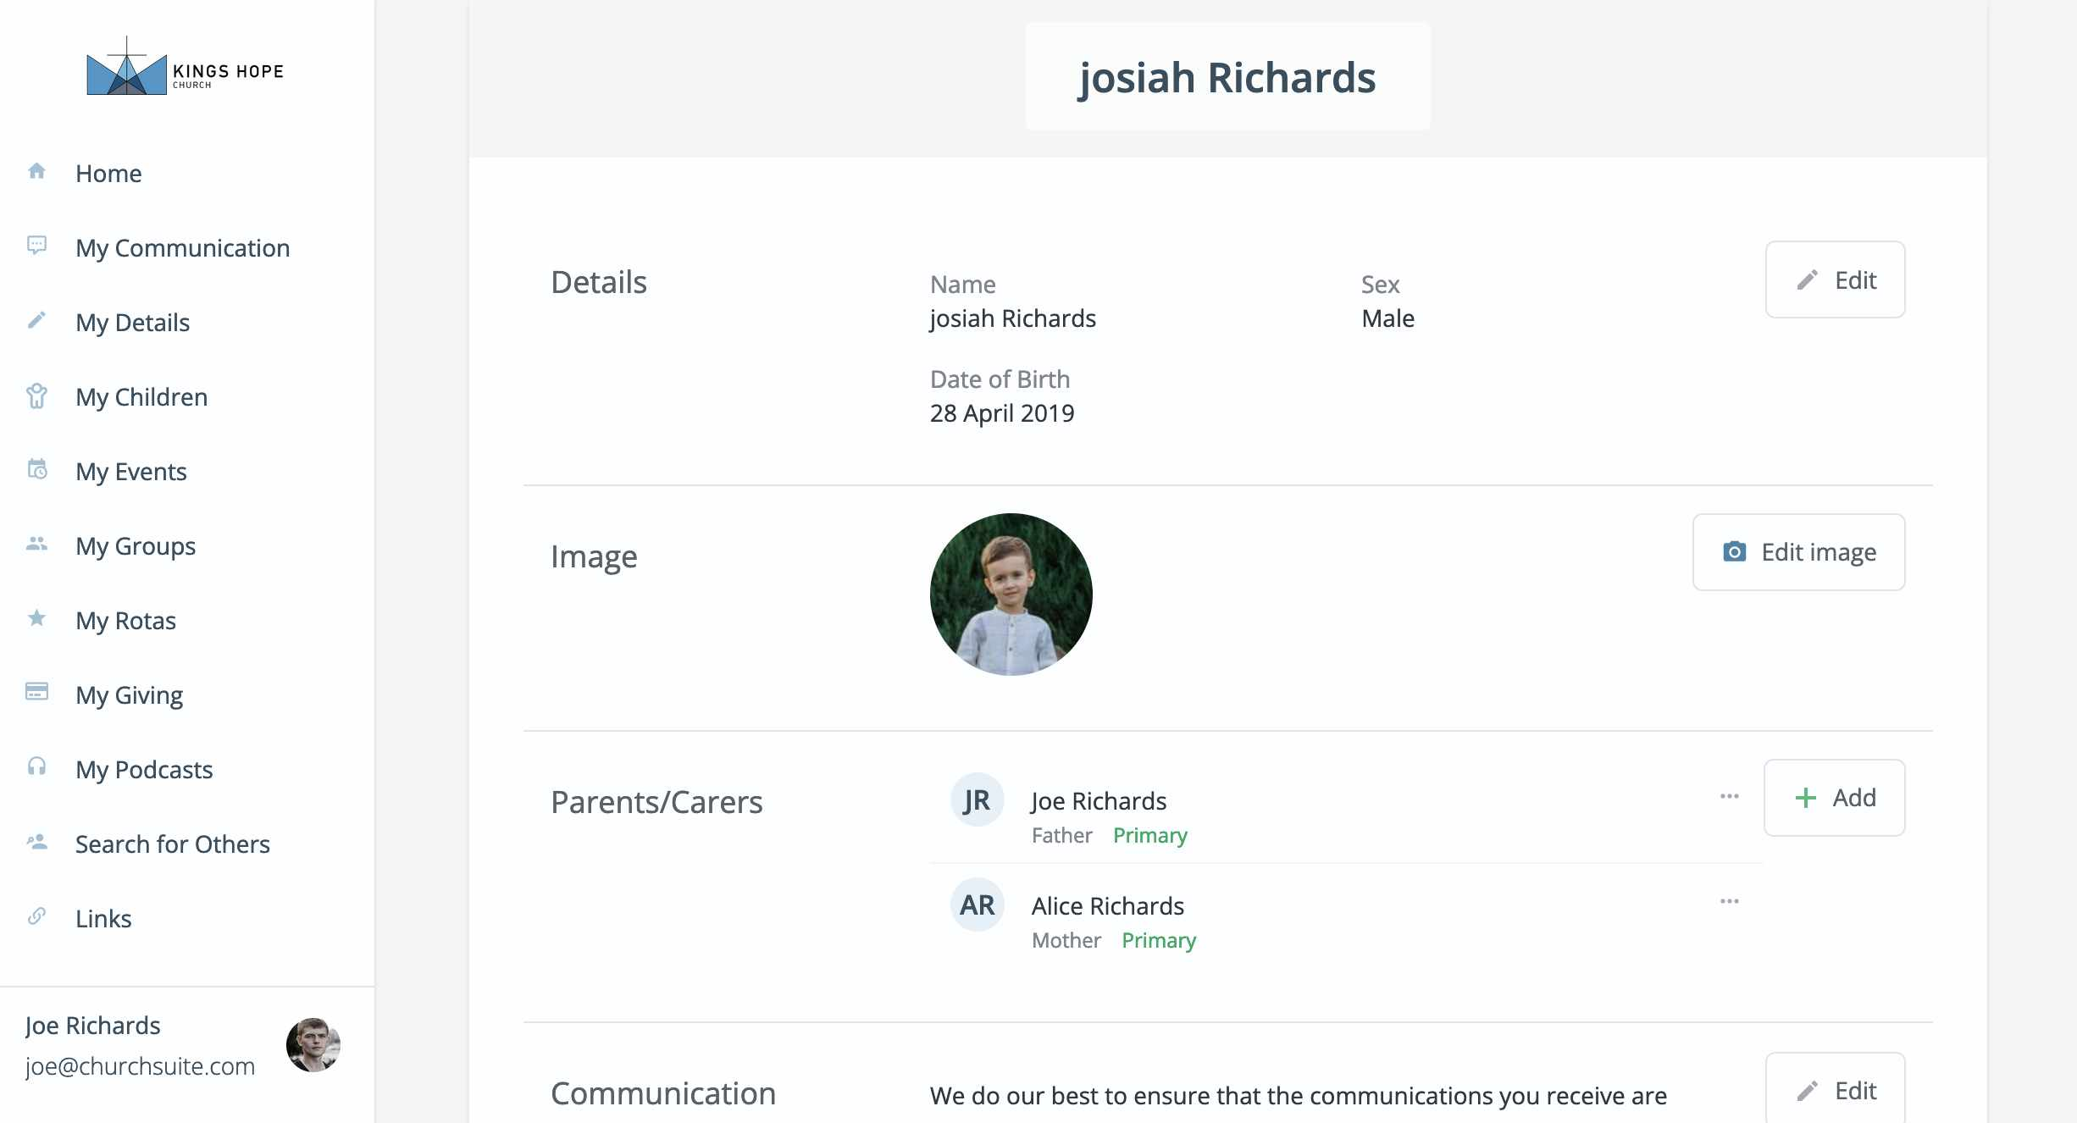
…ensuring their leaders have current information

Slide 12
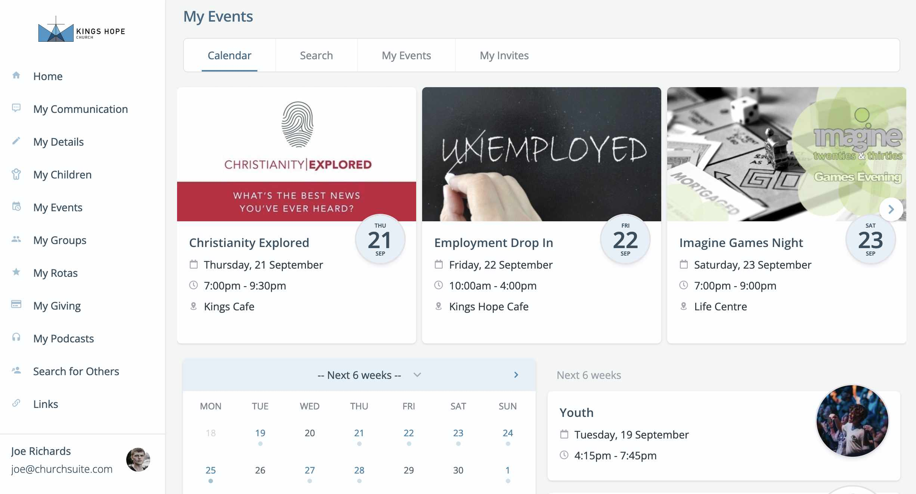
View and sign up for upcoming events and courses

Slide 13
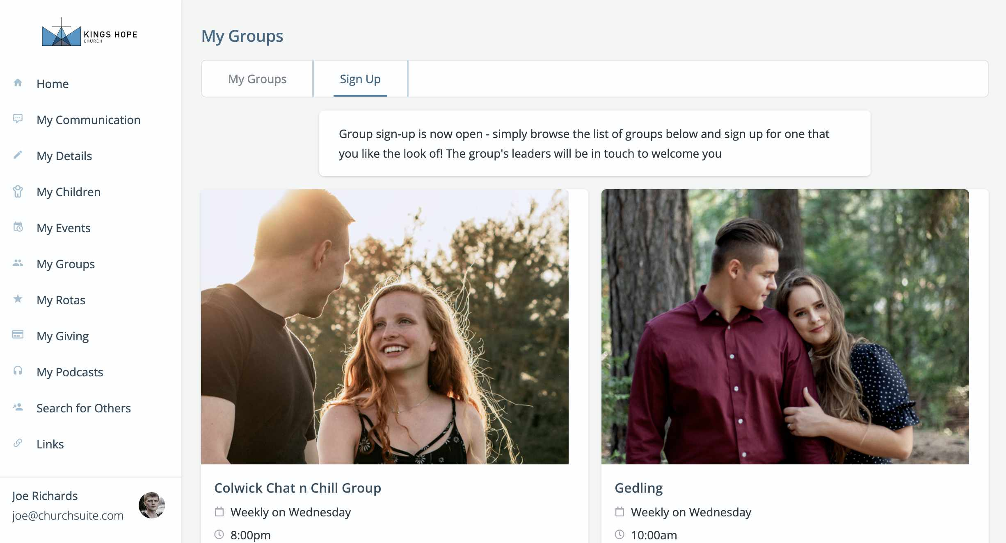
Join a small group and stay in touch with fellow group members

Slide 14
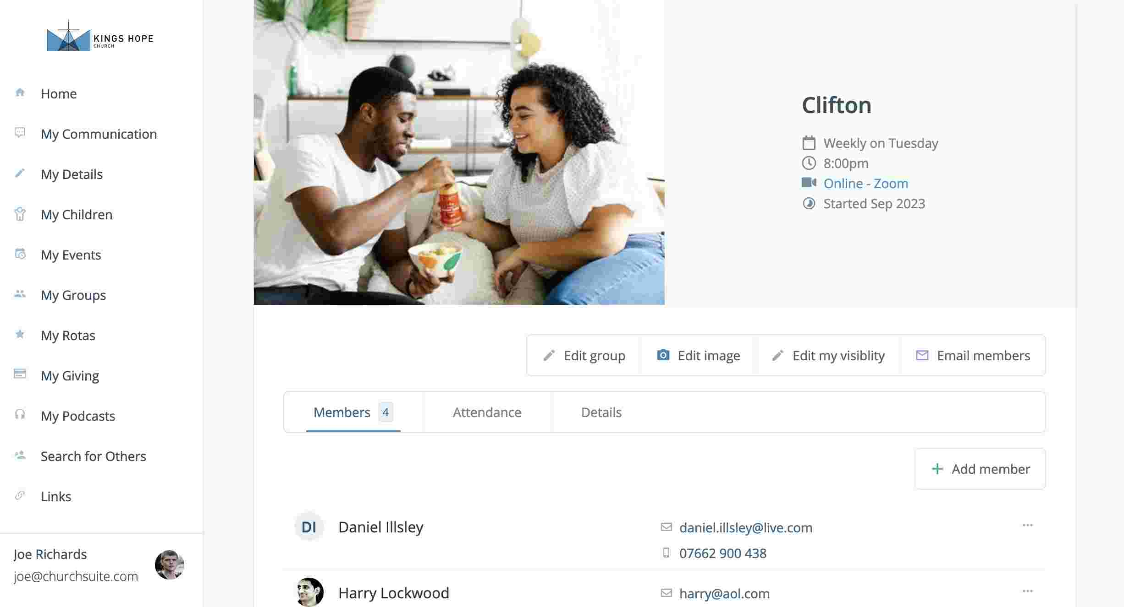
Group leaders can easily manage their group details

Slide 15
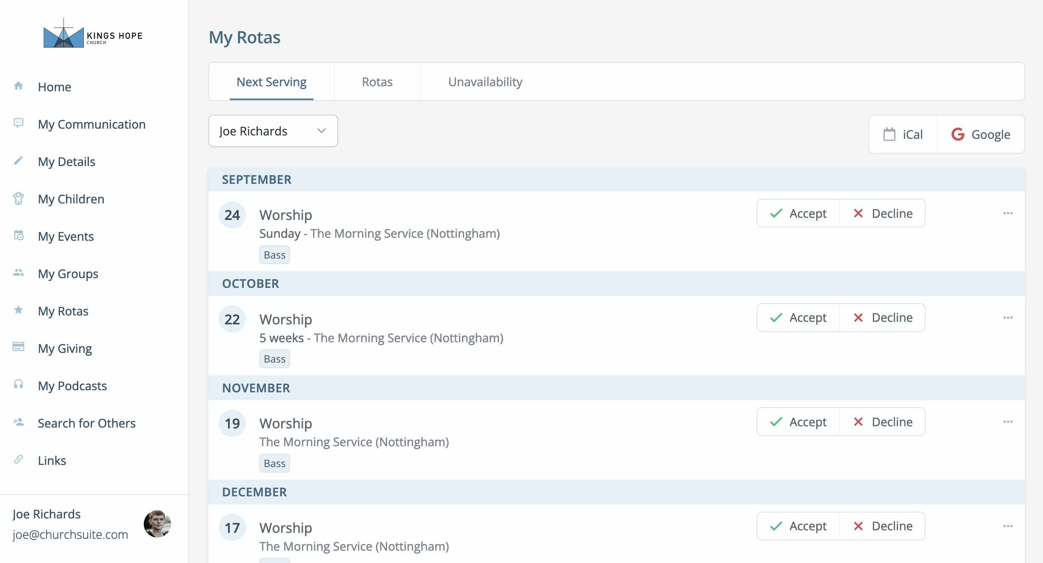
View all your rotas in one place

Slide 16
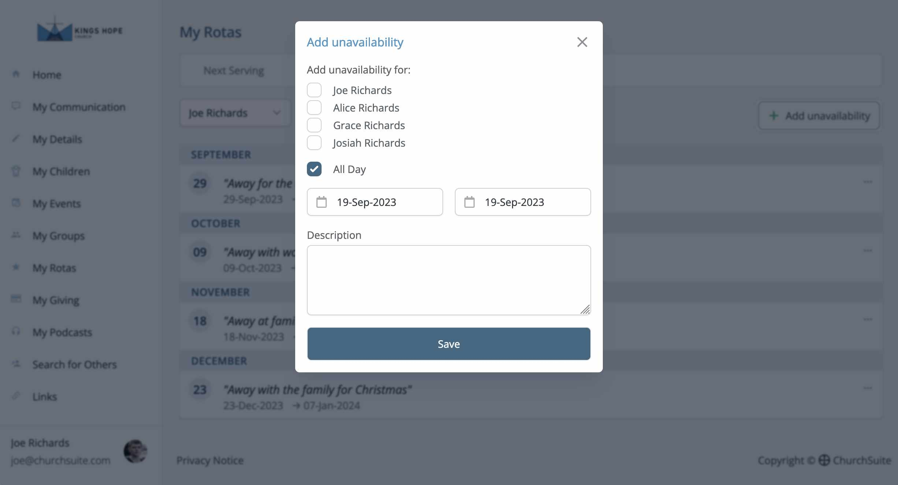
Help the church by adding your unavailability or processing a swap

Slide 17
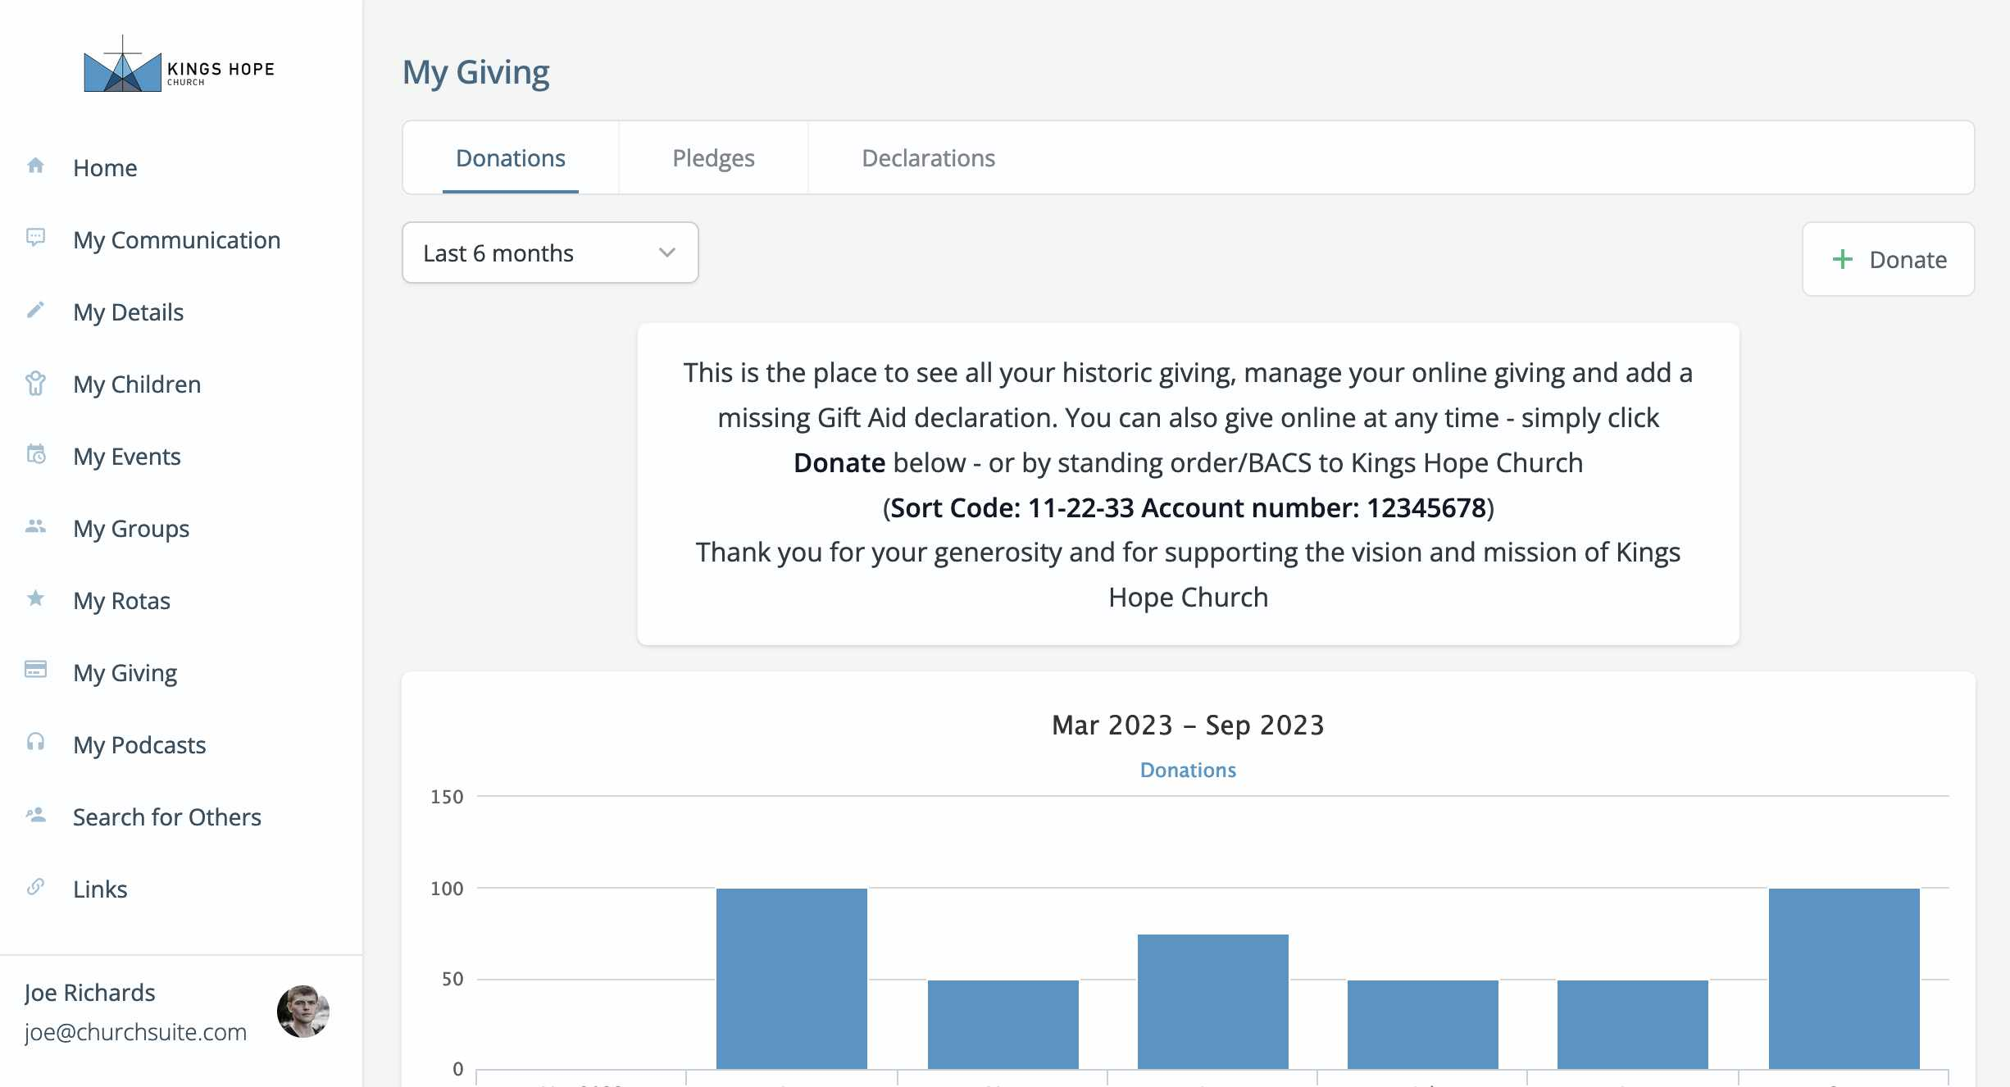
View your historic
donations to the
church

Slide 18
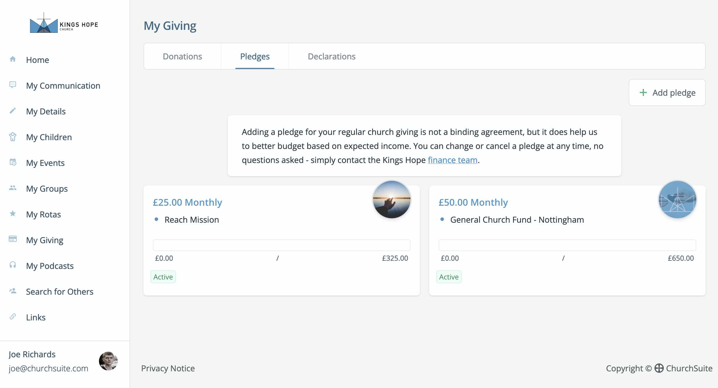
Take more control of your financial giving

Slide 19
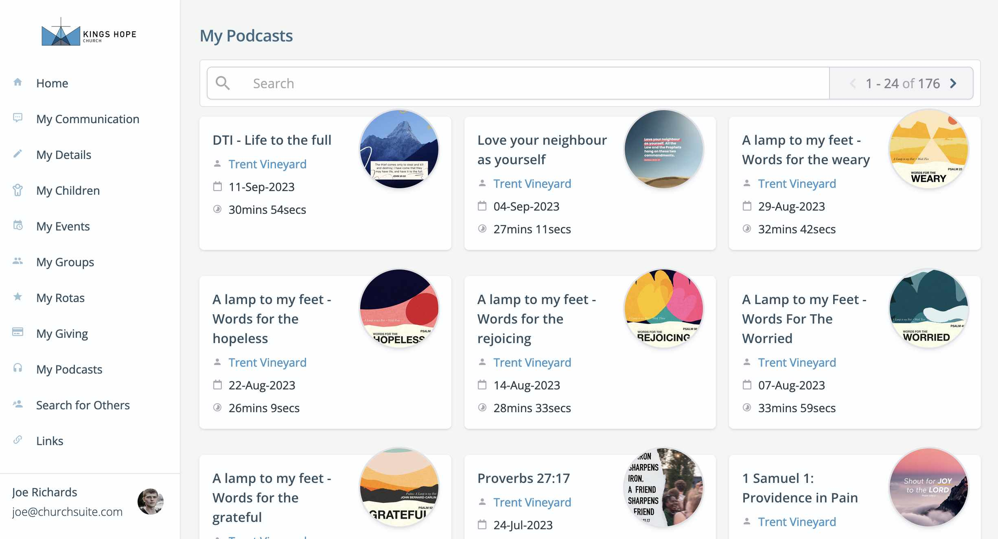
Catch up on a missed
sermon message

Slide 20
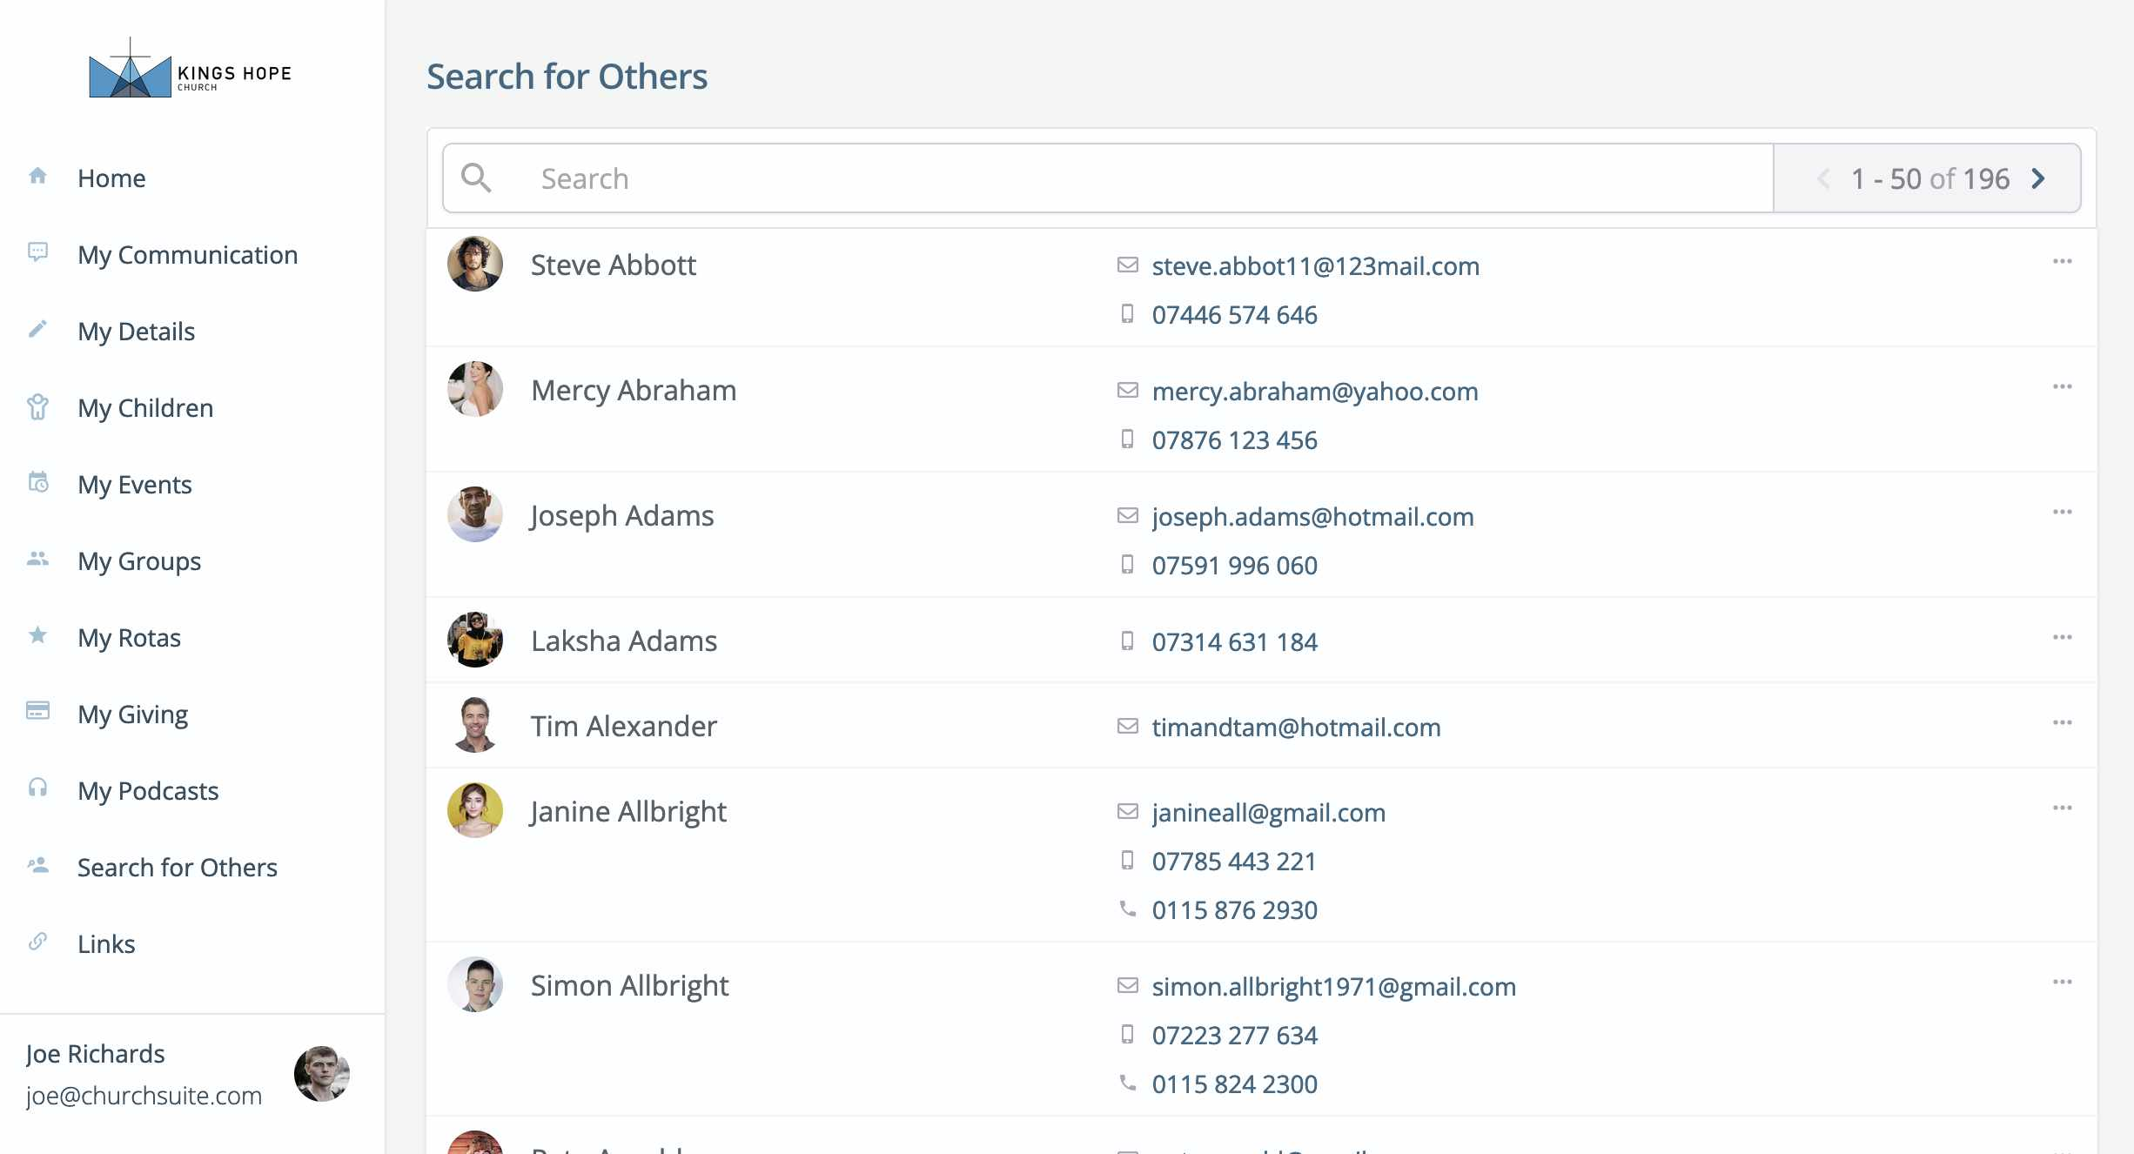
Search for others in the church

Slide 21
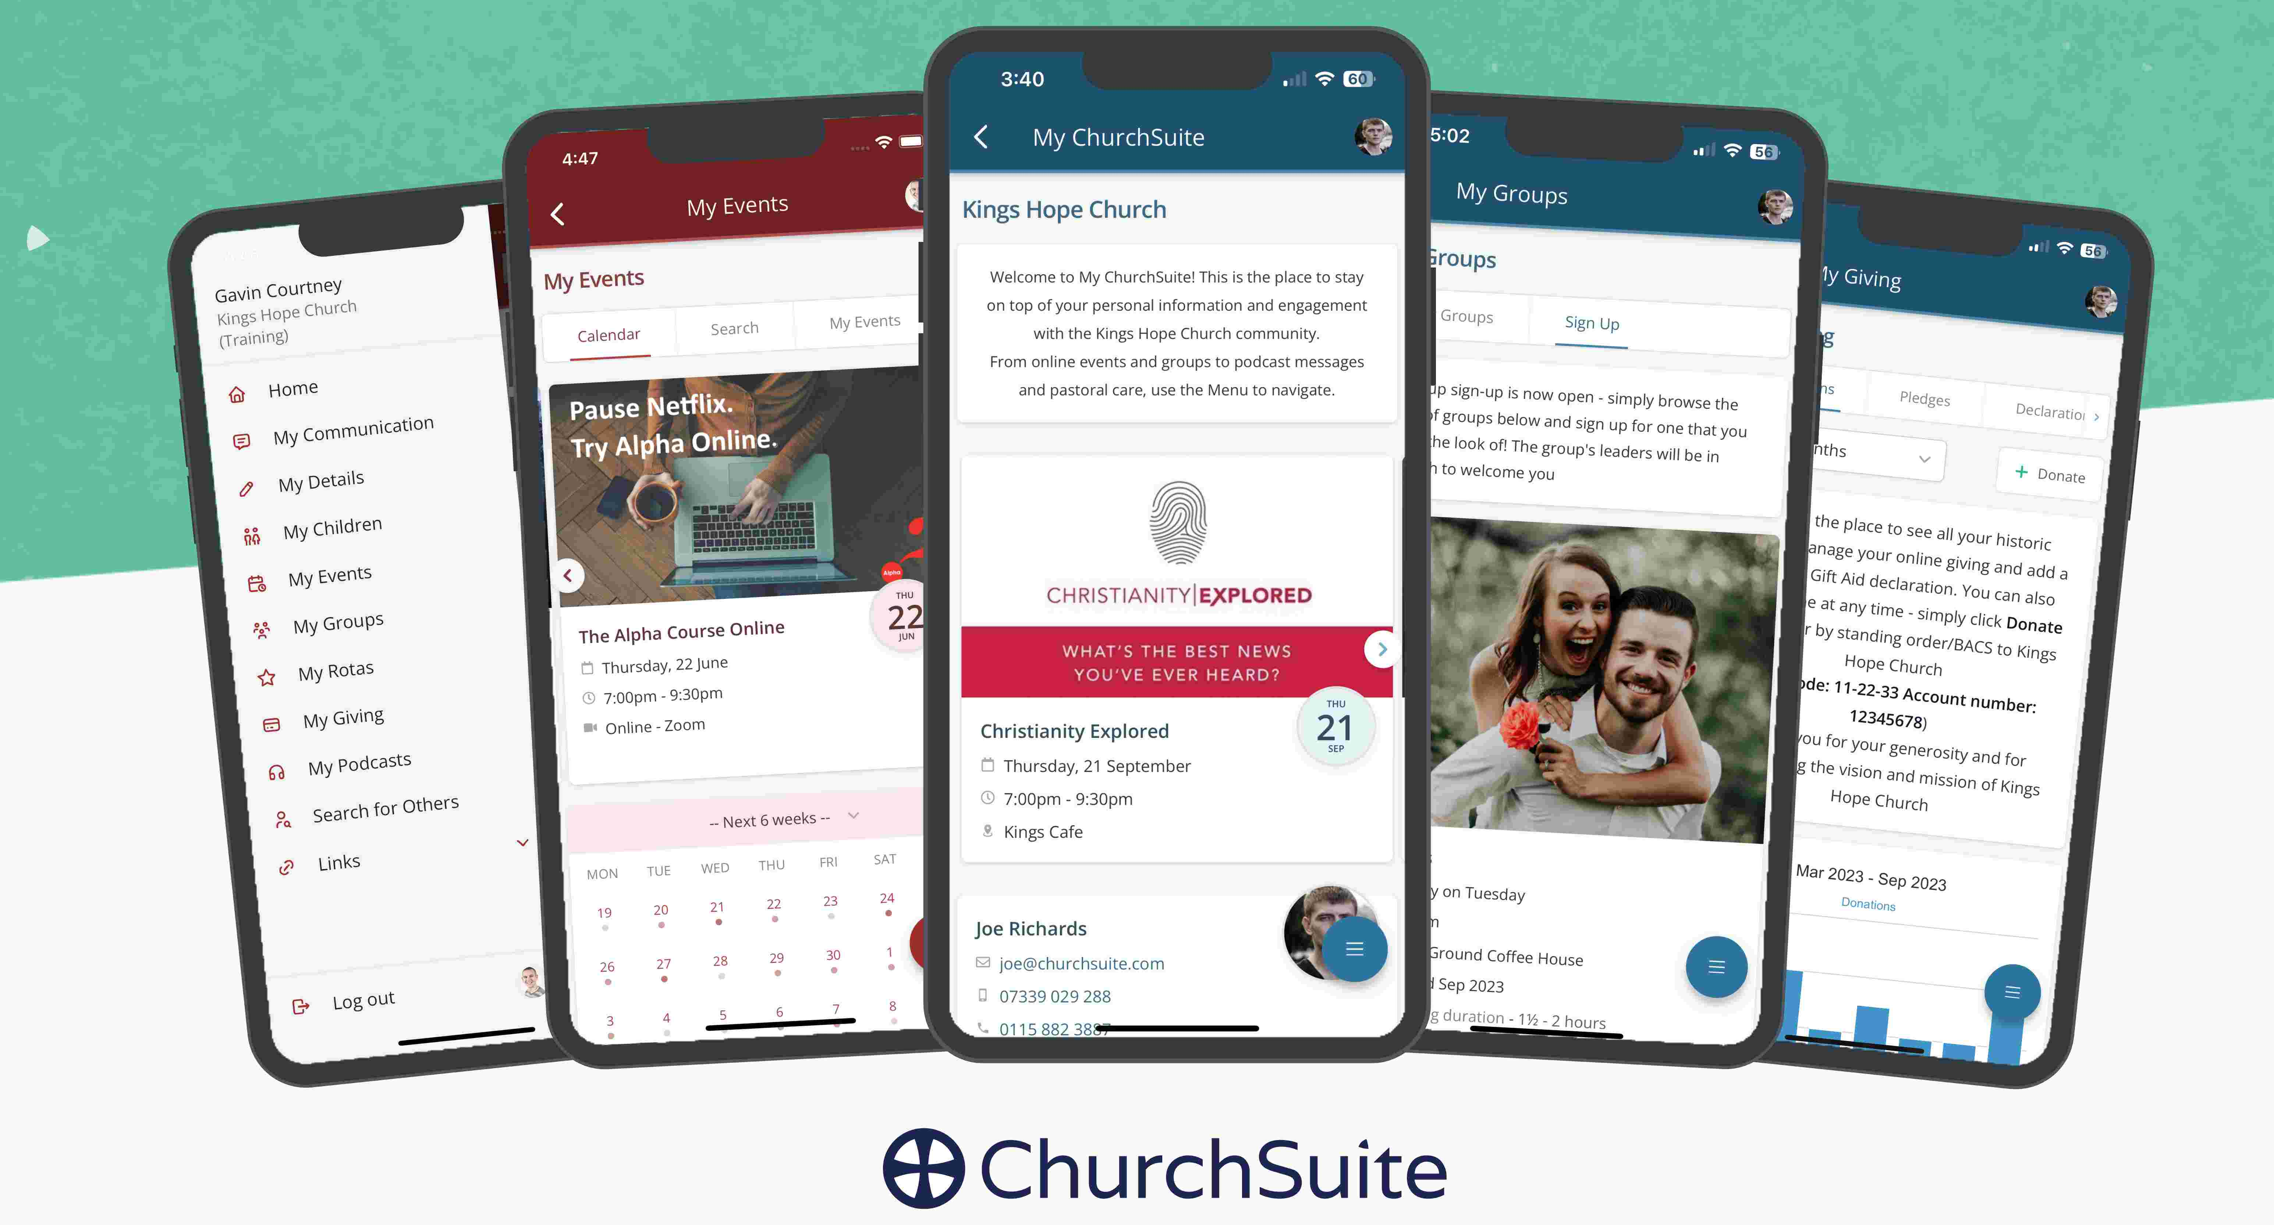
Use My ChurchSuite with any browser or the iOS/Android app

Slide 22


Slide 23


