Slide 1

Knowing God in Daily Life
Living in Light of the Reality of God

Slide 2
Course Description
2
It’s a lifelong journey to connect the dots between what we know to be true about God in our heads with where the rubber hits the road in our lives. This class will explore how themes from the “doctrine of God” can make a tangible difference in our daily lives.

Slide 3
Schedule
3
June 7: The Trinity & Our Relationships
June 14: Providence & Peace
June 21: God’s Glory & Our Purpose
June 28: God’s Mission & You

Slide 4
Knowing God in Daily Life
Lesson 1: The Trinity & Our Relationships

Slide 5
Reflecting on the Trinity

Slide 6
Mystery!
6
Great is the Lord and most worthy of praise;
his greatness no one can fathom.(Psalm 145:3)
Perhaps the greatest example of mystery concerning God:
“Trinity” = “tri-unity” or “three-in-oneness”
Notes:
Because God is infinite and we are finite, we can never fully understand God. We can’t put Him in a box or “totalize” Him. Nevertheless, God can be known, because God has revealed Himself to us—He has accommodated Himself and made Himself knowable. Even though we cannot know God exhaustively, we can know Him truly. What Scripture teaches about God is true.
Why is this a good thing?
If we could completely understand God, his greatness and majesty would be limited to what our finite minds can understand. But since he is greater than we can fully understand, there will always be more for us to learn, even in eternity. We will plumb the depths of His character, learning more and more that our Creator is infinitely more glorious than we could ever imagine. It’s good that God is “bigger” than what we can get our hands around!
And this suggests that we should expect “mystery” concerning God—things that we can’t fully understand. (We’ll come back to the idea of “mystery” later.)

Slide 7
Brief Scriptural Basis for the Trinity
7
The OT implies or suggests the Trinity.
Then God said, “Let us make mankind in our image, in our likeness... (Gen. 1:26)
The angel of the Lord went up from Gilgal to Bokim and said, “I brought you up out of Egypt and led you into the land I swore to give to your ancestors. I said, ‘I will never break my covenant with you, ² and you shall not make a covenant with the people of this land, but you shall break down their altars.’ Yet you have disobeyed me. Why have you done this? (Judges 2:1-2)
Yet they rebelled and grieved his Holy Spirit. So he turned and became their enemy and he himself fought against them. (Isa. 63:10)
Notes:
1. The doctrine of the Trinity is progressively revealed throughout the Bible. It is partially revealed (by implication and suggestion)
in the OT (Gen 1:26; 11:17; Ps 45:6-7; 110:1; Isa 48:16; 63:10—reference to Holy Spirit; Hosea 1:7; the angel of the LORD in Gen 16:13; Ex 3:2-6; 23:20-22; Num 22:35 with 38; Judg 2:1-2; 6:11; etc.)

Slide 8
Brief Scriptural Basis for the Trinity
8
The OT implies or suggests the Trinity.
The NT explicitly reveals the Trinity.
  Passages where all three Persons are listed together (Matt. 3:16-17; Matt. 28:18-20)
  Each Person is declared to be God (cf. John 1:1-3, 14; 20:28-31;
  Col. 2:9; Acts 4:3-4 etc.)
  But there is only one God! (a short list: Exod 15:11; Deut 6:4-5; 1 Kings 8:60; Isa 45:5-6, 21-22; 44:6-8; Rom 3:30; 1 Cor 8:6; 1 Tim 2:5; James 2:19, etc.)
Notes:
2. It is more completely revealed in the NT. It makes sense that, in the context of the polytheism of the surrounding cultures, God would stress to the Israelites in the OT that there is only one God. But when it came time for God the Father to send God the Son to earth to be born as a man to save His people, more explicit teaching about the Trinitarian nature of God is given.
The Father is God.
This is self-evident throughout the Bible.
Jesus is God.
1 In the beginning was the Word, and the Word was with God, and the Word was God. … 3Through him all things were made; without him nothing was made that has been made. … 14 The Word became flesh and made his dwelling among us. We have seen his glory, the glory of the One and Only, who came from the Father, full of grace and truth. (John 1)
28 Thomas said to him, “My Lord and my God!” 29 Then Jesus told him, “Because you have seen me, you have believed… 31 But these are written that you may believe that Jesus is the Christ, the Son of God… (John 20)
9 For in Christ all the fullness of the Deity lives in bodily form… (Colossians 2:9)
The Holy Spirit is God.
3Then Peter said, “Ananias, how is it that Satan has so filled your heart that you have lied to the Holy Spirit and have kept for yourself some of the money you received for the land? 4… You have not lied to men but to God.” (Acts 4:3-4)

Slide 9
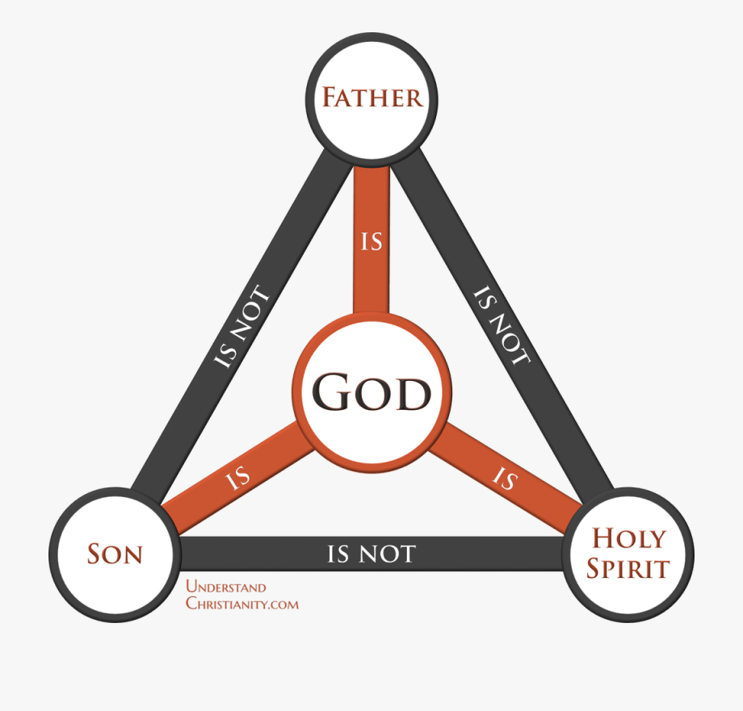
The Trinity Summarized
9
Westminster Shorter Catechism #6
Q: How many persons are there in the Godhead?
A: There are three persons in the Godhead: the Father, the Son, and the Holy Ghost; and these three are one God, the same in substance, equal in power and glory.
How do we make sense of this?
Notes:
The one and only God eternally exists as three Persons—Father, Son, and Holy Spirit.
These three Persons are one God, the same is substance, and equal in power and glory.
How do we make sense of this? ...
There have been many analogies suggested to try to explain this, but they all fall short. Every one leads to some sort of error that the church has determined contradicts some teaching of Scripture. See “Lutheran Satire...” (next slide).

Slide 10


Slide 11
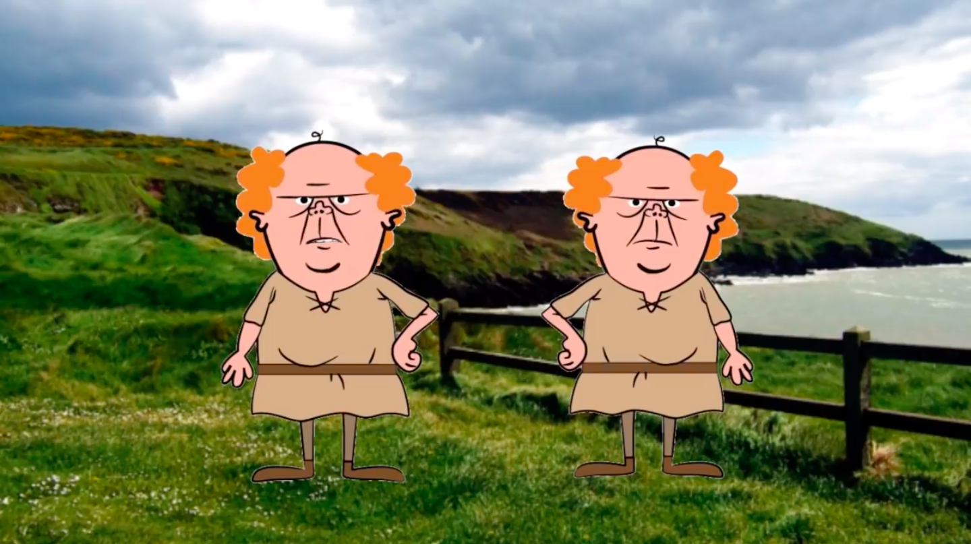
Notes:
Thoughts?
What do we conclude from this? While Scripture regularly uses analogies from nature of humanity to teach aspects of who God is (e.g., God is like a rock, fortress, mother, shepherd, etc.), it never attempts to provide an analogy for the Trinity. The closest analogy is found in the titles of “Father” and “Son.” And yet, when applied to a human level, even this analogy breaks down as they are two entirely separate human beings. Thus, no analogy adequately teaches the Trinity. This doctrine is one of the great mysteries of the Christian faith.
We can never remove the ultimate mystery of the Trinity, yet that is not to say that we cannot understand it at some level. We know that there is one God in three Persons, that these Persons are distinct yet fully God (not just a part of God), etc. We know these things because the Bible teaches them. But what we cannot know is how to fully fit them together. How can there be three distinct Persons, yet each have the whole being of God in Himself? How can that be true and yet God remain an undivided being? It’s spiritually healthy to acknowledge that God is far greater than we can comprehend! It humbles us before Him, and it leads us to worship Him for His glory.

Slide 12
Is it a contradiction?
12
Webster: “(a) a proposition, statement, or phrase that asserts or implies both the truth and falsity of something, (b) a statement or phrase whose parts contradict each other. <a round square is a contradiction in terms>”
“Trinity” is NOT a contradiction. It does not say:
There is one God and there is not one God (1 God and 3 Gods).
God is three Persons and not three Persons (3 Persons and 1 Person).
Notes:
But someone might ask if we are being asked to believe in a contradiction. Let’s touch on that…
What is a contradiction?
Scripture is NOT asking us to believe in a contradiction. For the Trinity to be a contradiction it would have to teach something like:
There is one God and there is not one God (e.g., 1 God and 3 Gods).
God is three Persons and not three Persons (e.g., 3 Persons and 1 Person).
To say, “God is three Persons and yet there is only one God” is not a contradiction. It is certainly true to say it is something that we don’t fully understand. But, as we’ve already said, this should not concern us. (1) It is clearly taught in the Scriptures, and we’re called to submit our understand of what is true to them, and (2) do we actually believe that we should fully understand the nature of God!?
See Berkhof quote, next slide.

Slide 13
Is it a contradiction?
13
“[The Church] has never tried to explain the mystery of the Trinity but only sought to formulate the doctrine of the Trinity in such a manner that the errors which endangered it were warded off.”
(Louis Berkhof, Systematic Theology)

Slide 14
What’s the point of having three Persons?
14
God is personal and yet not dependent on anything else in Creation.
The Persons of the Trinity have different primary functions in relating to the world:
CREATION
  The Father spoke the words to create the universe (Gen 1).
  The Son carried out these creative decrees. (Jn. 1:3; Col. 1:16)
  The Spirit sustained/manifested God’s immediate presence in the creation. (Gen. 1:1-3)
Notes:
If we say that each Person is fully God and that each fully shares in all the attributes of God, then is there any difference at all among them? What’s the point in having three of them?

Slide 15
What’s the point of having three Persons?
15
God is personal and yet not dependent on anything else in Creation.
The Persons of the Trinity have different primary functions in relating to the world:
REDEMPTION (Salvation)
  The Father planned and sent His Son (John 3:16; Galatians 4:4; Ephesians 1:9-10; etc.).
  The Son obeyed the Father and accomplished our redemption.
  (John 6:38; Heb 10:5-7; etc.).
  The Spirit was sent by Father & Son to apply Christ’s redemption to us
  (John 14:26; 16:7; John 3:5-8; Rom 8:13; 15:16; 1 Peter 1:2; Acts 1:8).

Slide 16
Important Point
16
While the Persons of the Trinity are equal in all of their attributes, dignity, and glory, they are:
Relational
Relate to one another differently
Complementary in their activities in the world
How does God being a Trinity increase your appreciation of him and lead you to worship?
Notes:
St. Augustine, in his great work on the Trinity, makes an incredible point. He says that if you’re not Trinitarian, you have a defective god. (Lot’s of people believe in God, but don’t necessarily believe in the Trinity.) Augustine would say that, if that’s you, you have an inferior god.
You have a god who never loved anyone until he created the world. This god would have existed from all eternity, but until he created, he never had a relationship. If that’s the case, your god is dependent upon the world. You could even say that he created to meet a love need. He created in order to have love. But, Augustine points out, that’s not the God of the Bible.
Love and relationship is eternally inherent in the God of the Bible. He has always had loving relationships… beginninglessly. The Father has always loved the Son and the Spirit, and vice versa.
Therefore, when God created the world, He didn’t do it because He needed to experience or receive love; He did it because He chose to give love. He created just to let us take in the spillover of the love He had within Himself.

Slide 17
Applying the Trinity to Daily Life
Relationships

Slide 18
The Trinity is Ultimate Community
18
“Community and friendship are foundational to the universe. If God were only one this would not be true.
If he were dual, in him there would be love. But because he is Triune, community is the highest form of life in the universe. God always existed in a lifestyle of community.”
(Redeemer Fellowship Group Handbook)
Notes:
What does this quote suggest to you?
What implications does it have for the priority you place on community/relationships?
Having been made in God’s image, we are built for community and connection.
When we live outside of community and interdependence on one another, our very humanity is compromised and subverted.
(Stress the important, yet counterculture, priority of community!)

Slide 19
The Trinity is Ultimate Community
19
“Within God’s very nature is a ‘rhythm’ or pattern of continuous giving and receiving—not only love, but also glory, honor, life…each in its fullness. Think. God the Father loves and delights in the Son (Matt. 3:17). Jesus receives that love and pleases the Father (John 8:29). Jesus honors the Spirit (Matt. 12:31), and the Spirit glorifies the Father and the Son (John 16:14). Each person in the Trinity loves, honors and glorifies the other and receives love and honor back from the others…there is never any lack.”
(John Samaan, Servants Among the Poor Newsletter)
Notes:
What implications does this have for your attitude and the way you interact with others?

Slide 20
Implications for Us
20
²⁶ Then God said, “Let us make mankind in our image, in our likeness, so that they may rule over the fish in the sea and the birds in the sky, over the livestock and all the wild animals, and over all the creatures that move along the ground.”
²⁷ So God created mankind in his own image,
in the image of God he created them;
male and female he created them.
(Genesis 1:26-27)
Notes:
What are some of the implications for us of being made in the image of God in light of the fact that God is an eternal relationship?

Slide 21
Implications for Us
21
³ Now this is eternal life: that they know you, the only true God, and Jesus Christ, whom you have sent. ...
²⁰ “My prayer is not for them alone. I pray also for those who will believe in me through their message, ²¹ that all of them may be one, Father, just as you are in me and I am in you. May they also be in us so that the world may believe that you have sent me. ²² I have given them the glory that you gave me, that they may be one as we are one— ²³ I in them and you in me—so that they may be brought to complete unity. Then the world will know that you sent me and have loved them even as you have loved me.
(John 17)
Notes:
In light of being created in God’s image, what does Jesus’ prayer for us in John 17 suggest about the nature or quality of our relationships with one another?
Unity, harmony, mutuality—we are to experience something profound about the fellowship of the Trinity, and that should be so tangibly expressed in our relationships with one another that the world understands something about God—that is, in fact, a big part of what it means to be his “image”—to reflect what is true of him in his creation.
Although God is not dependent on his Creation (us) in order to experience or express love, the Father, Son, and Holy Spirit decided that the joy and glory of their eternity community was too good not to share, and so they created us so that we might share in their fellowship. We can know God! And not just know about him. We can be “one” just as the Father and Son are one: Jesus in the Father, the Father in Jesus, and us in them.
John 14
¹ “Do not let your hearts be troubled. You believe in God; believe also in me. ² My Father’s house has many rooms; if that were not so, would I have told you that I am going there to prepare a place for you? ³ And if I go and prepare a place for you, I will come back and take you to be with me that you also may be where I am. ⁴ You know the way to the place where I am going.” ...
⁵ Thomas said to him, “Lord, we don’t know where you are going, so how can we know the way?”
⁶ Jesus answered, “I am the way and the truth and the life. No one comes to the Father except through me. ⁷ If you really know me, you will know my Father as well. From now on, you do know him and have seen him.” ...
¹⁶ And I will ask the Father, and he will give you another advocate to help you and be with you forever— ¹⁷ the Spirit of truth. The world cannot accept him, because it neither sees him nor knows him. But you know him, for he lives with you and will be in you. ¹⁸ I will not leave you as orphans; I will come to you. ...
²³ Jesus replied, “Anyone who loves me will obey my teaching. My Father will love them, and we will come to them and make our home with them.

Slide 22
Implications for Us
22
Family
What does the interdependent, complementary roles of Father and Son suggest for the relationship between husbands and wives?
How does Jesus’ prayer for unity in John 17 inform how we think of our immediate families and the way we relate to one another?
How is this experience “missional”?
What are some ways in which your family relationships could reflect the unity of the Trinity more fully?
How might you treat your family members in a way that is incompatible with the Trinity? What would God have you do about it?
Notes:
The immediate application of being made in God’s image, male and female, in Gen 1-2 is the formation of a family: husband and wife... with children, of course, in the picture (“be fruitful and multiply”).

Slide 23
Implications for Us
23
Church
How might your thinking need to change about your relationship with Christ’s Church to better reflect God’s intention for what it means to be in fellowship with him and one another? (cf. John 17)
What are some ways we can live more fully into this vision that Jesus has for us?
Notes:
Moving out from the family as image-bearers of God—reflections of the Trinity—Jesus’ prayer for us in John 17 was as a church. The church is to be a redeemed and renewed humanity (Eph. 2:14-18) and the family of God (Eph. 2:19), and we are called to walk in a manner worthy of our calling (cf. Eph. 4:1-16).

Slide 24
The Great Prerequisite
24
As an image-bearer of God, each of us is nevertheless “fallen.”
We CANNOT fulfill what it means to reflect his image
We CANNOT love and serve one another the way the Trinity does
But the gospel tells us that God is renewing us in him image.
As we experience the Trinity (Father, Son & Holy Spirit) in our lives, he renews and empowers us to live more fully into his design.
Jesus prays for us... The Spirit empowers us... The Father pours out his love on us and through us.
Notes:
You need to experience God in this way (through the gospel) before you can live out the implications of the Trinity in your daily life in a way that pleases him.

